Slide 1
What is PREVENT?
“Prevent is a part of the UK’s Counter Terrorism Strategy, preventing people from becoming involved in terrorism or supporting terrorism”
Notes:
What is Prevent?
The Counter Terrorism and Security Act 2015 places a statutory duty on agencies to prevent people from being drawn into extremism. Local Authorities are one of those agencies.
The safeguarding process assesses vulnerability using a consistently applied vulnerability assessment framework built around three dimensions:
Engagement with a group, cause or ideology;
Intent to cause harm; and
Capability to cause harm.

Slide 2
Where Does The Threat Come From?
Northern Ireland Related Terrorism
Al - Qaida
Islamic State
EXTREMISM
Environmental
Animal Rights
Far Right Wing
Racism
Nazism
Fascism
Far Left Wing
Civil rights‘ movements
Feminist movement
Anti-war
Notes:
Prevent aims to stop people becoming terrorists or supporting terrorism.
These threats may come from groups such as those mentioned here
What these groups have in common is a belief in the use of extreme violence and terror to achieve their aims which are often political.
When we think of terrorism we most often think of the attacks – pictures and images come to mind – those we see in the news and media.
They show the acts of violence themselves.

Slide 3
What do you need to do?
It is your responsibility to be aware of any changes in the behaviour of those around whom you spend most time – in your case, pupils/colleagues.
Notice
Check
Share
Notes:
It is your responsibility to be aware of any changes in the behaviour of those around whom you spend most time – in your case, pupils/colleagues.

Slide 4
Staff member NOTICES a concern. (Aide Memoire)
CHECKS the validity of that concern
And the concern is then SHARED with the Council’s SPOC
Escalation – next steps
The Council has a process of
NOTICE, CHECK, SHARE
Staff member NOTICES a concern
CHECKS the validity of the concern
SHARES that concern with our SPOC
Notes:
A key message from WRAP is Notice, Check Share – from the video clip a staff member notices a concern; checks the validity of that concern and then shares that concern with the SPOC.

Slide 5
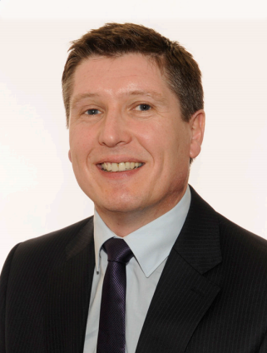
Single point of contact
The Clackmannanshire Council Single Point of Contact (SPOC) is:
Stuart Crickmar
Head of Service
Strategy & Customer Services

Slide 6
Further resources are available on CONNECT under the heading Safety & Your Security You will find the Clacks Academy E-Learning module there. Another excellent resource can be found here https://www.elearning.prevent.homeoffice.gov.uk/
Notes:
There are excellent resource on CONNECT under the Safety & Your Security link. You will find a link to the e-learning module there.

