Slide 1
The Telegram: Iain Crichton Smith
Contrast
Imagery
Word Choice
Symbolism
Context
Relationships
Conventions of a short story (structure)
- Opening
- Development
- Climax
- Falling action
- Resolution

Slide 2
Historical Context
Time Period: WW2
A telegram is a letter sent to citizens via electronic codes to inform people of urgent or important news. This mode was quicker than a letter. Commonly used during WW2 and around this time period
Many people lived in fear of discovering unwelcome news
An elder delivered the telegrams straight to a person’s house
A telegram is a written message transmitted by using an electric device. The message was carried along wires, and the text printed and delivered by hand.
Telegrams were very widely used, but are now not useful because most people use telephones and e-mail. The idea was developed by the British Post Office as a service for urgent letters.

Slide 3
“For more than a century, bad news always came by telegram. A slip of pastel paper through the door would confirm our worst fears, from the death of a relative to the loss of a battle far from home.”
Tom Rowley ‘The Telegraph’ Newspaper. May 2013.

Slide 4
THE TELEGRAM – A BRIEF HISTORY
For more than a century, bad news always came by telegram. A slip of pastel paper through the door would confirm our worst fears, from the death of a relative to the loss of a battle far from home.
The first telegram : May 1844
Great Britain stopped using the telegram in 1982
Text messages and e-mail have replaced it
Telegrams reached their peak popularity in the 1920s and 1930s when it was cheaper to send a telegram than to place a long-distance telephone call. People would save money by using the word “stop” instead of periods to end sentences because punctuation was extra while the four character word was free.

Slide 5
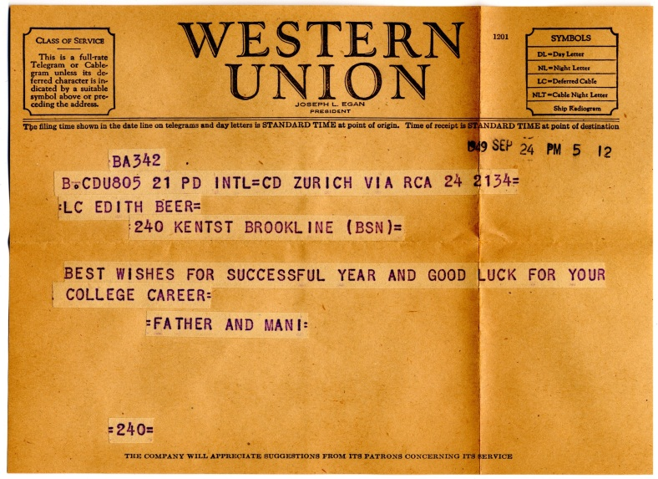
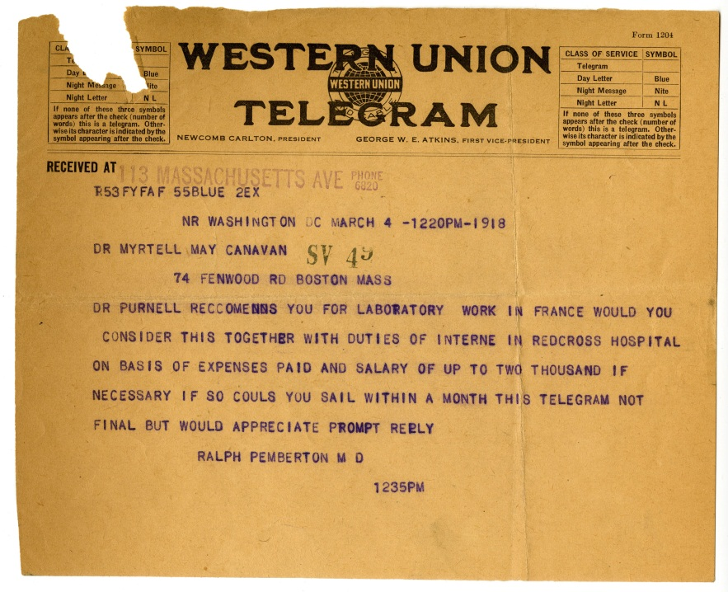
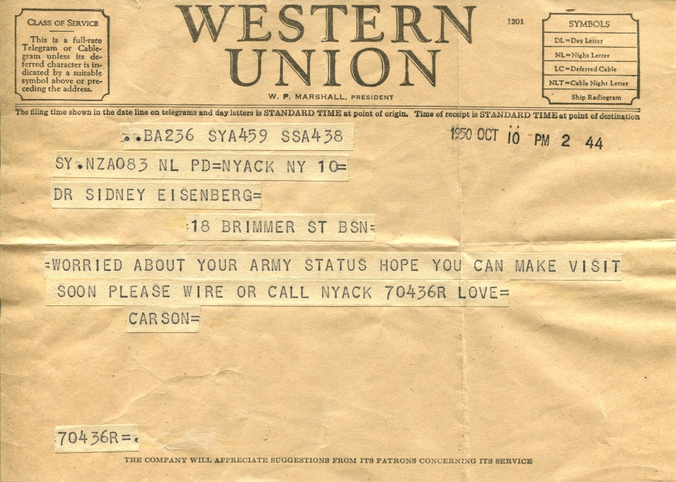
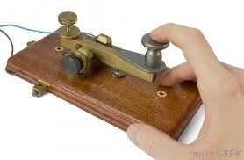

Slide 6
Setting
A small Highland village: “bare” with “little colour”.
This bleak, uninviting environment is reflected in the inhabitants of this island community.
The two women fear the telegram may inform them of the death of their sons
the story hinges on the tension created by the two women as they watch the telegram getting closer.
Crichton Smith exposes the pointlessness of the kind of petty rivalries that he associates with small, rural, island communities.
https://en.wikipedia.org/wiki/Bayble

Slide 7
Vocabulary
aquiline (line 4) – like an eagle
gaunt (line 5) – lean and haggard
reverberations (line 7) - echoes
desolation (line 29) – emptiness / destruction
irrelevantly (line 78) – not linked to topic
dignified (line 162) - serious / worth respecting
remorselessly (line 91) – unstoppable
diffused (line 102) – spread out
pulpit (line 171) raised platform in church
spontaneous (line 196) sudden / impulsive
compressed (line 224) put under pressure
somnambulistic (line 243) - sleepwalking

Slide 8
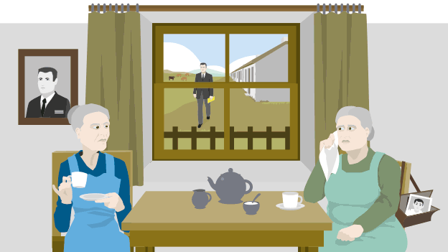
Some Thinking Points
1) What themes can you identify?
2) Can you recognise any element of contrast? If so, how?
3) Thinking of the elder delivering the telegram, what is he wearing?
Does this carry any symbolic significance?
4) Referring to specific examples, how does Crichton Smith build
suspense and tension in the story?
destructiveness of war / class / rural life

Slide 9
Themes - 2 quotations for each
Destructiveness of war
“O God save my son” – fat woman, when she thinks her son has been killed
Class
Rural life

Slide 10
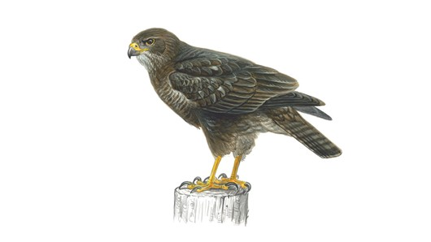
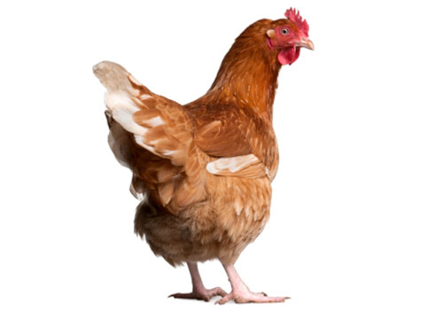
Contrast
Task:
Find evidence in the text to support the following statements
Fat woman (Sarah)
Son (Donald)
- Ordinary Seaman who
saluted to thin woman’s son.
Son left school at 14
Donald doesn’t spend much time with his mum
when he is home.
- Enjoyed fishing and his friends
She was a village native
Has a lack of drive and determination
Resents the thin woman “outsider” “snob”
Small minded
Gossip
Thin woman
Son was a Sub-Lieutenant in the Navy (Iain)
More pay
Better uniform
Went to university
She was not popular in the village, recently
moved there (30 years!).
Widow
Saved to send her son to university – ambitious
Knits clothes for her son
Dainty
Pale and unfed (saving for her son’s university)
Doesn’t like gossip

Slide 11
CONTRAST
Contrast means opposite or a striking difference between two
things.
PAIRED TASK >>
Using a Venn diagram pull together as many differences as you can find between the two women. Fill in quotes to back up what you have said.
Fat woman
Thin woman

Slide 12
Character
You have been introduced to a few of the main characters by now. Complete your Venn diagram for the characters of the fat woman and the thin woman.
Actions (What they do and what this tells us about the kind of person they are)
Speech (What they say, how they speak or what others say about
them.What does this tell us about their personality?)
Appearance (what do they look like and the impression this
creates in your mind)
Associations (Imagery) – Are there any images or comparisons
when the writer describes this character?

Slide 13
Taking a Closer Look at Character
Copy and complete the following table into your jotters, paying close attention to the
text.
 | Fat Woman (Sarah) | Thin Woman
Actions
Speech |  | “I made sacrifices to have my son educated. I lived on a pension of ten shillings a week.” (p.58)
Appearance
Associations (similes/metaphors)

Slide 14
ANALYSIS
1) Write a brief summary of the short story ‘The Telegram’
2) ‘They were like two birds’ (line 3).
Draw the two types of birds the author compares the women to. Annotate your drawing, demonstrating your understanding of the simile.
3) Explain the simile ‘It came upon them as a strange plague’ (line 20).
4) What is the significance of the local elder being “clad in black?” (line 24)
5) Re-read paragraph 4.
In what ways was the telegram ‘just like any other weapon’? (line 30)
6a) How were the two women different?
6b) In what ways were they alike?
7) How was the paper ‘strange and unnatural’? (line 52)
8) The women ‘spoke feverishly’ (line 57).
What does this tell you about their emotions?

Slide 15
ANALYSIS CONTINUED…
9a) How were the two sons different?
9b) In what ways were they alike?
10)‘They looked at each other wildly.’(lines 159)
What does this tell you about their emotions?
11) The fat woman behaved ‘like the Catholics’(line 187).
What things did she do? What does this tell us about her character?
12) How did the thin woman behave (lines 193-198 and 205-210)?
13) What is the twist in the story?
14) Describe the character of Macleod.
Include quotes from the story that illustrate his character.
15) What are the main themes in the short story?

Slide 16
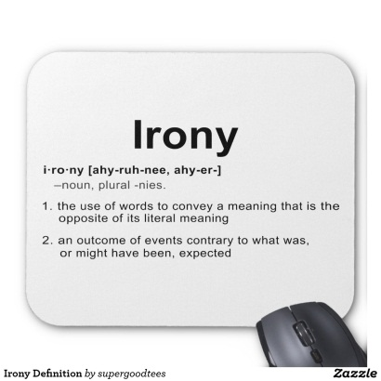
Symbolism and Irony
The elder Macleod is wearing black, how is this symbolic?
In stark contrast to elder Macleod, the telegram is colourful, it was “a piece of yellow paper.”(lines 50-51)
The writer’s choice of colour is deliberately ironic, you would expect yellow paper to carry a cheerful message, instead it carries something dreadful. Update your notes appropriately!
Write a few lines explaining why Crichton Smith has used the colour yellow to describe the telegram and how effective you find this irony.

Slide 17
Emotions and Feelings
Both of the women in the short story go through a range
of emotions when they see elder Macleod walking up the
street towards them with the yellow telegram.
Find evidence (so, quote) from conversations between the two women from the text to highlight these emotions. Both women deal with these emotions in very different ways. **Pages 61-62**
You may wish to collate your ideas in a table >>
Fat Woman’s Emotions (with examples) | Thin Woman’s emotions (with examples)
“Oh, pray God it wasn’t hers. And yet it must be hers. Surely it must be hers.” Repetition emphasises the frantic emotion felt be the fat woman as Elder MacLeod approaches her house.

Slide 18
Imagery
Imagery or figurative language is used in ‘The Telegram’ to
great effect.
The story opens with the simile:
“They were like two birds, one a fat domestic bird perhaps, the other
more aquiline, more gaunt, or, to be precise, more like a buzzard”
Crichton Smith uses an effective simile to describe the two women in the
story. He compares the fat lady to a domestic bird to highlight her need to nurture and look after her family – she is happy and content with her life.
However, the thin lady is compared to a buzzard, a bird of prey who is
ambitious and is determined to achieve her goals, this is shown when the thin lady sends her son to university scrimping and saving to achieve what she wants. This simile is used to highlight the difference between the two women and is effective because the reader is able to distinguish the contrast in their characters.
Task >> Referring closely to the text, highlight and label all features of imagery.

Slide 19
Imagery in ‘The Telegraph’
Complete the table below identifying and analysing each figure of speech used in the story
Figure of Speech (simile/metaphor) | Analysis/Explanation
“It came on them as a strange plague, taking their sons away and then killing them, meaninglessly, randomly.” (p.56)
“People began to think of the telegram as a strange missile pointed at them from abroad” (p.56)

Slide 20
Structure, Tension and Suspense
Crichton Smith craft fully structures the narrative so that it create tension and suspense.
The story follows the conversation between the two women about their sons while the elder, Macleod walks up the street. Crichton Smith stops the conversation between the women as he progresses further and further up the street on approach to their houses, thus building tension.
Task 1
There are 11 instances when Macleod’s approach interrupts the conversation between the mothers, abruptly and filled with tension and suspense. Can you identify and annotate when this happens on your story?
Task 2
Write a detailed paragraph about tension and suspense built up through the structure and how effective you find this.

Slide 21
Structure – Conventions of a short story

Slide 22
Exposition/Opening
Resolution/Denouement
I can use quotes from the text
I can identify techniques
I can identify themes
I can summarise the narrative
in each convention.
Rising action
Falling action
Climax

