Slide 1
The Red Door
Draw all the objects (things) that are important in the story
Now think about what they might represent… Add your ideas to your drawing.

Slide 2
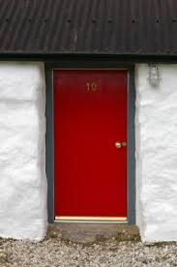
Symbols?
https://www.youtube.com/watch?v=69A6xyXGC-M
Red door – courage? / love? / refusal to conform? / Hope? Emotions?
Wellington boots – conformity? / everything Murdo is dissatisfied with in his life ? - 414
Halloween Masks – Murdo’s concealment of his identity
Green doors - Conformity
Cock (413) – passion / wild emotion
Red linoleum (415) – magic / childhood
Frost diamonds / snow (415): contrasts with red door – represents boredom of village life

Slide 3
Symbols in previous stories
Home
The Telegram

Slide 4
Examples
The dove is a symbol of peace.
A red rose, or the colour red, stands for love or romance.
Black is a symbol that represents evil or death.
A ladder may stand as a symbol for a connection between heaven and earth.
A broken mirror may symbolize separation.

Slide 5
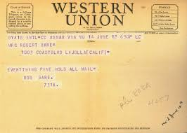
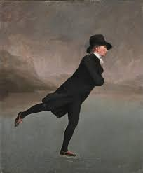
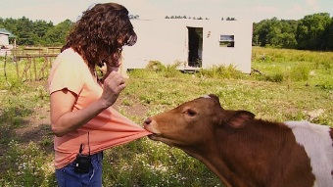
Symbols in previous stories
Home
The Telegram

Slide 6
Symbolism
2 short quotations from each story
The Telegram
Home
The Red Door
“It was like a magic door out of the village”
“Perhaps his belonging had been like the halloween mask”
“An umbrella dripped what seemed to be black rain”
“He took out a cigar to show who he was”
“The people began to think of the telegram as a strange missile pointed at them from abroad”
“The tall man in black clothes”

Slide 7
Example final question: symbolism
Crichton Smith makes extensive use of symbolism in The Red Door. Referring to the extract and at least one other story, explain how symbolism is used to develop key ideas or themes.
Red Door – Murdo wants to change his life
Telegram – the terror / destructiveness of war
Home – the difficulty of fitting in to where you lived in the past

