Slide 1
2013-14 Attainment
Peter Gorrie, QIO
September 2014

Slide 2
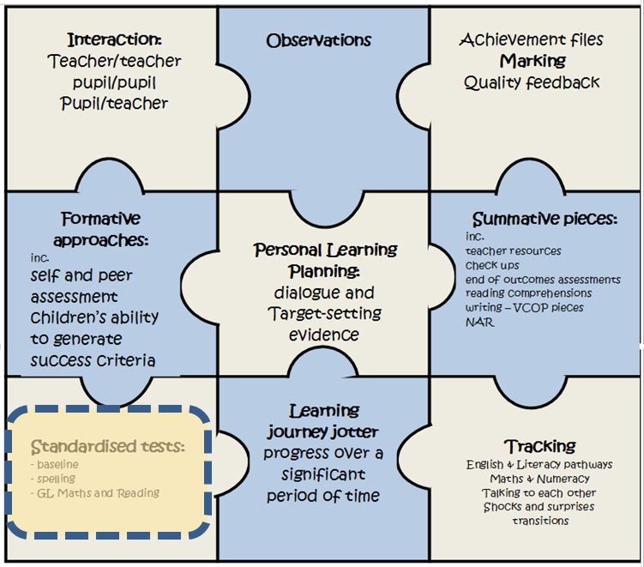
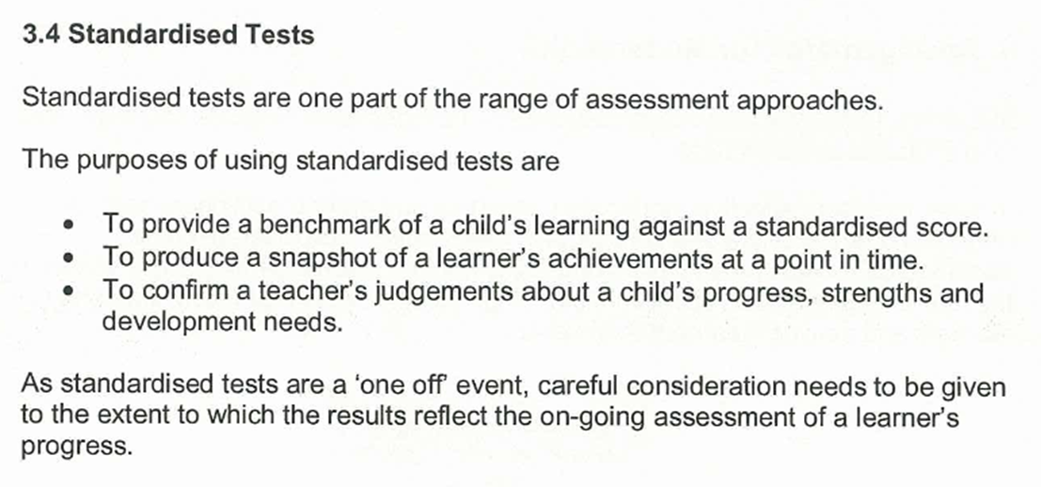
Title
From CEC Assessment Framework, 2012

Slide 3
Trends
Standards of Attainment over time

Slide 4
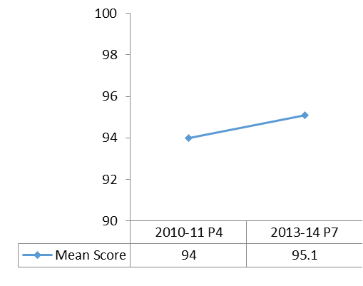
P4-P7 Maths Progress (10/11 to 13/14)
These graphs shows the performance of the cohort of P4 pupils tested in 2010/11 and then the same cohort tested in P7 last session.
Stanine Band Progress
Mean Score Progress
There are less children (≈7%) scoring a mean score less than 89.
The mean score has increased (≈1%).
There are more children (≈6%) scoring a mean score more than 112.

Slide 5
P7-S2 Maths Progress (10/11 to 13/14)
These graphs shows the performance of the cohort of P7 pupils tested in 2010/11 and then the same cohort tested in S2 last session.
Stanine Band Progress
Mean Score Progress
There are less children (≈18%) scoring a mean score less than 89.
The mean score has increased (≈6%).
There are more children (≈9%) scoring a mean score more than 112.

Slide 6
Maths Mean Score Trend
Maths Mean Scores
P7 maths mean score has improved each year for the last four years
P4 maths mean score has improved since 2010
But
P4 maths mean score has fluctuated
P4 and P7 maths mean remains below UK mean of 100.
P7

Slide 7
Literacy Progress
These graphs shows the performance of the cohort of P4 pupils tested in 2010/11 and then the same cohort tested in P7 last session.
There are less children (≈11%) scoring a mean score less than 89.
The mean score has increased (≈3%).
There are more children (≈5%) scoring a mean score more than 112.
Assessments - 2010-11 Suffolk Reading Test, 2013-14 – New Group Reading Test

Slide 8
CfE Levels
 | Primary 1 |  |  |  |  | Primary 4 |  |  |  |  | Primary 7
 | Literacy |  | Maths |  |  | Literacy |  | Maths |  |  | Literacy |  | Maths
11-12 | 69 |  | 69 |  |  | 55 |  | 54 |  |  | 73 |  | 48
12-13 | 69 |  | 72 |  |  | 61 |  | 61 |  |  | 56 |  | 54
13-14 | 74 | 68 | 77 | 73 |  | 66 | 61 | 65 | 62 |  | 59 | 56 | 59 | 57
% Pupils with Levels – at or better than expected level eg if a school enters data for 1 pupil who achieves a level they will have 100% !
% Pupils on roll - at or better than expected level

Slide 9
CfE Levels
 | Primary 1 |  |  |  |  | Primary 4 |  |  |  |  | Primary 7
 | Literacy |  | Maths |  |  | Literacy |  | Maths |  |  | Literacy |  | Maths
11-12 | 69 |  | 69 |  |  | 55 |  | 54 |  |  | 73 |  | 48
12-13 | 69 |  | 72 |  |  | 61 |  | 61 |  |  | 56 |  | 54
13-14 | 74 | 68 | 77 | 73 |  | 66 | 61 | 65 | 62 |  | 59 | 56 | 59 | 57
% Pupils with Levels – at or better than expected level eg if a school enters data for 1 pupil who achieves a level they will have 100% !
% Pupils on roll - at or better than expected level
Discuss
What can be done to increase the numbers of pupils achieving a level?

Slide 10
Performance in Primary One

Slide 11
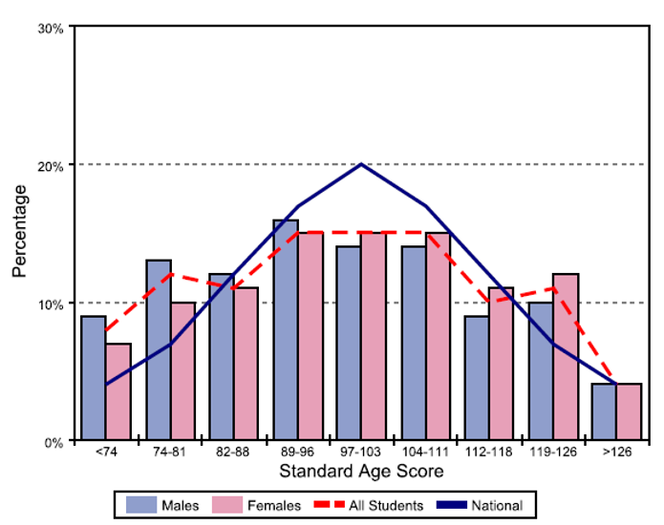
Pim5 Distribution
Girls performing well at higher stanines. (and better than boys at lower stanines)
BUT
The distribution of scores is lower than UK average
Mean male score is 97.0%, mean female score is 99.6%.
Overall mean standard age score is 98.3%. Better than P4 & P7.

Slide 12
P1 Pim5 2013-14
Performing above UK average in all 4 process areas.
Performing above UK average in the 2 assessed categories of number and shape.
Process
9% better than UK average in number
Question with -ve Difference
 | CEC % 2013-14 | UK %
Show an equilateral triangle | 96 | 98
Show a shape with four sides all the same length | 70 | 71
Content

Slide 13
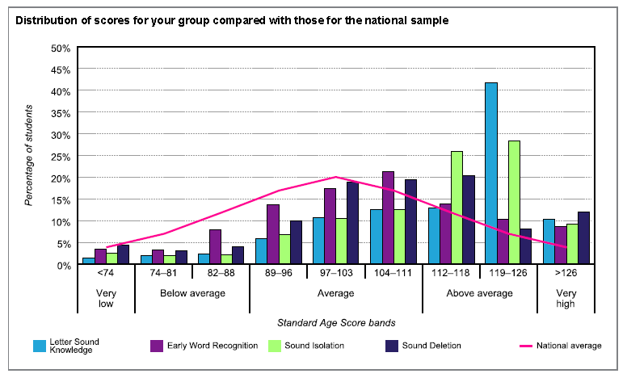
YARC Distribution
There is a positive distribution. CEC cohort has fewer children than UK in “Very low, Below average and average stanines”.
There are more CEC pupils in the “above average and very high” stanines than UK average.
The mean score across all categories is higher than UK.
Early word recognition and sound deletion were the aspects which performed least well.

Slide 14
P1 YARC and Maths Distribution Comparison
YARC P1 2013/14
Pim5 P1 2013/14
Overall performance in YARC at P1 is better than that of Maths.

Slide 15
Performance in Primary 4

Slide 16
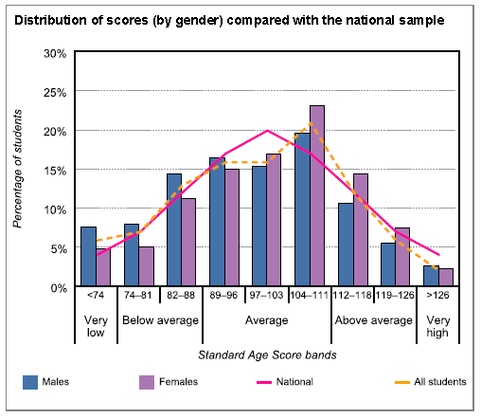
P4 Reading Distribution
Girls at P4 performing consistently well. Mean Score – 100.8
Edinburgh generally following UK trend with the overall mean 99.1
BUT
Boys at P4 performing less well than girls across stanine distribution.
P4 male mean score is 97.6

Slide 17
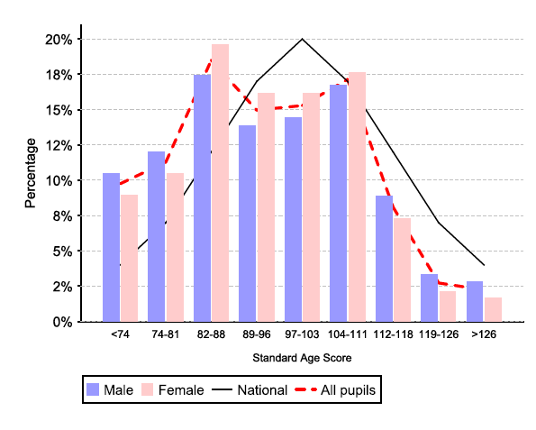
P4 Maths Distribution
P4 Maths Distribution 2013-14
 | 10-11 | 11-12 | 12-13 | 13-14
% <89 | 41 | 44.2 | 39 | 39.6
% ≥89 and <112 | 49 | 44.6 | 47.4 | 47.4
% ≥112 | 10 | 11.1 | 13.7 | 13
Mean Score | 94 | 93 | 94.8 | 94.5
The percentage of pupils < 89 has decreased since 10/11.
The percentage of pupils ≥ 112 has increased since 10/11.
BUT
The distribution of scores is lower than UK average.
Boys at lower stanines perform less well than girls, however at the upper stanines boys perform better than girls.

Slide 18
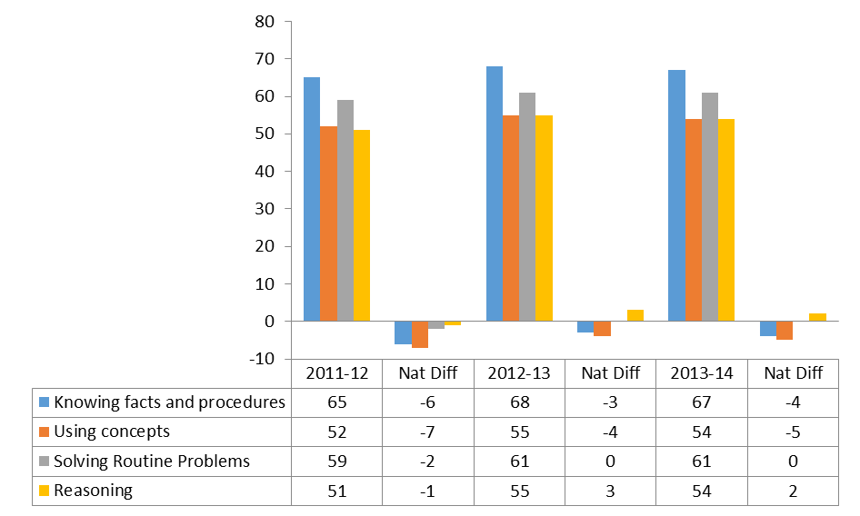
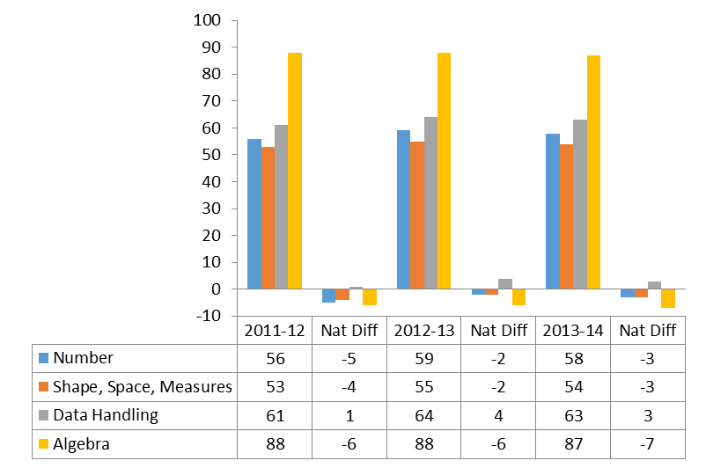
P4 Performance
3 Year Improvement across all process category areas and in the content area of number.
Process
BUT*
Performing below UK average in Number (21), Shape … (10) and Algebra (2)
Performing below UK average in knowing facts and procedures and using concepts
Content
* Number of marks in brackets

Slide 19
P4 Questions
Significant Question with -ve Difference relative to UK
Question Content Pim8 P4 | CEC % 2011-12 | CEC % 2012-13 | CEC % 2013-14 | UK %
In a queue 3 people are behind Pat. Click on Pat. | 60 | 63 | 62 | 90
Complete the number pattern – each number is half of the one before. | 54 | 56 | 57 | 67
Show 3 degrees c on a thermometer | 46 | 49 | 46 | 58
Make 6 using green and white counters | 72 | 74 | 75 | 82
100-45= | 45 | 51 | 47 | 50
Pim8 P4 Year | Number of questions which were equal to or more than National % Correct | Number of questions which were less than National % Correct | Difference
2011-12 | 9 | 24 | -15
2012-13 | 20 | 13 | 7
2013-14 | 20 | 13 | 7
There has been an overall improvement in the number of questions which P4 are answering successfully
however
there are key aspects in understanding and application of number processes that have a negative performance in relation to the UK

Slide 20
P4 Reading and Maths Distribution Comparison
Reading P4 2013/14
Mathematics P4 2013/14
Overall performance in reading at P4 is better than that of Maths.

Slide 21
Performance in Primary 7

Slide 22
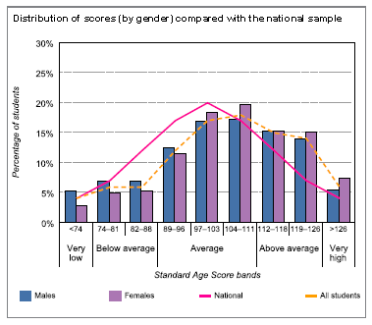
P7 Reading Distribution
Girls at P7 performing consistently well. Mean Score – 105.7
Positive distribution of scores compared to UK. CEC Mean 104.4
P7 boys mean score is 103.2
BUT
Boys at P7 performing less well than girls across stanine distribution.

Slide 23
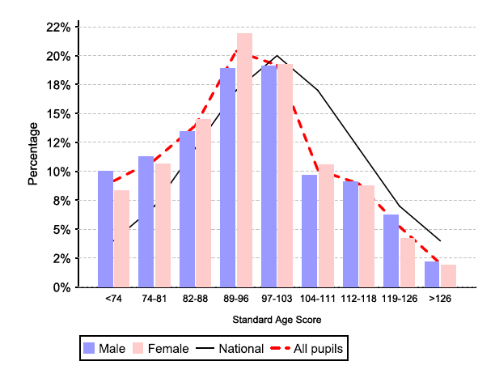
P7 Maths Distribution
Session | 10-11 | 11-12 | 12-13 | 13-14
% <89 | 40 | 39.6 | 36.1 | 34.2
% ≥89 and <112 | 47 | 47.6 | 49.1 | 49.7
% ≥112 | 12 | 13.5 | 13.4 | 16.1
Mean Score | 93 | 93.4 | 94.1 | 95.1
The percentage of pupils < 89 has decreased by 6% since 10/11.
The percentage of pupils ≥ 112 has increased by 4% since 10/11.
The mean score has increased each year
BUT
The distribution of scores is lower than UK average.
Boys at lower stanines perform less well than girls, however at the upper stanines boys perform better than girls. (This being the same as P4)

Slide 24
P7 Performance
3 Year Improvement across all process category areas and in the content area of number.
Process
BUT*
Performing below UK average in Number (22), Shape … (15), Data Handling (12) and Algebra (3)
Performing below UK average in all processes.
Content
* Number of marks in brackets

Slide 25
P7 Questions
Significant Question with -ve Difference relative to UK
Question Content Pim11 P7 | CEC % 2011-12 | CEC % 2012-13 | CEC % 2013-14 | UK %
1 bus = 49 people. How many buses for 379 people? | 37 | 43 | 49 | 61
What is Sam’s number if he divides it by 100 to get the answer 6.2 | 38 | 41 | 42 | 61
What temperature does the thermometer show? | 61 | 63 | 66 | 81
Fill in the gap ?/168=45 | 45 | 50 | 51 | 64
Click on the value of 3 in 637.082 | 60 | 63 | 66 | 75
Pim11 P7 Year | Number of questions which were equal to or more than National % Correct | Number of questions which were less than National % Correct | Difference
2011-12 | 10 | 35 | -25
2012-13 | 11 | 34 | -23
2013-14 | 17 | 28 | -11
There has been an overall improvement in the number of questions which P7 are answering successfully
However
There continues to be more questions answered wrongly than correctly relative to UK performance.
Like P4 there are key aspects in understanding and application of number processes that have a negative performance in relation to the UK

Slide 26
P7 Reading and Maths Distribution Comparison
Reading P7 2013/14
Mathematics P7 2013/14
Overall performance in reading at P7 is better than that of Maths.

Slide 27
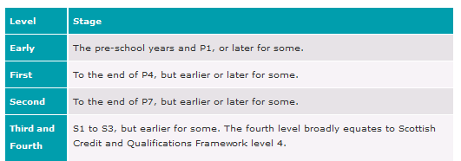
 | Primary 1 |  |  |  |  | Primary 4 |  |  |  |  | Primary 7
 | Literacy |  | Maths |  |  | Literacy |  | Maths |  |  | Literacy |  | Maths
11-12 | 69 |  | 69 |  |  | 55 |  | 54 |  |  | 73 |  | 48
12-13 | 69 |  | 72 |  |  | 61 |  | 61 |  |  | 56 |  | 54
13-14 | 74 | 68 | 77 | 73 |  | 66 | 61 | 65 | 62 |  | 59 | 56 | 59 | 57

Slide 28
So what ?
Authority
Support material for interpreting GL assessments (on blog shortly)
Continue to
Support Literacy programmes and interventions
Support Maths – SEAL, Mental Agility Guidelines P1-P7, CPD in maths in upper primary
Develop CPD for middle primary stages in mathematics
Tracking and monitoring support / guidance to come from SLWG
Build on last session Language assessment and moderation with maths this session
School
What will you do with this authority level information?
Are you identifying knowledge and skills gaps of cohorts and individuals?
How are you acting on the attainment data and assessment evidence you have ?

