Slide 1
Primary Headteacher CfE Meeting
April 29th 2014

Slide 2
Key strategic school priorities
Attainment – raise attainment and achievement for targeted groups; the lowest 20% and LAAC
Curriculum – review BGE across the 4 contexts for learning 3-15 in light of Ed Scotland key inspection findings in order to ensure progression and to increase the pace
Pedagogy – ensure appropriate challenge, appropriateness of activities to meet the needs of all children and improving the quality of learning activities to ensure that all needs are met.(5.3)

Slide 3
Headline Primary School Priorities
Attainment – Literacy and Numeracy ( SEAL), assessment and moderation
Curriculum -Curriculum planning, 1+2 languages
Monitoring and tracking (OTwL)
Pedagogy – Aifl, meeting learners’s needs
CLPL
Implementation of 600 hours

Slide 4
English / Literacy
CD of Resources for Literacy Rich for P1/P2
Pilot of vocabulary enhancement Nursery-P2 (small group of PA schools)
Literacy Interventions – Read Write Inc, Fresh Start
Assessment and Moderation – cluster and school
Literacy Hub

Slide 5
OUR exemplars
A4 or A3 format.
Level
Title -Reading/Writing/L and T
Significant aspects
context in which the learning took place
learner evidence
Annotations - teachers’ notes- what is going on inside teacher’s head/ pupil voice -may be captured within the evidence
learner reflection/conversations
No names
ES exemplars - http://tinyurl.com/edscotexemplars
Notes:
Annotated exemplars will be viewed as an on-line resource
Accessible - evidence should be visible/legible
Annotations should link clearly to the evidence and add value (not descriptive but illustrate why this evidence demonstrates x

Slide 6
Next step as a school assessment coordinator
What will you need to do now ?
Share information with your headteacher
Share annotated exemplars with P1,P4 and P7 staff before end of term
Arrange meetings as a cluster group? (Cover provided for two days cover - one twilight )
To support our authority moderation -For one learner - P1/4 or P7-Gather evidence of achievement at a level
Create 1 annotated exemplar
Moderate this evidence as a cluster
Liaise with cluster coordinator to plan cluster CATs - plan to be brought back on JUNE 3
+ Network meetings for coordinators
Notes:
Annotated exemplars will be viewed as an on-line resource
Accessible - evidence should be visible/legible
Annotations should link clearly to the evidence and add value (not descriptive but illustrate why this evidence demonstrates x

Slide 7
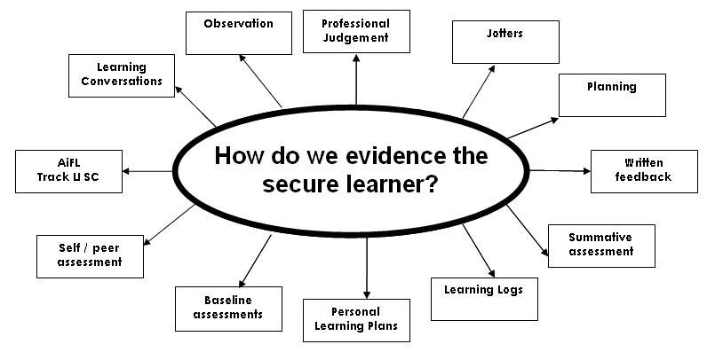
Where will you find evidence of learning?
Plenary
Self Assessment
Peer Assessment

Slide 8
Mathematics / Numeracy
SEAL Update
CPD
Resources
Assessment
Home learning wall
Pinterest
Mental agility guidelines draft
Difficulties with numeracy guidelines
Numeracy coordinators meeting - 7th May
Numeracy Hub (East Lothian, Mid Lothian, Edinburgh)
Assessment / Moderation – same model as for literacy (Oct-Feb cluster coordinators, Feb-June school coordinators)

Slide 9
Assessment AS
learning
Assessment FOR
learning
Organisation for
learning
Skills for learning
Evidencing
learning
Dialogue about learning
Questioning &
interactions
Assessment OF
learning
Significant aspects of learning

Slide 10
Higher Order
Thinking
Skills

Slide 11
Follow up to anti-bullying questionnaire
NEXT STEPS
The next survey will take place between 3 and 28 November, 2014 and will be sent out to schools with resources and staff notes by the end of September.
For child protection purposes, Head Teachers should read every comment by pupils
Individual school reports will be issued by the end of February, 2015 and should be shared with those pupils who took part as well as with staff and the pupil council.
Quality Improvement Officers will discuss with individual schools any matters of concern
The pupil council should be supported to develop actions and plans to improve the school’s results.

Slide 12
OTWL Tracking and Monitoring
OTwL Routes – 3 current pathways
Full planning and assessment
Assessment focus on significant aspects (now entered onto OTwL for Mathematics and English)
Coverage of Learning
Or a combination of the above
Development of OTwL management reports

Slide 13
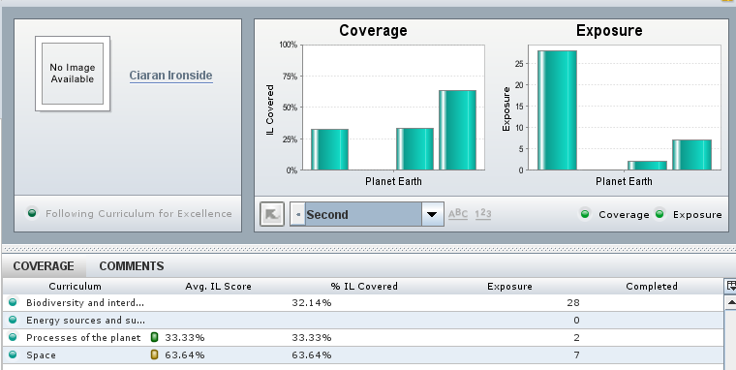
Science Example
Coverage - experience
Exposure - (frequency of experience)
Add comments on learning ... then export for reporting

Slide 14
OTwL developments - Management Reports
Possible coverage overview of Es and Os – with override
Possible assessment progress

Slide 15
Tracking and Monitoring
Group looking at Tracking and Monitoring (initial meeting after 5.1) – volunteers ?
Monitoring and Tracking guideline paper
Consideration of role of DCS
New schools OTwL next session ?

Slide 16
Modern Languages
Ann Robertson

Slide 17
 | SEAL Whole school training | OTwL | Modern Languages 1+2 (agreed at cluster level)
2014-15
2015-16
2016-17
Please include name of school Return to heather.williamson@edinburgh.gov.uk by May 23rd 2014

Slide 18
HMIe Inspection Findings
Curriculum Expectations 2013-14
www.educationscotland.gov.uk

Slide 19
Theme 1 Rationale and Design of the Curriculum
Staff are working with increasing confidence with the experiences and outcomes and know how to use these in taking a coherent approach to learning, teaching and assessment.(2011) Focus continues to be on quality of curriculum as experienced by learners.(2012)
Curriculum designed to raise standards of attainment, advance equality of opportunity reduce disadvantage.(2013)
Clear vision and rationale taking account of entitlements.(2011)
and develops skills and attributes of the 4 capacities. (2013)
www.educationscotland.gov.uk

Slide 20
Theme 1 Rationale and Design of the Curriculum
Ensure development of literacy and numeracy is a corporate responsibility. Developed holistic approach to health and wellbeing.(2011)
A high priority is given to the development of health and wellbeing across 4 aspects of curriculum.(2012) Shared and clear strategy for developing literacy and numeracy.(2012)
Clear and effective strategy for development and assessment of literacy, numeracy and health and wellbeing to ensure smooth progression.(2013)
Staff familiar with design principles and can talk about how their work contributes to 4 contexts for learning/ BGE.(2011)
Curriculum is based on design principles. Designed to meet needs of all learners including those with ASN. Designed to deliver entitlements and in particular broad general education.(2012)
www.educationscotland.gov.uk

Slide 21
Theme 2 -Development of the Curriculum
Staff can
Talk about their role in curriculum innovation.(2011) Staff develop and refresh curriculum on a regular basis and manage change and innovation to develop curriculum. Work with stakeholders.(2012) Planned opportunities to collaborate with schools and partners. Schools along with partners further develop the curriculum to improve planning for progression BGE. (2013)
Working with partners to ensure curriculum provides a coherent experience for children. (2011) Engage regularly with other colleagues, partners and clusters about impact of developments on learning and teaching.(2012)
www.educationscotland.gov.uk

Slide 22
Theme 2 -Development of the Curriculum
Staff clearly identify benefits to learners from planned curriculum change and innovation.(2012)
Monitor and evaluate impact and outcomes of changes to curriculum. Action taken to ensure curriculum planning and structures evolve progressively over time.(2012)
Where school is not yet delivering Curriculum for Excellence entitlements there are clear plans over next year or two to ensure curriculum evolves.(2012) Immediate Plans (2013)
Staff can talk about actual and planned developments in courses and programmes, including rationale for change and expected outcomes for learners.(2011) Staff design and refresh programmes and courses to plan coherent approach to learning, teaching and assessment. Develop skills and attributes and capabilities across 4 capacities.(2012)
Engage in professional dialogue about impact of curricular developments on their own approaches to teaching and extent they helping children reach individual learning goals.(2011)
Are planning progression through Curriculum for Excellence levels

Slide 23
Theme 3 – Programmes and Courses cont’d
Using Experiences and Outcomes within and across curriculum improving use of Experiences and Outcomes.(2011) and embed them in learning, motivating challenging learning experiences.(2012)
Staff and partners are further developing the curriculum to ensure coherence and progression to deliver well planned joined up learning across 4 contexts.(2013)
Planning coherent courses and programmes ensuring depth and breadth in learning and embedding assessment, including reporting on progress and achievement.(2011) Provide a range of progression routes through BGE to meet needs.(2013)
Planning for Breadth, Challenge, Application.(2011)
Planning for appropriate progression through BCA.(2012)
Planning for appropriate progression through BCA. Developing manageable approaches to assessing progress and achievement in all curricular areas.(2013)
Increasing opportunities for personalisation and choice and personal achievement.(2012)

Slide 24
Theme 3 – Programmes and Courses cont’d
Developing skills for learning, life and work.(2011)
Supporting learners to acquire key skills in English Language and mathematics which allow application in context which develop literacy and numeracy.(2011)
Further embedding and extending active approaches, applying literacy, numeracy and health and wellbeing across curriculum.(2011) Assessment of literacy, numeracy and health and wellbeing to ensure smooth progression and achievement.(2013)
Delivering coherent well planned joined up learning within the 4 contexts.(2011)
Using Experiences and Outcomes plan for progression and achievement.(2011)
Can talk confidently about actual and planned Interdisciplinary learning and the extent to which they are impacting on outcomes for learners.(2011)Through well planned IDL projects and studies which focus on a selection of Experiences and Outcomes and support learners making links across different aspects of their learning.(2012)

Slide 25
Theme 3 – Programmes and Courses cont’d
Promotes personal achievements.(2012)
Staff are developing programmes and courses to balance progressive development of knowledge and skills as detailed in Principles and Practice papers. (2012)
Staff are planning for progression through Curriculum for Excellence levels.(2012)
www.educationscotland.gov.uk

Slide 26
Theme 4 – Transitions
Take account of info for effective transitions, into during and beyond stage of young persons learning.(2011)
Transition programmes and procedures effectively meet needs of all learners. Ensure continuity and progression in learning particularly into P1 and between P7 and S1. (2012)
Taken steps to improve range of personal support and induction to next phase for all learners.(2011)
Developing effective means to monitor and track and promote achievements of all learners.(2011)
Staff are embedding profiling and are supporting P7 pupil profiles. Staff are improving the curriculum to support children in developing an increased awareness of themselves as learners.(2012)
Main difference in 2013 is greater emphasis on planning for progression coherence and improving transitions. Assessment and Moderation
www.educationscotland.gov.uk

Slide 27
Activity
Identify overall evaluation of curriculum (1-6) from the RIF
As a group identify key features of excellence.

Slide 28
Main issues to consider when evaluating 5.1
Strategic overview.
Continual Development of the curriculum.
Planned progressive routes for all curricular areas.
Well planned 4 contexts, including Interdisciplinary learning.
Clear framework for interdisciplinary learning to ensure a build up of knowledge and understanding and skills over time.
Teachers providing high-quality experiences for learners across curriculum.
Teachers understanding of Curriculum.
Assessment.
Curricular transitions.
www.educationscotland.gov.uk

Slide 29
5.1 / 5.9 Joint Practice – Self Evaluation of the Curriculum
15 minute overview based on 4 themes from 5.1 (Draft Dates on blog)
Bring along 5.1 SQIP page and any examples to share of the following
Strategic overview
Planned progressive routes for a curricular area
Well planned 4 contexts
Clear framework for interdisciplinary
Assessment exemplar
Curricular transitions – including tracking and monitoring
Toolkit (5.1,5.9) – updated expectations on blog
Next session 1.1, 5.1, 5.9 Joint practice meetings

Slide 30
Transition
Early Years QIO – Eve Lyon
P7 Profile and P7/S1 transition

Slide 31
Support Materials
CEC Position Paper
BtC 5 Recognising achievement, profiling
and reporting
http://www.educationscotland.gov.uk/publications/b/publication_tcm4641218.asp?strRefer
ringChannel=educationscotland&strReferringPageID=tcm:4-615801-64
CfE Briefing 3: profiling and the S3 profile
http://www.educationscotland.gov.uk/resources/c/genericresource_tcm4731978.asp

Slide 32
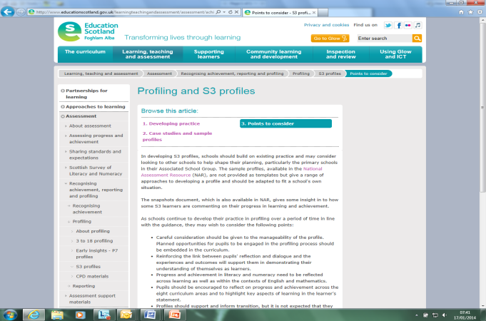
Support Materials
Education Scotland website:
Profiling and S3 Profiles
http://www.educationscotland.gov.uk/learningteachingandassessment/assessment/achievement/profiling/s3profiles/pointstoconsider.asp
Information on Parentzone
http://www.educationscotland.gov.uk/parentzone/cfe/recognisingachievement/recognisingachievement/reocgnisingachievement.asp

Slide 33
Where are we?
CEC Position Paper 2013
All nursery, primary, secondary and special schools in a position to produce profiles at Nursery, P7 and S3 as appropriate by June 2014
Professional learning opportunities have been delivered to P7, DHTs primary, those with lead responsibility for S3 profiles, Special School HTs
We have information on progress from primary schools, S3 lead practitioners self-evaluation in secondary and special

Slide 34
What’s new?
Greater focus on learner dialogue and the ‘process’ of
profiling - embedded in learning, teaching.
supporting young people to talk about and reflect on their learning in curriculum areas, their achievements and the skills for learning, life and work they are developing.
Emerging approaches to 3 -18 profiling
http://www.educationscotland.gov.uk/learningteachingandassessment/assessment/achievement/profiling/3to18profiles/index.asp
..... avoid the ‘profiling week’ .....

Slide 35
What do we need to get better at?
embed learner dialogue and profiling in learning, teaching and assessment
ensure all teachers understand their responsibility to support learner dialogue and profiling
structure (scaffold) support to ensure the profile identifies skills and achievements (not descriptive)
flexibility in the format - appropriate to the leaner’s age, stage and individual needs
ensure all teachers are aware of profiling and the profile at each stage and that is supports transition

Slide 36
What are we going to do next?
SLWG
Update Position Paper to include key features of good practice in:
embedding learner dialogue and profiling
best use of profiles at points of transition
structuring support to complete profiles
differentiated/flexible formats
Paper completed by May
share at cluster HTs meetings, with S3 lead practitioners, DHT networks

Slide 37
Transition
P7 Transition information – cluster agreement – as per last session (Mathematics, English)
Standardised test results / reports to be emailed to secondary school
SEEMIS
English/literacy and mathematics/numeracy levels will be collected end May 30th 2014.
Sub organiser if you wish BUT overall is required
All curriculum areas in SEEMIS, D,C,S
Email from Andy McKenzie / Joanne Burns including instructions for what to do to allow Secondary to “see” S1 pupils

Slide 38
Transition for current P7
 | Mathematics and Numeracy | Literacy and English
What? | Transition information criteria Process / Documentation shows How much content has been covered How well have learners achieved within this Indication of specific learning needs for particular pupils | Transition Writing Approach In the final term of P7, learners write in a new “jotter” that will travel with them and continue to be used in their secondary school. Evidence of planning and formative assessment should be included.
Cluster role | Agree process at cluster level which meets criteria. This is likely to involve … Face to face P7/S1 staff discussion, documentation – electronic, paper, SEEMIS
Support / Options | Use … annotated CEC learning intention level overviews or Spreadsheet (Es and Os) or cluster agreed documentation | Clusters should determine the genres of writing to be covered
Notes:
Lesley McDowall will provide an update on Pre-5 / P1 under discussion on profile

