Slide 1
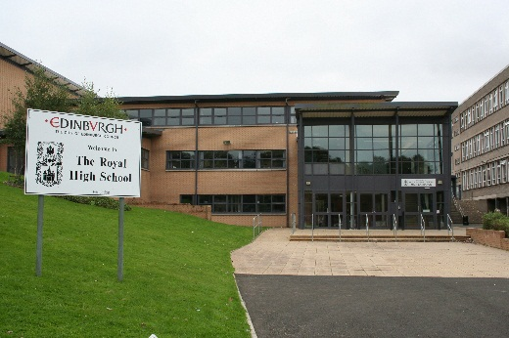
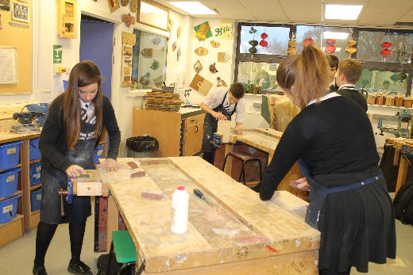
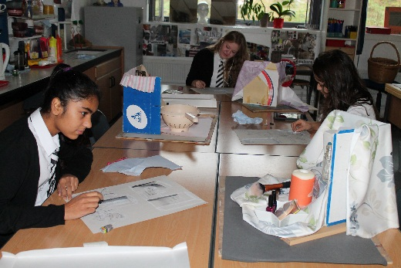
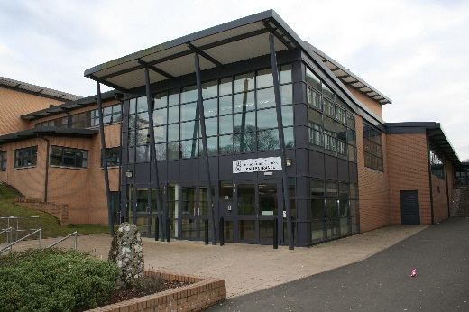
Pauline Walker Headteacher The Royal High School The Smarter Way To BGE?

Slide 2
How do we make the best use of the tools we have in Curriculum for Excellence?

Slide 3
What Opportunities Are Arising?

Slide 4
Broad General Education
Breadth
Balance
Choice as appropriate
Ongoing skills development
IDL in its truest form
Connections?

Slide 5
So How Can We Approach This?
Positive Destination
S1 & S2 BGE

Slide 6
Building progression
pathways and foundations for success
Senior Phase
Broad General Education

Slide 7
Positive
Destination
Progression
S1 & S2
BGE
Skills
Development
E’s and O’s
Curricular Areas

Slide 8
Learner Journey is the most important factor
What do I experience across the school?

Slide 9
How does this develop?
Make good use of the Significant Aspects of Learning
What do these mean in your schools context?
Within the context of assessing progress and achievement in the Broad General Education, the significant aspects of learning brings together a coherent body of knowledge and understanding and related skills as detailed within the experiences and outcomes. These significant aspects of learning refer to the core learning against which learners’ progress can be compared periodically.

Slide 10
How does this develop?
How do the Significant Aspects of Learning contribute towards good assessment judgements within the levels?
Has D,C and S had its day or still a useful tool if redefined in a local context?
Developing
Consolidating
Secure

Slide 11
How does this develop?
Tracking in a meaningful manner across the Significant Aspects
Should not be just be a tick-box exercise
Significant Aspects of Learning
Use reading and listening strategies to understand, analyse and evaluate texts.
The learner has demonstrated…
Teacher Voice
• I learned to…
• I can …
• I know how to …
Learner Voice

Slide 12
Building on the Significant Aspects
This gives us a progression journey for each student and a meaningful way to engage in learner conversations with a substantial focus.
Key points can be used to give snapshots of progression and demonstrate individual and cohort journeys
Reporting to parents can be more substantial and meaningful
The learner voice can be used to build a profile around the significant aspects

Slide 13
And What About Skills?
These must be core to a young persons development and not an add-on or an after-thought.
Business and Higher Education are very clear about the value they place on a strong skills base in young people
Skills must become an integral part of a learners journey

Slide 14
Positive
Destination
Progression
S1 & S2
BGE
Skills
Development
E’s and O’s
Curricular Areas

Slide 15
Skills Framework
Establishing a progressive skills framework across S1-6 is desirable and can enable progression tracking
This can be clearly linked to wider achievement goal points at all levels

Slide 16
Skills Framework
– What would this look like?
BASIC:
Short 5 minute talk giving information
I can clearly present my ideas
What is the learning journey to get to here?
COMPLEX:
Q&A session presenting researched topic with
conclusions based on research question with
the ability to hold debate in peer forum
returning a consensus opinion at the end of the session.

Slide 17
Bringing It All Together
Can we build a framework which incorporates the Significant
Aspects of Learning alongside Skills and Wider achievement
which enables progression, challenge and a strong foundation
for the Senior Phase?
How do we track this effectively without creating bureaucracy?

Slide 18
Bringing It All Together
Can we build a framework which incorporates the Significant
Aspects of Learning alongside Skills and Wider achievement
which enables progression, challenge and a strong foundation
for the Senior Phase?
How do we track this effectively without creating bureaucracy?

Slide 19
We need to ensure the BGE is not the poor neighbour but in fact a relevant, exciting and challenging experience which paves the way for a successful Senior Phase.
If we get this right then we have risen to the challenge!

