Slide 1
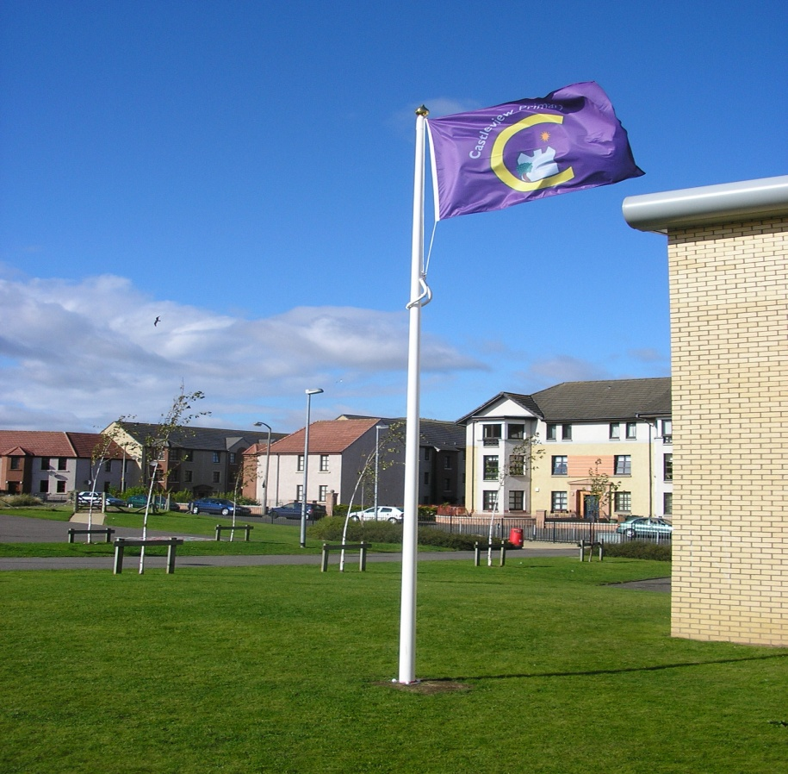
Leadership of Learning at Castleview Primary School
Lindsey Watt, Headteacher

Slide 2

Edinburgh Learning Festival

Slide 3
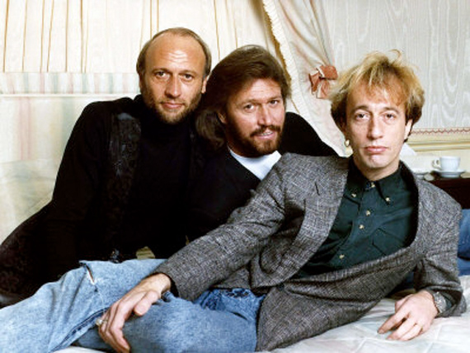

BGE

Slide 4
2004 HMIe - Ensure Improvement in ..
the structure of the curriculum by establishing clear expectations about what pupils are to learn and how this will be planned and assessed;
raising attainment in reading, writing and mathematics by ensuring appropriate levels of pace and challenge for all pupils in their learning;
monitoring pupils’ progress to help further develop their learning experiences.

Slide 5

6 Columban Leadership Values
Notes:
In more detail these are:

Slide 6

HMIE 2013
Improvements in performance | Very good
Learners’ experiences | Very good
Meeting learning needs | Excellent
Curriculum | Excellent
Improvements through self-evaluation | Very Good

Slide 7
What was observed at Castleview?
Dynamic positive and nurturing environment.
Approaches to planning learning consistent across the school which helps children to progress well.
Teachers plan motivating interesting tasks which meet the needs of individual children exceptionally well
Staff are highly-skilled and reflect continuously on the quality of learning and teaching and plan different way of helping individual children to progress.
Staff used an agreed system very well to identify children's needs and set clear targets to help them make progress.
Staff have very high expectations for children's learning behaviour and engagement.
Children play a key role in improving their own learning.
Additional staff are deployed very well to support children as individuals and in small groups, enabling children to achieve well
Notes:
Focus on differentiation changing a structured planning format to ensure that Experiences and outcomes are delivered effectively.
Use of Blooms taxonomy from Nursery to P7 – Higher order questioning at Staff Discussion sessions.
Focus on practising skills and then planning for transfer into the world of work. – HMIE said they saw aspirational transfer of skills and encouragement to plan for a better life – attempt to eradicate the poverty of ambition
Staff are highly-skilled and reflect continuously on the quality of learning and teaching and plan different way of helping individual children to progress.
The following planning sheet is high in quality but low in time to complete. Evidence supports PRD and Professional Learning

Slide 8
Forward Plan Discussion Checklist
CLASS…………. DATE……….…. BLOCK…..…
TEACHER………………………………………………
SMT MEMBER: ……………………………….……
Variety of Assessment Approaches | Literacy Across Learning
Engaging parents in their children’s learning and the life of the school | Numeracy Across Learning
Consulting and communicating with learners and parents | Health and Wellbeing Across Learning
Links to Rights Respecting Schools | Modern Languages 1+2
Evidence of Outdoor Learning | Co-operative Learning
Interdisciplinary Learning | SEAL
Opportunities for Personal Achievement | Use of specialist staff/PSAs/additional adults
Self-Evaluation Highlight above | How can I share practice with colleagues? | Review comment & date (next block)
I feel confident in this area/this is a strength of mine
Self-Evaluation Highlight above (1/2 per term) | Action Points: | Review comment & date (next block)
Development point; I would like to enhance my practice in this area

Slide 9
Self Evaluation to support Personal Development
Area/Element of L&T | Session/Block for planned focus: (date) | Review Date | Evidence and Impact | Sharing Practice (how you have/plan to)
Assessment Approaches (using a variety)
Interdisciplinary Learning
Literacy Across Learning
Numeracy Across Learning
Health and Wellbeing Across Learning
Co-operative Learning
Modern Languages
Engaging parents in their children’s learning and the life of the school
Consulting and communicating with learners and parents
Links to Rights Respecting Schools
Evidence of Outdoor Learning
SEAL
Use of specialist staff/PSAs/additional adults
Opportunities for Personal Achievement

Slide 10
4 Contexts for Learning
ethos and life of the school as a community
curriculum areas and subjects
interdisciplinary learning
opportunities for personal achievement
Notes:
The 4 contexts of learning are at the heart of all that we do in BGE at Castleview

Slide 11
Broad General Education in the Castleview Context
Clear, teaching rationale vision and purpose
Programmes of study have progression for all children across all curriculum areas
Transitions support continuity in learning
Children’s interest in owning their learning are taken into consideration

Slide 12
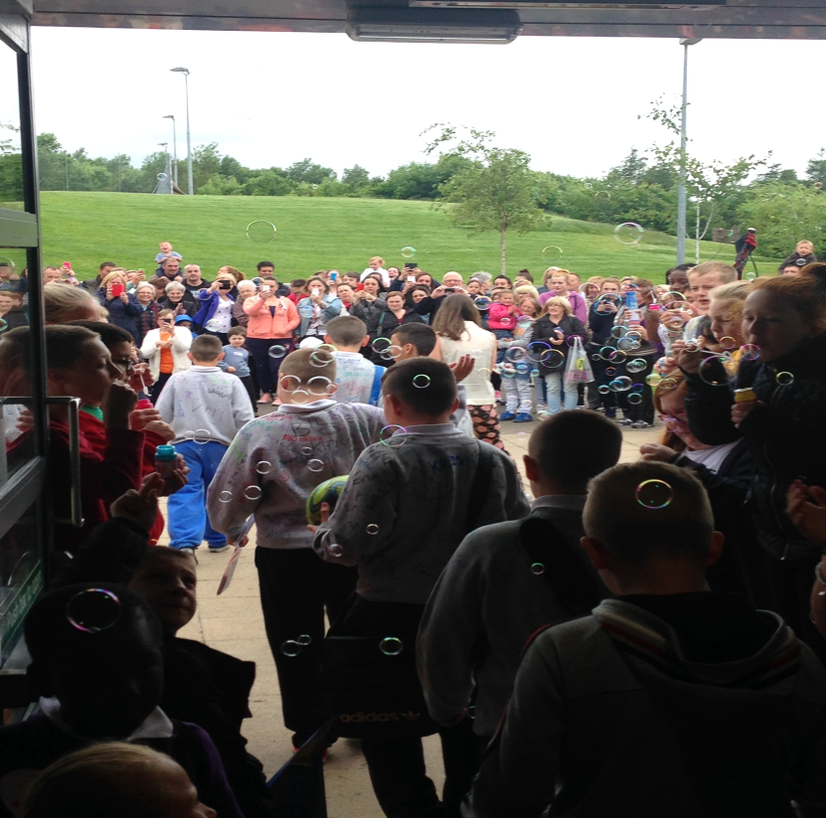
Outstanding Culture of Leadership for Learning through out the school
Standards, Quality
& Improvement Plan
Assessment and
Self Evaluation
Evidence
Involvement
Partnerships
Reflection
Notes:
Assessment Literate – school family
Success Criteria, self/peer-assess, identifying and application of the skill being taught
Classroom Discussion, Quality Feedback and Formative Evaluation
Many organisations are over-communicating and under-conversing.’
precise and focused
forensic in the analysis of children’s progress
Direct line of sight on every child
practice-based as well as paper-based
Recognition of areas of strengths and areas for improvement
Focus on learners’ experiences and outcomes.
“Flash/Frequent” moderation eradicates inconsistency in curriculum areas
Development of strong relationships and connections
Element of constructive competition in Team Castleview
Inspirational Teaching

Slide 13

Where is your
Inspirational Teaching - Comfort Zone?
Notes:
Pirate King!
For Castleview we have a resource on our doorstep to support Inter Disciplinary Learning

Slide 14
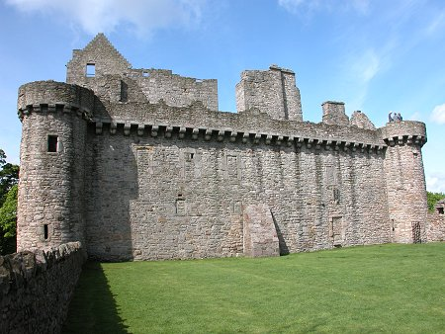
Craigmillar Castle

Slide 15
Social Studies Example
Having explored my local area, I can present information on different places to live, work and relax and interesting places to visit. SOC 2-10a
I can investigate a Scottish historical theme to discover how past events or the actions of individuals or groups have shaped Scottish society. SOC 2-03a
Pathways not Tramlines

Slide 16
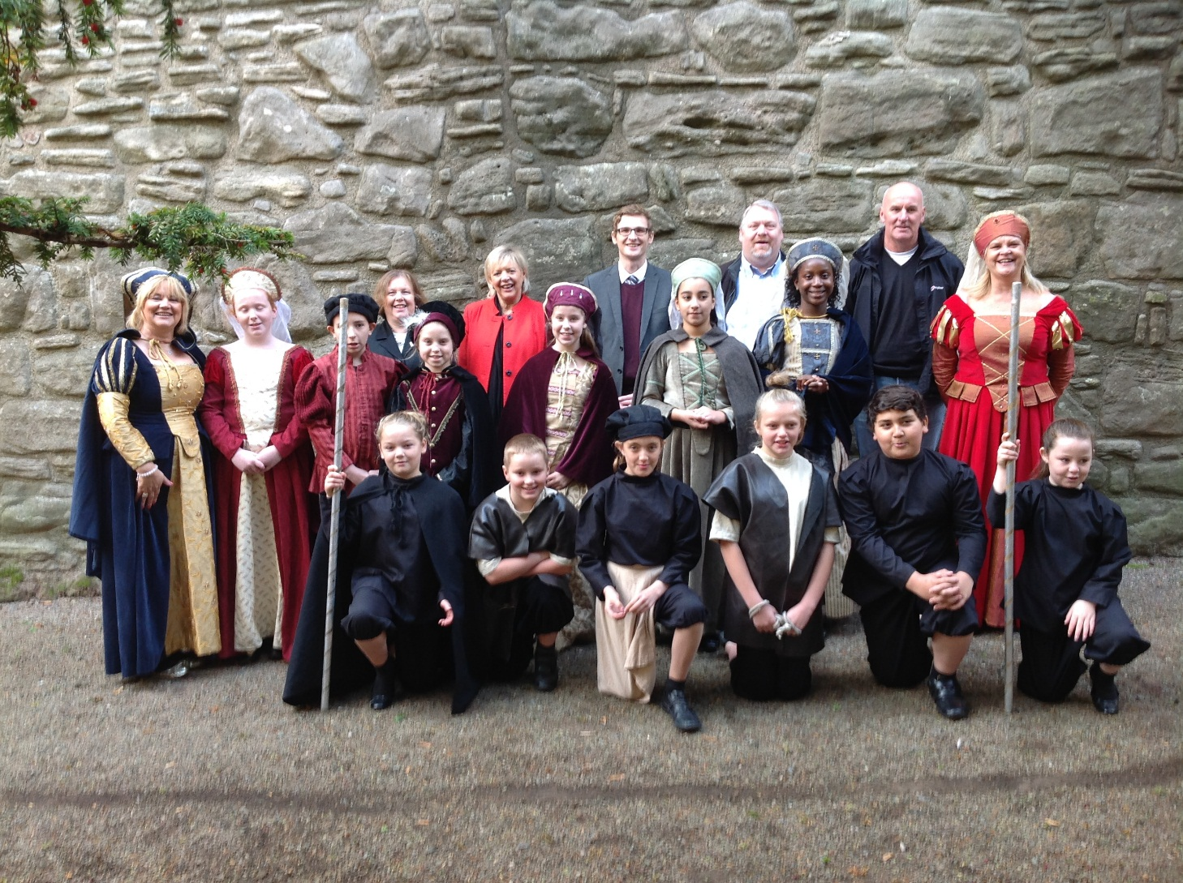
Develop your Curriculum to your School’s circumstances
Notes:
Now a nationally renowned award winning initiative grows every year

Slide 17
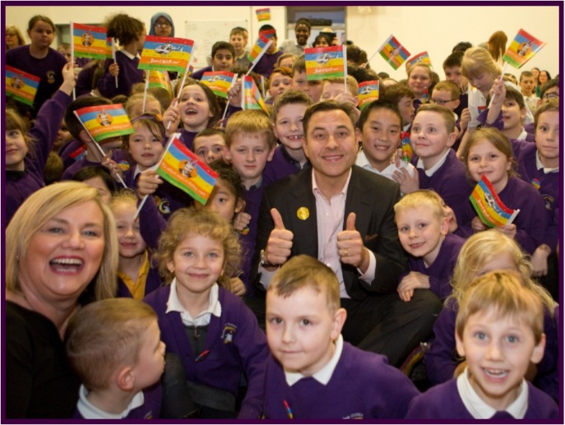
Learning should be Joyful and Purposeful
Notes:
Simple application through the One Show by a CT led to wonderful raising of interest in literacy and books.

Slide 18
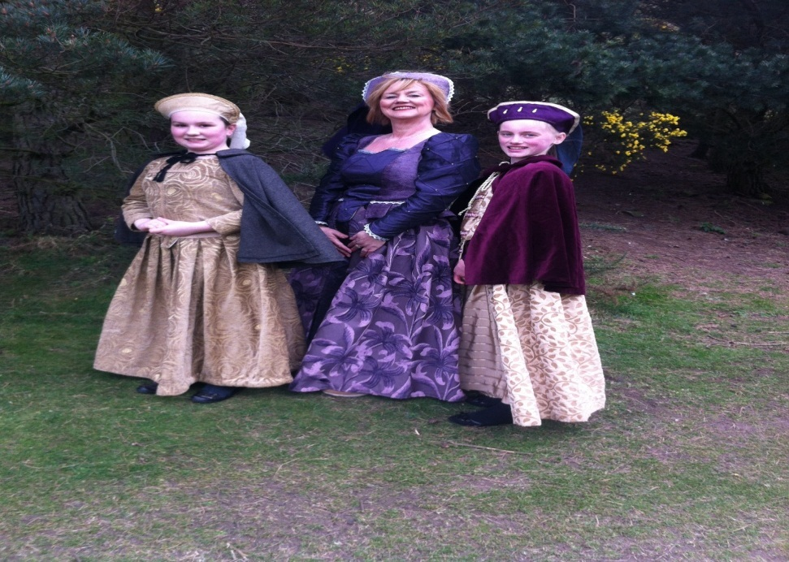
If not you then who?
The leader of the school is
the narrator of the school
Core vocation as educators and
role models to future generations
Children to understand the role they play in creating a better Edinburgh, a greater Scotland

Slide 19
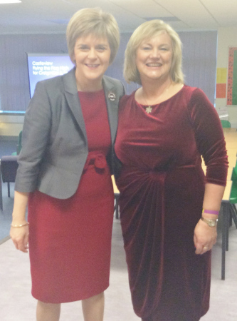
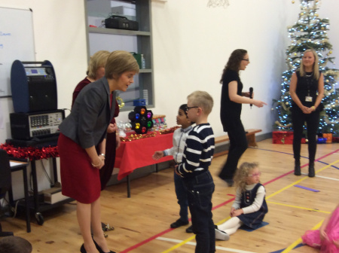
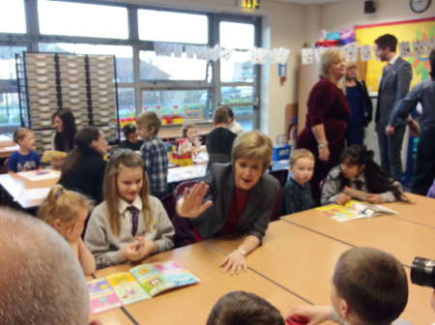
Visit of First Minister
to Castleview
December 2014

Slide 20
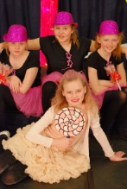
HMIE Report
Further develop
Continue to review
Re-establish
“I knew that I would be meeting some of Scotland’s most disadvantaged children. In the end I have met some of Scotland’s luckiest children due to the quality of their teaching and learning experience.”

Slide 21




Continue to seek ways of building partnerships with Castlebrae Community High School to support children who move there for secondary education

Slide 22

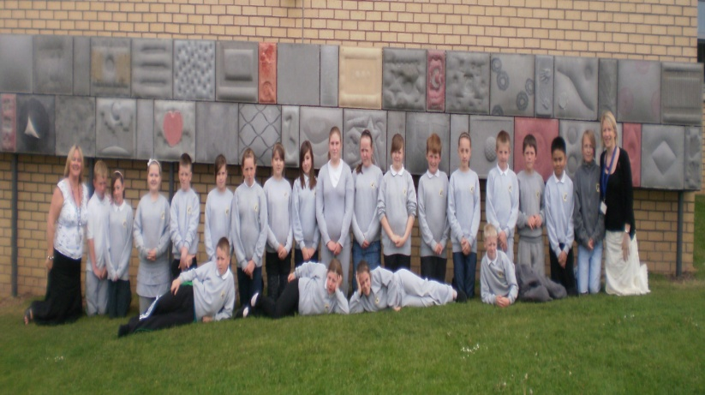
Partnerships support and add interest to learning
Cluster
Richmond’s Hope
Nairn's Oatcakes
Sheffield University
Community Citizenship Project
Castlegreen Care Home
Social Work and Health
Community Police & Park Rangers
Edinburgh University School of Architecture
Napier University
Benmore Outdoor Centre
Columba 1400
Historic Scotland
Notes:
Sharing resources selflessly & effectively, using your strengths & experience to take meaningful action & contribute to the greater good
Reaffirming their commitment to a spirit of education that is never content unless making an effective and measurable difference
22

Slide 23
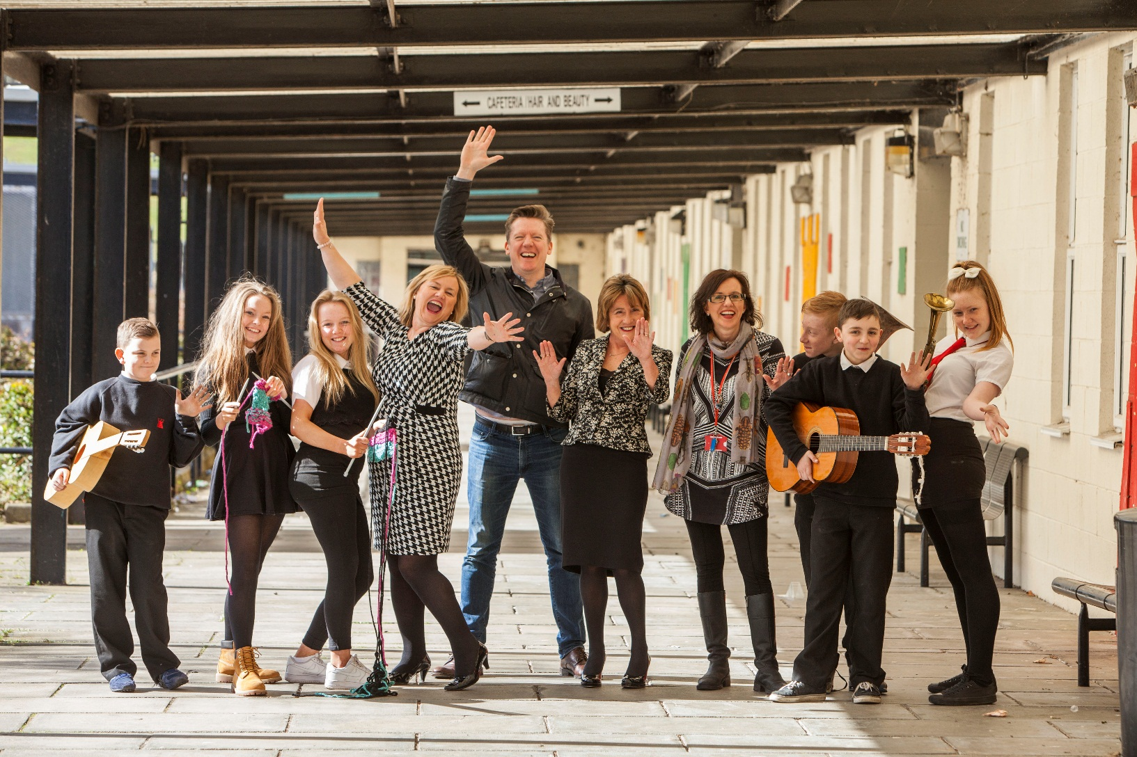
Partnership development is - Continuous with effective evaluation of Impact
Notes:
So what?!

Slide 24
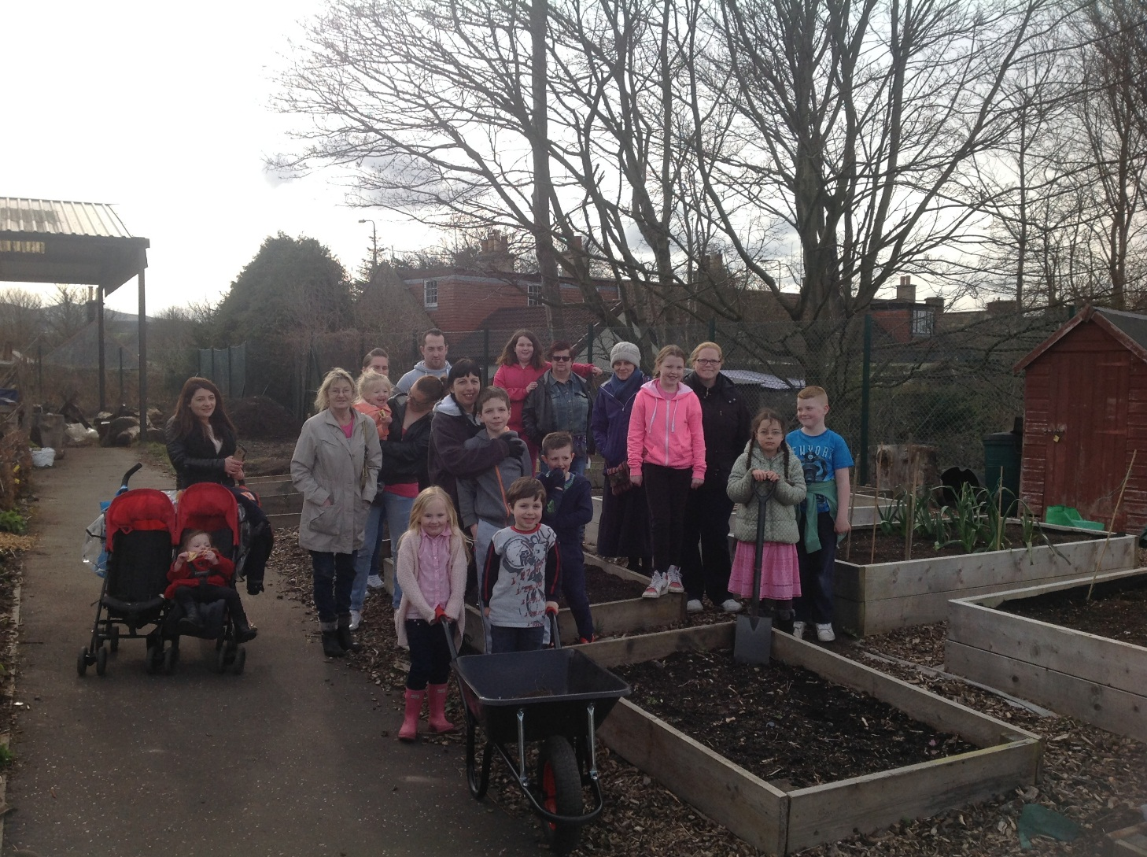
Our most important partners are our parents
Notes:
Dear Ms Watt
I am feeling sad to inform you that my tenure of work in Edinburgh is complete on 07 May leading us to move back home to India.
I observed that Castleview school brought confidence in writing and speaking, caring sharing and creativity. I will always be very thankful to your school for the phenomenal contribution you have made to Atharv’s personality and making him such a brilliant and studious pupil.
I am deeply thankful to Miss Florence for her creativity in teaching and methodologies and you for your high vision maintaining quality education and discipline in school. May you bring all progress and happiness to all pupils through your future endeavours. I appreciate you as a leader and mentor.

Slide 25

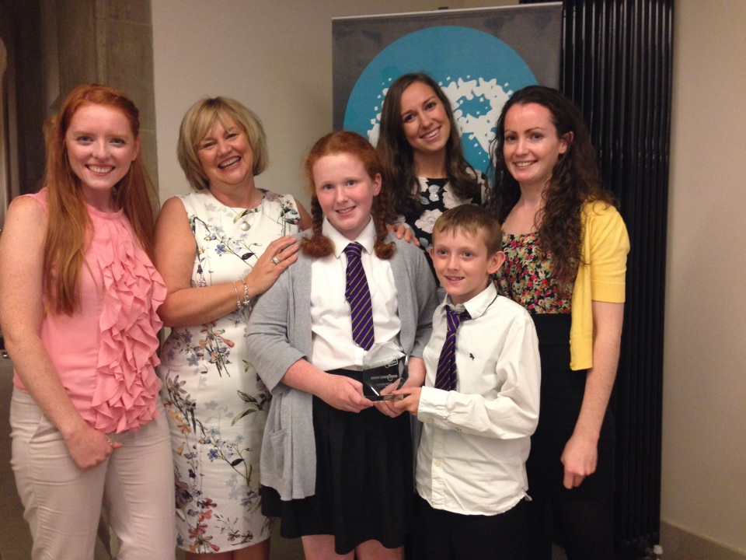
Build Leadership Capacity
MAKING THE DIFFERENCE: TEAM
Winners in this category needed to demonstrate that leaders who guide or direct others can be anyone, from the smallest child to the highest ranked person in the organisation. Teams can also lead the way. Leadership is about inspiring and motivating others and supporting others to achieve a common goal.

Slide 26
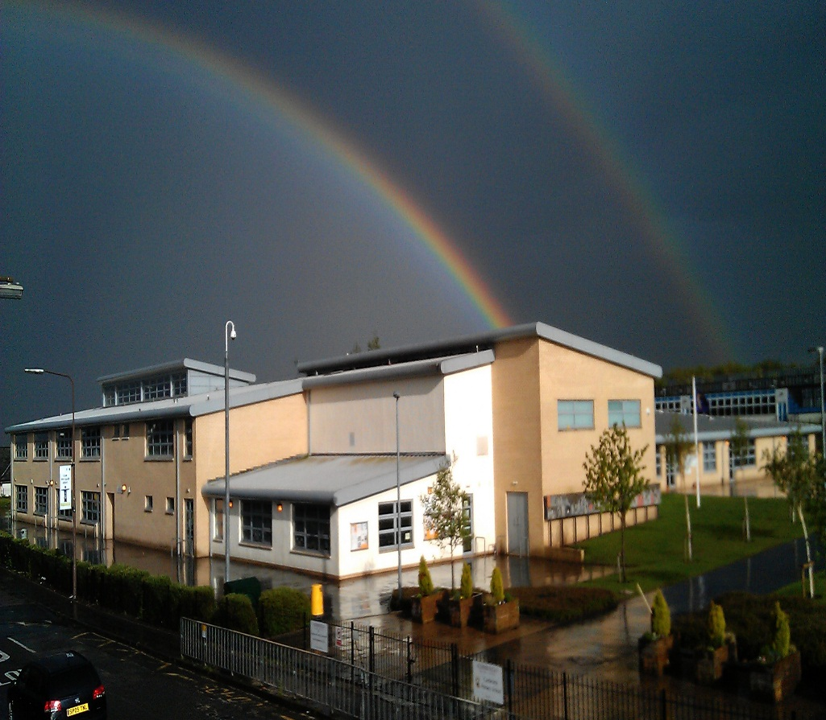
Create a Rainbow
Over Your Community

Slide 27
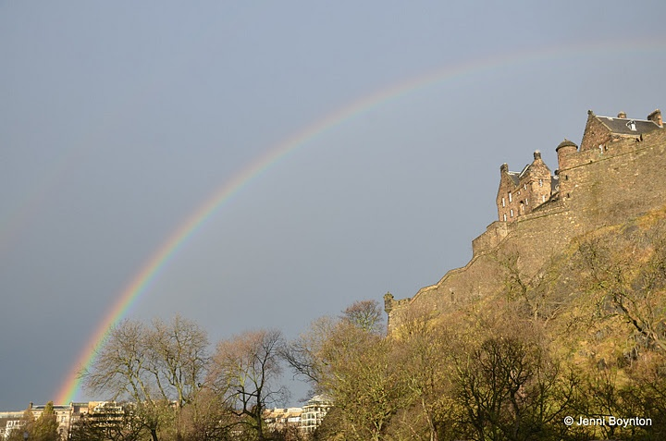
Create a Rainbow
Over Our city

