Slide 1

Edinburgh Learning Festival May 2015
The Broad General Education – From Good to Great
Planning, documenting and communicating progress of a young person’s individual learning journey
Carol McDonald HMI

Slide 2
Have we realised our vision for the BGE?
Is the design providing all children and young people with suitably challenging progression pathways?
Notes:
l

Slide 3
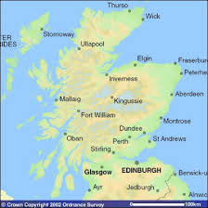

The Learning Journey in Scotland

Slide 4

A look back
A look in
A look forward

Slide 5

2003 - National Debate
Increase pupil choice and reduce
5-14 overload (de-cluttering)
More flexible curriculum with well-
balanced core entitlements
Simplify and reduce the amount of
assessment and time spent on exams
Create learning and teaching programmes that better meet learner needs
Increase access to vocational qualifications and strengthen school/college/university links

Slide 6
Our curriculum
National Framework
Education Act 2000
Children and Young People (Scotland) Act 2014
CfE - curriculum framework
Local Framework
City of Edinburgh framework
Autonomy for schools
GIRFEC, Languages 1 + 2, new qualifications, tackling bureaucracy, GTCS Standards, DYW, Inspection Advice Note

Slide 7
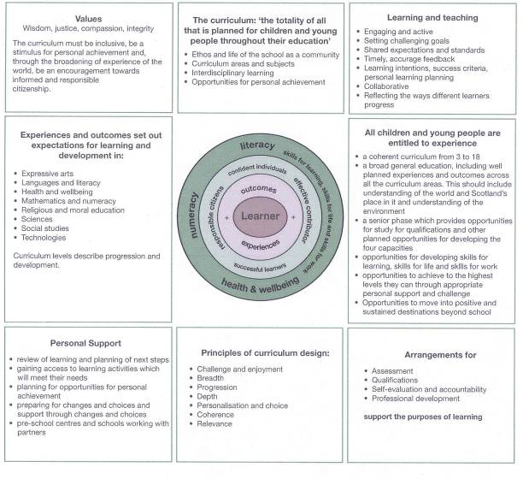
Curriculum framework

Slide 8
The curriculum
CfE aims to achieve a transformation in education in Scotland by providing a coherent, more flexible and enriched curriculum from 3 – 18, firmly focussed on the needs of the child and young person and designed to enable them to develop the four capacities.
The curriculum is the totality of experiences which are planned for children and young people through their education, wherever they are being educated.

Slide 9
BGE – Scotland’s curriculum
Our vision for young people’s learning
What are we trying to achieve?
  Breadth
  Progression
  Challenge & enjoyment
  Depth
  Coherence
  Relevance
  Personalisation and choice.

Slide 10
Progression
Progression
Progression

Slide 11
Rationale for your curriculum
What is the rationale for your curriculum?
How has the rationale informed the design of the curriculum?
Is there a shared understanding of, and commitment to, the rationale across the school and community?
What are you trying to achieve through the curriculum design?
To what extent are the courses and programmes across the curriculum in line with the rationale?
Is the curriculum supporting all children and young people to progress across their learning and achieve as highly as possible?

Slide 12
QI 5.1 The Curriculum
Evaluating the curriculum
rationale
meeting the needs of young people
progression
literacy, numeracy, health and wellbeing
assessment

Slide 13
Evaluating the Curriculum

Slide 14

tracking and monitoring progress
Why?
What?
Analysis and intervention to support every young person make the best possible progress based on a range of assessment evidence.
Gathering of data at a school / faculty school level to inform improvements….to the curriculum…to progression pathways…to meeting the needs of all learners

Slide 15
Inspection Advice Note
Schools use a range of approaches to monitor and evaluate the impact of curriculum change in the BGE and the senior phase to inform on-going improvements to provision.
Schools and other settings are further developing approaches to monitoring and tracking learners’ progress and achievement in the BGE to provide robust evidence of standards of achievement across all curriculum areas and trends over time……
  .

Slide 16
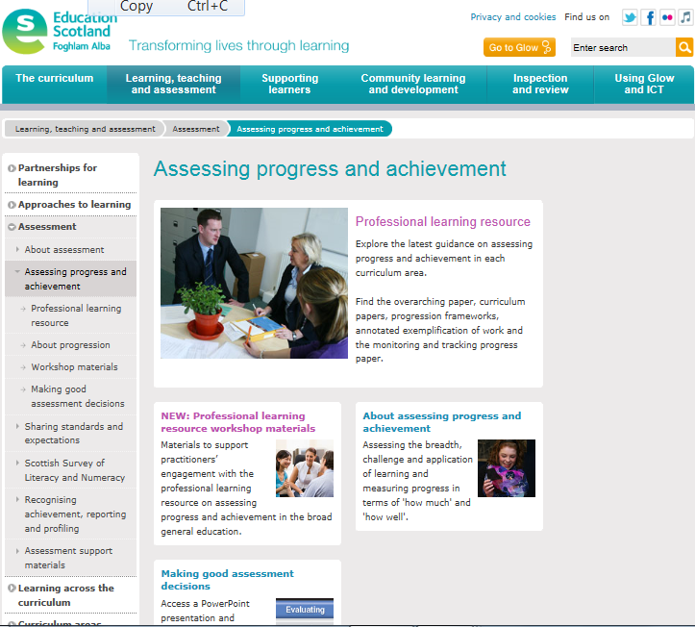

Slide 17
your school assessment strategy
Shared understanding of assessment in your school
purpose and principles
language of assessment and progress
  professional discussions
  with children and young people
range of assessment methods
arrangements for moderation
Valid; reliable; robust
arrangements for tracking and improving young people’s progress
reporting, recognising achievement, profiling

Slide 18


Slide 19
Purpose of the Professional Learning Resource
progression in the significant aspects of learning in each curriculum area
professional practice in assessing progress and achievement of a level within the broad general education
quality assurance and moderation activities and approaches to managing assessment
To
support
To
support
To
support

Slide 20
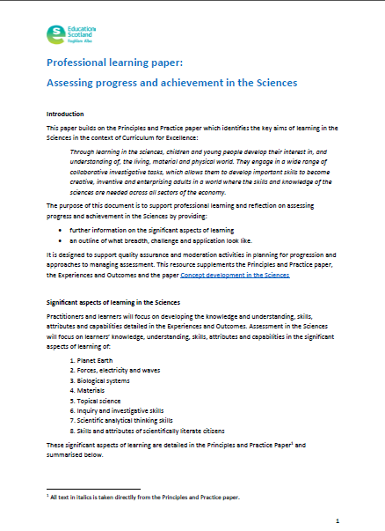
Curriculum Papers
A description of the significant aspects of learning within that area of the curriculum
An outline of what breadth, challenge and application look like within the area of the curriculum
Information on planning for progression through curriculum levels, using breadth challenge and application

Slide 21
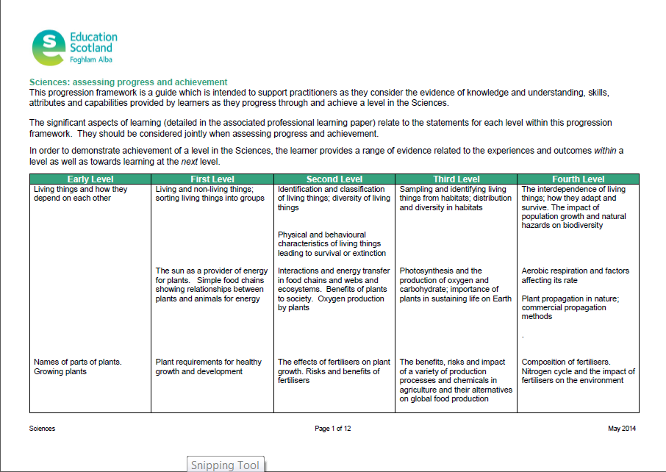
Progression Frameworks
Identifies for each level a body of knowledge and understanding and related skills, as detailed in the experiences and outcomes
Describes progression within the significant aspects of learning

Slide 22
Using data to support improvement
Whole school level - internal
SIMD profile - individual, cohort & whole school level
Raising Attainment & Achievement
-groups of learners e.g. ASN/LAC/SIMD/lowest attaining 20%/middle attaining 60%/highest attaining 20%
“closing the gap”
Predicted to actual attainment based on progression pathways
  in secondary course awards, units only, “by-pass”

Slide 23
Supporting improvement
What evidence do you have that school improvement policies and procedures have resulted in raised attainment and achievement?
What evidence do you have of the extent to which the curriculum supports all young people to achieve as highly as they can?

Slide 24
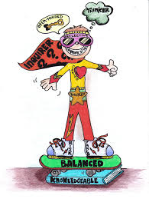
The learner at the culmination of the BGE?
Does the curriculum design provide progression routes which enable all children and young people to achieve/ attain as highly as possible?
    the courses and programmes in the BGE from 3 - 15
    Knowledge, skills, attributes
    Readiness for next steps

Slide 25
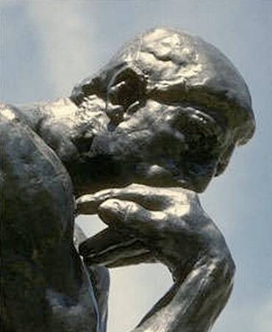
Future attributes
  Innovative and creative
  Able to cross boundaries
  Adaptable and flexible
  Analytical and critical
  Problem solving
  Self management
  Technologically literate
Foresight: The World in 2020

Slide 26
Leadership role of the head teacher
The Head Teacher acts as the leading professional in a school and an officer of the local authority. The Head Teacher also plays a pivotal role within the broader children’s services network.
Head teachers lead the whole school community in order to establish, sustain and enhance a positive ethos and culture of learning through which every learner is able to learn effectively and achieve their potential
The Standards for Leadership and Management

Slide 27
Building a culture of self-improvement within your school
‘Headteachers are accountable for ensuring that the context and culture is set for others to lead effectively and that there is a clear and agreed focus on self-evaluation and improvement.’ SCEL
What is your role in mobilising, enabling and supporting others to develop and follow through on strategies for achieving change?

Slide 28
The Virtuous Cycle of Improvement
Nationally shared aims and goals
applied and
developed
flexibly in
local contexts
Core principles, experiences and expected outcomes
BETTER LEARNING
knowledge
spread
effectively to
practitioners
impact
evaluated
at multiple
levels
knowledge drawn
out about
‘what works’
external research and intelligence

Slide 29

The vision
Learners in Scotland will progress in
one of the most effective education
systems in the world, renowned for
the ability of national and local
partners to work flexibly together to
achieve high quality and equitable
outcomes for all
Notes:
29

Slide 30
School Improvement
“Each particular stage of the school improvement journey is associated with a unique set of interventions. This suggests that systems would do well to learn from those at a similar stage of the journey, rather than from those that are at significantly different levels of performance. It also shows that
systems cannot continue to improve by simply doing more”
How the World’s Most Improved School Systems
Keep Getting Better, McKinsey, 2010
Notes:
.

Slide 31
School Improvement
To change the school, change the everyday preoccupations
Struggling schools talk about Coping and Administering
Good schools talk about Teachers and about Teaching
Great schools talk about Learners and about Learning
World Class schools talk about Re-inventing

Slide 32
Context is important
Being successful in one context doesn’t guarantee success elsewhere. The same intervention may provide radically different outcomes at different points in a school’s journey.
.
Notes:
.

Slide 33




Next steps:
How Good Is Our School?
The Next Generation
Further consultation through conversation days and stakeholder meetings.
No proposals will be published nor pilot conducted until the beginning of 2015 at the earliest.
All decisions informed through discussion with external reference group of all key stakeholders.
Planning for change over time, not a single large-scale change.
2015
HGIOS 4
??????

Slide 34


Slide 35
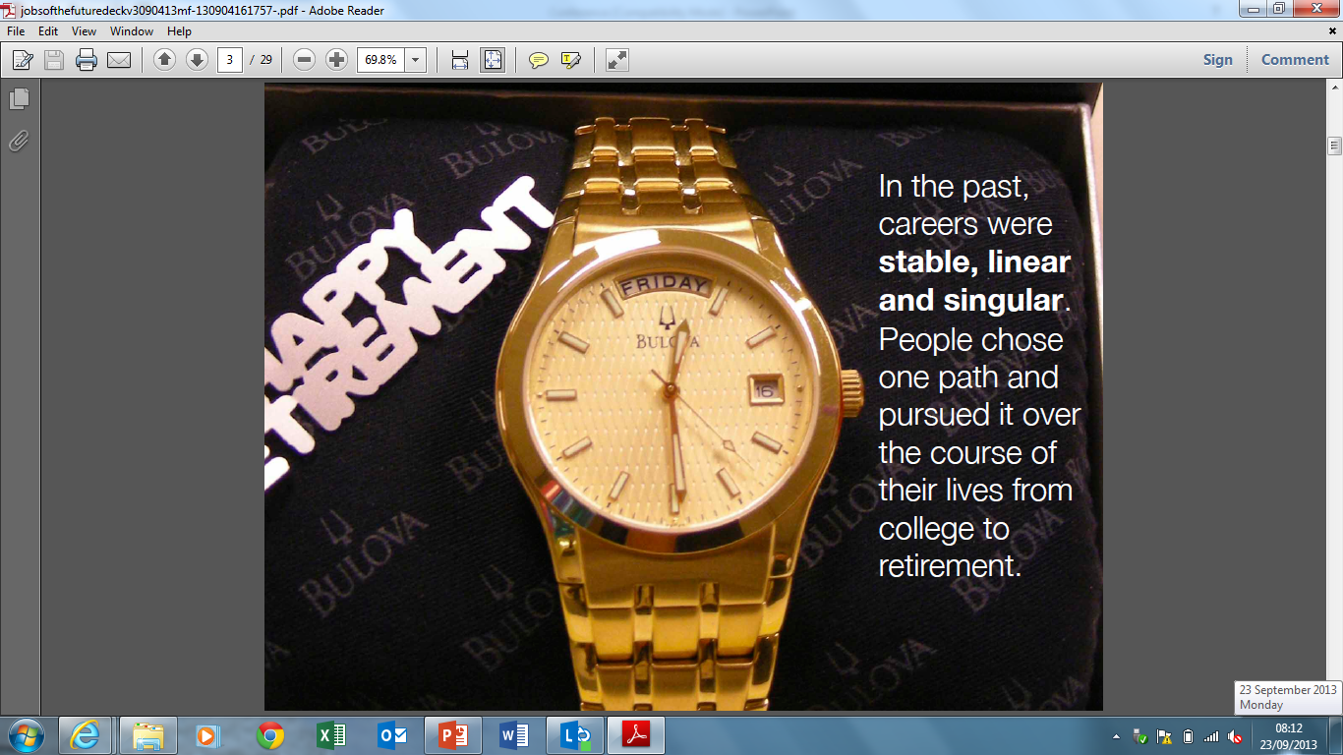

Slide 36


Slide 37
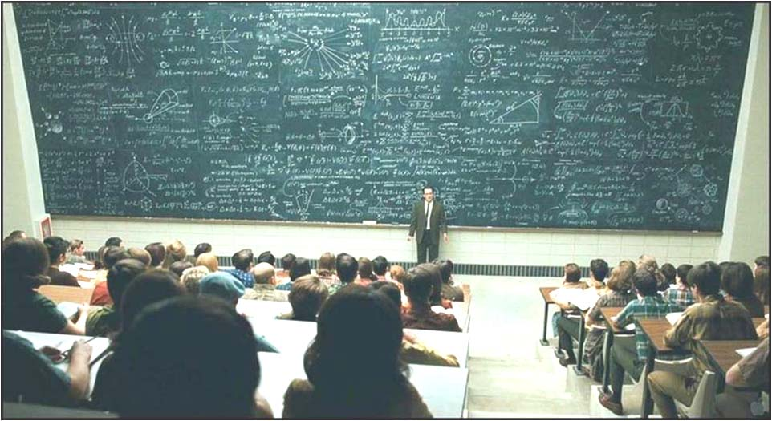
= CfE
CfE - it’s as simple as that!

Slide 38
Education Scotland
Denholm House
Almondvale Business Park
Almondvale Way
Livingston EH54 6GA
T +44 (0)141 282 5000
E enquiries@educationscotland.gov.uk
www.educationscotland.gov.uk

