Slide 1
Tracking Progress in the
Broad General Education
Lyndsay McRoberts
Kyle Academy

Slide 2
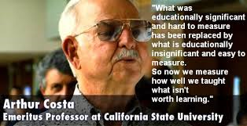

Slide 3
‘How well are young people progressing through the BGE and how do we know?’
Notes:
Will start by saying that in no way do we have this cracked!
This is work in progress and we are constantly adjusting our approach as we learn more about what works and more importantly what isn’t working. However at the centre of what we are trying to do is to answer the question. About two years ago pre HMIe we began to look at how we could answer this question........
how well are young people progressing through the BGE and how do we know?

Slide 4
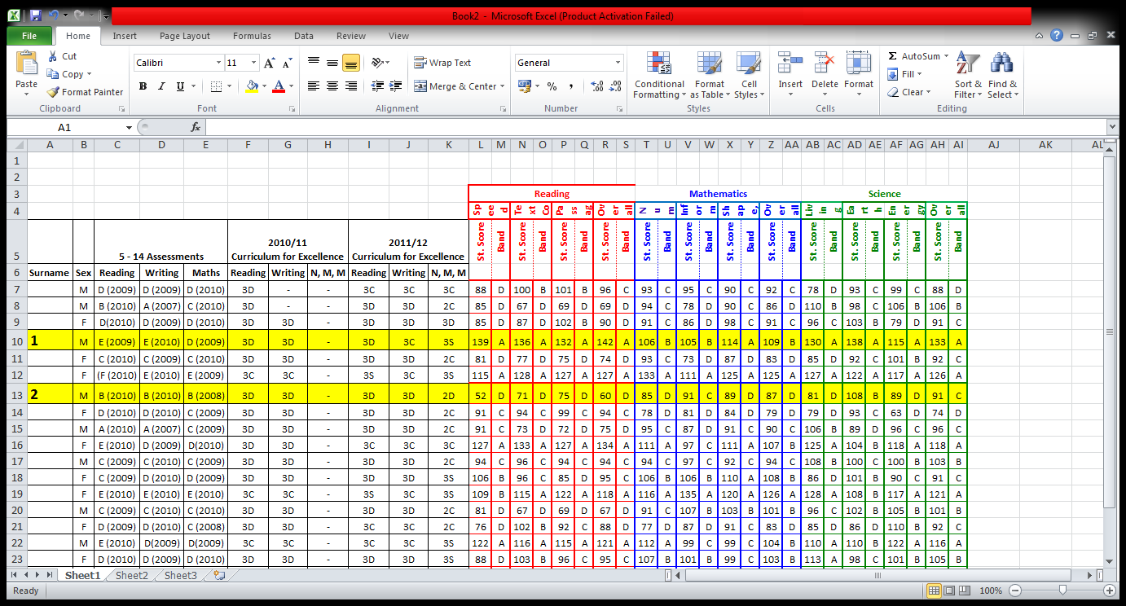
The Workshop
Notes:
Over two years ago SLT carried out a workshop to try to answer this question. We started by gathering what data we had at the time and tried to make sense of it!
In South Ayrshire we work with CEM testing from Durham University. Standardised testing at P1,P3, P5, P7 and S2 SOSCA< PIPPS, INCAS
This was probably the most significant turning point in moving forward. At this time we could still use historical 5-14 data, we had CEM data and working level data from SEEMIS. It was really apparent that we had significant issues. You can see from the slide some of these included two pupils one with CEM data in the bottom 4% one in the top 4% both working at 3D!
We than took the same workshop to our staff and working in depts asked them a series of questions about the data. Discussions brought us back to assessment, moderation, understanding standards.

Slide 5
The Learning
Planning for Progression
Assessment
Moderation
Building Capacity
Tracking Systems
Notes:
It was clear when looking at the data that we had issues around understanding standards and progression within and across levels.
In order to try and answer the question ‘ how well are young people progressing’ it is absolute key to start looking progression within curricular areas. You cannot track progress if staff are not clear on what progress looks like.
Can staff what secure learning looks like in each subject?
It took us back to look at the range of assessments teachers were using on which they were basing their judgements of DCS.
Although we had a focus on moderation it was clear that this work had to be built upon to ensure there was a consistency across staff in how they were developing their judgements of learners progress.
At the same time we knew we needed a simple management system which would allow all staff to access a range of data to support them in assessing progress.

Slide 6
Progression Frameworks
Significant Aspects of Learning
Knowledge AND Skills
Course Planning
SECURE learning

Slide 7
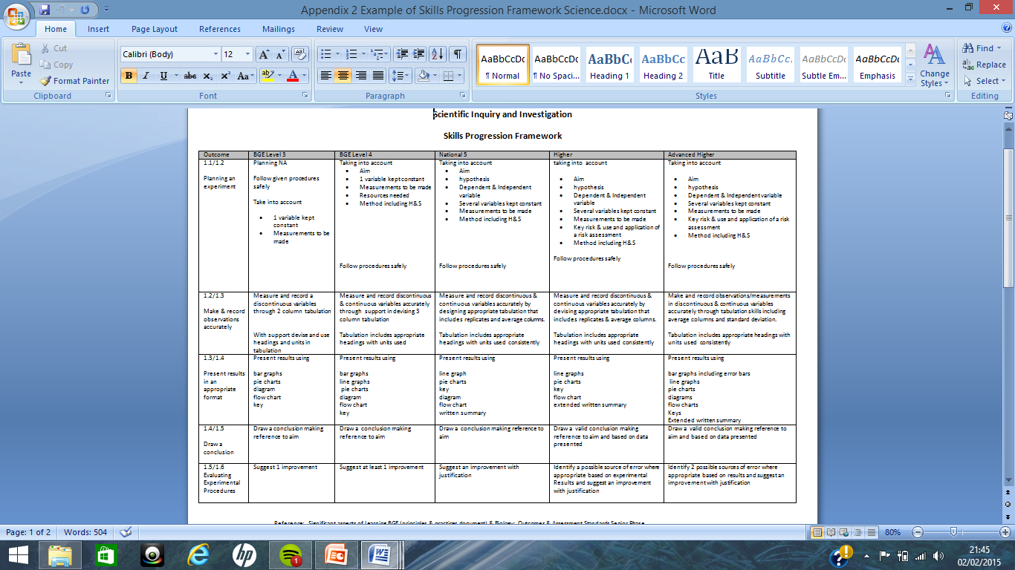
Progression Frameworks

Slide 8
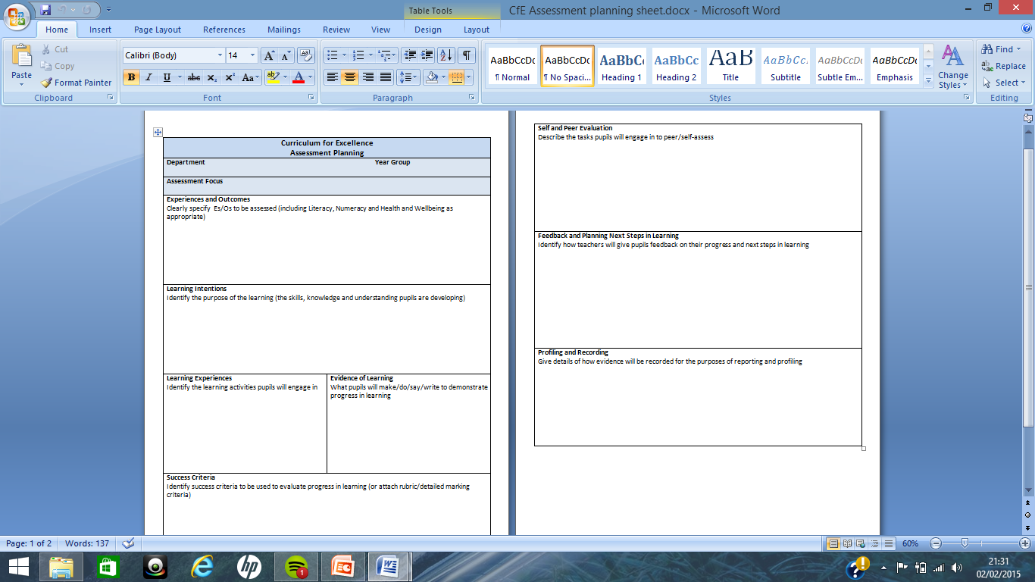
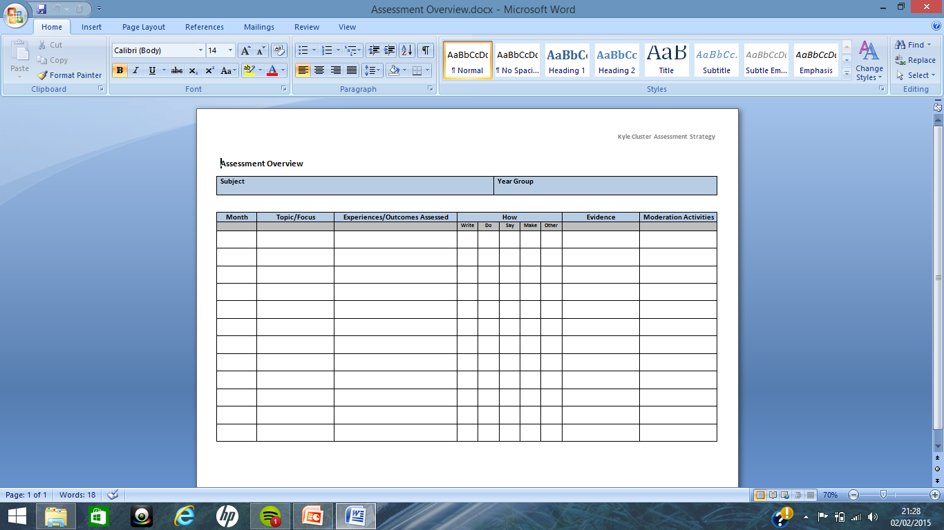
Assessment –A Strategic Focus
Notes:
Strategic approach to assessment. Asked staff to look at assessment around the SAL could we sure we were assessing the right things?
Assessment planning across the school every dept asked to look at assessment across S1-3 courses and plan for a range of assessments beyond a test. Look at a range of assessments that allow staff to make a holistic judgement of a young person’s progress.
Professional learning
Assessment overviews – SLT monitoring

Slide 9
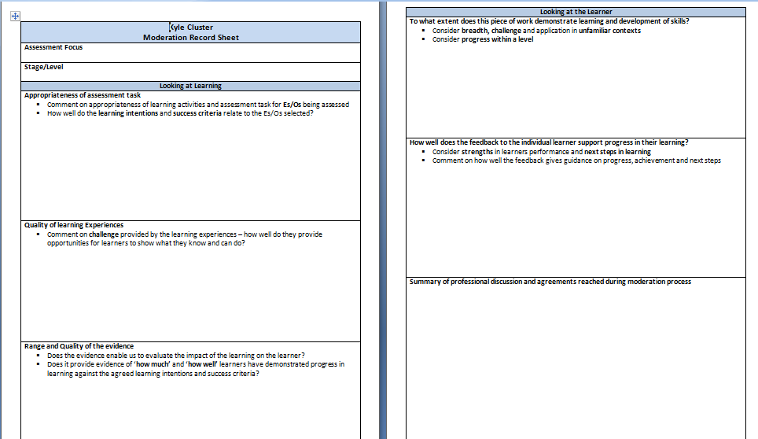
Moderation
Notes:
Whole school approach to moderation
People used to sharing standards but needed more structure in how to do this.
Planned opportunities as part of collegiate time, structured approach consistent across all depts
Time for moderation
Education Scotland materials this session

Slide 10
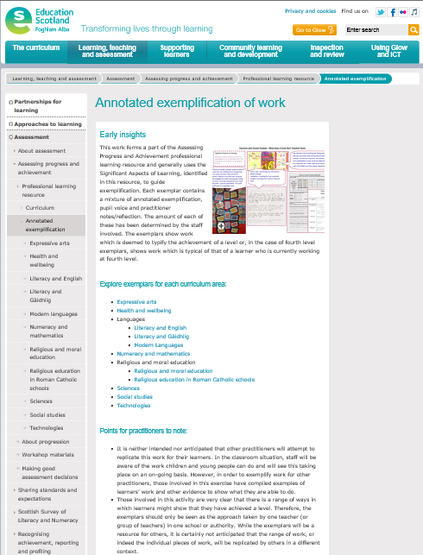
Moderation
Planned approach
Collegiate time
Annotated exemplars

Slide 11
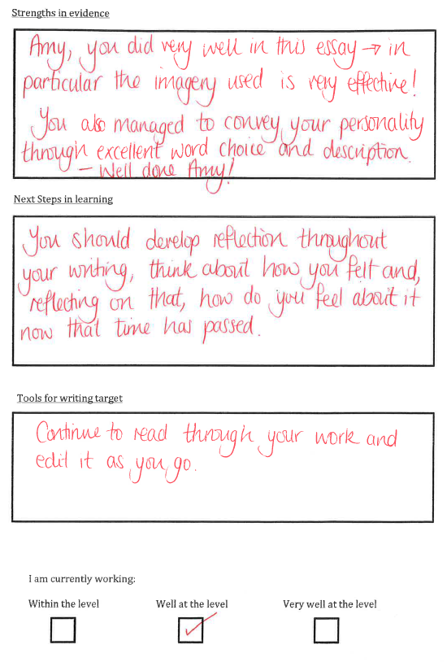
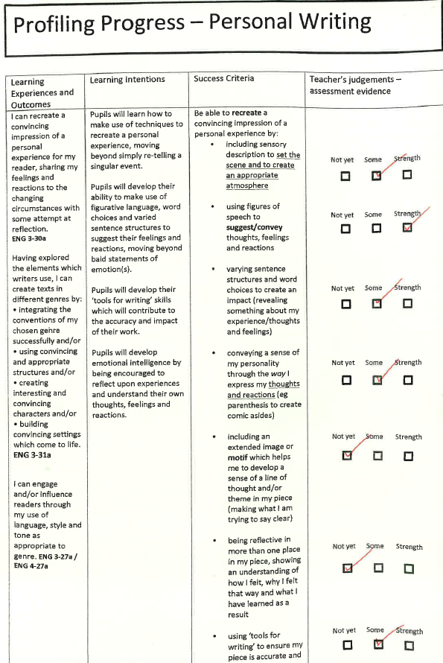
Profiling
Notes:
Tying profiling in with SAL
Every dept connected pupil profiles with assessments and key skills needed for progression so you people could begin to develop an understanding of their skills and strengths in learning
Sample English dept

Slide 12
Building Capacity
‘’…probably nothing within a school has more impact on students in terms of skills development, self confidence or classroom behaviour than the personal and professional growth of their teachers”
STOLL AND FINK: Changing Our Schools
Developing
Professional
Judgement
SAL
AifL
Profiling
Data
Literacy
Notes:
We have had to invest in developing capacity in staff
Developing practice in aifl beyond tricks and tips
Profiling – why do it
Data literacy – lessons from London , increased expectations

Slide 13
Tracking in the BGE
Reflecting the principles of Curriculum for Excellence, progress is now defined in terms of 'how well' and 'how much' as well as learners' rate of progress
Education Scotland 2012
Working level data
CEM/SOSCA
Departmental tracking systems
SA Tracker
Notes:
When looking at tracking progress now, we have a range of data that we can use to build that picture of progress however it has been very difficult to pull all this together effectively.
The SA Attainment Tracker has been crucial in allowing us to do this. The Tracker is now a central resource for Self Evaluation and supports SE at whole school level and we are planning systems to support dept level analysis of data.

Slide 14
South Ayrshire Attainment Tracker
‘Not everything that can be counted counts, and not everything that counts can be counted’.
Albert Einstein, Physicist
Notes:
When downloaded, the data looks like this. Its very easy to see three years of working level data together with CEM and other pupil data.
We have been working to highlight those pupils working in the upper and lower centiles of CEM, tying this into working level data – are identifying that we still have issues here.
Beginning to look at SIMD data and progression across three years. This is enabling us to work with staff to identify whole-school targets across stages for secure learning.
If as we do in Kyle we are targeting 65% of learners to achieve 5@5 how does that translate to where young people should be at the end of S3 , S2 and S1. How many of learners should be secure at third level in S2 for example. Are all staff engaged with this dialogue about progress? Do they understand their part in ensuring progression for all.

Slide 15
Triangulating our evidence
Data
Pupil Voice
Observation
‘The school is using a range of very effective approaches to track and monitor young people’s progress across the broad general education’ (HMIE, 2013).
Notes:
When making judgements about progress we do not just use data alone we look at the experience of the learner across the BGE by triangulating our data with
Each dept carries out pupil questionnaires for each year group, questions are based on learning and teaching. All data for all depts is published across the school.
Lesson observation data with a particular focus on learner progress and on learners understanding of their progress is also looked at to provide a coherent picture of learners experiences in each dept.

Slide 16
 |  |  |  |  | Kyle Academy - S2 Pupil Survey
Coding: White - 100% (all): Blue - 90%-99% (almost all) : Green - 75% - 89% (most) : Amber - 50%-74% (the majority) : Red- 0% - 50% (less than half)
Pupil Surveys – S2 - Evaluative Statement | Ave | Eng | Mat | Fre | Hist | MSt | Geo | RME | Sci | Art | Mus | D&T | BsEd | Com | HFT | PE | PSE | Pupil
 |  |  |  |  |  |  |  |  |  |  |  |  |  |  |  |  |  | Supp
Learning in this subject is helping me to become more confident. | 86 | 95 | 100 | 92 | 83 | 77 | 58 | 77 | 95 | 84 | 92 | 81 | 77 | 77 | 88 | 89 | 82 | 100
I enjoy learning in this subject | 85 | 80 | 83 | 75 | 91 | 86 | 68 | 88 | 100 | 79 | 96 | 71 | 77 | 100 | 82 | 89 | 82 | 93
I am becoming more successful as a learner in this subject | 87 | 95 | 96 | 96 | 74 | 82 | 79 | 73 | 100 | 95 | 92 | 67 | 100 | 85 | 88 | 83 | 77 | 100
I get help to improve my learning when I need it | 93 | 100 | 92 | 92 | 91 | 86 | 84 | 92 | 90 | 100 | 100 | 84 | 88 | 92 | 100 | 100 | 82 | 100
I know what my targets are to improve my learning in this subject. | 76 | 85 | 100 | 75 | 78 | 82 | 53 | 96 | 68 | 79 | 76 | 55 | 53 | 54 | 94 | 100 | 59 | 93
I know what steps to take to achieve my learning targets. | 77 | 85 | 88 | 71 | 83 | 86 | 52 | 92 | 79 | 90 | 76 | 58 | 59 | 54 | 94 | 100 | 64 | 86
I get good written feedback from my teacher on how to improve my learning | 74 | 100 | 92 | 83 | 78 | 91 | 79 | 73 | 84 | 79 | 68 | 55 | 53 | 54 | 100 | 50 | 55 | 64
I get good oral feedback from my teacher on how to improve my learning | 89 | 100 | 96 | 96 | 83 | 95 | 95 | 73 | 95 | 95 | 96 | 81 | 70 | 77 | 100 | 94 | 82 | 93
The work in this subject is not too easy – it challenges and stretches me to learn more. | 89 | 95 | 75 | 92 | 87 | 91 | 100 | 81 | 100 | 95 | 92 | 84 | 88 | 85 | 94 | 83 | 77 | 93
Notes:
Tri-learning
Learning walks but focussed on progression, talking to young people about strengths and next steps.

Slide 17
May
Full reports issued
August
Attainment Tracker to depts
November
Tracking report issued
Ongoing
Formative assessment
Year Group Conference
Final Year Group Conference
Profiling
Observations
Surveys
Notes:
We are now using this data as part of the SE cycle.
This session we have been looking at piloting Year Group conferences where Year Head and Guidance staff will analyse this data along with attendance, demerits and highlight any concerns in progress and look at early intervention.
.

Slide 18
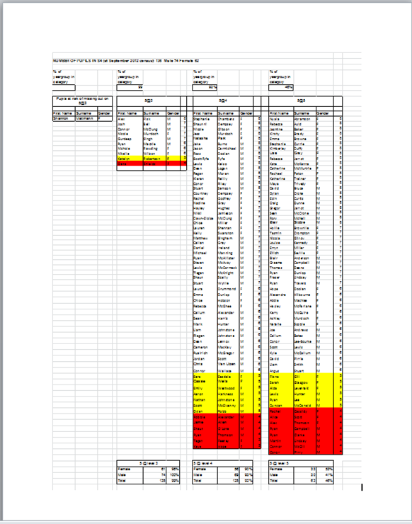
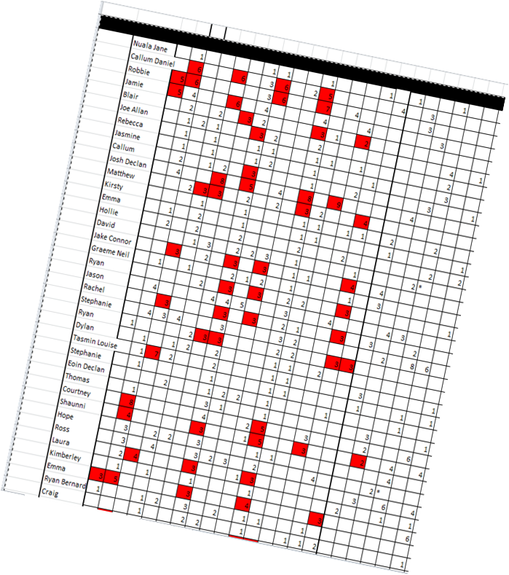
Tracking Progress into the Senior Phase
Notes:
Current practice
Threshold lists, whole school targets
Insight changes – literacy numeracy, pathway planning, point of exit,
Role of guidance staff

Slide 19
Developing Accountability and Responsibility
Attainment Analysis meetings
Standard and Quality Meetings
Learning and Teaching Meetings
Professional Standards
‘Staff share a common understanding of their collective responsibility and accountability for school improvement’.
Education Scotland 2013

Slide 20
Next Steps
Closing the Gap- working level/CEM across SIMD
Principal Teachers/ Teachers
AifL
Transition
Insight
kyle.mail@south-ayrshire.gov.uk
lyndsay.mcroberts@south-ayrshire.gov.uk
Notes:
As I said at the start, this is a work in progress are we are refining what we do continually. In line with the focus in SA we are going to start looking at working level data and CEM data for lower, middle and upper SIMD and begin to use the tracker to filter this data.
We are currently piloting work in the English dept where the PT has 1-1 meetings with every teacher to look at progress of young people. This type of meetings did happen previously but have not always been data driven. We need teaching staff to engage with data, to understand and question data intelligently at class teacher level –it is part of the increased expectations around QI5.9.
Next session we will be focusing further on the SA curricular frameworks and in particular level three. We feel if we get level three right we will get progression right for all learners. Developing a shared understanding of what secure learning looks like at level 3 and what progress through the level will look like for all learners.
AifL
QUESTIONS?

