Slide 1
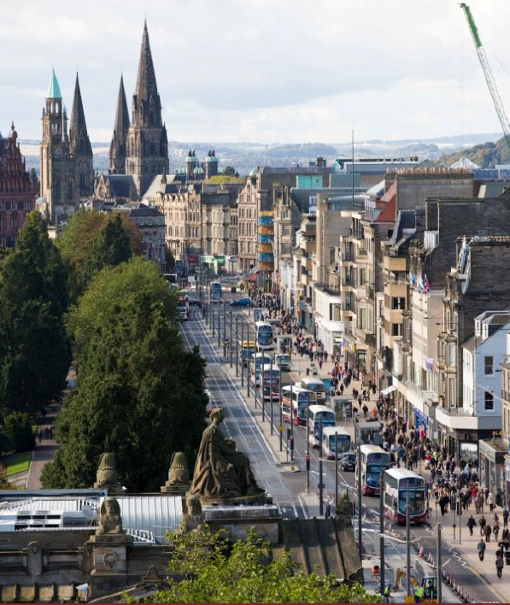
New Staff Induction
Welcome
Notes:
1
Welcome

Slide 2

Session Aims
To introduce newly appointed staff to the City of Edinburgh Council, its senior management team, vision and values
Notes:
2
2
< Read slide >

Slide 3
The Council: Facts and Figures
A coalition of Scottish Labour and SNP Councillors
Council Budget: Approx £1 billion
City Population: Approx 500,000
Five Council Service Areas led by Chief Executive and Five Directors
19,000 Council Employees
Notes:
3
3
< Read slide >

Slide 4
Council Outcomes
Capital Coalition Pledges
Notes:
After the local government election in May 2012, the Capital Coalition set out its commitment to build a cooperative, more prosperous, Edinburgh in which every resident and community benefits.
53 Capital Coalition Pledges were agreed in August 2012. The pledges are about building a Co-operative Capital, with decision-making that shows the Capital Coalition is listening to public opinion. A key part of this means being accessible and transparent about performance.
Details are on the CEC website and are regularly reviewed by the coalition to ensure they are being met.

Slide 5
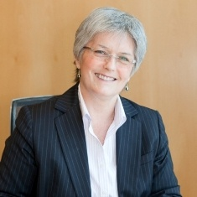
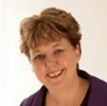
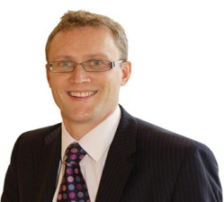
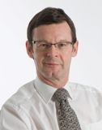

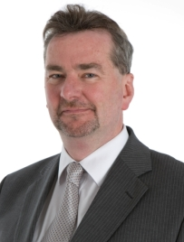
Council Management Team
Sue Bruce
Chief Executive
Gillian Tee
Children and Families
Alastair Mclean
Corporate Governance
John Bury
(Acting Director)
Services for Communities
Peter Gabbitas
Health and Social Care
Greg Ward
Economic
Development
Notes:
5
The City of Edinburgh Council consists of five Service Areas, with the Director of each Service Area being responsible to the Chief Executive, Sue Bruce.
Children and Families (Gillian Tee)
Corporate Governance (Alastair Maclean)
Services for Communities (Mark Turley)
Health and Social Care (Peter Gabbitas)
Economic Development (Greg Ward)

Slide 6
Gillian Tee
Responsible for:
Support to children and young people
Schools and community services
Planning and performance
Directorate Support
Director of Children and Families
Edinburgh’s children and young people enjoy their childhood and fulfil potential
Notes:
The service has 9000 staff (including teachers) and an annual budget of £380m. Its responsibilities cover:
3,000 children (aged three to five) attending 18 nursery schools, 78 nursery classes in primary schools, two nursery classes in a special school, 12 Health and Social Care centres, and the Council's workplace nursery.
Over 1,500 teachers providing learning and teaching to over 24,000 pupils in over 90 primary schools.
Over 1,700 teachers providing learning and teaching to over 19,000 pupils at 23 secondary schools.
Over 700 pupils with special needs who are catered for in our special schools and classes.
Around 40 community centres providing a range of learning, teaching and support services to residents of the city.
Recruiting and supporting carers (foster, adoptive and day carers) for over 400 children.
Over 100 residential care places are provided for children in young person centres, two secure accommodation units, four close support units and a unit which provides respite care for about 70 young people.

Slide 7
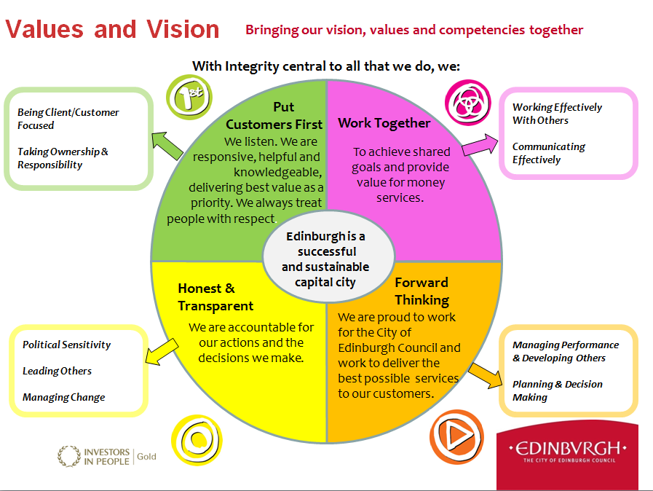

Slide 8
Schools and Community Services
23 Secondary Schools
88 Primary Schools
13 Special Schools
18 Nursery Schools
A range of services to support schools including Additional Support Services, Arts and Learning Team, Sports and Outdoor Team, Digital Learning Team, Information, Learning Resources Team
Notes:
8
8
< Read slide >

Slide 9
Quality and Benchmarking Systems
CEC has ‘gold’ accreditation with Investors In People Scotland
Customer Service Excellence has been achieved in four service areas and is a priority for further roll-out in future
CEC Best Value assessment every two years
CEC achieved ‘silver’ status with EFQM in 2012
Education Scotland and Care Commission inspection process (rolling programme)
Staff Survey every two years
Local Government Benchmarking Framework

Slide 10
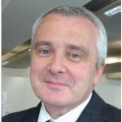





Schools and Community Services
Acting Head of
Schools and
Community Services
Karen Prophet
Schools
Moira Wilson
Inclusion and Pupil /Parent Support
David Bruce
Community Services
Audrey Palmer
Business Support
Aileen McLean
Early Stages
Notes:
10
The City of Edinburgh Council consists of five Service Areas, with the Director of each Service Area being responsible to the Chief Executive, Sue Bruce.
Children and Families (Gillian Tee)
Corporate Governance (Alastair Maclean)
Services for Communities (Mark Turley)
Health and Social Care (Peter Gabbitas)
Economic Development (Greg Ward)

Slide 11
Staff Benefits
The Staff Benefits scheme is available to all Council staff as well as foster carers and volunteers with Council services. It offers a wide range of exclusive discounts, both in Edinburgh and other areas of Scotland.
Information about the scheme, including how to access a Premium Benefits card (which you will have to show to benefit from any discount) can be found by searching ‘Premium Benefits’ on the Orb
A full range of the benefits on offer can be viewed at the following website
http://www.premiumbenefits.co.uk/

Slide 12
Council Policies and Procedures
You can access a directory of Council policies and procedures by searching for ‘policies, procedures and eforms’ on the Orb
This will allow you to then identify a policy or procedure by title or to browse by category

Slide 13
The Edinburgh Approach
A corporate approach to service planning has been developed to:
  provide a consistent approach to the way the Council develops, presents, communicates and reviews plans and strategies;
  provide a coherent, proportionate framework for establishing how the Council delivers its corporate, strategic and service objectives; and
  strengthen the 'line of sight'/ relationship between plans and strategies at all levels.

