Slide 1
Insight
Benchmarking for Excellence
Insight Regional Events
Getting ready for August
Eileen Gill, Project Manager
Colin Sutherland, Professional Advisor
#Insightevents

Slide 2
Agenda
Scottish Government - presentation and tour of Insight
- group activity
Education Scotland
- scenarios
- use of Insight in inspections
Plenary and Q & A
Closing remarks

Slide 3
Aligned with CfE
Outcomes focussed
Aims to help ‘raise attainment for all’ and reduce the gap between higher and lower attainers
Measures attainment and achievement at point of exit from school
Reflects performance within a schools context
Provides the ability to look at different cohorts of pupils

Slide 4
A dynamic benchmarking tool
Access for all secondary school staff
Easy and intuitive to use
Provides a rounded picture of performance
Measures units where appropriate
Includes a wide range of SCQF credit-rated awards and learning programmes

Slide 5
Inclusion of wider awards
Wider awards must meet set criteria:
Be on the SCQF
Fit CfE principles
- Meet Insight technical requirements

Slide 6
Valuing wider achievement
Just one way in which information will be provided on wider achievement e.g. pupil profiles, school handbooks and inspections
Decisions for wider achievement should be made on the best needs of the learner rather than on the basis of the awards included in the tool

Slide 7
A tool for professional reflection
Access for all secondary school staff
Aims to encourage professional reflection and collaborative working
Prompts reflective questions

Slide 8
Using Insight as part of your improvement process
.
.
.
.
.

Slide 9
Using Insight as part of your improvement process
.
.
.
Outcomes for young people
.

Slide 10
Using Insight as part of your improvement process
What does the data show us?
.
.
Outcomes for young people
.

Slide 11
Using Insight as part of your improvement process
What does the data show us?
Identify what we want to improve
.
Outcomes for young people
.

Slide 12
Using Insight as part of your improvement process
What does the data show us?
Identify what we want to improve
Identify actions to take
.
Outcomes for young people

Slide 13
Using Insight as part of your improvement process
What does the data show us?
Identify what we want to improve
Identify actions to take
Use data to measure success
Outcomes for young people

Slide 14
Updating Insight
August 2014
Local measures updated
February 2016
February 2015
Four national measures updated
Four national measures updated
August 2015
Local measures updated

Slide 15
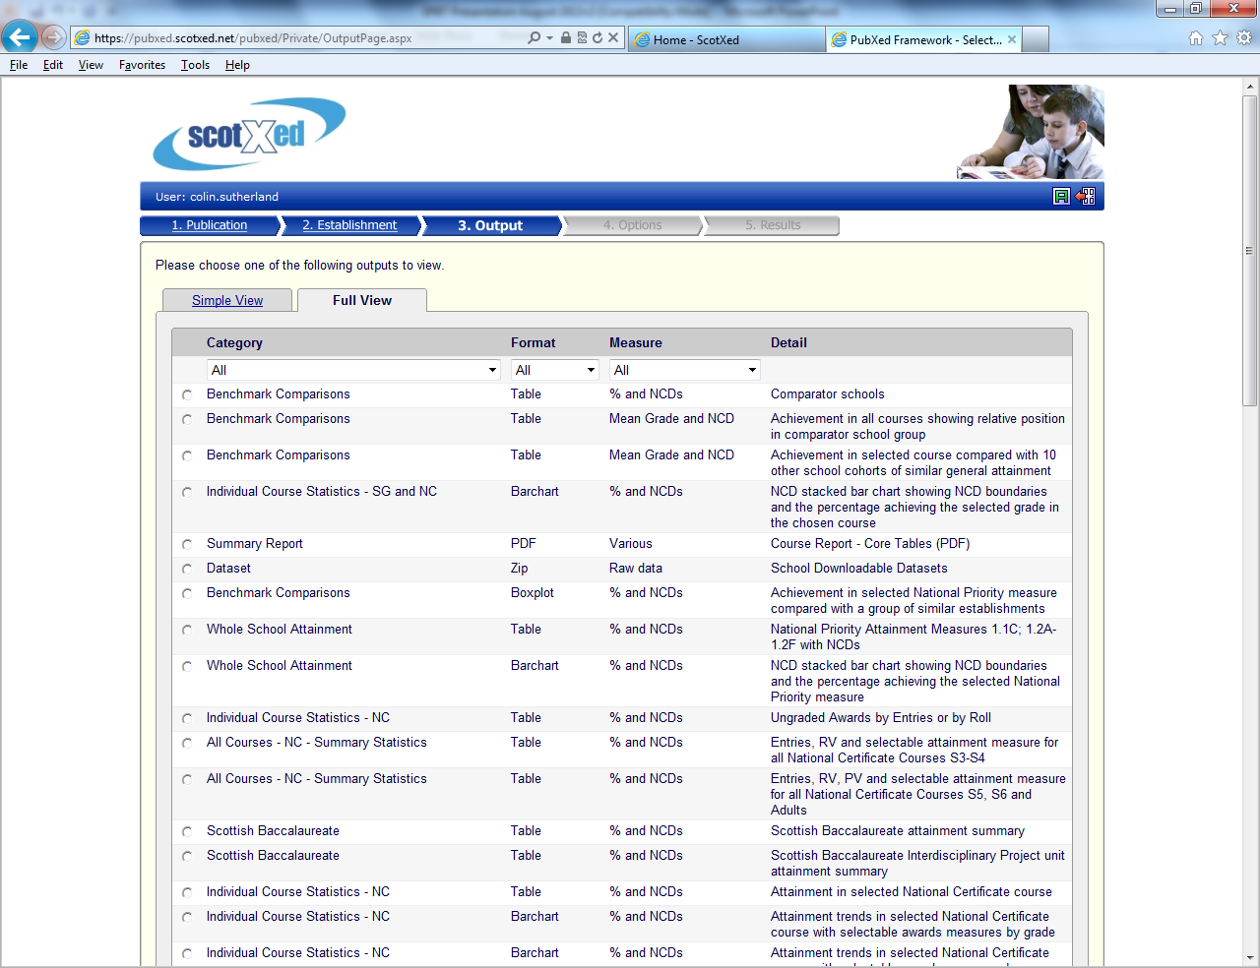
Out with the old …

Slide 16
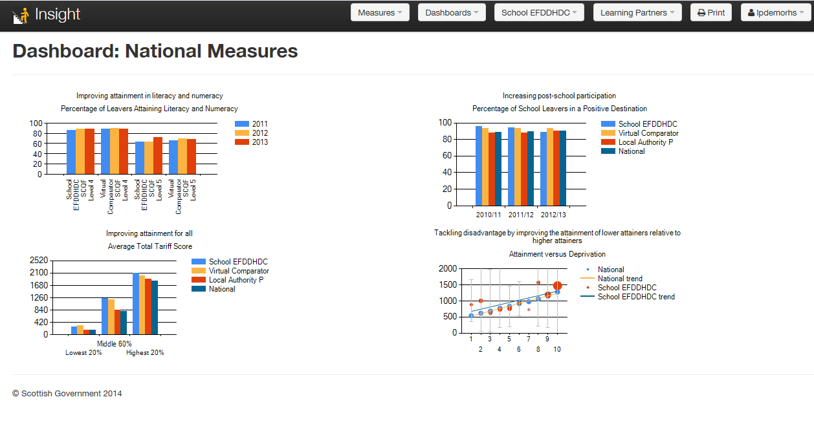
… In with the new
Learning Partners
Intuitive dashboard
National measures
Virtual Comparator

Slide 17
The Virtual Comparator
The key benchmark
Characteristics of pupils in a school matched with pupils from across Scotland with similar characteristics
10 matching pupils are randomly selected based on gender, additional support needs, latest stage and the Scottish Index of Multiple Deprivation

Slide 18
Learning Partners
Find partners via ranked list of real schools
Propose/accept partnership requests
Schools that become Learning Partners will be able to share data relating to local measures
Encourage professional dialogue between and among different schools

Slide 19
National benchmarking measures
Show four nationally consistent measures
Focus on ‘leavers’ since point of exit is a consistent point of comparison
Use ‘latest’ and ‘best’
National benchmarking data available for all users
http://insight.scotxed.net

Slide 20
Local benchmarking measures
The local dashboard provides staged-based versions of the national dashboard
Additional measures on curricular areas, subjects and courses
Available at individual school level and for the
school’s local authority
Available also to Learning Partners
http://insight.scotxed.net

Slide 21
Development timescales
September 2013 Preview Edition
Awards 2013
Virtual schools with updated methodology
April 2014 Preview Update
Stage cohort version of national dashboard measures
August 2014 Insight - Live
Continual development
Case studies
Post go-live
First release with live data
Curricular areas, graded & ungraded courses 2013
Further awards providers
Additional measures
Focus groups
Relative value (interim solution)
Learning Partners

Slide 22
www.scotland.gov.uk/insightbenchmarking
@Insight Benchmarking
@Insightupdates
#Insightevents

