Slide 1


Reflections on City Challenge:
Implications for a self-improving system in Edinburgh?
Chris Chapman

Slide 2
A rationale
for change
The system has untapped capacity to improve itself
There is a need to further strengthen collaboration within, between and beyond schools
Collaborative enquiry can be used to bring a critical edge to new practice and arrangements
Improvement efforts have to be adapted to and owned by local context
Some co-ordination of effort is needed to optimise improvement efforts
The system requires a rethinking of roles and responsibilities if we are to meet this challenge
2

Slide 3
Greater Manchester: Context
Greater Manchester has a population of 2.5 million organised in to 10 Local Authorities
600,000 students in about 1,150 schools and colleges
Deprived children in low attaining schools do worse than their deprived peers who attend higher attaining schools
Variation in school performance and LA performance

Slide 4
City Challenge:
Impact
the improvements that occurred during the time the Challenge programmes were in operation have generally been sustained in London and Greater Manchester, but that in the Black Country, low attaining schools did less well than schools nationally over the year 2011‐12.
(Hutchings and Manaray, 2013: 21)
4

Slide 5
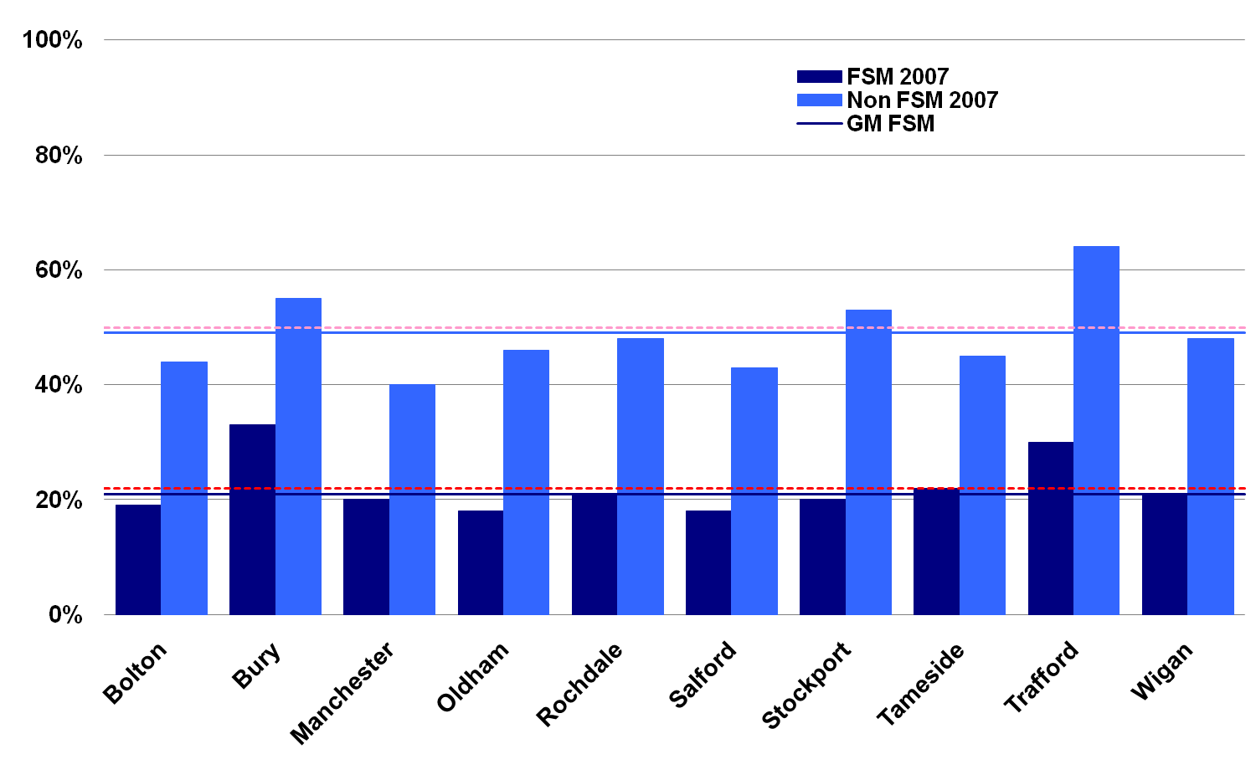
Performance variations 2007

Slide 6
GMC Claims
    Three years on…
    GM primary schools outperformed national averages on tests taken by all young children
    2010 GM secondary schools improved faster than schools nationally and schools serving the most disadvantaged communities made three times the improvement than schools across the country
    Schools judged as outstanding by OfSTED rose from 17% to 22% (Primary) and from 12% to 18% (secondary)
    (Ainscow, 2012: 295)

Slide 7
Aim and Approach of GMC
Aim
  To develop a system which aspires to world class standards of education and has the capacity to lead its own journey of improvement
Approach
    Vision – co-creating an inspiring and realistic vision which all players in the system buy into
    Catalysts – eg Keys to Success: direct engagement with schools causing concern and using the full range of options to secure improvement
    Systems, structures and networks - developing an infra-structure which identifies expertise in the system and relationships to help move it around quickly and easily to address key concerns

Slide 8
Rallying point
Access- to address underperformance, so that all children and young people attended the schools they deserve;
Aspirations- to give all children and young people a sense of the positive opportunities open to them, by raising expectations about how good education across Greater Manchester could and should be
and
Achievement- to make sure that all children and young people were able to achieve their potential, by breaking the link between the home backgrounds of learners and educational outcomes and life chances

Slide 9
The Strategy
Leadership Strategy
Keys to Success Schools
Families of Schools
Rethinking and strengthening the roles of local authorities
Workstrands
Notes:
9

Slide 10
Families of Schools: Data
58 primary
11 secondary
12-20 schools
Attainment/
3yr improvement
Family and GMC
Sub-groups
Headteacher led

Slide 11
Keys to Success:
Low attainment
160 schools in most challenging settings
Challenge advisors
Detailed analysis of local context and tailored improvement strategy- tactical and strategic
Partnerships and trios cut across boundaries- eg. Outstanding grammar school partnered with low performing inner-city comprehensive in another LA
Use of federations and changes in governance arrangements where necessary

Slide 12
Work strands:
Priorities for action
Led by DCS
Injection of innovation and pace
Involved a wide range of partners
Cross LA
Range of projects focusing on key priorities including:
  Innovating teaching and learning
  Contributions of governors
  Closing the gap
  Raising aspirations

Slide 13
Leadership strategy:
School-led improvement
NCSL support for co-ordination local office
Investment in peer support and mentoring across the region
By 2011 170 National/ Local Leaders of Education leading Teaching School Alliances
Facilitating school-to-school collaboration and support for improvement
Links directly into the work of Families and Workstrands

Slide 14
Implications for
leadership practice
 | Within School | Between Schools | Beyond Schools
Management
Leadership
Governance
Other roles
Headteacher role
Direction of System Travel- A continuously improving system?

Slide 15
Key messages for
A self-improving system
Rehearse a coherent vision and consistent message
Use data as a catalyst for change
Encourage innovation and experimentation
Work on tactical and strategic priorities in tandem
Create a climate for school-to-school collaboration
Promote system leadership
Working beyond schools

