Slide 2
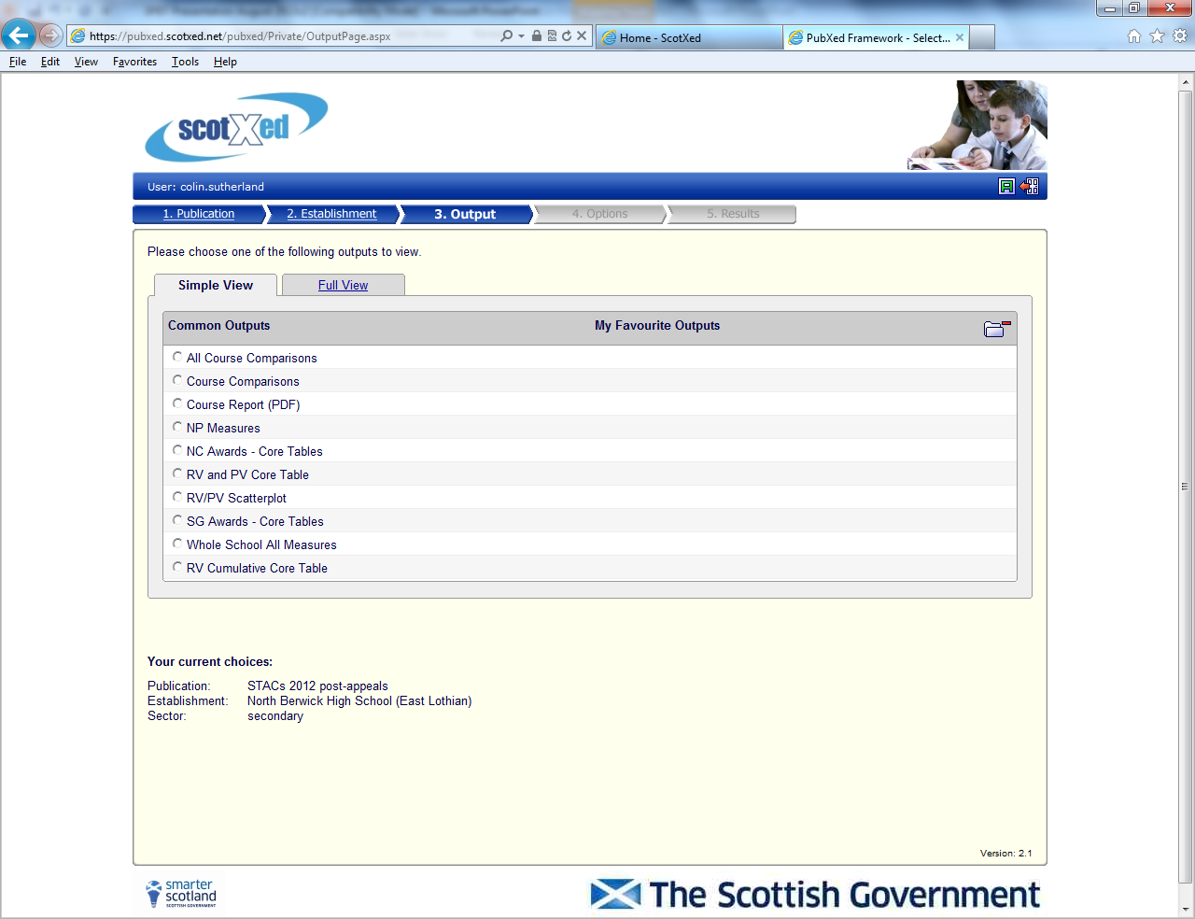
STACs – a reminder!

Slide 3
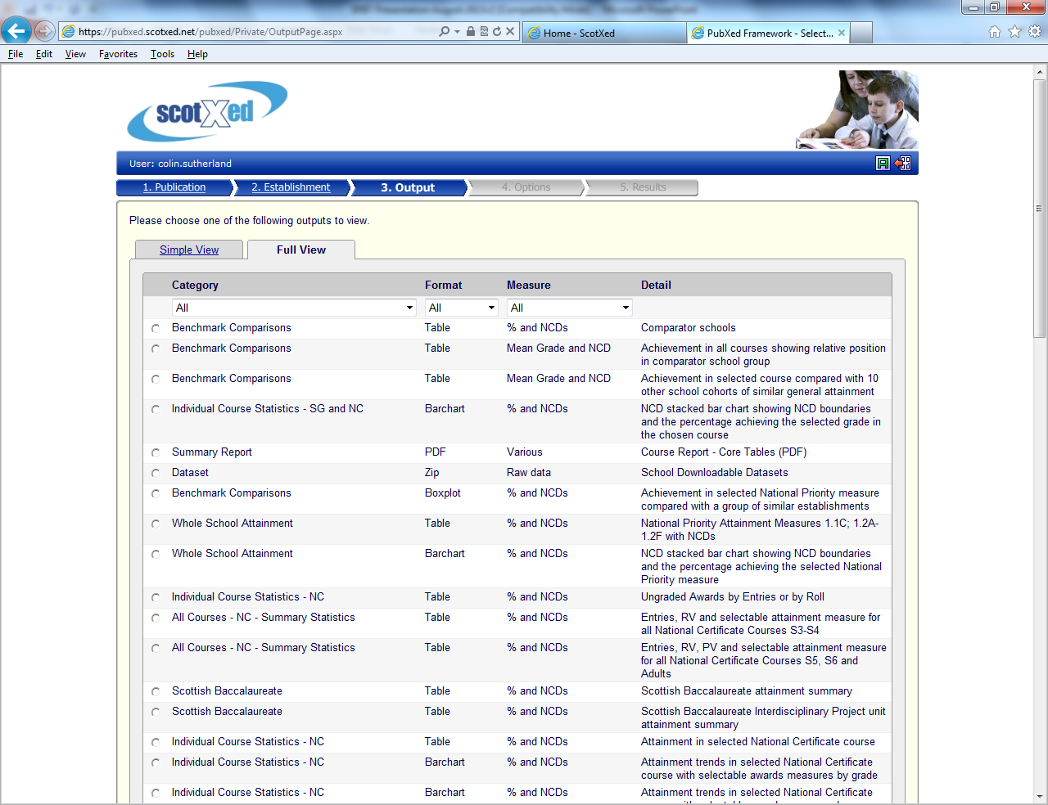

Slide 4
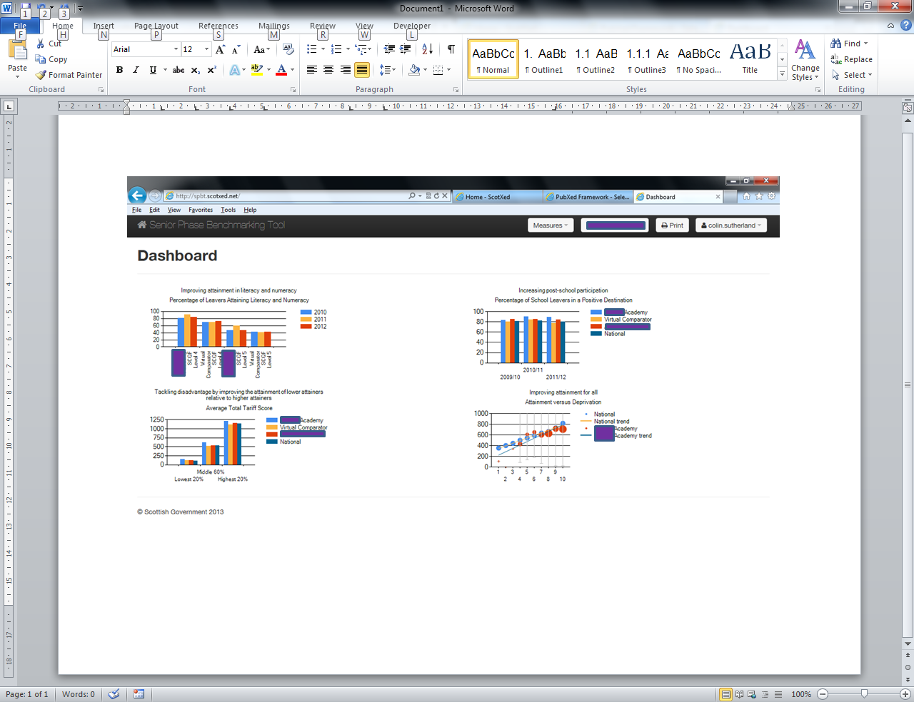
Senior Phase Benchmarking Tool
Senior Phase Benchmarking Tool

Slide 5
Access to the SPBT
Web site
http://spbt.scotxed.net
Discussions with MIS providers.
Discussions with Glow ‘Plus’.

Slide 6
Enhancements to the tool
Development of some of the existing measures, eg literacy and numeracy at levels other than 4 or 5 and leavers’ destinations ‘by stage’.
The Curriculum
Ten curricular areas
The eight CfE areas, with
English as separate entity from languages
A tenth area for Wider Achievement
Subjects and courses, including relative performance and development of ‘virtual school’ to take account of specific groups.
Development of ‘learning partners’: real schools.

Slide 7
Timeline & Roadmap
July 2013
Early Adopter edition
Awards & Destinations data 2012
Tariff & Virtual Schools
September 2013
Preview Edition
Awards 2013
Staged-based 2013
Early 2014
Preview Update
Literacy & Numeracy in depth
Measures for comparative performance in courses
Summer 2014
SPBT – Live
National dashboard
Graded and Ungraded courses, Wider Awards (Youth Scotland, SQA)
Stage cohort version of national dashboard
First release with live data
Further awards providers

Slide 8
Development and roll-out
Ongoing engagement with LAs and schools.
Some LAs developing case studies.
Education Scotland developing scenarios.
Guided analysis.
Possible National events April to June 2014
Several around the country: staff from schools and from LAs
Inputs from Sco Govt, ES, LA, workshops
Thoughts?

Slide 9
Happy to help!
Colin Sutherland
Professional Advisor for Senior Phase Benchmarking
colin.sutherland@scotland.gsi.gov.uk
0131 244 0994
07772 604167

