Slide 2
Qualifications Update
Isabel Millar
CfE Liaison Manager

Slide 3
Purpose/Aims
Review of Documentation and Assessment Support
Quality Assurance
Working together
Questions

Slide 4
Finalised documents
National 2 to National 5 for use from now onwards
Higher - valid from August 2014 for session 2014-15
Advanced Higher - valid from August 2015 for session 2015-16
Mandatory Information
Course Specification
Course Assessment Specification (N5, Higher, AH)
Unit Specifications
Advice and Guidance
Course and Unit Support Notes
Assessment Support
Specimen Question Paper and Marking Instructions (N5)
Coursework Information (N5)
Unit Assessment Support
Notes:
22 QGs
53 VGs
21 VGs with IACCA
9 VGs with Visiting

Slide 5
Unit Assessment Support N2 to N5
Unit Assessment Support Packages issued during session 2012-13
3 approaches – unit by unit, combined, portfolio
Valid from August 2013
Confidential and held on SQA secure
N4 Added Value Unit Assessments – SQA devised assessments must be used for the first two sessions

Slide 6
We have made minor updates and clarifications to mandatory documents in most subjects. We have published these documents as version 1.1.
Changes have been made to mandatory documents in light of feedback from stakeholders for the following subjects: Dance, Media, Fashion and Textile Technology, ESOL, and Latin. We have published these documents as version 2.0.
All versions of assessment documents are acceptable for verification
Summary of changes
http://www.sqa.org.uk/sqa/65989.html

Slide 7
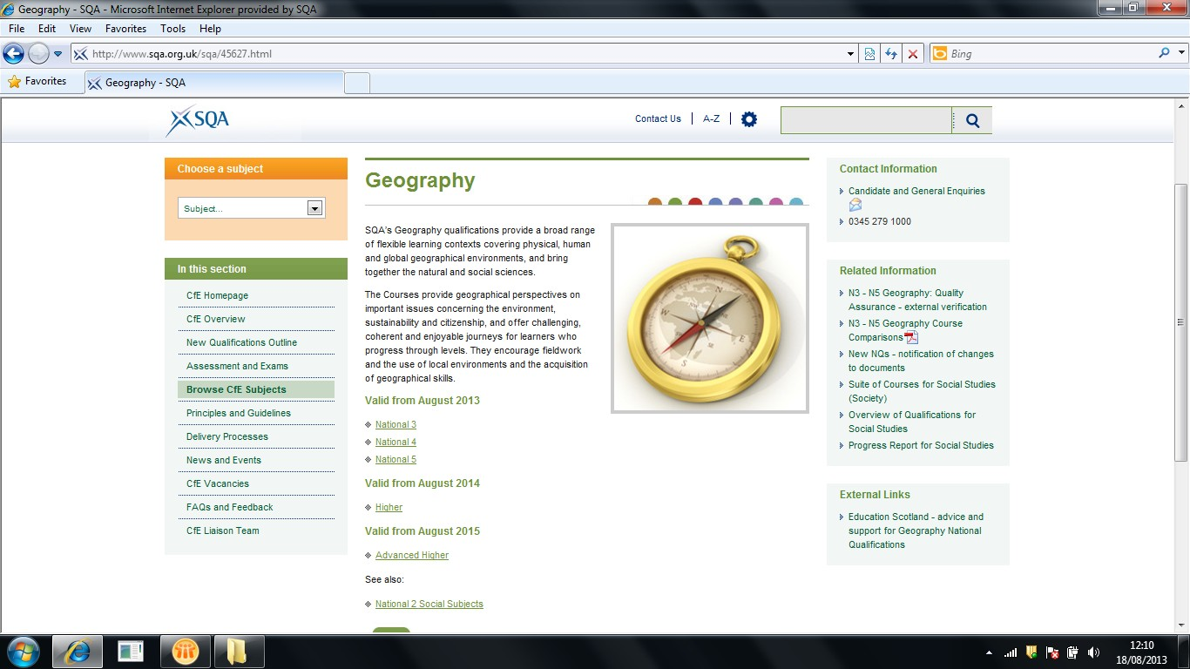

Slide 8
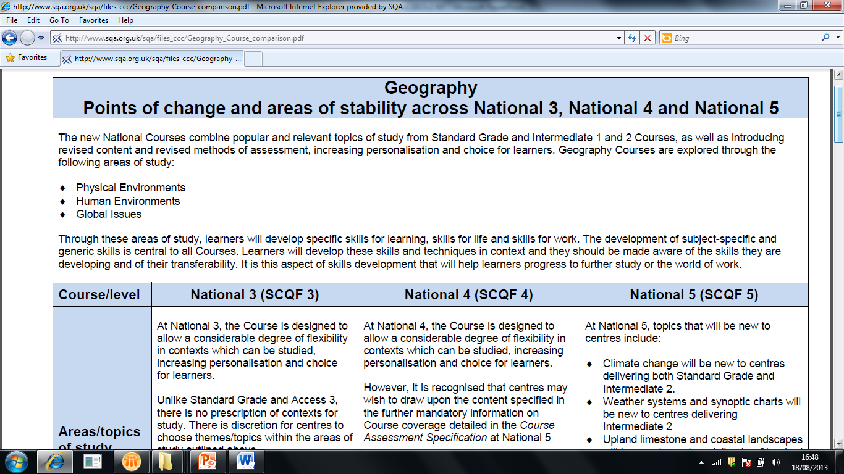

Slide 9
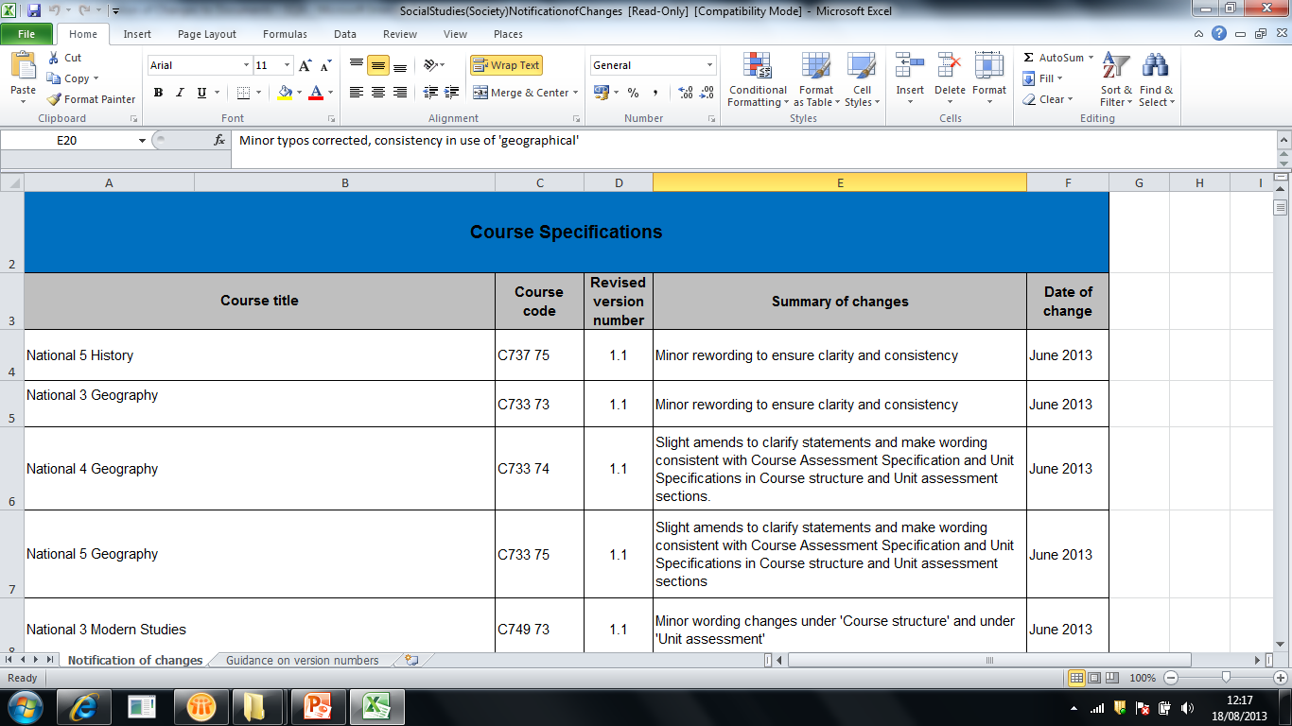

Slide 10
Summary of support from June 2013
June 2013
National 5 Course Assessment Specification – further info/clarifications
Higher Assessment Overview – Course and Unit assessment
August 2013
National 2 to 5 Unit Assessment Support Packs – clarifications, consistency and continuity update across packs
National 2 to 5 Key Messages – updated + information on stability and change
Bridging packs for Literacy and Numeracy at National 5
September/October 2013
National 2 to 5 CfE update letter for all subjects
National 4 Added Value Unit Assessment/National 5 Coursework Assessment Tasks – banks fully populated

Slide 11
Quality Assurance

Slide 12
Key aspects of the approach
There will be Course and Unit verification
In the initial years, each centre will be verified at least once for each broad subject area in which they are presenting candidates
There will be multiple rounds of verification via a managed programme
Complete evidence or interim evidence - which clearly demonstrates assessment judgements - can be used
Verification type will depend on the evidence type
Verification will be undertaken by quality assurance panels
Principal Verifier/Team Leaders/Nominees
New roles - dual responsibilities
Notes:
22 QGs
53 VGs
21 VGs with IACCA
9 VGs with Visiting

Slide 13
Verification Selections
Centres will be notified of selection in advance of each round via new NQ QA software on SQA Connect
Live entries will be monitored throughout the year
Selections will specify:
Unit or Course
Event/Postal or Visiting

Slide 14
Evidence
Sampling Regime and Submission of Evidence detailed in Delivering National Qualifications: Guide for SQA Co-ordinators 2013–14
Assessment evidence and Candidate evidence for 12 candidates – across multiple levels
For portable materials, there will be a national uplift of materials from, and return to, centres
For non portable materials, Subject Experts will arrange a specific date to visit the centre during the specified round

Slide 15
Verification Outcomes
Range of outcomes depending on the scale of issue identified
Outcome and Reports will be available electronically via NQ QA software on SQA Connect
Follow up action may require to be undertaken – may involve resubmission of evidence/amendments to results
Outcome feeds into the centre’s priority rating for the next year

Slide 16
Exemplification, Key Messages & Annual Reports
SQA will publish exemplification materials identified during verification which can be used as an ‘understanding standards’ guide for all centres
Key Messages will be published after each round of verification
Annual Internal Assessment Report will be published at the end of the academic year
Above information will facilitate early and ongoing support to all centres throughout the academic year

Slide 17
^{Verification - Key Dates}
Activity | Round 1 | Round 2 | Round 3
Notification of Selection | 1 October 2013 | 2 December 2013 | 3 March 2014
Stationery Issued | 2 October 2013 | 3 December 2013 | 4 March 2014
Materials Uplifted | 4 November 2013 | 15 January 2014 | 28 April 2014
Note: Visiting Verification dates will be arranged between SQA Coordinator and Subject Specialist

Slide 18
Benefits of the approach
Ensures the continued credibility of National Qualifications
Facilitates the partnership approach of Curriculum for Excellence
Supports the sharing of knowledge about national standards earlier and more widely
Increases confidence in assessment decisions
Supports flexible delivery of our qualifications

Slide 19
Prior Verification
Free service offered to centres who:
devise their own assessments
significantly change SQA’s assessments
Provides additional confidence that a proposed assessment is fit for purpose
Internal Quality Assurance
Every SQA centre is responsible for operating an effective and documented internal quality assurance system. This is a requirement of being an SQA approved centre.
http://www.sqa.org.uk/files_ccc/InternalVerificationGuideforSQAcentres.pdf
Making Good Assessment Decisions
http://www.educationscotland.gov.uk/learningteachingandassessment/
assessment/

Slide 20
Summary of Key Sources of Information
NQ Verification Team:
Email: nqverification@sqa.org.uk
Tel: 0345 213 6766
Information Source | Location
Delivering National Qualifications: Guide for SQA Coordinators 2013-14 | SQA Connect, www.sqa.org.uk/sqa/66008.html
Evidence Documentation: Interim Evidence Units/Events Units/Visiting National 5 Course verification | www.sqa.org.uk/cfeqa
Prior Verification | www.sqa.org.uk/cfeqa - Delivery Processes
Nominee Induction Training (Part 1 & 2) | SQA Academy – May 2013
Software Userguides Selection Notifications Outcome Records | SQA Connect June 2013 September 2013

Slide 21
Recognising Positive Achievement
A candidate who achieves grade 8 or 9 (No Award) in a National 5 course will achieve a National 4 course if the following criteria are met:
There is a hierarchical/corresponding course at National 4
The candidate has passed all the internally assessed Units in the National 5 course
The candidate has passed the National 4 Added Value Unit
For English, Gàidhlig and Maths courses the candidate has passed the required additional Literacy/Numeracy Unit
Detailed guidance on Recognising Positive Achievement is available at www.sqa.org.uk/cfedelivery

Slide 22
Support Events
142 subject specific events to support introduction of N3 –N5 courses were held between October 2012 and March 2013 – over 7000 teaching staff attended.
Video/presentations online at www.sqa.org.uk/events2012 (Username: events2012, Password: cfe2012)
Events were held for new Awards in April
Events were held for SQA Coordinators in June

Slide 23
Support Events
146 events to support introduction of new Higher courses will be held November 2013 – March 2014 www.sqa.org.uk/cfeevents
Events to support new Advanced Higher courses will be held in November 2014 - March 2015. Dates will be published in April 2014
Webinar sessions throughout 2013/14 on key operational topics http://www.sqa.org.uk/sqa/67047.html

Slide 24
Working Together
National Qualification Courses 2014
Course Assessment Component Information
Course Code | Course Assessment Code | Level Code | Level Name | Course Name | Component No. | Component Name | Assess Type | Assess Method | Max Mark | PBNC | Coursework Assessment Route | Ext Assessed Coursework uplift date | Visiting Ass Period | Int Assessed/ Verified Coursework uplift date | Int Assessed/ Visiting Verification Period | IAMF Submission Date
C209 | X209 | 10 | Int 1 | Accounting | 1 | Paper 1 | QP | Ext Assessed | 120
C209 | X209 | 11 | Int 2 | Accounting | 1 | Paper 1 | QP | Ext Assessed | 160
C209 | X209 | 12 | Higher | Accounting | 1 | Paper 1 | QP | Ext Assessed | 200
C209 | X209 | 13 | Advanced Higher | Accounting | 1 | Paper 1 | QP | Ext Assessed | 240
C700 | X700 | 75 | National 5 | Accounting | 1 | Question Paper | QP | Ext Assessed | 100
C700 | X700 | 75 | National 5 | Accounting | 2 | Assignment | CW | Ext Assessed | 50 |  | Submit to SQA | 25/03/14
http://www.sqa.org.uk/files_ccc/Course_Assessment_Components.xls

Slide 25
Working together
Managing assessment across the centre www.sqa.org.uk/managingcfeassessment
Senior Phase Benchmarking Tool
www.educationscotland.gov.uk/thecurriculum/howisprogressassessed/qualifications/benchmarking/index.asp
engageforeducation.org/2013/03/cabinet-secretary-blog-senior-phase-benchmarking-tool/
Engagement with National Parent Forum Scotland
HEI events - March and May 2014
National Qualifications Support Teams
Employer engagement
Publication of updated leaflets
Providing centre and authority support

Slide 26
^{Questions}

Slide 27
Contact details:
Email: isabel.millar@sqa.org.uk
Tel: 07768 083698

