Slide 1

Balancing a Budget
Learning Targets:
I can make good money choices.
I can balance a checking account.

Slide 2
Children
Draw out of the bag to see if you have children. Remember that you must buy clothes and food for your children, too.
Depending on how many players you have do a mix of 0,1,2 on pieces of paper close your eyes and pick one.

Slide 3
Employment
You work for a grocery store.
You earn $300 each week for stocking shelves.
In one month, you earn $1,200.

Slide 4

Taxes
In America, we may taxes from our paycheck. The money is used to build roads, pay for schools, and support the government.
15% of your pay goes into taxes.
You can deposit $1,020 in your checking account.

Slide 5


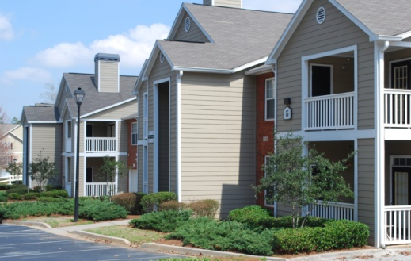
Housing (3 choices)
Big house
Mortgage
is $500
Small house
Mortgage
is $200
2 bedroom
apartment
Rent is $160

Slide 6

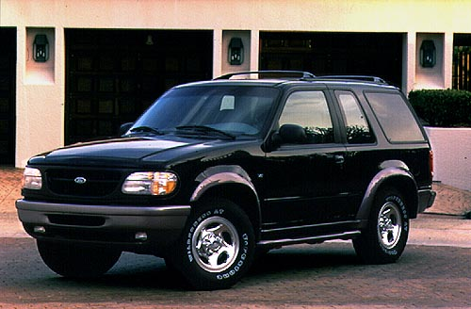
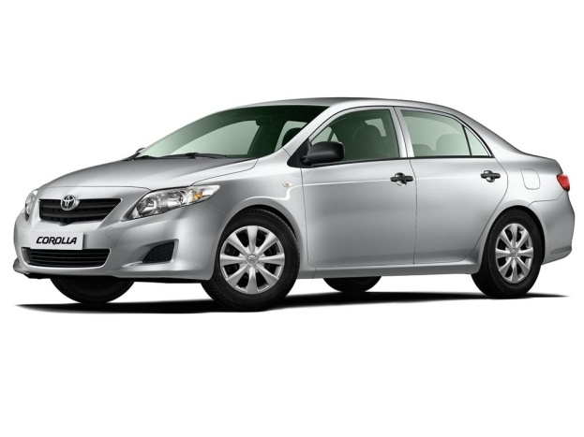
Car Payment (3 choices)
Dodge Charger
$390
each month
Ford Explorer
$230
each month
Toyota Corolla
$125
each month

Slide 7

Insurance (car + house)
+
= $20
+
= $30
+
= $40

Slide 8
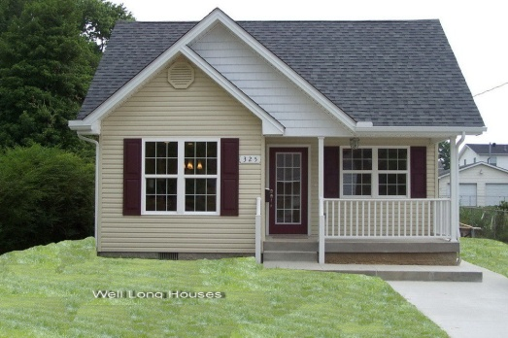
Insurance (car + house)
+
= $30
+
= $40
+
= $50

Slide 9
Insurance (car + house)
+
= $40
+
= $50
+
= $60

Slide 10
Daycare
Daycare is very expensive, usually around $100 each week, per child. This daycare has a special discount for employees of the grocery store.
1 child = $150
2 children = $170

Slide 11









Clothing…for the family
$70
$25
$10

Slide 12










Food…for the family
Restaurant once a week.
Meat everyday.
Name Brands
Restaurant once a month.
Meat 4 or 5 days a week.
½ Name Brands
½ Store Brands
No Restaurant
Meat 2 or 3 times a week.
Store Brands
$150
$100
$50

Slide 13
Utilities (water & electricity)
No children = $30
1 child = $40
2 children = $50

Slide 14

Utilities (water & electricity)
No children = $30
1 child = $40
2 children = $50

Slide 15
Utilities (water & electricity)
No children = $30
1 child = $40
2 children = $50

Slide 16
Gas
Dodge Charger
Gas is $150
Ford Explorer
Gas is $100
Toyota Corolla
Gas is $50

Slide 17
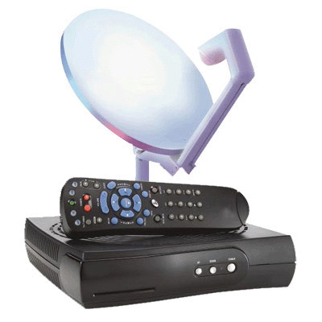

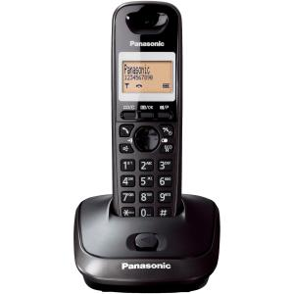
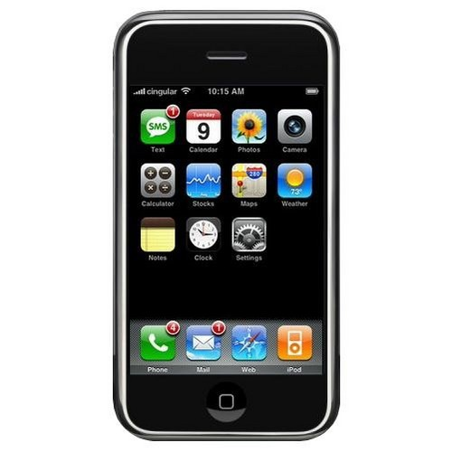
Media
High Speed Internet $20
Satellite TV
$50
Home
Phone
$10
Cell
Phone
$30

Slide 18
Transaction | Credit - | Debit - | Balance

