Slide 1
TOP 4 PHOTOGRAPHY TIPS
WITH

Slide 2
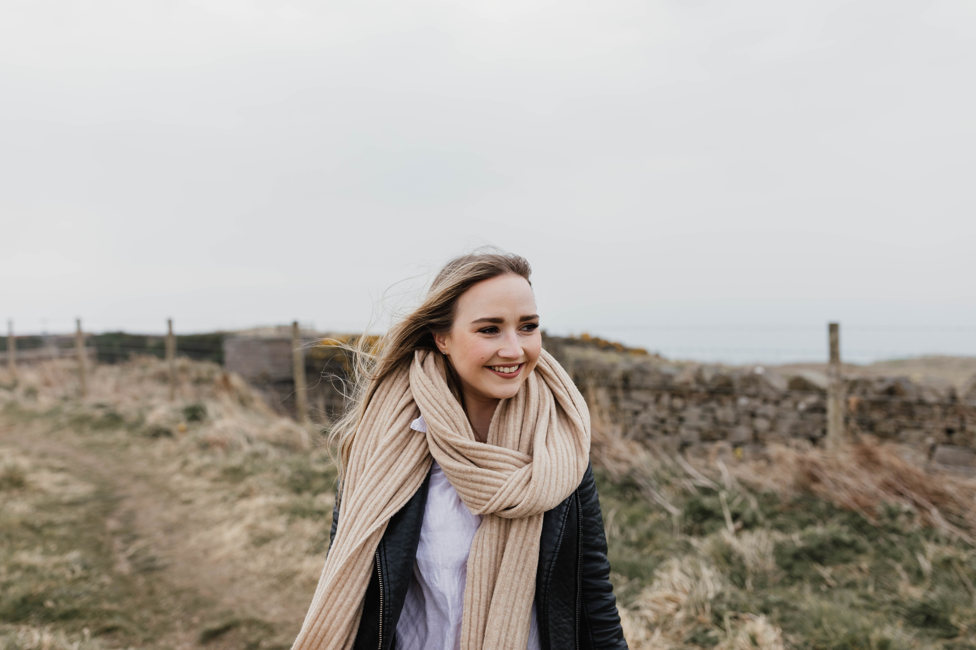
First of all here is a little bit about me
My journey started when I was 7 years old when I was gifted my first ever digital camera. I would take photos of everything and anything! Toys, food & my family! I would never leave the camera at home, it was always attached to me. Of course you guys are now far more advanced with technology than it was when I was 7… you maybe don’t know what a digital camera is! But I am sure you know what an iPhone is!
As I went through school, I still always had the camera out with me and it has never left me since! When I left Ellon Academy I went on to study Art & Design. Some may wonder why I didn’t study photography straight away? The truth is, as much as I loved it, I had never really thought of it as a career and I already knew all the technical terms of a camera! I love all things creative so being able to use my Art & Design qualification within my photography journey has made it all worth while! Almost three years ago, I took the leap and started my own business!
I absolutely love my job and the creative side that comes with it. I have the ability to capture a memory in a special way that you and your families can keep forever. It really is a special job!

Slide 3
Let’s get started!
Have you been using your camera or maybe your parents camera?
Have you been really happy with what you captured or are you just having a play about?
Great! We have something to start with!
Let me share some tips with you on how to improve your photography!
In this presentation we will go over 4 simple tips!
Settings
Lighting
Positioning
Have fun

Slide 4
THE THREE KINGS
ISO
SHUTTER
APERTURE
“The three kings” are the three main settings we use when using our camera! You choose these settings depending on the lighting and object. A lot of people will use their camera in Auto (the green camera option on the camera settings dial) This is when the camera chooses the settings for you and can photograph away as you like and not have to worry about the settings but sometimes the camera doesn’t choose the right setting so you might not get the picture you are looking for!
But what do these mean? Let’s go!

Slide 5
The First King - ISO
ISO is your camera’s sensitivity to light. You choose your ISO setting on your camera depending on the situation you are photography.
Your ISO setting can range from 100 to 32,000!
The easy way to remember it is, if you are outside on a sunny morning or afternoon you are best to have your camera set to a low ISO of around 100-300. Lower ISO settings are less sensitive to light and make your images super sharp! As the day goes on you will need to adjust your ISO setting to a higher number, maybe all the way up to 1000. The darker it is, the higher the ISO needs to be. A high ISO is sensitive to light and can cause your images to look a little grainy if you go too high!
Where can I find this setting on my camera? There should be a dial at the top of your camera to change this setting with a sign saying “ISO”, for a digital camera it may be in your menu. On a touch phone, you can tap your screen whilst focusing on an object and slide your finger up and down to change the lighting setting.

Slide 6
The Second King - Shutter
Our camera’s have a shutter inside them! This is what the clicking sound is when you take your photograph!
To use the shutter in our camera’s we have to set the speed of it. Again a little like ISO you can change your shutter from a low to high number. They can go as low as 10 (slow objects) and all the way up 10,000 (fast objects). The lower the shutter number the less your object will be in focus. We tend to only use low shutter numbers for taking photographs of still objects. Maybe a toy or a plant! If you were photographing a fast moving person you would want to have your shutter at a high number such as 300+ to get them in focus.
A slow shutter is brighter in a dark light. So the slower the shutter, the more light is let into your photo. A fast shutter means less light will be in your images. This is when you would adjust your ISO to make your images a little brighter with a faster shutter!
The shutter on your camera will be the opposite dial to the aperture dial. On a phone you can adjust the shutter speed by choosing the number you want the speed to be at.

Slide 7
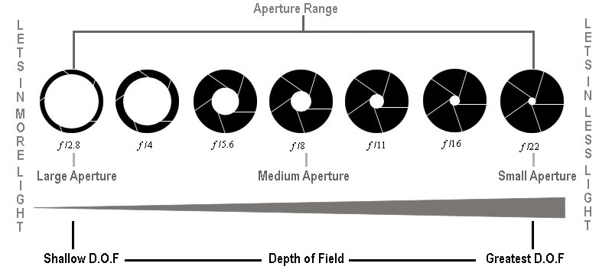
The Third King Aperture
Aperture controls the opening and closing of the lens. We call this the depth of field. This is how you get a blurry background for your photos!
Aperture settings can range from F1.4 to F14
Fun fact! Just to make things complicated – A high aperture actually starts from f1.4 not f14 and a low starts from the highest number rather than the lowest!
So for a super blurry background you should want to shoot at a high aperture. Such as 1.4,1.8 or 2.8! If you were looking to do a landscape you would be looking to do a low f stop of f10 up!
You decide your aperture setting depending on the light you have around you when photographing. If you used a high aperture (f1.4) this let’s in more light through your lens or phone camera. If you used a low aperture, this let’s in less light. You would use a low aperture on really sunny days to let in less light through the lens or phone camera.
If you look for this circle sign on your phone you will be able to adjust your blurry background from there! On a camera you spin your aperture dial to adjust.

Slide 8
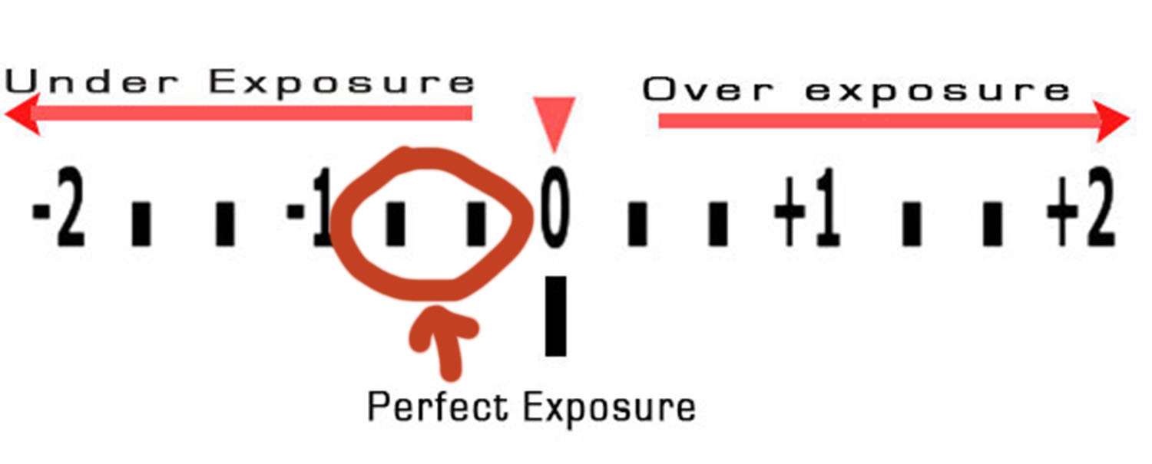
And here are the three kings all together! This is also known as the exposure triangle.
… are you still with me or having you falling asleep? We are almost at the fun stuff!
In short - you need to set your ISO first to suit the lighting around you then choose your shutter speed depending if it is a still object or a fast moving object then set your aperture depending if you want a blurry background or not.
On a DSLR when looking through your view finder you will have exposure line which looks a little like this
If the arrow is sitting at 0 you should be able to capture the perfect picture! It is more to the left hand side of the 0 your picture will come out a little dark. If it is more to the right this means your image will be a little too bright. Both these mean you just need to tweak your settings a little bit, such as maybe making the shutter faster to let light less in when it is too far to the right or make it a little slower to let more light in when the arrow is too far to the left.

Slide 9
Tip number 2 – Lighting!
When out with your camera or phone, look around for nice lighting. If the sun is making you squint your eyes, move to somewhere in the shade! If you are indoors, try take photos beside the window. You will get lots of lovely natural light!
The best light for outdoor photography is a cloudy day! We never want the sun to be shining bright when it is at it’s peak! If you do want some nice sun light, try going out early in the morning when the sun is rising or later in the evening when the sun is setting.

Slide 10
Tip number 3 – Positioning!
Where is the best place for you to put your object or person you are taking a photo of?
The best place would be to put the object in the middle of the camera or phone screen when looking through your view finder or phone camera.
If you are outside and it is sunny, always put your object or person facing away from the sun and not towards it. This will make your picture look really nice and not too harsh.

Slide 11
Tip number 4 – Have fun!
The most important part is to remember to have FUN! Don’t worry if you can’t get your settings right! Stick the camera on Auto and go out and photograph everything you want!
Ask your parents or siblings to be models for you, get them to pull funny faces! Get close up so you really capture that facial expression!
Grab a toy and pop it Infront of the window and test playing with the window light. Remember the more sunlight that comes in, the harsher your picture will look! Try stick to the shade or move further away from the window but still make sure you get some of that natural light coming through.
If you have a dog, practise taking photos of them running up to you really fast! The list is endless! Just remember to have fun whilst learning!

Slide 12
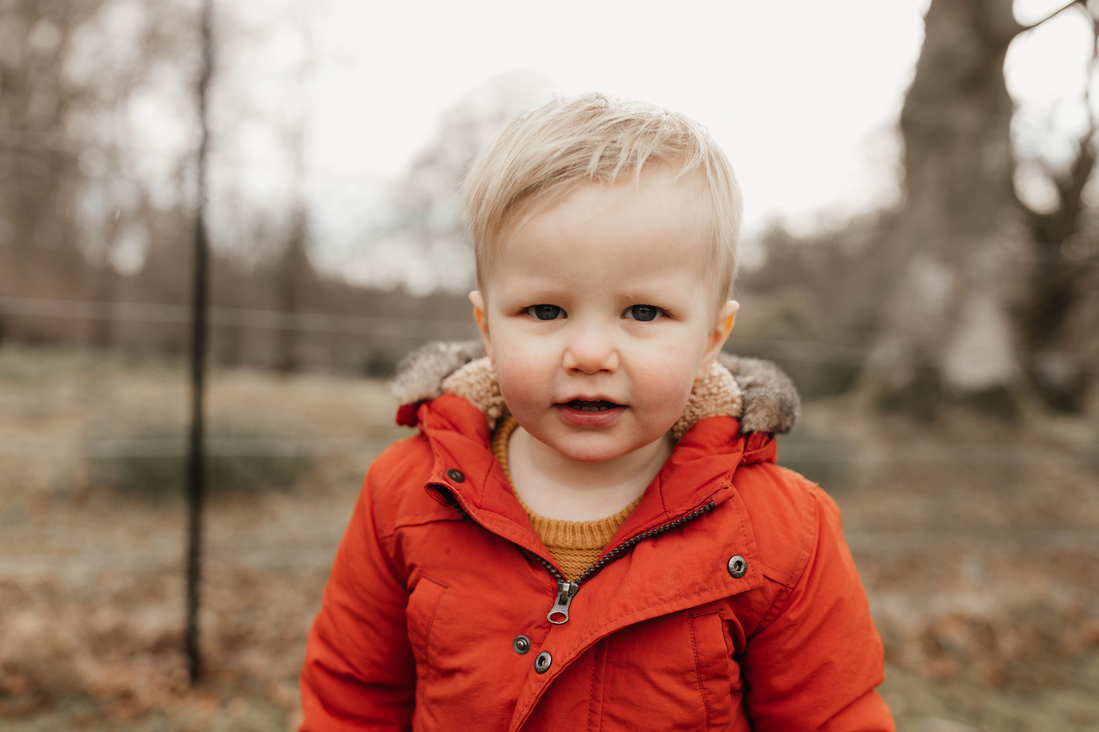
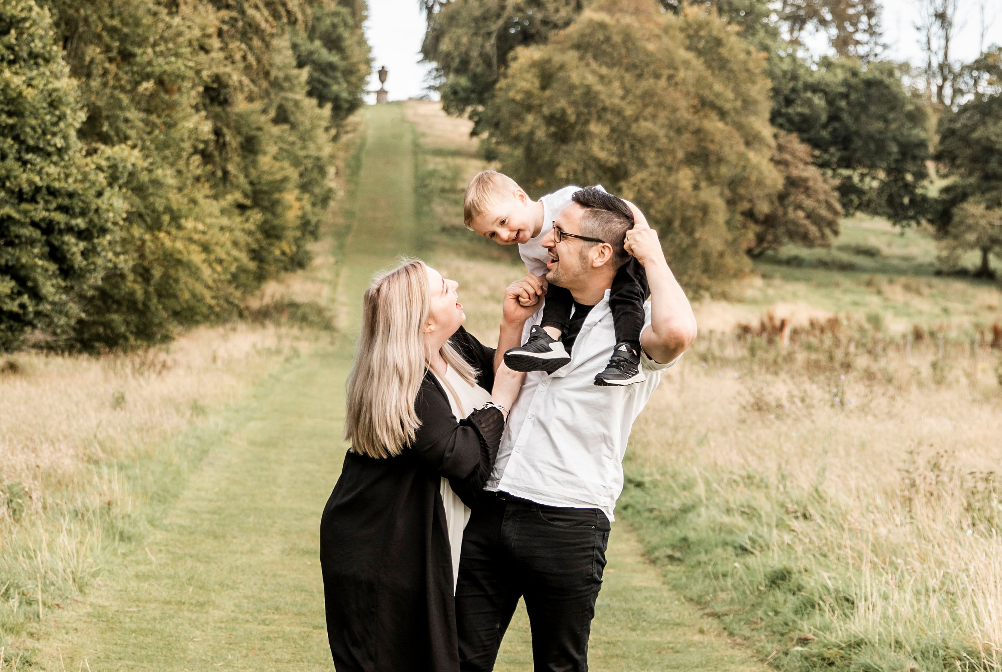
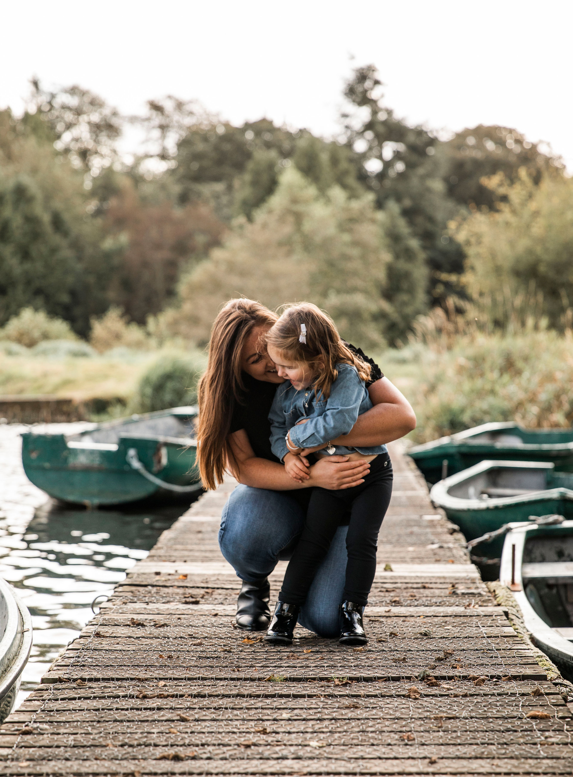
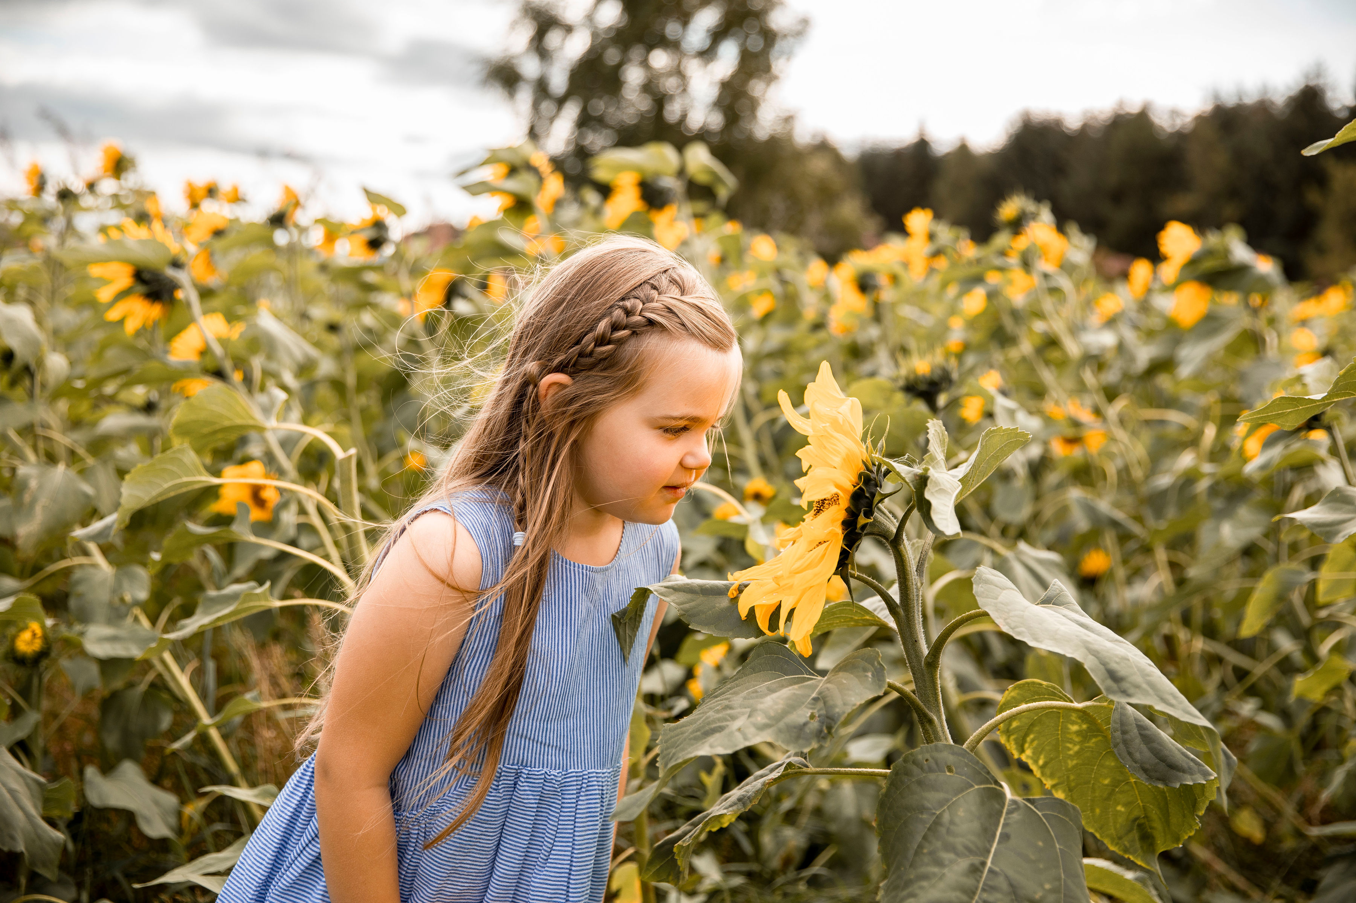
THANK YOU!
Hopefully you all take away something from this short presentation and always remember to look for the best natural light and to have fun, then you can't go wrong!
If you have any questions, please pass them onto Miss Deans and I will happily answer any questions for her to pass back onto you!

