Slide 1
Welcome to Kemnay Academy
S4/5 Parents’ Information Evening

Slide 2
Design Principles for the Curriculum
ethos and life of the school
curriculum areas and subjects
interdisciplinary learning
opportunities for personal achievement
Challenge and enjoyment
Breadth
Progression
Depth
Personalisation and choice
Coherence
Relevance
2
Notes:
2

Slide 3
Curriculum in the Senior Phase
Building a portfolio of qualifications gathered over a two or three year period.
S5/6 – achieving greater depth in subjects studied at S4, or breadth through picking up new subjects.

Slide 4
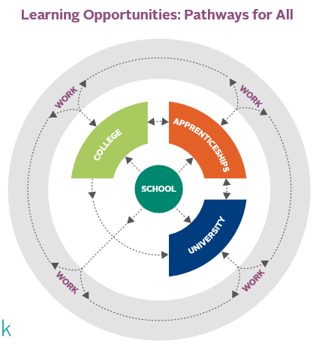
Learner Pathways
Learner pathways help to map out:
Courses and qualification
Deliver skills and knowledge
Create opportunities for new interests
Improve employment prospects

Slide 5
S4-S6 Progression
S4
S5
S6
FA
FA
Progress to another subject (breadth)
Adv Higher
Higher
Higher
Progress to higher level in same subject (depth)
National 5
National 5
National 5
National 4
National 4
National 3

Slide 6
S5 Curriculum
Students should select 5 subjects for study.
A full timetable is the expectation
These can be a mix of National qualifications based on their S4 attainment
Students will also continue PSE and core PE.
Study will be offered

Slide 7
S6 Curriculum
Students should select a minimum of 4 certificated courses – exceptions acknowledged
These can be a mix of National Qualifications.
(OR 3 Advanced Highers)
Students continue with PSE.
Study periods offered
Wider Achievement is compulsory in S6

Slide 8
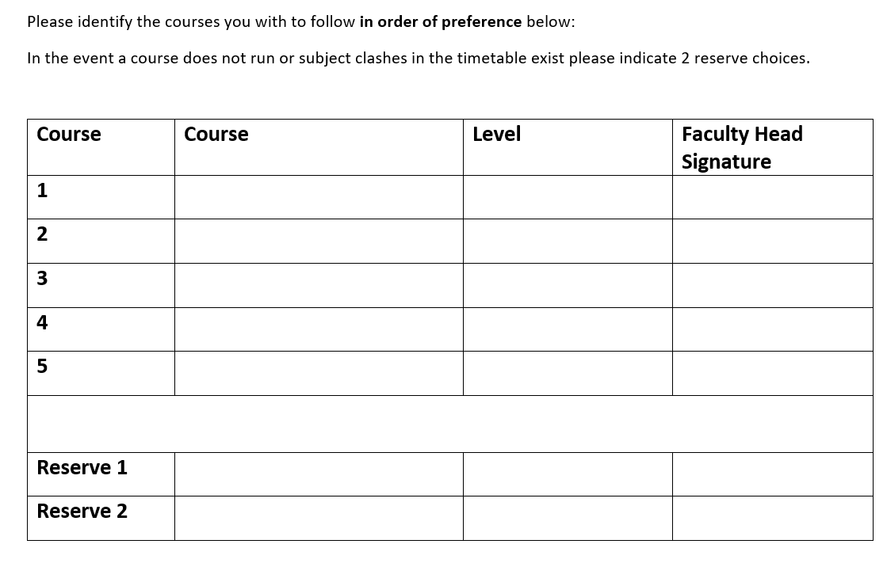
Course Choice Form
Guided free choice
Pupils to identify courses that they would like to study in order of preference.
Discuss choices and level of study with guidance teacher.
Level of study to be confirmed with Faculty Head for subject.
Identify 2 reserve options

Slide 9
Process For Making Choices
Information Evening – tonight
Parents’ Evenings S4 – 27th Feb S5 – 4th March
Subject choice info issued early next week via email & website
Pupil/Guidance discussion – on-going
Link to Electronic Course Choice Form issued next week via text message
Deadline for return of choices – 6th March

Slide 10
Any questions?
?

