Slide 1
Young carers

Slide 2
Young carers
At least 7% of children in Scotland under the age of 18 have a caring responsibility.
Who is a young carer?
What responsibilities may a young carer have?
What support is available for a young carer?

Slide 3
S1 Presentations What we understand about young carers

Slide 4
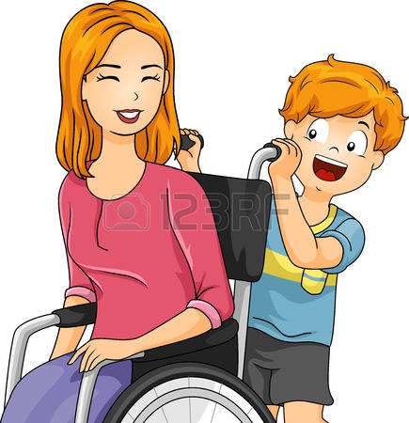
Young Carers

Slide 5
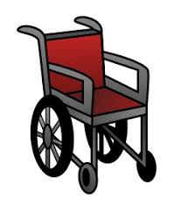
Who is a Young Carer?
A young carer is someone under
Who cares or helps care for a member of
It might be their sibling or one of their parents.
They can even be caring for someone who was or is addicted to drugs or alcohol
They could have a mental or physical illness for
example being in a wheelchair

Slide 6
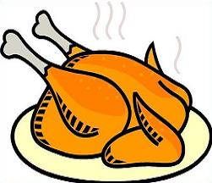
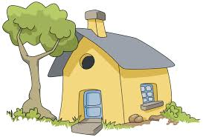
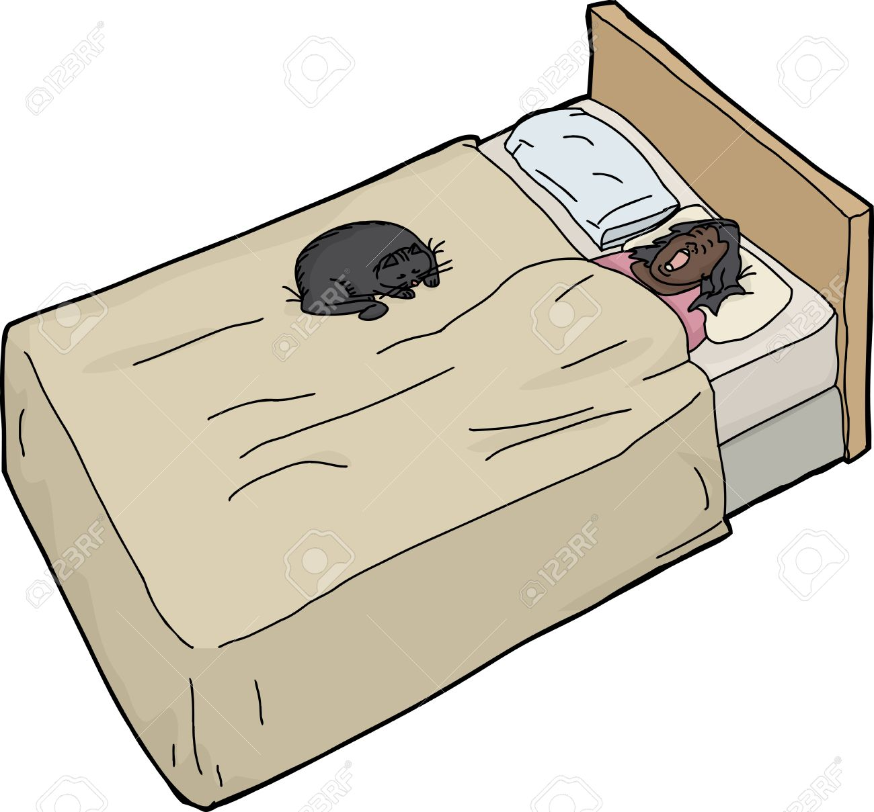
What are some of the responsibilities a young carer may have?
A young carer may have to cook for their families or go shopping
A young carer may have to help a family member cope with mental or physical illness. This could include talking about their mental illness or fetching medicine from the cupboard
A young carer may have to clean the house
They may have to help their ill family member around the house and in and out of bed

Slide 7
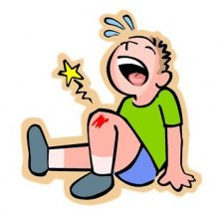
How may a caring role effect a young person’s life?
A caring role may make a young person feel disconnected from the rest of the world because they have to help at home. They may not be able to go out
A young person may become distressed and worried at school
Their grades may go
They may get bullied because they care for a
family member
They may worry about their duties at home and if their family member is ill

Slide 8
What support is available to young carers?
There are plenty of places a young carer can go for
They can talk to an adult that they
At school they can even ask a guidance teacher
And they can talk to someone from

Slide 9
Young Carers
Time to reflect
Banchory Academy.mp4

Slide 10
Future plans
Working towards a Young Carers charter
further promotion of young carers
P.S.E lessons in S3
Young carers group
Young carers noticeboard
If you think you may be a young carer, think about speaking to your Guidance teacher. We may be able to help.

