Slide 1
Positive Relationships at Kemnay Academy
-School Captains

Slide 2
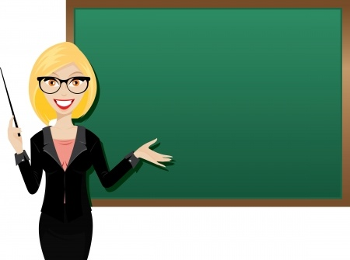
Positive attitudes with our teachers
Students who have positive and supportive relationships with their teachers will attain higher levels of achievement than those students who do not show positive relationships or respect to their teachers

Slide 3
Let’s be positive to each other!!
Being nice and having respectful relationships with your fellow classmates is VERY important.
A lot of pupils can treat school as an escape from any worries they might possibly be having going on, out of school
Being nice or even having a short positive conversation with someone that you don’t usually speak to could in fact make someone's day

Slide 4
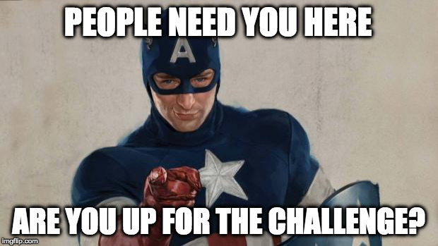

Slide 5
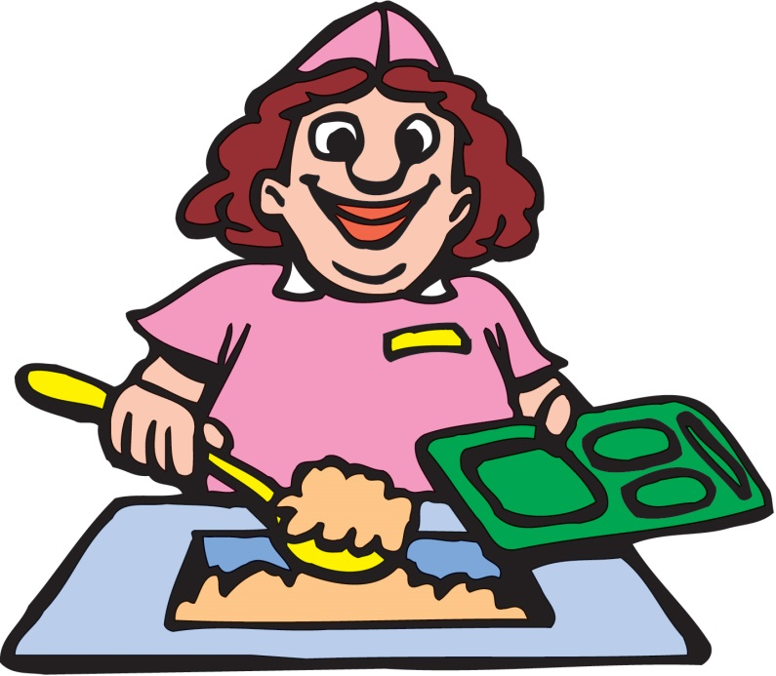
let’s have a positive relationship with our hard working canteen workers
Our canteen staff are equally important to us as our teachers are, speak, treat and respect them as you would do to a teacher
It is not their job to clean after your mess – they are not cleaners
If they ask you to pick up a piece of litter or a plate that might not be yours – be a role model and pick it up anyway without complaining, this is building a positive relationship with the canteen staff

Slide 6
How can you be a positive role model to others?
See a piece of litter or a dirty plate?
Pick it up or throw it in the bin
Not understanding something? Speak calmly with respect to your teacher
Prefects
School Captains
Pupil Council
Anti-bullying group
Health and well being group
Peer Mentoring
If someone looks down? Cheer them up have a simple conversation with them

Slide 7
Thank you for listening
We hope you take away something from this message and remember to always respect one another and all the staff here at Kemnay Academy.
We also really hope a lot of you’s are aiming to apply or join some of these groups and positions that encourage positive relationships as they are a great opportunities to grab

