Slide 1
EXAM TIPS

Slide 2
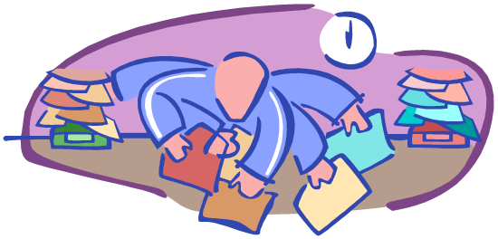
Response to a challenge, threat or excitement. Symptoms caused by presence of adrenaline. A certain amount of exam stress can be used as a motivating force. However if adrenaline levels become excessive, unpleasant physical symptoms take over.
What is stress?
Notes:
Stress is the body’s normal response to a challenge, threat or excitement. The physical symptoms associated with stress are caused by the presence of adrenaline, produced to prepare the body for ‘ﬁght or ﬂight’. A certain amount of exam stress can be used as a motivating force. However if adrenaline levels become excessive unpleasant physical symptoms take over.
A certain amount of exam stress can be used as a motivating force however, if adrenaline levels become unpleasant physical symptoms begin to take over. A little bit of stress can be energising but too much stress can be paralyzing.
2

Slide 3
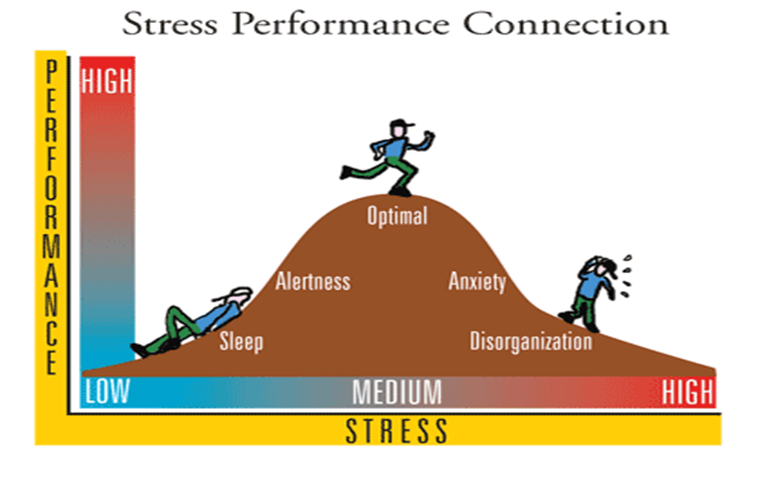
The pressure to preform well in exams contributes to feeling worried and stressed, increasing the chances of overreacting to situations and possible conflict
Notes:
Study stress is also about your beliefs about and attitude towards studying. The way you think & interpret the pressure of studying can cause you to: 1. feel threatened by a situation (e.g. an essay deadline) 2. doubt your capabilities in dealing with the situation (e.g. keeping up with reading) How you feel also depends on how you think about studying & your resources for dealing with your studies. The main reason for this is because of increased pressure and stress that they receive from their parents and teachers to perform well in the exams. Although a little bit of exam fear and anxiousness is important to study and learn before the exams, too much tension can hamper the student's ability to do well. Many times, due to exam fear, students tend to forget what they have learned, thus scoring less than they could have
3

Slide 4
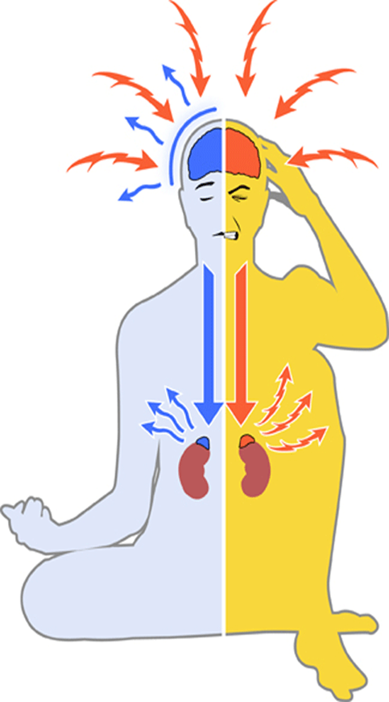
Our Brain, Body & Behaviour changes when we are under stress. Stress can prevent us being productive, happy & successful. Stress can cause us to feel unwell & unable to cope. Stress can make us lose sleep & can lead us to do things we won’t otherwise do!
Notes:
A lot of people find that the stress before exams is often worse than the actual exam and it can be made even worse if they have older brothers or sisters who have already done well and feel they have to match up to their standards.
4

Slide 5
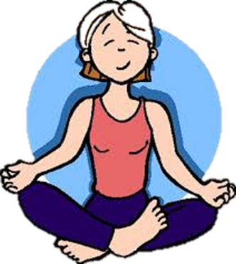
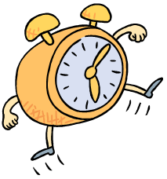
Exam stress help sessions
Help is at hand
‘The Spark’
Get guidance with exam related stress
Ensure you have the right mindset to preform to the best of your abilities on the day of the exam
Notes:
last year there were sessions to help people cope with exam stress- this is happening again this year and would be beneficial if you suffer from exam stress or are just looking for some helpful tips to improve your study skills. I went to a class that they ran last year which was extremely useful and allowed you to take part in a number of activities to help reduce stress levels- I went last year and found it extremely beneficial as it allowed me to develop new ways to cope with exam stress
See Ms Arthur
5

Slide 6
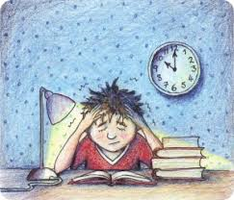
S4 FIRST-TIME EXAMS
Feeling the pressure of your first set of official SQA exams
Seeking extra advice and support
10 Top Tips
The lead up to exams
Study leave
On the day
What happens next?
Notes:
S4 SLIDE ONLY- FIRST TIME EXMAS
10 top tips for s4 exams, leading up to the exams, on the day
6

Slide 7
SIGNS OF STRESS
Anger
Excessive Worries
Depression
Mood swings
Anxiety
Forgetfulness
Tiredness
Poor concentration
Profuse sweating
Lack of interest in studies despite efforts made
Changes in sleep or eating patterns
Notes:
Holding negative thoughts can also have a big impact on your feelings; you may be aware of feeling scared about the exam or you may feel generally irritable but not be sure why. You may also observe behavioural changes, such as putting off thinking about and planning for the exam or alternatively being unable to stop thinking about and planning for it. You may also experience physical changes, such as experiencing headaches, changes in your appetite or developing sleeping difficulties.
Taking care of yourself physically and emotionally will help to control your anxiety levels by making you feel relaxed and using up some of the nervous energy that is produced when you are under stress.
7

Slide 8
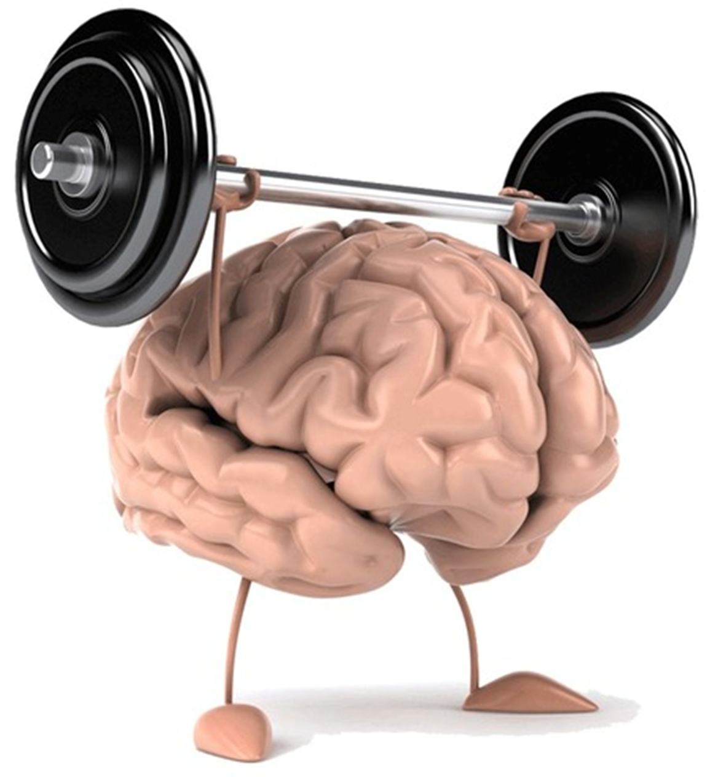
Positive mindsets
Focus on positives
Learn from mistakes
Don’t compare yourself
Take steps to overcome problems.
Don’t try to be perfect.
Pay attention to how your body responds to stressful situations.
“ To succeed, we must first believe that we can.”
Notes:
Throughout the exam period its important to maintain a positive mindset, this is achieved by taking an optimistic approach on exams and the preparation that goes with exams- for example, if you get a question wrong don’t look at it as a failure, look at what you can learn from it and how you can imorove,
8

Slide 9
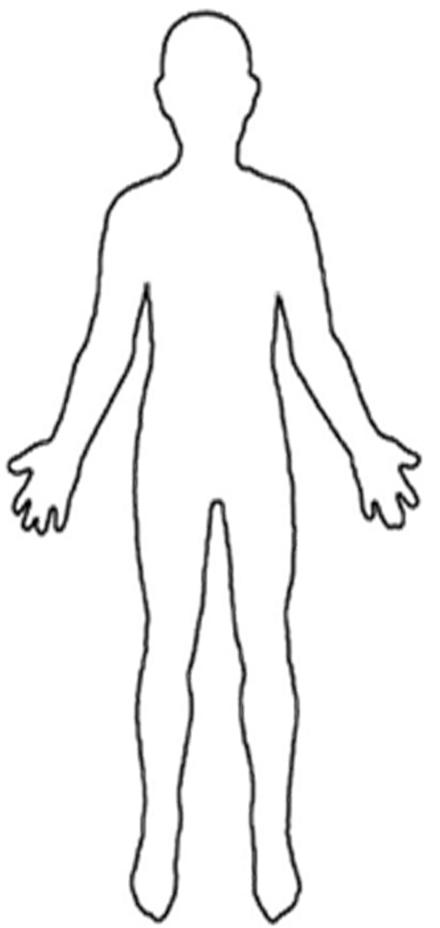
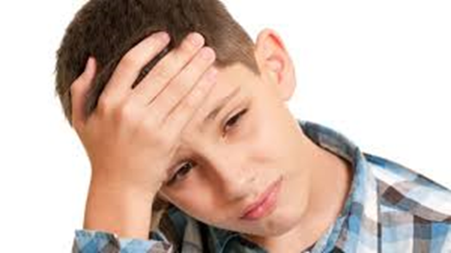
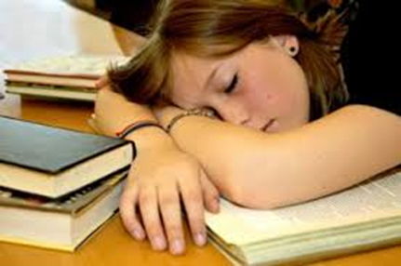
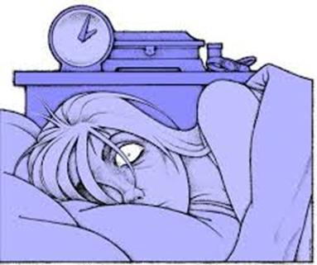
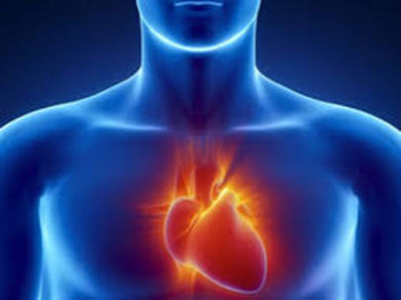
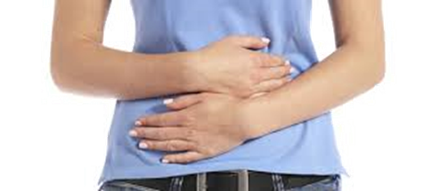
Feeling tense can lead to headaches and migraines
Exhausted, no energy.
Worry leads to lack of sleep.
Stress over a long time causes
high blood pressure,
Panic could lead to lack of
control and sickness
Notes:
Its important to have a sense of perspective if you feel under pressure. Talk through the problem with someone and to break it down into manageable chunks and remember the positive things that you have achieved
9

Slide 10
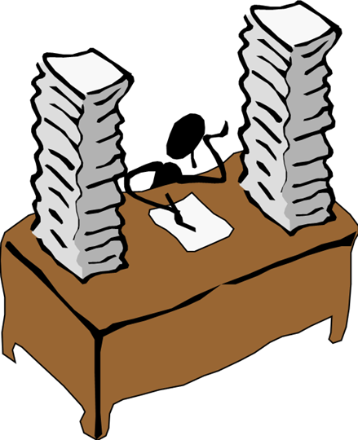
Lack of preparation!
•
Past experiences of blanking out or performing
badly on exams.
•
Focusing too much on the outcome.
•
Focusing too much on how other classmates and
friends are doing.
•
Issues outside of school distracting you from
studying for or concentrating on exam.
What causes test anxiety?
CAUSES OF ANXIETY
Lack of preparation
Past experiences of blanking out or performing badly on exams.
Focusing too much on the outcome.
Focusing too much on how other classmates and friends are doing.
Issues outside of school distracting you from
Notes:
Its natural to feel anxious about exams however there isn’t just one cause of exam nerves. There are steps that you can take to reduce the anxiety to ensure you preform your best.
Pressure from older siblings doing well
Covering your stress onto others
10

Slide 11
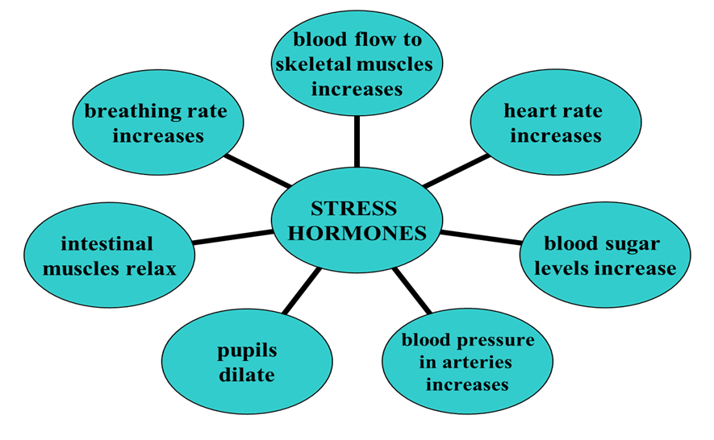
Notes:
To be most effective in
your learning, develop good
techniques to manage
study stress.
A little bit of stress is
energising but too much stress can be paralyzing.
Monitor your stress levels, spot stress signs early & do something about it quickly. A little bit of stress is
energising but too much stress can be paralyzing.
11

Slide 12
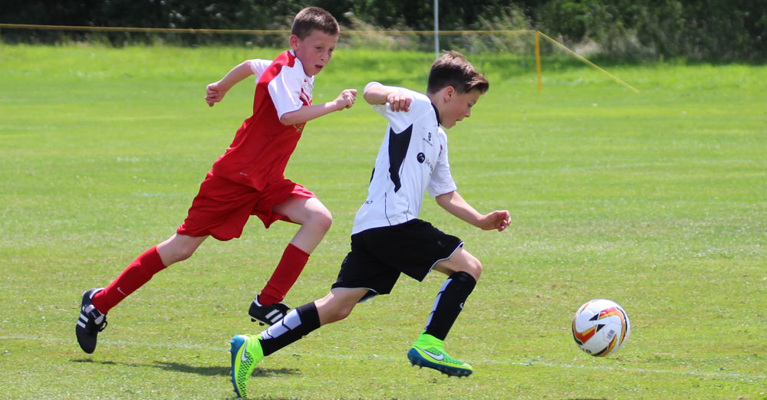
Reducing adrenaline
To reduce adrenaline, take part in physical activity
This will use up the adrenaline
Additional beneﬁts include release of endorphins
Notes:
The natural way to reduce adrenaline levels, and consequent symptoms, is to take part in physical activity - this will use up the adrenaline and additionally you will beneﬁt from the release of endorphins - a natural high.
12

Slide 13
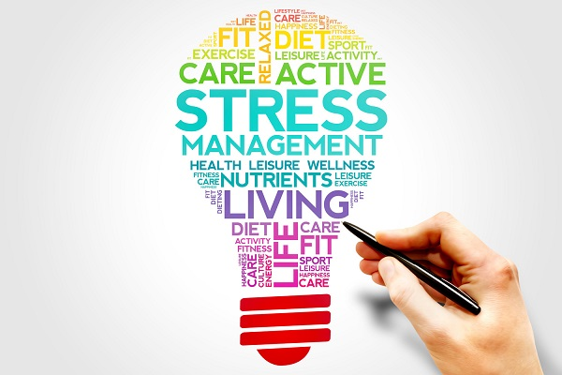
How to revise
Time Management
Find a balance between working hard and working too much
Early identification = early intervention
Notes:
There is no right way to revise. Everyone is diﬀerent Try diﬀerent methods to ﬁnd out what is best for you. Many people fail to understand the importance of planning and utilising time efficiently, the reason for this seems to arise from the many other pressures put upon them
13

Slide 14
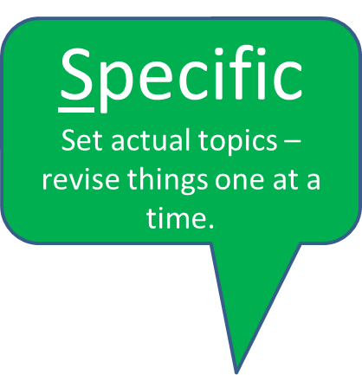
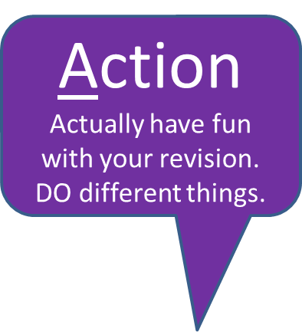
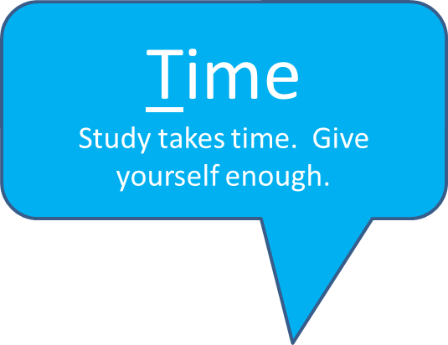
ARE YOU BEING SMART?
Notes:
However,
it
can
become
a
problem
and
start
to
aﬀect
our
mental
health
and
physical
wellbeing
when
our
stress
is
greater
than
our
ability
to
cope
• The
important
point
is
that
we
learn
how
to
recognise
our
own
stress
triggers
and
responses,
so
that
we
can
develop
skills
to
help
manage
these
14

Slide 15
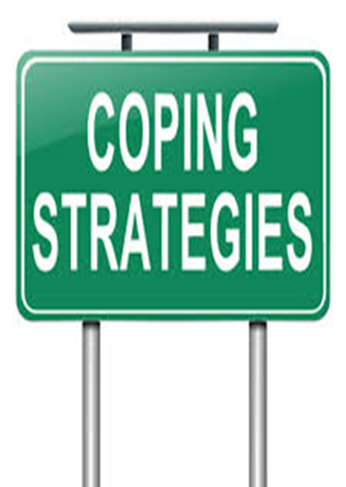
COPING STRATEGIES
Find balance between working hard and working too much
Have a hobby/ activity
Speak to peers
Stick to your revision timetable
Notes:
Stress can make some people develop unhealthy coping mechanisms- alcohol, not eating, eating too much
15

Slide 16
SETTING REALISITC TARGETS
Notes:
Of course everyone would like straight As but it’s not achievable for everyone. It’s more important to set yourself realistic targets which you can achieve.
16

Slide 17
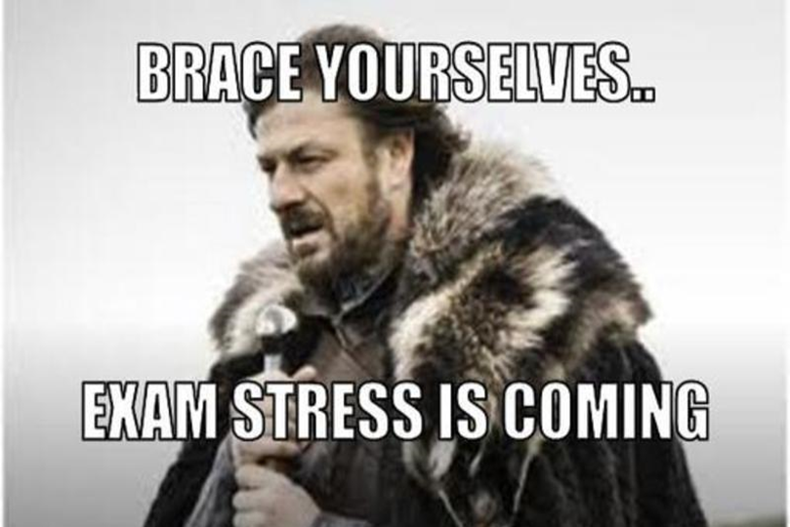
STUDY SESSIONS
Most subjects have study sessions
Ask your teacher when and where they are
Receive extra help
Notes:
Lunchtime revision sessions- most subjects- these allow you to get additional help with specific areas within the subject that you are finding challenging with no distractions.
17

Slide 18
Ways To Increase Concentration
Study Environment
Distraction free
Materials you need for studying are present
Structure for Study Sessions
Develop realistic goals for the study session
Decide the order in which you will complete tasks
Plan a reward
Notes:
Good concentration will enhance memory. If we only practice skills that improve your memory but never look at factors that enhance concentration, our efforts will only be marginally successful.
18

Slide 19
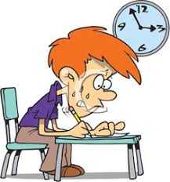
Easter revision sessions
Taking place over Easter holidays
Timetable will come out
Limited spaces

Slide 20
Different Paths, Same Destination
Notes:
If it doesn’t work out on the day- Remember, exams are important – but they’re not the only way to a successful future and not the end of the world. Lots of people achieve success in life without doing well in school exams. If you have the right attitude and determination, then you can get any qualification you set out to get and if you have a passion for something you can still get there although it may not be the path you set out to be and take an extra few years.
20

Slide 21
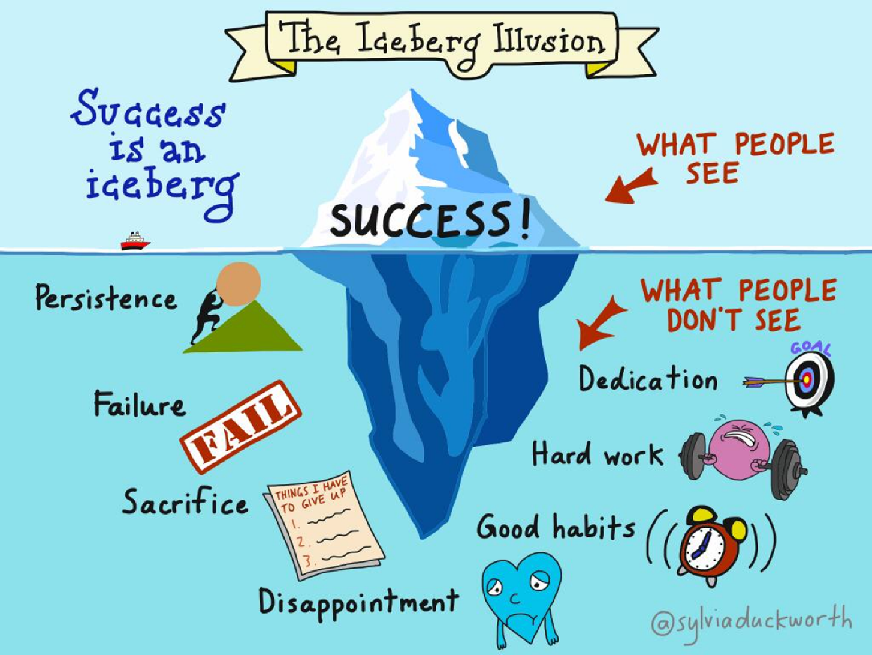

Slide 22
BE THE VERY BEST VERSION OF YOU THAT YOU CAN BE!
https://www.youtube.com/watch?v=7AgswlakjRw
Notes:
One of our school’s messages is to be the best you can be. At the end of the day, if you do your best then you should be proud of yourself no matter what the outcome. We wish you all the best in your exams and your journeys after school
22

