Slide 1
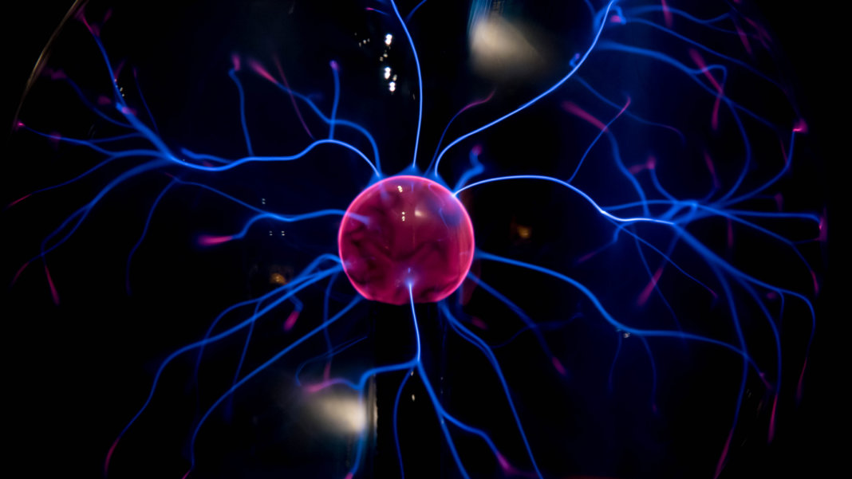
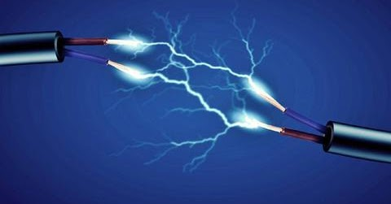
Our Circuit journey!
By Orange group
This Photo by Unknown author is licensed under CC BY-ND.
This Photo by Unknown author is licensed under CC BY-NC-ND.

Slide 2
Contents
How it all started
Once we got back to school
How we used squishy circuit app
The final project
This Photo by Unknown author is licensed under CC BY-SA.

Slide 3
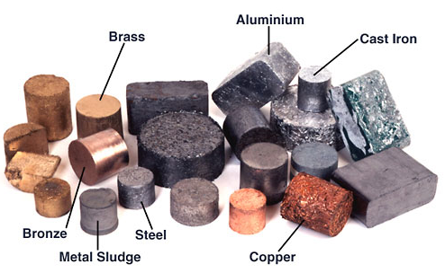
How it all started
In home learning we used online to find out what insulators and conductors. An insulator is something that does not let electricity pass through and is commonly known as rubber and clear water. And a conductor does the complete opposite and lets electricity pass through and is commonly known as metals and the best is gold.
This Photo by Unknown author is licensed under CC BY-NC-ND.

Slide 4
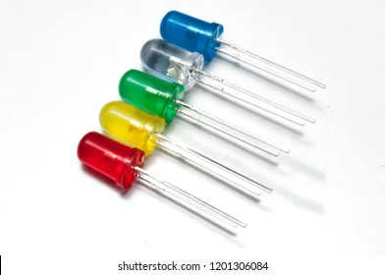
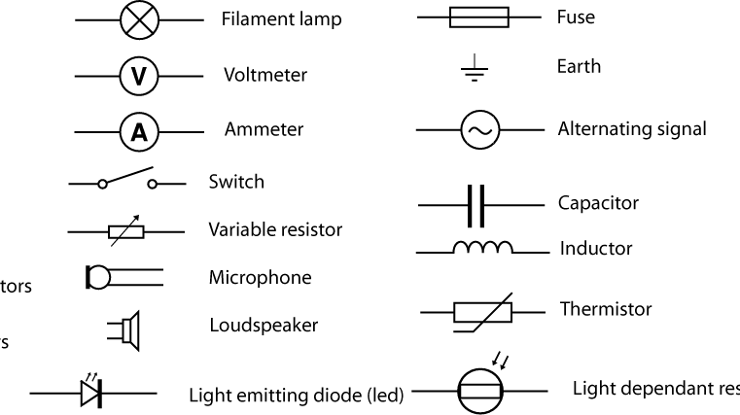
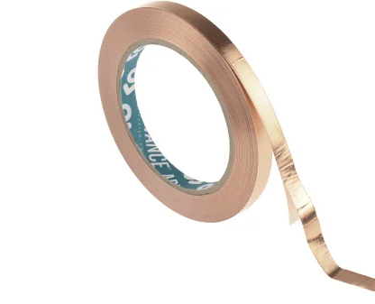
Once we got back to school ...
Once we were back in school the first thing, we did was make circuits out of copper tape. And made a small LED light, light up.
And hears a scientific explanation one how it works :>.

Slide 5
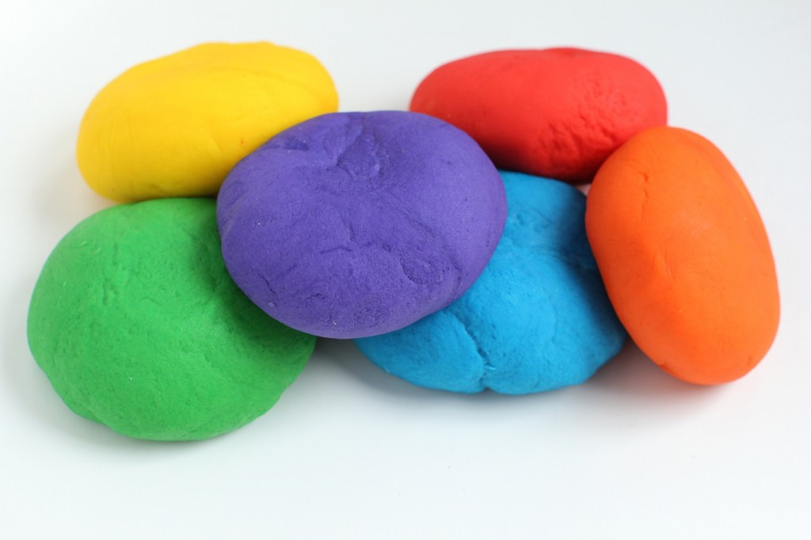
How we used Squishy circuit app
In the getting started part of the app, we can make different play-dough circuits. Our group made a play-dough campfire. We learned how to use play-dough as a circuit. You can see a picture of it on the school blog!
This Photo by Unknown author is licensed under CC BY-NC-ND.

Slide 6
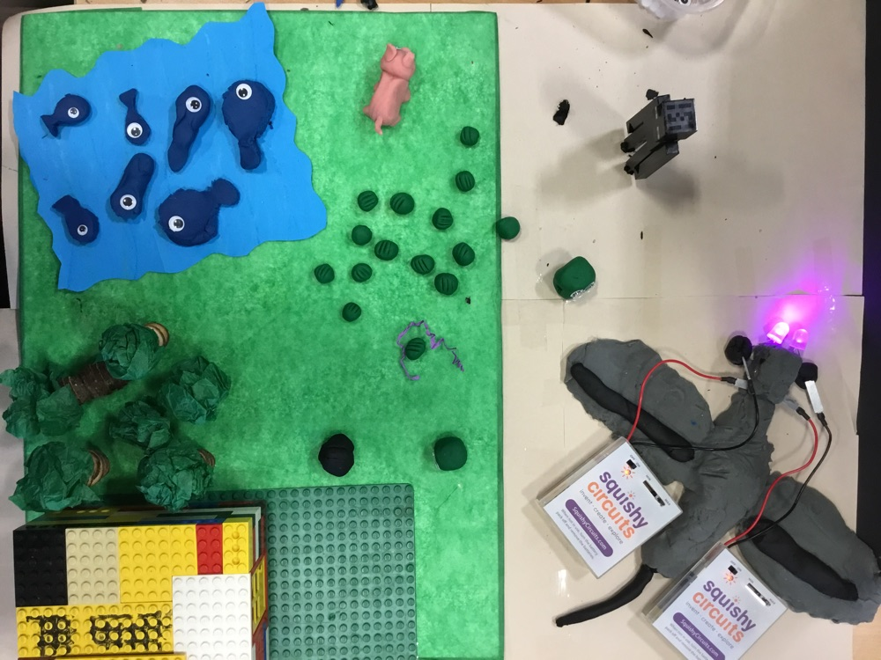
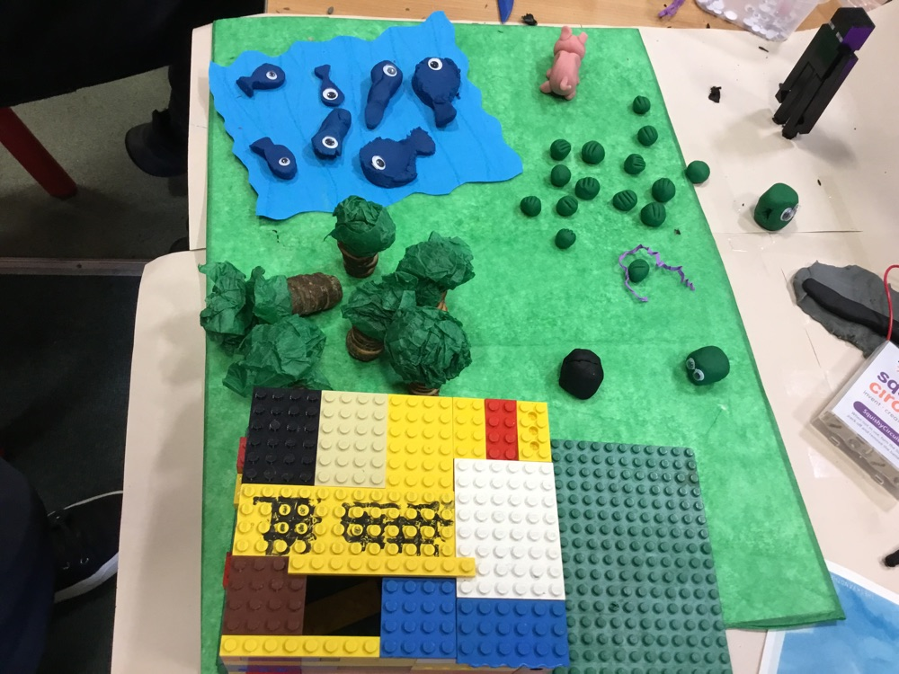
The final project
We made a circuit from end/over world Minecraft
We made a Minecraft presentation which included and ender man, ender dragon, bee, pig, Steve and a slime.

Slide 7
This is our final video
https://blogs.glowscotland.org.uk/as/public/greatlearning/uploads/sites/3534/2021/04/01131207/video-1.mp4
Click on the link above!

