Slide 1
Our Squishy Adventure
Dark Blue Group

Slide 2
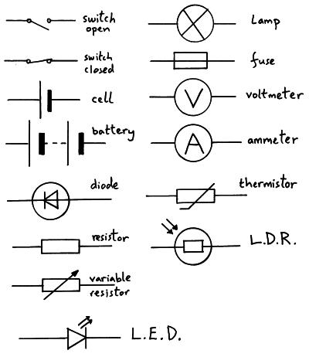
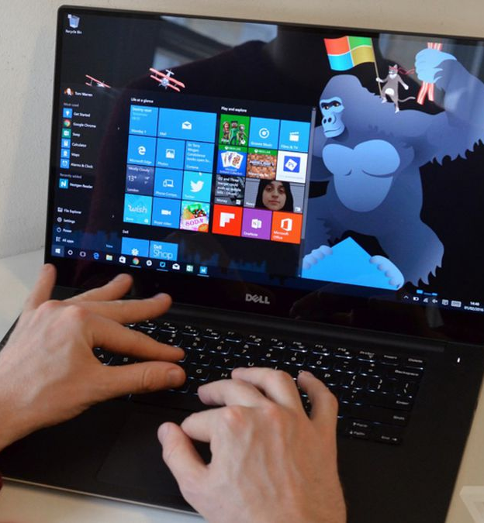
Day 1
It all started a week before home learning ended. Our teacher gave us the task of researching conductors and insulators. We researched them on the internet and provided a PowerPoint presentation on it. Conductors allow electricity to pass through, powering things, and insulators do the opposites. Some examples of conductors are copper, gold, silver and any other metals also clean, pure water.
Some examples of insulators are plastic, oil, wood and things along those lines. Salty water is also a good insulator

Slide 3
Day 2
Once we got back to school our teacher gave us some copper tape and challenged us to power a light, motor and/or buzzer. At first the light worked well and when we tried the motor it worked, but we decided we wanted to experiment with it we added a pencil to the end of Motor and put it on paper (it worked) we also did the same with a rubber and it rubbed out the pencil.
The scientific explanation for this is that the battery powers through the copper into the lights allowing to power it on.

Slide 4
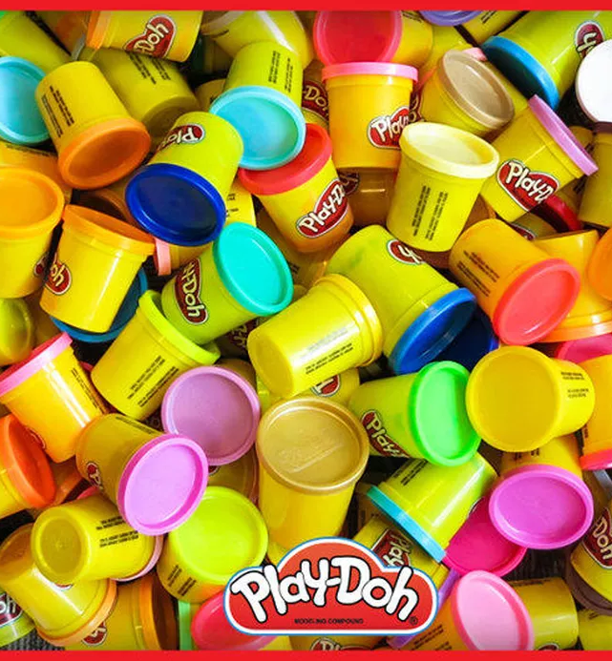
Day 3
On the third day we were given play-doh and an iPad to go onto the squishy circuits app and click on the getting started part. We learned that Play-doh is a conductor you also get special play-doh that is an insulator. Then we made a boom box with the video link below
Our time-lapse for our squishy circuits
Go to this Sway

Slide 5
Day 4
For day four we had full control over what we made, we had a four-day time limit to make a big project. We chose an alien invasion! We made a backdrop, a bunch of aliens, used toy cars, we also made a guy with a goob-slobber 3000 (a slime gun) and we added a few electrical components which were a buzzer which acted like the noise of the aliens and a LED light which was in the goob-slobber 3000 we recorded everything for you on the link below. ENJOY!
our big squishy project
Go to this Sway

