Slide 1
Yellow group circuit journey

Slide 2
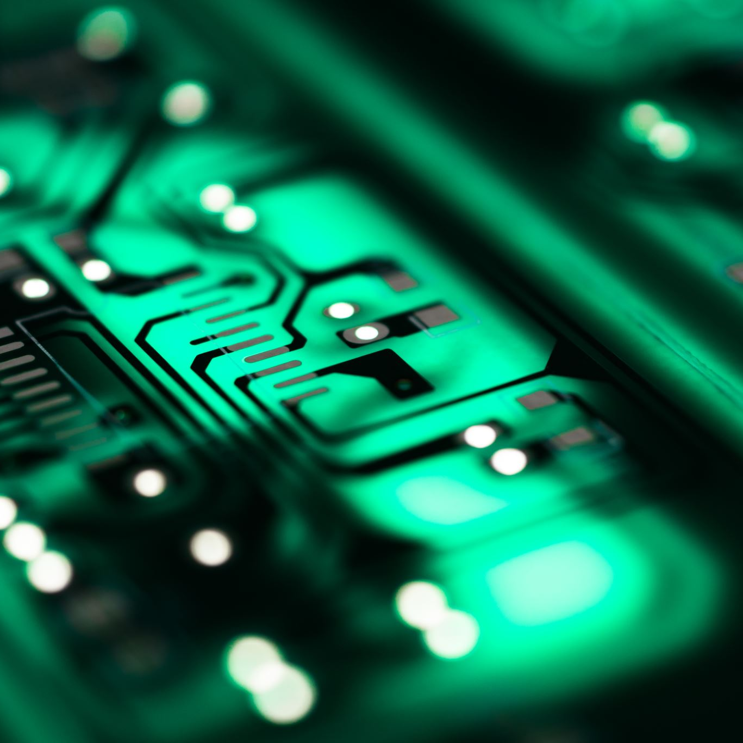
The past few weeks we have been learning about circuits and how they work. Our group really enjoyed doing this and hope we do it again

Slide 3
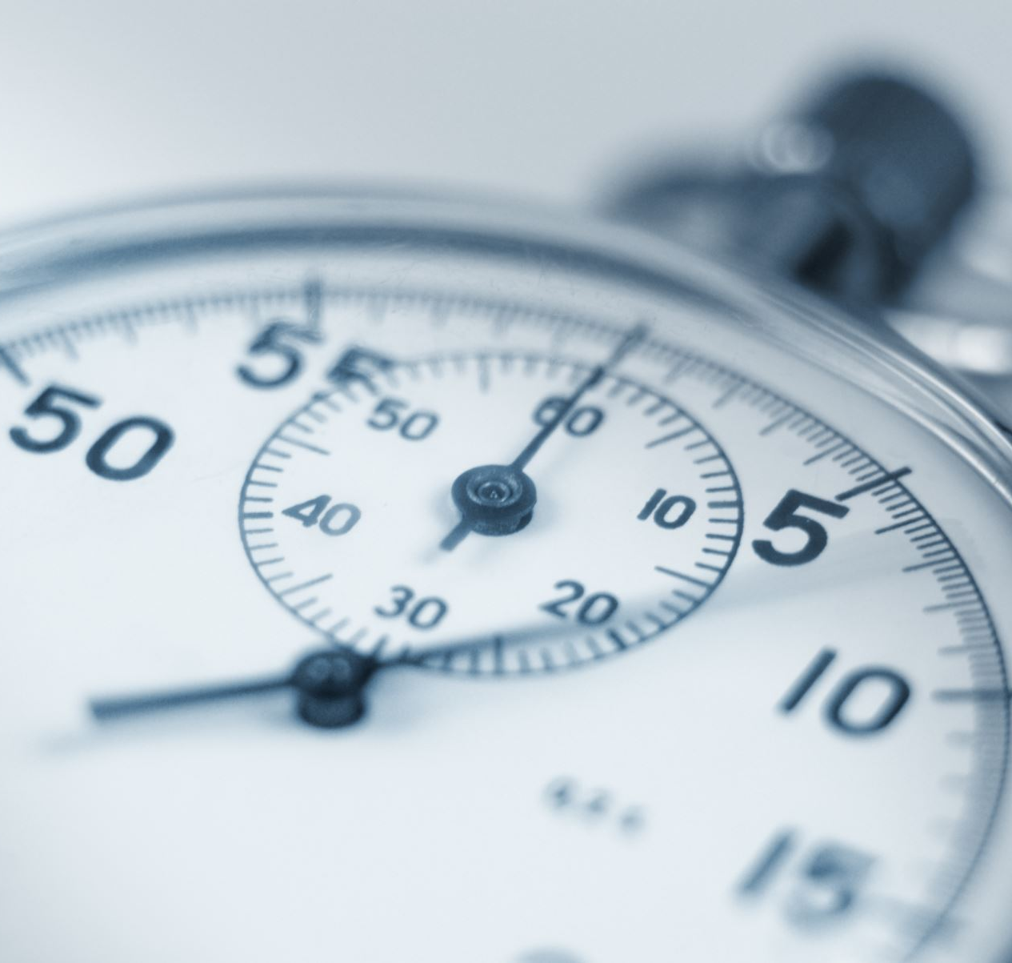
When did it start?
It all started on the second last Friday of this year's lockdown. Our teacher gave us an activity to search up Conductors and Insulators.

Slide 4
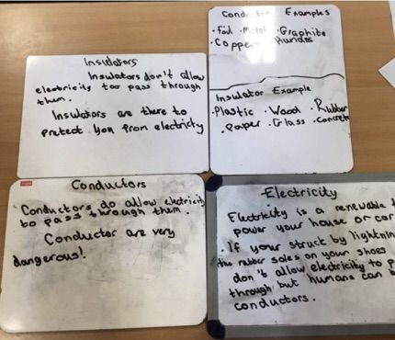
What did we learn?
We learned what Conductors and insulators are. A conductor is something that lets electricity through for example copper and gold. An insulator does not let electricity to pass through for example plastic and ceramic.

Slide 5
What we used to find the facts.
We used the BBC Bitesize to find all the facts.

Slide 6
Here are the symbols we used to identify the parts.

Slide 7
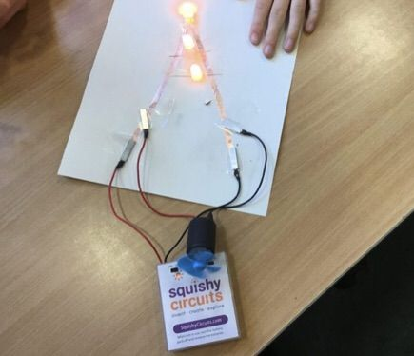
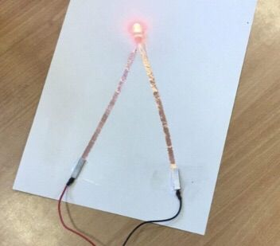
What we did when we got back in the building
When we got back, we started making circuits. We made easy circuits. When we turned the batteries on the LED lit up and the fan spun around because the positive and negative electrons went through the copper tape to these components. After that we started to use a fan and switch.

Slide 8
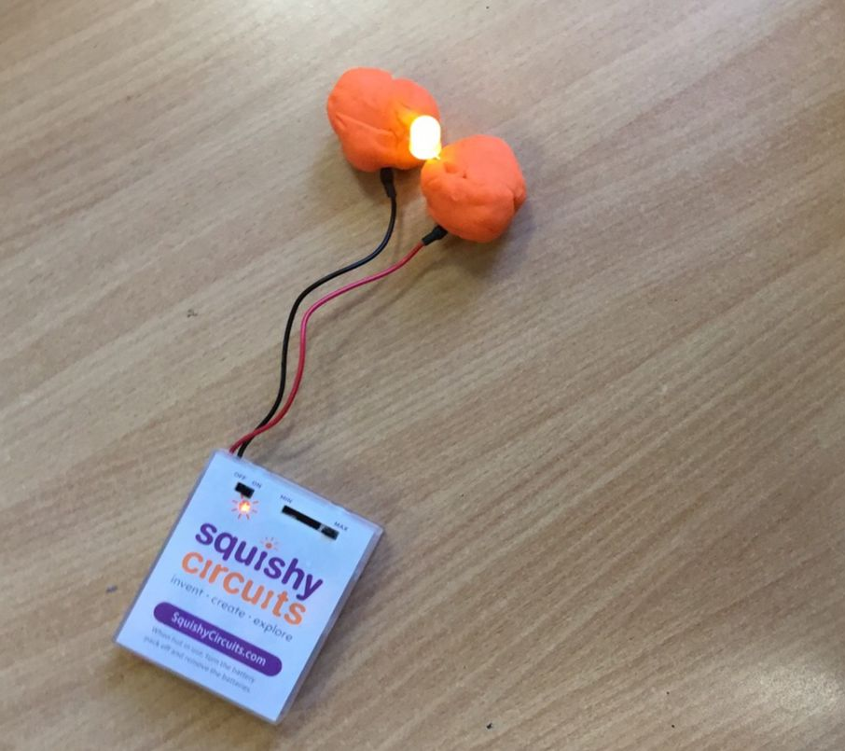
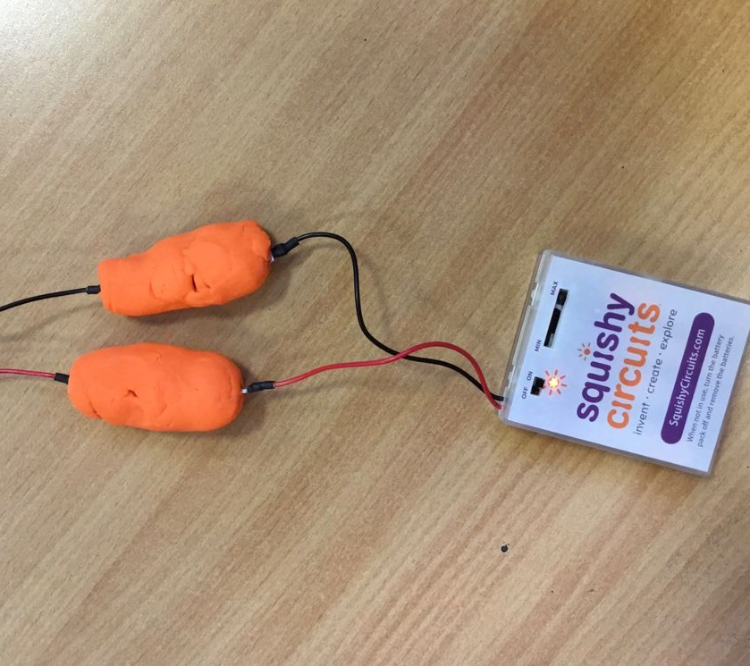
Squishy Circuits "Getting Started"
Our teacher told us to use an app called squishy circuits. We went through the getting started tasks. Here are some pictures.

Slide 9
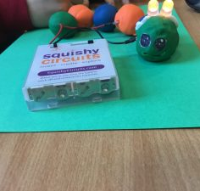
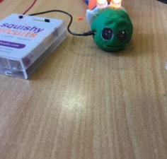
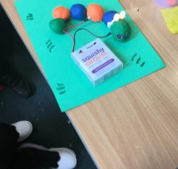
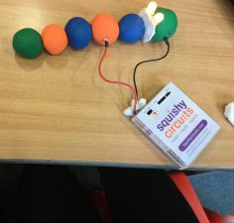
Then what did we do?
Then we proceeded to make a caterpillar out of playdough. It looked very cool.

Slide 10
What happened when we turned the battery pack on
When we turned the battery pack on the lights turned on. The lights acted as the ears.

Slide 11
The process.
For our final project we had to make a scene. We decided to make a kitchen. We started to plan the whole process. We had loads of wonderful ideas, but we decided to only build an oven and a timer. This took a long time. We started by discussing what the inside of the oven would be like. After a lot of testing, we found out our original plan would not work. So, our oven was cardboard and we covered it in grey play-dough. The inside was pink play-dough. The electrical components used was the fan in the oven, the leds in the meatballs and the buzzer in the timer.

Slide 12
Our sway with our time-lapse
Kitchen Circuit

Slide 13
Here are some pictures of our final project-->
Spaghetti and meatballs ------>

Slide 14
Thank you for listening!
byeeeeeeeeeeeeeeeee

