Slide 1
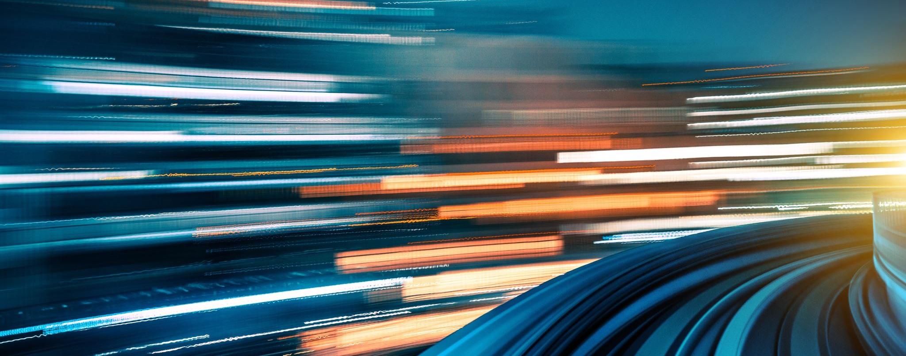
Our circuit journey.
Light Blue Group.

Slide 2
Insulators.
When we got back to school after home learning Mr Reid told us what an Insulator is. An Insulator is something that does not conduct electricity. The materials that do not conduct electricity are wood, plastic and rubber.

Slide 3
Conductors.
Mr Reid also told us what a conductor is. Some people in the class did a PowerPoint on conductors and insulators and we learnt a lot more. The materials that are good conductors are silver, gold, copper, aluminium, mercury, steel, iron, seawater.

Slide 4
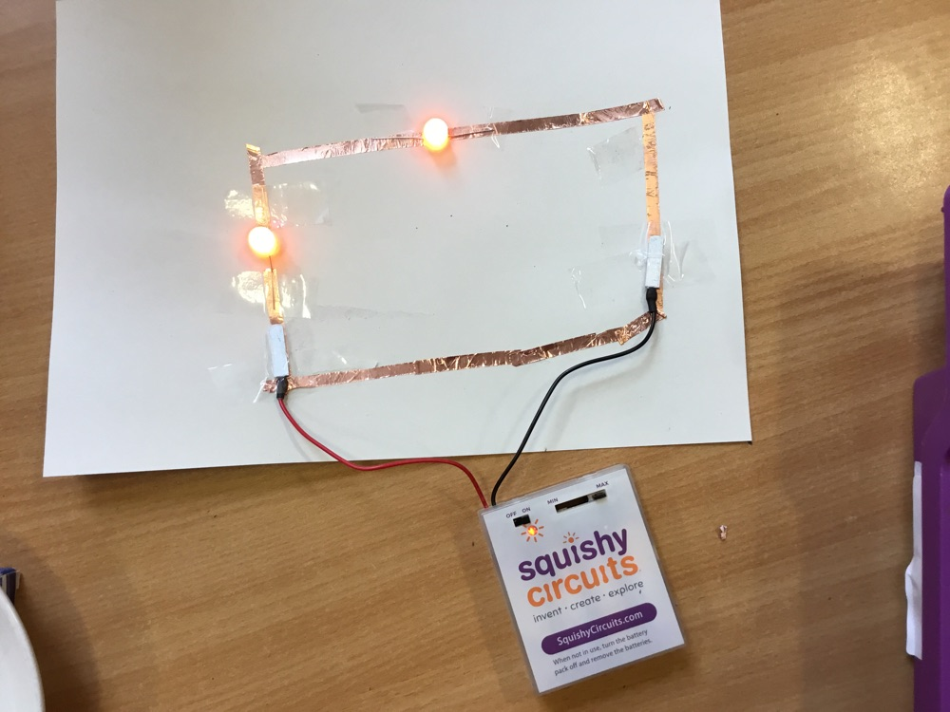
Copper tape circuit.
We made a circuit using copper tape and small L.E.D bulbs and a squishy circuit battery pack to power the circuit.

Slide 5
Using the squishy circuit app
This was our first time using the squishy circuit app. We had to pick a project of the getting started section. Our groups project was to make a whale :)

Slide 6
Here is a picture of our plane
We discussed different ideas and voted on a boat or a plane and we decided to do a crashed plane.
The process of us making our plane started with the sky and the desert island. Then we started to make the plane which took a few attempts. Then we added a bit more detail to our scene.
We added the electrical components by taping the wires together to make it work. When we turn on the battery pack the fan/propeller turned on because the wires were taped together. We did the same to the L.E.D. but the wires were in the playdough the make the bulb work.

Slide 7
Here is a time-lapse of us making our project.
https://blogs.glowscotland.org.uk/as/public/greatlearning/uploads/sites/3534/2021/03/30144326/video-1.mp4
Copy the URL into your internet browser to watch our video! We hope you enjoy.

