Slide 1
Making Thinking Visible
(An introduction)
Notes:
I have been to some sessions on MTV at westhill academy. This

Slide 2
What does thinking look like to you?

Slide 3
Thinking

Slide 4
Disclaimer: *(I am no expert, I have only been to two sessions!)*
Children’s concept of what learning is – different from us and from each other
The Power of Culture – sends messages to everyone in that place “this is what matters here”
With that in mind… what messages are we sending about what learning is?
Notes:
Is learning about getting the right answer, do we dismiss children sometimes? Does every child feel like their opinion is valid? Do they feel rushed to answer?

Slide 5
Classroom Culture
What kind of thinkers / learners do we want our children to be?
What kind of habits do we want them to hone?
How conscious are you of the culture/ethos in your classroom?
It speaks loudly – whether we want it to or not!
If you are brave enough – ask your children… “what do you think I want for you as learners?”
Notes:
This will be different in every school, every classroom. Age/stage dependent. I personally want to promote independence and try to give the children lots of ways to try and solve problems/find answers that will be their first ‘port of call’ – I don’t want their first move to be coming to me to wait in a queue!
Hopefully the children will take these routines out of the classroom.

Slide 6
Thinking Routines
These are designed to be embedded into our practice so that (eventually) the children build up a bank of thinking routines they can use independently – no matter what the subject / situation.
See / Think / Wonder is one of the routines we’ve been ‘taught’ and I have used it with the children and I used it with the parents at the curriculum showcase.
Ian uses it with the children at assembly regularly!
https://www.youtube.com/watch?v=ziaYE5S4Po8

Slide 7
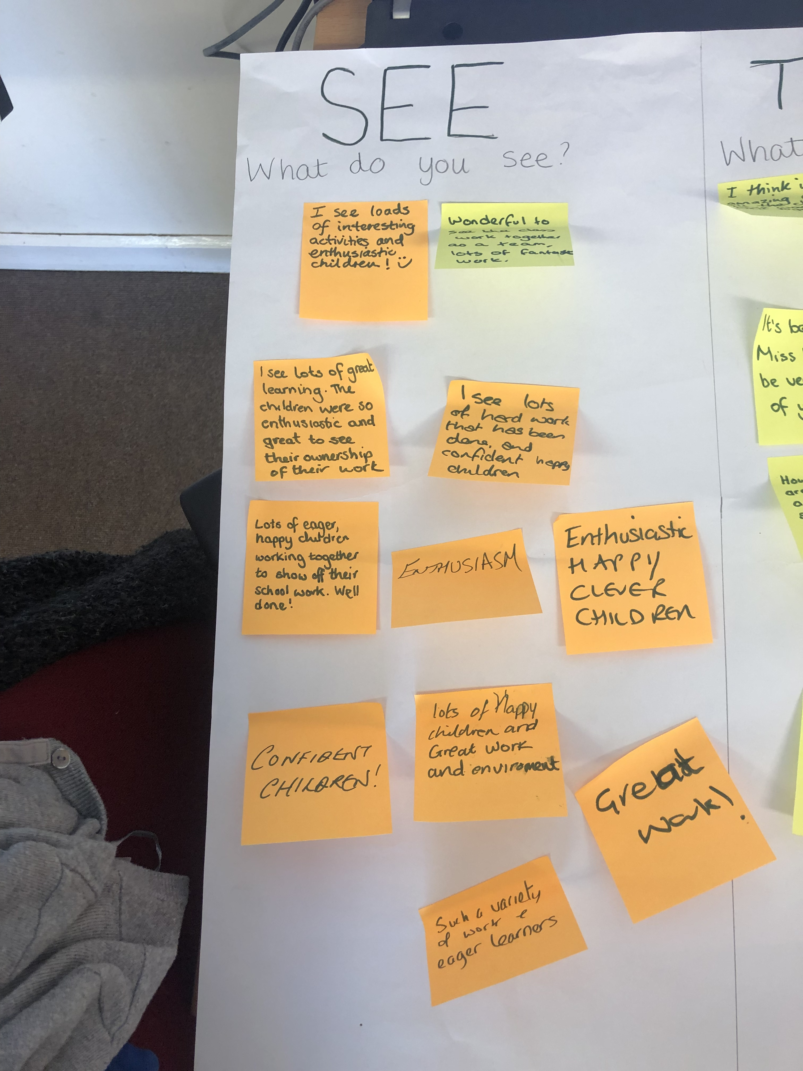
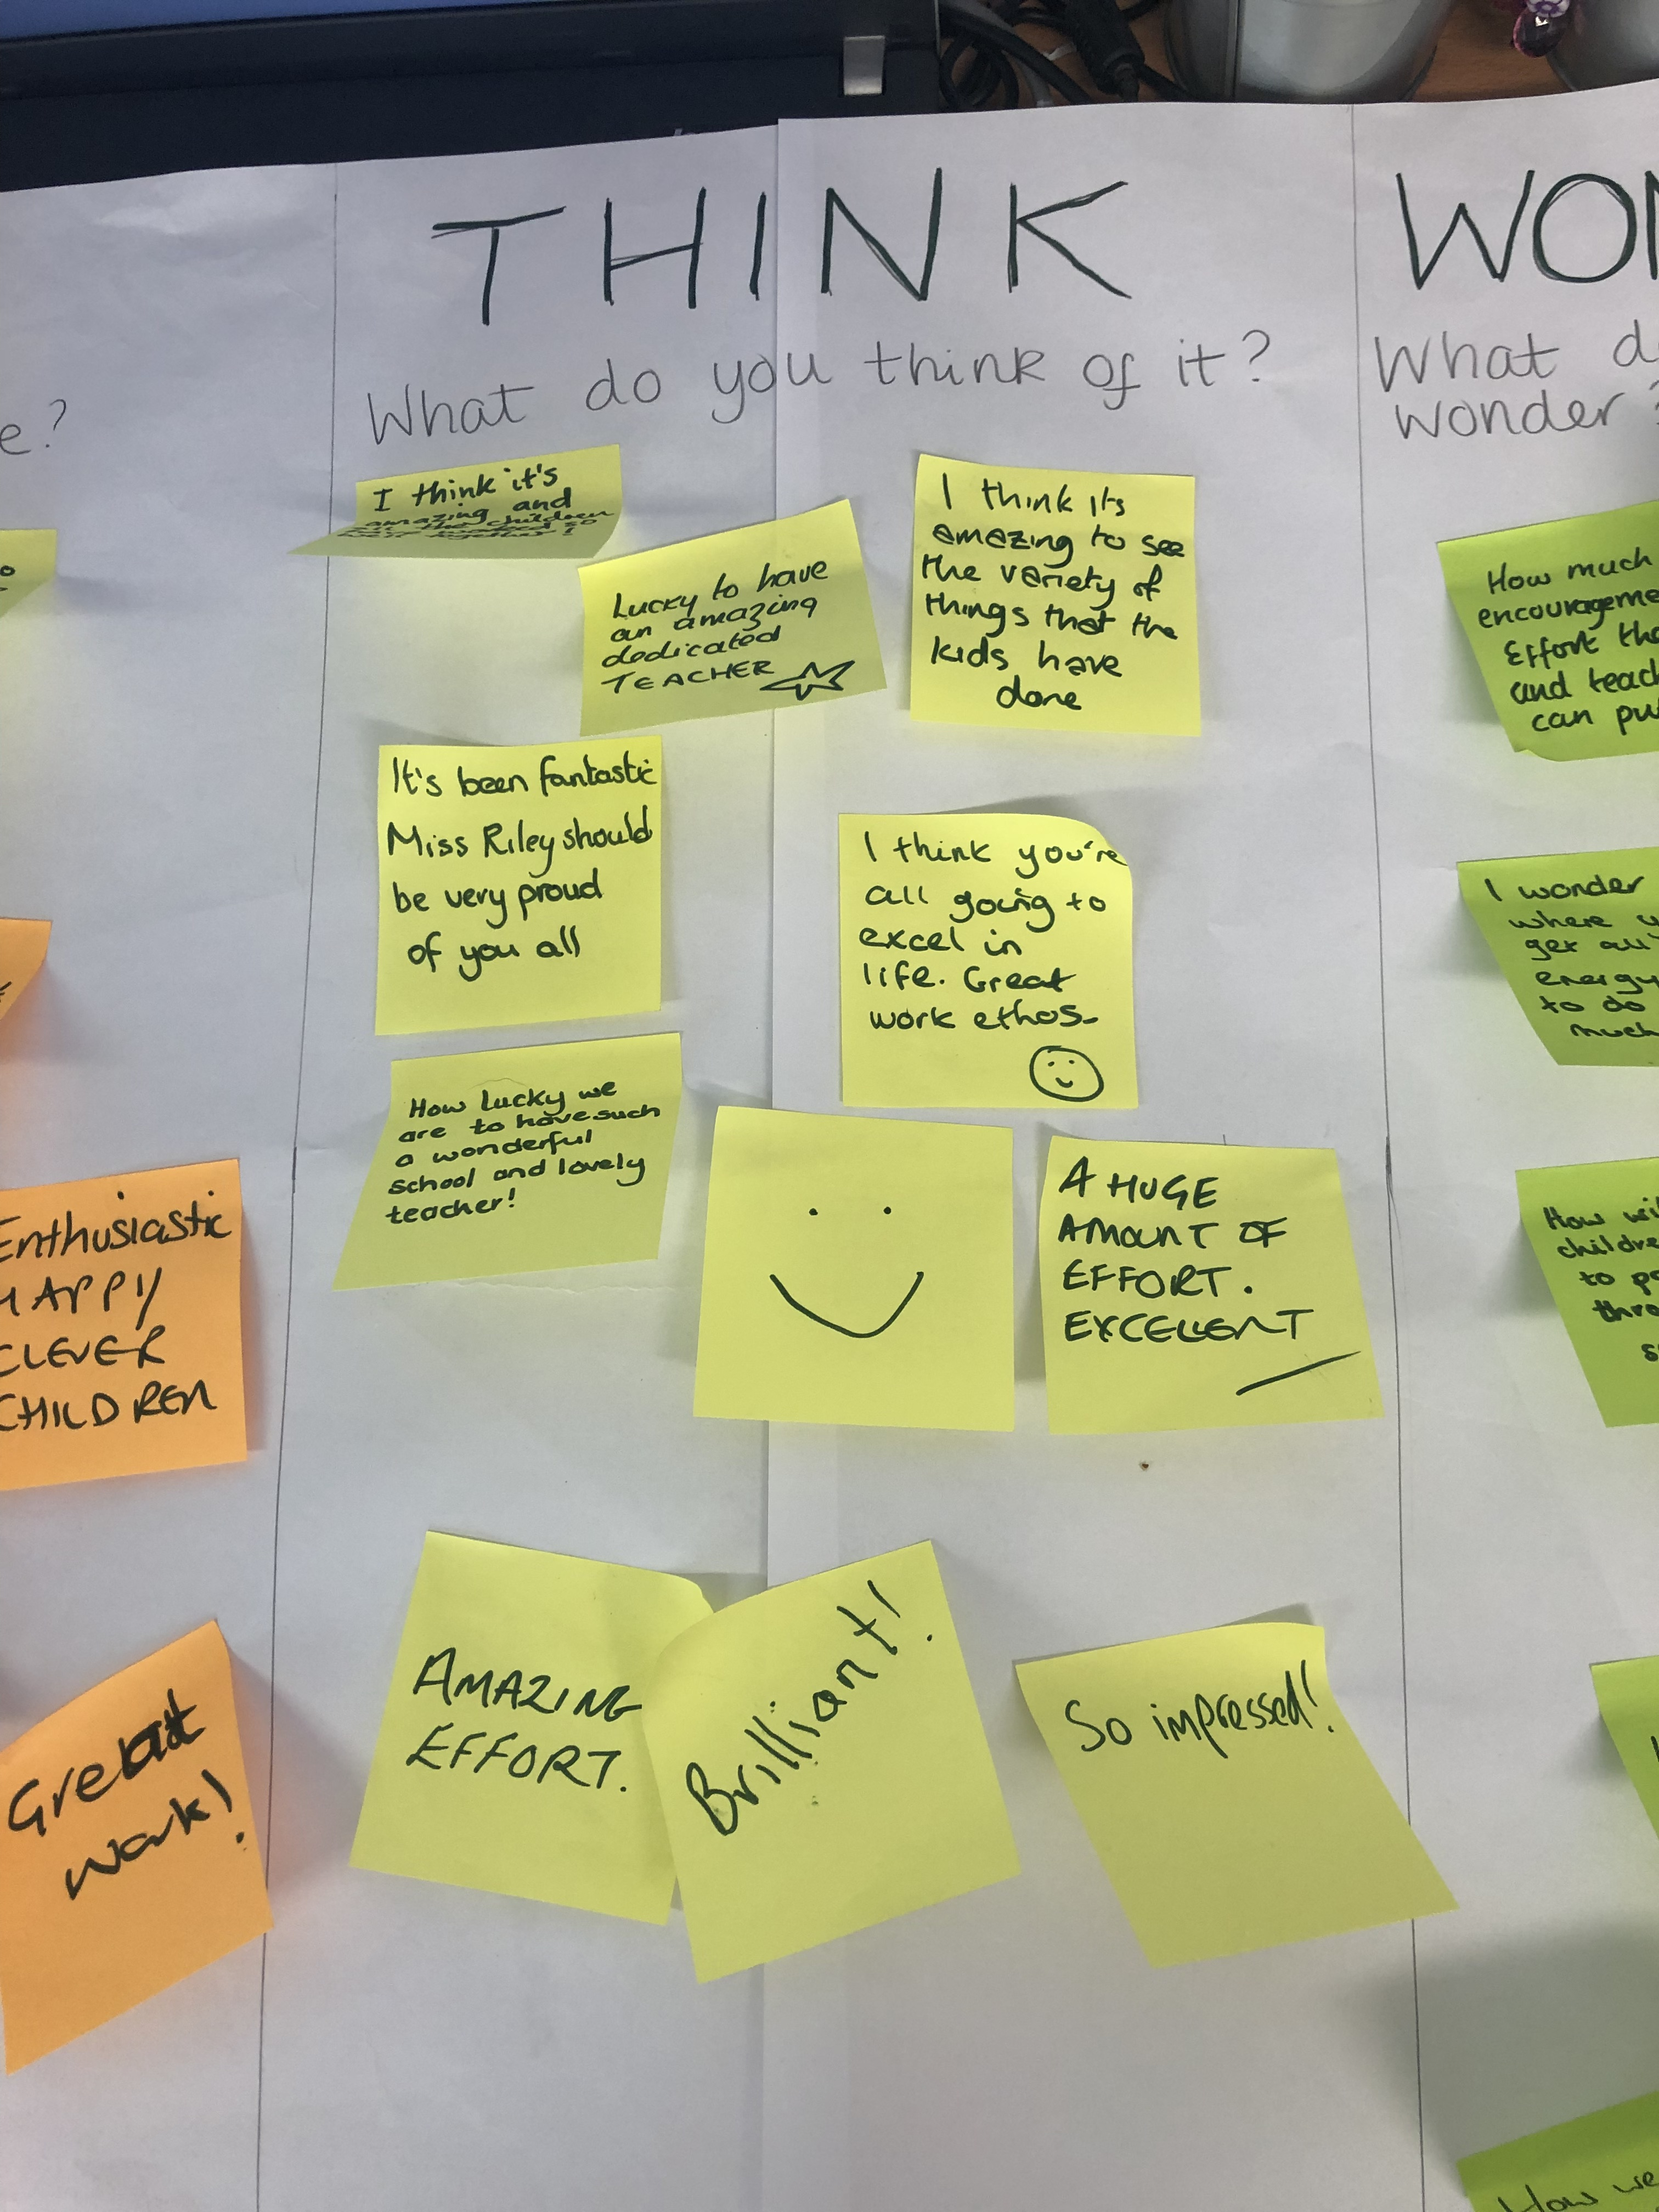
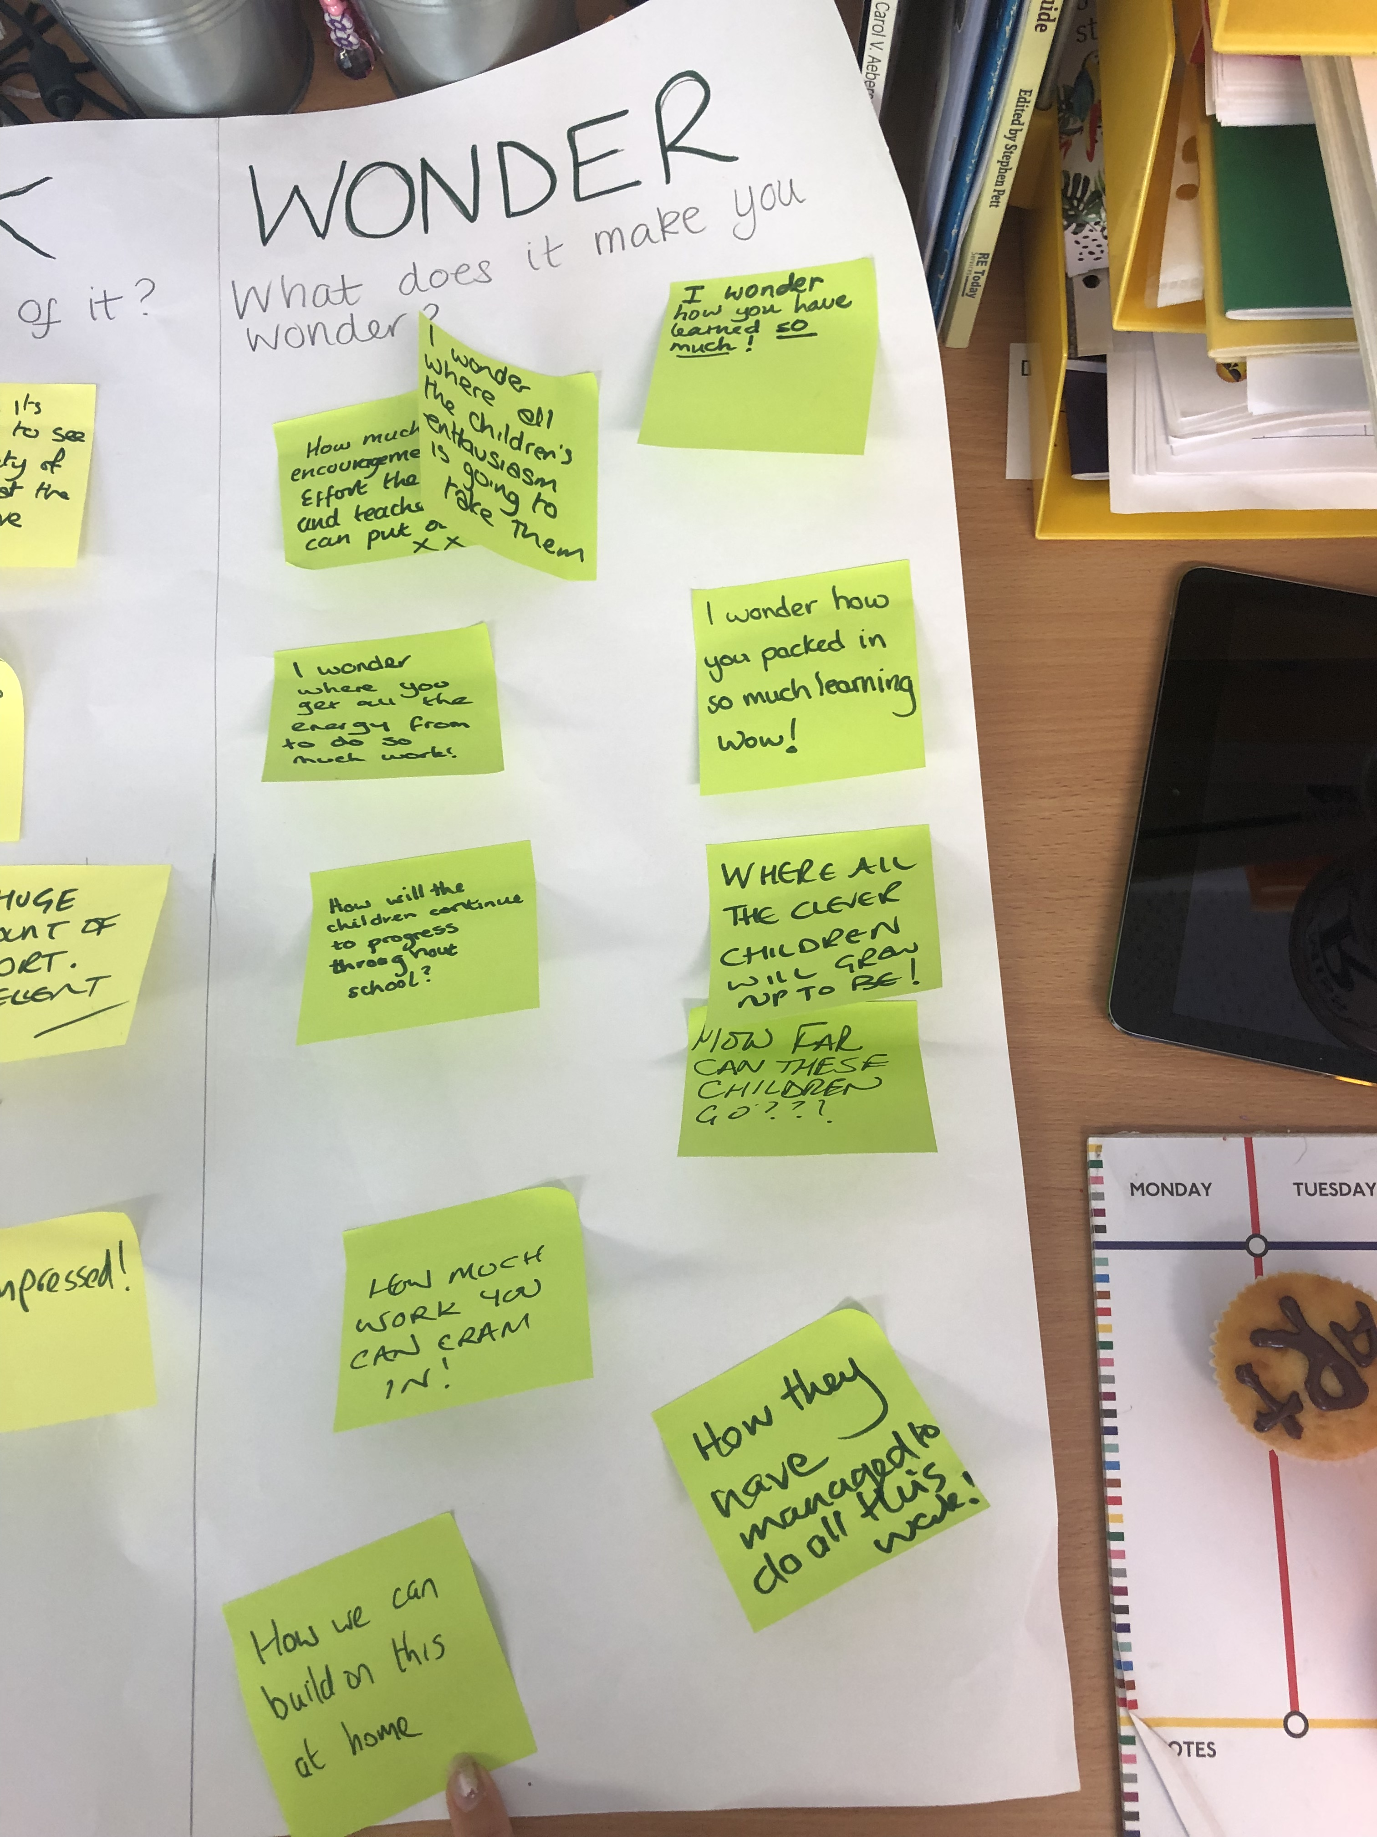

Slide 8
SEE / THINK / WONDER
*Show your class a picture*
What do you see? “I see…”
There is no right or wrong answer!
So what does that make you think? “I think”
What makes you think / say that?
What does it make you wonder about that? - ‘wonder’ helps kids to form deeper questions – H.O.T
Inference – what is the bigger picture?
Read between the lines!

Slide 9
SEE / THINK / WONDER
You need to leave time for your kids to think/form an opinion for this to ‘work’
Although it may never feel like it in our jobs, time is the best resource we have!
This thinking routine helps the invisible to manifest.
When you use these – everyone is on a level playing field! – not about right or wrong. Everyone’s opinion is justified (within reason – I can think of a few random remarks from my class already!)
Try to keep your responses to children’s answers equal/fair
Notes:
Think of a routine as a certain pattern of behaviour you want to become second nature. For example – a fire drill is a routine. This is a tool used over and over again.
These routines should be a structure through which students initiate, explore, discuss, document and manage their thinking.
Keeping responses equal – not always easy!!

Slide 10
Compass Points
E – excitement
W – worries
N – needs
S – steps /suggestions
Notes:
I cant access any of the videos on ALDO for some reason. This was modelled in an autism unit in a Scottish school with P7’s as transition for moving up to high school.
She started on a positive note with Excitement. They could see each others points of view and managed to alleviate their worries.
I thought I could use it in HWB, at the start of a new block of maths, to get feedback from parents etc.
Might also be good for the children to put themselves in others shoes!

Slide 11
Self-assessment

