Slide 1
Catterline 23-25 Eco Vote

Slide 2
Biodiversity, MOre Gardening more time in nature and creative mindset.
Kids and teachers want to have a creative mindset where we create, build and make things together, while relaxed, happy and enjoying fun and learning outside.

Slide 3
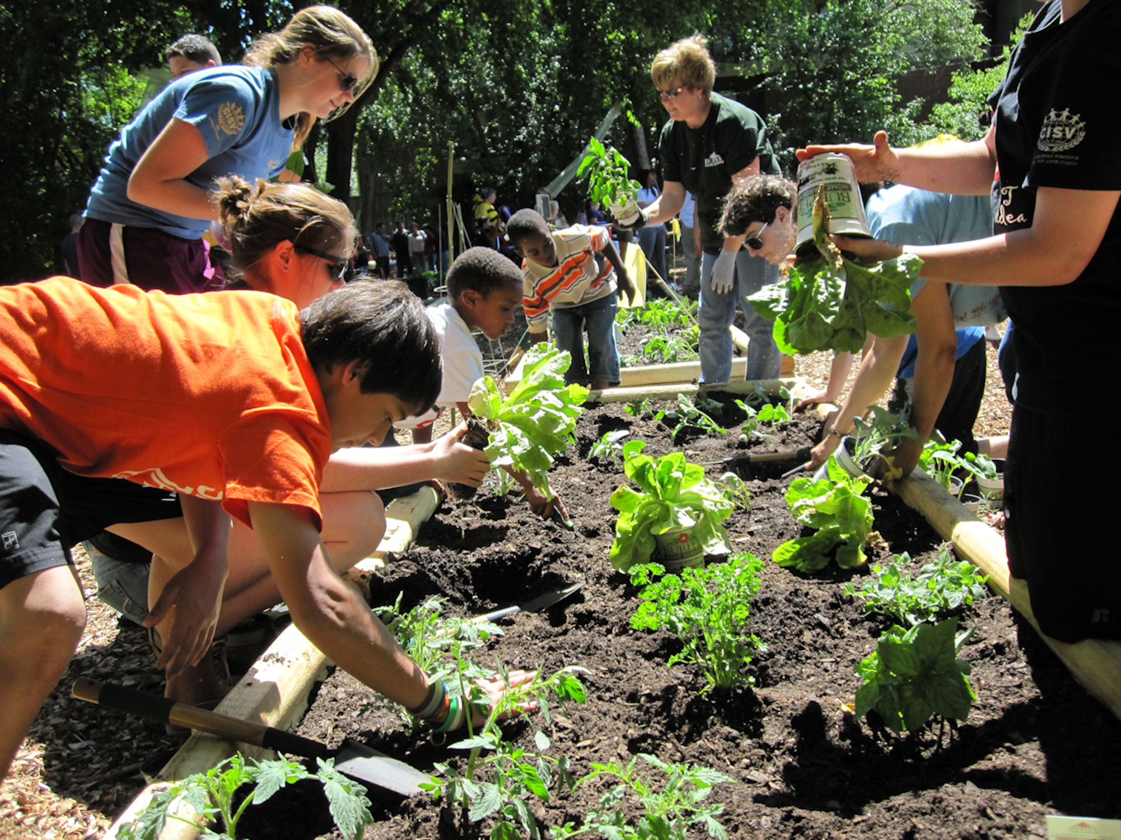
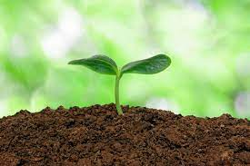
Food and the Environment
We want everyone to get to grow and cook food,
We want to learn about what makes our soil healthy.

Slide 4
Global citizenship
We want to learn about life all around the world for different people and try and help by learning about charities and helping others.
This Photo by Unknown author is licensed under CC BY-NC.

Slide 5
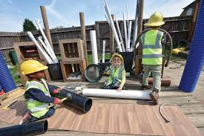
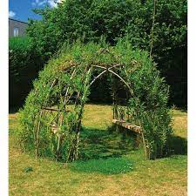
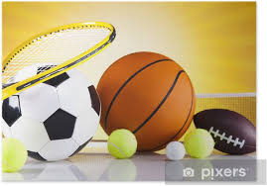
School grounds
In our school we have a shortage of play equipment wouldn't it be nice to have more stuff for our play ground.
A willow tunnel would be amazing for reading groups and a quiet space just to chill.

Slide 6
Climate Action
We want to learn about climate action
We can learn about saving energy
We can also learn about rethink, reduce, reuse, repair and recycle

