Slide 1


Planning STEM through Stories

Slide 2
Step-by-Step Guide on Planning
Step1
Read the book and take notes of learning experiences as you go along

Slide 3
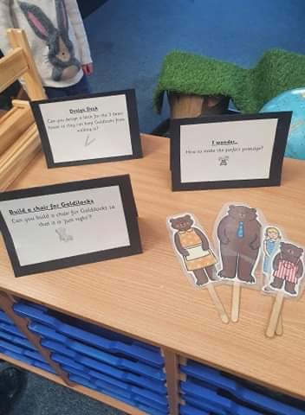

Slide 4
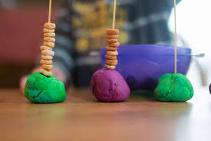
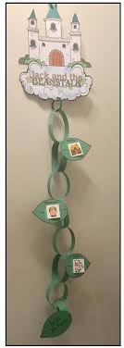
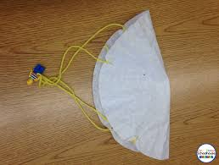
Use the green paper to create a paper chain beanstalk for Jack to climb down. It should be strong enough for him to climb down and reach the ceiling.
Using the materials on the table create a parachute to help Jack escape from the giant quickly.

Slide 5
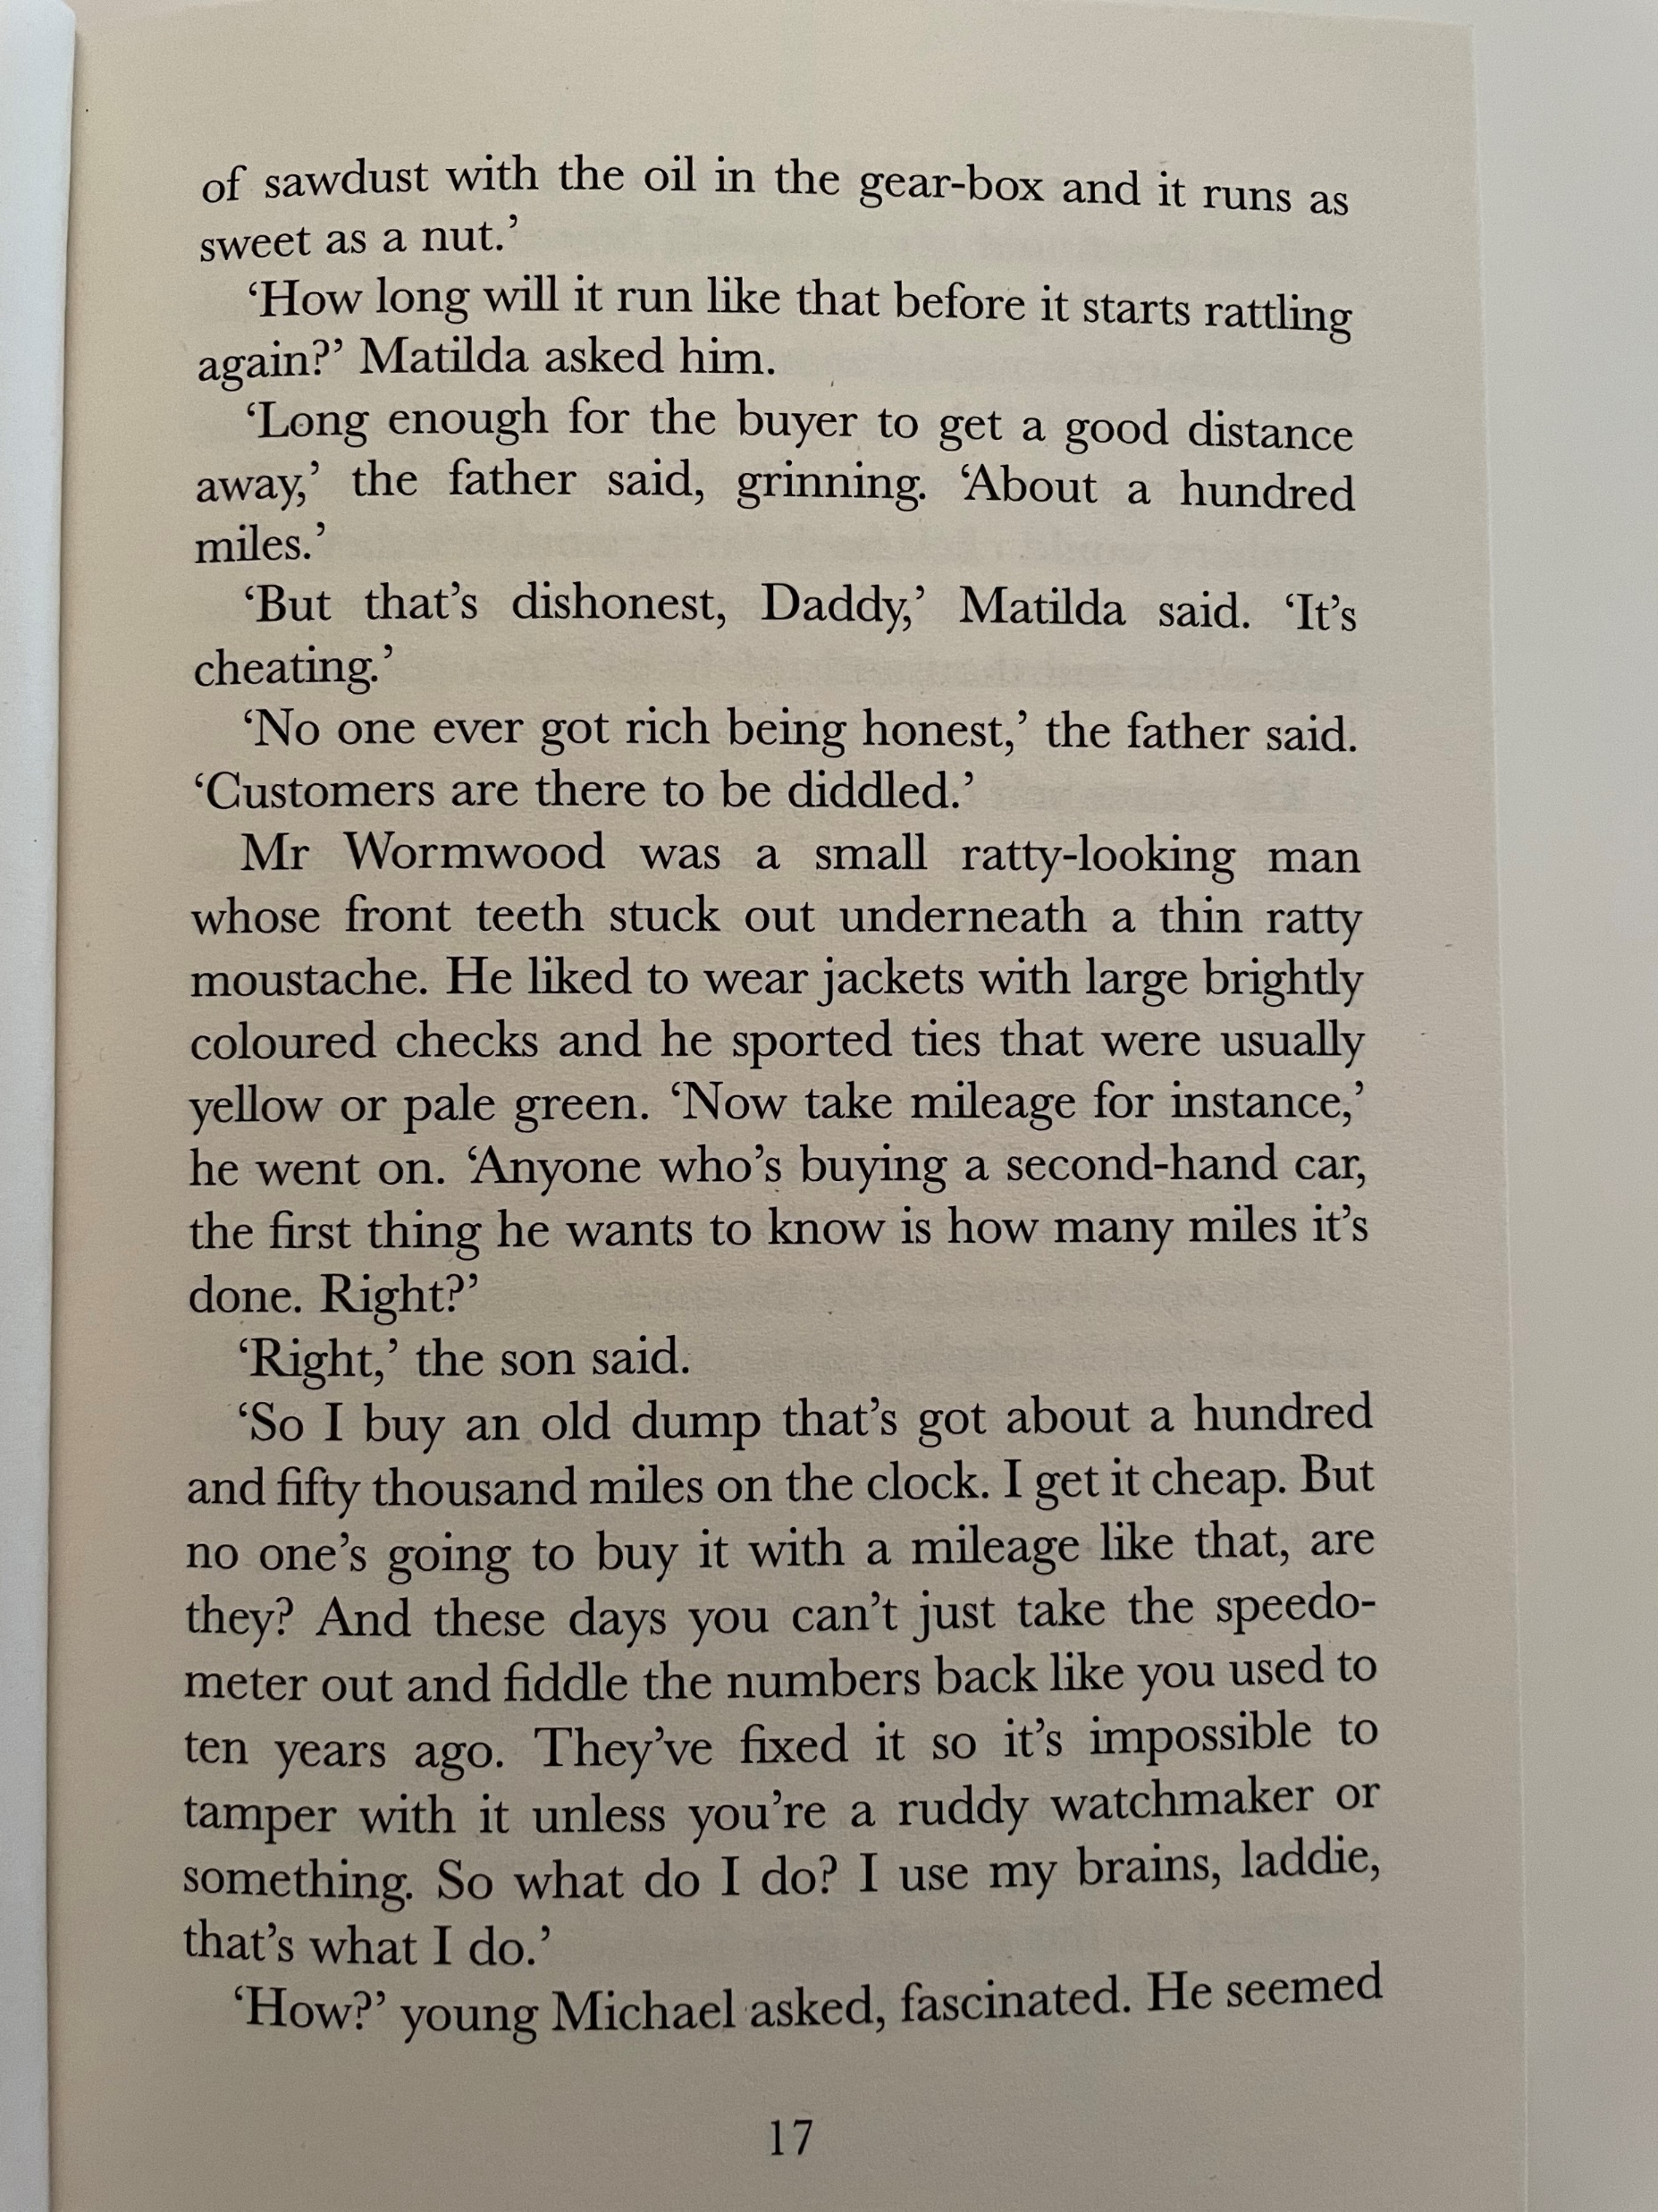
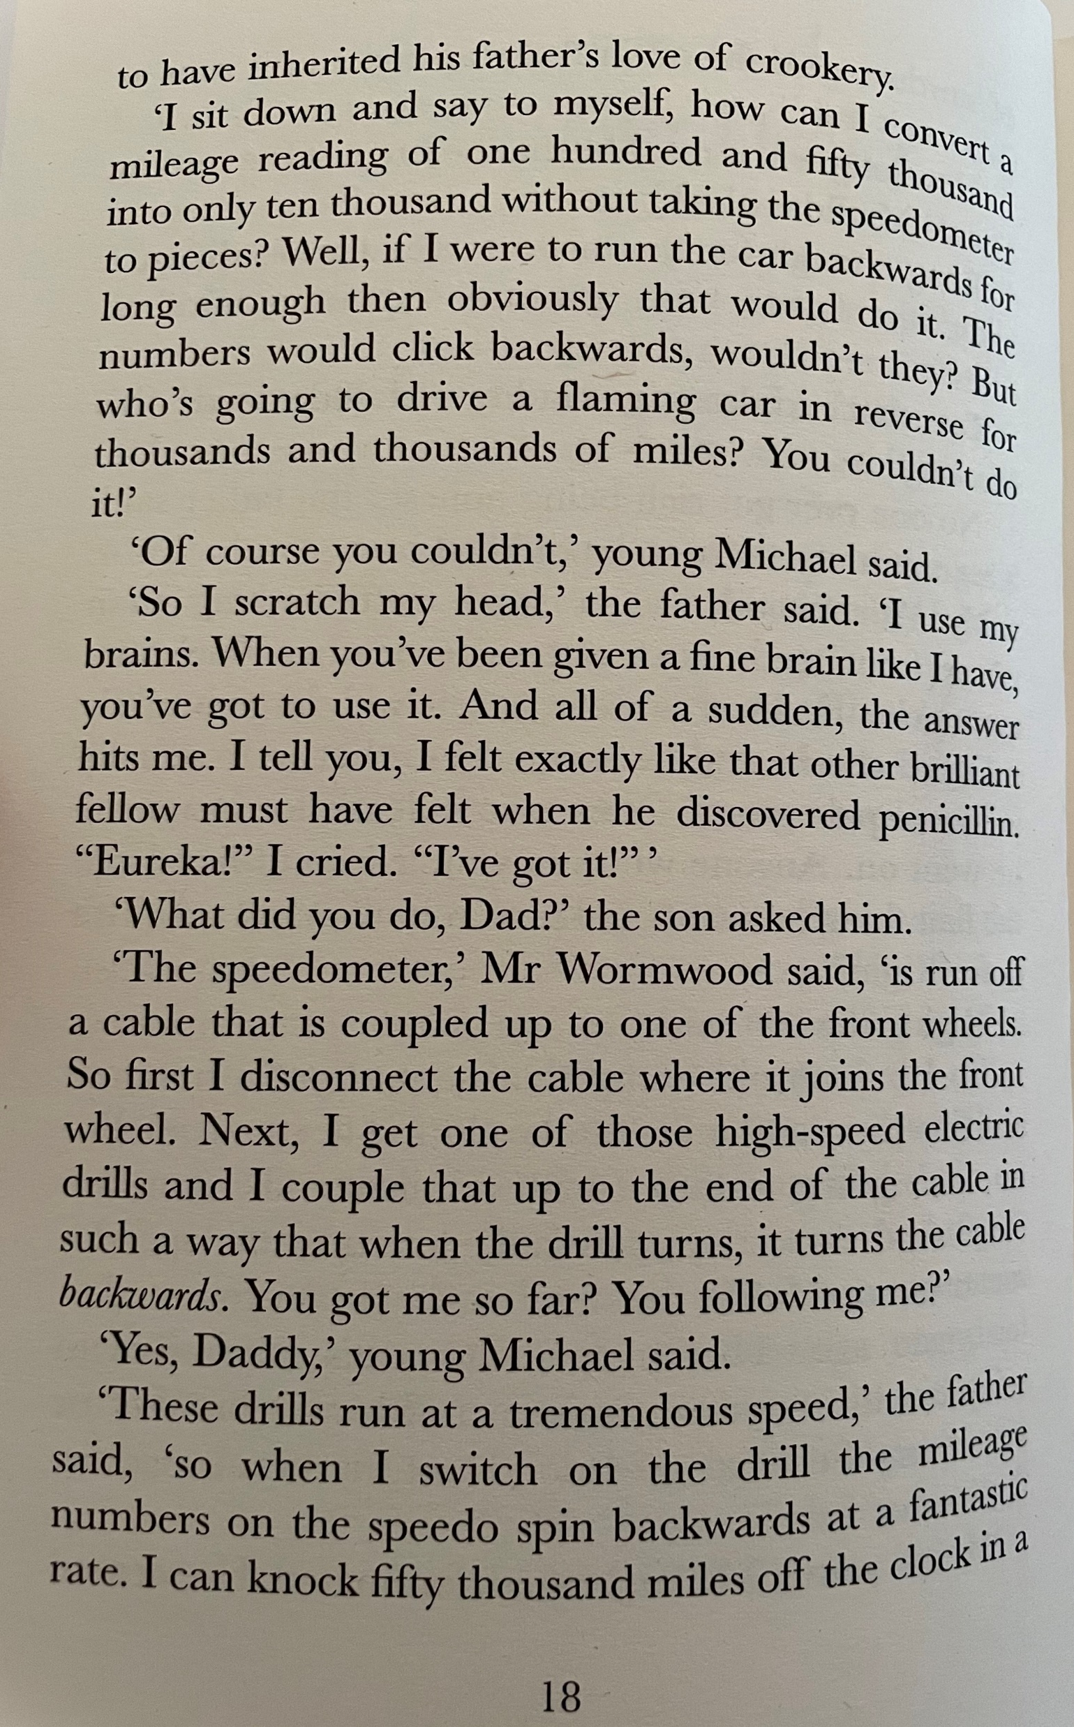
Inheritance
Visualiser

Slide 6
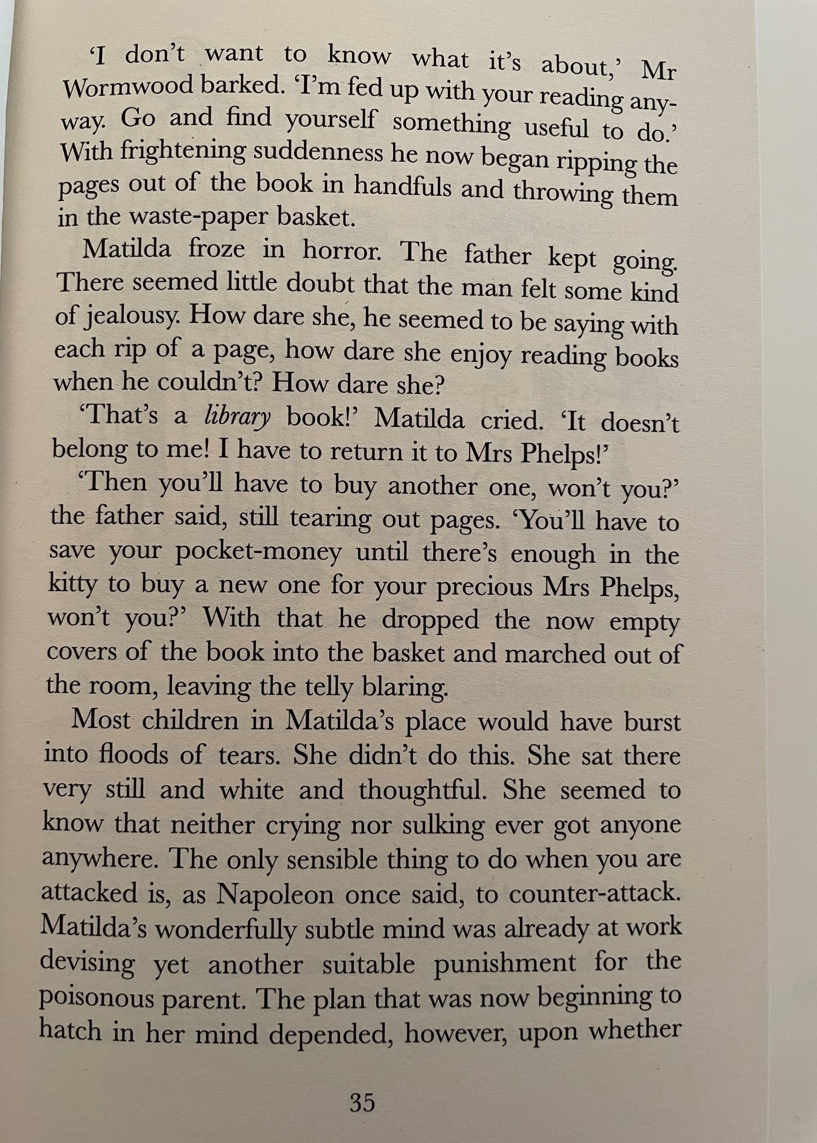
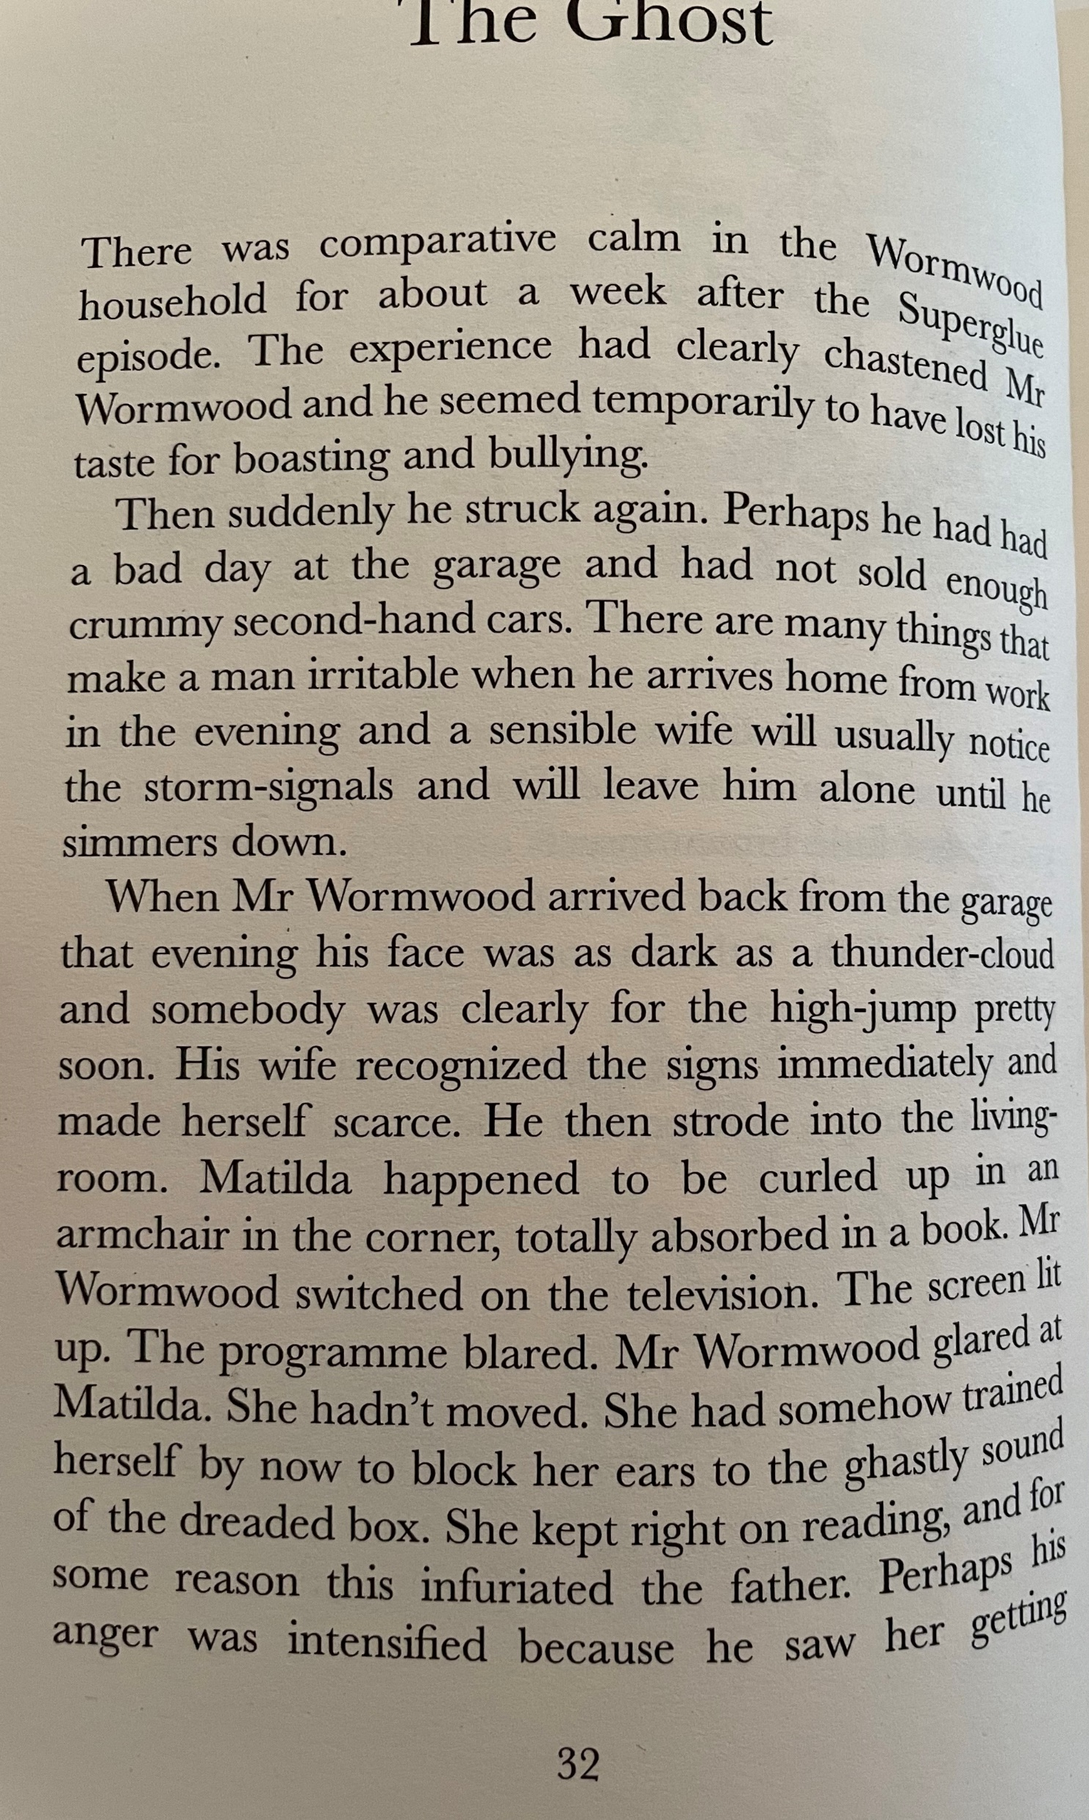
Types of language – why is using ‘barked’ more effective than ‘said’?
Similes

Slide 7
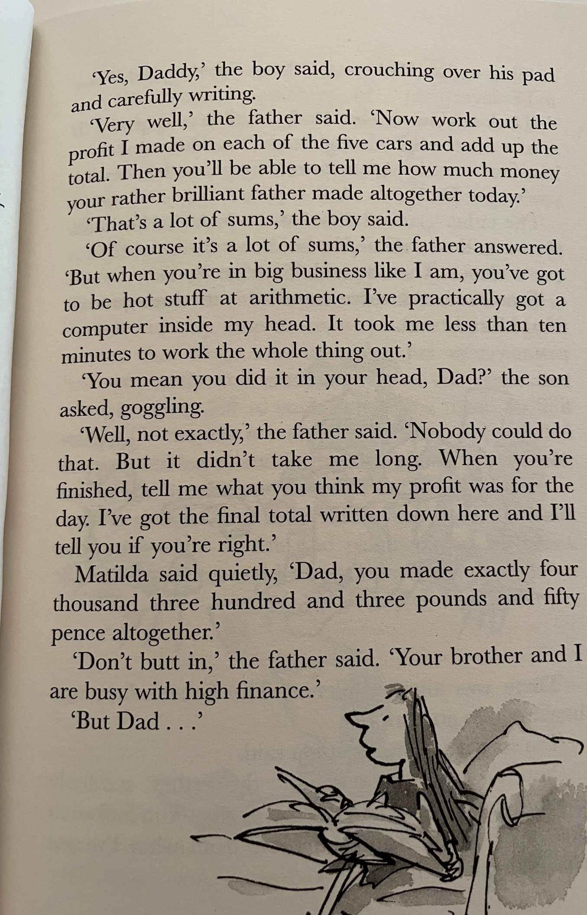
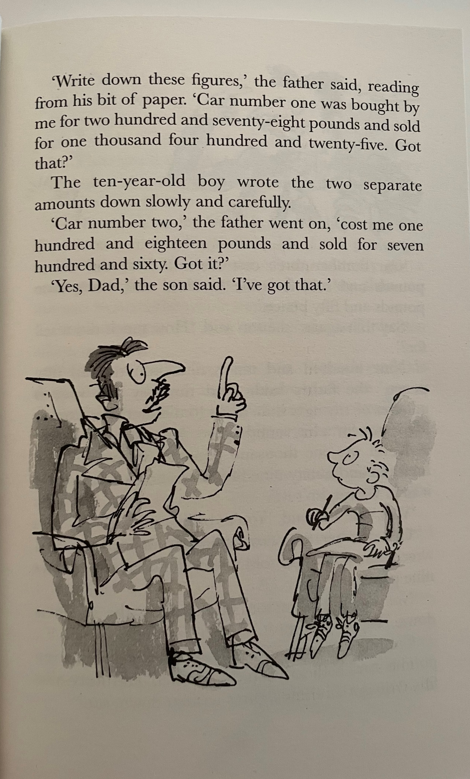
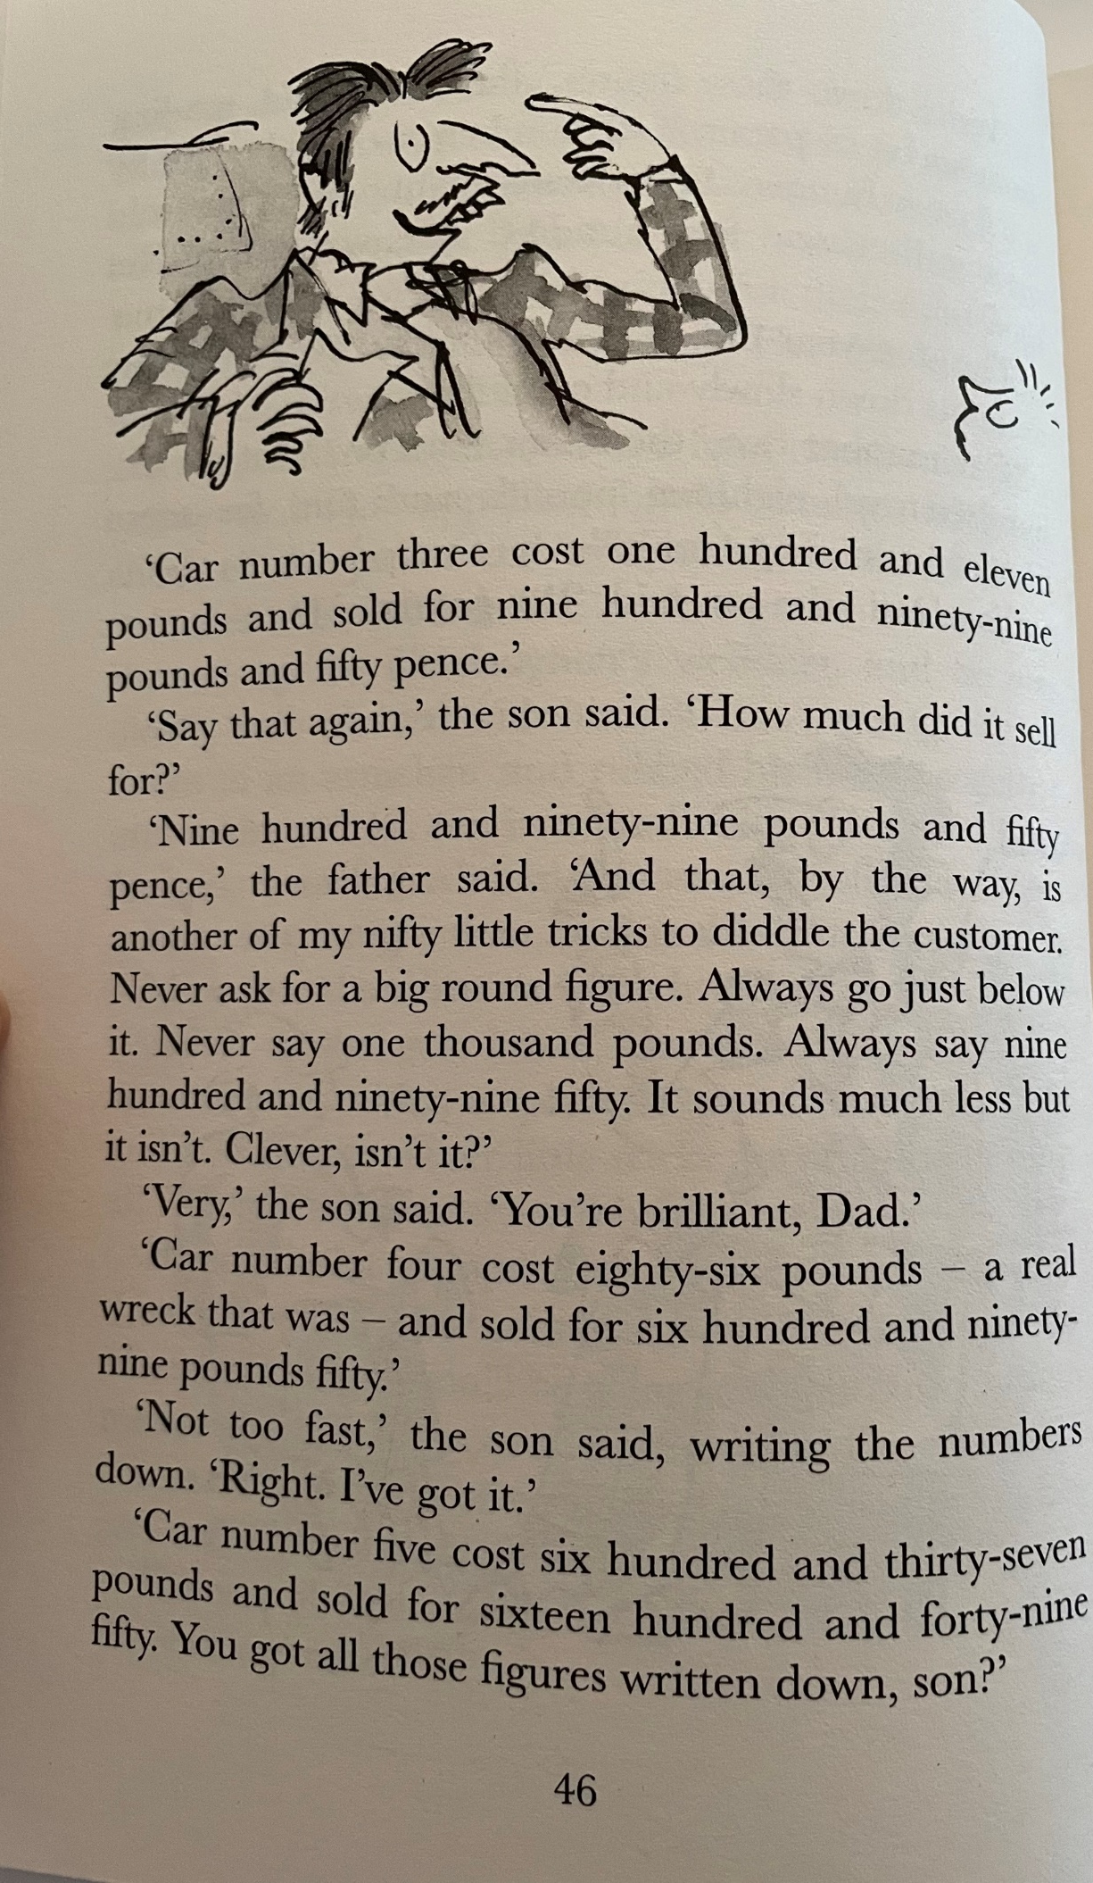

Calculating profit

Slide 8
Step-by-Step Guide on Planning
Step 2
Look for any additional resources to support learning when introducing something new

Slide 9
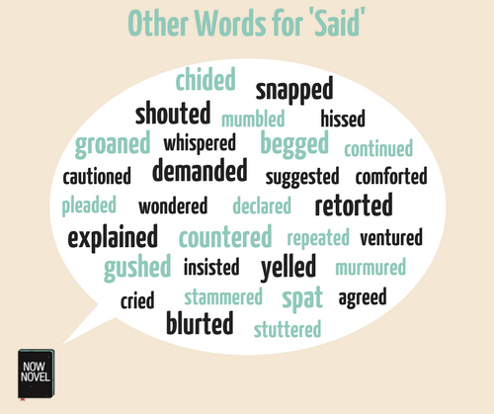

Slide 10

SIMILES
The moon glowed like . . . . . .
Raindrops dripped down the window pane like . . . . . .
Smoke floated on the air like . . . . . .
The air smells as fresh as . . . . . .
The rose petals are as delicate as . . . . . .
The surface of the water is as smooth as . . . . .
The icicles pointed downwards like . . . . . .
The fog covered the city like . . . . . .
The clouds are as fluffy as . . . . . .
Similes
A simile compares two things, using as or like.
The teacher was as wise as an owl
Similes
She runs like the wind

Slide 11
Step-by-Step Guide on Planning
Step 3
Create a sequenced plan linking to Experiences and Outcomes

Slide 12
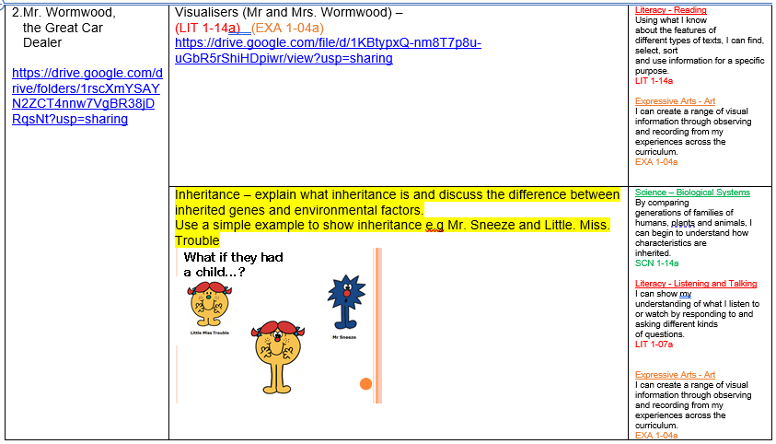

Slide 13
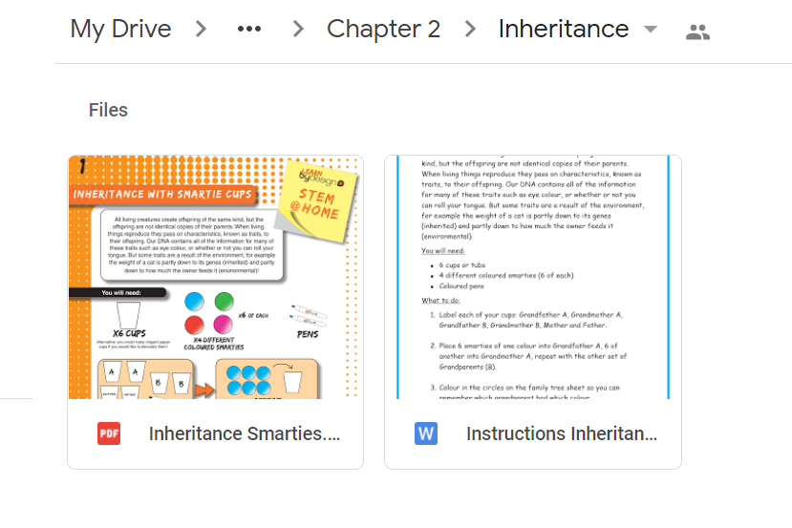

Slide 14
Remember…
These are only SUGGESTED learning experiences, the children in your class may want to take things on a completely different learning journey and that’s perfectly fine.

Slide 15
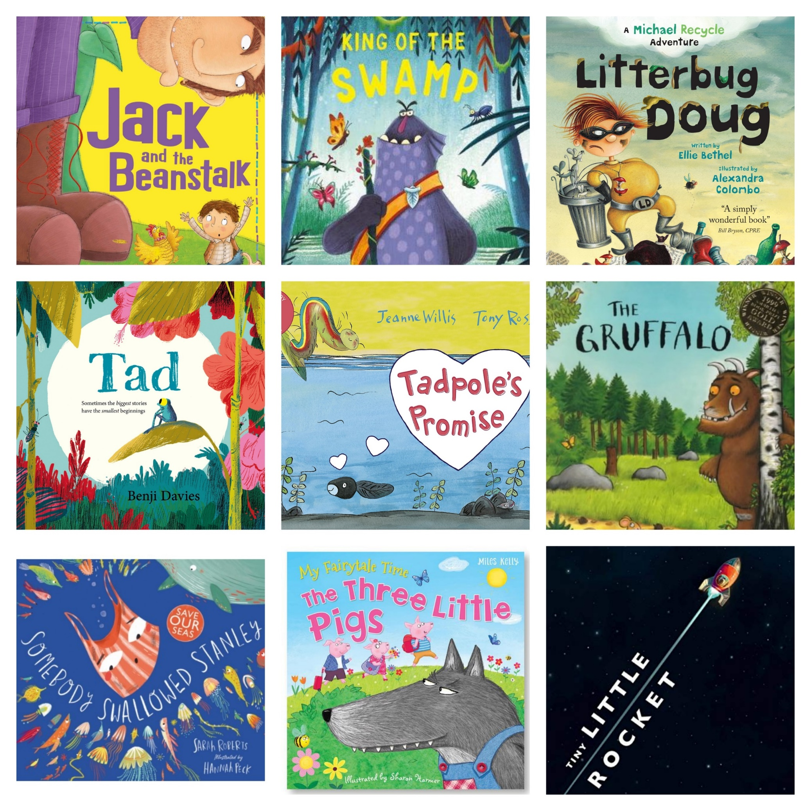


Early Level

Slide 16

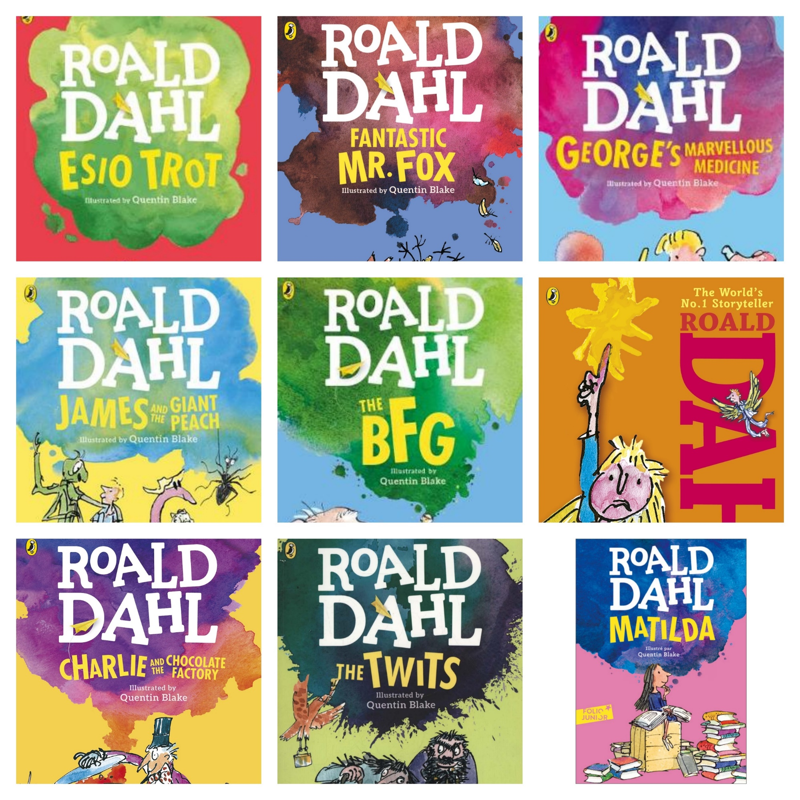


First Level

Slide 17






Second Level

Slide 18

All planners can be accessed on the Google Drive
https://drive.google.com/drive/folders/1vIA47m6m1oh1Qq4HUGDNc6I2UU4-_5za?usp=sharing

Slide 19
Any questions?

