Slide 1
First, read the story with your child or watch it together here:
Whatever Next! Stories read aloud - YouTube.
Then discuss:
1. What do you both like about it?
2. Are there any parts you didn’t like? Why?
3. Can you both think of a different ending?
4. What do you think Baby Bear’s next adventure might be?
Next look at the STEM challenges based around the story - feel free to do any or all of these!
You can draw/write or take pictures so they can be shared with the class!

Slide 2
What is STEM and why is it important?
STEM stands for science, technology, engineering and maths. These subjects give young people important skills for their future lives and work.
The skills which come from doing STEM subjects are used in many different jobs: from cooking to commerce; finance to farming; apps/game development to animal welfare and brewing to building. Some jobs might be STEM-specific, for example developing new food and drink products or calculating the likelihood of rain tomorrow.
Others might be in a STEM-type workplace, for example a librarian in a medical school or a lawyer in an energy company.
Whether or not young people end up working in a STEM job or workplace, they need the skills which STEM subjects give them. Employers are looking for young people with these skills, but there’s a big shortage (skills gap).
You can find out more here:
Supporting science, technologies, engineering and mathematics (STEM) at home | Learning at home | Parentzone Scotland | Education Scotland
You can foster STEM skills at home by encouraging observation, curiosity, creativity and problem-solving and by building simple projects using household items/recycled materials; examples of the kinds of activities that could be done to help support STEM learning at home are those suggested in this pack.
Look at the STEM challenges based around the story, feel free to do any or all of these!
You can draw/write or take so that you can share these with your class!
We would love to know how you got on – if you would like to, please write a comment in the ‘feedback sheet’ ☺

Slide 3
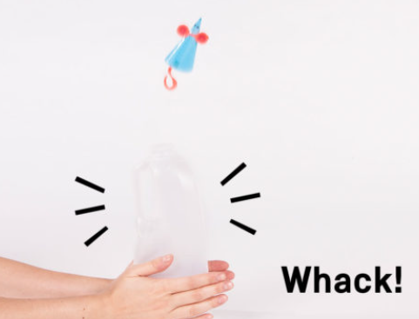
Thinking of new and innovative ways of using things by creatively problem solving and adapting are key habits of mind in engineering
Engineering
Baby Bear turns an old box into a rocket. Can you find a box and turn it into something new and useful?
Draw some of your ideas or make your model and take some pictures!
Science: Forces
Make Baby Bear a rocket to help him get to the moon!
You will need an empty, washed milk carton, things to decorate your rocket (pens, feathers, glitter, coloured paper etc), scissors, sticky tape and a piece of paper.
Make a cone shape from the paper that fits over the top of the milk bottle and stick it with tape: this is your rocket.
Decorate your rocket – you could make it into Baby Bear! Put it on to the top of the bottle and hit the sides and launch your rocket into the air!
What makes your rocket fly?
What makes it come down again?
How could you make your rocket travel higher?
How could you make your rocket
go more slowly?
Whatever next!
Engineering & Design
Can you design an astronaut’s spacesuit for Baby Bear to wear during his adventure? What will it look like? You can draw it and label all the different parts and its special features!
Engineering & Design
Can you design a space rocket for Baby Bear? You can draw it and label all the different parts and its special features!
You can do any or all of these STEM activities! Have fun!

Slide 4
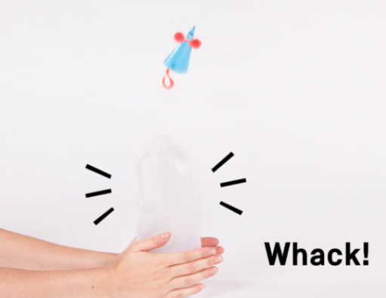
Rocket: What’s the science?
The bottle used as the rocket launcher is not empty: there is air inside it. Air is elastic (squashy), and when you squash it, it pushes back and the air pressure inside the milk bottle increases.
The sudden increase in air pressure inside the bottle pushes hard on the bottom of the rocket, sending it flying high into the air.
Just as increasing the air pressure in the bottle sends the rocket flying, you use air pressure when you squeeze shampoo or ketchup from a plastic bottle!

Slide 5
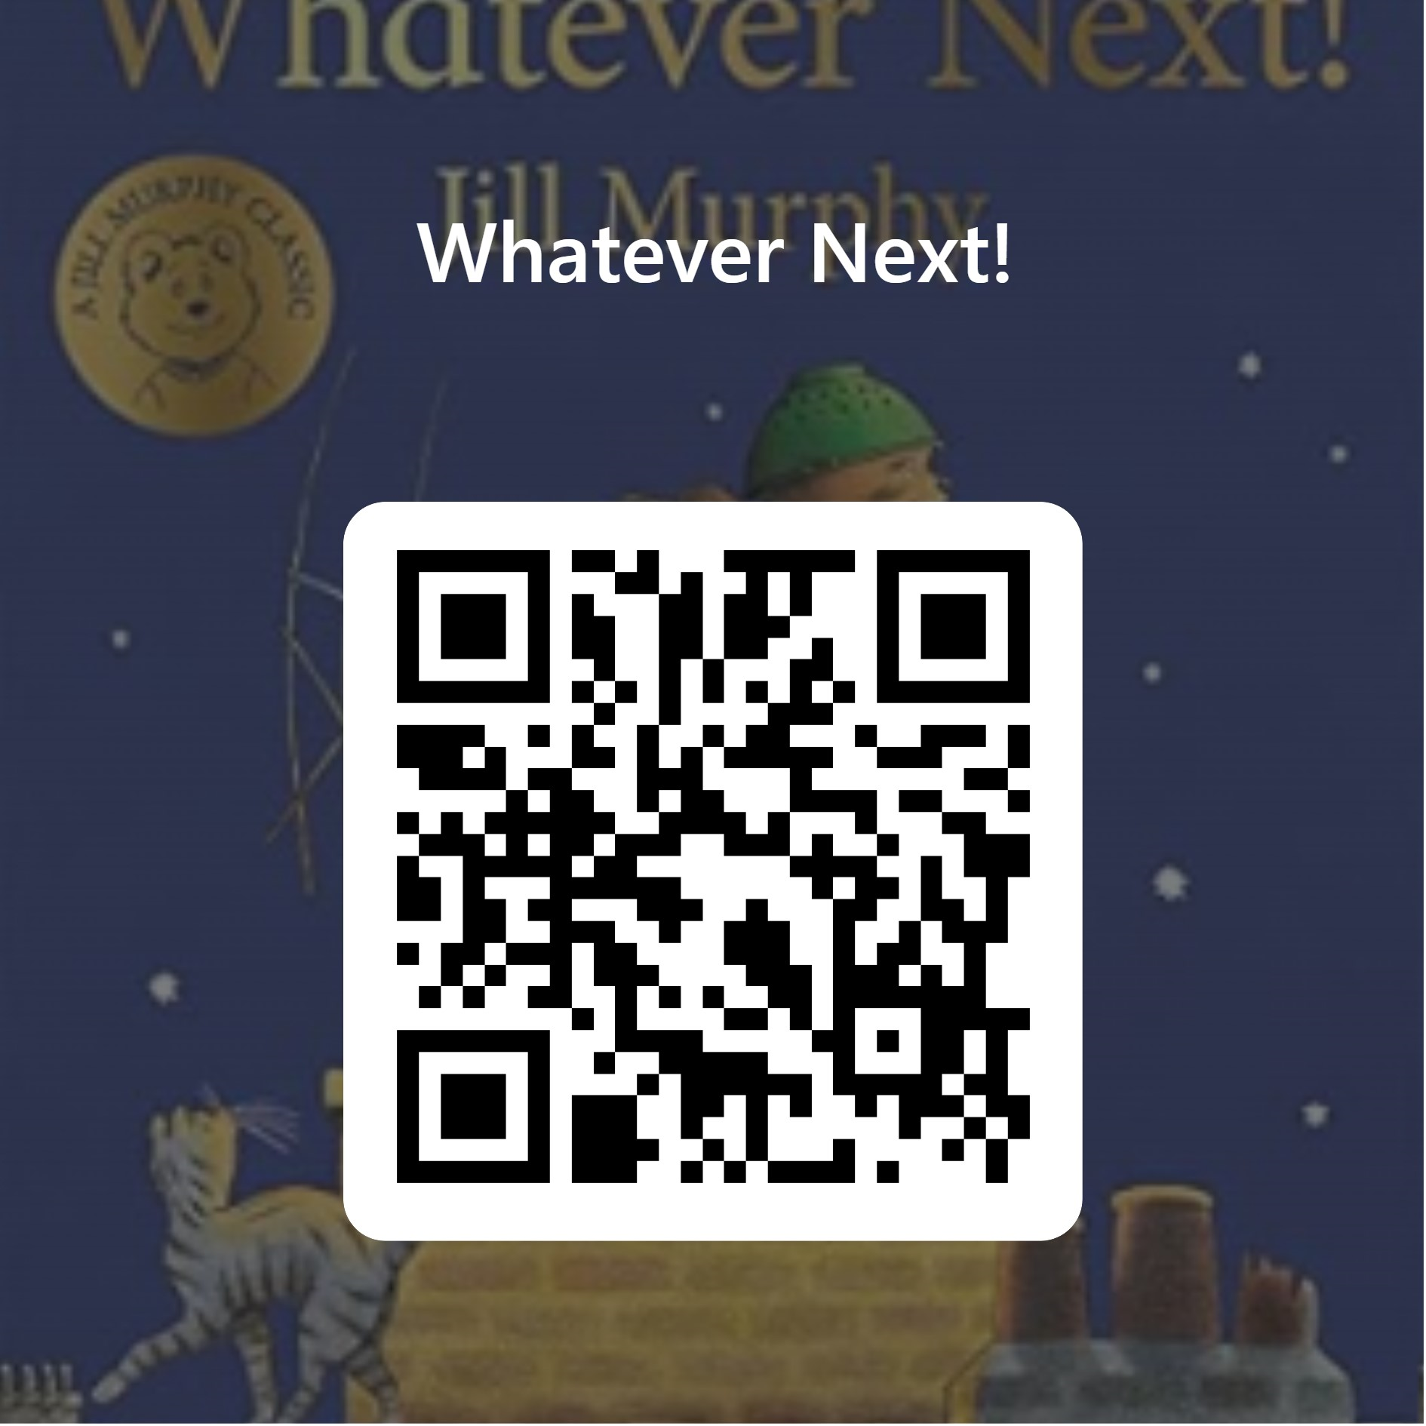
How did you feel using this pack?
We would love to know how you got on and what you thought about this pack.
If you would like to give us some feedback, please either click on the link or scan the QR code and complete the very short questionnaire. Thank you ☺
A paper copy is available too if you would prefer to complete the questionnaire that way.
https://forms.office.com/e/b9NRU3dAsF

Slide 6
How did you feel using this pack?
You
Adult
Any other comments?
Do you have any ideas for other story books to use for STEM challenges/activities?

Slide 7
Some of the Curriculum for Excellence Experiences and Outcomes that these activities may cover
Whatever next!
Curricular area | Outcome
Technologies | Design and Construct Models/Products TCH 0-09a/1-09a/2-09a Representing ideas, concepts and products TCH 0-11a/1-11a/2-11a I can explore and discover engineering disciplines and can create solutions TCH 0-12a/1-12a
Science | Through everyday experiences and play with a variety of toys and other objects, I can recognise simple types of forces and describe their effects. SCN 0-07a | By investigating forces on toys and other objects, I can predict the effect on the shape or motion of objects. SCN 1-07a
Art and Design | Working on my own and with others I use my curiosity and imagination to solve design problems EXA 0-06a | I can use exploration and imagination to solve design problems related to real life situations EXA 1-06a
Literacy | I enjoy exploring events and characters in stories and other texts, sharing my thoughts in different ways. LIT 0-01c
Literacy | To help me understand stories and other texts, I ask questions and link what I am learning with what I already know. LIT 0-07a / LIT 0-16a | I can show my understanding of what I listen to or watch by responding to and asking different kinds of questions. LIT 1-07a

