Slide 1
First, read the story with your child or watch it together here:
The Extraordinary Gardener by Sam Boughton - YouTube
Then discuss:
1. What do you both like about it?
2. Are there any parts you didn’t like? Why?
3. Look at the double page of Joe’s world. What do you both notice? Can you spot Joe?
Next look at the STEM challenges based around the story - feel free to do any or all of these!
You can draw/write or take pictures so they can be shared with the class!

Slide 2
What is STEM and why is it important?
STEM stands for science, technology, engineering and maths. These subjects give young people important skills for their future lives and work.
The skills which come from doing STEM subjects are used in many different jobs: from cooking to commerce; finance to farming; apps/game development to animal welfare and brewing to building. Some jobs might be STEM-specific, for example developing new food and drink products or calculating the likelihood of rain tomorrow.
Others might be in a STEM-type workplace, for example a librarian in a medical school or a lawyer in an energy company.
Whether or not young people end up working in a STEM job or workplace, they need the skills which STEM subjects give them. Employers are looking for young people with these skills, but there’s a big shortage (skills gap).
You can find out more here:
Supporting science, technologies, engineering and mathematics (STEM) at home | Learning at home | Parentzone Scotland | Education Scotland
You can foster STEM skills at home by encouraging observation, curiosity, creativity and problem-solving and by building simple projects using household items/recycled materials; examples of the kinds of activities that could be done to help support STEM learning at home are those suggested in this pack.
Look at the STEM challenges based around the story, feel free to do any or all of these!
You can draw/write or take so that you can share these with your class!
We would love to know how you got on – if you would like to, please write a comment in the ‘feedback sheet’ ☺

Slide 3
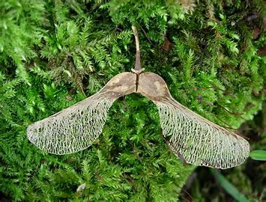
Thinking of new and innovative ways of using things by creatively problem solving and adapting are key habits of mind in engineering
Engineering
Can you design a birdfeeder? Draw some of your ideas and/or make it from recycled materials/unwanted household items and take some pictures!
Science
Some trees such as Ash
trees and Sycamore trees
have ‘helicopter seeds’
which are a type of seed that spin as they fall from a tree. The spinning movement and the fact that they are light and can catch the wind takes them further from the parent tree than if they just dropped to the floor. This helps the trees to grow in new places so that they aren’t crowded together and competing for light, water and all the things that they need from the soil to grow into healthy plants. This means new seeds have more space and a better chance of growing into a new tree.
Can you make your own ‘seed helicopter’ and watch as it spins to the ground just like the seed?
(Please see next page for instructions)
Science
Look inside an apple and grow a tree! Cut an apple in half and draw a picture of the seeds inside. You could try planting them in a small pot like Joe? You will need to look after the seeds and to wait – they may take a long time to grow, or they might not grow at all!*
The Extraordinary
Gardener
Engineering & Design
Can you design your own garden space full of extraordinary things? What will grow? What colours will there be? - Will there be water in your garden? Maybe a waterfall, or a river? What amazing animals might be in your garden? Draw it and label all the different parts.
You can do any or all of these STEM activities! Have fun!
* You could also use a carrot top: Chop the top off a carrot and place in a shallow dish. Add enough water to cover the base of the carrot stump. Monitor the water daily and water and observe it grow.

Slide 4
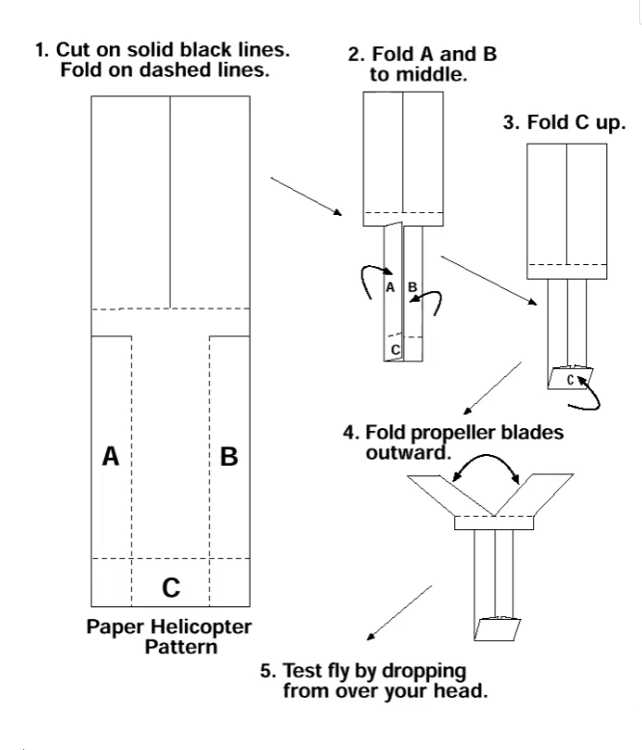
You will need:
Paper
Scissors
Cut out a rectangle from paper like the image. Any size works well.
Cut down the dotted lines and fold as in the pictures.
Why do helicopter seeds spin?
When the helicopter seed falls, the air pushes upwards against it. Air also pushes sideways on the arms of the helicopter shaped spinning seed. The two arms get pushed in opposite directions, which makes the seed spin.
Investigation ideas:
Experiment with bigger and smaller spinners and different types of paper. Do smaller helicopters spin faster than large helicopters?
Investigate how far each helicopter moves from the point where it is dropped
Drop the helicopters inside and outside. Does the wind make a difference to how far they travel?

Slide 5
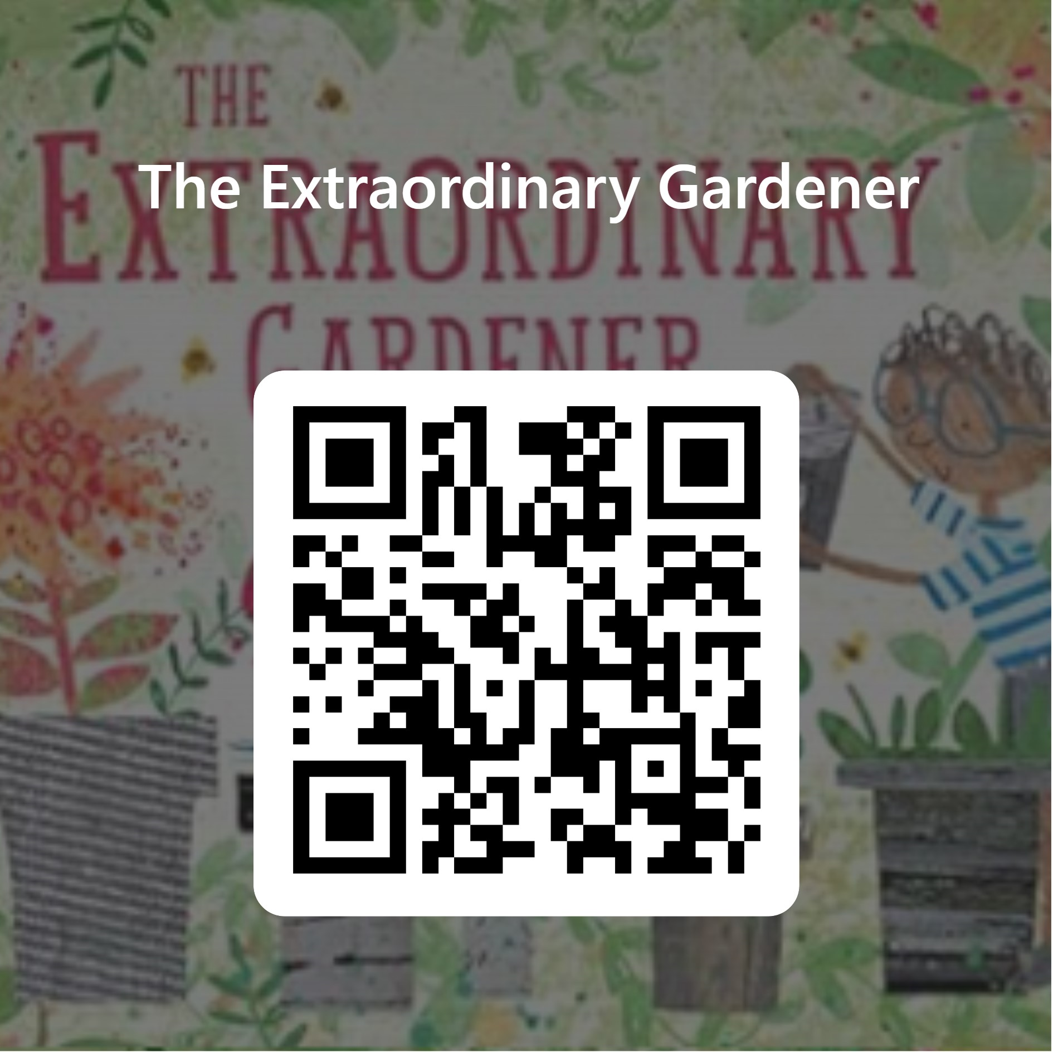
How did you feel using this pack?
We would love to know how you got on and what you thought about this pack.
If you would like to give us some feedback, please either click on the link or scan the QR code and complete the very short questionnaire. Thank you ☺
A paper copy is available too if you would prefer to complete the questionnaire that way.
https://forms.office.com/e/SCb1g9rJZU

Slide 6
How did you feel using this pack?
You
Adult
Any other comments?
Do you have any ideas for other story books to use for STEM challenges/activities?

Slide 7
Some of the Curriculum for Excellence Experiences and Outcomes that these activities may cover
The Extraordinary Gardener
Curricular area | Outcome
Technologies | Design and Construct Models/Products TCH 0-09a/1-09a/2-09a Representing ideas, concepts and products TCH 0-11a/1-11a/2-11a I can explore and discover engineering disciplines and can create solutions TCH 0-12a/1-12a
Science | Through everyday experiences and play with a variety of toys and other objects, I can recognise simple types of forces and describe their effects. SCN 0-07a I have helped to grow plants and can name their basic parts. I can talk about how they grow and what I need to do to look after them. SCN 0-03a | By investigating forces on toys and other objects, I can predict the effect on the shape or motion of objects. SCN 1-07a I can help to design experiments to find out what plants need in order to grow and develop. I can observe and record my findings and from what I have learned I can grow healthy plants in school. SCN 1-03a
Art and Design | Working on my own and with others I use my curiosity and imagination to solve design problems EXA 0-06a | I can use exploration and imagination to solve design problems related to real life situations EXA 1-06a
Literacy | I enjoy exploring events and characters in stories and other texts, sharing my thoughts in different ways. LIT 0-01c
Literacy | To help me understand stories and other texts, I ask questions and link what I am learning with what I already know. LIT 0-07a / LIT 0-16a | I can show my understanding of what I listen to or watch by responding to and asking different kinds of questions. LIT 1-07a

