Slide 1
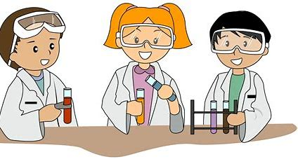
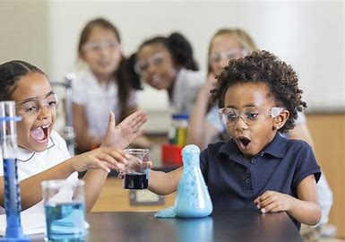
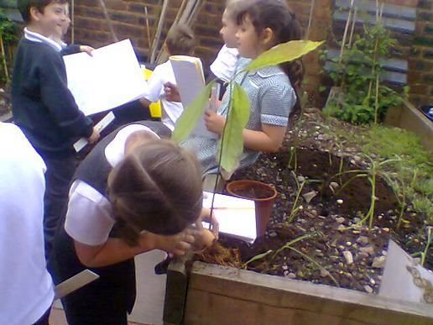
Primary Science Enquiry
Kim Aplin, RAiSE PSDO, Aberdeenshire

Slide 2
In this session we will look at the following questions:
What do we mean by science enquiry?
What kinds of questions can lead to science enquiry?
What does science enquiry look like in practice?
How do I plan for science enquiry?
How do I develop children’s science enquiry skills?
Notes:
Today we will all possibly starting with different degrees of understanding, experience and confidence?
For some this may be revision or a refresher or perhaps a reminder about things that you may have forgotten about?
For others this may be new information and new ideas.
Whatever the starting point for you is, I hope that everyone takes away something from this presentation to use in the classroom.
In this session we are going to look at these questions:

Slide 3
What is science enquiry?
‘Scientific enquiry describes the processes and skills pupils should be taught and use, to find out more about the world and how it works.’
(Scientific Enquiry: The Association for Science Education (2018))
‘Science enquiry is what children do in order to answer scientific questions about the world around them.’
(Turner, Keogh, Naylor and Lawrence (2011))
‘Children take part in scientific investigations and enquiries which develop their understanding of the underlying scientific concepts…
They develop a growing awareness of themselves and the world around them through observation, collecting specimens and carrying out experiments.’
(Sciences: Principles and Practice, Education Scotland (2009))
Notes:
Here are several explanations of what is meant by primary science enquiry:
Basically, children do this by exploring, asking questions, collecting and analysing data, developing explanations and solving problems.

Slide 4
What is science enquiry?
Science enquiry starts with a question. Science investigations in school can often be focused on the traditional concept of a fair test. There’s nothing wrong with fair testing, but it is only one approach to investigating science questions.
How do we help children learn what to do to answer scientific questions? Different types of questions and situations require different types of enquiry and different ways to find answers; in order to acquire a breadth of science skills, children need to learn to carry out a variety of investigations.
There are five approaches that children need to learn to recognise and use:
fair testing
observation over time
pattern seeking/finding an association
identifying and classifying
researching using secondary sources.
It is important that children are given the opportunity to
carry out many different types of investigations in Science
Notes:
Science investigations in school can often be focussed on ‘fair testing’.
If this is the case in our classrooms, then children’s experience of other types of science enquiry is limited
If we are going to help children learn to answer different types of scientific questions, they need a repertoire of different types of enquiry to choose from. Different types of questions and different situations require different types of enquiry.
There are five different types of approaches to science enquiry:
fair testing
observation over time
pattern seeking/finding an association
identifying and classifying
researching using secondary sources.
The slide includes a link to a video clip that is a useful discussion about different types of science enquiry that you may or may not want to view in your own time and possibly use with staff.

Slide 5
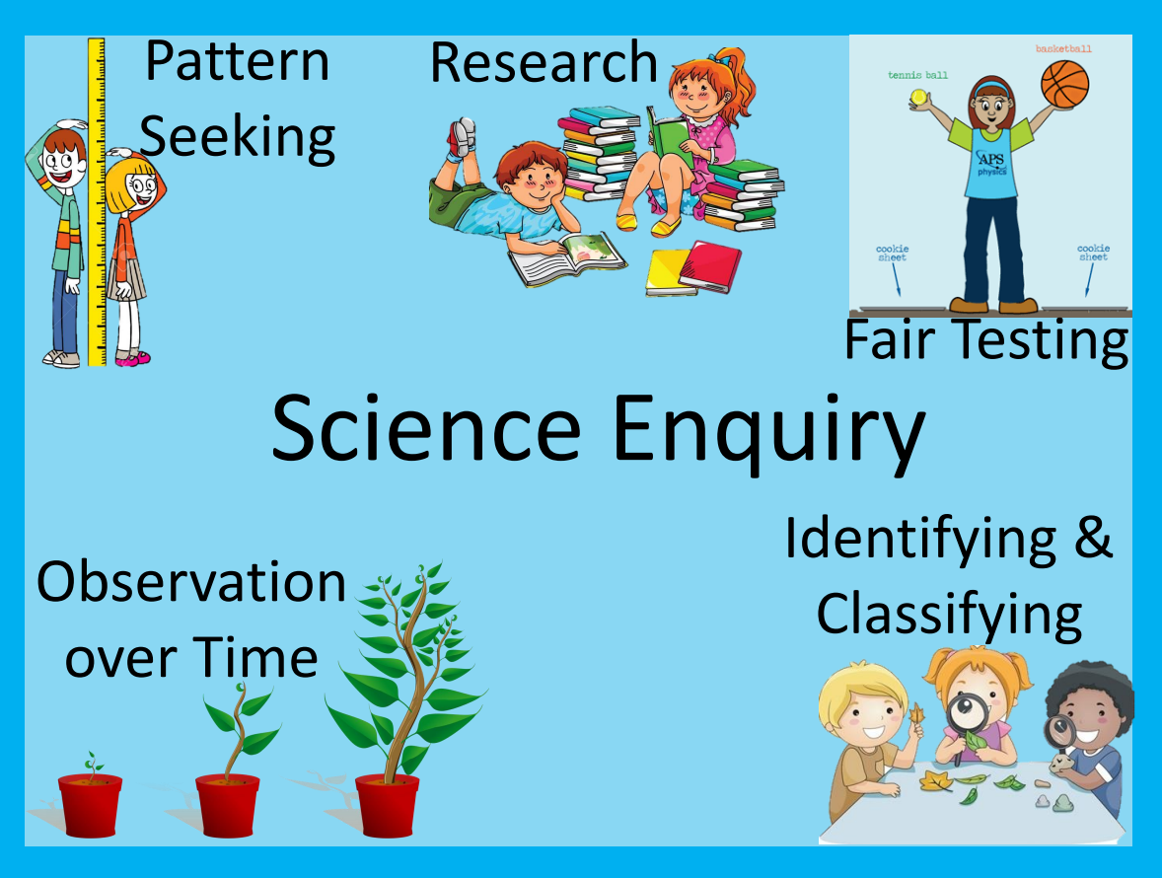
Notes:
I have included this poster which is a nice reminder of the 5 approaches to science enquiry

Slide 6
Links to Literacy, Numeracy and Health and Wellbeing
Observation over time | MNU
Pattern seeking/finding an association
Identifying and classifying
Researching using secondary sources | LIT
Fair testing | LIT / MNU
I have carried out investigations and surveys, devising and using a variety of methods to gather information and have worked with others to collate, organise and communicate the results in an appropriate way. MNU 2-20b
To show my understanding across different areas of learning, I can identify and consider the purpose and main ideas of a text and use supporting detail. LIT 2-16a
I am learning to assess and manage risk, to protect myself and others, and to reduce the potential for harm when possible. HWB 2-16a
Notes:
There are also strong links to Maths, Literacy and Health and Wellbeing too and the examples I have used here are from Second Level although there are also the links at Early and First Level too:
So for example, the first 3 types of enquiry have strong links to information and data handling in numeracy,
Researching using secondary sources obviously links to outcomes in reading,
Fair testing could easily involve both and all would involve safety especially if the research involved looking online.

Slide 7
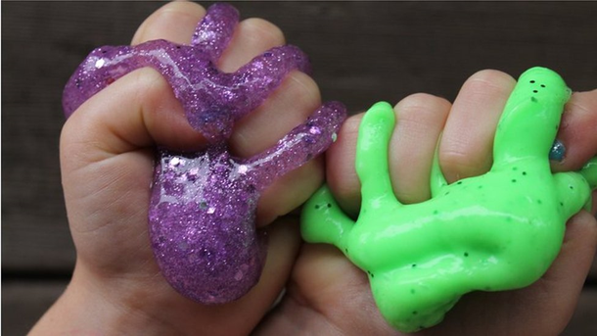
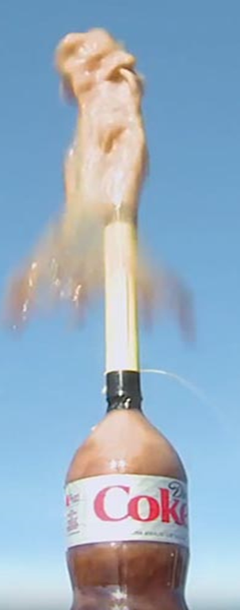
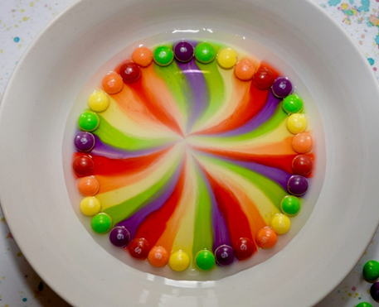
Fun investigations…
Notes:
There are lots of ‘fun’ investigations already carried out in our classrooms – some of which are pictured here; making and experimenting with slime, Mentos in coke bottles, looking at the colours in skittles when they are put in water…

Slide 8
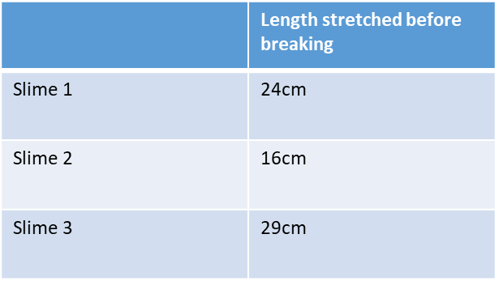
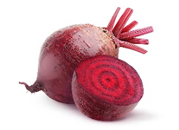
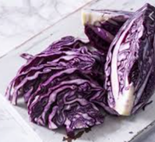
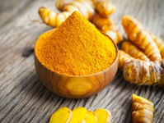
… but there is also an opportunity to develop skills
Measure and record data
Relate findings to the wider world
Dyes
Introduce variables: test different types of drinks
Notes:
…but it is important that these fun activities are also opportunities for the children to develop skills too and this slide shows the skills that could be developed during these 3 activities.

Slide 9
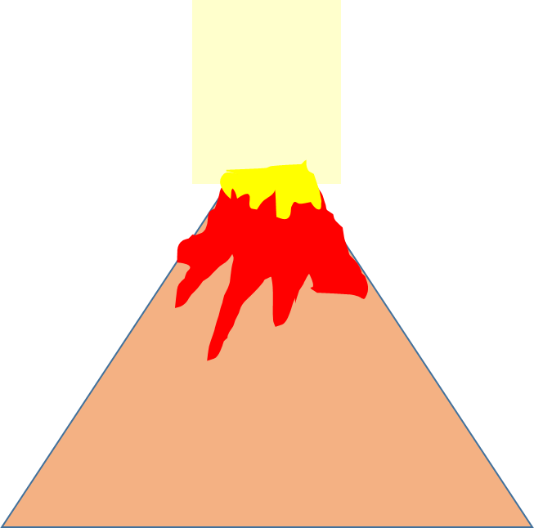
A word about ‘volcanoes’...
Volcanoes do not erupt because of a chemical reaction e.g. between vinegar and baking soda (SCN 2-19a)
Volcanoes erupt when gas bubbles trapped in magma below the Earth’s crust cause a build-up of pressure, when the pressure gets too high an explosive eruption happens (SOC 2-07b)
Notes:
A word about volcanoes…..the chemical reaction between vinegar and baking soda is often used as part of a model of an erupting volcano. Volcanoes do not erupt due to a chemical reaction so the use of volcanoes for this needs to be carefully considered and how this might be confusing for the children?

Slide 10
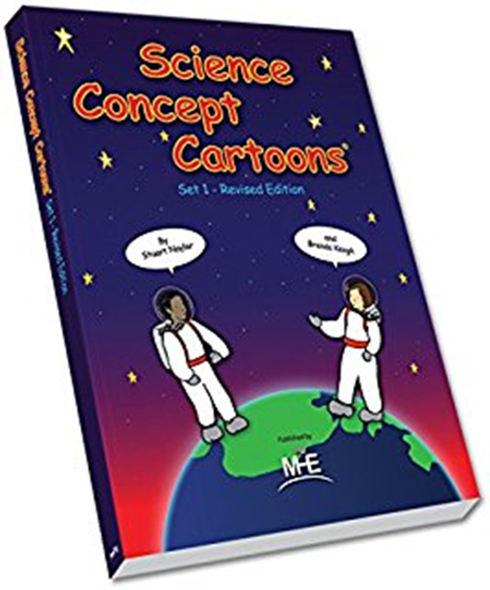
What is science enquiry?
Science enquiry starts
with a science question
Notes:
Science enquiry as I have said starts with a science question.
You may or may not know about Concept Cartoons. If you do you will know that ideas about the answer to a question are presented in cartoon form.
The answers presented were generated by collecting common misconceptions around science ideas, so all the answers are generally believable. The concept cartoons are designed to set up cognitive conflict.
Children might be confident in what they think but when they work with the concept cartoon, they begin to question whether they were right.
They are put into the ‘wobble zone’ and usually can’t wait to carry out an investigation to find out the answer. Most schools should have a copy of the Concept Cartoon book – it is one really good way of beginning science enquiry.

Slide 11
Notes:
So here we have an example of a concept cartoon.
Having seen the cartoon the children generally can’t wait to find out what the answer is. By asking the children who they agree with and why at this point also gives you an insight into their understanding at this point.
A lot of schools will have this book somewhere!

Slide 12
Science enquiry: observation over time
When Darwin was asked how he came up with the theory of evolution he replied that he was simply good at noticing things. This is at the heart of ‘observing over time’.
This type of investigation allows children to identify and measure events and changes in a range of phenomena. It can take place over seconds, minutes, hours or days and begins with children making decisions on what and how to observe, as well as how to measure and record any changes. It also allows children to make predictions as time passes and patterns emerge.
This type of enquiry lends itself to observing the natural world but can also be used to compare materials and observe physical processes. There are many opportunities to take children outdoors when carrying out these types of enquiries, and children’s observations will often lead on to other, different, types of enquiries.
Notes:
Now we will look at each of the 5 types of science enquiry starting with observation over time.
I love the answer Darwin gave to the question about how he came up with the theory of evolution; he was good at noticing things, and this is at the heart of this type of enquiry.
This type of enquiry can last seconds, minutes, hours or days. The children have to decide what and how to observe as well as how to measure and record any changes.
This type of enquiry obviously lends itself to observing the natural world but can also be used to compare materials and observe physical processes.
The observations that the children make can prompt result in more questions and can lead on to other types of enquiries.

Slide 13
Science enquiry: observation over time
Typical observations over time might be triggered by these types of questions:
What happens to a seed when it germinates?
What happens to bread if it’s left out for a long time?
What happens to the ice cube in your hand?
What happens to a puddle when the sun comes out?
What happens to the flowers on the plant?
How does a nail in saltwater change over time?
How does my heart rate change over the day?
Notes:
Here are some typical questions that can result in this type of enquiry:

Slide 14
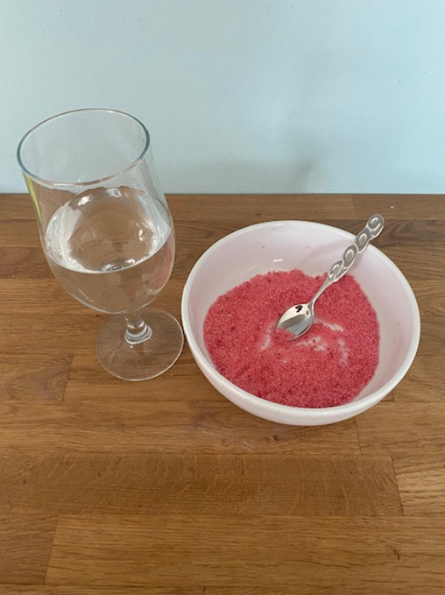
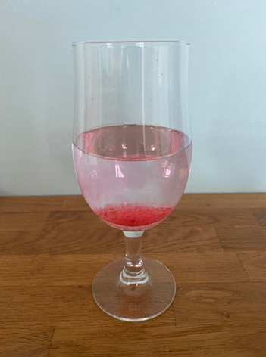
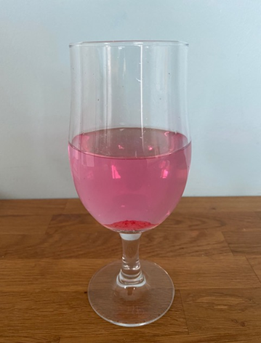
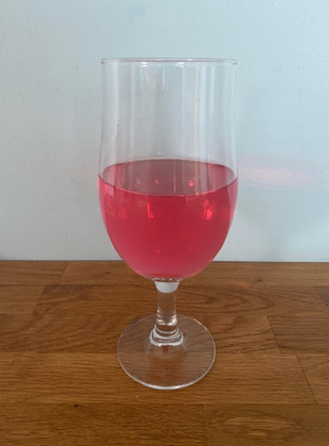
How does a beaker of salt
and water change over time?
Add coloured salt (salt and food colouring) to a beaker of water and leave the beaker still for 10-15 minutes, checking it regularly.
What did you observe?
0 min
5 min
10 min
Notes:
Here is an example of a simple experiment where children are observing changes over time.
Ask the children to add the coloured salt to the water and ask them what they observe. At the beginning we can see the salt lying at the bottom and the colour of the water has hardly changed. Overtime, the amount of salt lying at the bottom appears to decrease and the water changes colour. By the end of the time, the salt appears to have disappeared and the colour of the water has changed completely.

Slide 15
Observation over time progression:
Early Level observation: During messy play we mixed coloured salt and water together; the salt disappeared, and the water changed colour.
First Level observation: After 10 minutes the salt dissolved in the water. Starting at the bottom of the container, the colour of the water gradually changed from clear to red. We know the salt hasn't disappeared because the water tasted like seawater.
Second Level observation: The salt dissolved in the water creating a solution. We know the salt is still there because we measured the mass of the water and salt before and after the salt dissolved and it remained the same. Afterwards we left the water to evaporate, over time we discovered that cubic crystals of salt had re-formed in the container.
Notes:
So how might the skills progression look at different stages for this investigation:
At Early Level the children observe that the salt disappeared, and the water changed colour.
At First Level we are looking for more detail: the use of some scientific vocabulary and describing things in more detail.
At Second Level the children should be able to talk about the salt dissolving to form a solution; they could measure the mass before and after and find out that these stay the same so the salt must still be there. Then they could extend the period of time for observation to allow the water to evaporate and look at and describe the crystals that reform in the container.

Slide 16
Science enquiry: observation over time
Notes:
A short video clip to end this section on science enquiry by observing over time

Slide 17
Science enquiry by pattern seeking/finding an association
Pattern-seeking investigations involve observations or surveys where variables aren’t easily controlled.
They answer questions by identifying patterns in the results.
They enable children to find out more about the world and provide rich contexts to learn about habitats, diet, weather and animal and plant behaviour.
When children gather the information and notice the patterns involved, this leads them to form important conclusions about why these patterns emerged. This has a greater impact than if they were just told!
Notes:
Pattern seeking or finding an association science enquiries involve surveys or observations, and the question is answered by identifying patterns in the results.
Typical contexts for this type of enquiry are habitats, diet, weather etc.
When the children are given the opportunity to notice patterns and draw conclusions it has a greater impact than just telling them!

Slide 18
Science enquiry by pattern seeking/finding an association
Pattern-seeking questions might include (may also involve collecting data from secondary sources):
Are the oldest children in our school the tallest?
Do bigger seeds grow into bigger plants?
Is there a pattern in where we find moss growing in the school grounds?
Do all flowers have the same number of petals?
Does every planet take the same time to orbit the Sun?
Pattern-seeking enquiries may lead to more systematic enquiries, such as fair tests. The key difference is that pattern-seeking enquiries are not fair or comparative tests because certain variables can’t be controlled.
Notes:
Examples of questions that trigger this type of enquiry are presented in this slide: are the oldest children in the school the tallest, do bigger seeds grow into bigger plants etc.
Again, these types of enquiries may lead to other enquires.

Slide 19
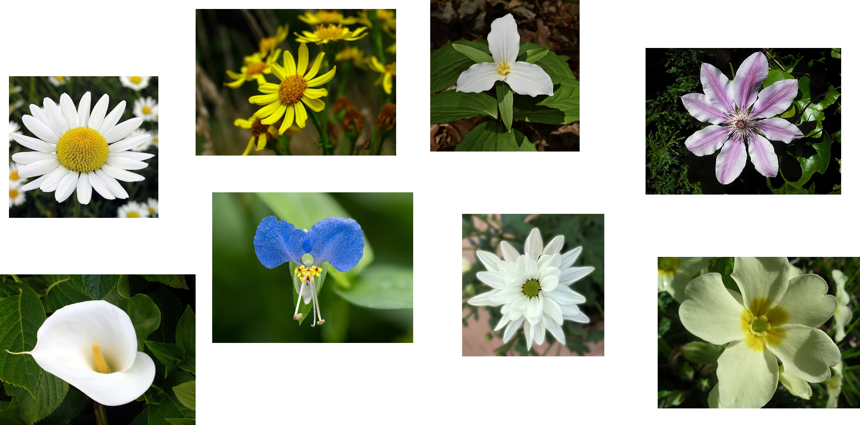
Science enquiry by pattern seeking/finding an association
Petal Patterns: Do all flowers have the same number of petals?
You will need:
Pictures of flowers/ real flowers
What to do:
Sort the flowers by number of petals
How many petals does each one have?
Links to Maths outcomes
MTH 0-13a, 1-13b and
2-13a
Notes:
Enquiry skills are not confined to science enquiry. This example is linked to these Maths outcomes; here the children are asked to investigate if flowers all have the same number of petals, and they go on to sort or order the flowers according to the number of petals
It goes without saying that any Maths involved in science investigations should match the expectation and attainment in the children’s Maths learning!

Slide 20
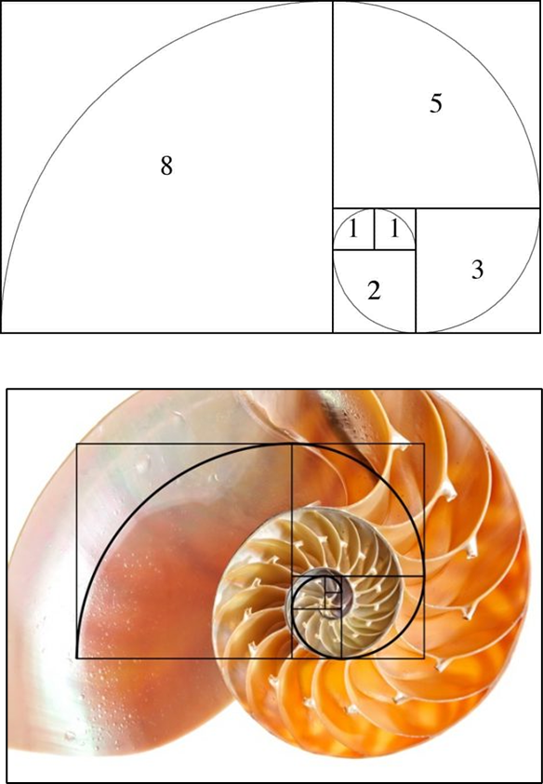
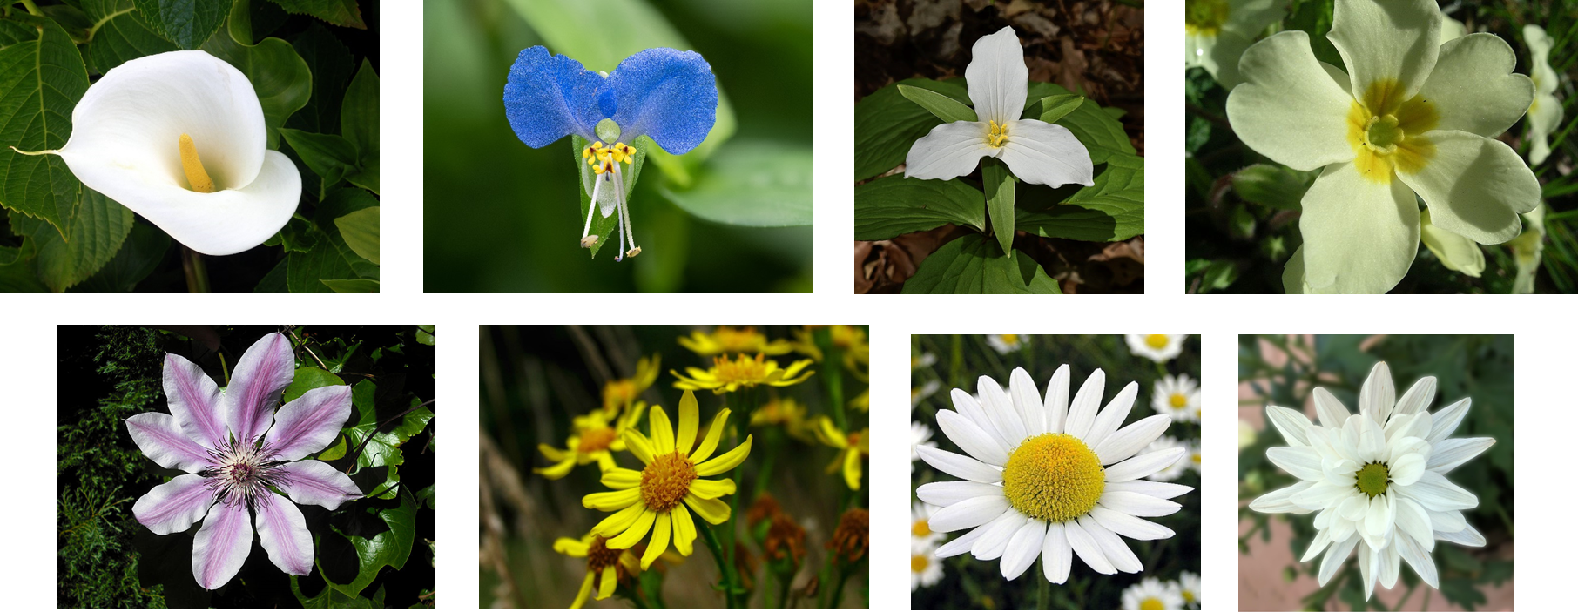
Pattern seeking/finding an association progression
Early Level: Pupils recognise that the flowers have a different number of petals and order them visually.
First Level: Pupils recognise that the flowers have a different number of petals, count the petals and then order them numerically – 1, 2, 3, 5, 8, 13, 21, 34.
Second Level: Pupils recognise that the number of petals follow the Fibonacci Sequence and then explore other examples of this sequence appearing in nature.
Notes:
Looking at progression across the levels within this activity then:
At Early Level the children might be sorting them just be looking and recognising one has more petals than the other and then order them from biggest to smallest or smallest to biggest. So the pattern they are looking for is has one flower got more or less than another
First Level the children would be counting the petals and then would put them in order numerically
By Second Level, the children could be identifying that 1,2,3,5,8,13,21,34 is the pattern of the Fibonacci Sequence and they might look for other examples in nature and that the pattern is to do with spirals and is found in the natural world. For example in shells.

Slide 21
Science enquiry by pattern seeking/finding an association progression
Daisy Patterns: Where and how do most daisies grow?
Early Level:
Using a simple map of the area being surveyed, record where daisies grow visually and create a display of where the daisies are found
Identify simple patterns and talk about them e.g. ‘More daisies grew in short grass than in long grass.’
First Level:
Count and create a tally chart of the daisies in different locations within the area surveyed (e.g. long grass, short grass, on the path, under the tree etc.)
Create a bar chart or table of their findings
Draw conclusions about the data: e.g. growth patterns and the possible connection to environmental conditions: ‘There were more daisies where it is sunniest, so daisies grow better where it is light and warm.’ (This can easily lead to suggestions for further investigations)
Second Level:
Systematically survey the area to determine the exact number of daisies using e.g. a quadrat (a square frame usually 50 x 50 cm (0.25m²) but can be other sizes depending on the location or what is going to be counted)
Create a graph or table of the data
Identify any trends or patterns across the habitat/changes within the area and suggest links to e.g. changes in light, moisture, soil etc. These could be further investigated by using moisture sensors, light sensors etc.
This survey could also be repeated at a later date or in a different location and results compared
Notes:
Another example:
Daisies are easy to spot , lots of children are familiar with them and they grow readily in short grass so most school playing fields will have them!
The question Where and how do most daisies grow? might come up.
At Early Level the pattern they are looking for is has one area got more or less daisies than another. If the children are interested in the different heights of the daisies in different areas, these could be measured using nonstandard units e.g. Lego bricks?
At First Level we are looking for more detail. The children would be counting and tallying the daisies from different areas and starting to draw conclusions
At Second level the children should be becoming more systematic in their collection of data so they could use a quadrat placed at regular distances e.g. every 5 metres along an imaginary line; changes in the number of daisies seen along the line could then be linked to changes in e.g. light, moisture and these ideas could be investigated further to see if their reasons and ideas for the patterns in growth are right

Slide 22
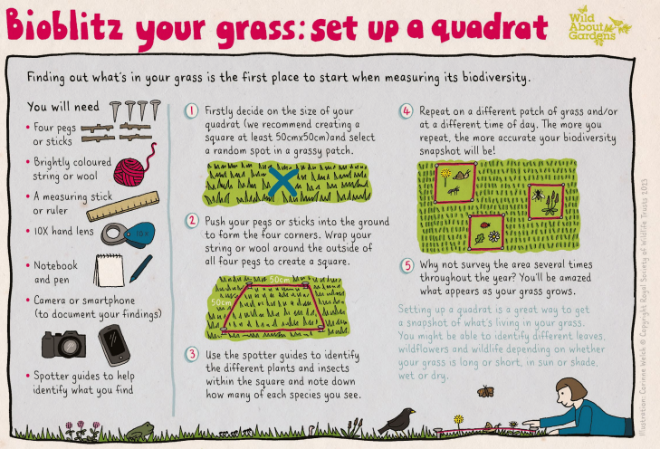
Science enquiry by pattern seeking/finding an association
Notes:
A graphic that explains one way of how to set up and use a quadrat – in this example however they are using quadrats to survey the area for all the different plant species, not just daisies!

Slide 23
Science enquiry by pattern seeking/finding an association
Notes:
A short video clip to end this section on science enquiry by pattern seeking/finding an association

Slide 24
Science enquiry by identifying and classifying
Children begin identifying and classifying objects in the world around them from a very young age. In this type of enquiry, children make observations and measurements to help them look for similarities and differences. This will help them to organise things into groups and make connections.
Identifying and classifying enquiries provide great opportunities for children to make and record detailed observations. Younger children will be able to record what they see in the form of a drawing; over their time in primary school, children should be supported to become skilled in producing scientific drawings of their observations, which increase in fine detail as they move up the school.
For this to happen, children need access to a variety of equipment that will support them in making closer observations such as magnifying glasses, binoculars, telescopes, microscopes, and digital microscopes.
As children progress through school, they should be learning to use identification keys to help them with this type of enquiry, as
well as learning how to create their own branched key.
Notes:
Science enquiry by identifying and classifying is probably a common type of enquiry undertaken when the topic involves biodiversity and living things.
Central to this type of enquiry is developing the children’s ability to make and record detailed observations and as they move up the school, they are learning to use identification keys and also creating their own.

Slide 25
Science enquiry by identifying and classifying
Identifying and classifying questions might include:
We need to sort these toys into baskets – can we make a key or guide to help us?
If we had a power cut, which things in the kitchen would still work?
We need to choose a material to make an umbrella. Which materials are waterproof?
How can we group the food that we eat?
How would you make a classification key for vertebrates/invertebrates?
Can we use the classification keys to identify all the animals that we saw in our mini beast hunt?
What types of trees are in our playground?
Notes:
Examples of questions that lead to science enquiry by identifying and classifying are in this slide

Slide 26
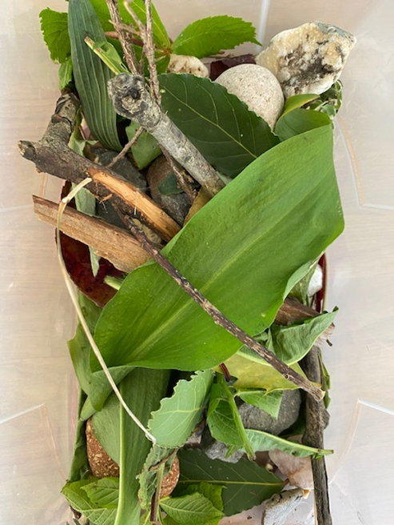
Science enquiry by identifying and classifying progression
Early Level
I have observed living things in the environment over time
and am becoming aware of how they depend on each other.
SCN 0-01a
A collection of rocks, sticks and leaves from the local area
leaves/stones/sticks
living/non-living/once living
rough/smooth
order by size
Notes:
This example links to the science outcome SCN 0-01a and is an activity using a variety of natural objects collected locally. It could also be done with pictures of animals, materials, seaside objects, different insulators, different conductors etc or a collection of objects such as the toy box. .
Encourage the children to categorise the objects
Ask the children to sort them into categories of their choice, ask them if they can sort them in different ways, can they create subgroups etc.
So using the collection of natural objects from the local area, at Early Level they may sort them in ways like this – sticks, stones and leaves; or living, non-living and once living. Just working with the rocks, they might sort them in to rough and smooth or by size

Slide 27
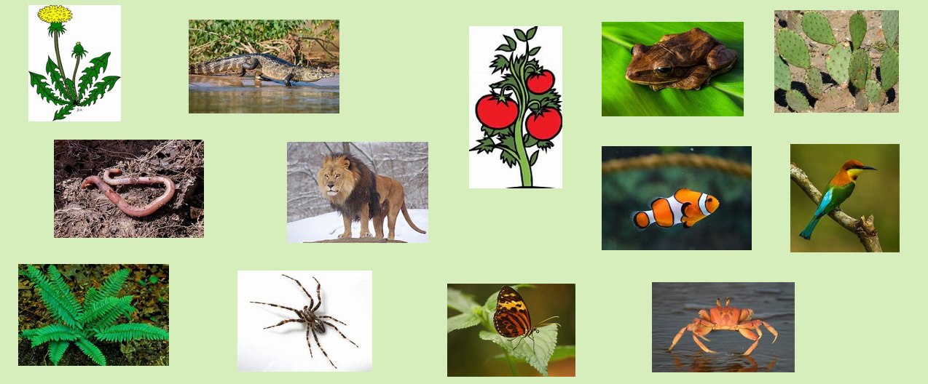
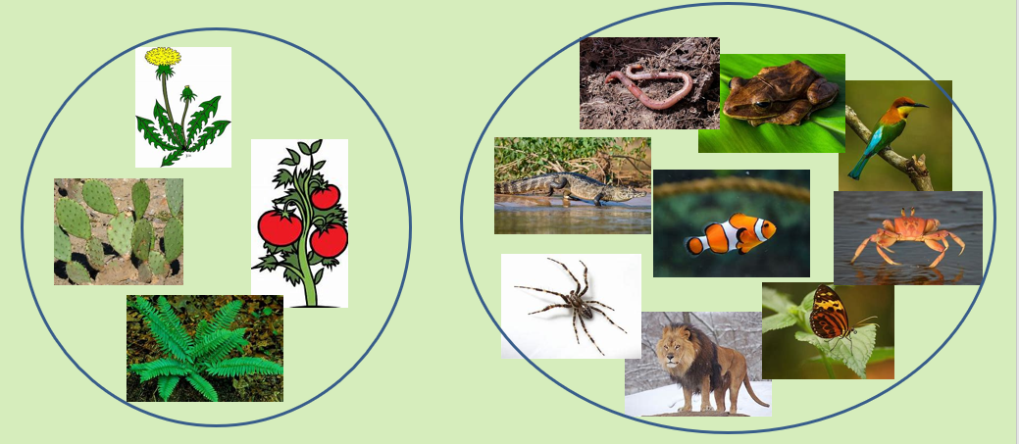
Science enquiry by identifying and classifying progression
First Level
Activity: Sorting and grouping living things
Ask the children to sort these living things into two groups:
The obvious two groups are plants and animals
SCN 1-01a
‘Creates criteria for sorting living things and justifies decisions’ ‘Sorts living things into plant, animal and other groups using a variety of features’
Notes:
At First Level, the children should continue to sort living things by creating their criteria and justifying their decisions.
You could give the children pictures of a variety of plants and animal ask them to sort them into two groups. In this example the obvious groups are plants and animals so none of the living things can be in both groups because clearly they can’t be both a plant and an animal! The ability to sort living things into plants and animals is also specifically mentioned in the benchmarks.
The children could then sort them in other ways, by creating different criteria: e.g. tail and no tail, lives in water/ lives on land.
By First Level we are looking for more detail and the children should now be able to identify a number of ways of categorising and sub categorising the objects or living things and be able to say what criteria they have used.

Slide 28
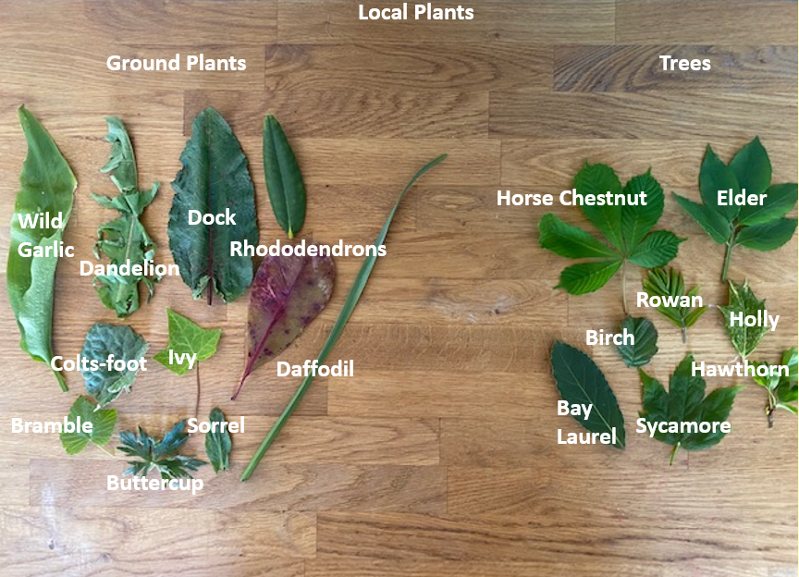
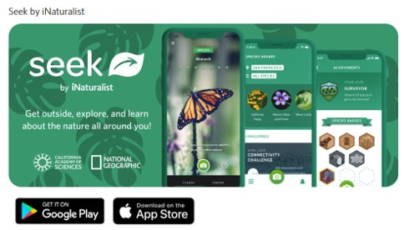
Science enquiry by identifying and classifying progression
Second Level
SCN 2-01a
iNaturalist Seek App
Notes:
By Second Level they could then be using an app such as this one, or identification keys to identify individual species of plants.
They could also use different categories to sort them: ground plants and trees, edible and non-edible, native and invasive species such as Rhododendron,. and discuss the possible impact of having invasive species in the area etc.

Slide 29
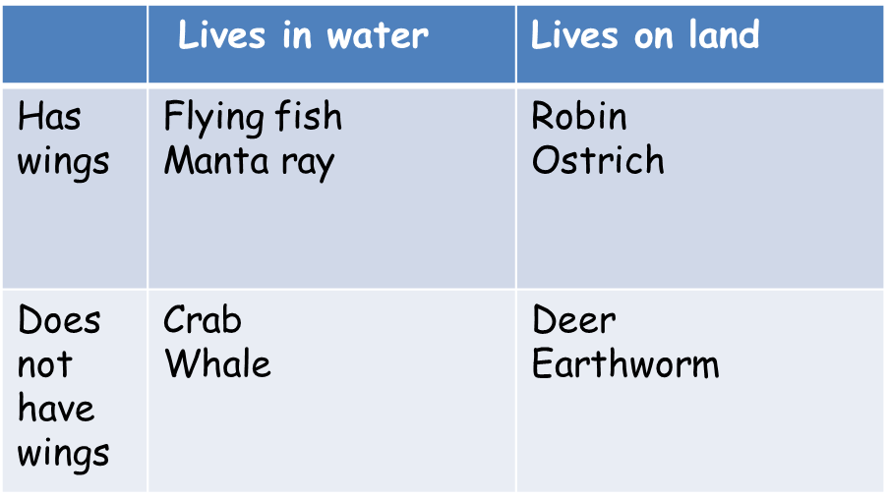
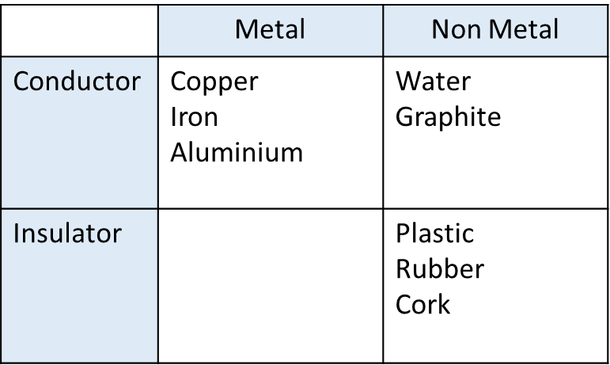
Science enquiry by identifying and classifying
Maths: MNU 1-20b/ 2-20b
Notes:
There are lots of opportunities to link with Maths in these types of enquiries – Venn Diagrams for example or as shown in this slide, Carroll Diagrams. A real opportunity for teaching these things in a context!

Slide 30
Science enquiry by identifying and classifying
Notes:
A short video clip to end this section on science enquiry by identifying and classifying

Slide 31
Science enquiry by researching using secondary sources
Research enquiries are a great opportunity to use a science context to practise and develop ‘Reading for Information’ and writing ‘Explanation, Report or Discursive texts’
Children use a range of secondary sources to help them find the answers to their ‘big questions’
Children could also plan research tools, such as questionnaires and interviews, to collect their own data.
This type of enquiry is great for collaborative learning in the researching and sharing of information but also in presenting their findings to a variety of audiences.
Research enquiries help to develop children’s scientific literacy, as children learn to compare and evaluate information from different sources. Children learn to recognise the differences between fact and opinion and consider the concept of bias. Teach them about reputable sources too– FAKE NEWS!
Local libraries are a great resource for this type of enquiry.
Use pupil friendly websites – check them first!
Research is not an optional homework task - all pupils need to be
given the opportunity to be taught and to develop this essential skill.
Notes:
Research using secondary sources obviously links to outcomes in reading and writing.
This type of enquiry could also involve the children creating questionnaires or interviewing people to collect data.
Great opportunity also for collaboration.
It is important that we teach the children about reputable sources; children for example can go onto YouTube and get all sorts of information from there and may take everything at face value. It is important that children also learn the difference between fact and opinion. Bias
Local libraries are great for this type of enquiry.
It is important also to check the websites that we direct the children to.

Slide 32
Science enquiry by researching using secondary sources
Researching using secondary sources questions might include:
Where does salt come from?
Are all microbes harmful to us?
How does a barometer work?
What are microplastics and how are they harming the planet?
Which materials can be recycled?
How does a cactus survive in a desert with no water?
Who was Mary Anning and what did she discover?
How much energy do low energy lightbulbs save us?
What is the most common spider in the UK?
This type of enquiry is also ideal for learning about how real scientists work, both interesting scientists from history, but also scientists working in your local community.
Notes:
Examples of the types of questions that trigger these types of enquires are on this slide. A good opportunity for finding out about the work of scientists past and present too!

Slide 33
Science enquiry by fair testing
Fair test questions involve making comparisons, often trying to find out which is the ‘best’ or ‘most.’ Through fair testing, children are encouraged to see that one thing has an effect on another, identifying the differences they have noticed and exploring all the variables (any phenomena subject to change) that may have an effect. Children decide which variable to investigate and how to measure or observe the effects.
It’s important children really understand what a fair test is before they carry out their own. They should learn to recognise when tests are fair, be able to generate fair test questions themselves and be practised in identifying variables.
Notes:
Lastly, science enquiry by fair testing. Fair testing involves making comparisons and seeing that one thing has an effect on another, identifying the differences they have noticed and exploring all the variables.
It’s important that children really understand what a fair test is before they carry out their own.
I have included a poster with a mnemonic to help the children remember a fair test involve changing one variable, measuring something and keeping everything else the same!

Slide 34
Science enquiry by fair testing
A note about comparative and fair test enquiries: these are very similar but there are differences:
Comparative tests: these compare one event with another e.g. Does the red car go down the ramp faster than the blue car?
A comparative test (where we just compare two things) is simpler than a fair test, so this is where we should start with young children.
Fair tests: these are used to identify a casual relationship between two variables. A variable is identified to change that can be quantified and then the effect of changing it on another variable is tested while keeping all the other variables the same e.g. How does changing the height of the ramp affect how quickly a toy car rolls down it? The type of car, the type of surface on the ramp, the position of the car on the ramp, the position of the starting point etc. are all kept the same; the only thing changed is the height of the ramp.
Fair tests are suitable when variables are numeric and can be changed e.g. investigating the relationship between the surface area of the parachute and the falling time. Comparative tests are used when categoric variables are compared e.g. the material a parachute is made from.
Fair testing is the most commonly used type of investigation in schools,
but it can be used incorrectly to answer questions best solved by other
methods. Therefore, it’s important to understand the types of questions
best suited to fair testing!
Notes:
A note about a comparative test vs a fair test: very similar but there are differences. Comparative tests compare one thing with another and are simpler than fair tests and are good for using with for younger pupils.
Fair testing is the most common type of investigation seen in schools but can be used incorrectly to answer questions best answered by other types of enquiry.
It is important to understand the types of questions suited to fair testing enquiry.
It is perfectly acceptable for pupils to discuss their results and/or present them in different ways – they do not have to formally ‘write up’ experiments every time!
Perfect opportunity though for report writing, writing instructions, writing explanation texts, for information handling, weight and measure etc.!

Slide 35
Science enquiry by fair testing
Science enquiry questions that children might ask
Question | Fair test? | Type of enquiry
Which of these things stick to a magnet? Sycamore seeds spin as they fall. How do other seeds fall? What happens to our snowman when the Sun shines? How does the sound change if we put more water in a bottle? Can people with the longest legs jump furthest? How much bread could you make from a field of wheat? How far can a snail travel in 5 minutes? Which musical instrument makes the loudest sound? Which makes the deepest sound? Which toy car goes fastest down the slope? Which minibeasts can we find on the compost heap? What attracts bees to our flowers? It is icy outside - which of our shoes has the most grip?
Notes:
Here are some questions that the children might come up with for science enquiry. Can you decide which type of investigation each question would lead to? Can you spot the ‘fair test’ ones?

Slide 36
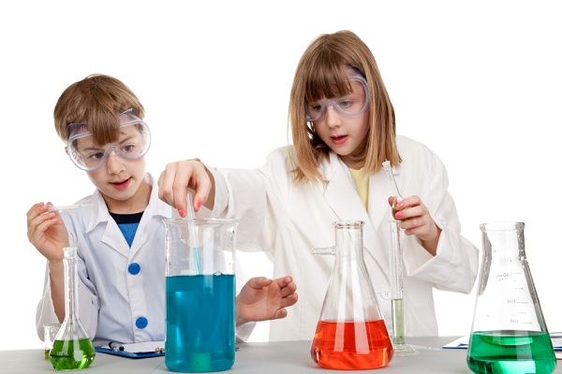
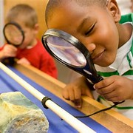
Science enquiry by fair testing
Science enquiry questions that children might ask:
Question | Fair test? | Type of enquiry
Which of these things stick to a magnet? Sycamore seeds spin as they fall. How do other seeds fall? What happens to our snowman when the Sun shines? How does the sound change if we put more water in a bottle? Can people with the longest legs jump furthest? How much bread could you make from a field of wheat? How far can a snail travel in 5 minutes? Which musical instrument makes the loudest sound? Which makes the deepest sound? Which toy car goes fastest down the slope? Which minibeasts can we find on the compost heap? What attracts bees to our flowers? It is icy outside - which of our shoes has the most grip? | Yes Yes Yes | Id & Class Pattern seeking Obs over time Pattern seeking Research Obs over time Id & Class Id & Class Research
Notes:
…and the answers! Were you right? This is just a reminder that not all science enquiry questions should try to be answered by doing a fair test! The children need a repertoire of science enquiry experiences!

Slide 37
Science enquiry by fair testing
Science enquiry using fair testing questions might include:
Which material is the best for keeping Teddy dry?
What type of boats stay afloat the longest?
On which ramp do the cars go down fastest?
Where will the plants grow the tallest?
Which is the strongest magnet?
How does adding different amounts of sand to soil affect how quickly water drains through it?
How does the temperature of tea affect how long it takes for a sugar cube to dissolve?
How does the volume of a drum note change as you move further away from it?
Notes:
Examples of the types of questions that trigger these types of enquires are on this slide.

Slide 38
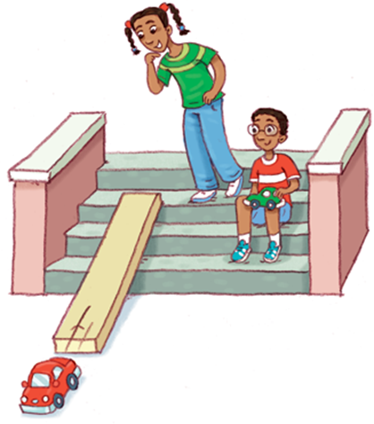
Science enquiry by fair testing
A ‘deliberate mistakes’ approach can be very effective in helping children learn how to carry out science enquiry
Which surface will a car travel the farthest on?
Notes:
Really exaggerate how ‘unfair’ the investigation is – e.g. big and little cars, give some a big push and others not, start from different places, alter the height of the ramp etc.

Slide 39
Science enquiry by fair testing
What can we (the children) learn from this about how to set up a science enquiry? We can see that in order to learn anything useful the test needs to be fair.
We can also see that in order to make the test fair, we need to keep most things the same and only change one thing at a time. If we change more than one thing, then we can’t tell what makes a difference to the result.
The question we wanted to answer is:
Does changing the surface of the ramp make a difference to how far the car travels?
Fair test questions have this kind of format:
If I change . . .(variables)
What happens to . . .(measure or observe)?
One variable is changed and everything else is kept the same
Notes:
The deliberate mistakes approach to an investigation is a way to illustrate to the children the need to be ‘fair’ and the need to change just one thing at a time to achieve any meaningful results!
Here is the question we were trying to answer: Does changing the surface of the ramp make a difference to how far the car travels?
Planning fair test enquiries involves using this format: If I change……What happens to….?

Slide 40
Science enquiry by fair testing
Components of a Fair Test
What are you trying to find out? Aim
What do you think will happen? Hypothesis
What are you going to change? Variable
What will stay the same? Constants
What will you do? Method
What happened? Observations, data and results
What did you find out? Conclusion
How could you improve your test? Evaluation
Remember to change only one variable.
Nothing happening is still an important observation!
Notes:
The components of a fair test are these:
It isn’t always necessary to cover all of these components all of the time! It is better to focus on a particular aspect of reporting for each enquiry so that children can focus on developing skills in that area, rather than try to do all of these all at once and every time they carry out a fair test enquiry.
Fair test enquiries provide opportunities for children to work on all aspects of reporting, from creating written instructions to describe their plan, to tabulating data, graph-drawing, or writing conclusions and evaluating.
A written report is not the only way the children can capture and report on their enquiry. For example, using technology offers many alternative ways e.g. video, photographs, eBooks, science workbooks in number on the iPad etc.

Slide 41
Science enquiry by fair testing: progression
Notes:
This one which involves a car going down a ramp and I will use this to show progression of the skills across the levels.

Slide 42
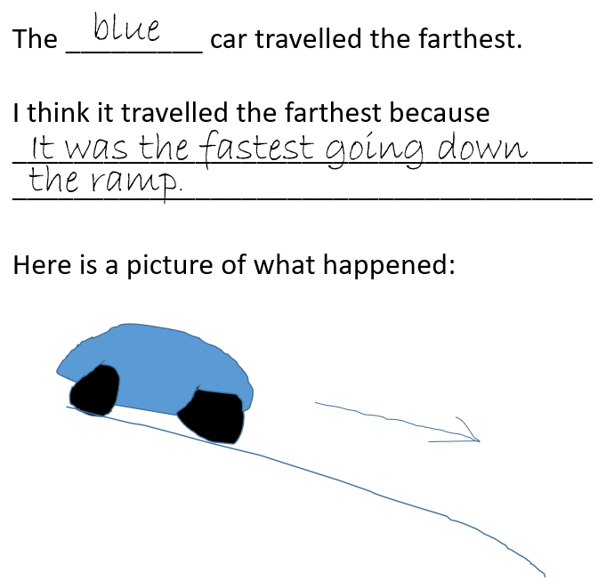
Science enquiry by fair testing: progression
Toy cars: Early Level:
Does the red car go down the ramp faster than the blue car? (comparative test)
(Find out which toy car goes furthest after travelling down a ramp).
Through everyday experiences and play with a variety of toys and other objects, I can recognise simple types of forces and describe their effects. SCN 0-07a
Variable:
Car
Constant:
Height of ramp
Notes:
Early Level – the children are just changing the car but are keeping everything else the same. They are not measuring the distance to see how far the 2 cars go but just comparing the distances.
The conclusion might be that the blue car goes the fastest and that is why it travelled the furthest. They aren’t making the connections at that point between the material on the ramp, the friction of the wheels, how heavy the car is etc.
They are just simply noticing that this one went the fastest that is why it travelled the furthest.

Slide 43
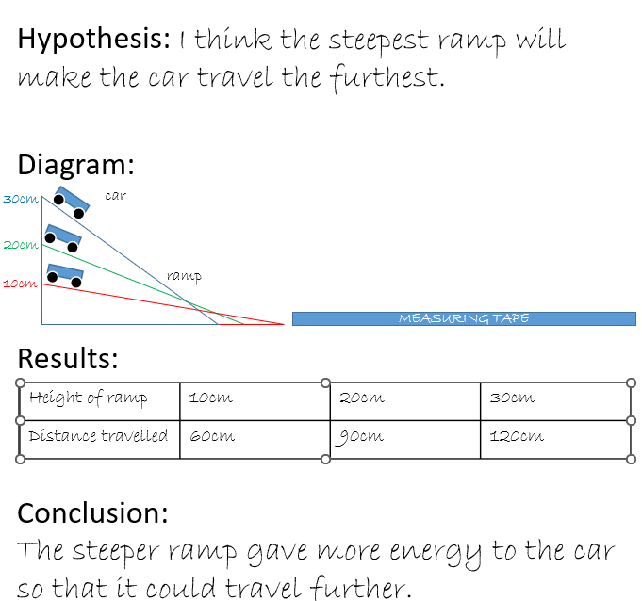
Science enquiry by fair testing: progression
Toy cars: First Level:
Find out what effect changing the height of a ramp has on the distance travelled by a toy car.
By investigating forces on toys and other objects, I can predict the effect on the shape or motion of objects. SCN 1-07a
Variable
Height (gradient) of ramp
Constants:
Car
Surface material of ramp
Starting position on the ramp
Notes:
By First Level they can begin to talk about the hypothesis (what they think is going to happen), they could be encouraged to draw a diagram and record their results.
This time they are changing the height of the ramp, but keeping the car and the surface material of the ramp constant and now the conclusion could include some knowledge of energy and how that impacted on the results: the steeper ramp gave the car more energy so that it could travel further.

Slide 44
Science enquiry by fair testing: progression
Toy cars: Second Level:
By altering the surface material of a ramp at a constant height find out which material generates the most friction and explain how you came to this conclusion. Relate your findings to car safety e.g., seatbelts, brakes, road conditions.
By investigating how friction, including air resistance, affects motion, I can suggest ways to improve efficiency in moving objects. SCN 2-07a
Variable:
Surface material
Constants:
Car
Gradient of ramp
Starting position on ramp
Notes:
By Second Level, we are changing the surface of the ramp, so we are beginning to get into a discussion about friction, and are keeping the car, the gradient of the ramp and the starting position on the ramp all constant.

Slide 45
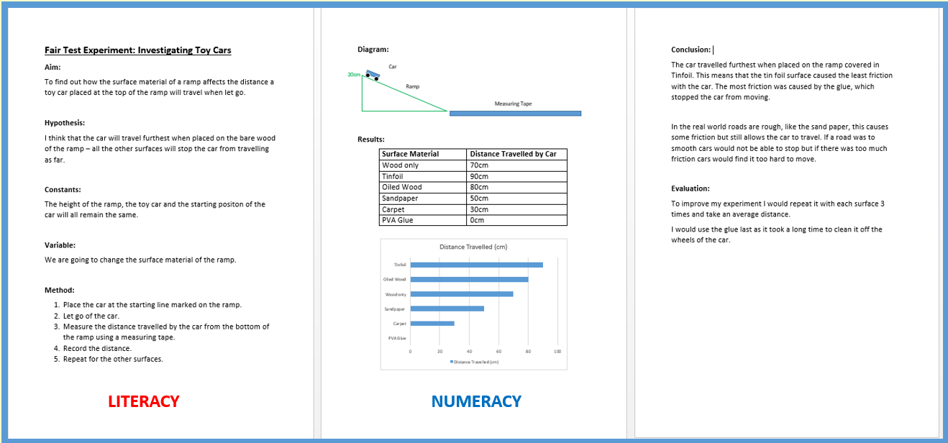
Science enquiry by fair testing: progression
Toy cars: Second Level: By altering the surface material of a ramp at a constant height find out which material generates the most friction and explain how you came to this conclusion. Relate your findings to car safety e.g., seatbelts, brakes, road conditions.
By investigating how friction, including air resistance, affects motion, I can suggest ways to improve
efficiency in moving objects. SCN 2-07a
Describes friction as a force which opposes the motion of moving objects, for example, two solid
surfaces rubbing against one another or a solid surface moving through air or water.
Demonstrates understanding of how friction and air resistance can both be useful, for example,
in braking systems, and also a problem, for example, causing moving parts to wear.
Notes:
Then they might write up the enquiry as a full report – this could possibly be used as an assessment in P7 after practising all the components of a fair test enquiry report?
There are obviously clear links to literacy and numeracy, The report includes a diagram, measurements, results recorded in a table and then presented as a graph.

Slide 46
Science enquiry by fair testing; Planning
Anne Goldsworthy is well known in primary science for her ‘Post it’ approach to planning.
It helps the children to:
identify what to change or vary
identify what to measure or observe
decide on one thing to change and one thing to measure, while keeping everything else the same
Notes:
You may have heard of Ann Goldsworthy and her Post it Approach to planning a fair test investigation with children?

Slide 47
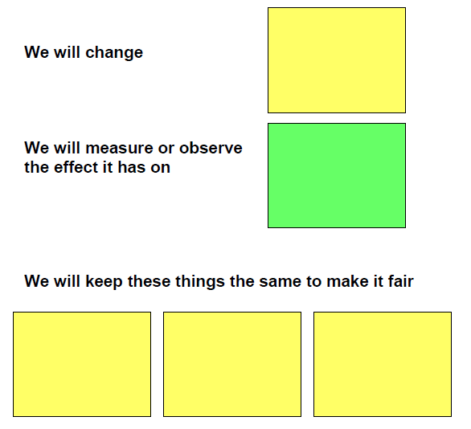
Science enquiry by fair testing; Planning
Use Post-it notes in two colours.
Choose one colour and ask the children to write one thing that could be changed. Use a new Post-it for each thing they think of. (If I change…(variable))
Using the second colour, write down one thing that could be measured/observed (What will happen to…) Use a new Post-it for each one
Notes:
Her method uses post-it notes in 2 colours; one colour to record the variables the things that could be changed) and the other colour to record the things that could be measured or observed.

Slide 48
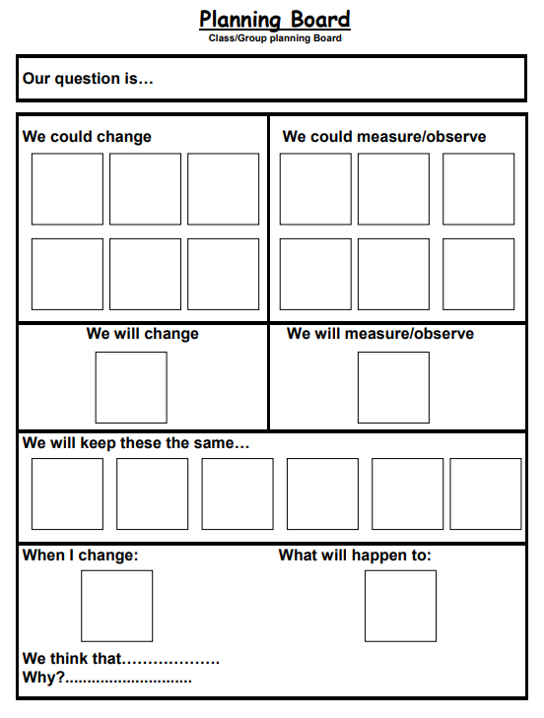
Use a planning template like this
Put all your variables in the top left box and all the things that you could measure or observe in the top right box.
Choose one post it note from each of the big top boxes and move it into the row below. Now put all your variable (things we could change) in the row ‘We will keep these the same…’
Now move the one from ‘we will change to the box ‘When I change and the one from, we will measure/observe to ‘what will happen to:
This last part of the planning sheet is to generate discussion and gather the children's ideas.
Notes:
You can see by going through this process several times that different investigations can be generated. By allowing different groups of children in the class to choose a different investigation to do rather than everyone doing the same one, it gives the children choice and a real purpose to the investigation because they are going to report back to the class.

Slide 49
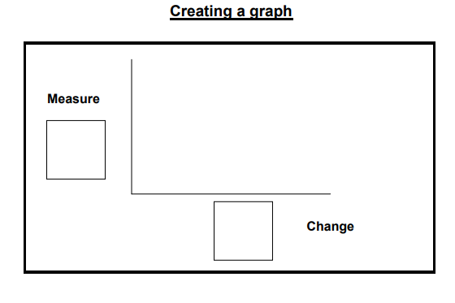
Creating a graph
Notes:
Just to show how easy it is then to show the children how to construct a graph of their results (if appropriate) – the ‘measure’ post it goes on the y axis and the thing that was changed goes on the x axis

Slide 50
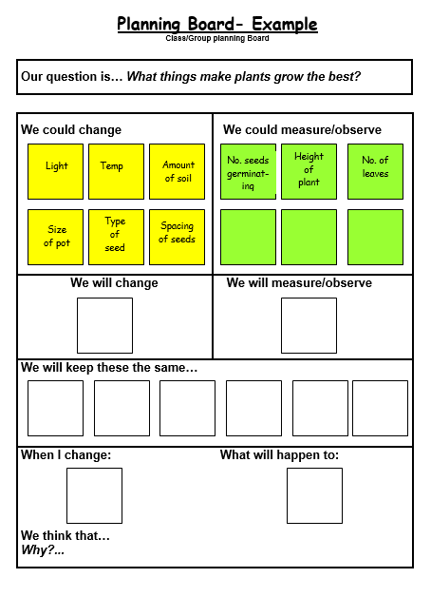
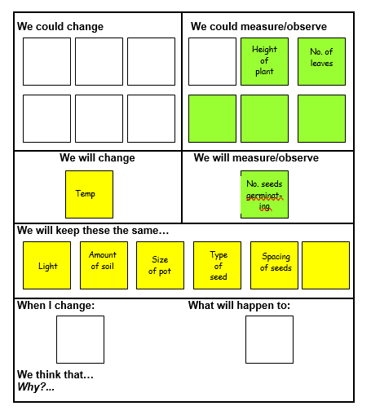
Notes:
So here is an example: What makes plants grow the best?
The things that could be changed are on yellow and the things that could be measured or observed are on green.
Start off by populating the top left hand and top right-hand corners of the planning board,
Choose one thing to change and move the Post it note down to ‘We will change’ and move the rest of them down to the ‘We will keep these the same…’
Choose one thing to measure or observe and move that Post it down to ‘We will measure/observe’.
Then move the one thing that is going to be changed down to ‘When I change’ and move the one thing that is going to be measured/or observed down to ‘What will happen to ‘ so that you can explore the children’s ideas/predictions etc.

Slide 51
Creating a graph

Slide 52
Making science enquiry ‘fair’
Fair testing is a specific way to set up a science enquiry by isolating and controlling variables.
But don’t forget that any science enquiry needs to be fair, even if it isn’t a fair test. To be more precise, what we really mean by ‘fair’ is valid.
Just because we can’t do a fair test, it doesn’t mean that we can’t make the enquiry fair!
Notes:
Fair testing is a specific way to set up a science enquiry but any science enquiry needs to be fair or ‘valid’!

Slide 53
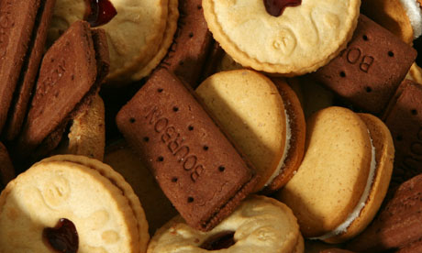
Different types of science enquiry: The biscuit curriculum!
Observing changes over time – put a biscuit in hot water and observe the changes
Pattern seeking/finding an association – the pattern or relationship between fat and calories
Identifying and classifying – sort the biscuits in a variety box by constructing a key
Fair testing – which biscuit is the best biscuit for dunking?
Researching using secondary sources
– how do they make jammy dodgers?
Notes:
Just a reminder that one context can provide opportunities for different types of enquiry!

Slide 54
Curriculum for Excellence
Science skills:
Observing and exploring
Classifying
Fair test
Finding an association
Notes:
Something to be aware of: the terminology in the Curriculum for Excellence documents is slightly different from that used in other publications but it is not that different!

Slide 55
Some things to consider/suggestions…
For children there is not always an obvious link between the practical activities and the theory, so it is important to reinforce that link
It can be worth spending time teaching the children how to use the equipment before the experiment (e.g. pipette, measuring cylinder, microscope etc.)
Teamwork can result in one person doing most of the work!
It is important to teach the concepts and ensure learning in science is not just doing the activity!
Have a working scientifically notice board with a display that changes to a new type of enquiry each half term
Display high-quality examples of scientific enquiry work from each class or year group and identify key features and progression
Notes:
A few general things to consider and a few suggestions some of which I am sure you have already thought about!

Slide 56
Review and next steps…
Think about what your class has done recently in science. What different kinds of enquiry have gone on?
How can you build in more opportunities for science enquiry?
Can you see ways to extend science enquiry beyond fair testing with your class?
Please share your ideas and thoughts!
Notes:
Time to pause and reflect!

Slide 57
References
J Turner, B Keogh, S Naylor & L Lawrence (2011) It’s not fair – or is it? A guide to developing children’s ideas through primary science enquiry. Millgate House & ASE.
A Goldsworthy & R Feasey (1994) Making sense of primary science investigations. ASE.
B Keogh & S Naylor (2010) Science Questions stories. Millgate House.
J Moules, J Horlock, S Naylor & B Keogh (2014) Concept Cartoons Set 2. Millgate House.
Scientific Enquiry (The Association for Science Education updated 2018)
Enquiring science 4 all poster set: download here
Thank you to Colin Dorman (STEM officer, North Lanarkshire Council) for some of the examples of progression in science enquiry
Notes:
Just some general references. I would strongly recommend the first book on the list! It has lots of ideas and practical examples for all 5 types of science enquiry.

Slide 58
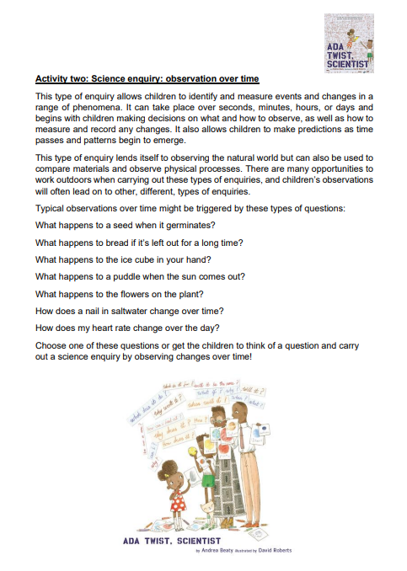
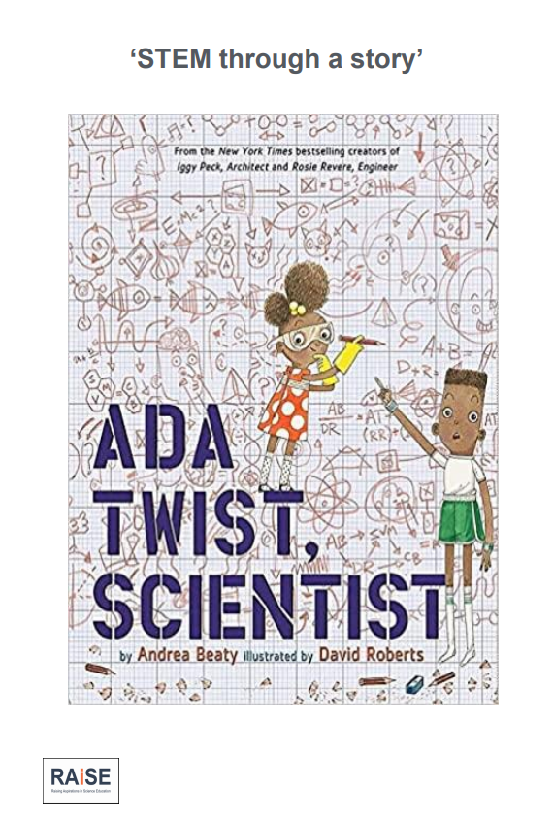
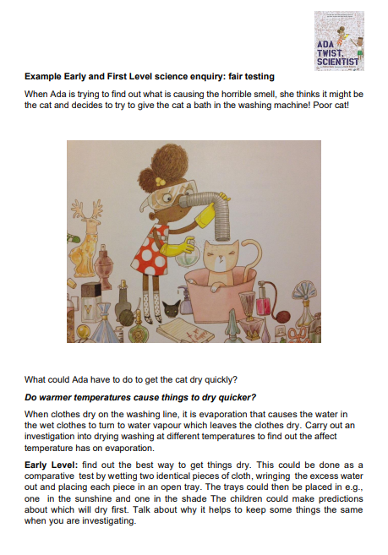
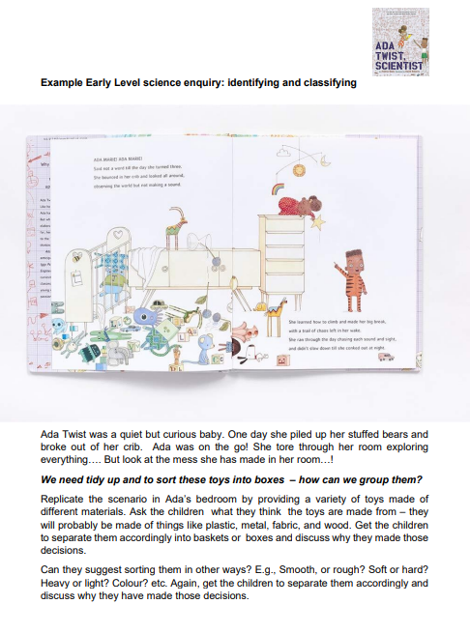

Slide 59
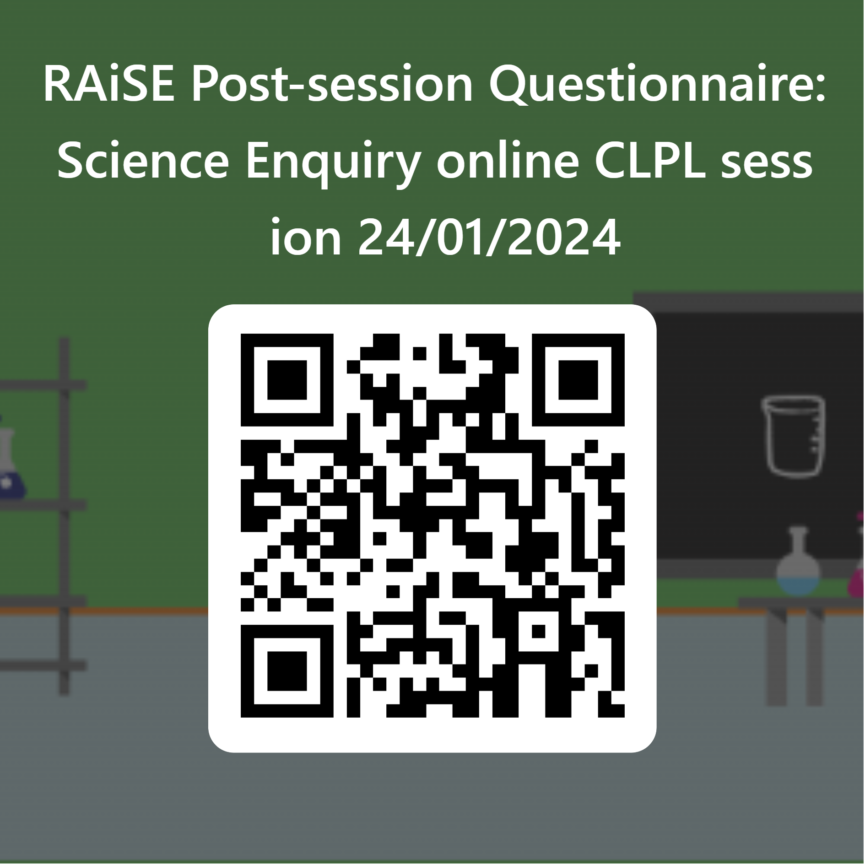
https://forms.office.com/e/NbeyV6PSJq

