Slide 1
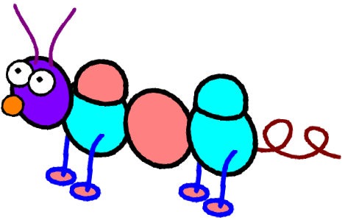
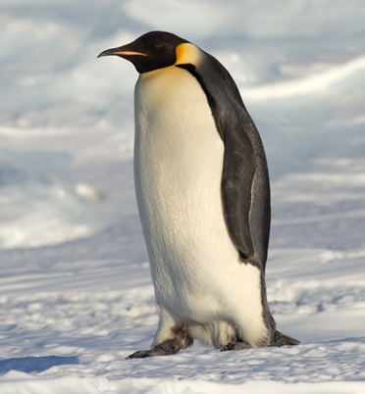
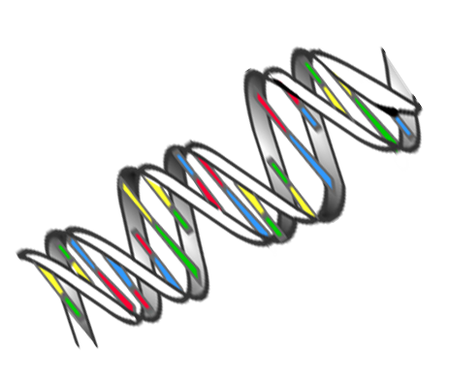
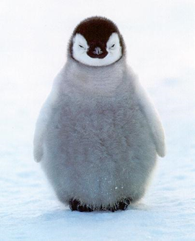

INHERITANCE
CLPL Session: 2024
Kim Aplin (RAiSE PSDO, Aberdeenshire)

Slide 2
Curriculum for Excellence
Biological systems and cells Inheritance
‘Starting with observations of similarities and differences between individuals, learners develop their understanding of how organisms develop and pass on genetic information to the next generation. They begin to develop their knowledge of genetics and of the role of DNA and examine moral and ethical questions which arise from technological developments’.

Slide 3
Big ideas of the science of inheritance (Early – Second Levels)
Genetic information is passed down from one generation to another
Genetic information in a cell is held in the chemical DNA
Genes determine the development and structure of organisms
In asexual reproduction all the genes in the offspring come from one parent
In sexual reproduction half of the genes come from each parent
Living things produce offspring of the same kind, but offspring are not identical with each other or with their parents
Plants and animals, including humans, resemble their parents in many features because information is passed from one generation to the next
Other features, such as skills and behaviour, are not passed on in the
same way and have to be learned.

Slide 4
No ‘Outcome’ for Early Level for Inheritance but a close link to:
I recognise that we have similarities and differences but are all unique. HWB 0-47a
Benchmarks:
Identifies body differences and similarities.
By comparing generations of families of humans, plants and animals, I can begin to understand how characteristics are inherited. SCN 1-14a
Benchmarks:
Uses their own experiences to illustrate how inherited characteristics are passed from one generation to the next
Knows that genetic information determines characteristics such as colour of eyes and shape of petals.
Demonstrates understanding of the variations within family groups.
By investigating the lifecycles of plants and animals, I can recognise the different stages of their development.
SCN 2-14a
By exploring the characteristics offspring inherit when living things reproduce, I can distinguish between inherited and non-inherited characteristics. SCN 2-14b
Benchmarks:
Knows that genetics is the study of inherited characteristics and that inherited characteristics are carried on genes and can sometimes skip a generation.
Explores and categorises characteristics into inherited (eye and hair colour, height and right/left handedness) and non-inherited (native language spoken and favourite colour).
Describes how every living thing has its own DNA fingerprint.

Slide 5
Some definitions….
What is heredity/inheritance? Heredity/inheritance is when certain traits are passed from parents to child/offspring
What are traits? Traits are characteristics such as eye colour, height, skin colour, blood type etc.
How is heredity passed from parents to child/offspring? Heredity is passed through genes in the DNA molecule. All of us/all offspring are made up of DNA from both mother and father that is why we/they have characteristics from both parents.
What is the study of heredity called? Genetics.
What is DNA? DNA is a molecule made up from a group of atoms stuck together. DNA is the molecular blueprint/ or recipe for a living thing. DNA ‘tells’ amino acids how to line up/group together to create proteins. This process is based on chemistry.
What is RNA? RNA is a partial copy of DNA code but shorter and is a single strand (as opposed to the double stranded DNA). RNA fits through tiny pores in the cell nucleus and into the surrounding cytoplasm and provides the code so that proteins can be built from amino acids. These new proteins then form e.g., new cells.
What are amino acids? Amino acids are very important, tiny chemicals inside our body that are referred to as ‘the building blocks of life’. There are approximately 20 different kinds, each with their own shape. Amino acids combine to make proteins, which combine to form cells, which make tissues, which make organs, which form living creatures.
What is a gene? A gene is a segment of DNA that codes for something. Each gene tells a cell how to make a protein or a group of proteins. Different creatures have different genes, but all genes are written in the same basic DNA language.
What is a chromosome? A chromosome is an entire chain of DNA plus proteins. Humans typically have 23 pairs of chromosomes in each cell (46 all together). One member of each pair comes from the father, and one comes from the mother.
People look like people. Every person is unique, but they have far more in common than they are different. This is because we are all related and we have all inherited characteristics from our ancestors.
What is DNA and How Does it Work? – YouTube
What is a gene? – YouTube
What is a Chromosome? - YouTube

Slide 6

Early Level
I recognise that we have similarities and differences but are all unique. HWB 0-47a
Benchmarks:
Identifies body differences and similarities.

Slide 7
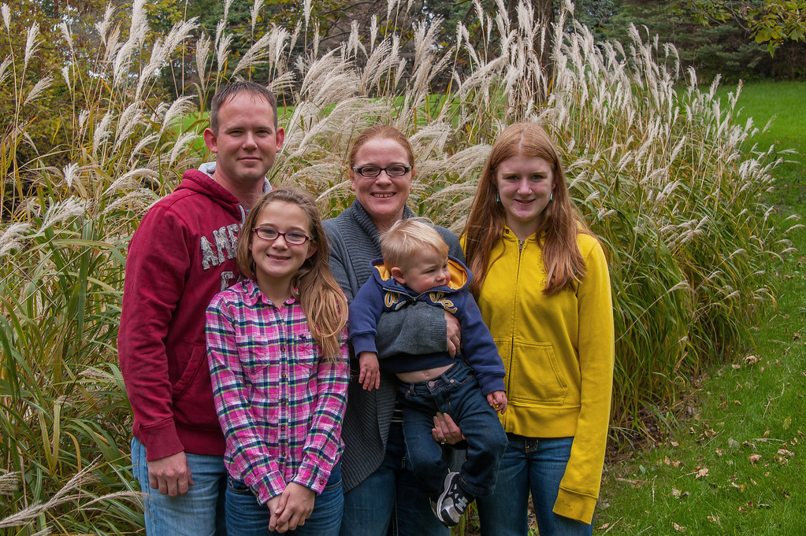
Dad
Mum
Isla
Discuss and describe different physical features, identifying similarities and differences. For example:
This is Isla. What colour is Isla's hair? (red)
What do you notice about Isla’s hair? (It is like her Mum’s)
This is Isla’s sister, Emma. How is Isla's hair different from Emma's hair? (Emma’s hair is brown, like her Dad’s )
This is Ben. What colour is Ben’s hair? (blonde)
What do you notice about Emma and her Mum? (They both wear glasses)
What do you notice about Ben’s hair and Dad’s hair? (They have short hair)
In order from tallest to smallest, name the characters (Dad, Mum + Isla, Emma and Ben)
Why is Ben the smallest? (He is the youngest)
Are the oldest people always the tallest? (No, people can be shorter than people that are older than them. People are all different heights)
Emma
Ben
I recognise that we have similarities and differences but are all unique. HWB 0-47a
Benchmarks:
Identifies body differences and similarities.

Slide 8
Provide each child /group with an A3 copy of a body outline and ask them to share their thoughts about the body outlines:
Do you think this body outline is a boy or girl? Why? (The children may give a range of ideas, encourage them to justify their ideas E.g., Boy - looks like it has short hair. Do all boys have short hair?)
How is this body outline the same as your body? (legs, arms, fingers, head, etc)
How is it different? (I am shorter/taller, I have long hair, I have eyes/nose/other features not identifiable on the outline)
What parts of our bodies are quite similar to other people’s bodies? (arms, legs, brain, lungs, heart, toes, etc)
What parts of our bodies can be very different to other people? (hair - colour, curls/straight, eye colour, height etc. This might lead to the children discussing the difference between boys and girls)
This also provides a good opportunity to talk about body diversity. Some people are not born with some body parts, some people may have had injuries that mean their bodies look/work differently .

Slide 9
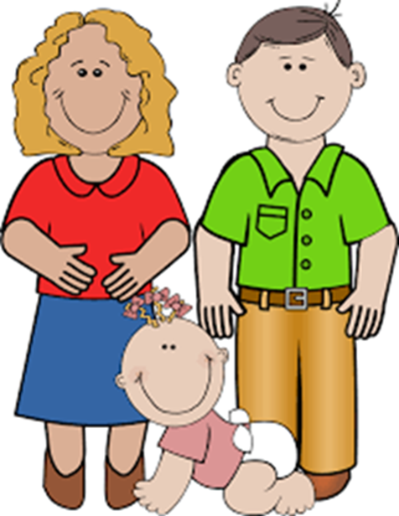
First Level
By comparing generations of families of humans, plants and animals, I can begin to understand how characteristics are inherited. SCN 1-14a
Benchmarks:
Uses their own experiences to illustrate how inherited characteristics are passed from one generation to the next.
Knows that genetic information determines characteristics such as colour of eyes and shape of petals.
Demonstrates understanding of the variations within family groups.
Why do offspring/children often look like their parents in some way?
All living creatures create offspring of the same kind, but the offspring are not identical copies of their parents.
When living things reproduce, they pass on characteristics, known as traits, to their offspring.
Offspring/ children look like their parents because of these inherited characteristics.
These are determined/passed on by something called genes/genetic material.

Slide 10
Variation within our own species
Children/offspring are not identical to their parents or their brothers and sisters/litter-mates, hatchlings, brood etc.
This is because children/offspring inherit some characteristics from each parent: half of the genes come from each parent, and that’s why they resemble their parents, but are not identical to them or to each other.
These differences are called VARIATION

Slide 11
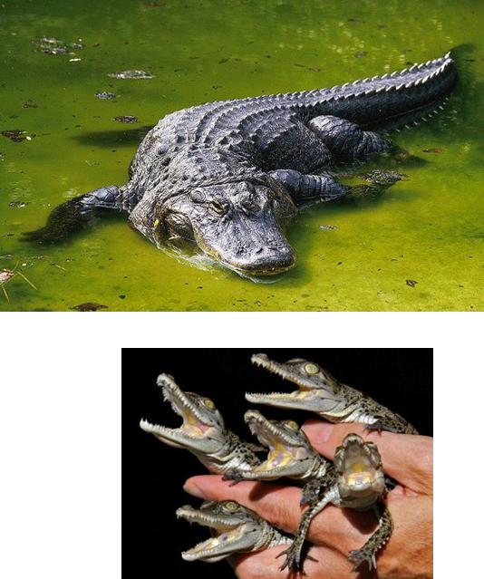
Inherited Characteristics
Whose baby are you?
This matching activity can be used to introduce the idea that an animal’s offspring often resembles their parents in some way (because genetic material is inherited).
Do the babies look exactly like their parents?
- what things are the same or similar, what things are different?
Do the babies look exactly like each other?

Slide 12
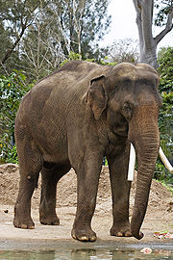
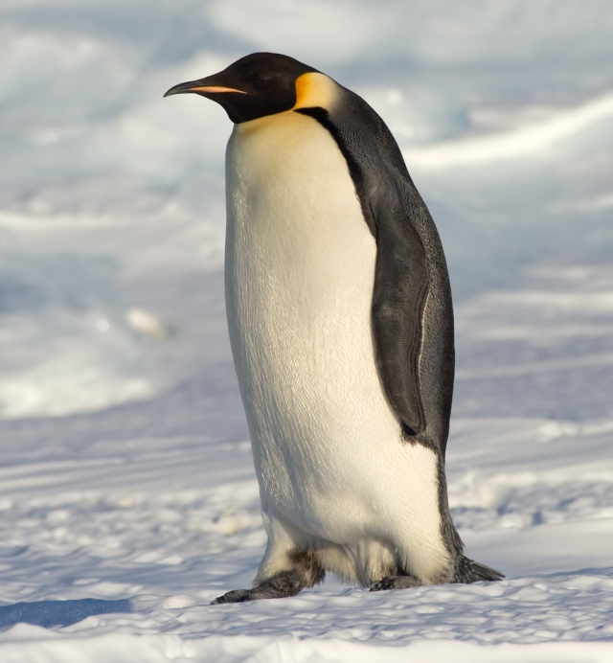
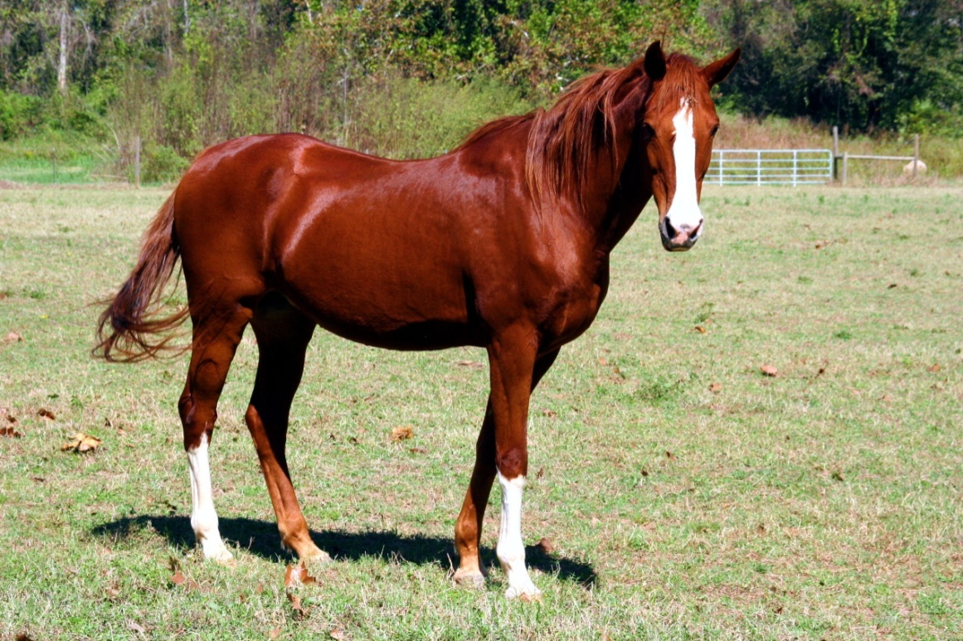
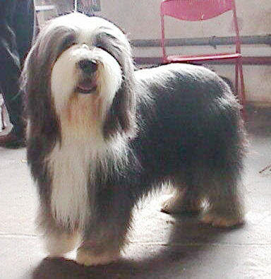
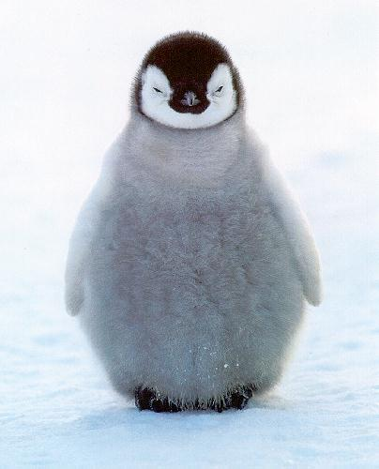

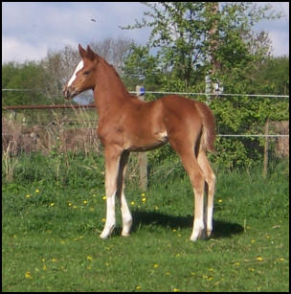
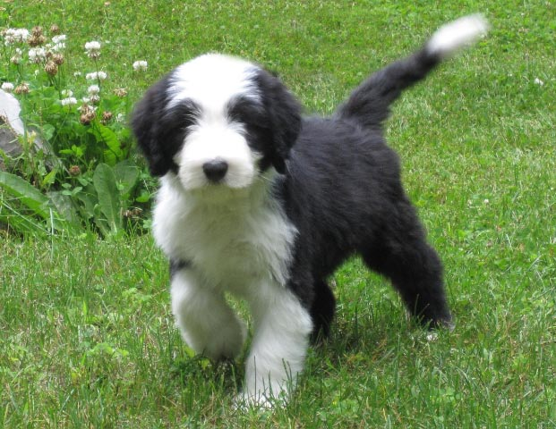
Inherited Characteristics

Slide 13
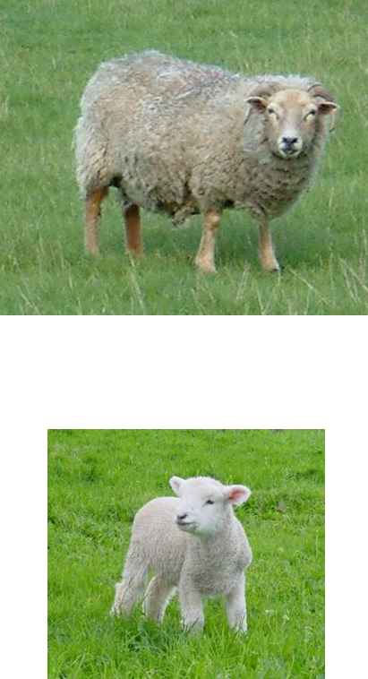
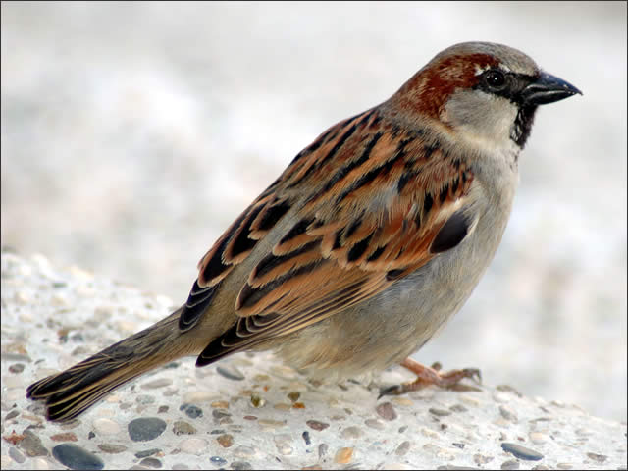
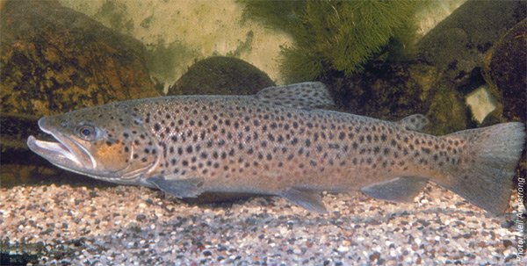
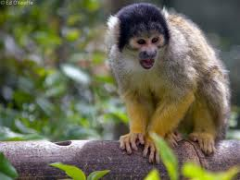
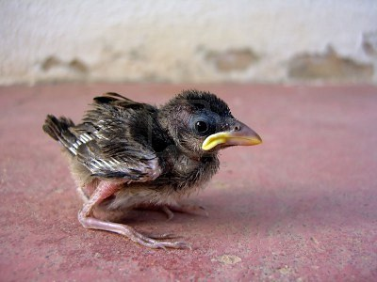
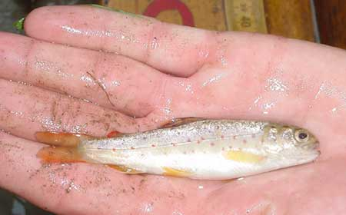
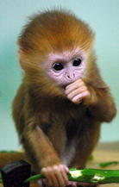
Inherited Characteristics

Slide 14
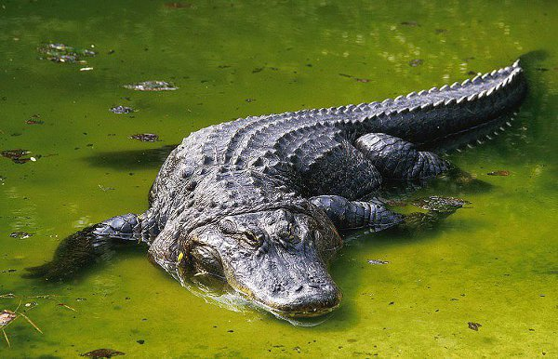
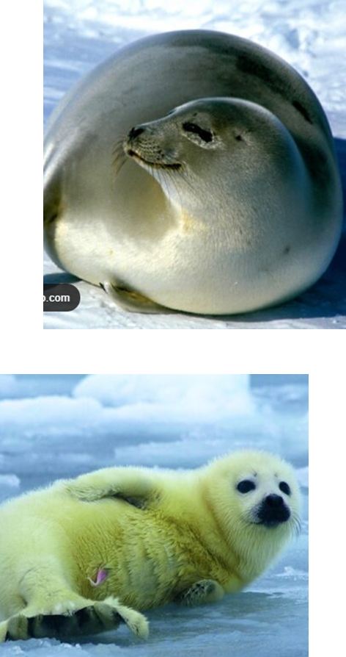
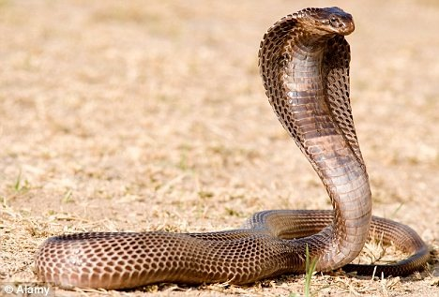
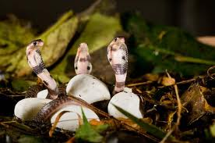
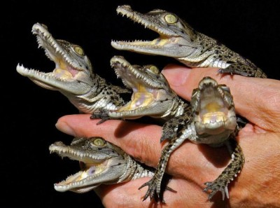
Inherited Characteristics

Slide 15
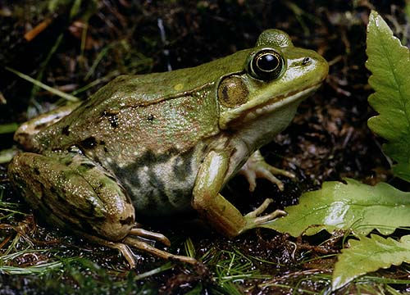
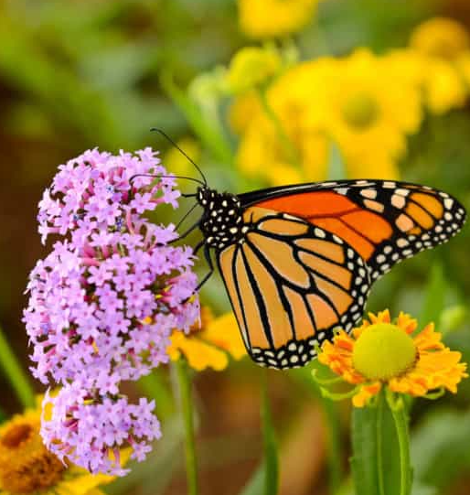
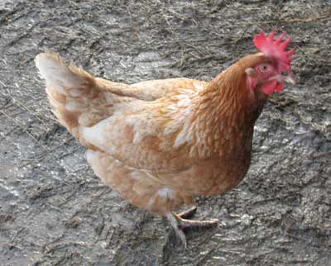
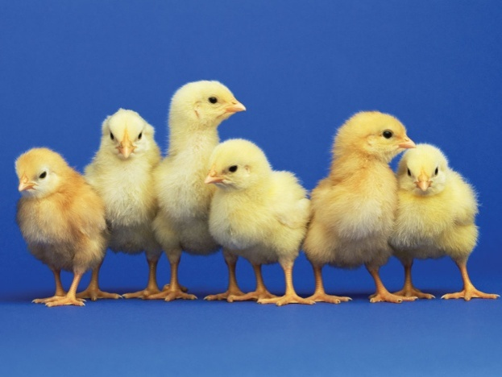
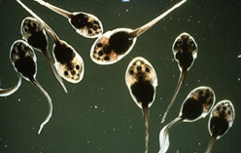
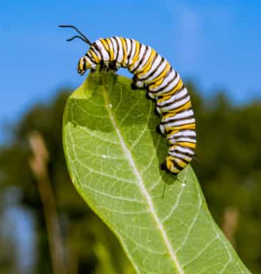
Inherited Characteristics

Slide 16
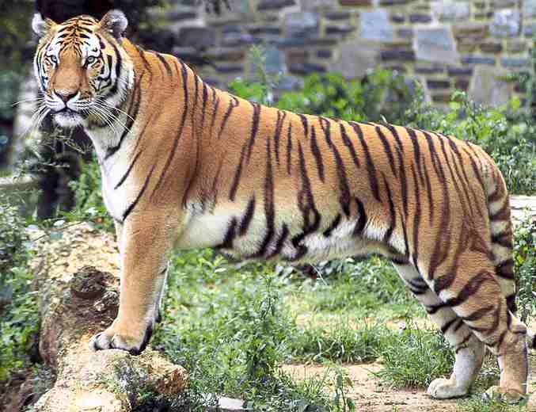
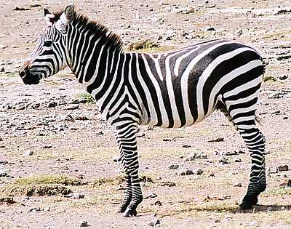
Looking for similarities and differences
Think about similarities and differences across different species.
i.e. there can be similarities between species, but these are NOT inherited from each other
Activity:
Look at the animals on the following slides.
List as many similarities as you can.
List as many differences as you can.

Slide 17
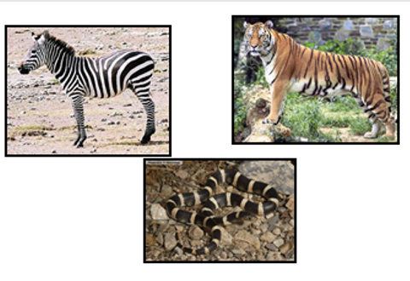

Slide 18
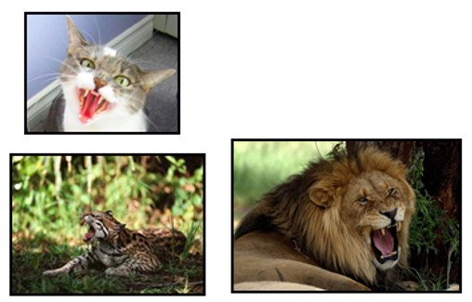

Slide 19
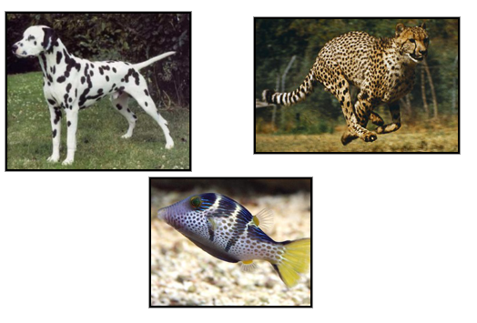

Slide 20
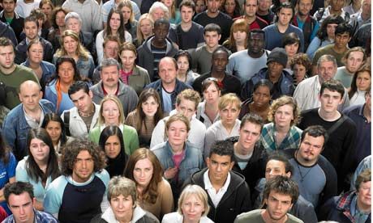
Variation is all around us; both between species and within the same species.
Let’s look at the variation within our own species.

Slide 21
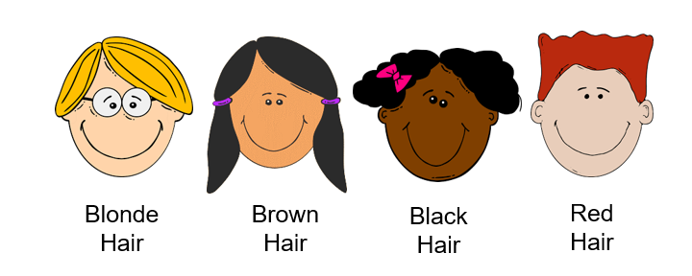
Inherited characteristics
Inherited Characteristics are those we get from our parents and/or grandparents.
They are aspects of our bodies or our abilities which are passed down through the generations.
They can also determine some aspects of your appearance…
…such as
Hair Colour

Slide 22
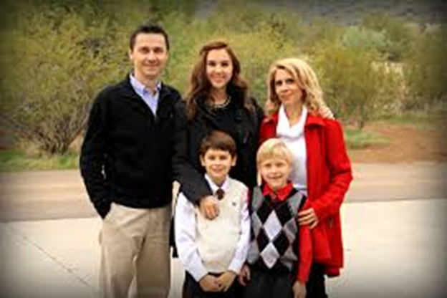
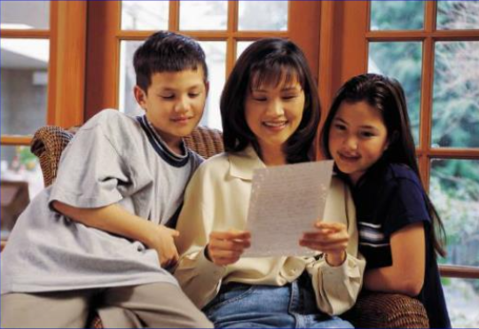
Inherited Characteristics
What do you notice?

Slide 23
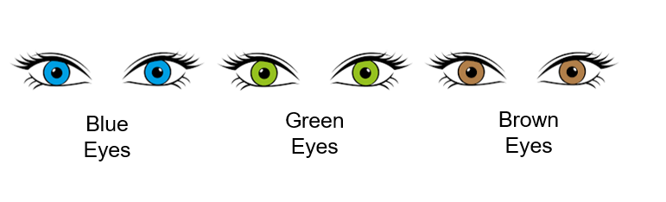
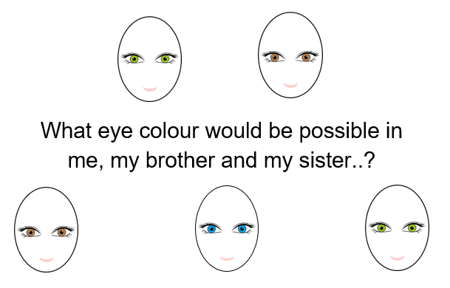
Inherited Characteristics
Eye Colour

Slide 24
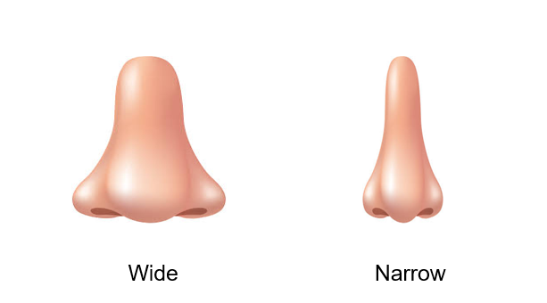
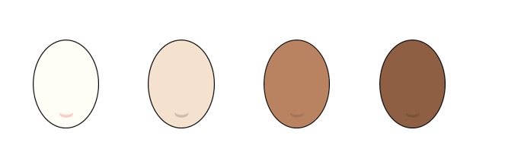
Inherited Characteristics
Nose Shape
Skin tone

Slide 25
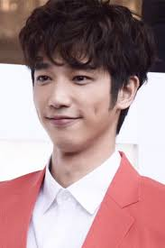
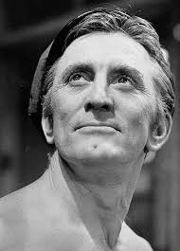
Inherited Characteristics
Dimples
Cheek Dimples
Chin Dimple
Do you have dimples?

Slide 26
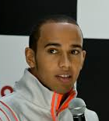
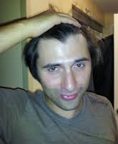
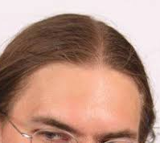
Hairline
Inherited Characteristics
Widow’s Peak
Round
Straight
Help your partner – what do you each have?
Are you the same?

Slide 27

Plants!
Inherited Characteristics
Plants also inherit things from their parent flower!
How do you know? The new plants look like their parent plants.
Ask the children what type of things do they think they inherit?

Slide 28
Inherited Characteristics
They include…
Colour of the flower
Number of petals
Shape of the petals
Shape of the leaves
Length of the stem
Shape of the seed
Colour of the seed
Position of the flower on the stem
Flower scent
How many of these did you think of?

Slide 29

Look closely…
Inherited Characteristics
What things do you think this flower inherited?

Slide 30

Inherited Characteristics
Shape of the flower
Red colour
Long stem
Long leaves
Crescent-shaped leaves

Slide 31

Inherited Characteristics
Can you see what is being inherited?

Slide 32

Inherited Characteristics
Activity: Try it yourself with your own flowers!

Slide 33

Activity: Try it yourself with these flowers!
From:
Inherited Traits Plant activity- for notebook or bulletin board display (thesciencezone.org)

Slide 34
Activity: Try it yourself with these flowers!
Characteristics (traits) of each parent plant
Parent 1 | Parent 2
Orange petals | Purple petals
Yellow centre | Brown centre
Dark green leaves | Light green leaves
Dark green 7 cm stem | Light green 9 cm stem
From:
Inherited Traits Plant activity- for notebook or bulletin board display (thesciencezone.org)

Slide 35
Inherited Characteristics
Build Lego ‘animals’ (towers) – use 4 blocks of Lego to create a daddy ‘animal’ and a mummy ‘animal’ with different colour combinations.
Children can then make a baby ‘animal’ using two blocks from daddy and two blocks from mummy to physically demonstrate the passing down of features.

Slide 36

Second Level
By exploring the characteristics offspring inherit when living things reproduce, I can distinguish between inherited and non-inherited characteristics. SCN 2-14b
Benchmarks:
Knows that genetics is the study of inherited characteristics and that inherited characteristics are carried on genes and can sometimes skip a generation.
Explores and categorises characteristics into inherited (eye and hair colour, height and right/left handedness) and non-inherited (native language spoken and favourite colour).
Describes how every living thing has its own DNA fingerprint.

Slide 37


Slide 38
True or false?

Slide 39
True or false?
False
False
Odds are that the baby will have brown eyes, but if either or both parents have family members with blue or lighter-shade eyes, there is a chance that the baby could have an eye colour other than brown.
True
False
Sometimes traits can skip a generation.
True
True

Slide 40
Variation within a population: inherited and non-inherited traits
Variation (differences) between individuals of the same species/within a population , is caused by genetic and environmental factors.
These can be split into:
Discrete variation: characteristics that are genetically controlled (no other influence) e.g. tongue rolling, blood groups etc
You either have the trait or you don’t!
Continuous variation: characteristics that may have some genetic influence, but environmental factors influence these e.g. height, weight, hand-span etc

Slide 41
Inherited Characteristics?
Height standing (cm)
Height sitting (cm)
Outstretched arm span (cm)
Left foot length (cm)
Right foot length (cm)
Head circumference (cm)
Resting pulse rate (beats per min)
Right thumb print
Left thumb print
Can you roll your tongue?
Do you have blue eyes?
Are you right-handed?
Do you have a hitchhiker’s thumb?
Is your second toe longer than your “big” toe?
Do you have dimples?
Do you have unattached earlobes?
Do you have a straight hairline (cf widow’s peak)?
Do you have freckles?
Are you male?
Clasp your hands – is your right thumb on top?
Do you have curly hair?

Slide 42

Variation within a population
Activity: let’s look at the discrete characteristics of this group!
Place a sticker on the chart:
My characteristics (Discrete) | Yes | No
Can you roll your tongue?
Do you have blue eyes?
Are you right-handed?
Do you have a hitchhiker’s thumb?
Is your second toe longer than your “big” toe?
Do you have dimples?
Do you have unattached earlobes?
Do you have a straight hairline?
Do you have freckles?
Are you male?
Clasp your hands – is your right thumb on top?
Do you have curly hair?

Slide 43

Variation within a population
Collect some class data and graph the results
Links with: I have carried out investigations and surveys, devising and using a variety of methods to gather information and have worked with others to collate, organise and communicate the results in an appropriate way. MNU 2-20b
Discrete variation data will produce a graph like this:
e.g. % of population and blood group
My characteristics (Discrete) | Y (yes) or N (no)
Can you roll your tongue?
Do you have blue eyes?
Are you right-handed?
Do you have a hitchhiker’s thumb?
Is your second toe longer than your “big” toe?
Do you have dimples?
Do you have unattached earlobes?
Do you have a straight hairline?
Do you have freckles?
Are you male?
Clasp your hands – is your right thumb on top?
Do you have curly hair?

Slide 44

Variation within a population
My characteristics (Continuous)
Height standing (cm)
Height sitting (cm)
Outstretched arm span (cm)
Left foot length (cm)
Right foot length (cm)
Head circumference (cm)
Resting pulse rate (beats per minute)
Right thumb print (arch, loop, whorl or composite)
Left thumb print (arch, loop, whorl or composite)
Continuous variation data will produce a graph like this:
e.g. height
Collate the data into a ‘class’ list so that everyone can share the ‘class’ data. Each group chooses two of the measured characteristics (e.g. height and outstretched arm span) and plot each set of class data as a graph or use a computer spreadsheet programme. Repeat for other pairs of measured characteristics if time allows.
Which pair of measured characteristics are most closely related to each other?
E.g., do taller people have longer feet, bigger heads, faster pulse rates etc or
If you know someone’s arm span measurement , can you accurately predict their height?

Slide 45

By exploring the characteristics offspring inherit when living things reproduce, I can distinguish between inherited and non-inherited characteristics. SCN 2-14b
Benchmarks:
Knows that genetics is the study of inherited characteristics and that inherited characteristics are carried on genes and can sometimes skip a generation.
Explores and categorises characteristics into inherited (eye and hair colour, height and right/left handedness) and non-inherited (native language spoken and favourite colour).
Describes how every living thing has its own DNA fingerprint.
How does genetics work?

Slide 46











Where do our genes come from?
From our parents
Mother
Father
egg from mother
sperm from father
2 copies of DNA in each cell
2 copies of DNA in each cell
nucleus containing
1 copy of mother’s DNA
nucleus containing
1 copy of father’s DNA
Child
Cell divides
Fertilised egg
DNA from both parents
nucleus containing complete set of DNA (set=2 copies, 1 copy from each parent)
Each cell has a complete set of DNA

Slide 47












Meet our Mr Men…
…and our Little Misses
Now let's meet their children!

Slide 48






Who do you think the parents are?
1
2
6
3
4
5

Slide 50
Making Reebops
The purpose of this practical work is:
To examine how characteristics are inherited
To show how sexual reproduction is responsible for tremendous variation within a population
Investigate the factors that can influence an individual’s characteristics

Slide 51

Reebops
Mum chromosomes
A
a
Q
q
E
e
D
d
M
m
T
t
L
l

Slide 52
Reebops
Dad chromosomes
A
a
Q
q
E
e
D
d
M
m
T
t
L
l

Slide 53



Slide 54

Reebops
Baby No. 1
a
a
Q
q
E
e
D
d
M
m
T
T
L
l

Slide 55
Baby Reebops: Pedigree
Lay the chromosomes face down on the table and randomly pick one chromosome of each length. The blue half set and pink half set are the set of chromosomes for a new Reebop.
This set of chromosomes determines the baby’s characteristics. Using the genetic code you have created, make the baby Reebop!
Choose a name for your Reebop, fill in the pedigree card and place the baby in the nursery .

Slide 56


Genetic code for models
Pedigree card

Slide 57
Dominant, recessive and codominant genes
Pupils will be able to see dominant genes, such as in the gene for the number of eyes: EE and Ee give 2 eyes, E being dominant(or visible) while e is recessive (or hidden).
Recessive genes are only visible when there are two copies inherited, e.g. three eyes are only produced by ee combinations.
Codominant genes are different: each version of the gene is as strong as the other and each combination will give different results e.g.in the case of nose colour, QQ, Qq and qq all produce
different colours.

Slide 58
Ideas for discussion:
Place your Reebop in the “nursery” along with the other babies
What do you notice about the features of the babies?
How much genetic material does each parent provide?
Where is this genetic material stored in the parent?
Are there any babies that are identical?
How many babies are the same as their parents?

Slide 59


