Slide 1
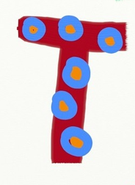
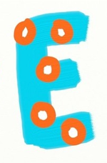
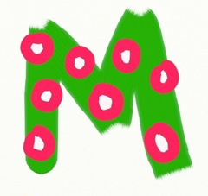
in the classroom and the use of technologies to support/ enhance STEM learning and teaching
Caroline Nicol & Kim Aplin RAISE PSDOs, Aberdeenshire

Slide 2
What is STEM?
Science
Technology
Engineering
Mathematics
Notes:
What is STEM? STEM stands for Science, Technology, Engineering and Mathematics. The reason that we often find these bundled together is that they are a set of very interrelated subjects that all share an emphasis on innovation, problem-solving, and critical thinking.
STEM is all around us in our every day lives – from a visit to the shops, following a recipe, using reasoning and problem-solving skills when faced with a challenge, in transportation, in entertainment etc. Without sometimes realising it, many of the experiences that we plan and carry out with the children have STEM skills embedded right at their core!
We are going to think briefly about each of these subjects and what they might look like as learning experiences in the classroom

Slide 3
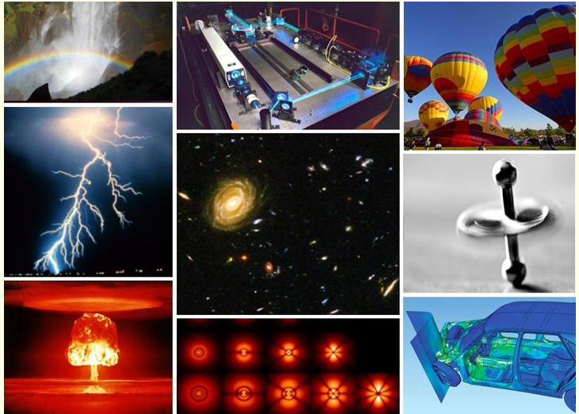
Defining Science
Science is…
“the pursuit and application of knowledge and understanding of the natural and social world following a systematic methodology based on evidence”
~ The Science Council
Notes:
Science! This definition comes from The Science Council which states…
Science is the pursuit and application of knowledge and understanding of the natural and social world following a systematic methodology based on evidence.
Science is about discovering new things. Using investigation and experimentation to understand ourselves and the world around us.

Slide 4
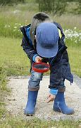
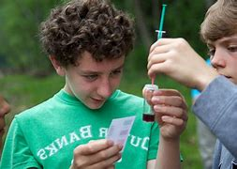
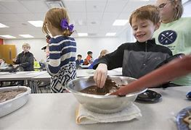
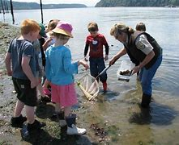
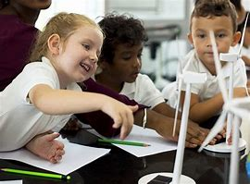
But in the classroom science is also this…
Developing curiosity about the world
Creativity and inventiveness
Problem solving
Learning through play and investigation
Asking questions, observing and experimenting
Notes:
But it is also this: exploring the changes in the colours of the leaves in Autumn, finding bugs and other animals, being inquisitive about the world, baking biscuits or making soup, watching puddles turn to ice and ice creams melting in the summer. It is about making predictions and exploring new and unfamiliar things

Slide 5
Defining Technology
Technology is…
“the study and knowledge of the practical, especially industrial, use of scientific discoveries”
~ Cambridge Dictionary
Notes:
Technology. According to the Cambridge dictionary, Technology is the study of knowledge of the practical, especially industrial, use of scientific discoveries. In other words, about the development and use of new, practical, innovative things to support us in our everyday lives and work.

Slide 6
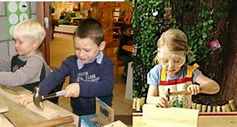
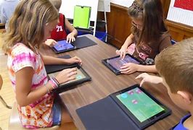
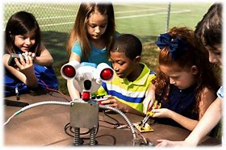
But in the classroom technology is also this…
Creativity, exploration, curiosity and discovery
Identifying patterns in the world around me
Skills in using tools, equipment, software, graphic media and materials
Making connections between skills developed within learning and those in the world of work
Sustainability
Communication
Notes:
Children using technology to document new things and share their learning with others. Taking photographs and videos, playing games, using Beebots and robots. Technology includes using tools to construct new and exciting structures from natural materials. It is about working with others to make connections in our daily lives.

Slide 7
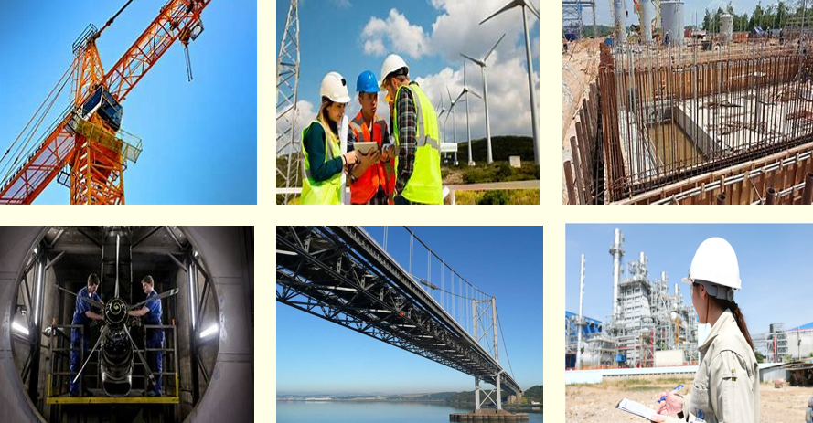
Defining Engineering
Engineering is…..
“a specific branch of the technologies, drawing on scientific methods and knowledge to address and solve real-world problems”
~ ekosgen, for Skills Development Scotland
Notes:
Engineering is a specific branch of the technologies, drawing on scientific methods and knowledge to address and solve real-world problems.

Slide 8
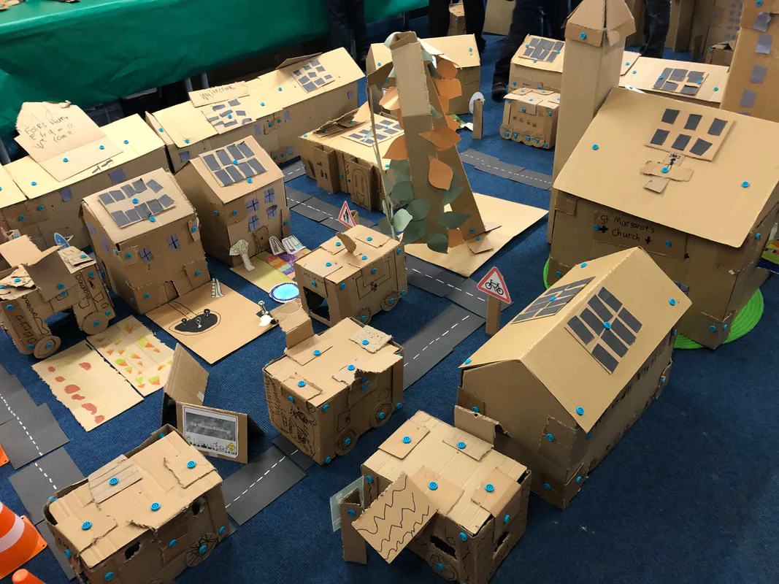
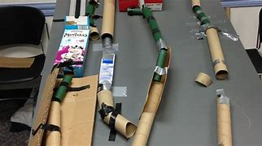
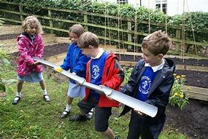
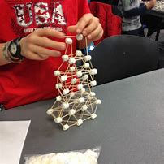
But in the classroom engineering is also this…
Designing, building and testing new things
Problem seeking and solving
Creativity and imagination
Exploring
Teamwork
Notes:
Exploring new materials and using them in creative and innovative ways. Building dens and forts in the outdoors. Creating amazing structures, playing with pipes, water, ramps and more – believing in the impossible and setting out to create something new.

Slide 9
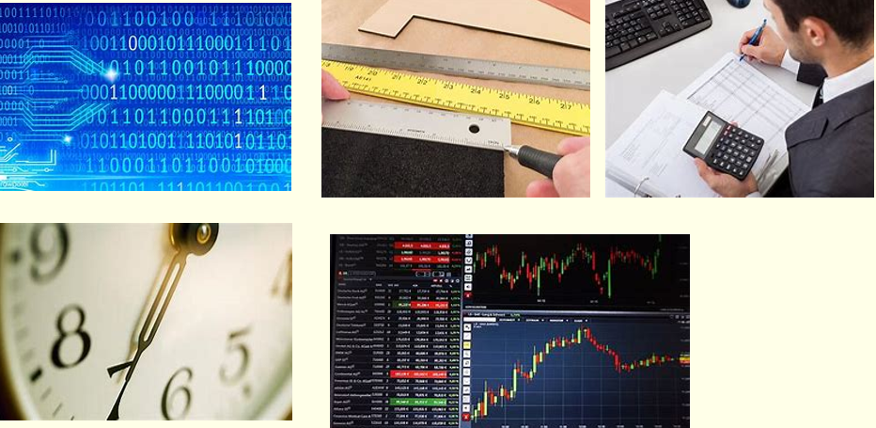
Defining Mathematics
Mathematics is…..
“All of STEM is underpinned by Mathematics, which includes numeracy, and equips us with the skills and approaches we need to interpret and analyse information, simplify and solve problems, assess risk and make informed decisions.”
~ Scottish Government, 2017

Slide 10
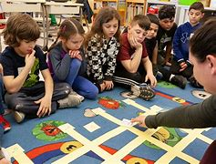
But in the classroom Mathematics is also this…
Exploring size, shape and number in the world around me
Sharing, matching and sorting
Problem solving and creativity
Collecting and gathering
Exploring the seasons, time and space
Making meaningful connections

Slide 11
STEM learning in the classroom and how we can use digital technologies to enhance/support learning and teaching

Slide 12
Digital technologies as part of STEM learning and teaching
Evidence of learning – e.g. pupils capture examples of learning and demonstrate understanding in creative and meaningful ways e.g. photos, videos, presentations, researching, creating a science journal
Assessment – e.g. creation of quizzes using Office 365 that auto-assess.
Flipped learning – e.g. Learning can be shared with pupils before and after learning via tools such as Glow blogs, MS OneNote, Google Classroom

Slide 13
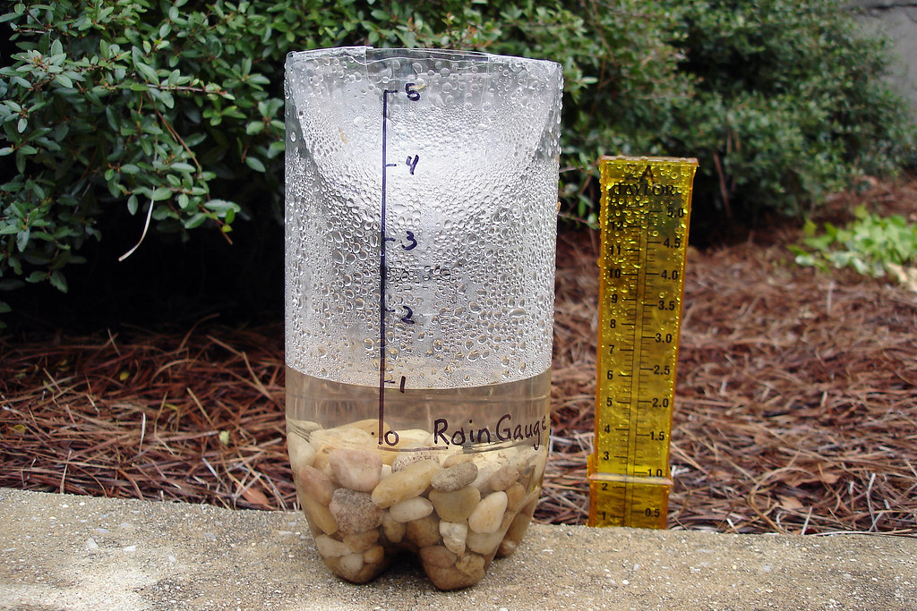
STEM in the Outdoors
Can you create an instrument to measure and record (e.g. wind, rain or temperature) the weather using natural and other resources?
Learners work together and using natural resources and/or additional materials, create an instrument to measure the weather. They explain how their instrument works and justify their choice of materials.
They record the weather using their instrument; this could involve recording data on a table, making sketches or taking photographs. Learners then display their data appropriately.
By using a range of instruments, I can measure
and record the weather and discuss how
weather affects my life. SOC 1-12a
I can estimate how long or heavy an object is,
or the amount it holds, using everyday things
as a guide, then measure or weigh using
appropriate instruments. MNU 1-11a
By safely observing and recording the sun and
moon at various times, I can describe their
patterns of movement and changes over time.
I can relate these to the length of a day, a
month and a year. SCN 1-06a
I can design and construct models and explain
my solutions. TCH 1-10a
Use an Excel spreadsheet to analyse the data
This Photo by Unknown Author is licensed under CC BY-NC

Slide 14
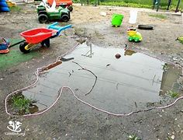
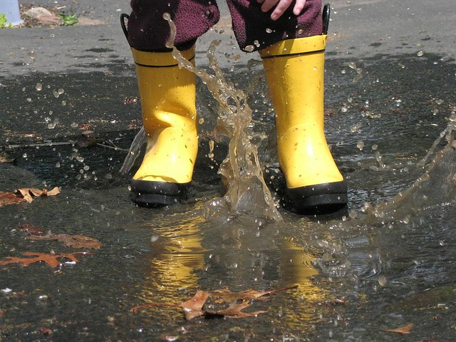
STEM in the Outdoors
How long does it take for a puddle to evaporate?
Learners explore the change in state of water on a sunny day.
I can explain how different methods can
be used to find the perimeter and area of a simple 2D shape or volume of a simple 3D object. MNU 2-11c
I can apply my knowledge of how water
changes state to help me understand
the processes involved in the water cycle in nature over time. SCN 2-05a
Use a camera with a time-lapse function to capture the puddle evaporating

Slide 15
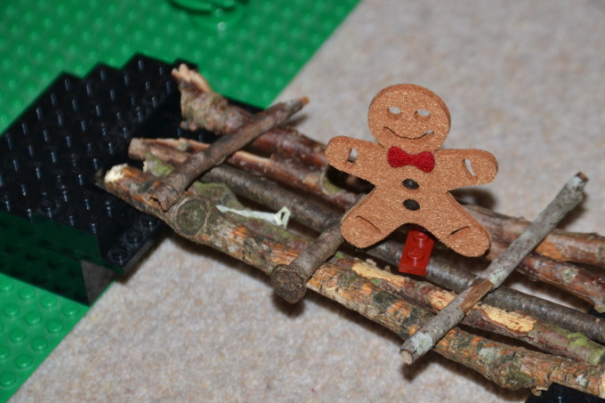
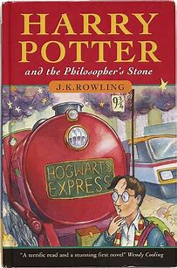
STEM through Stories
Help the Gingerbread Man by building him a bridge to stop him being eaten by the fox
Do different types of chocolate melt at the same temperature?
Use a camera with a time-lapse function to watch the chocolate melting
Build ‘Golden Snitch’ catapults
Build a rocket to help Baby Bear get to the moon!
Use a ’slow-mo’ app or
video in slow motion to analyse the performance of the catapult
Notes:
Children’s stories provide a great context for learning STEM! They can be used with younger children as an introduction to learning how to set up investigations correctly and how to work scientifically and can be used for thinking about variables and ‘fair test’ investigations with older children.
Stories can also provide a context for many engineering challenges too!

Slide 16
SPACE
Pupils photograph the phases of the moon and put the photos together in an animation or presentation to show the lunar cycle.
Use apps to learn about the stars, planets and Space e.g. Scale of the Universe
The Scale of the Universe 2 (htwins.net)

Slide 17
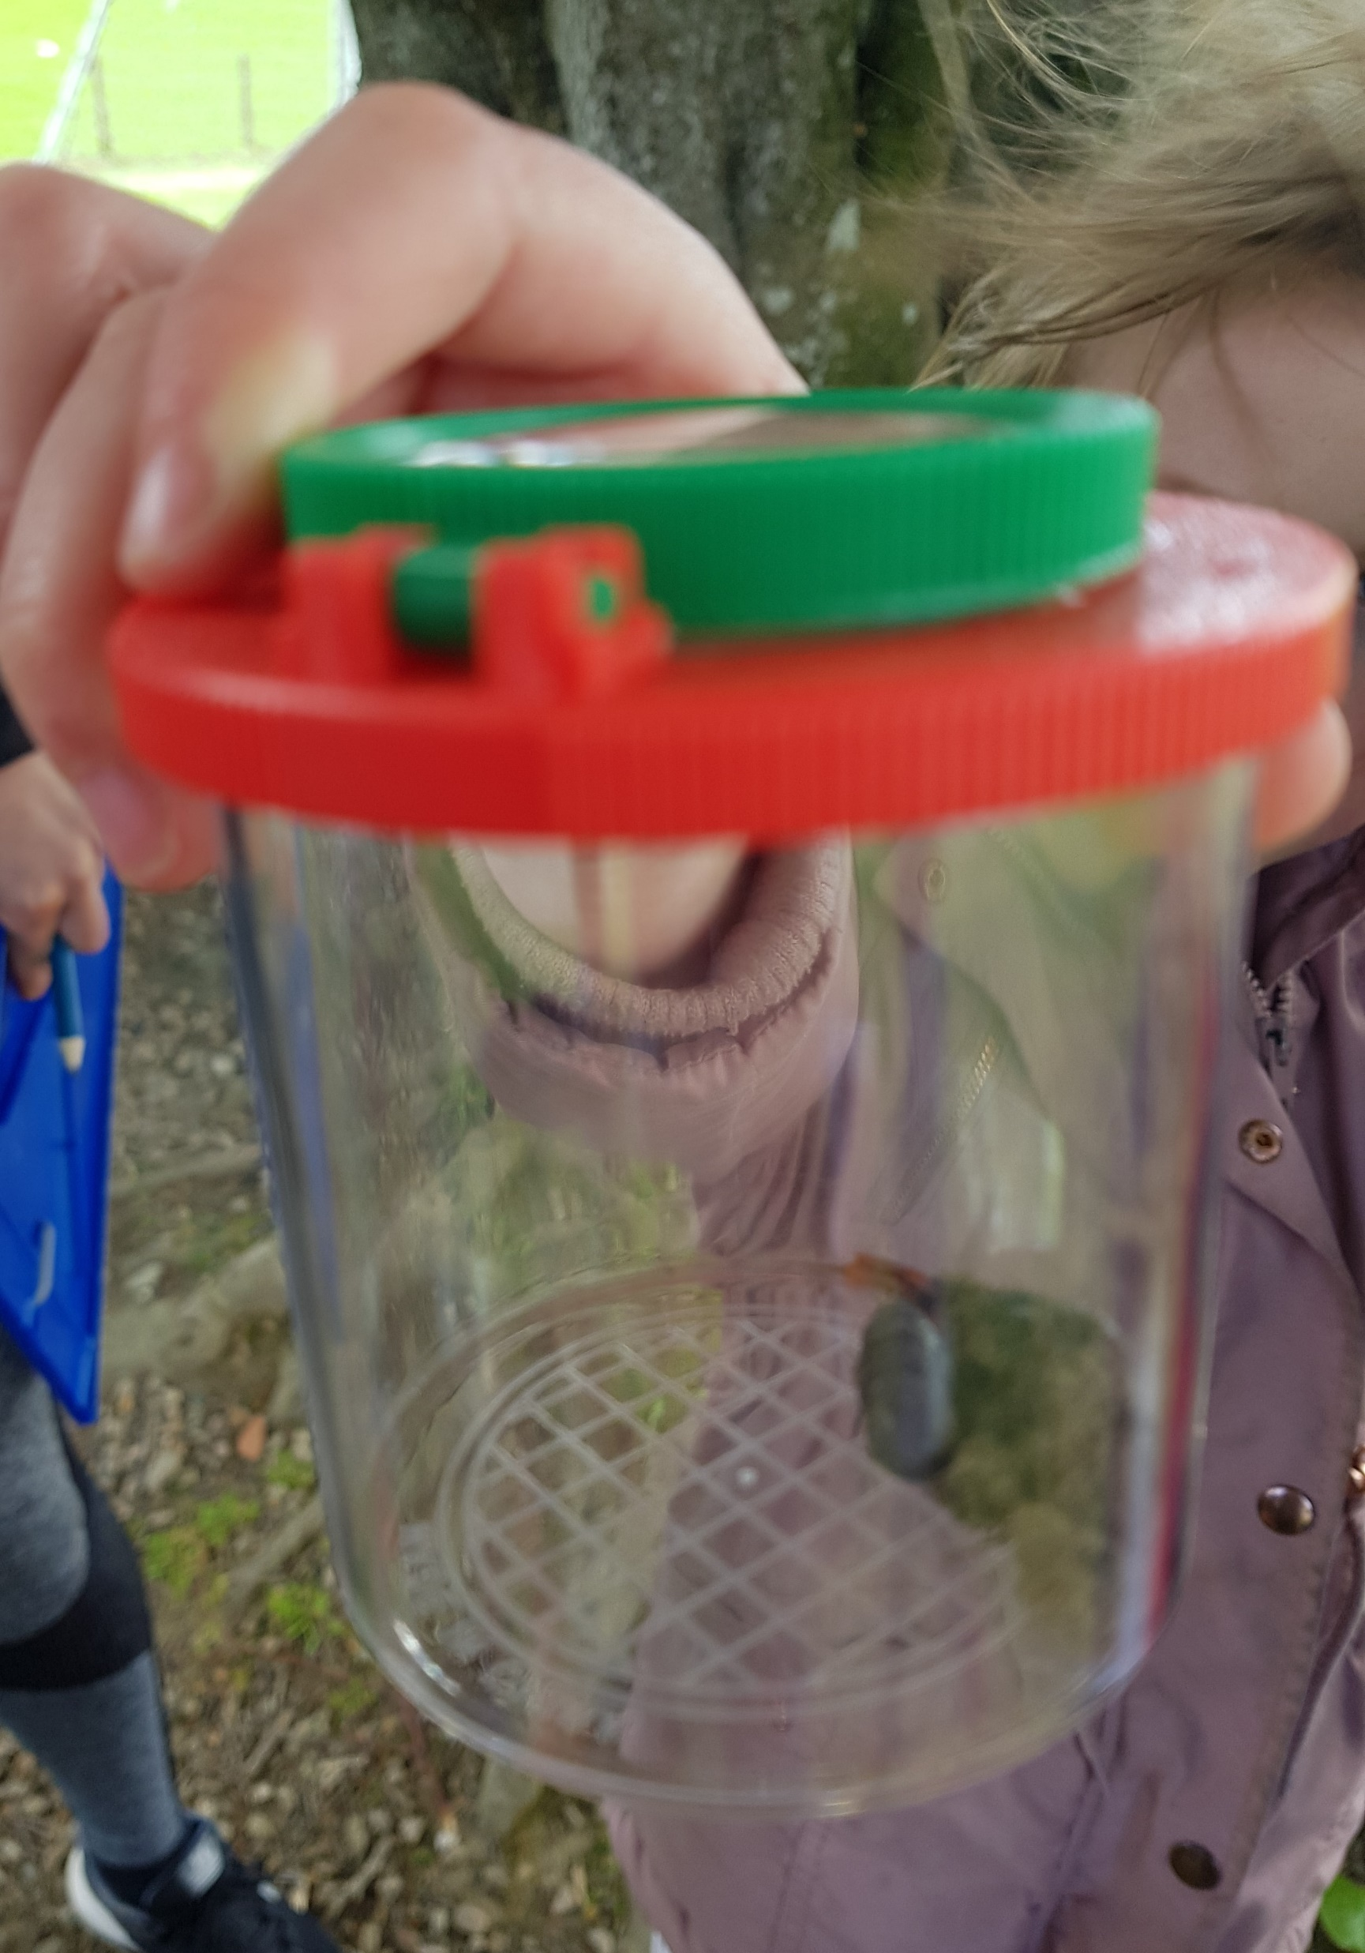
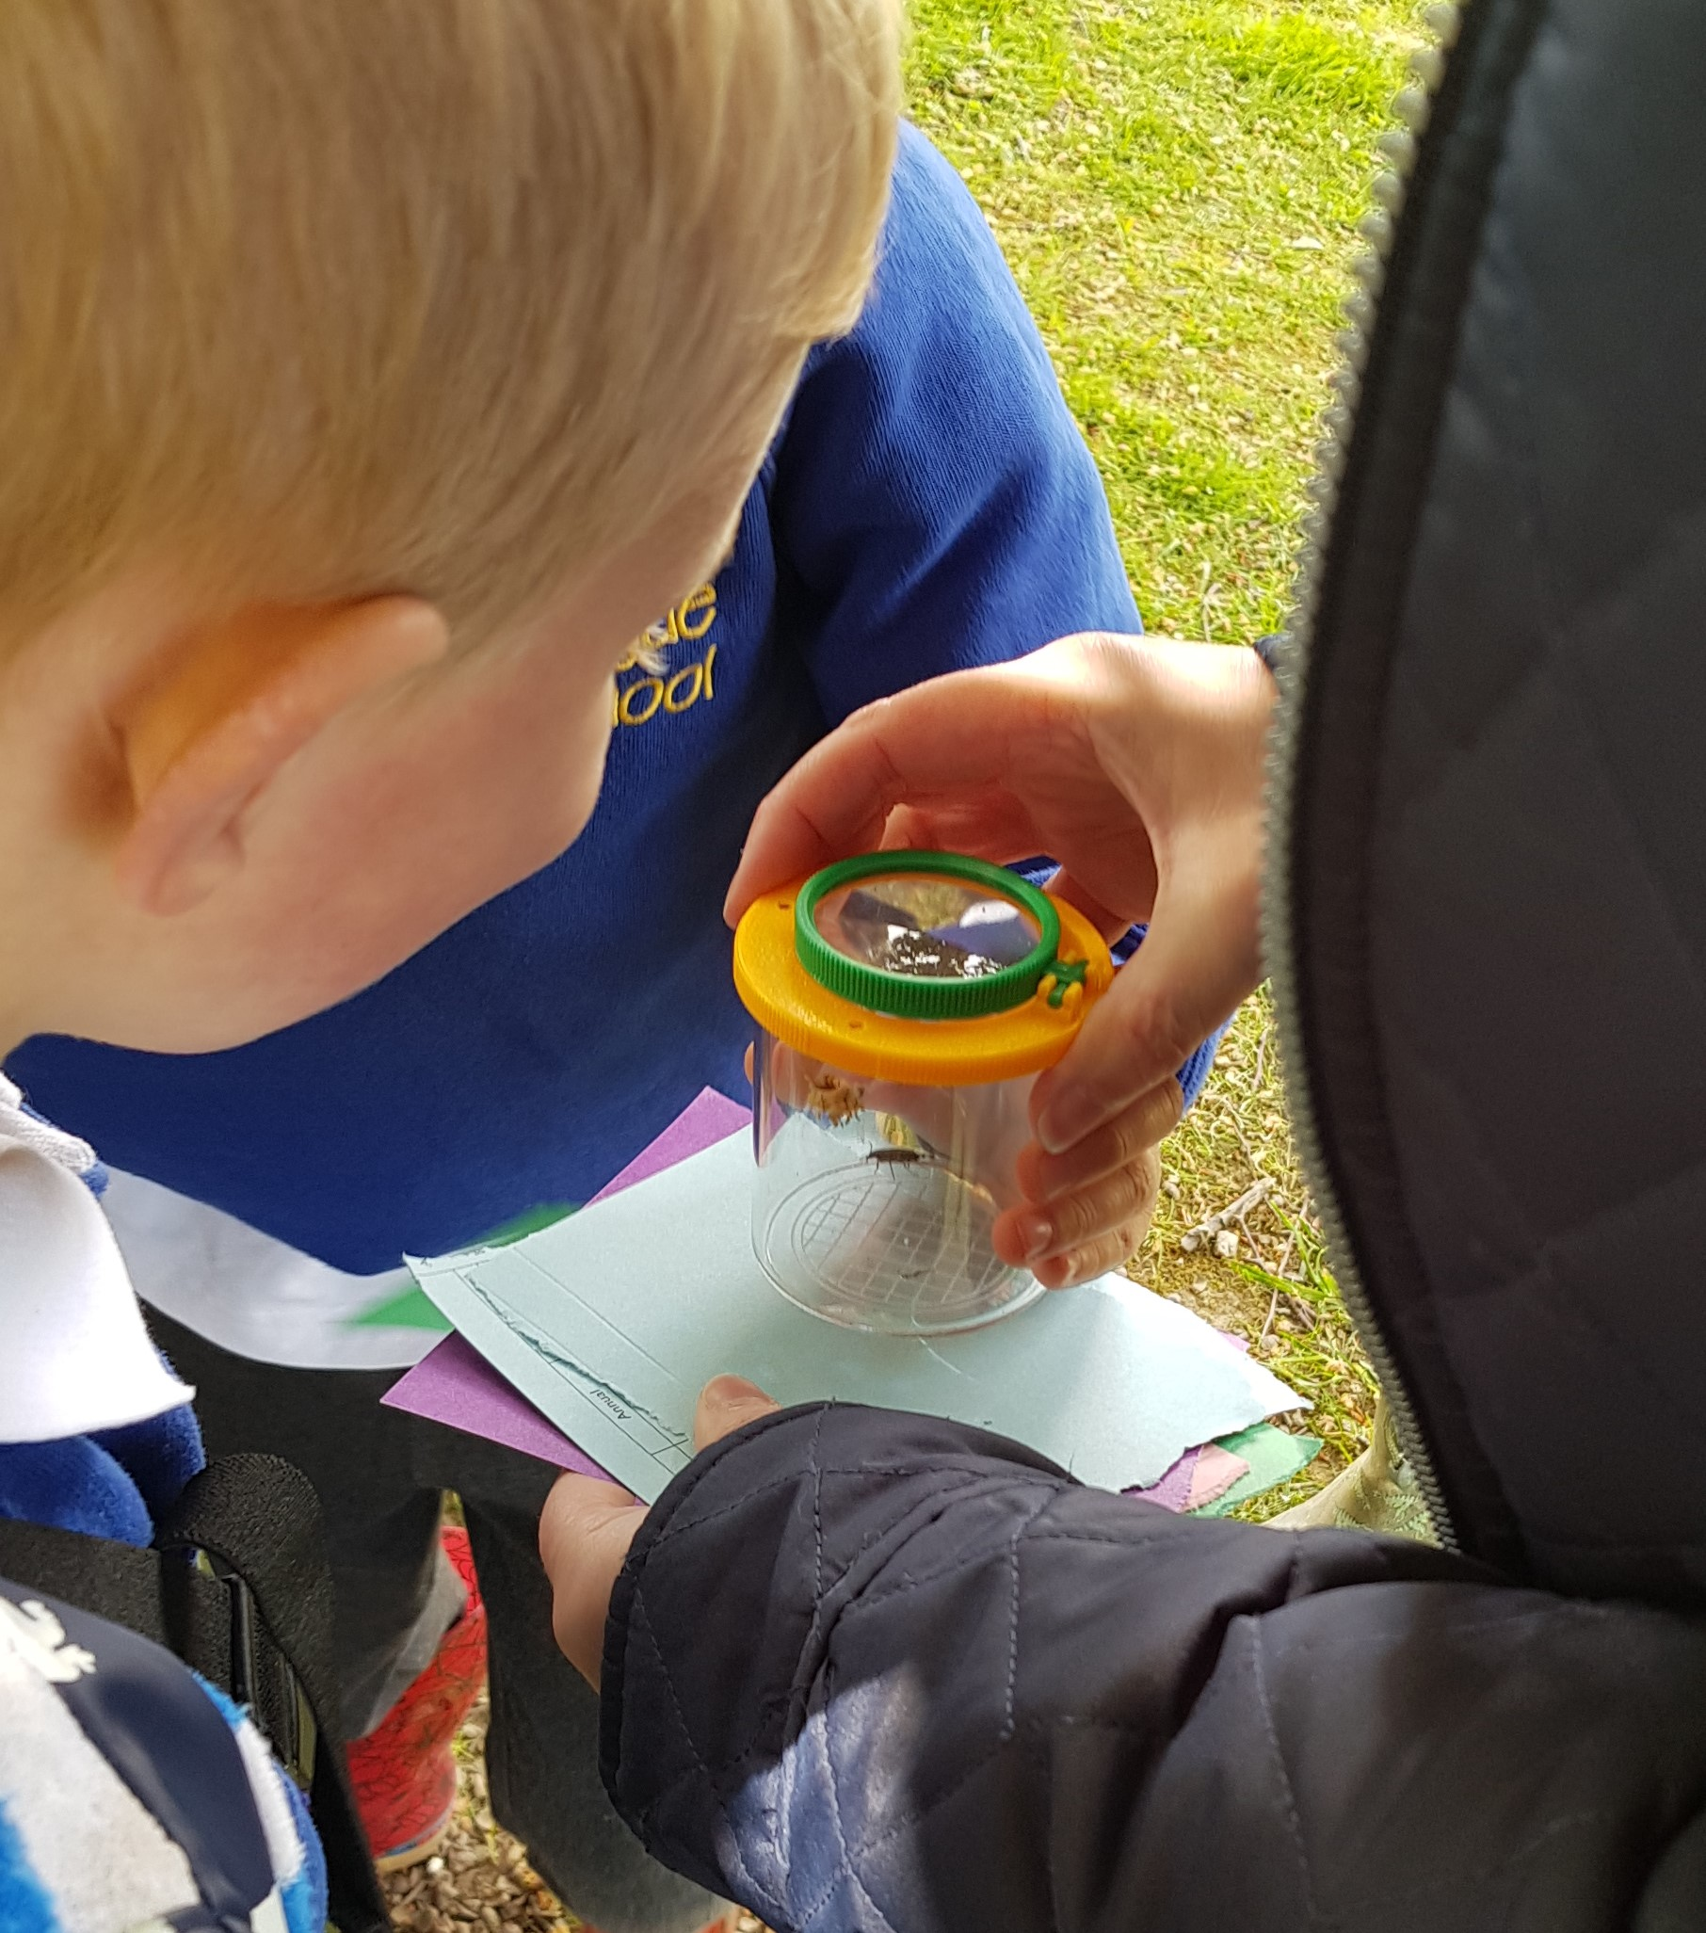
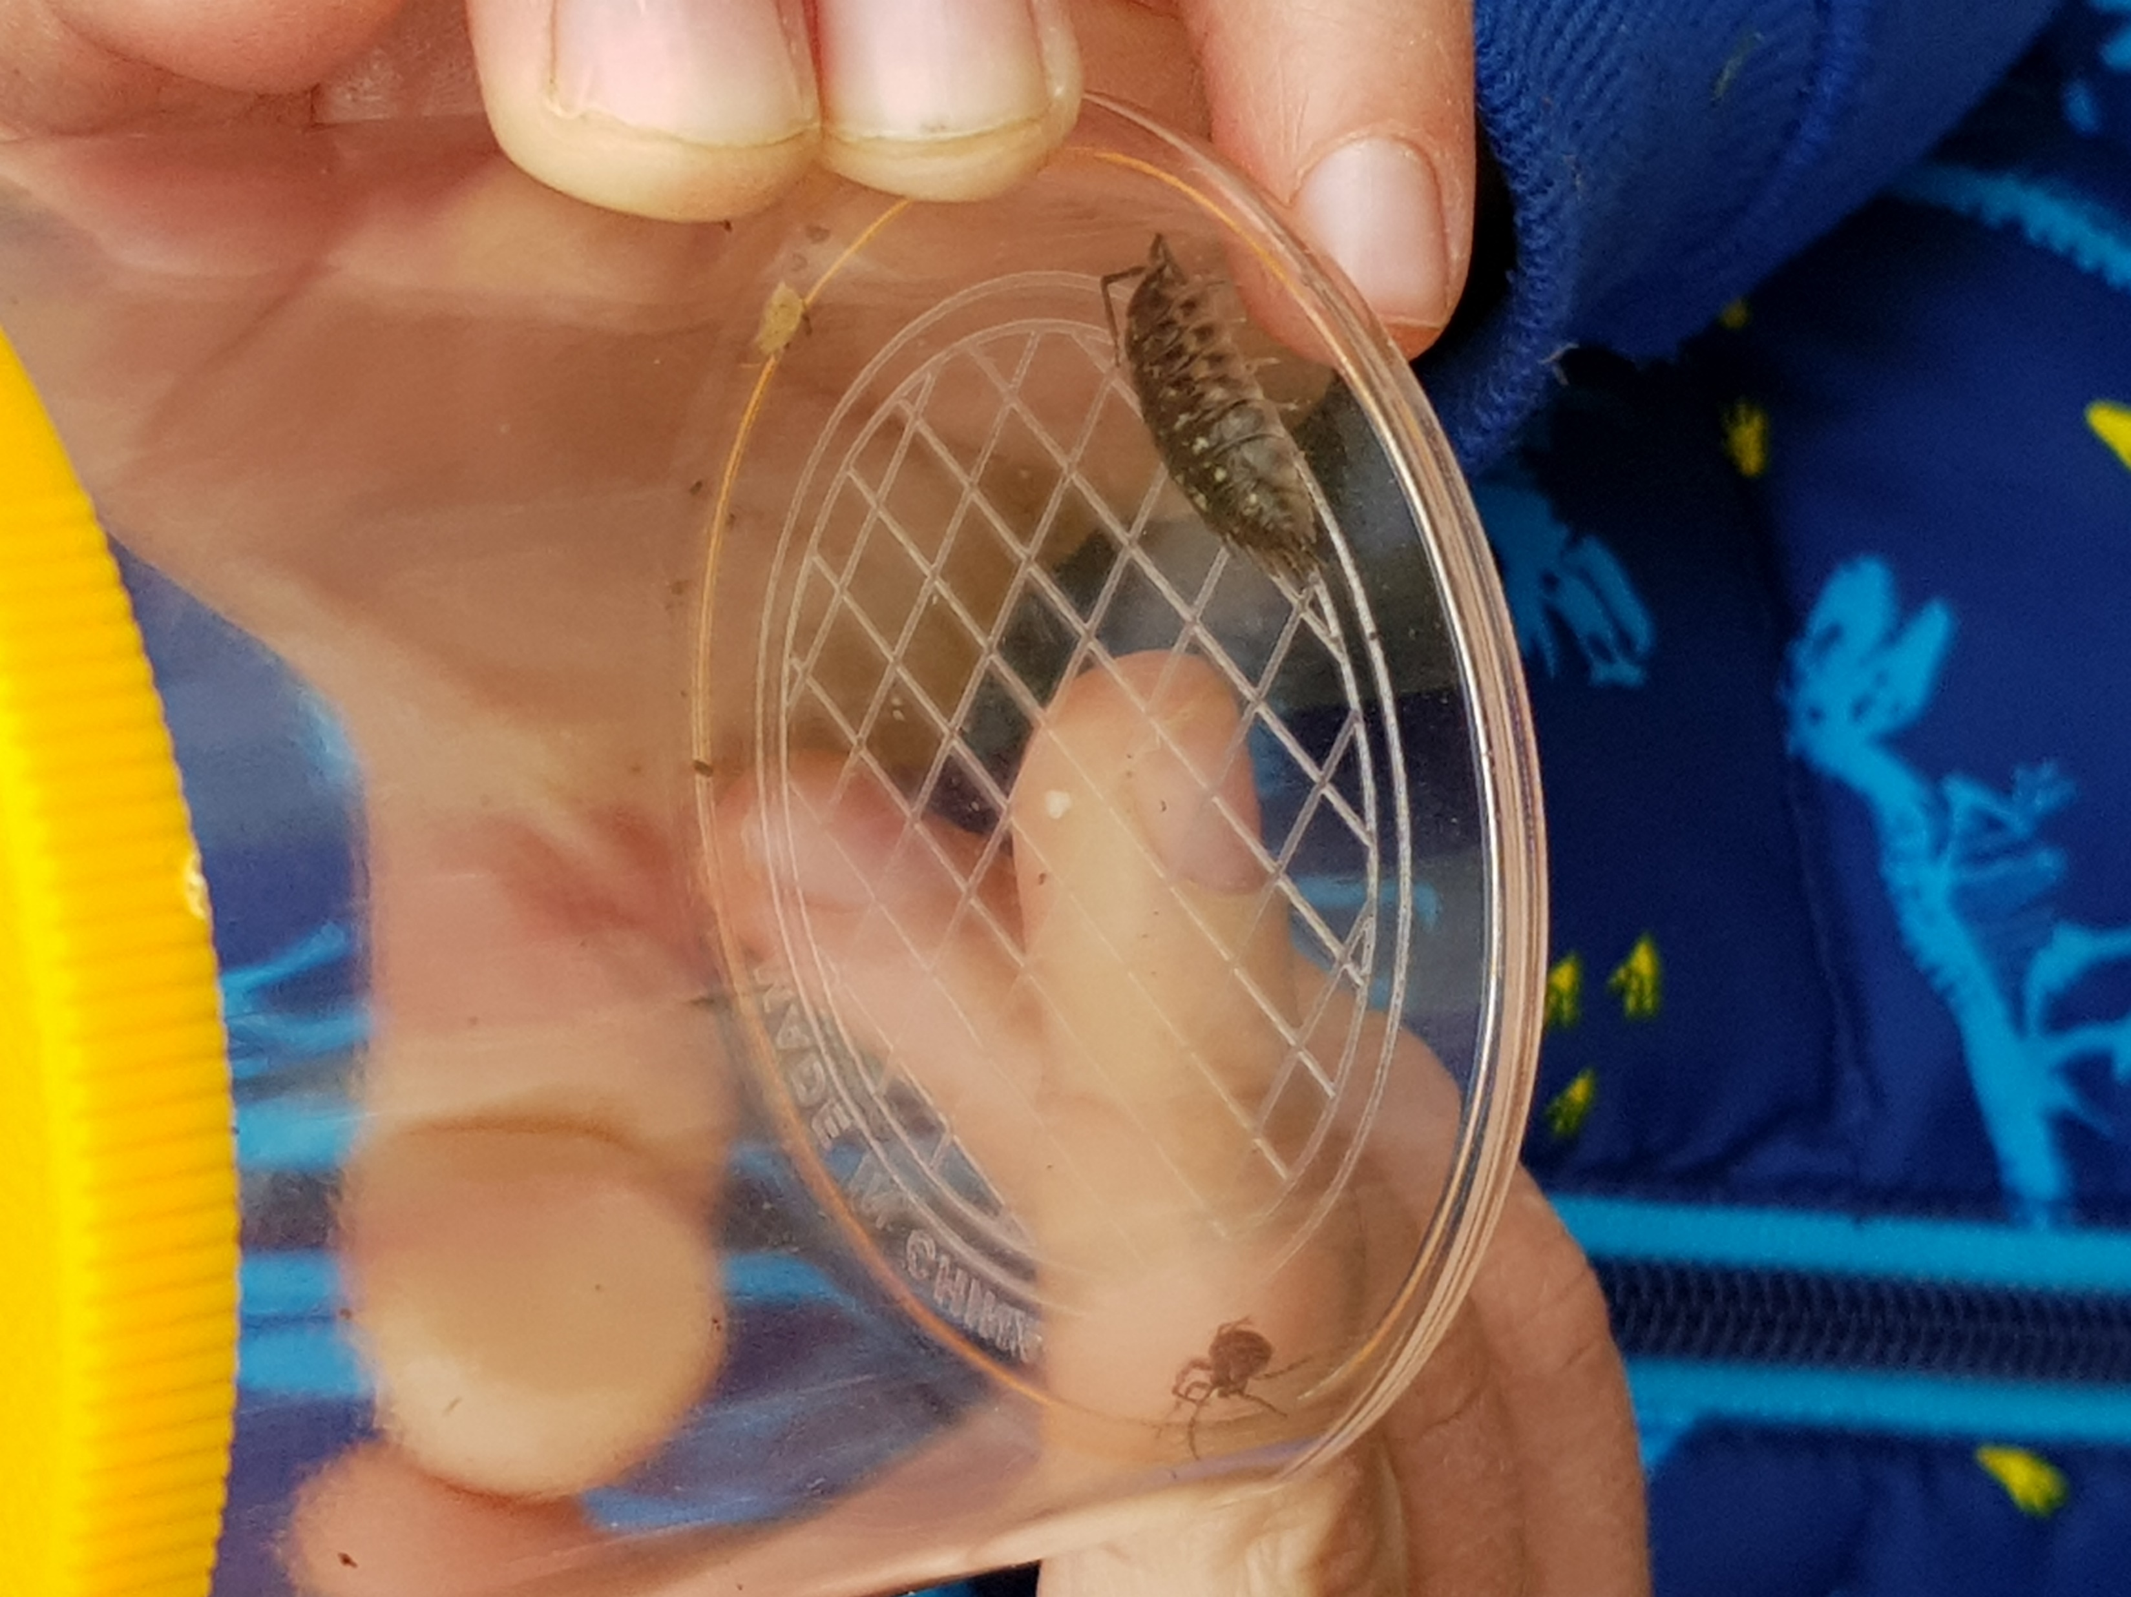
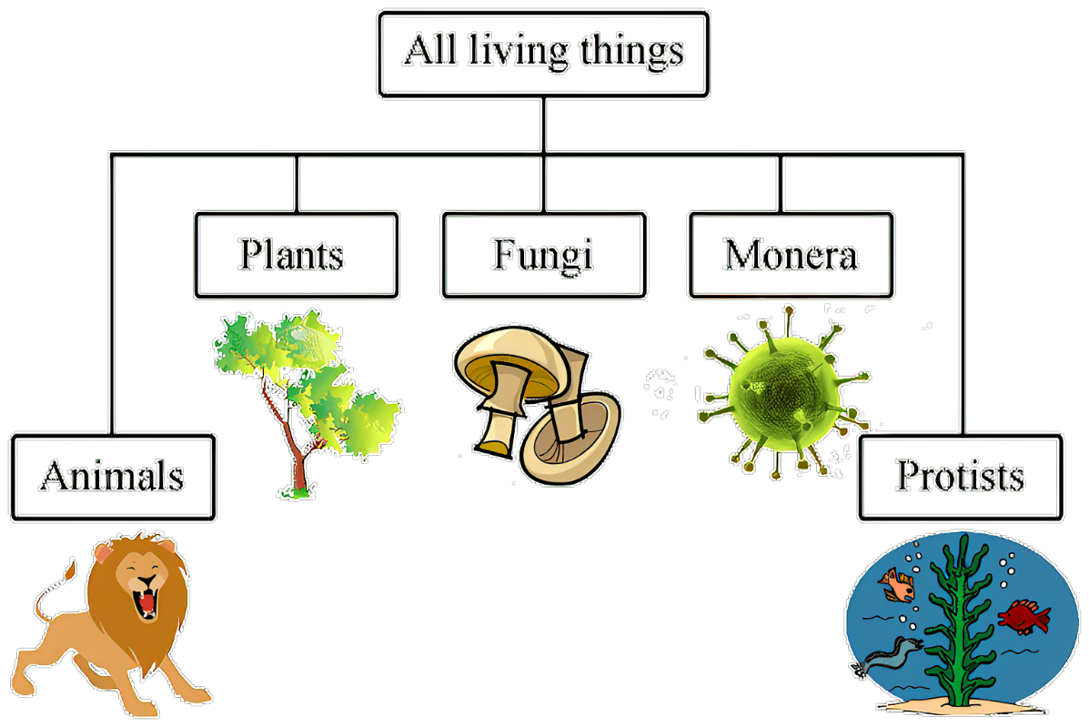
Biodiversity and interdependence
Pupils photograph and/or video living things for using in a e.g. science journal or in a presentation
Pupils use a database or presentation software to sort/classify living things

Slide 18
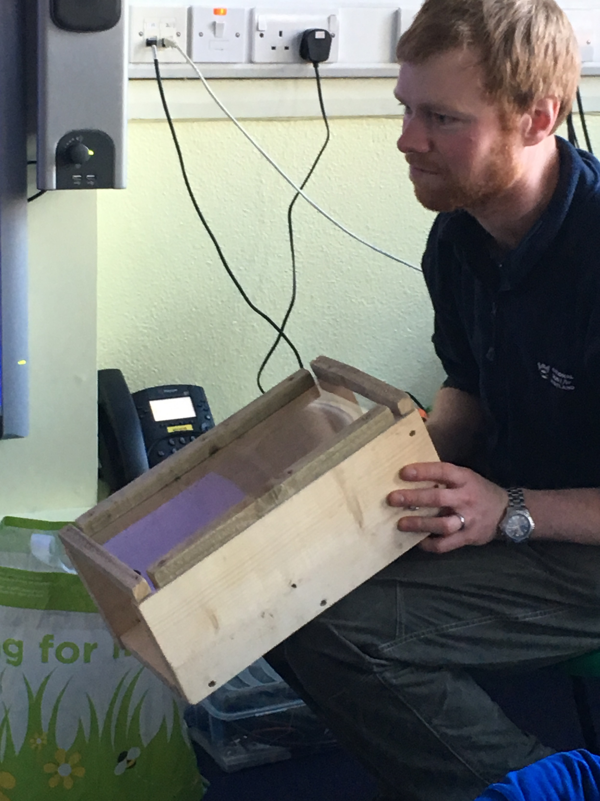
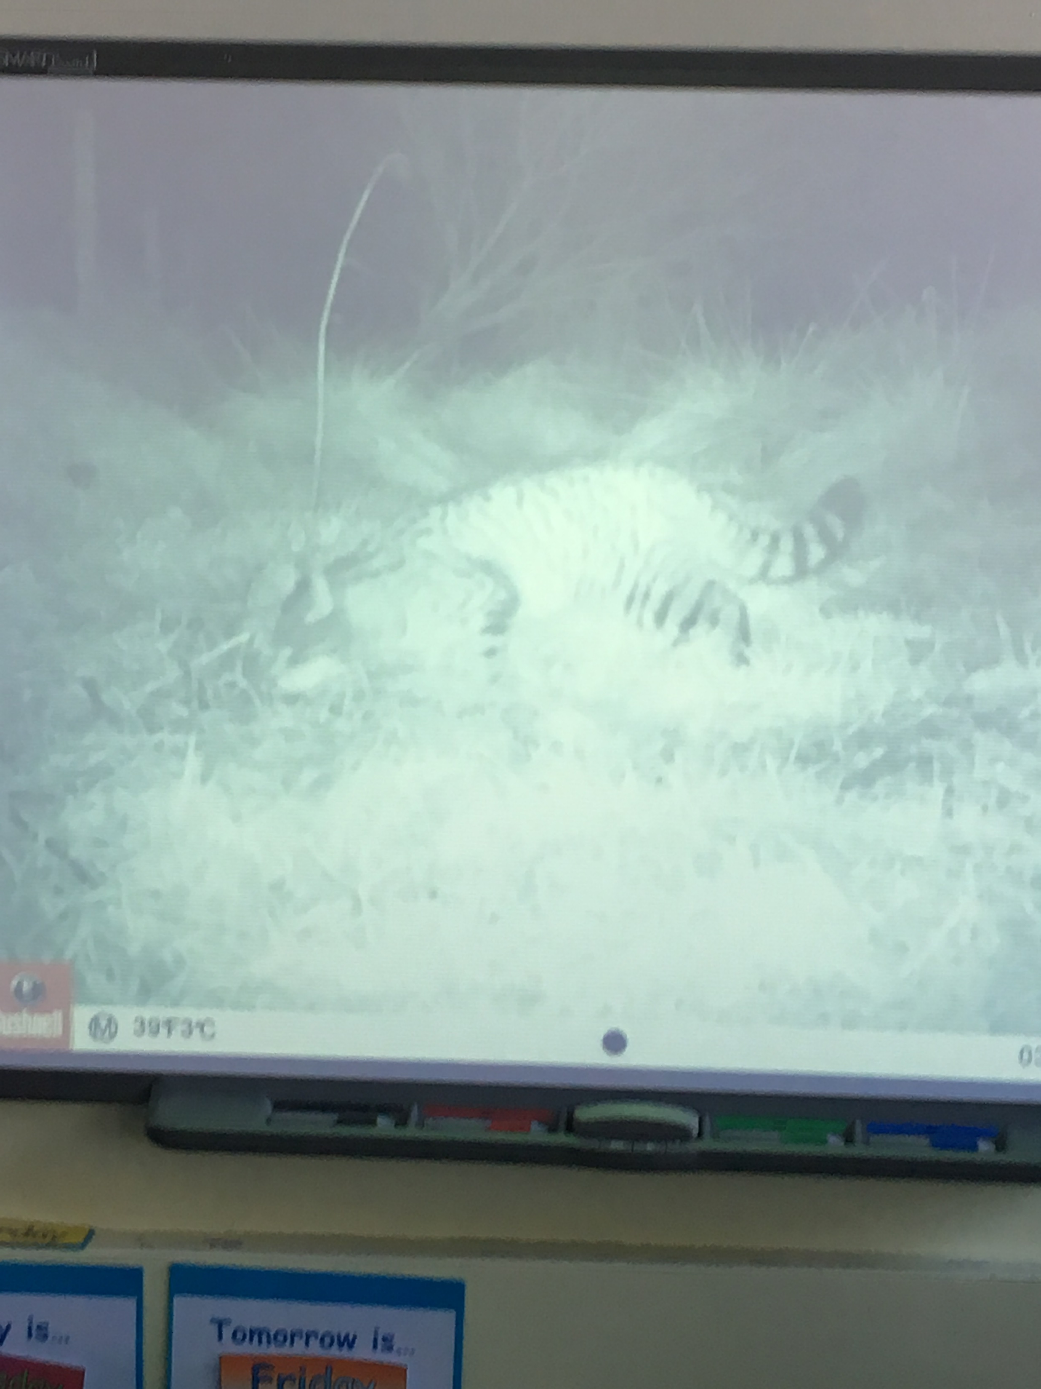
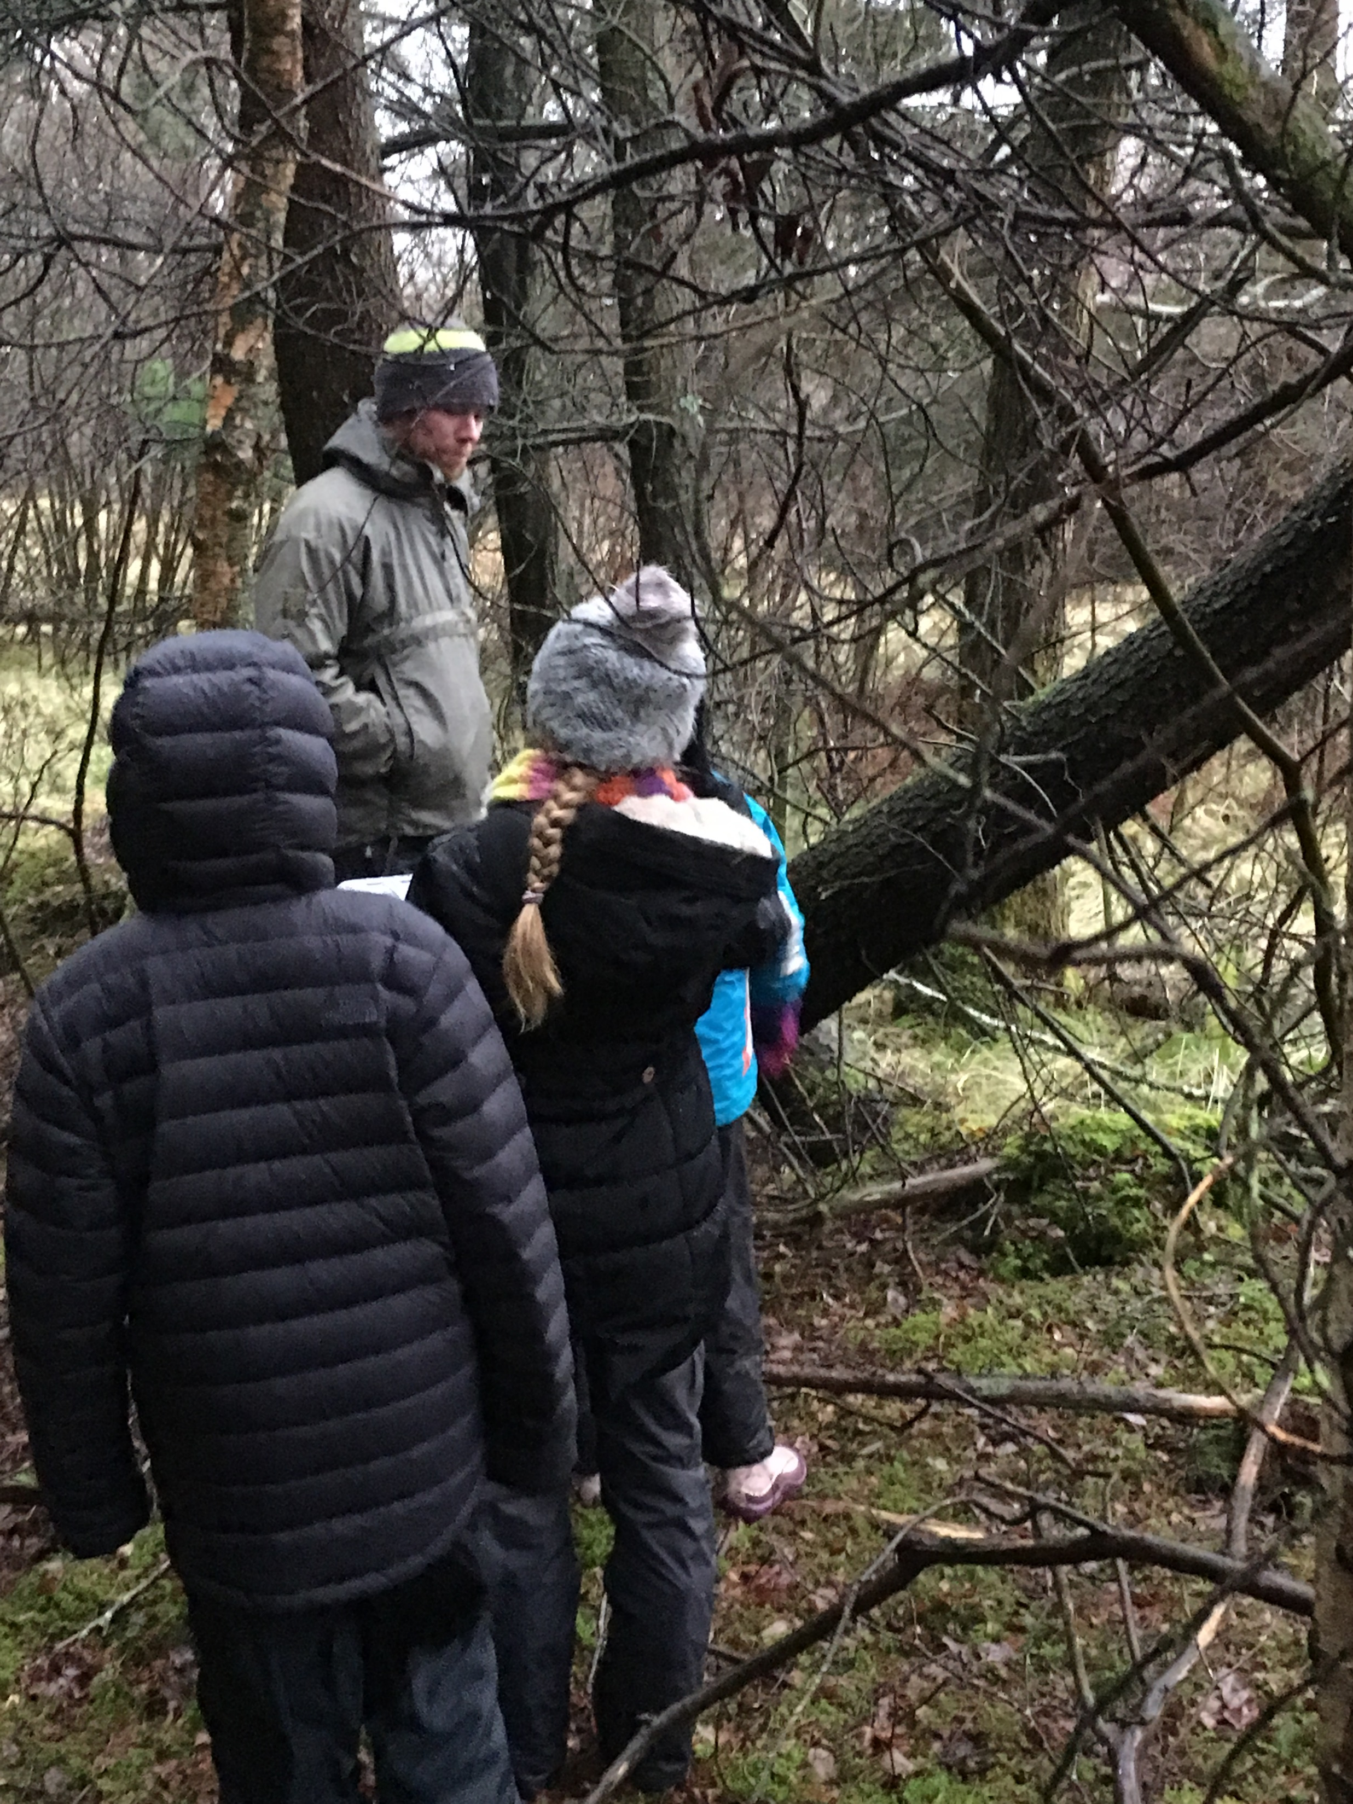
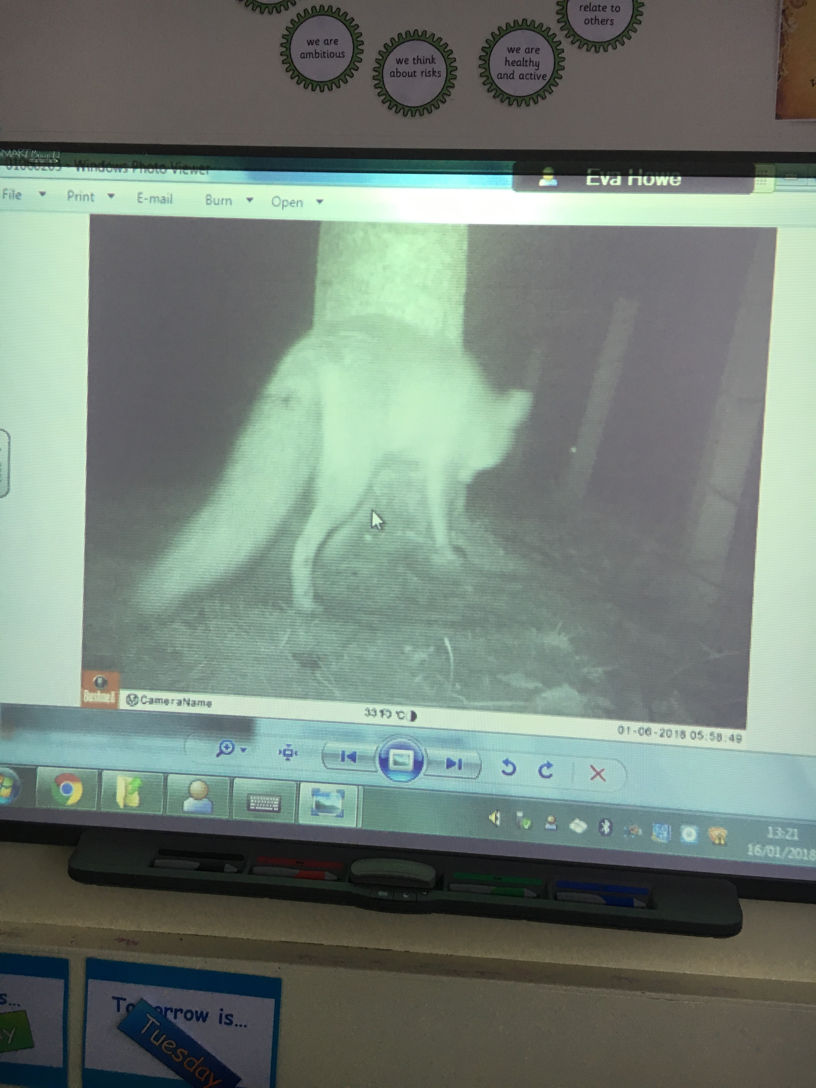
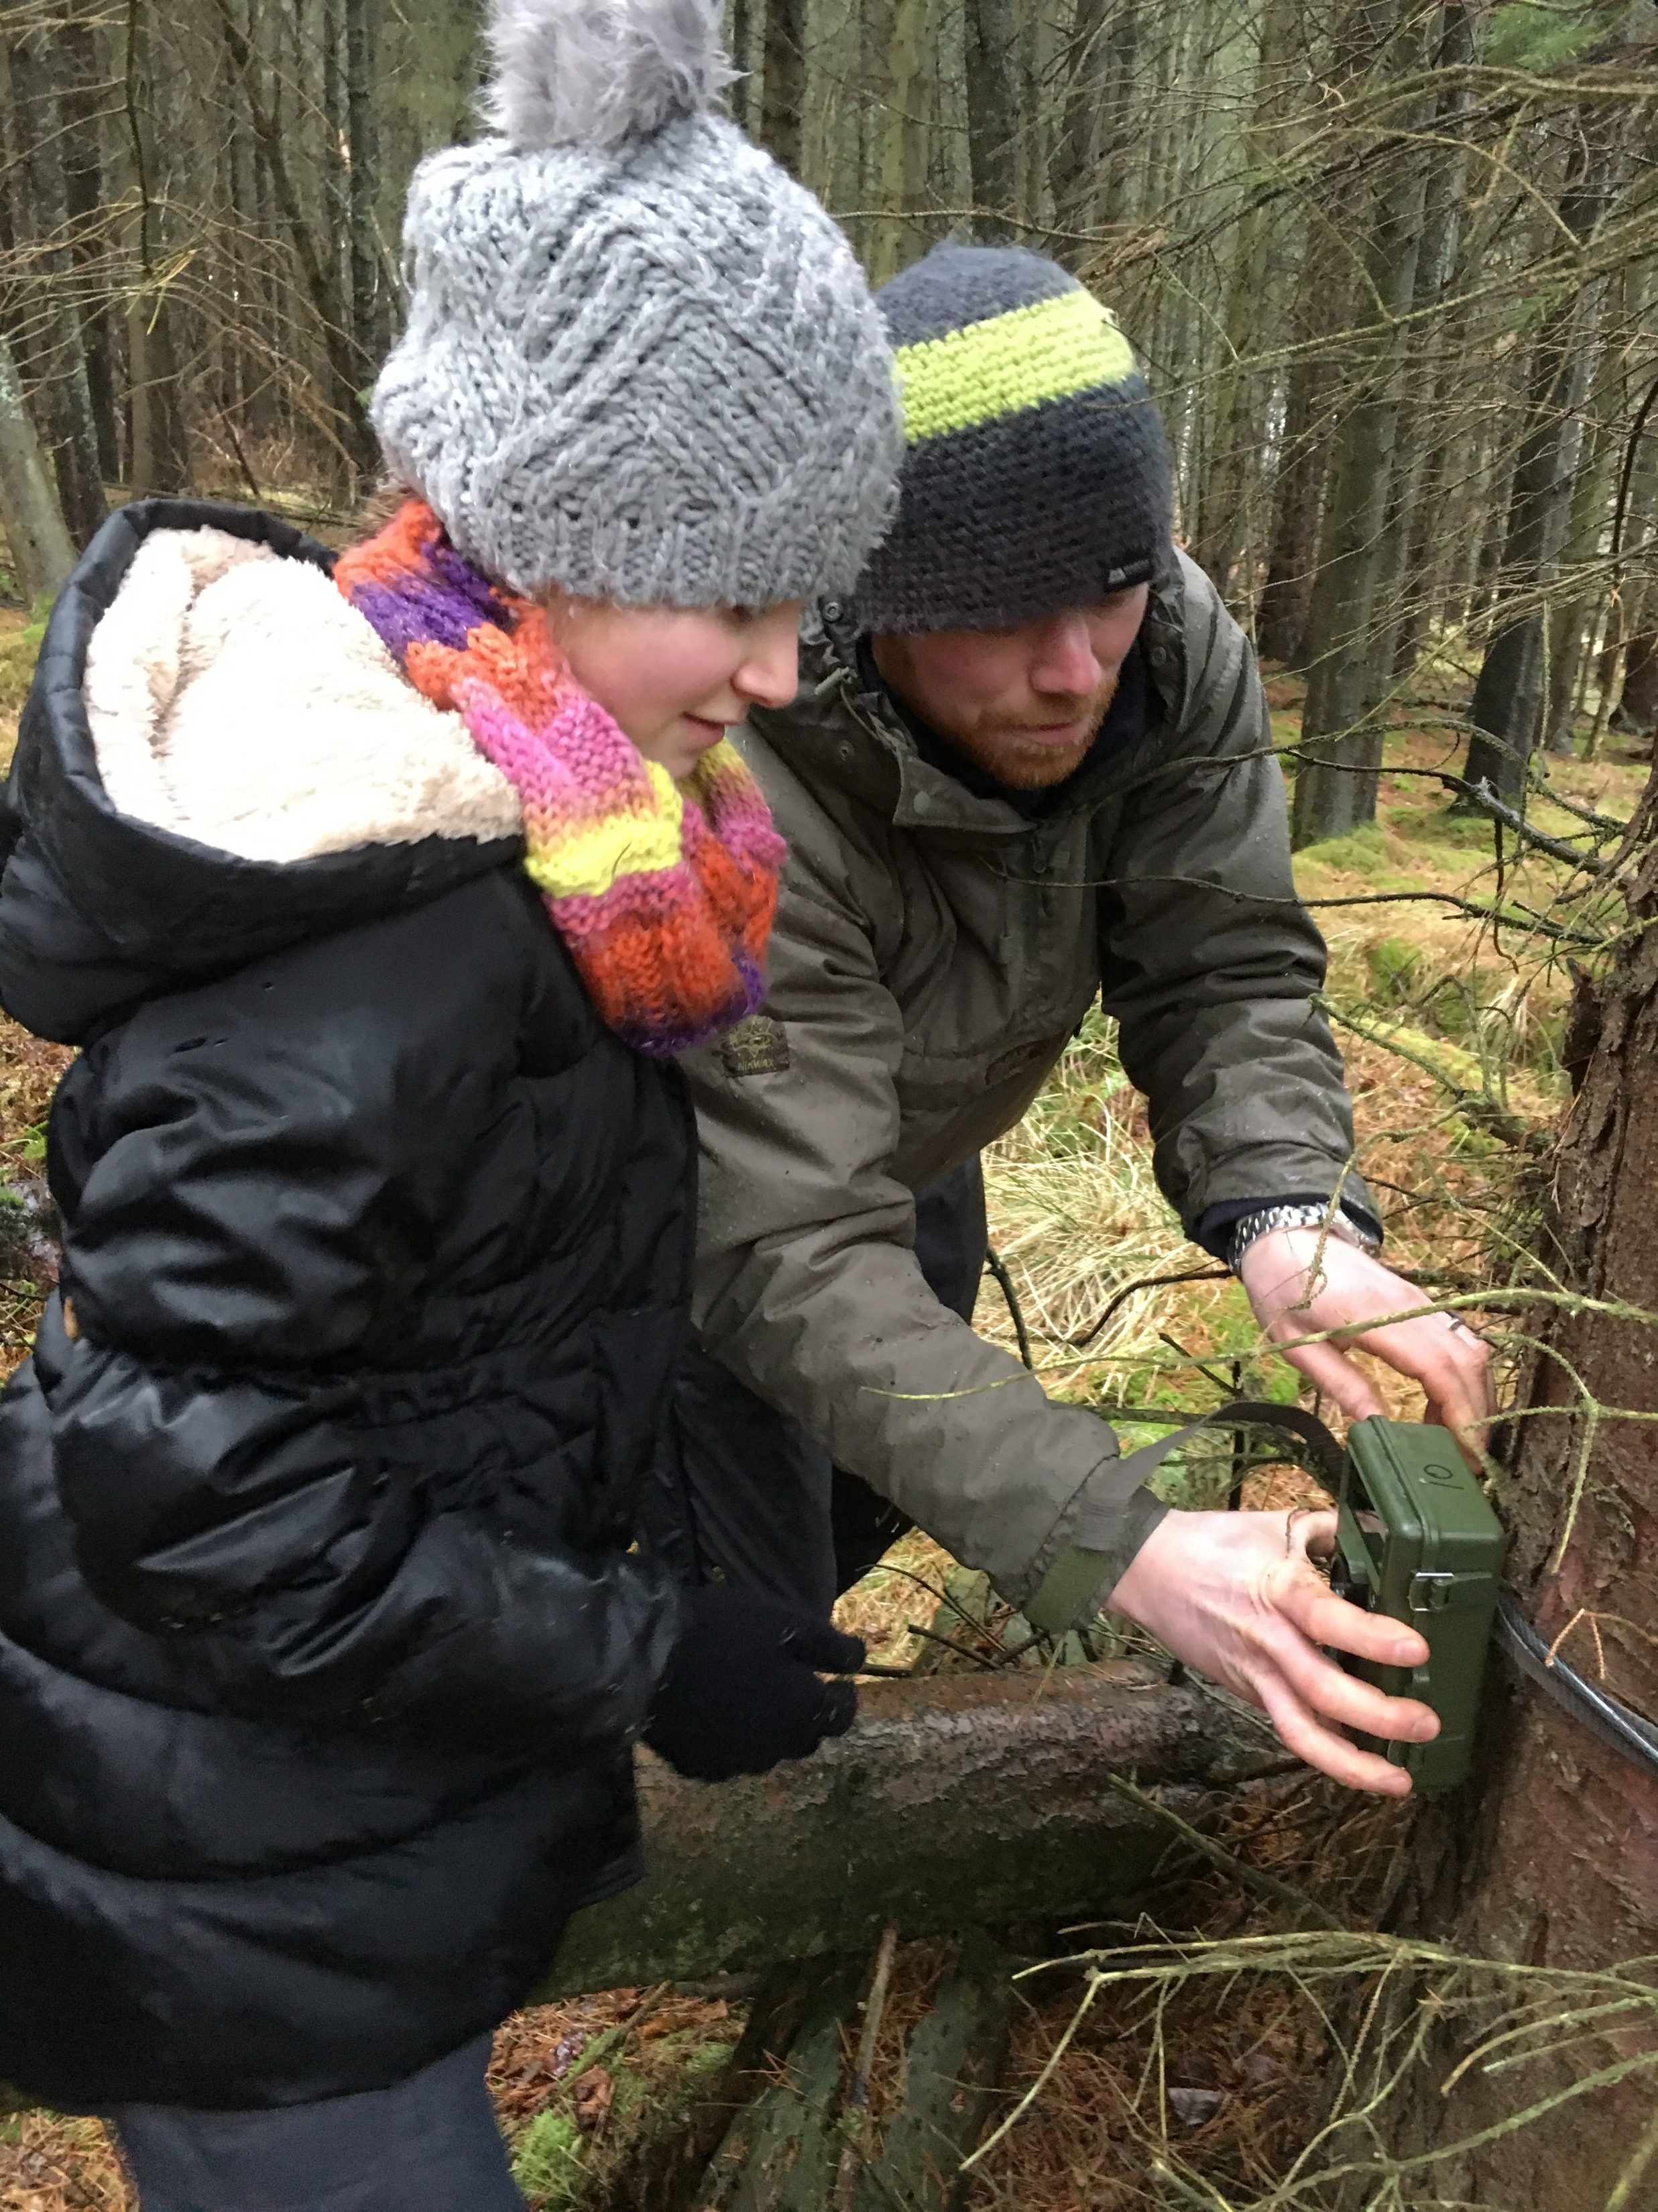
Biodiversity and interdependence
Use a camera trap to photograph and/or video animals in the local environment

Slide 19
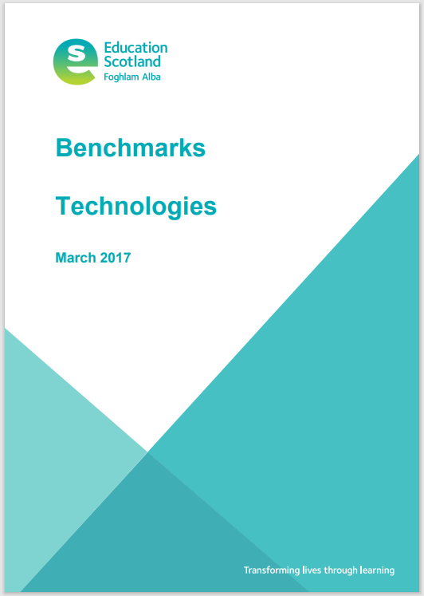
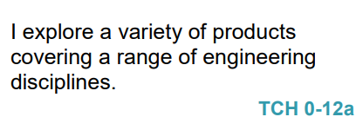
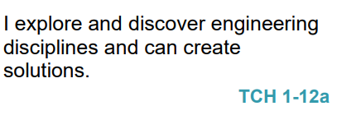
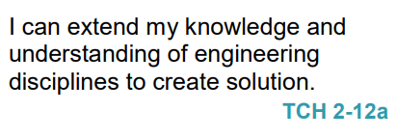
Engineering is part of the Curriculum for Excellence but information is limited
Recognises engineering in the world around them for example bridges, construction, electronics, computers.
Recognises and identify different engineering disciplines.
Builds a solution to a specific task, which has moving parts.
Understands the difference between different engineering disciplines
Understands different energy types.
Builds/simulates solutions to engineering problems.
Notes:
Let’s come back now to Engineering.

Slide 20
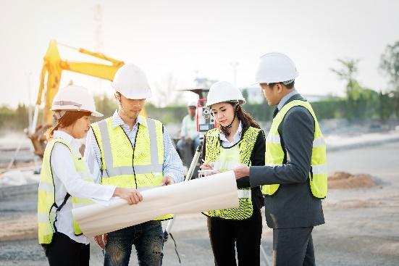
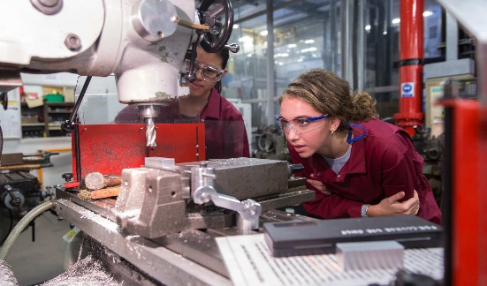
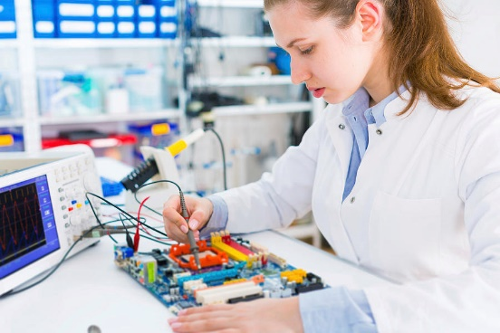
Engineering Disciplines/Engineering Across the Curriculum
Civil – infrastructure, roads, houses, bridges
SOC: People, Place and Environment
TCH: Exploring Uses of Materials, Design and Construct Models
SCI: Forces, Materials
MNU: Measure
EXA: Creating objects for specific tasks/solutions to a design problem.
Mechanical – engines, machines, moving parts
TCH: Design and Construct Models
SCI: Forces
MNU: Measure
EXA: Creating objects for specific tasks/solutions to a design problem.
Electrical – application of electricity and electronics
SCI: Electricity
Software – computer programming and computational thinking
TCH: Computing Science
MNU: Shape Position & Movement, Chance and Uncertainty
EXA: Creating solutions to a design problem.
Other engineering disciplines: Aerospace, Chemical, Biomedical, Biological, Nuclear, Industrial, Agricultural, Structural, Environmental…
HWB: Career education

Slide 21
How can we encourage pupils to think like and act like engineers and develop the associated skills?
Answer: by teaching the children to use the ‘Engineering Design Process’

Slide 22
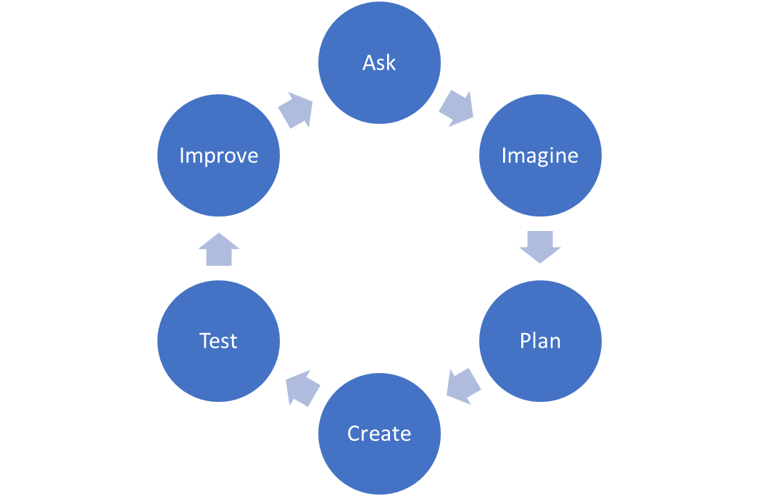
The Engineering Design Process
ASK: Students identify the problem, requirements that must be met, and constraints that must be considered.
IMAGINE: Students brainstorm solutions and research ideas. They also identify what others have done.
PLAN: Students choose two to three of the best ideas from their brainstormed list and sketch possible designs, ultimately choosing a single design to prototype.
CREATE: Students build a working model, or prototype, that aligns with design requirements and that is within design constraints.
TEST: Students evaluate the solution through testing; they collect and analyse data; they summarise strengths and weaknesses of their design that were revealed during testing.
IMPROVE: Based on the results of their tests, students make improvements on their design. They also identify changes they will make and justify their revisions.
THIS PROCESS IS A CYCLE – NOT LINEAR

Slide 23
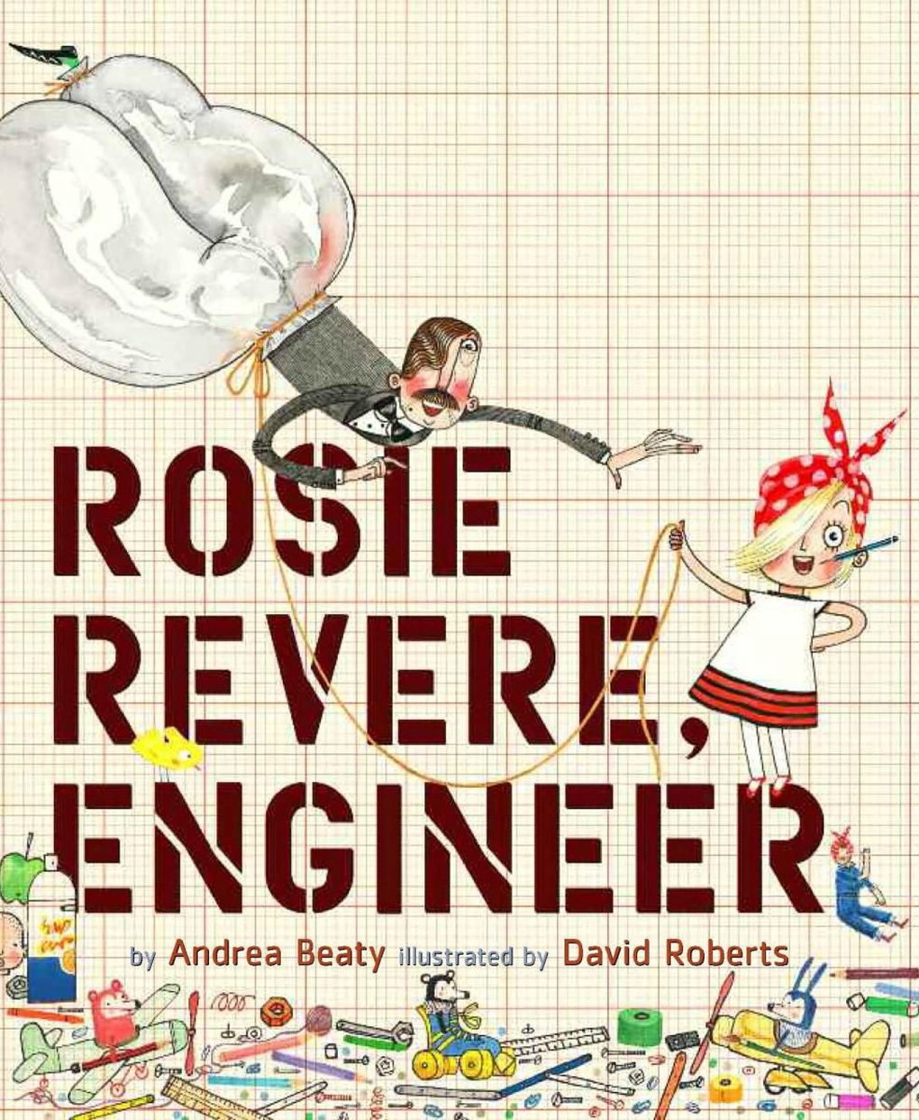
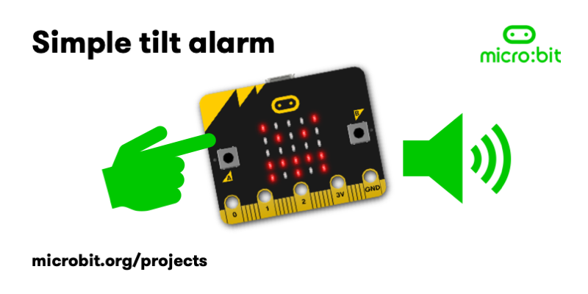
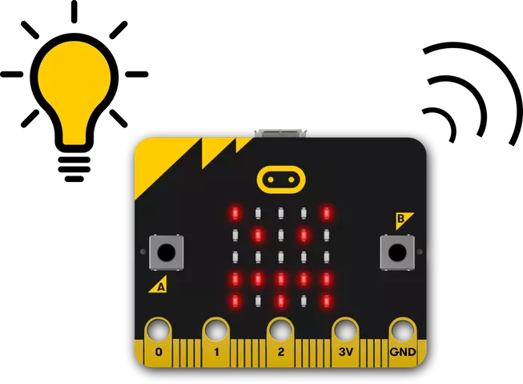
Rosie Revere Engineering Project
(based on the story book)
Uncle Fred is having a problem keeping the chimpanzees in their enclosures because they have learnt how to open the doors and let themselves out!
Can you engineer a solution that will keep the chimpanzees from escaping from their enclosure and incorporate it into your design?
A few suggestions but the children will have many more ideas! Some might not even involve circuits or programming a device!
It could be an alarm system that goes off when the door is opened
Build | Hidden Alarm . DESIGN SQUAD GLOBAL | PBS KIDS
It could be an alarm that lights up and plays a tune created using a micro: bit and works when the micro: bit is moved
Simple tilt alarm | micro:bit (microbit.org)
It could be a light sensor that lights up when light falls below a certain level because a chimpanzee has passed by creating a shadow
Nightlight | micro: bit (microbit.org)
Coding micro:bits as part of Engineering Design Challenges

Slide 24
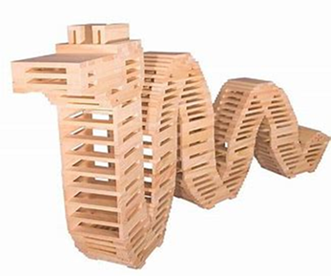
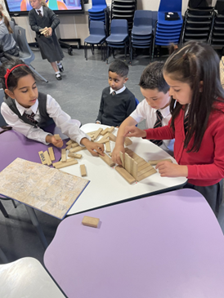
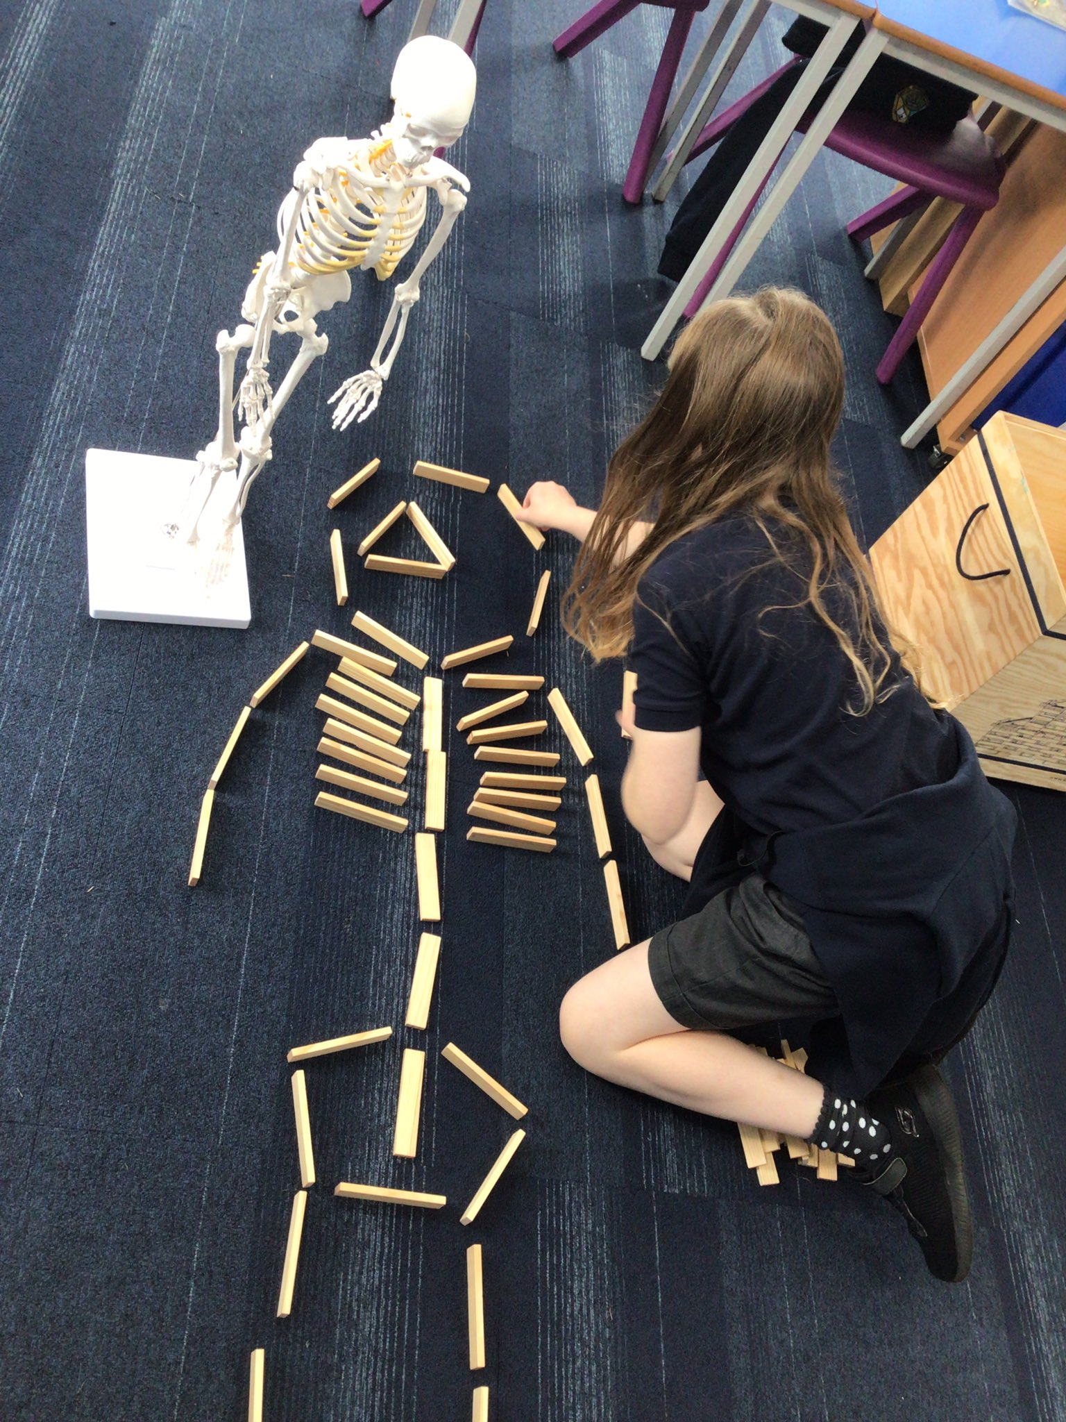
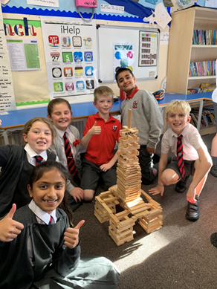
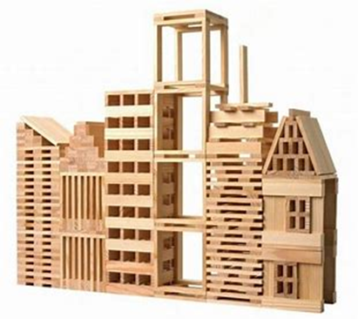
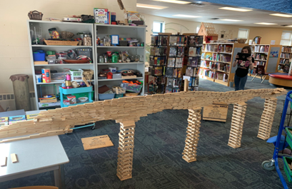
and for Engineering/STEM learning
KAPLA is suitable for children of all ages.
KAPLA consists of loose parts that are identical pine planks that can be used to create unique models by stacking them. It can be used in classrooms for a wide variety of purposes:
To stimulate creativity
Promote teamwork
Resilience
Perseverance
To teach STEM concepts

Slide 25
and for Engineering/STEM learning
makedo is a construction system with simple tools that allows children to create models out of cardboard and can provide hands-on learning experiences across the curriculum that teach design, construction and problem solving.
Coding micro:bits as part of Engineering Design Challenges

Slide 26
Body systems and cells
Use vr and ar apps to explore ‘inside the body’
e.g. Curiscope’s Virtuali-Tee and free app

Slide 27
Examples of STEM Projects that include the use of digital technologies

Slide 28
FIRST® LEGO® League Challenge 2022 – 2023
‘SUPERPOWERED’: Explore Level (ages 6-9 years) (IET)
FIRST® LEGO® League teams will reimagine the future of sustainable energy and power their ideas forward.
In the SUPERPOWERED challenge, FIRST® LEGO® League teams will explore where energy comes from and how it is distributed, stored, and used – and then put their superpowered creativity to work to innovate for a better energy future.
Children will learn about different types of energy sources, storage, distribution methods, and ways in which energy is consumed.
The team need to do in depth research and come up with an Innovative solution to a specific ENERGY idea.

Slide 29
FIRST® LEGO® League Challenge 2022 – 2023
‘SUPERPOWERED’: Explore Level (ages 6-9 years) (IET)
The Explore teams research sustainable energy and power and display their ideas on a poster.
They build a LEGO® model and program one part to move using LEGO® Education WeDo 2.0 software.
Experiences and Outcomes covered in:
Science (Topical Science, Energy Sources and Sustainability, Electricity)
Technologies (Digital literacy, Craft, Design, Engineering and Graphics, Computing Science)
Literacy
Art and Design
Health and Wellbeing
Social Subjects

Slide 30
FIRST® LEGO® League Challenge 2022 – 2023
‘SUPERPOWERED’: Explore Level (ages 6-9 years) (IET)

Slide 31
FIRST® LEGO® League Challenge 2022 – 2023
‘SUPERPOWERED’: Explore Level (ages 6-9 years) (IET)

Slide 32
Climate Smarter Project (SCDI/YESC)
The Scottish Government has declared a climate emergency.
While there is natural change in the Earth’s climate over long periods, humans are responsible for the increase in speed at which our climate is changing.
Greenhouse gases are naturally present in our atmosphere however activities such as fossil fuel energy generation produce huge volumes each year which increases the amount of greenhouse gases in the atmosphere resulting in a gradual atmosphere warming.

Slide 33
Climate Smarter Project (SCDI/YESC)
Challenge: design and build a model of your future school to demonstrate the results of your investigations into electricity generation and storage, water sustainability smart controls/sensors and sustainable materials / timber.
Experiences and Outcomes covered in:
Science (Topical Science, Planet Earth, Energy Sources and Sustainability, Processes of the Planet, Forces, electricity and Waves)
Technologies (Digital literacy, Technological Developments in Society and Business, Craft, Design, Engineering and Graphics, Computing Science)
Literacy
Maths
Art and Design
Health and Wellbeing
Social Subjects

Slide 34
Climate Smarter Project (SCDI/ YESC)
Challenge: design and build a model of your future school to demonstrate the results of your investigations into electricity generation and storage, water sustainability smart controls/sensors and sustainable materials/ timber.
Coding micro:bits to use as sensors as part of design challenges

Slide 35
Support
Aberdeenshire Science and STEM Blog:
https://blogs.glowscotland.org.uk/as/abshireprimaryscience/
Our Twitter account: @AbshireSTEM
Contact us:
Caroline: caroline.nicol2@aberdeenshire.gov.uk
Kim: kim.aplin@aberdeenshire.gov.uk

