Slide 1
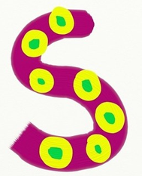
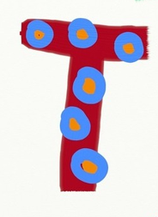
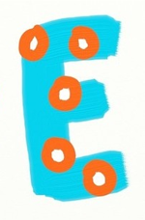
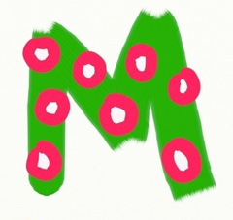
in the curriculum
Caroline Nicol & Kim Aplin RAiSE PSDOs, Aberdeenshire
Notes:
RAiSE Programme. Raising Aspirations in Science Education (RAiSE) is a programme of The Wood Foundation, Education Scotland, Scottish Government and participating local authorities which aims to enhance the delivery of STEM education in primary schools.

Slide 2
What is STEM?
Science
Technology
Engineering
Mathematics
Notes:
What is STEM? STEM stands for Science, Technology, Engineering and Mathematics. The reason that we often find these bundled together is that they are a set of very interrelated subjects that all share an emphasis on innovation, problem-solving, and critical thinking.
STEM is all around us in our every day lives – from a visit to the shops, following a recipe, using reasoning and problem-solving skills when faced with a challenge, in transportation, in entertainment etc. Without sometimes realising it, many of the experiences that we plan and carry out with the children have STEM skills embedded right at their core!
We are going to think briefly about each of these subjects and what they might look like as learning experiences in the classroom

Slide 3
Defining Science
Science is…
“the pursuit and application of knowledge and understanding of the natural and social world following a systematic methodology based on evidence”
~ The Science Council
Notes:
Science! This definition comes from The Science Council which states…
Science is the pursuit and application of knowledge and understanding of the natural and social world following a systematic methodology based on evidence.
Science is about discovering new things. Using investigation and experimentation to understand ourselves and the world around us.

Slide 4
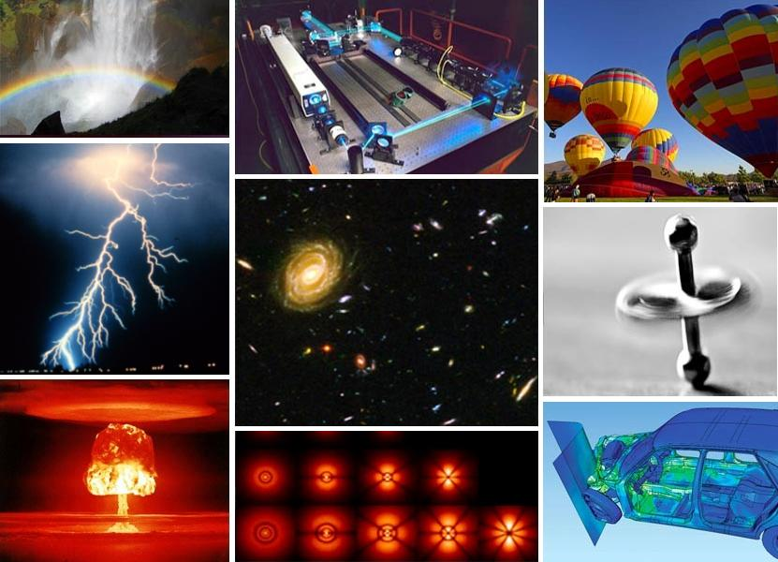
Notes:
Science is lots of things; an astronaut launching into space, medical science, pharmaceuticals, plants and animals, forensics and DNA and many many more things! Science can be found in the work of a hairdresser, mixing dyes to the precise colour, texture and consistency. From musicians, to food technicians to meteorologists. Science is all around us!

Slide 5
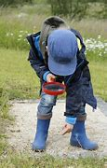
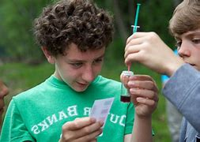
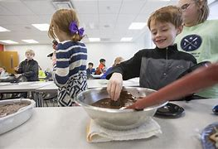
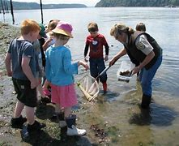
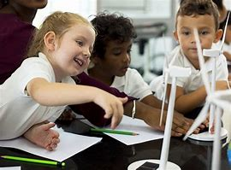
But science is also this…
Developing curiosity about the world
Creativity and inventiveness
Problem solving
Learning through play and investigation
Asking questions, observing and experimenting
Notes:
But it is also this: exploring the changes in the colours of the leaves in Autumn, finding bugs and other animals, being inquisitive about the world, baking biscuits or making soup, watching puddles turn to ice and ice creams melting in the summer. It is about making predictions and exploring new and unfamiliar things

Slide 6
Defining Technology
Technology is…
“the study and knowledge of the practical, especially industrial, use of scientific discoveries”
~ Cambridge Dictionary
Notes:
Technology. According to the Cambridge dictionary, Technology is the study of knowledge of the practical, especially industrial, use of scientific discoveries. In other words, about the development and use of new, practical, innovative things to support us in our everyday lives and work.

Slide 7
Notes:
Technology is lots of things: smart phones, tablets, computers and new technology which helps us to connect with the wider world! Motherboards, computer chips and electric cars might also spring to mind, but technology is also the use of tools to create and craft new things – woodwork, textiles, knitting, cookery.

Slide 8
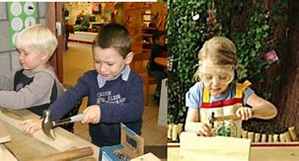
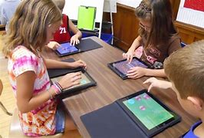
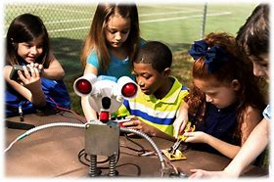
But technology is also this…
Creativity, exploration, curiosity and discovery
Identifying patterns in the world around me
Skills in using tools, equipment, software, graphic media and materials
Making connections between skills developed within learning and those in the world of work
Sustainability
Communication
Notes:
Children using technology to document new things and share their learning with others. Taking photographs and videos, playing games, using Beebots and robots. Technology includes using tools to construct new and exciting structures from natural materials. It is about working with others to make connections in our daily lives.

Slide 9
Defining Engineering
Engineering is…..
“a specific branch of the technologies, drawing on scientific methods and knowledge to address and solve real-world problems”
~ ekosgen, for Skills Development Scotland
Notes:
Engineering is a specific branch of the technologies, drawing on scientific methods and knowledge to address and solve real-world problems.

Slide 10
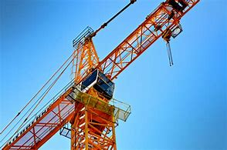
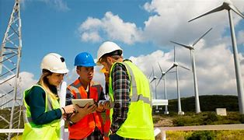
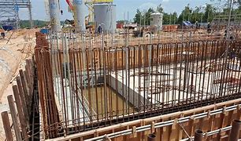
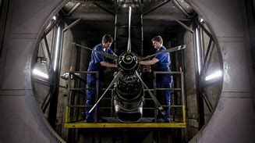
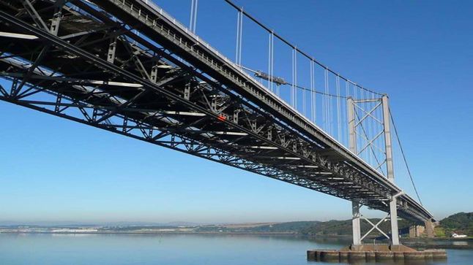
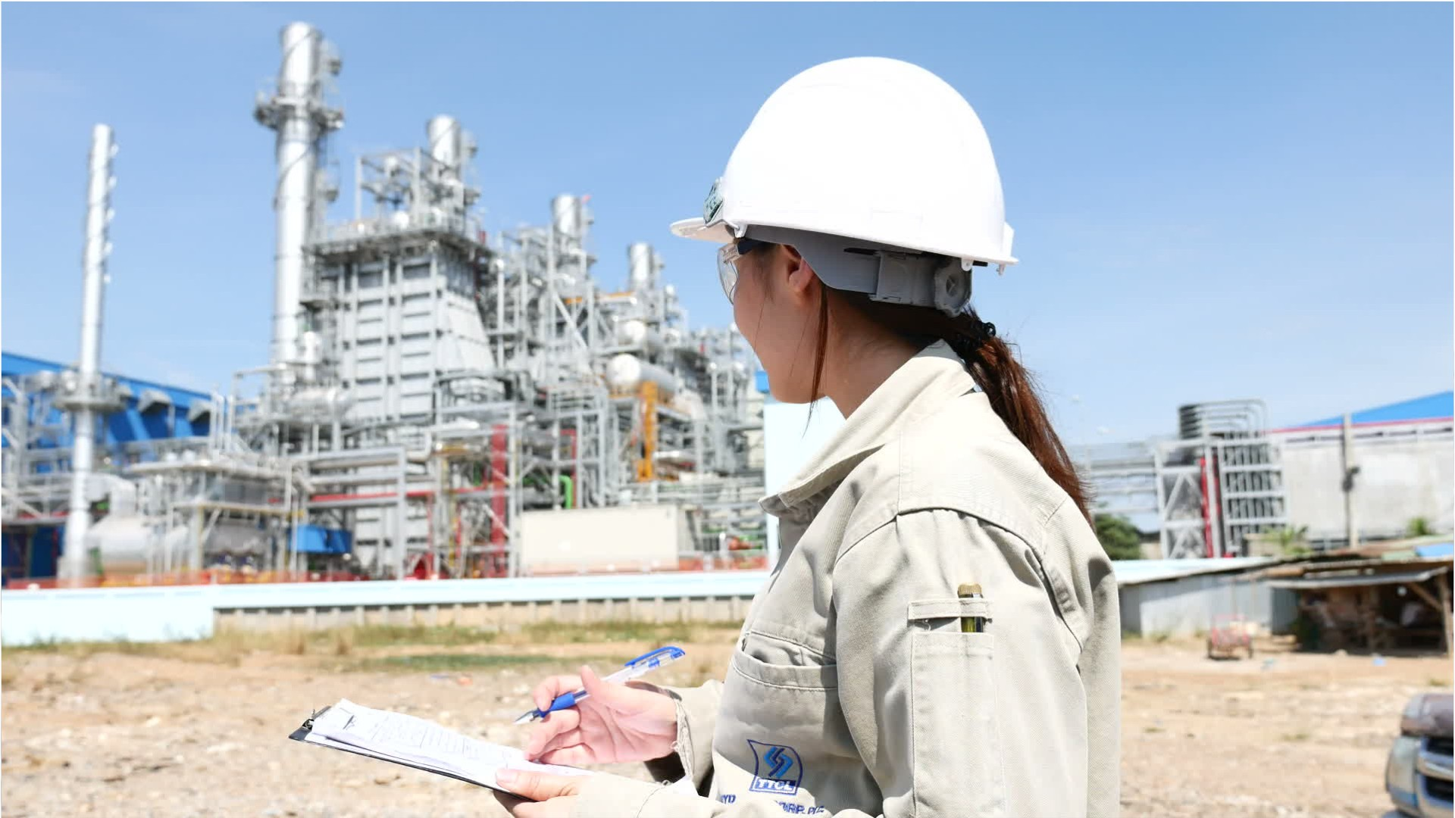
Notes:
Engineering may include the design and creation of skyscrapers, buildings, bridges and aircraft Engineering also includes sustainable energy development – wind turbines and solar panels. Engineering skills are essential in stonemasonry, car mechanics, theatre stage design and factory work. Software engineers design, develop and maintain computer software.

Slide 11
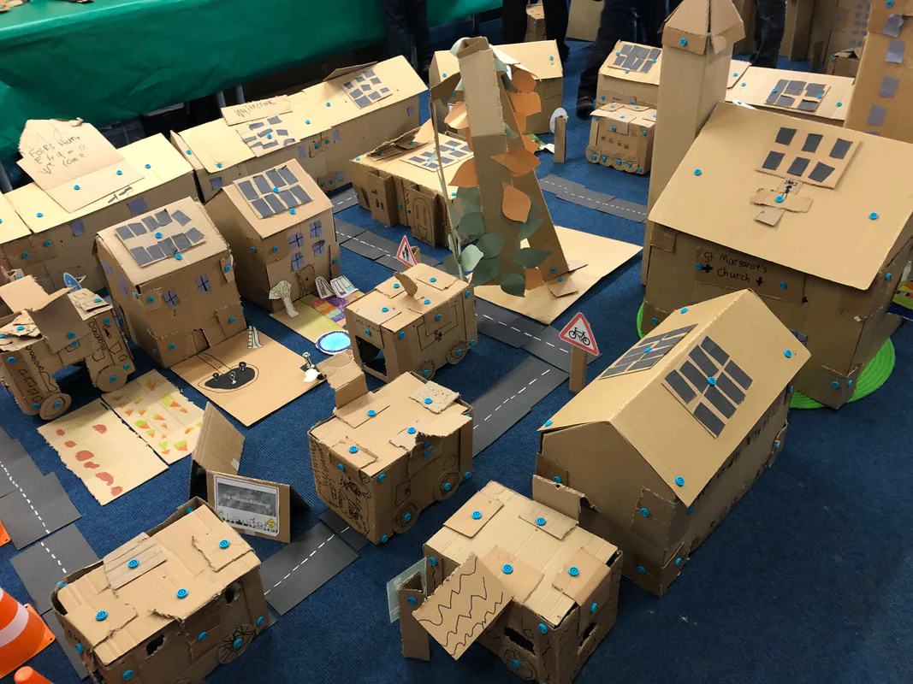
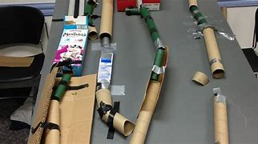
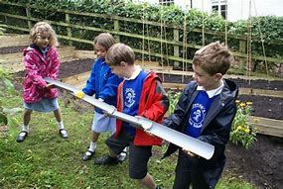
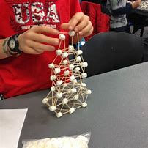
But engineering is also this…
Designing, building and testing new things
Problem seeking and solving
Creativity and imagination
Exploring
Teamwork
Notes:
Exploring new materials and using them in creative and innovative ways. Building dens and forts in the outdoors. Creating amazing structures, playing with pipes, water, ramps and more – believing in the impossible and setting out to create something new.

Slide 12
Defining Mathematics
Mathematics is…..
“All of STEM is underpinned by Mathematics, which includes numeracy, and equips us with the skills and approaches we need to interpret and analyse information, simplify and solve problems, assess risk and make informed decisions.”
~ Scottish Government, 2017

Slide 13
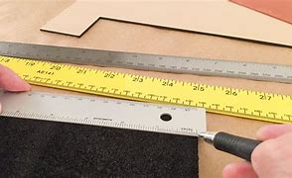
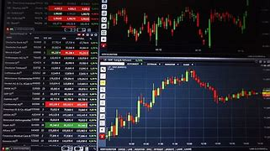
Notes:
Often, if we think of Mathematical careers, we picture someone working in finance or accountancy – but Mathematics is everywhere! From joinery, to shop keeping, to IT!

Slide 14
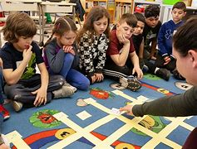
But Maths is also this…
Exploring size, shape and number in the world around me
Sharing, matching and sorting
Problem solving and creativity
Collecting and gathering
Exploring the seasons, time and space
Making meaningful connections

Slide 15
So how do you ‘fit’ STEM in/ what does STEM learning look like in the classroom?
Notes:
As I said before, without sometimes realizing it, many of the experiences that we plan and carry out with the children have STEM skills embedded right at their core! However, other activities in the classroom can be easily ‘tweaked’ to include the STEM skills as part of the learning experience.

Slide 16
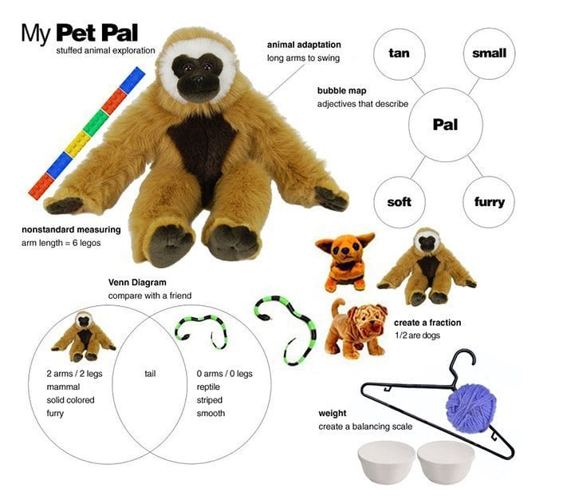
SHOW and Tell: Explore STEM Concepts With Stuffed Animals/Toys!
Can the children predict which stuffed toy is the longest, tallest, shortest, widest, and thinnest?
Choose a nonstandard tool for measuring and record the measurements (ear, eye, nose, mouth, head, paw, arm, leg, tail, body).
Can they order them from the longest to shortest, widest, to thinnest etc?
Can they estimate which one is lightest, which one is heaviest?
Provide the resources and get the children to create a balancing scale, then weigh them using non standard units!
Create Venn diagrams by comparing the characteristics of the toys
For literacy, the children could think about and write down/draw the characteristics that might help (inference) the animal (adaptations)
Research the attributes to find out how the characteristics (e.g. large ears) help animals.
Notes:
An example of tweaking something that might happen regularly in the classroom is this – obviously depending on age and stage of the learners in your classroom. This is a great example of an activity that involves Literacy and Numeracy and science!

Slide 17
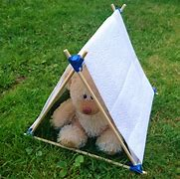
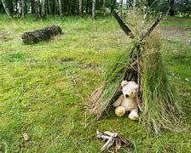
STEM in the Outdoors
Can you make a dry and warm tent for teddy to sleep in?
Learners select materials and create a shelter and test.
I enjoy experimenting with a range of textiles. TCH 0-04b
I can share thoughts with others to help further develop ideas and solve problems. TCH 0-04c
I explore ways to design and construct models. TCH 0-09a
I explore everyday materials in the creation of pictures/models/concepts. TCH 0-10a
Notes:
STEM can easily be incorporated into outdoor learning!

Slide 18
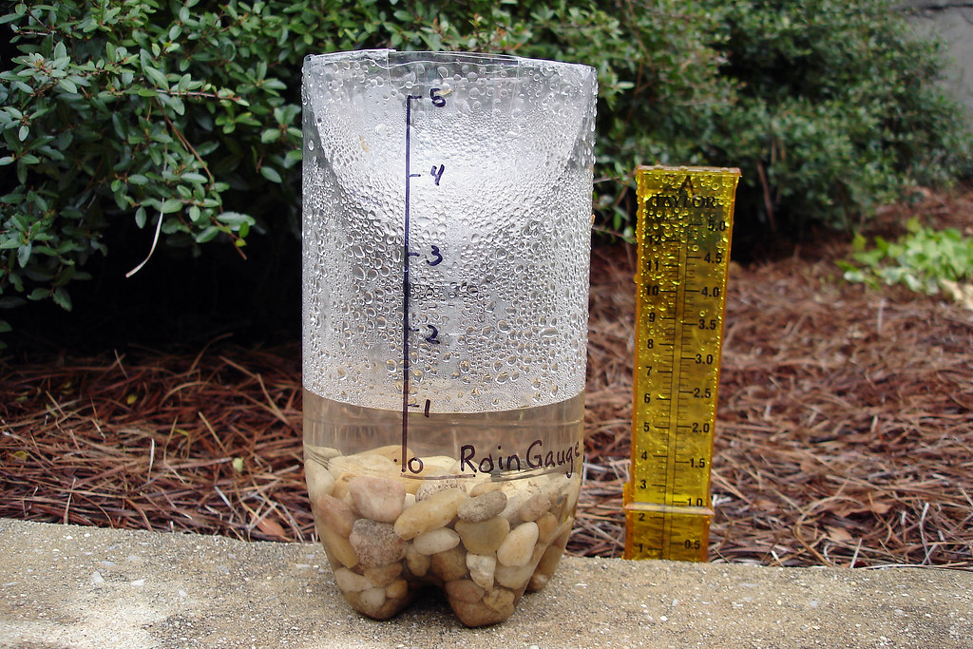
STEM in the Outdoors
By using a range of instruments, I can measure
and record the weather and discuss how
weather affects my life. SOC 1-12a
I can estimate how long or heavy an object is,
or the amount it holds, using everyday things
as a guide, then measure or weigh using
appropriate instruments. MNU 1-11a
By safely observing and recording the sun and
moon at various times, I can describe their
patterns of movement and changes over time.
I can relate these to the length of a day, a
month and a year. SCN 1-06a
I can design and construct models and explain
my solutions. TCH 1-10a
Can you create an instrument to measure and record (e.g. wind, rain or temperature) the weather using natural and other resources?
Learners work together and using natural resources and/or additional materials, create an instrument to measure the weather. They explain how their instrument works and justify their choice of materials.
They record the weather using their instrument; this could involve recording data on a table, making sketches or taking photographs. Learners then display their data appropriately.
This Photo by Unknown Author is licensed under CC BY-NC

Slide 19
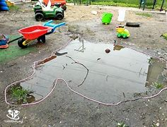
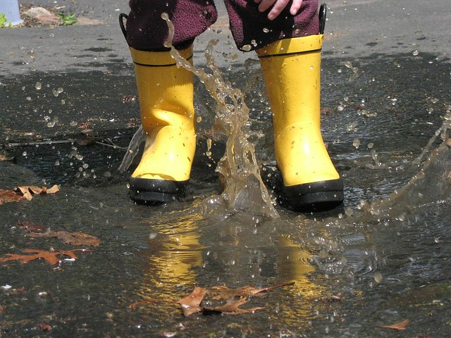
STEM in the Outdoors
How long does it take for a puddle to evaporate?
Learners explore the change in state of water on a sunny day.
I can explain how different methods can
be used to find the perimeter and area of a simple 2D shape or volume of a simple 3D object. MNU 2-11c
I can apply my knowledge of how water
changes state to help me understand
the processes involved in the water cycle in nature over time. SCN 2-05a

Slide 20
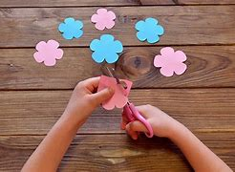
Now it’s your turn...
Floating Flowers
In groups of 4:
Using the paper provided, draw a flower shape with petals and carefully cut it out. (In class, the children might like to decorate the flowers: real flowers are often brightly coloured to attract insects so this could be a discussion/research opportunity)
Fold each petal into the centre of the flower; be gentle, don’t crease the fold too tightly!
Carefully place your folded flowers onto the surface of the water, with the folded petals facing upwards.
Watch and see what happens.
Notes:
You don’t need fancy resources or equipment! Here is a STEM activity involving water, paper and scissors!

Slide 21
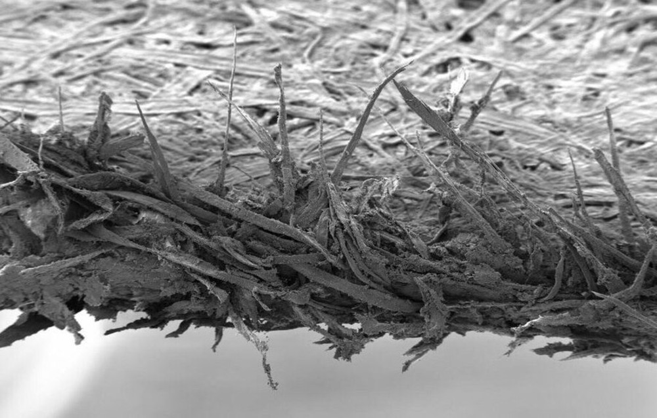
How does this work/ why does this happen?
Paper is made up of lots of fibres. There are lots of tiny spaces
between the fibres. You can see these by using a powerful
microscope. Paper 100x magnified
When you float the flower on the water, the water starts to fill the tiny spaces at the folded edges. As they fill, the paper fibres absorb the water and start to swell. This pushes open the folds on your paper flower.
This movement of water into the spaces in the paper is an example of capillary action. Real plants need capillary action to survive because it lets the water they need move up into their stalks or trunks.

Slide 22
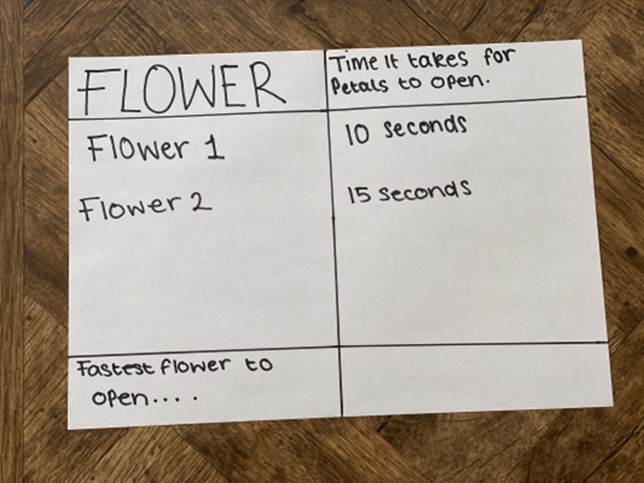
Developing this further…
What happens if:
You use thicker or thinner paper
You use different types of paper
You change the order in which the petals are folded – what happens if the petals are folded in sequence vs folding opposite petals?
You change the size or shape of the flower
You change the number of petals
You change the type of liquid
You change the shape – do other paper shapes do the same thing?
How are you going to make this a fair test? What are you going to measure or observe?
Note – timing something isn’t something younger children will manage accurately – it is better for
them to compare two things – e.g. two different flowers opening at the same time
Notes:
If each group in the classroom chooses something different to investigate, they have a real purpose in completing the investigation which then they can report to the whole class.
Choose something to investigate as a group and have a go!

Slide 23
Links to Es and Os:
Through exploring properties and sources of materials, I can choose appropriate materials to solve practical challenges. SCN 1-15a
I can recognise a variety of materials and suggest an appropriate material for a specific use. TCH 1-10
I can recognise basic properties and uses for a variety of materials and can discuss which ones are most suitable for a given task. TCH 2-10a
I have explored a variety of ways in which data is presented and can ask and answer questions about the information it contains. MNU 1-20a
I have used a range of ways to collect information and can sort it in a logical, organised and imaginative way using my own and others’ criteria. MNU 1-20b
I have carried out investigations and surveys, devising and using a variety of methods to gather information and have worked with others to collate, organise and communicate the results in an appropriate way. MNU 2-20b
…and develops inquiry and investigating skills across the Levels!
Notes:
…and lots of opportunity for Listening and Talking too! This could also be written up as a report.

Slide 24
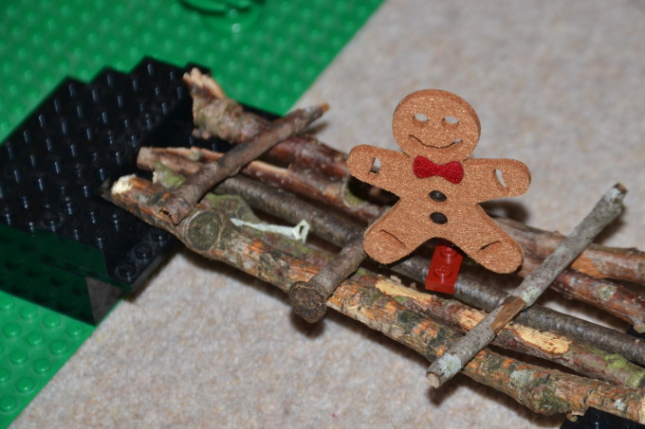
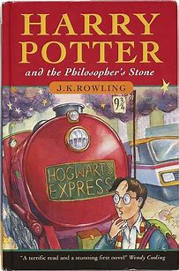
STEM through Stories
Help the Gingerbread Man by building him a bridge to stop him being eaten by the fox
Do different types of chocolate melt at the same temperature?
Build a rocket to help Baby Bear get to the moon!
Build ‘Golden Snitch’ catapults
Notes:
Children’s stories provide a great context for learning STEM! They can be used with younger children as an introduction to learning how to set up investigations correctly and how to work scientifically and can be used for thinking about variables and ‘fair test’ investigations with older children.
Stories can also provide a context for many engineering challenges too!

Slide 25
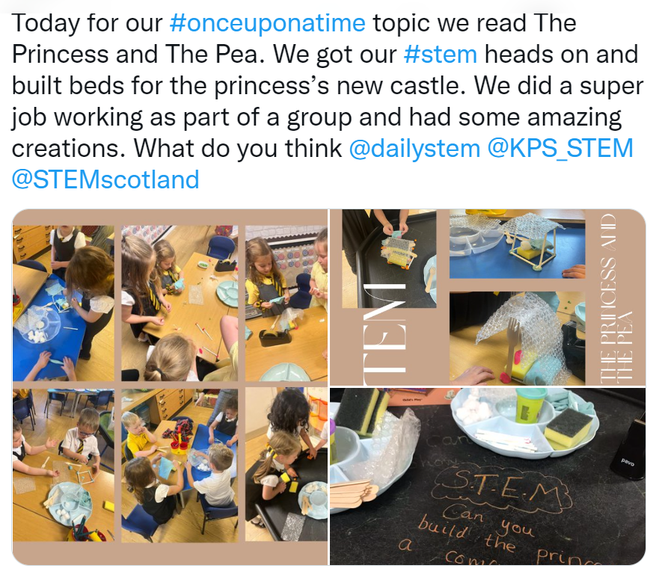
STEM through Stories
Notes:
Here’s an example from Twitter - a P1 class getting their ‘STEM heads on’ to build a bed for the princess after enjoying the story The princess and the Pea’

Slide 26
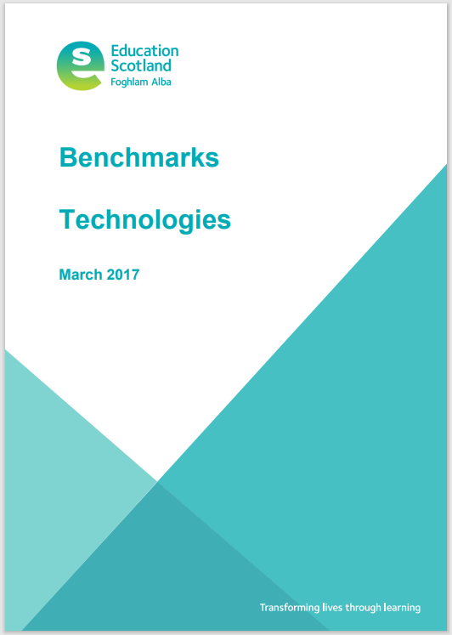
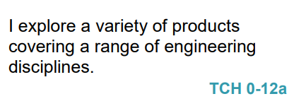
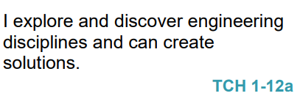
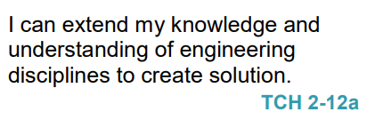
Engineering is part of the Curriculum for Excellence but information is limited
Recognises engineering in the world around them for example bridges, construction, electronics, computers.
Recognises and identify different engineering disciplines.
Builds a solution to a specific task, which has moving parts.
Understands the difference between different engineering disciplines
Understands different energy types.
Builds/simulates solutions to engineering problems.
Notes:
Let’s come back now to Engineering.

Slide 27
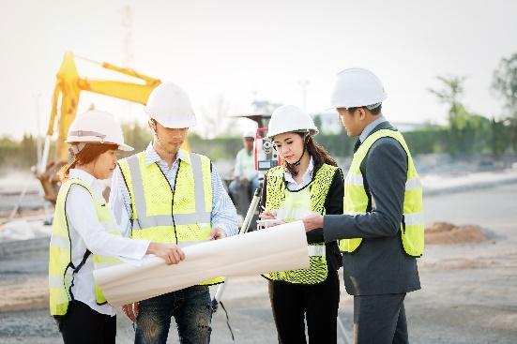
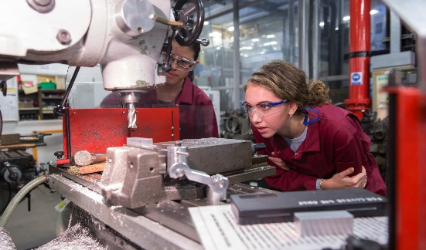
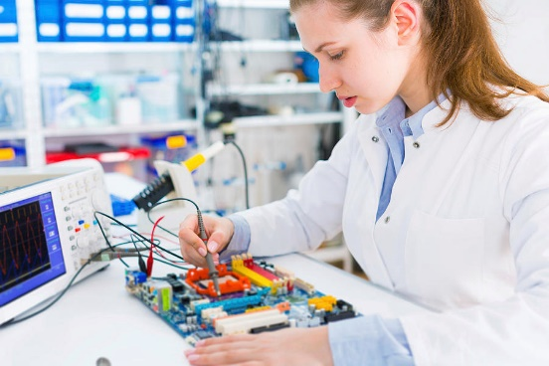
Engineering Disciplines/Engineering Across the Curriculum
Civil – infrastructure, roads, houses, bridges
SOC: People, Place and Environment
TCH: Exploring Uses of Materials, Design and Construct Models
SCI: Forces, Materials
MNU: Measure
EXA: Creating objects for specific tasks/solutions to a design problem.
Mechanical – engines, machines, moving parts
TCH: Design and Construct Models
SCI: Forces
MNU: Measure
EXA: Creating objects for specific tasks/solutions to a design problem.
Electrical – application of electricity and electronics
SCI: Electricity
Software – computer programming and computational thinking
TCH: Computing Science
MNU: Shape Position & Movement, Chance and Uncertainty
EXA: Creating solutions to a design problem.
Other engineering disciplines: Aerospace, Chemical, Biomedical, Biological, Nuclear, Industrial, Agricultural, Structural, Environmental…
HWB: Career education

Slide 28
So…. how can we encourage pupils to think like and act like engineers and develop the associated skills?
Answer: by teaching the children to use the ‘Engineering Design Process’

Slide 29
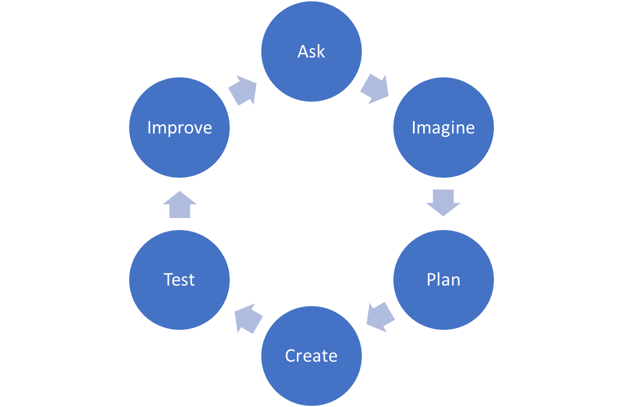
The Engineering Design Process
ASK: Students identify the problem, requirements that must be met, and constraints that must be considered.
IMAGINE: Students brainstorm solutions and research ideas. They also identify what others have done.
PLAN: Students choose two to three of the best ideas from their brainstormed list and sketch possible designs, ultimately choosing a single design to prototype.
CREATE: Students build a working model, or prototype, that aligns with design requirements and that is within design constraints.
TEST: Students evaluate the solution through testing; they collect and analyse data; they summarise strengths and weaknesses of their design that were revealed during testing.
IMPROVE: Based on the results of their tests, students make improvements on their design. They also identify changes they will make and justify their revisions.
THIS PROCESS IS A CYCLE – NOT LINEAR

Slide 30
Now it’s your turn to…
Think like an engineer!

Slide 32
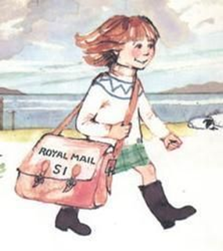
Oh no! The postie needs help to get the mail across to the Isle of Struay Post Office!
Can you build something that floats that will carry the mail and the parcels?
You must work as a team and can only use the materials provided…
Notes:
A little bit about ‘task’ vs ‘brief’. A task has a narrow focus and potentially prohibits creative problem solving. A problem to solve is a ‘brief’. Here, the brief is to design a way to transport goods across to the Isle of Struay. i.e. By keeping the word ‘boat’ out of this, it broadens the possibilities that the children will come up with!

Slide 33
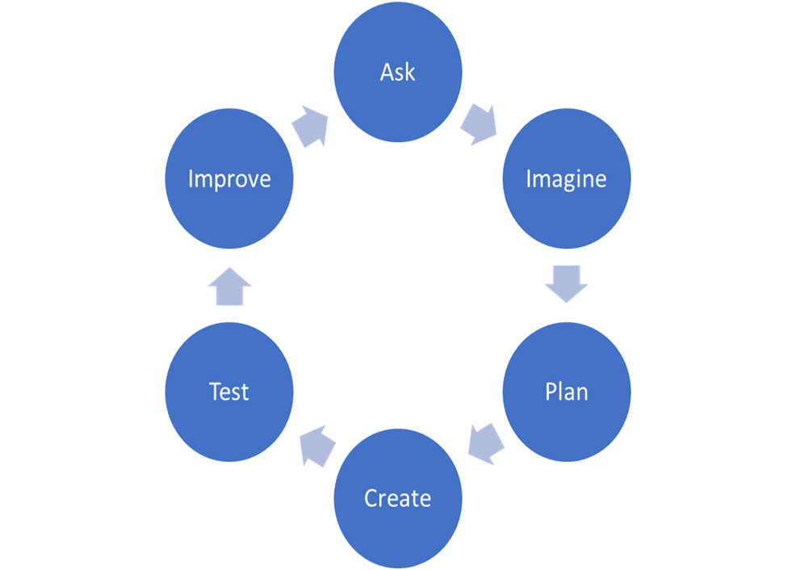
Using the engineering design process, your team brief is to design and create something to carry cargo across water
ASK: What is the problem, the requirements and constraints?
Problem: design something to carry cargo across water
Constraints: you can only use the materials provided
IMAGINE: Brainstorm solutions and research ideas
PLAN: Choose two/three of the best ideas from the brainstormed list and sketch possible designs, then choose a single design to prototype
CREATE: Build the model/prototype
TEST: Evaluate and testing identifying strengths and weaknesses of the design
IMPROVE: Based on the test, make improvements to the design, identify changes and justify the revisions.

Slide 34
Support/ resources
Aberdeenshire Science and STEM Blog:
https://blogs.glowscotland.org.uk/as/abshireprimaryscience/
Our Twitter account: @AbshireSTEM
Contact us:
Caroline: caroline.nicol2@aberdeenshire.gov.uk
Kim: kim.aplin@aberdeenshire.gov.uk

