Slide 1
Please say hello in the chat and introduce yourself

Slide 2
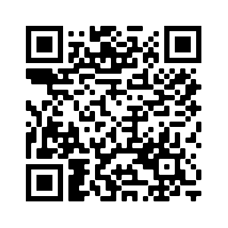
STEM Nation Award
Aberdeenshire – 7 February 2023
Kim Aplin & Caroline Nicol – RAiSE PSDOs
Mark Irwin – Regional STEM Education Officer
Fiona Shaw – Regional STEM Education Officer
Ian Stewart – Development Officer (STEM Nation Award)
STEM@educationscotland.gov.scot
STEM Nation
Award

Slide 3
The STEM Nation Award and the Young STEM Leader Award Programmes have been developed with support and funding from the Scottish Government.
The STEM Nation Award Programme, led by Education Scotland, provides a focus for colleagues across a setting to work collegiately to identify, celebrate, promote and develop excellent STEM learning.
Notes:
The award has been developed to allow settings - ELCs, Schools and CLD settings. To celebrate, promote and build on effective practice in STEM.
Successful pilot programme with ELC settings and schools
Guidance documents are available in Gaelic for ELCs and schools
CLD guidance documents developed with practitioner working group
CLD documents have been co-developed with practitioners, with CLD exemplars prioritised for later this year

Slide 4
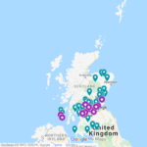
STEM Nation Award – Update
National Update :
Over 160 settings have registered from across all six regions;
45 settings have been awarded one or more elements.
24 settings have achieved the full STEM Nation Award.
Update for Northern Alliance:
18 settings are registered
3 settings have been awarded one or more elements.
2 settings have achieved the full STEM Nation Award.
Notes:
The successful pilot programme with ELC settings and schools led to 23 settings successfully achieving the full STEM Nation Award, with 44 other settings awarded for one or more elements, this is an impressive engagement when you consider this took place with the backdrop of lockdown.
In Falkirk – 11 settings are registered … 4 high schools, 4 primary school, 1 joint primary and ELC setting, 2 ELC setting

Slide 5
Benefits
The STEM Nation Award Programme addresses the key aims of the STEM Strategy for Scotland, to deliver Excellence, Equity, Inspiration and Connection in STEM education and training. The structure of the Programme provides opportunities which allow settings to address many key priorities within the STEM context, including
Closing attainment gap Closing equity gap Social Justice Gender balance GIRFEC | Learning for Sustainability Green Skills STEM Skills UNCRC
Notes:
The Programme is designed to address the key aims of the STEM Strategy to deliver Excellence, Equity, Inspiration and Connection in STEM education and training. This provides opportunities for settings to engage in many key priorities such as closing attainment and equity gaps, social justice, gender balance and UNCRC goals

Slide 6
The five elements
For CLD settings, optionality built into STEM learning in the community element – CLD applicants can focus on adult learning, family learning or youth work.
Five key elements – evidence can be used across multiple elements
Three year window to submit evidence
Leadership in STEM
STEM family learning /
STEM learning in
the community
Employability and STEM partnerships
Curriculum and learner pathways
Equity and equality in STEM
Notes:
The structure of STEM Nation Award addresses the main aims of the STEM Education and Training Strategy, which are key to ensuring high quality STEM learning in all settings.
Five key elements …….
– evidence can be used across multiple elements
Depending on the needs of their learners CLD settings can focus of adult learning, family learning or youth work

Slide 7
Leadership in STEM examples:
Our shared vision and rationale for STEM was developed in collaboration with a range of stakeholders.
Where appropriate, a core team of staff provide effective planning, coordination and leadership for STEM.
We make time for professional dialogue, collegiate learning and self-evaluation to support and inform improvements in STEM.
Ongoing collaborative and collegiate working helps to build our STEM practice and develop our pedagogy.
Practitioners demonstrate leadership in STEM learning and are helping to motivate, inspire and support others.
We use data and evidence of learners’ progress in STEM to help us meet the needs of our learners and promote equity and equality.
Learners are empowered to take on STEM leadership roles and, in line with the UNCRC, have a say in decisions that affect them, including their STEM learning.
Leadership in STEM
Notes:
Further details on each element is given in the Application Guidance.
https://blogs.glowscotland.org.uk/glowblogs/public/stemnation/uploads/sites/8486/2022/10/03191711/01-STEM-Nation-Award-Application-guidance-ELC-and-schools.pdf
For Leadership in STEM this can relate to practitioners or learners
5

Slide 8
Curriculum and Learner Pathways examples:
STEM learning strongly supports Learning for Sustainability, the UN Sustainable Development Goals including learning about the climate emergency and threats to biodiversity.
Engaging STEM contexts help us deliver literacy, numeracy and digital literacy.
We are using creative approaches in STEM to promote curiosity, open-mindedness, imagination, problem solving and diversity.
Collaboration with learning community colleagues is helping us to improve continuity and progression in STEM learning.
We are helping learners develop a belief in their own abilities. The support we provide to learners and their families helps learners make informed choices about STEM learner pathways, not limited by stereotypes.
We encourage all learners to develop a wide range of skills and take account of labour market needs when planning the curriculum to prepare learners for a variety of STEM careers, including green jobs.
Curriculum and learner pathways
Notes:
For Curriculum and Learner Pathways you may consider how curiosity, imagination and diversity is encourages.
or consider how improving collaboration is supporting progression
5

Slide 9
Programme Process
Register and carry out self-evaluation
Complete setting profile
Collate and submit evidence using PowerPoint template
For full award - Action Plan and Validation Conversation
Notes:
The process has been designed to be straightforward.....
Can apply for all five elements at once or work towards the award over a three year period
5 elements
3 year window
For settings who are embracing STEM learning
It's completely free!
Submission template is a PowerPoint and populated with extracts from improvement plans, photographs of learners, survey feedback from families, learner profiles, Tweets or newsletters
There is a maximum of 5 slides of evidence per element

Slide 10
Reflection
Take a few minutes to reflect on current practice / activities in STEM in your classroom and across your setting
Leadership in STEM
STEM family learning /
STEM learning in
the community
Employability and STEM partnerships
Curriculum and learner pathways
Equity and equality in STEM

Slide 11
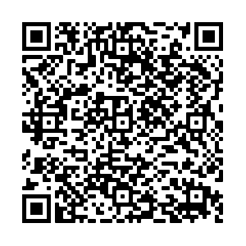
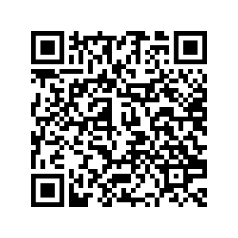
Discussion and Jamboard
Discuss the practice / activities in your classroom / across your setting.
Complete the Slides 1 & 2 of Jamboard to match them with Award Element(s).
Leadership in STEM
STEM family learning /
STEM learning in
the community
Employability and STEM partnerships
Curriculum and learner pathways
Equity and equality in STEM
Application Guidance
For ELC & Schools
Jamboard

Slide 12
Identifying Challenges
Complete Slide 3 of Jamboard to identify:
which elements you think your setting may find challenging?
what support would be useful?
Leadership in STEM
STEM family learning /
STEM learning in
the community
Jamboard
Employability and STEM partnerships
Curriculum and learner pathways
Equity and equality in STEM

Slide 13
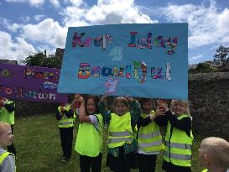
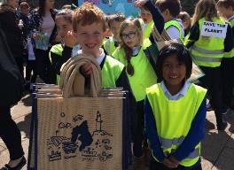
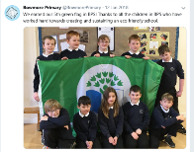
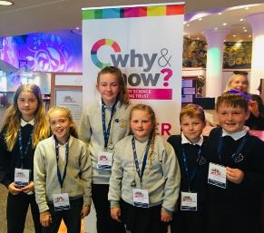
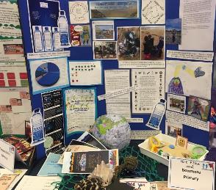
Plastic Warriors
After conducting a number of beach cleans and recording their findings, it was clear that plastic pollution on Islay was a problem.
The children in P1-4 discouraged the use of single use plastic in our school, they encouraged all staff and pupils to use re-useable water bottles. They also planned their ‘Keep Islay Beautiful’ campaign. The children marched through the village spreading the word on plastic pollution and sold re-useable bags that they had designed themselves.
The P5-7 collated the data collected from our each cleans and presented it in a clear way. This was shared with parents and carers to spread the concern about plastic pollution.
Finally, three children attended the Primary Science Teaching Training Conference in Edinburgh where they presented their findings to teachers, MSPs and science leaders.
Change Makers
Through our Change Makers groups, the children lead different areas of development throughout the school. These include the Eco Group who are responsible for ensuring our school is as eco-friendly as possible. We also have a Digital group
Leading Change in the Community
Following our plastics topic, a group of children independently designed and displayed posters to inform people about global warming and plastic pollution.
Bowmore Primary School

Slide 14
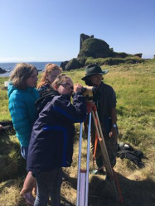
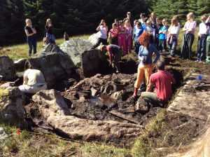
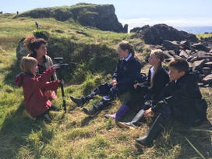
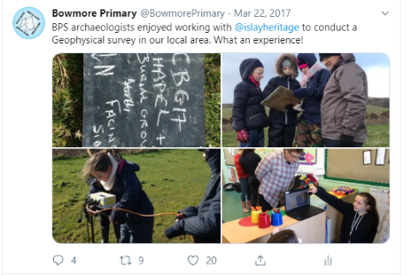
Archaeology
Dunyvaig ​
For the past few years we have worked alongside Islay Heritage and Reading University on an archaeology topic. The children applied their numeracy skills to draw scale drawings and conduct surveys at the Dunyvaig Archaeological site.
Giant’s Grave
The children worked with Islay Heritage and Reading University and were introduced to the technology required to conduct a full archaeological dig. They used geo-physics and technology to create an image of the site with the archaeologists.
Bowmore Primary School
Notes:
You may wish to use the notes area to provide a written narrative to support your evidence.

Slide 15
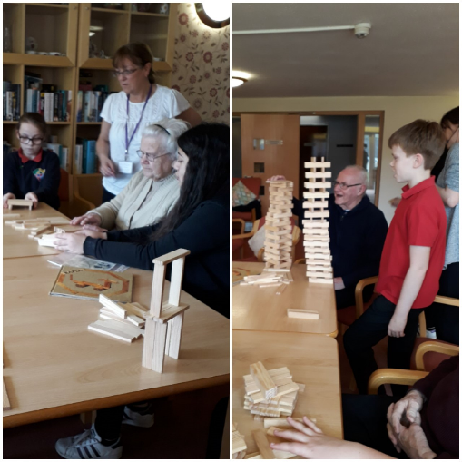
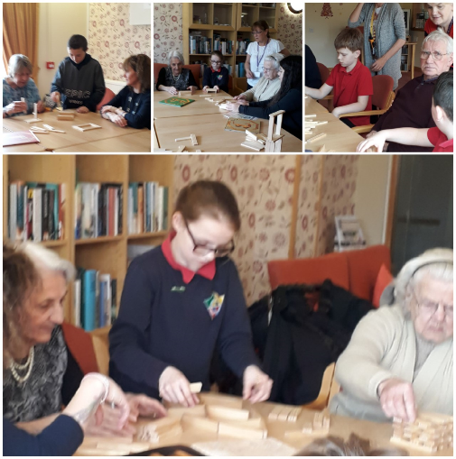
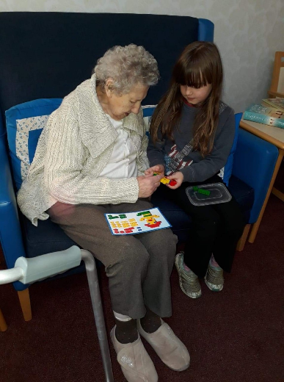
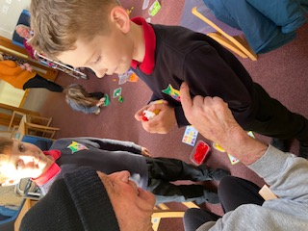
Community Engagement
Our community outreach groups regularly visit a neighbouring residential care home and engage in activities with the elderly residents.
STEM activities are often a focus for these visits, with learners engaging in construction challenges with resources such as Lego, Kapla and K'Nex. Pupils have also taught residents to use creative apps on iPads.
Pitteuchar East Primary School

Slide 16
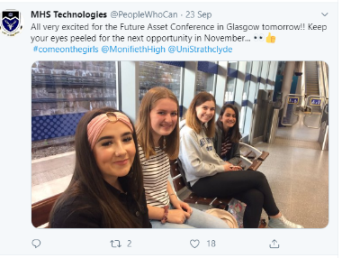
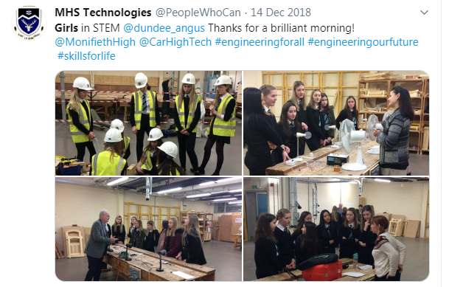
Monifieth High School
Notes:
You may wish to use the notes area to provide a written narrative to support your evidence.

Slide 17
Who can help?
children and young people
parents and wider community
Kim Aplin Caroline Nicol PSDOs
Mark Irwin / Fiona Shaw Regional officers
partners
community learning & development colleagues
practitioners
STEM Nation network members
Ian Stewart DevelopmentOfficer
Notes:
There are many sources of support ...

Slide 18
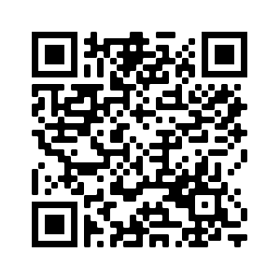
Support Structures / Opportunities
Initial Support within Northern Alliance: Mark Irwin – Regional STEM Education Officer Fiona Shaw – Regional STEM Education Officer Kim Aplin– RAiSE PSDO (kim.aplin@aberdeenshire.gov.uk) Caroline Aplin – RAiSE PSDO (caroline.nicol2@aberdeenshire.gov.uk)
Collegiate Support: STEM Coordinators, STEM Networks, colleagues, etc
Partners / Supporters : STEM Ambassadors, SSERC, Aberdeen Science Centre, RHET, Royal Society of Chemistry, The Royal Society, Universities, Colleges and many more
Networks
Notes:
myself and Regional STEM EO can provide support prior to registration and during process.
Currently looking in to process of formalising relationship with Partners as STEM Nation Award Supporters.

Slide 19
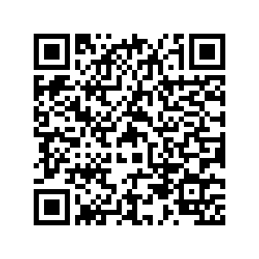
STEM Nation update
ELC
settings
primary schools
secondary schools
Regular drop in sessions for interested and registered settings.
STEM Nation Network Sessions
Upcoming STEM Events
Notes:
ES are also hosting drop in sessions for registered settings and those who are interested in registering
https://blogs.glowscotland.org.uk/glowblogs/STEMcentralinmotion/2022/10/06/stem-nation-award-drop-in-sessions/

Slide 20
Any questions ?
Notes:
10 minutes

Slide 21
STEM@educationscotland.gov.scot
Notes:
https://jamboard.google.com/d/1pExlIa9vLNtJq-Mj5qIoFj0ShmA3cmSvh6EA8fYrw3I/edit?usp=sharing

