Slide 1
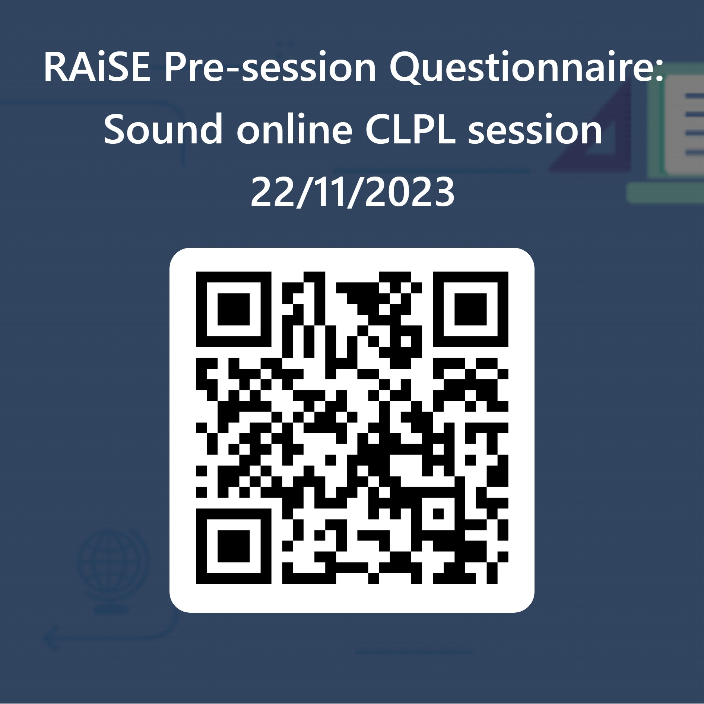
Sound
This session will begin at 4.05pm.
If you haven’t had the opportunity to fill in the pre-session questionnaire yet, please use this 5 minutes to complete it.
Thank you very much! ☺
https://forms.office.com/e/0cQkdXvVRW
Kim Aplin and Caroline Nicol
RAiSE PSDOs, Aberdeenshire

Slide 2
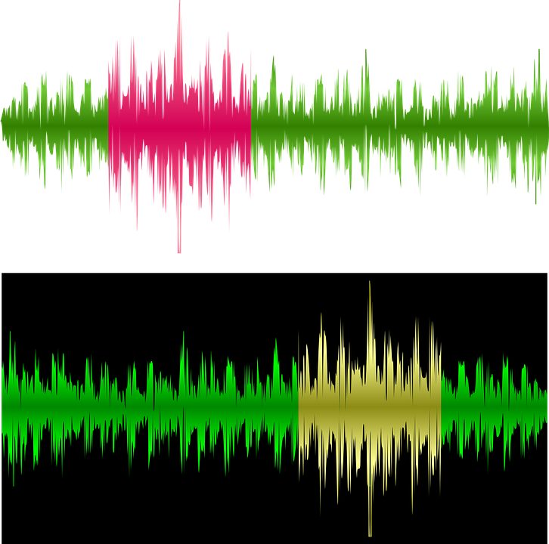
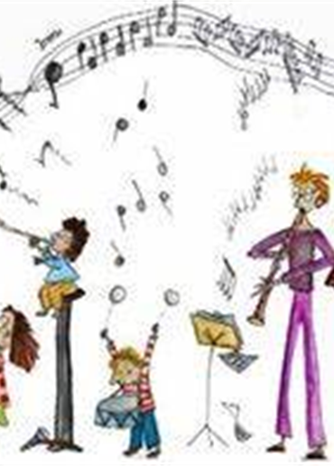
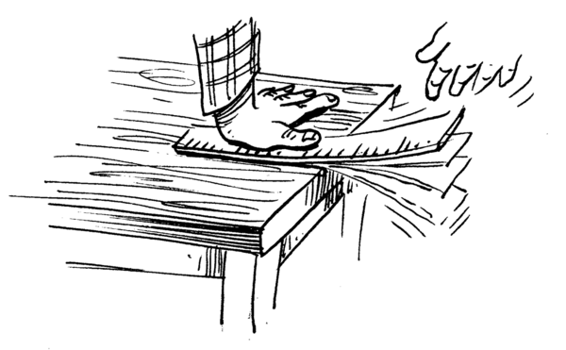
Sound
Kim Aplin and Caroline Nicol
RAiSE PSDOs, Aberdeenshire

Slide 3
Curriculum for Excellence
Forces, Electricity and Waves Vibrations and Waves
Learners explore the nature of sound, light and radiations in the electromagnetic spectrum. They use musical instruments to explore the relationship between vibrations and sounds produced.
Through play, I have explored a variety of ways of making sounds. SCN 0-11a
Benchmarks:
Predicts, then investigates, ways to make sounds louder and quieter.
Identifies different sources of sound.
By collaborating in experiments on different ways of producing sound from vibrations, I can demonstrate how to change the pitch of the sound. SCN 1-11a
Benchmarks:
Demonstrates how sounds can be made higher or lower pitch by altering tightness, length, width or thickness or other physical characteristics of the sound source.
Explains that sound is caused by a vibration in a material.
Through research on how animals communicate, I can explain how sound vibrations are carried by waves through air, water and other media. SCN 2-11a
Benchmarks:
Discusses and demonstrates through experiments how sound travels differently through air, water and solids.
Explains how hearing is limited by a range of factors, for example, age, position, and flexibility (direction) of ears.
Notes:
‘Sound’ comes in as part of the Vibrations and Waves sub organiser within the organiser ‘Forces, Electricity and Waves’ within the Curriculum for Excellence Sciences document.

Slide 4
Some Cross-Curricular Links...
Biological Systems – Body systems and cells
I can identify my senses and use them to explore the world around me. SCN 0-12a
I have explored my senses and can discuss their reliability and limitations in responding to the environment. SCN 1-12b
I have explored the structure and function of sensory organs to develop my understanding of body actions in response to outside conditions. SCN 2-12b
Technologies
During practical activities and design challenges, I can estimate and measure using appropriate instruments and units.
TCH 1-13a / TCH 2-13a
By applying my knowledge and skills of science and mathematics, I can engineer 3D objects which demonstrate energy transfer.
TCH 2-12a / TCH 3-12a
Expressive Arts: Music
I have the freedom to use my voice, musical instruments and music technology to discover and enjoy playing with sound and rhythm. EXA 0-17a
I can use my voice, musical instruments and music technology to discover and enjoy playing with sound, rhythm, pitch and dynamics. EXA 1-17a
I can use my voice, musical instruments and music technology to experiment with sounds, pitch, melody, rhythm, timbre and dynamics. EXA 2-17a
Notes:
Sound also links to some of the Es and Os in Biological Systems (senses and sensory organs i.e. hearing and ears) and also Music. If the learning activities include the design and construction of musical instruments, then there are also links to some of the Technology Es and Os.

Slide 5
Some terms used in music:
Dynamics
The varying degrees of loudness and quietness in sound (amplitude).
Pitch
The term used to describe how high or low/deep a note or sound is (frequency).
Music technology
The use of electronic devices and computer software in music compositions and performance.
Notes:
As learning about sound does have a close link to music, it is valuable to also look at some of the terms used in music too.

Slide 6
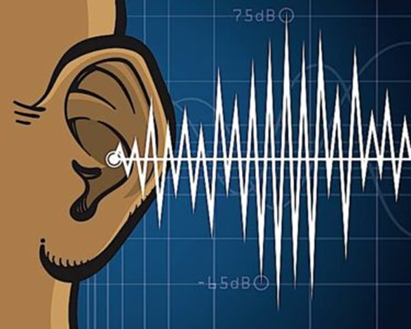
Background science…
Sound is created when objects vibrate. The vibration (waves of energy) makes the air molecules around the object vibrate and those vibrations travel through the air or another medium (solid, liquid or gas) to the ear.
The stronger the vibrations, the louder the sound.
Sounds are fainter the further you get from the sound source.
Sound waves need a medium (like air or water) to travel through.
Sound changes depending on how fast or slow an object vibrates to make sound waves.
Pitch is the quality of a sound (high or low) and depends on the speed of the vibrations. Different materials produce different pitches; if an object vibrates quickly, we hear a high-pitched sound, and if an object vibrates slowly, we hear a low-pitched sound.
Sounds are usually a mixture of lots of different kinds of sound waves.
The scientific study of sound waves is known as acoustics.
Notes:
Let’s look at the background science of sound:
This is a useful short video that could be used with the children to explain what sound is.
Learning about sound is best approached in an exploratory and hands-on way, giving children the opportunity to really experience what happens when sounds are made.

Slide 7
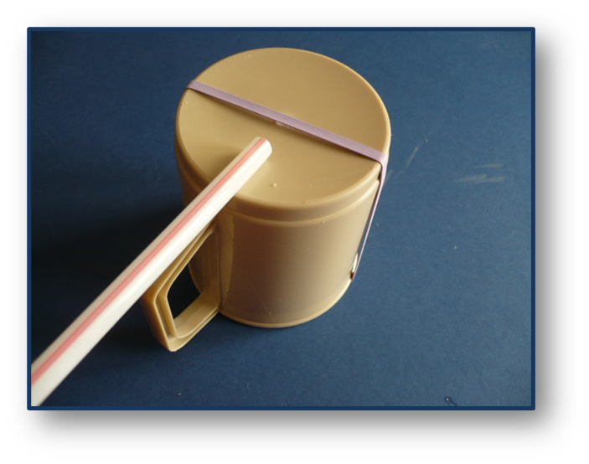
We have vocal cords!
Learners can feel the vibrations made as they talk by gently pressing their fingers against the base of their throat whilst talking or singing.
Say ‘Ahh’ or sing, or him or laugh! Can you feel the vibrations from your vocal cords?
The vibrations feel stronger when a louder sound is made – try it!
AHH!
Make your own model of a vocal cord by placing an elastic band around a cup as shown and blow quite hard through the straw! Watch the elastic band vibrate and hear the noise.
Notes:
One of the key things that learners need to know is sound is created when objects vibrate. We all have vocal cords so why not start with these?
Activity to do. Pick a sound to make – laughing, talking, singing, say Ahh? Place your fingers on your throat – can you feel something moving? When you stop – the movement stops. What is happening is your vocal cords vibrate as air passes over them when you speak or make a noise. What happens when you use a louder voice? What happens to the vibrations?
This could be done with the youngest learners too.
You could make a simple model of a vocal cord as in the picture above.
This is an interesting video that you could use with older pupils.
With adaptation to make it appropriate for the children , this activity could be done with learners at any level but also revisited to help to consolidate and/or deepen the learning.

Slide 8
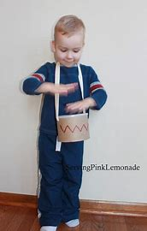
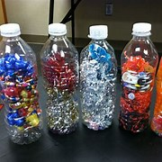
Let’s look at Early Level…
Through play, I have explored a variety of ways of making sounds. SCN 0-11a
Benchmarks:
Predicts, then investigates, ways to make sounds louder and quieter.
Identifies different sources of sound.
Hello!
Use everyday objects and things the children use in the classroom to make sounds and instruments e.g., tubs, plastic bottles cardboard boxes (taped around the outside to keep them in shape), saucepans and lids, wooden and metal spoons, paint brushes, thick card, plastic cups, mugs, beads, lentils, dried peas marbles, shells, gravel, paper clips, wool, string, elastic bands etc.
This could be done by creating a play area with a tinker table.
It is valuable to include everyday objects, to avoid sound being connected only with musical instruments.
Notes:
Let’s start with Early Level. Early Level learning experiences should be about exploring ways of making sounds, investigating how to make sounds louder and quieter and being able to identify sources of sound.
So, let’s start with investigating how to change the volume of sounds, one way you could start, as we did in the last slide is by asking the children to place their fingers on their throat and to pick a sound to make and feel the vibrations of their vocal cords. Ask them what happens to the vibrations when they use a loud voice and a soft voice and when they use an even louder voice.
You could ask the children to use different parts of the body to make sounds and make some loud and some soft. Link the volume of sound to the energy required to make the sound: the louder the noise, the bigger the energy required e.g., clapping, stamping.
Provide everyday objects and things from the classroom for the children to experiment with to create sounds and or instruments e.g., shakers, drums, stringed instruments etc.
Using the instruments they have created or the objects , let the children explore the ways to change the volume of sounds. Qu: How do you make the sound louder or quieter?
Just for a bit of fun, you could show the children this video of a group called STOMP using everyday objects to make sounds to create music! Yes, it is possible to make music without musical instruments!

Slide 9
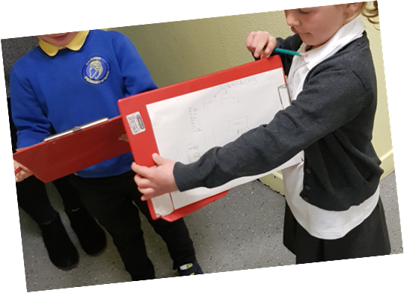
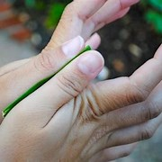
Let’s look at Early Level…
Activity: Go for a ‘sound’ walk!
Go for a walk to see what you can hear inside school and out in the playground.
The children could draw what they hear on their walk or use an iPad and take
photographs, or you could record the sound scape; these could then be used
for discussion back in the classroom.
Ask the children to think about whether it is a loud or quiet sound.
Ask: Where are the sounds coming from? Why are the sounds quiet/loud? How do we hear sounds?
The children could make a pictorial record/map of their sound walk.
(If you have a chance, as part of the walk, drop a pebble in a pond/puddle
or watch water dripping into a puddle, it is a useful image to explain how
sound waves (the movements/vibrations) radiate from the source getting
fainter the further they are from the source).
Use natural materials to make sounds! You could make a grass whistle!
Notes:
Another activity you could do is to go on a sound walk. Get the children to perhaps draw things that they hear that are making a noise or photograph them or record the sound scape. These could then be use for discussion – was it a loud or quiet sound? Why are they loud? Why are they quiet? Where are the sounds coming from? etc.
If you have a chance, drop a pebble in a puddle or a pond or watch water dripping into a puddle- the ripples are a useful image to explain how sound waves radiate from the source and get fainter the further they are from the source.
You could make a grass whistle and investigate making the sound louder and quieter!

Slide 10
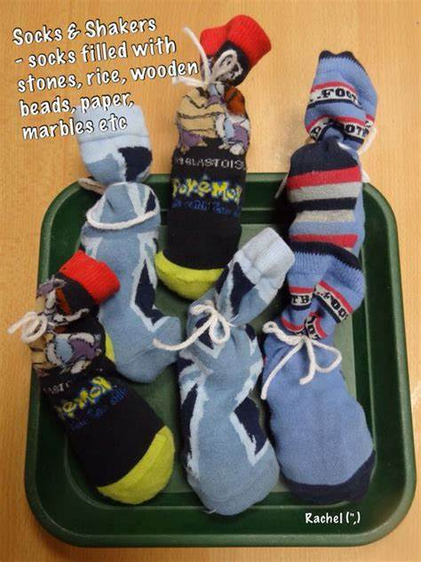
Let’s look at Early Level…
Different materials produce different sounds! Make shakers with different materials inside to make different types of sounds. Try to guess what is in each shaker. Do they make sounds that are high/low loud/soft short/long?
You will need:
non-transparent containers or plastic bottles put inside a sock
shakeable contents e.g., paper clips, beans, rice, sugar.
Challenge: How many shakers can you recognise?
Challenge: Can you make a shaker that is very difficult to recognise?
Plastic egg shakers – match the sounds and pair the eggs:
Sound Box with Plastic Eggs DIY Montessori Activity - YouTube
Notes:
Different materials produce different sounds. The children could make shakers with different materials inside them and see how many different sounds they could make. If the shakers are made from non- transparent containers, or the containers are covered up by putting them inside a sock for example, can the children guess what is in each shaker? Are the sounds high or low, loud or soft, short or long?
In this other activity plastic eggs are used to make shakers ( 2 of each kind) and the children pair up the eggs by listening to the sound and matching the pairs.

Slide 11
Let’s look at Early Level…
Sounds are all around us. Anything that makes a sound is called the source of the sound.
Listen to each of the sounds. What do you think is making the sound/the source of the sound could be?
1
2
3
Through play, I have explored a variety of ways of making sounds. SCN 0-11a
Benchmarks:
Predicts, then investigates, ways to make sounds louder and quieter.
Identifies different sources of sound.
4
Sound Effects from Pixabay
Notes:
The second benchmark states that Early level learners should be able to Identify different sources of sound.
Anything that makes a sound is called a source. This is a nice video to explore that with the children.
Similar to what they did in the video, you could record some sounds or use royalty free ones and ask the children to listen to them and tell you what they think is making the sound i.e. what is the source of the sound.
Owl
Bird song
Alarm clock
Thunderstorm

Slide 12
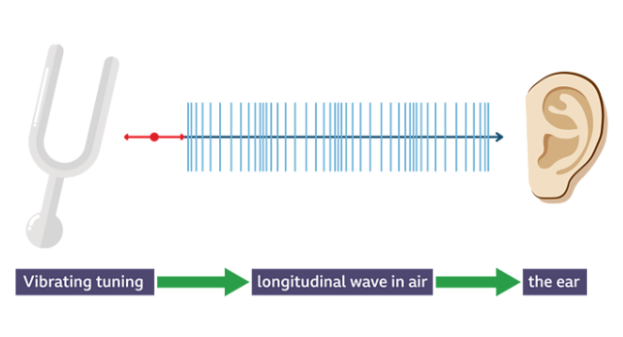
Let’s look at First Level…
By collaborating in experiments on different ways of producing sound from vibrations, I can demonstrate how to change the pitch of the sound. SCN 1-11a
Benchmarks:
Demonstrates how sounds can be made higher or lower pitch by altering tightness, length, width or thickness or other physical characteristics of the sound source.
Explains that sound is caused by a vibration in a material.
A sound wave is a longitudinal wave. When an object vibrates it produces a longitudinal wave which travels through air to your ear. The molecules collide with each other in the same direction as the sound is moving.
Notes:
Moving onto First Level now: now we are looking at sound and its link to vibration and experimentation and investigation of pitch.
So starting with a bit of background/reminder of the science; sound is a form of energy and is carried from its source in the form of sound waves. Sound waves are longitudinal waves. When an object vibrates, it causes for example, air molecules to vibrate and collide into each other in the same direction as the sound is travelling.
This can be demonstrated using a slinky!

Slide 13
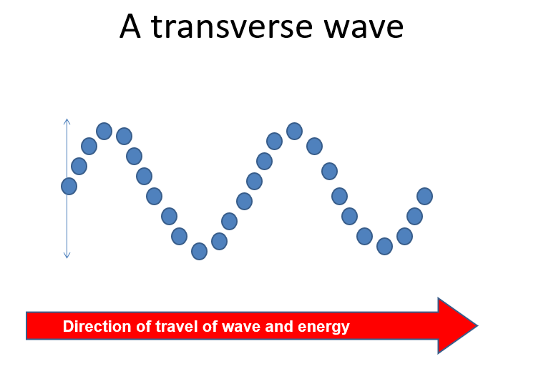
Let’s look at First Level…
A transverse wave travels at a right angle to the direction of disturbance and the particles move up and down.
Light travels in transverse waves and travels faster than sound. You often hear things after you see them, for example you see the lightning before you hear the thunder.
By exploring reflections, the formation of shadows and the mixing of coloured lights, I can use my knowledge of the properties of light to show how it can be used in a creative way. SCN 2-11b
Notes:
Just for completion – light waves travel in transverse waves. This means they travel at right angles to the direction of source and the particles move up and down. Think of a rope being moved quickly up and down.
The properties of light come in at Second Level

Slide 14
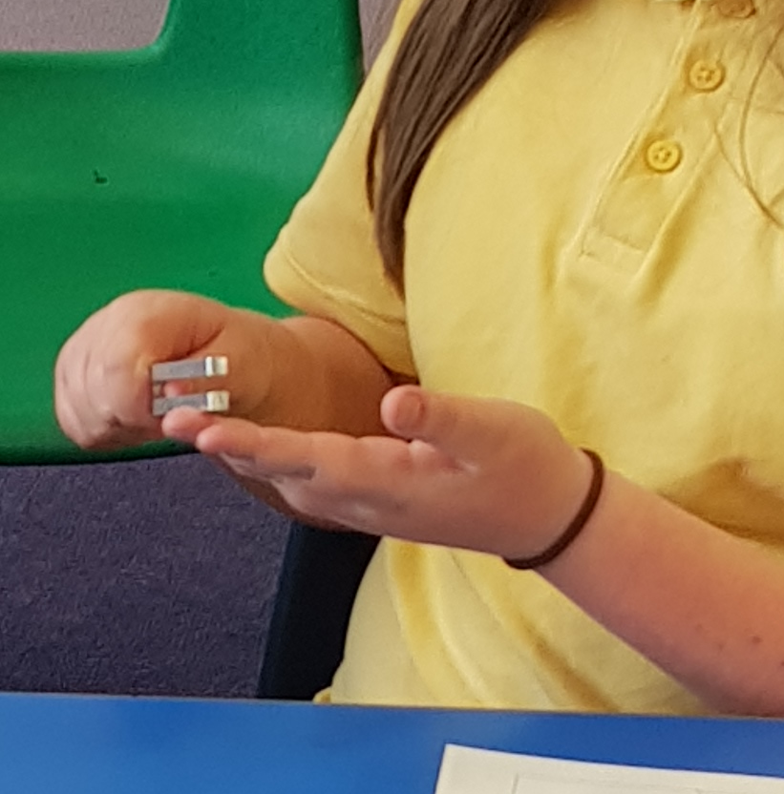
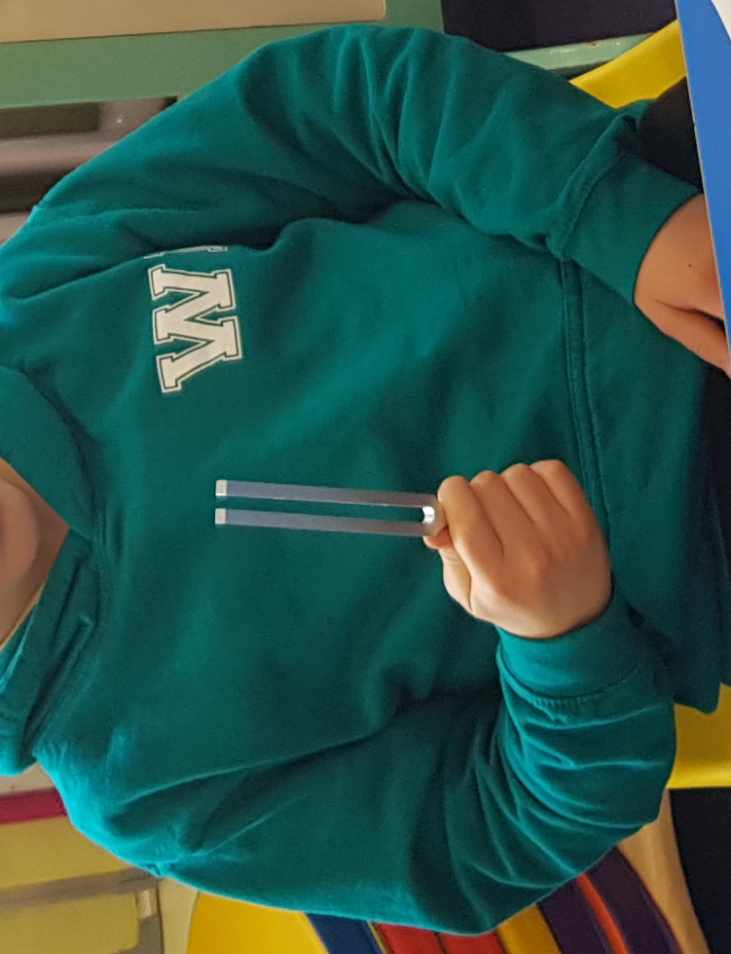
Let’s look at First Level…
‘Seeing’ Sound
These are experiments to demonstrate to the children that sound is caused by vibration.
Gently bang a tuning fork and hold it up – the children will hear sound coming from the fork. Allow the children to touch the fork – they will feel it vibrating, but as soon as they touch it, the vibrations will stop. Help them to make the connection that when it was vibrating, it was making a sound but when it stopped vibrating, the sound stopped. If the tuning fork is hit harder, it produces a louder sound.
Allow the children to try out the tuning forks.
Provide a container with cling film stretched across the top with a small amount of rice. Allow the children to pour the rice on the top of the plastic. Ask them what they think will happen when they touch the plastic top with the tuning fork?
Tap the fork so that it is making a sound/vibrating and touch the plastic top (be sure not to touch the side of the bowl) This will only need a gently touch.
As soon as the vibrating fork touches the plastic, it sends vibrations across the plastic top and causes the rice to ‘jump’ until the vibration, and therefore, the sound stops.
Notes:
So, back now to looking at First Level. To recap on what the learners experienced at Early Level and to start to make the connection between vibration and sound, you could start by again asking the children to place their fingers on their throat and to pick a sound to make and feel the vibrations of their vocal cords.. Ask them what happens to the vibrations when they use a loud voice and a soft voice and when they use a louder voice just as they may have done at Early Level. .
If you are lucky enough to have tuning forks in your school this is a great activity to help the children to see the link between sound and vibration.
You might start this with the children gathered on the carpet or decide to work the children in small groups. You may have to introduce the children to the tuning forks if they have used or seen them before. Gently bang the tuning fork and hold it up for the children to see – they will hear the sound coming from it but as soon as it is touched (and they will be able to feel the vibration) the vibrations stop, and the sound stops. Help them make the connection that the vibration was making the sound.
Next you could provide the children a container with cling film stretched across the top sprinkled with rice grains or do this as a demonstration; the rice grains are only there so that we can see the vibrations. Ask the children to predict what will happen when the plastic top is touched by the tuning fork. Tap the fork and touch the plastic; this will send vibrations across the plastic top causing the rice to jump; when the vibration stops and therefore the sound stops, the rice stops jumping.

Slide 15
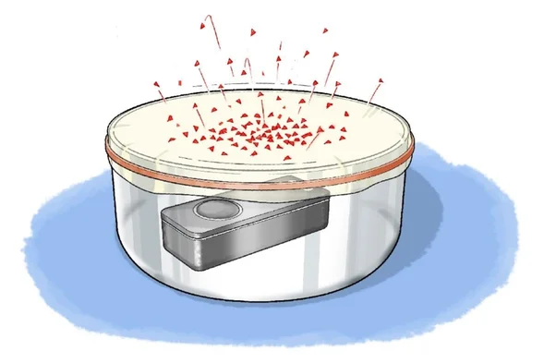
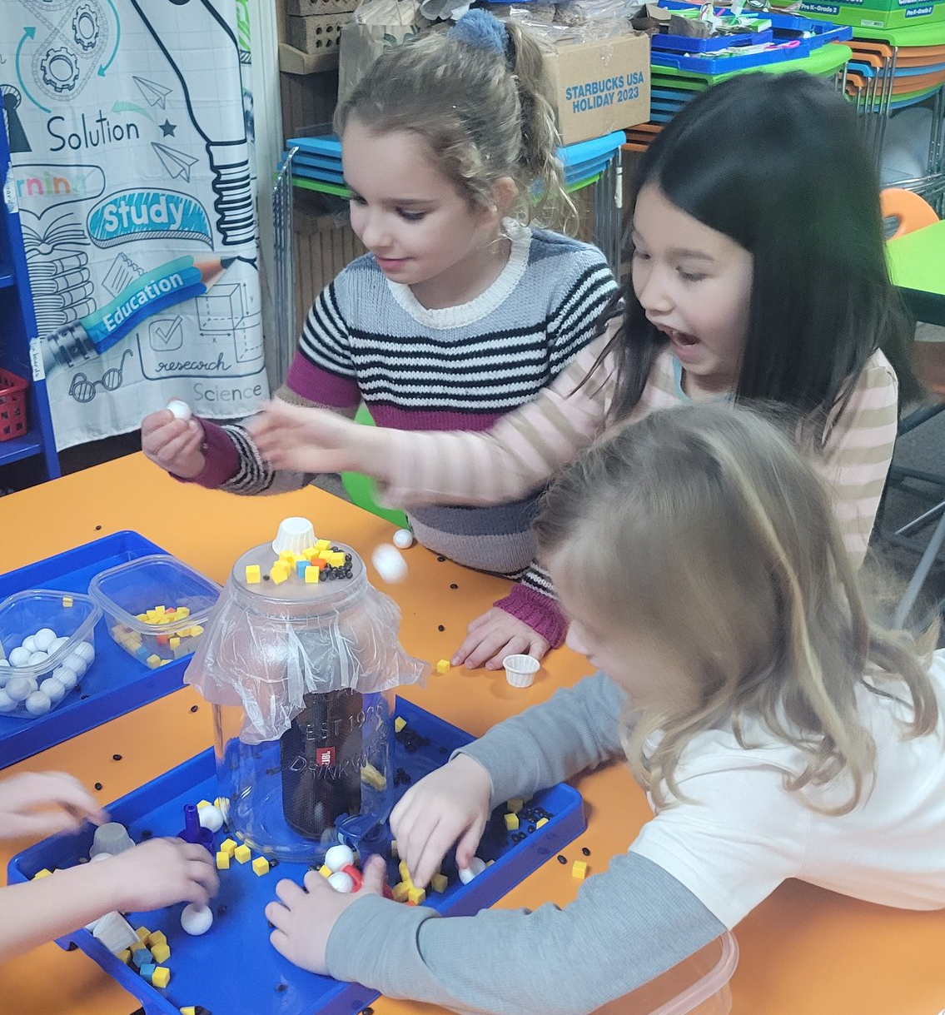
Let’s look at First Level…
No tuning forks? Try these instead!
Hold a pan or baking sheet close to the bowl which has the cling film and rice on the top but not touching. Bang on the pan or baking sheet with your hand or a spoon to make a loud noise. Watch the rice jump each time you bang on the pan or baking sheet.
Sprinkle sugar on to the top of the cling film. Hum over the bowl near to the cling film but away from the sugar grains and the sugar grains will move. . Make your voice deep and try again. Make your voice high and try again. Hum louder. Hum softly. Try SHOUTING, but do not blow on the cling film or the sugar. Can you get it to work with rice? Making a sound near the cling film causes the grains to move. This means the cling film is vibrating from the sound.
Put the bowl in front of a speaker or place a portable Bluetooth speaker
inside the bowl or in a jar and place rice, pom poms, pasta etc., on the top.
Play some music: what happens when you increase and decrease the volume?
Balloon Voices: Cut the neck off a balloon and throw it away. Stretch the rest of the balloon over one end of a cardboard tube. Talk down the open end of the tube and gently place a finger on the balloon to feel what is happening. What can you feel when you touch the balloon as you speak? What do you think is happening?
If you speak loudly or quietly, does it make a difference to what you feel as you touch the balloon?
Notes:
If you don’t have tuning forks, there are lots other ways you can investigate the relationship between vibration and sound some of which are described here:
Hold a pan or baking sheet close to the bowl with the cling film and rice. Bang the pan or baking sheet to make a loud noise and the rice will jump every time you bang the pan or baking sheet.
Replace the rice with sugar and hum near to the cling film and the sugar grains will move. Try a deep voice, a high voice humming louder and softer and tray shouting. Observe what happens – making a sound near the cling film causes the grains to move which means the cling film is vibrating from the sound.
Put the bowl in front of a speaker or a Bluetooth speaker inside the bowl. Play some music – what happens when you increase or decrease the volume. What happens when you use different things on top of the cling film?
Stretch a balloon over one end of a cardboard tube. Talk down the open end of the tube and place your finger on the balloon and feel what is happening. Speak loudly or quietly what do you notice? What do you think is happening?

Slide 16
Let’s look at First Level…
Other investigations might be…
Add water to the bowl, tap the tuning fork so that it is vibrating and gently lower it into the water.
The sound waves are transferred from the fork to the water. You could try filming this in slow motion with the camera focused on the water and discuss what you see.
Notes:
Other things you might try is tapping a tuning fork and gently lowering it into some water. The sound waves are transferred from the fork to the water. If you don’ have tuning forks, then you could use a video clip like this one.

Slide 17
Let’s look at First Level…
By collaborating in experiments on different ways of producing sound from vibrations, I can demonstrate how to change the pitch of the sound. SCN 1-11a
Benchmarks:
Demonstrates how sounds can be made higher or lower pitch by altering tightness, length, width or thickness or other physical characteristics of the sound source.
Explains that sound is caused by a vibration in a material.
Pitch describes how high or low a sound is.
A high sound has a high pitch, and a low sound has a low pitch.
Generally, the shorter, tighter or thinner the object is, the higher the pitch of the sound will be. This is because the vibrations will be faster.
The longer, looser or thicker the object is, the lower the pitch of the sound will be. This is because the vibrations will be slower.
High sounds can be quiet or loud, and low sounds can be quiet or loud too!
Notes:
Now let’s move on to looking at pitch.
So, first - the definition of pitch:

Slide 18
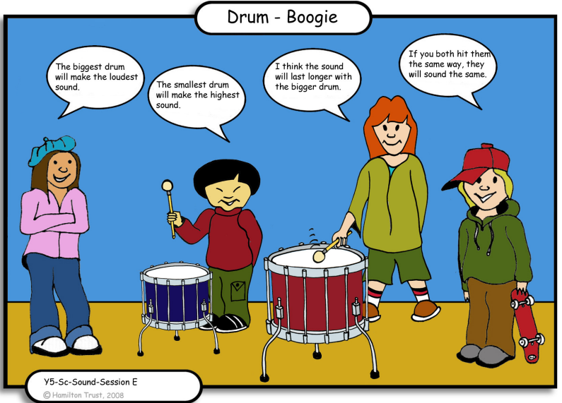
Let’s look at First Level…
Concept Cartoon:
Pitch and Volume
The shape, size and how the drums are struck will affect the sound made. Usually, larger drums make a lower pitched sound. If the skin is more tightly stretched the pitch will rise. The sound lasts longer usually in the bigger drum (resonates for longer).
Notes:
A concept cartoon is a great way to engage your class and stimulate discussion.
You can use it at any time, but it is particularly useful for finding out what children know at the beginning of a topic or assessing their understanding near the end. A concept cartoon can also be a great starting point for an investigation too!
Here is one that could be used to get the children talking about pitch and loudness/volume and could easily lead on to an investigation.

Slide 19
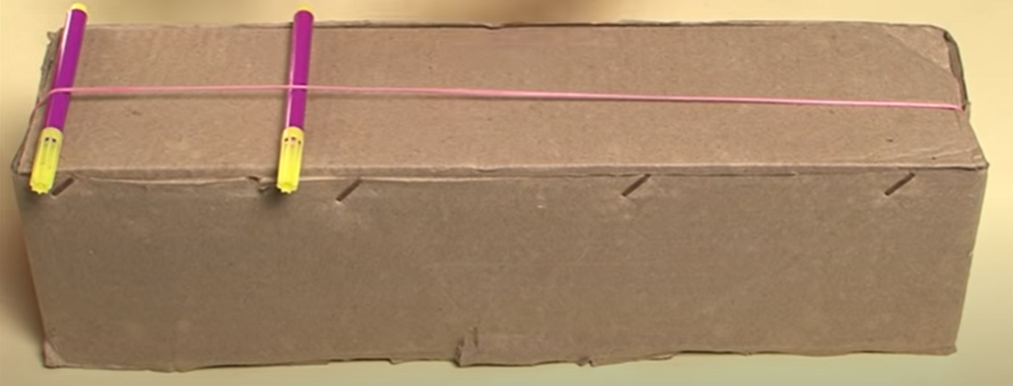
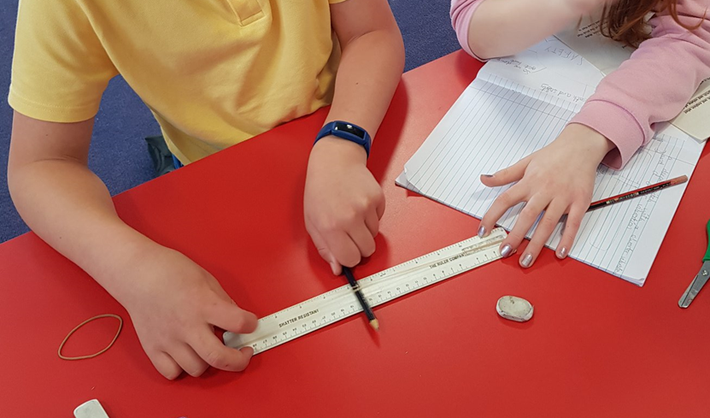
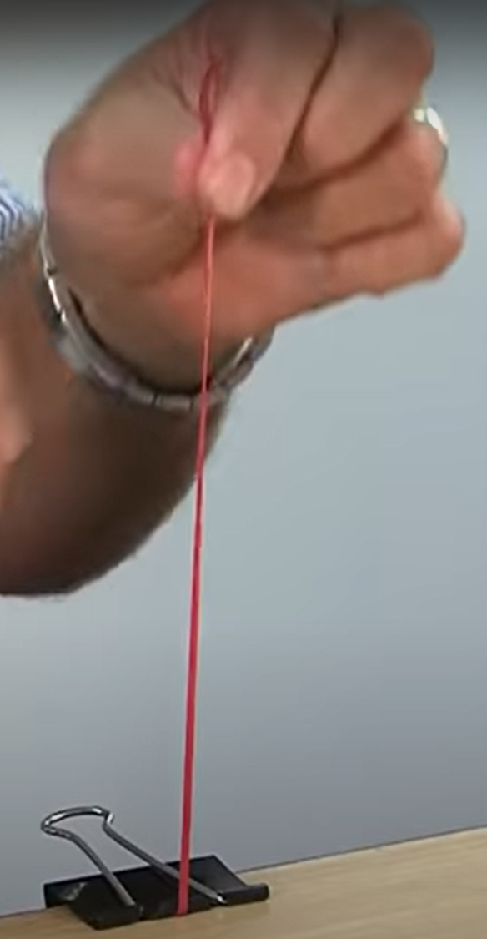
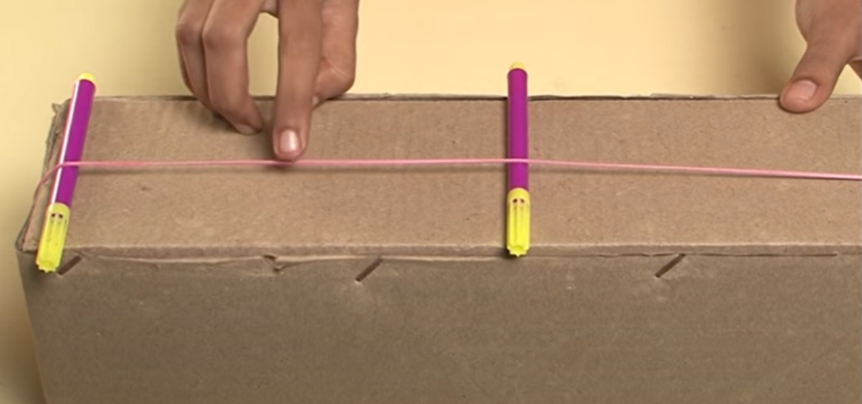
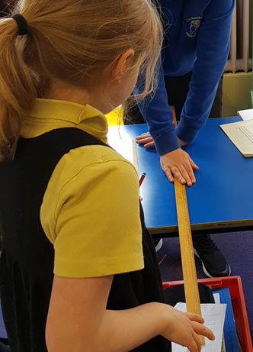
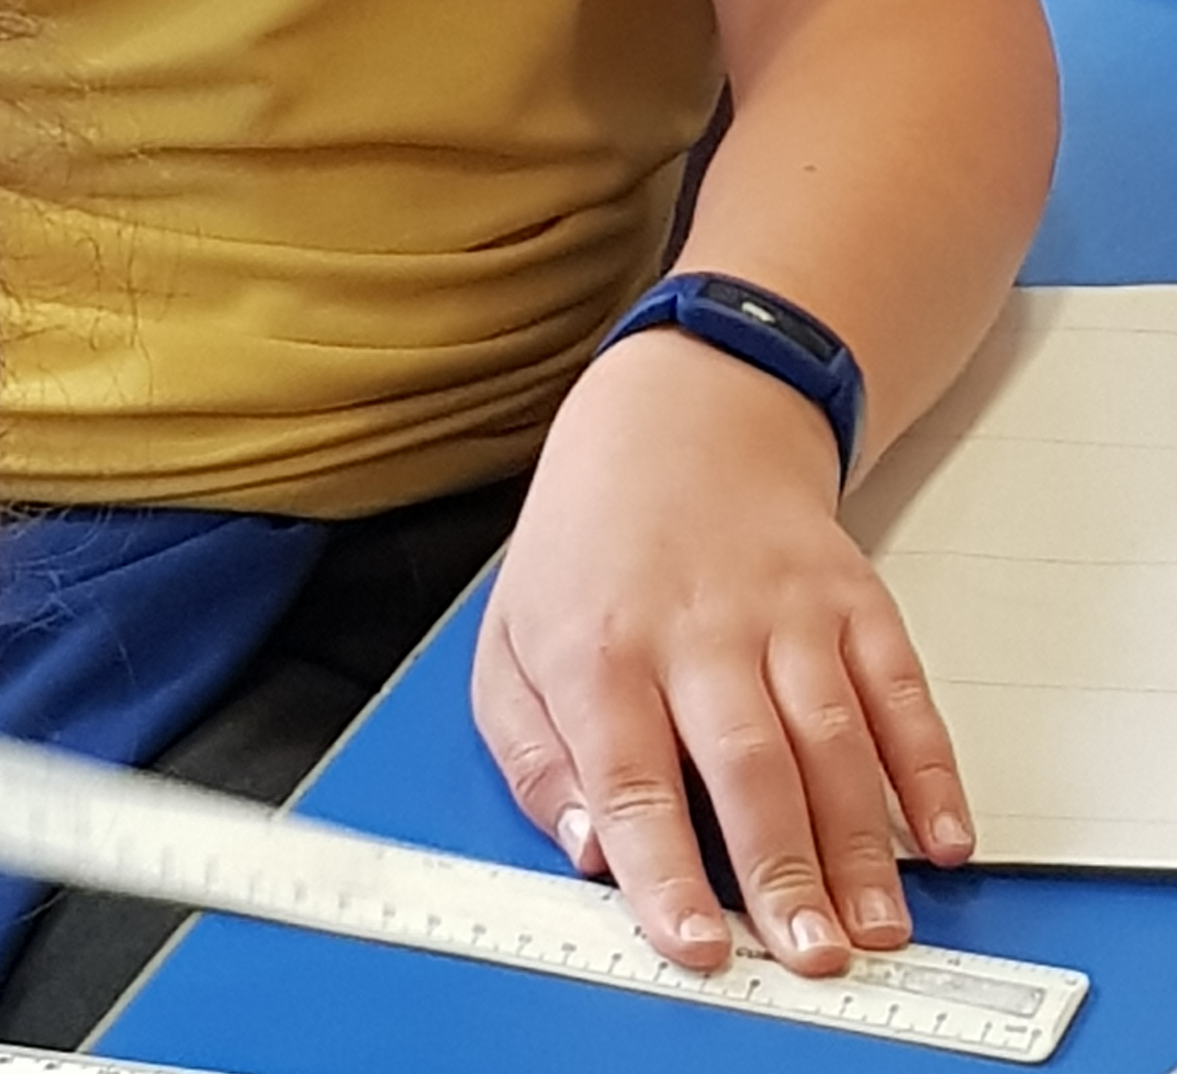
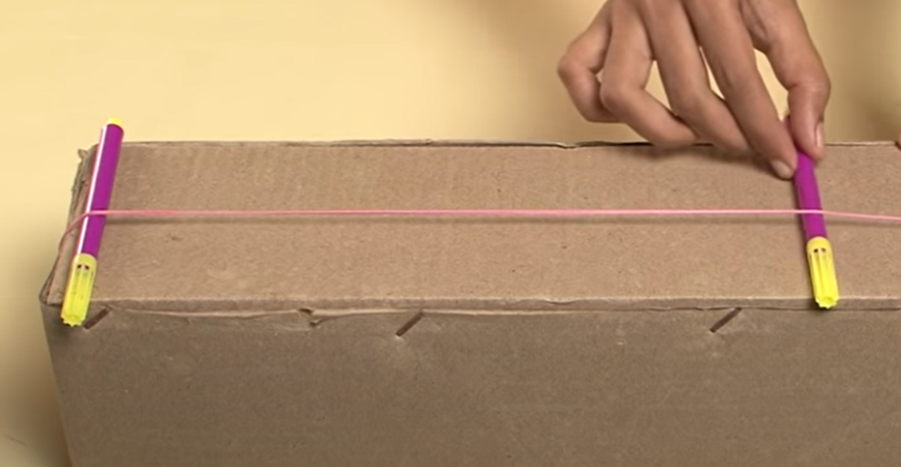
Let’s look at First Level…
3
2
1
4
Notes:
There are loads of ways to investigate links between sound, pitch and vibration and here are just a few! As I said at the beginning, learning about sound is best approached in an exploratory and hands-on way, giving children the opportunity to really experience what happens when sounds are made.
1 Elastic band: cut in half and fix it to the tabletop with a clip. Pull the elastic band upwards and pluck it. Stetch it higher and pluck it – what happens? The pitch changes. Try with thin and thick elastic bands. Try giving a ‘big tweak and a little tweak – pitch doesn’t change but the volume does.
2 Elastic band and a cardboard box: Take a box and stretch a rubber bad around it as shown. Put two pencils/pens under the band and listen to the sound produced by plucking the band between the pencils/pens. Keep increasing the distance between the pens and listen to the sound produced each time. The shortest length makes a high pitch sound and as the length increases the pitch becomes lower.
3. This can also be done with a ruler and an elastic band and a pencil; sliding the pencil along the ruler alters the length of the elastic band that is being plucked to see what happens to the pitch.
4 Twanging Rulers
Hold the ruler firmly by one end on the table and then ‘twang’ the other. Change the length of the ruler overhang and listen to the change of the ‘twang’. Do all the rulers make the same twanging sound? Does the sound change if you push more/less of the ruler over the edge? Are the sounds different if you use a thin or a thick ruler?

Slide 20
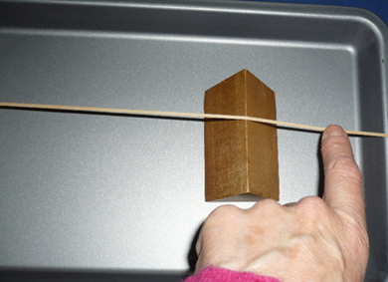
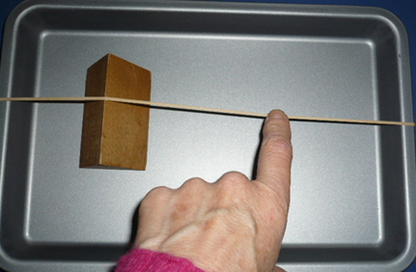
Let’s look at First Level…
Baking Tray Banjo
Elastic band
Baking tray
Bridge (triangular shaped piece of wood)
2
What to do
1
Move the bridge 5cm closer to the other end of the tray. Pluck the elastic band on the same side as before, do you notice any difference in the sound?
Is there a pattern between the pitch of the note and the length of the elastic band?
Move the bridge down to one end of the baking tray.
Pluck the elastic band halfway along the longer length
Taking it further…
Was this investigation a fair test?
Can you suggest another investigation?
Write down your suggestion for another investigation making clear how you would ensure it was a fair test.
Notes:
Another activity the children could try is the ‘baking tray banjo’; this could also be extended into a fair test investigation.

Slide 21
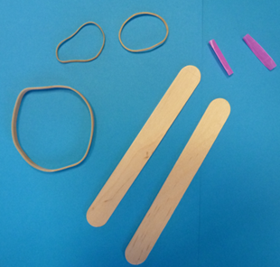
Let’s look at First Level…
Make a Kazoo
You will need:
1 wide elastic bands
2 shorter thinner elastic bands
2 jumbo lollipop sticks
A straw
scissors
What to do:
Put one of the lollipop sticks on the table.
Stretch the longer, thicker elastic band over the lollipop stick. Cut 2 pieces of straw 2cm in length
Take one of the pieces of straw and put it under the elastic band about 3cm from one end of the lollipop stick and put the other piece of straw on top of the elastic band the same distance from the other end of the lollipop stick.
Place the other lollipop stick on top making a sandwich with the straws, Hold the lollipop sticks firmly together using the two shorter, thinner elastic bands.
Hold the kazoo so the gap between the lollipop sticks is between your lips and blow.
Move the straws to 4cm from each end of the lollipop stick and blow as before.
Did you notice any change in the note?
If you substitute the lolly sticks for two 30 cm transparent plastic rulers, you should be able to see the elastic band vibrating as you play this version of the Kazoo.
Notes:
The children could make Kazoos to investigate pitch

Slide 22
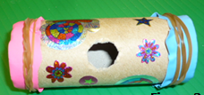
Let’s look at First Level…
Make a Flazoot
You will need:
2 balloons
2 elastic bands
A cardboard tube about 10cm long, 2.5 cm diameter and 4 mm thick with a 1.2 cm hole cut halfway along one side
What to do:
Decorate the tube – you could use stickers, paint and/or felt pens.
Cut the neck off a balloon and stretch it over one end of the tube. Make sure it is tightly stretched across the end of the tube and then fix it firmly in place using an elastic band. Do the same at the other end of the tube.
Put your lips up to the hole and gently blow across it. When you get a continuous sound, you can change its pitch by pressing in on one of the ends then try pressing on both ends. How many notes can you make?
NB Ensure the carboard tubes are clean.
Ensure that the children do not become faint due to blowing for extended periods.
Notes:
…or Falzoots

Slide 23
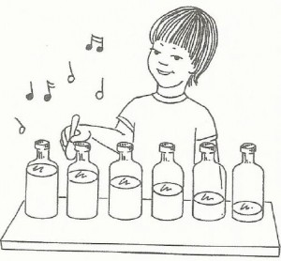
Let’s look at First Level…
Bottle/Beaker Organ
You need
4 - 6 identical glass bottles or glass beakers which are the same size and shape.
Fill the bottles or beakers to different levels, leaving one empty, and tap each bottle or beaker with a pencil.
Do all the bottles produce the same sound? Which ones have a higher/lower sound? Why?
When you tap an empty glass bottle the glass vibrates and makes a sound or note. Adding liquid to each bottle slows the speed of the vibrations of the glass. Slower vibrations lower the pitch, so a bottle full of water has a low pitch and an emptier bottle has a higher pitch
Are the sounds the same when you tap the bottles and when you blow over them? Why do you think this is?
When you blow over the mouths of the bottles, rather than tap them, you'll get a completely different result. The bottle with the smallest amount of water, that made a high note when tapped, will make a low note when blown. This is because when you blow over a bottle you're vibrating the air, not the bottle!
Can you put them in order from low pitch to high pitch? Check – were they right?
Notes:
And/or a ‘Bottle Organ’ and investigate what happens when you tap the bottles compared to when you blow across them. Can they then put them in order from low pitch to high pitch?

Slide 24
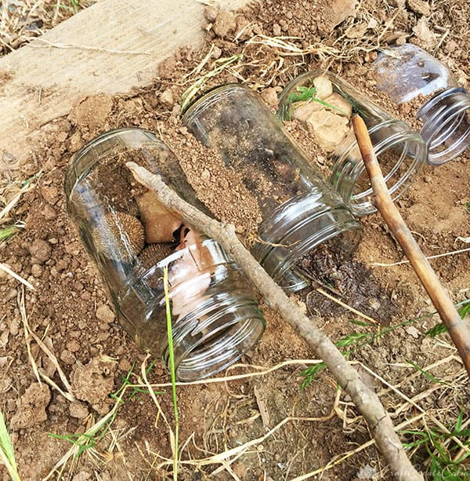
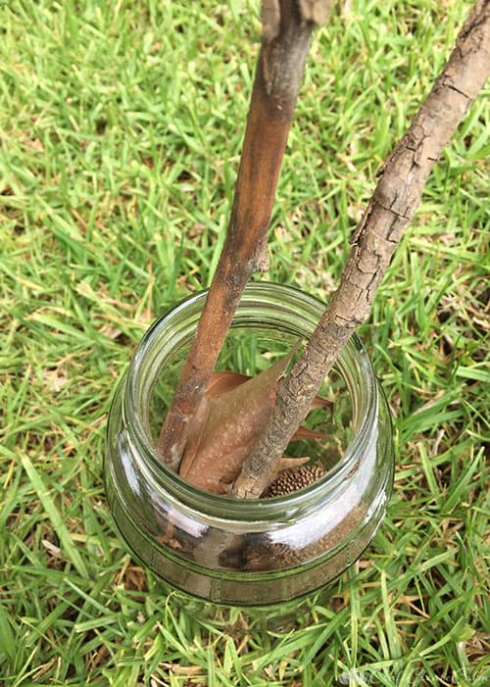
Let’s look at First Level…
Outdoor learning: The Garden Xylophone!
Garden Xylophone for Kids Outdoor Activity-CraftCreateCalm (themomentsathome.com)
You will need:
Empty Glass Jars: different sizes (mason jars are great, but so are leftover jars you’ve saved). You can use jars of the same size for this too
Gravel , grass, rocks, sticks water, mud or anything else that can find outdoors to fill the jars
Two sticks or two spoons (wooden or metal)
What to do:
Wash and dry jars
Set the jars on a flat surface outside and fill them with different objects found outside e.g., leaves, rocks, mud, gravel, grass and water.
If your jars are all the same size fill them with different amounts of objects - this will change the sound for each jar.
Once the jars are filled use sticks or spoons to play the xylophone while the jars are sitting upright. You can also set them in a pile of loose earth on their sides.
The children can experiment with the jars to see which objects make sounds for the jar? Which jars have a high
pitch? Which jars have a low pitch? ( A jar full of mud will have a lower pitch than a jar with leaves). What
difference does it make if the jars are upright or lying on their sides? What about the size of the jar?
Notes:
A similar activity to the last one could be done outdoors with the ‘Garden Xylophone’ which is made by filling the jars with different objects found outside and then tapped with sticks or wooden spoons. The children could investigate which of jars have a high pitch sound? Which have a low pitch sound? What difference does the size of the jar make? Does it make a difference if the jar is upright or lying down? Why?
When you tap an empty glass bottle the glass vibrates and makes a sound or note. Adding something to the bottle slows the speed of the vibration of the glass. Slower vibrations lower the pitch; a bottle full of mud will have a low pitch and a bottle full of leaves will have a higher pitch.

Slide 25
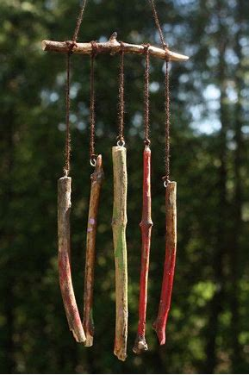
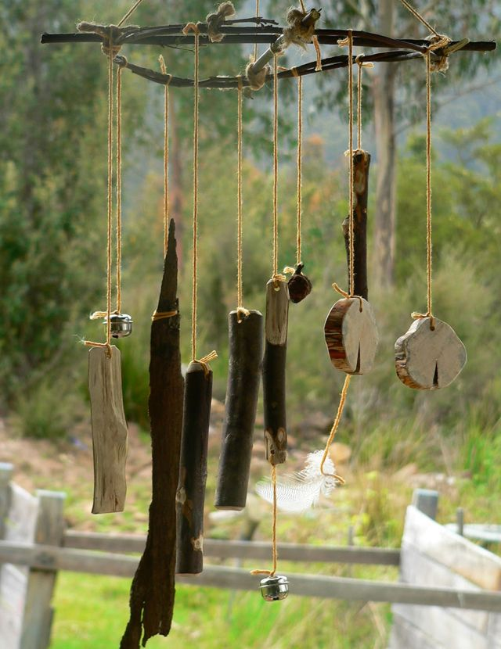
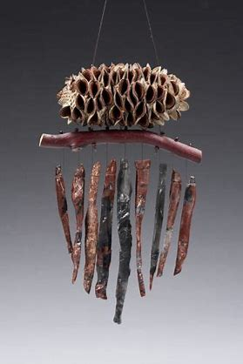
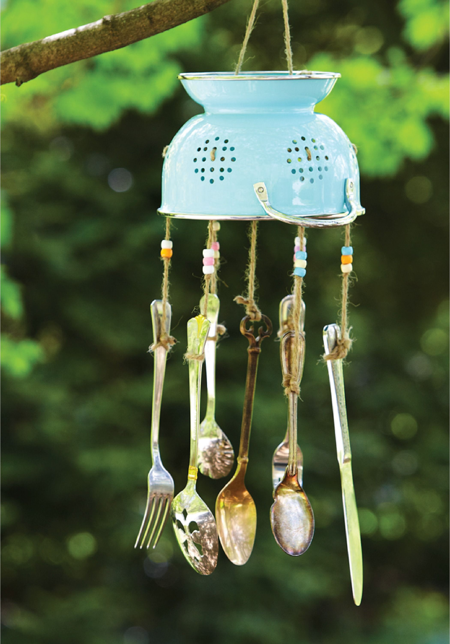
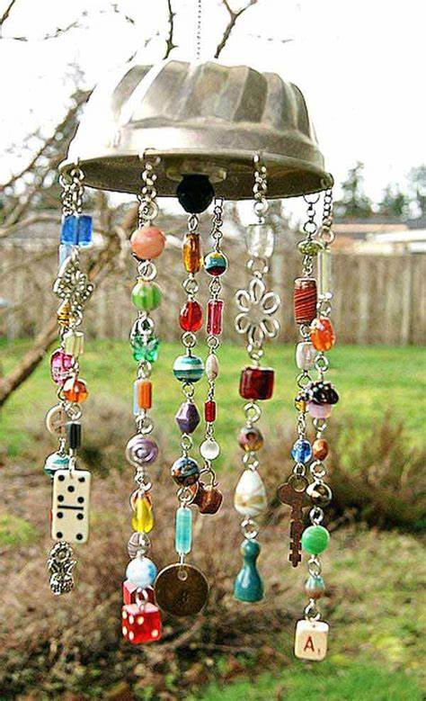
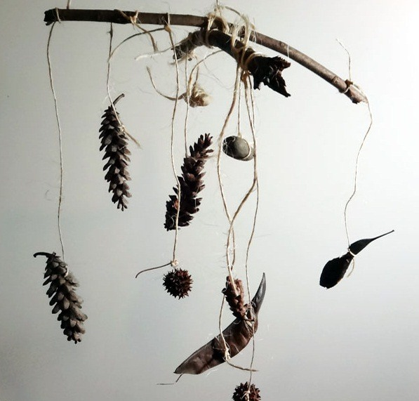
Let’s look at First Level…
Outdoor learning: Make a wind chime
Collect natural items from outside, maybe while you are on a walk: pinecones, leaves and sticks all work well. Tie them to a large stick using string or wool so that they all hang at similar heights.
Now make one with manmade items such as keys, beads or small bells. Hang the wind chimes outside and listen to the noise
What do you notice? What different sounds do you hear from the wind chimes? Which chimes make the loudest or quietest sounds? Which chimes sound high pitched and which sound low pitched?
When the wind blows on a wind chime, the hanging objects move and bump into each other which makes them vibrate. The type of sound an object makes when it vibrates depends on the material it is made from. Metals are hard and vibrate well and usually make a ringing noise. Fabrics are soft so they don’t vibrate very well and don’t make any noise.
Notes:
Making wind chimes is something else the children could do and compare the sounds made by a wind chime made of natural resources with one made of man made objects. Which chimes sound high pinched? Which sound low pitched? The sound depends on the speed of vibration.

Slide 26
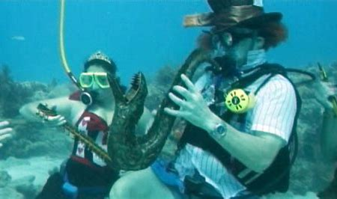
Let’s look at First Level…
Underwater recorder (useful to help understand the change of pitch)
For this experiment, you will need an old plastic recorder and a tall jug of water.
Cover all the holes on the recorder with your fingers (if this is too difficult, stick some tape over the holes). Blow gently into the recorder and you should hear a single, low-pitched note.
Take a deep breath and blow into the recorder while you push it into a jug of water and listen to the change in pitch.
(The pitch of the note depends on the length of the column of air inside the recorder: shortening the column of air will create a higher sound.)
Notes:
One other activity which I suggest you do as a demonstration to the class rather than the children trying this is this one. Blow and gently lower a recorder into a jug or bucket of water. It is a great way to illustrate the relationship of pitch and the length of the column of air inside the recorder. As the column of air shortens as you lower the recorder into the water, the pitch gets higher.

Slide 27
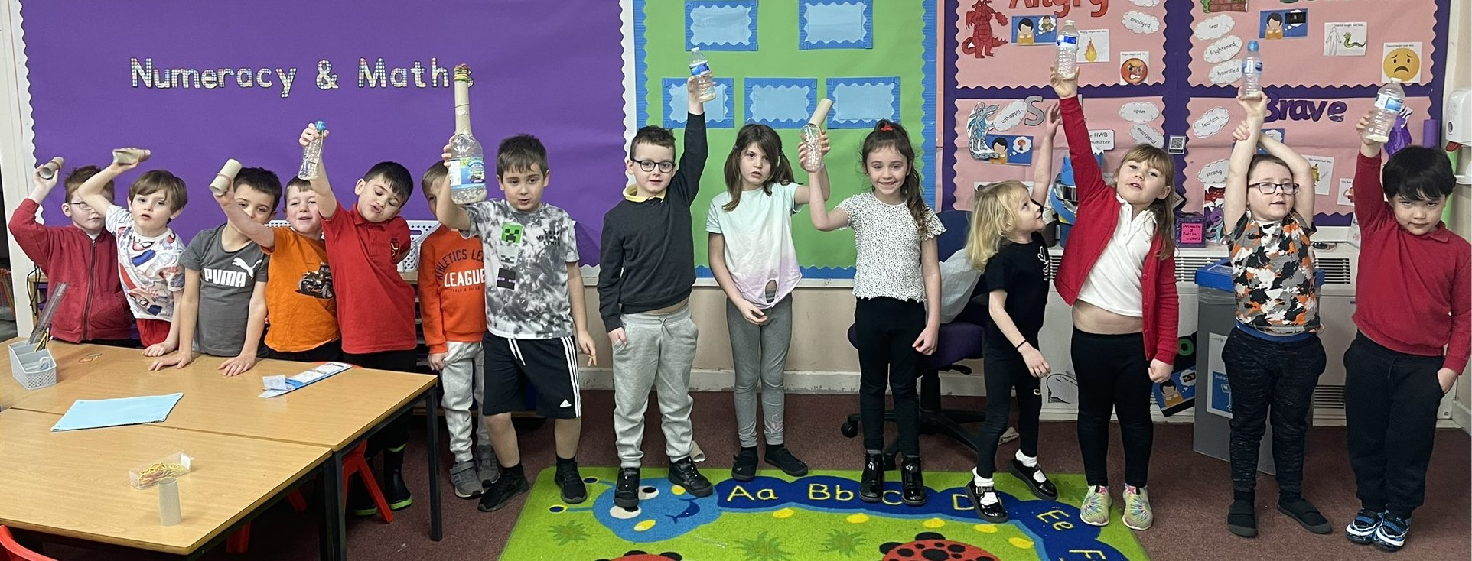
Let’s look at First Level…
Organising the line so the pitch goes from low to high! (P2)
Notes:
If the children have made their own instruments, get them to organise themselves into a line so the pitch goes from low to high – like this P2 class!
After the children have made all their instruments, create a music shop corner which becomes an interactive display for the learners to use to explore each other’s instruments.

Slide 28
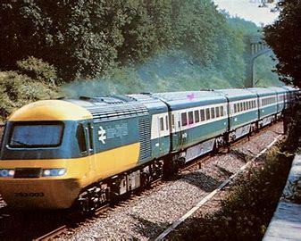
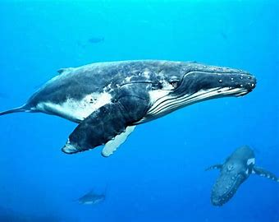
Let’s look at Second Level…
Through research on how animals communicate, I can explain how sound vibrations are carried by waves through air, water and other media. SCN 2-11a
Benchmarks:
Discusses and demonstrates through experiments how sound travels differently through air, water and solids.
Explains how hearing is limited by a range of factors, for example, age, position, and flexibility (direction) of ears.
Sound needs a material in order to travel. In a vacuum no sound can travel (or be heard) as there are no molecules for the vibration to pass through. The speed at which the vibrations travel through a material depends on its temperature, whether it is a solid, liquid or gas and its density, because the spacing between the particles are different in each of these cases.
Sound waves, or the vibrations made by sound, can travel through solids, liquids and gases. Usually, the vibrations travel faster and farther in solids and liquids than though air; this is because the particles that transmit the vibrations are closer together.
Approaching trains can be heard from far away because the vibrations travel quickly through the solid metal railway tracks. Keeping track - Explorify
Whales can be heard calling over very large distances in the sea because the water transmits sound faster than air.
Links to: By contributing to investigations into familiar changes in substances to produce other substances, I can describe how their characteristics have changed. SCN 2-15a
Benchmark: Explores and describes the characteristics of solids, liquids and gases, for example, solids retain the same volume and shape, liquids keep the same volume but the shape changes to fit the container and that gases change shape and volume to fill the container.
Notes:
Moving on now to Second Level. So here we meet the concept of sound travelling through different media – air, water and solids which the children should be investigating, and they should also be finding out about how animals communicate through research.
Starting off with a bit of background science: sound needs a material in order to travel. The speed at which vibrations travel depends on whether it is a solid, liquid or gas because of the spacing between the particles. Usually, sound travels faster and farther in solids and liquids than in air. There are obvious links to outcome SCN 2-15a here.
You can hear approaching trains from far away as the vibrations travel quickly through the metal of the railway tracks, Whales can be heard over huge distances in the sea because water (i.e., a liquid) transmits sound faster that air.

Slide 29
Let’s look at Second Level…
Starter activity:
Ask the children to feel some vibrations with their fingers that they cannot see, e.g., their larynx as they talk, a speaker for a stereo system, a cymbal or triangle that has been hit.
Explain that we are hearing these sounds through the air around us (a gas). Ask whether or not they think sounds also travel through liquids and solids.
Investigate sounds travelling through solids by tapping on the table and listening to the sound, then repeat the tapping while putting their ear to the table.
Listen to sounds they can hear from outside the classroom (or arrange for a loud sound to be deliberately made outside the classroom!) Ask: what have these sounds travelled through? Bricks, windows, doors and of course the air!
Misconceptions to watch out for: children may think that sound vibrations do not travel through solid materials but travel through gaps, for example, under the door.
Heard your neighbours in the next house or flat? - Explorify
Notes:
So, as a starter activity, you may wish to repeat the activity that you might have done before with the children where they feel the vibrations in the larynx as they talk. Or you might listen to some music through a speaker and get them to feel the speaker or use percussion instruments; the idea is that they feel some vibration that they cannot see. Remind them that we are hearing sound caused by these vibrations and these sounds are travelling through the air (gas) around us. Ask them if they think sounds also travel through solids and liquids.
Ask the children to tap the table and listen to the sound and then repeat but this time ask them to listen by putting their ear to the table – when they are doing this, they are hearing sound travelling through a solid. What difference does it make when they put their ear to the table?
Ask them to listen to the sounds they can hear outside the classroom. Ask them what have these sounds travelled through e.g., bricks, windows, doors and air. Watch out for children who think that sound is travelling through the gaps and not through solid materials.
There is a nice activity available on Explorify that supports a discussion about how sound travels.

Slide 30
Let’s look at Second Level…
How sound travels through different media.
Notes:
This is a fantastic video to use to demonstrate how sound travels through different media.

Slide 31
Let’s look at Second Level…
How Well Does Sound Travel Through a Gas? A Liquid? A Solid?
Will a pencil tap be heard through a bag of air sound different than a pencil tap heard through a bag of water? Will these taps sound different than a tap heard through a wooden block?
What you will need:
Zippered sandwich bag
Water
Wooden block
Pencil
What to do:
Blow into the sandwich bag and quickly seal it to create a puffed-up bag of air (a gas).
Cover one ear with your hand and the other ear with the bag of air.
Your partner taps the bag with a pencil. How does it sound?
Now fill the bag with water (a liquid) and seal it.
Hold this water-filled bag against one ear and cover the other ear with your hand.
Your partner taps this bag with a pencil. How does it sound?
Finally hold a wooden block (a solid) over one ear while covering the other ear with your hand.
Your partner taps the block with the pencil. How does it sound?
Compare and discuss the observations.
Notes:
This activity looks at how well sound travels through a gas, a liquid and a solid using a bag of air, a bag of water and a wooden block. The children could compare and discuss their observations.

Slide 32
Let’s look at Second Level…
Experimenting with sound waves
Have children test how sound travels through solids. Children work in pairs.
One taps lightly on his/her desk and the other one records what they hear through the air. The same person will tap lightly again while the second person lays his or her ear on the desk.
The children compare the sounds and record what they hear through the solid.
Have the children try the experiment one last time, tapping louder, and, again, recording the result, using a table like this one:
Discuss the observations.
Activity | Sound Observations
Light taps heard through air (gas)
Light taps heard through table (solid)
Heavy taps heard through air (gas)
Heavy taps heard through table (solid)
Notes:
Something else you might do is this: the children investigate and compare sound travelling through a solid and a gas (Remember, these are only suggested activities, and you may not choose to do them all as some of them are quite similar to each other).

Slide 33
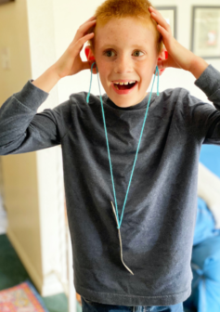
Let’s look at Second Level…
Experimenting with Sound Waves
You will need:
Metal kitchen spoon
String at least 75cm long
What to Do:
1. Stretch out the string and tie the handle of the spoon in the middle of the string.
2. Take one end of the string and tie around the child’s finger. Do the same using the other end but tie this string around the finger of the child’s opposite hand.
3. Instruct the child to put his or her fingers, with the string wrapped around each, into their ears.
4. Lean over so the spoon dangles and help him or her swing the spoon so it hits a chair or table.
5. Hit the chair of table again, but this time with more force. What do they hear?
Don’t allow them to strike the spoon too hard!
They should hear a bell-like sound travel up the string from the spoon and into their ears. Discuss how the sound waves created from the spoon hitting the door moves through the string until they can hear it!
Notes:
Experimenting with sound waves travelling through solids using a spoon and some string: The spoon is tapped and the sound travels from the spoon up the string until they can hear the sound.

Slide 34
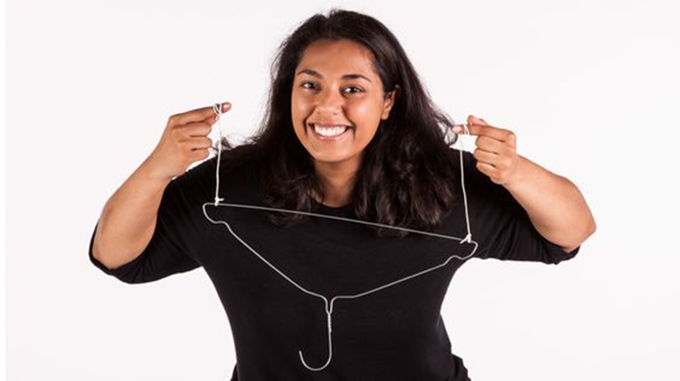
Let’s look at Second Level…
Make an ear-gong!
INVESTIGATE…
How does the sound change when you:
Use longer or shorter string?
Use wool or ribbon in place of the string?
Replace the metal coat hanger with a different material?
https://learning.sciencemuseumgroup.org.uk/resources/ear-gongs/
Notes:
Something similar to the last activity: Making an ear-gong using a metal coat hanger and string. Again, this is looking at sound travelling through solids.

Slide 35
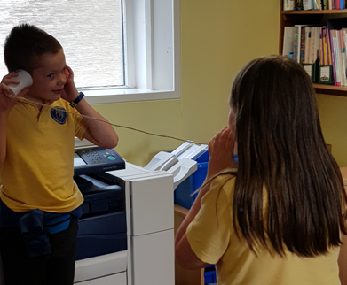
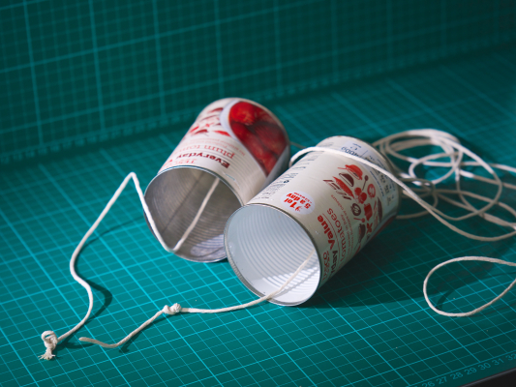
Let’s look at Second Level…
Make string telephones to demonstrate how sound is carried through a solid.
What is happening?
Sound is made up of vibrations. The sound waves travel from the first person's mouth, into the first cup which vibrates, then down the string (that’s why you can feel the string vibrating), then vibrates the second cup, and then into the ears of the second person.
What happens to the vibrations if you shout or whisper?
Can you find a way of using the tin can telephone around a corner?
What happens if they try to add another tin?
What happens if you use different types of string?
Notes:
A great activity to do is make a string telephone to demonstrate how sound is carried through a solid (i.e., the string). Here is a useful video to use for this. There are lots of things that can be investigated too – what happens if different types of string are used, the length of the string is changed, different cups are used , more than 2 telephones etc,.

Slide 36
Let’s look at Second Level…
Through research on how animals communicate, I can explain how sound vibrations are carried by waves through air, water and other media. SCN 2-11a
COMMUNICATION ON LAND - sound travelling through solids
The common misconception about snakes is that they are deaf. This assumption is mainly because a snake has no ear on the outside. They do, however, have inner ears, which gives them the ability to hear well, and they do have ear bones in their heads that they use to hear. They have one middle ear bone that connects the inner ear to the jawbone - this bone rests on the ground and slightly moves in response to vibrations while snakes slither on the ground. This enables snakes to hear vibrations, such as a predator creeping closer on the forest floor; those sound wave frequencies are felt in the ground by the snake. In other words, snakes hear vibrations travelling through solids; the sound waves we hear are from airwaves.
Notes:
This outcome involves children researching how animals communicate to help them to understand how sound travels through different media. So, an example of animals using sounds travelling through a solid would be the snake., although snakes don’t communicate by sound through a solid.
Snakes do not have visible ears, but they can hear because they have inner ears that have ear bones connected to the jawbone; this allows them to hear sound vibrations they feel in the ground such as a predator approaching.

Slide 37
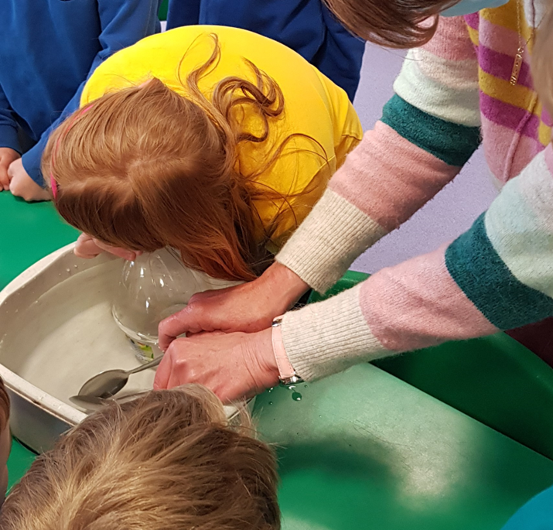
Let’s look at Second Level…
Listen to sounds travel underwater
You need:
A bucket or basin filled with water
A large plastic bottle
2 metal spoons
Scissors or sharp knife to cut the bottle
What to Do:
1. After filling the bucket or basin with water, take a sharp knife or scissors and cut off the bottom of the plastic bottle. Be sure that the cap is taken off the bottle.
2. Place the bottle in the water so that the cut bottom is in the water; the learner will then put his or her ear to the top of the bottle to listen.
3. Using the metal spoons, clang them together to make a sound, but do this in the bucket or basin as the learner is listening.
What do they hear?
The sound of the clanging is loud and clear. Sound travels faster through water than in the air; animals that live underwater can hear sound clearly. Discuss the conduction of sound waves through water.
Notes:
Now let’s look at sound travelling through liquid (water). An easy but great investigation to do is this one: fill a bucket or basin with water, cut off the bottom of a plastic bottle and place in the water. The children then put his or her ear to the top of the bottle whilst someone knocks two metal spoons together under the water. The sound is loud and clear! Discuss and relate to animals living underwater hearing sounds clearly and over large distances.

Slide 38
Let’s look at Second Level…
Listen to whale or dolphin sounds.
The sounds they make travel through the water so that they can communicate with each other.
Or learners could research how marine animals communicate; this relies on sound being able to travel through liquid (water), so that these animals are able to communicate.
Websites for whale and dolphin sounds
http://whalesounds.com/home/index.html
http://www.whale-images.com/whale_sounds.jsp
http://www.whalesong.net/
http://neptune.atlantis-intl.com/dolphins/sounds.html
Ask the children to listen to sounds underwater if they visit the swimming pool!
Notes:
Discuss this further by listening to whale or dolphin sounds; this could be linked to some research that the children do to find out how other marine animals communicate to help them to start to understand that sound must travel through liquid (e.g. the sea) in order for these animals to be able to communicate.
Ask the children to listen to sounds underwater if they are lucky enough to visit a swimming pool!

Slide 39
Let’s look at Second Level…
Through research on how animals communicate, I can explain how sound vibrations are carried by waves through air, water and other media. SCN 2-11a
COMMUNICATION IN WATER – sound travelling through liquid
Our planet has huge oceans that cover 71% of the Earth’s surface. Therefore, it makes sense that the best long-distance communicators live in the oceans. Whales are the greatest at long-distance communication, with almost all whale species able to communicate over incredibly large distances. One of the most famous species is the Humpback whale. The sounds they make are often referred to as ‘songs’ and are considered the longest and most intricate of all in the animal kingdom.
Interestingly, Humpback whales do not produce infrasound like elephants. The frequency of the Humpback whale’s song ranges between 40 Hz and 4,000 Hz and can reportedly travel thousands of kilometres through the ocean. This is because sound travels over four times faster in water compared to air.
To explain, imagine jumping on a bouncy castle - it’s incredibly bouncy! This is because air is very squishy, or compressible. Now imagine jumping on a giant water balloon—one that doesn’t break. You might create some ripples, but you wouldn’t experience the springy effect of a bouncy castle. This is because water is not easily compressed. In general, the less compressible the medium the faster the speed of sound.
Humpback whale song from Monterey Bay
Notes:
When carrying out research into animals communicating in water, the children may come across information like this: whales are fantastic at long-distance communication. The sounds made by Humpback whales are referred to as ‘songs’ and are very intricate and can travel thousands of kilometres. This is because sound travels more than 4 times faster in water compared to air. A good way to explain this difference is in this slide: imagine jumping on a bouncy castle – it is very bouncy because air can be easily squashed or compressed. Now imagine bouncing on a giant water balloon; it wouldn’t be nearly as springy or bouncy. This is because water is not easily squashed or compressed; the less compressible something is, the faster the speed of sound.

Slide 40
Let’s look at Second Level…
Through research on how animals communicate, I can explain how sound vibrations are carried by waves through air, water and other media. SCN 2-11a
COMMUNICATION ON LAND - sound travelling through air
Most animals use vocalised sounds to communicate with one another and with other species. For example, a cat hisses when it feels threatened and purrs when it feels comfortable; these sounds are the cat’s way of communicating whether it wants to be petted or not.
Many animals can communicate over large distances: elephants can communicate with each other at over 10 kilometres apart, (human voice has a 100-metre range) Surprisingly, it is not their loud trumpet-like call that they use to do this; elephants can produce incredibly low frequency sounds, known as infrasound. (This describes any sound that has a frequency of less than 20 Hertz (Hz)). These sounds have a long wavelength and produce a deep, low note. Without specialised equipment, humans cannot hear infrasound at all, but we can feel infrasound vibrations.
Elephants use infrasound because it can travel for many kilometres. This is especially important because elephant herds often split into smaller groups, and it allows elephants to communicate with each other at a distance. Low frequency sounds have wavelengths that are longer than many of the obstacles they encounter, such as tree trunks and boulders, which allows them to pass around them as if they were not there.
Wild things – Explorify This sound clip is of a savannah landscape in Kenya, Africa. It includes gazelles and various savannah birds, lions roaring and the sound of crickets in the background.
The Google Chrome sound visualizer was used to make this animation of natural sounds
Notes:
Lastly, a brief look at animals communicating through air. Most animals produce sounds as a way of communicating with each other and with other species. The example given here is the cat: a cat hisses when it feels threatened and purrs when it is happy and feels comfortable. By using these sounds, a cat can communicate whether it wants to be petted or not.
Many land-living animals can communicate over large distances. Elephants for example, can communicate with each other over 10 km a part. To do this they use very low frequency sounds called infrasound which have a long wavelength and a deep low note. Elephants need to communicate over large distances as the herds often split into smaller groups. The long wave lengths of the sounds are longer than many of the obstacles they come across so they can pass around them as if they weren’t there.
Here is the sound of forest elephants.
Explorify also has sound clip of a savannah landscape which includes gazelles, birds, lions and crickets – all of which are communicating through sound travelling through the air.

Slide 41
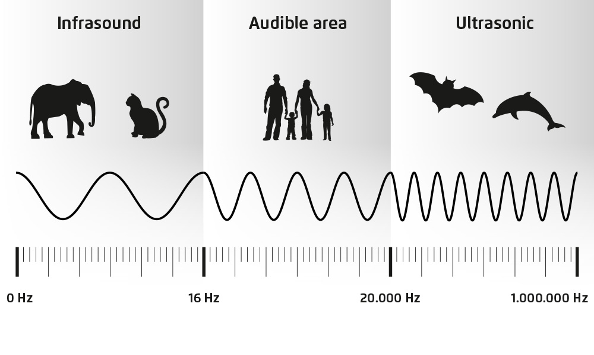
Let’s look at Second Level…
Notes:
I briefly mentioned infrasound waves. .
Infrasound waves are waves with frequencies too low for humans to hear and have longer wavelengths than other sound waves . Infrasound waves can record things like earthquakes that we might not even feel.
Ultrasound waves are waves with frequencies too high for humans to hear and have shorter wavelengths than other sound waves. They have medical uses, are used in testing mechanical equipment and in sonars.

Slide 42
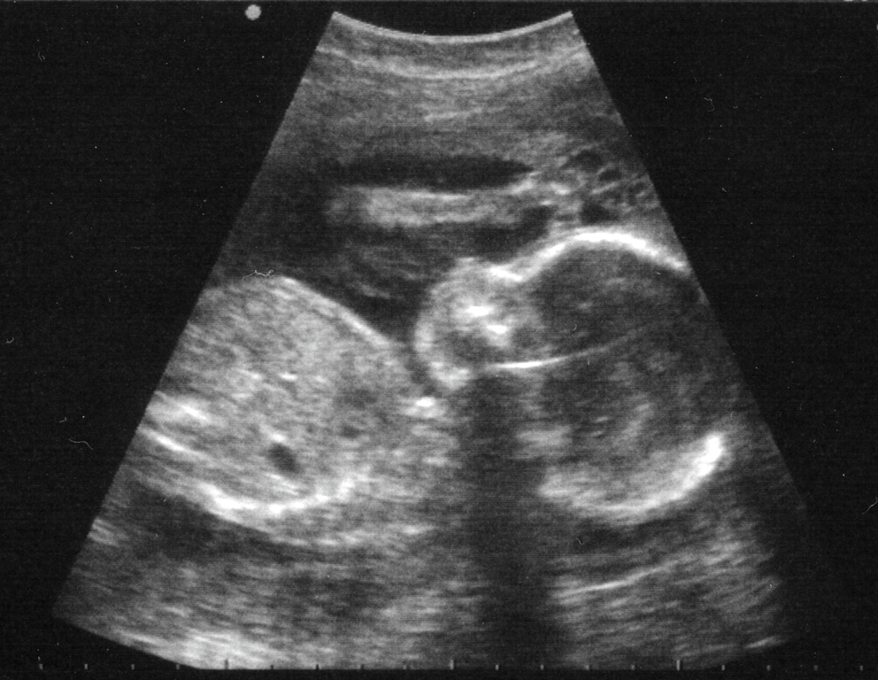
Let’s look at Second Level…
Sound has lots of uses!
Ultrasound is very, very high frequency sound. It is used to see inside people to see:
babies before they are born
if a heart is working well
blood flow
Notes:
Medical uses of Ultrasound waves include the scanning of babies before they are born, checking the heart and blood flow.

Slide 43
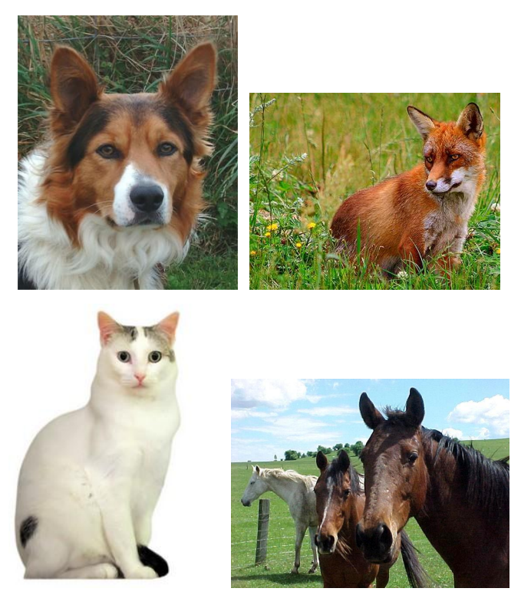
Let’s look at Second Level…
Through research on how animals communicate, I can explain how sound vibrations are carried by waves through air, water and other media. SCN 2-11a
Benchmarks:
Discusses and demonstrates through experiments how sound travels differently through air, water and solids.
Explains how hearing is limited by a range of factors, for example, age, position, and flexibility (direction) of ears.
Animal ears: position
Look at the pictures of animals. Why do animals prick up their ears? Do animals move their ears in other ways? Explain why.
Animals prick up their ears so that…
Animals also move their ears so that…
Discuss: if the animals couldn’t move their ears, how would it affect their hearing? Why is it important for many animals to hear sounds clearly and to know where the sound is coming from? (e.g., escape from danger, predator, hunting prey.)
Notes:
The second benchmark is all about the factors that can limit hearing.
You could start by looking at the position of animal ears and discuss the ways animals can move their ears and why and the importance of being able to do that.

Slide 44
Let’s look at Second Level…
Animal ears: shape
What do you notice about these animals’ ears? Explain why you think their ears are this shape. Where abouts are they positioned on the head? Why do you think that is? Can you suggest/research any other uses of ears?
Other uses e.g., elephants use their ears to lose heat by radiation – lots of blood vessels in thin ears which they flap when they are too hot; polar bears ears are small so that they do not lose too much heat; the sandy desert living sand cat has big and low set ears, which helps protect it from windblown sand; the caracal wildcat uses its large ears for hunting but also for communicating with other caracals.
If their ears were smaller, how do you think it would affect their hearing?
If they weren’t as high on the top of
the head, how might this affect their
hearing?
Notes:
This could then lead on to the shape of ears; these animals all have very large ears. Why? Discuss the position of the ears on the head and suggest why that is? What other uses might there be for ears? This could be researched – some examples are for temperature regulation and for communication.
This could then lead on to a discussion about if the ears were smaller, how would this affect their hearing. If the ears weren’t high on the top of the head, how might this affect their hearing?

Slide 45
Let’s look at Second Level…
Ask: How do we hear sounds? Vibrations in air (sound wave) caused by vibrations of objects, travel into our ears. When the vibrations in the air enter the ear, they cause the eardrum to vibrate, which in turns passes the vibrations to the small bones inside the ear. The vibrations then cause the fluid inside the cochlear to move the small hairs inside, which send messages to the brain which are interpreted as sounds. (SCN 2-12b)
Many animals move their ears to collect sounds, and some have large ears to help collect the sounds like an ear trumpet (show picture). Children can investigate cupping their hand around their ear like a larger ear and listening to the change in a sound.
Can we move our ears like the animals we have discussed? No. Lack of flexibility (direction) of ears is one way which limits hearing. We have to move our whole head. However, because we have two ears, it helps us to decide which direction the sound is coming from because the sound wave reaches one ear before the other.
Size is also another factor that limits hearing.
Notes:
It might be useful to recap how we hear sounds (which links to the outcome SCN 2-12b) and talk about many animals being able to move their ears to help collect sound and some have large ears to help with this too. You might talk about old fashioned ear trumpets and share pictures of one with the children and then get the children to cup their hand around their ear and listen to the change in sounds.
We can’t move our ears like the animals we have looked at and we don’t have big ears like them either: both factors limit hearing.

Slide 46
Let’s look at Second Level…
Ears: Do their design, size and shape matter?
Animal ears come in all shapes and sizes. How do these design details affect hearing?
Design and test your own ear like "hearing aids," looking at animal ears for clues about what helps improve the auditory sense.
The inner ear does most of the work when we hear sounds (see SCN 2-12b), so why do extensions of the ear that stick out on both sides of the head exist? These extensions —also called pinnae or auricula—act like funnels: they collect, amplify and direct sound waves to the ear canal and also reduce background noise.
Make replica animal pinnae also called (ear trumpets) and test them out on your own ears and see if
they give you super hearing!
Instructions for the investigation can be found here:
Ears: Do Their Design, Size and Shape Matter? - Scientific American
Notes:
You could investigate hearing and ear size and shape further by making and testing different shapes and sizes. Instructions for this investigation can be found by following the link on this slide.

Slide 47
Let’s look at Second Level…
Most people who experience hearing
loss as they get older do so because
of wear and tear to the tiny hair cells
in the inner ear.
Discuss the problems people have if they cannot hear (deaf) – e.g., dangers of traffic, difficult to communicate with others, etc.
Talk about sign language and show the British Sign Language Alphabet. (If any children can sign properly, they can show the rest of the class).
Discuss other things that affect hearing, e.g., glue
ear (a common childhood complaint), wax in ear
canal, exposure to loud sounds, etc.
Notes:
Hearing loss occurs in people as they get older due to wear and tear of the tiny hair cells in the inner ear. This video briefly explains this process and includes a hearing test.
What problems do people have if they are deaf? You might then go on to talk about sign language.
Discuss other things that affect hearing – for example glue ear, ear wax and damage caused by loud noise.

Slide 48
Let’s look at Second Level…
Loud noise can damage your ears
Noise pollution is any sound that continues for a long time and is loud, unpleasant or harmful to our ears. Noise pollution makes the area we live or work in very unpleasant. Noise pollution can be harmful and cause permanent damage to hearing. Even music that is too loud is noise pollution.
Most outdoor noise pollution comes from construction sites and noise from cars and trucks. If you live near an airport, there is a lot of noise pollution from the sounds made by the aeroplanes.
Loud sounds can damage your hearing.
Doctors have found that people who work with very loud machinery become hearing-impaired when they are still young.
They have also found that loud music can also cause hearing loss. Powerful amplifiers and speaker systems can be bad for your hearing. Headphones playing loud music can damage your hearing.
Some people are born with a hearing problem, and they can use hearing aids to help them hear better.
Notes:
I mentioned damage to hearing caused by loud noise; as something else that can damage you might want to discuss noise pollution with the children too as something else that can limit hearing.

Slide 49
Let’s look at Second Level…
Noise pollution
Animals can also be harmed by noise pollution. A good example is the whale. Whales communicate with each other by making sounds. The sound can travel over long distances through the water from the one whale to the next. When there are lots of ships present, they make additional noise. Water carries these noises very well and very far. This makes it difficult for whales to communicate with each other. This can cause whales to get lost in the ocean.
Dolphins 'shout' to get heard over noise pollution - BBC News
Studies have also found that songbirds, too, suffer from noisy (albeit terrestrial) urban environments and some species have had to change their singing styles and are now producing songs that are louder and shriller, in order to be heard above the noise pollution.
Traffic noise impairs songbirds' abilities - BBC News
Notes:
Animals are also affected by noise pollution: an example is the whale. When there are lots of ships in the ocean, the noise they make makes it difficult for whales to communicate with each other and can result in whales getting lost in the ocean. This video clip explains more about this and how a project called ‘Vessel Watch’ in America is trying to help.
It has been found that some songbirds too have had to change their songs to a louder and shriller song to be heard above noise pollution.

Slide 50
Let’s look at Second Level…
Difference Between Nocturnal and Diurnal Animals
Nocturnal animals are the animals that are most active during the night-time, and diurnal animals are the animals that are active during the daytime. There are some animals are neither diurnal nor nocturnal.
Hearing is an important method of sensing for nocturnal life. Nocturnal animals like fox, bats, bush babies etc. have extremely large ear trumpets so that even a small sound can be heard and to enable them to detect the location of the sound. Nocturnal animals cannot use vision to communicate so they use sounds to communicate with their group members and animal arrivals coming into their territory.
Some examples for nocturnal communication include; the night call of waterfowl, hooting and screeching of nocturnal owls, roaring of crocodiles, etc.
Notes:
The learning could also be extended by looking at and discussing the hearing of nocturnal vs diurnal animals. Nocturnal animals can have very big ears so that they can hear the smallest of sounds and they use sound to communicate with each other; they can’t of course use visual communication like some diurnal animals.

Slide 51
Some ideas for extending the learning
Research how hearing dogs are used to help those with hearing loss
Sound insulation - investigate which materials are good insulators e.g. to soundproof a room or as earmuffs Year 4 Science: Sound - Listen Up! | Hamilton Trust (hamilton-trust.org.uk); Sound Experiment - properties of materials (science-sparks.com)
bp educational service | Design a guitar activity
Activity: Draw Your Voice! - SAE STEM @ Home™: A World of Sounds | Rise 360 (articulate.com)
DIY Phone Speaker (science-sparks.com)
Research and investigate echolocation:
What is echolocation and which animals use it? | BBC Wildlife Magazine | Discover Wildlife;
Echolocation in Action! - Activity - TeachEngineering
Notes:
This topic can lead to many other opportunities for learning and here are just a few suggestions.

Slide 52
Resources
Hidden depths – Explorify – Zoom In, Zoom Out: human ear
Pink and knobbly – Explorify – Zoom In, Zoom Out: cat’s ear
Rice and rhythm – Explorify - What’s Going On video to demonstrate the physical action of the vibrations when a drum is struck
Martian waves – Explorify - What’s Going On activity that uses a less familiar context for helping explain how soundwaves travel
SSERC Primary 69.indd – Sounds good!
Activity: Draw Your Voice! - SAE STEM @ Home™: A World of Sounds | Rise 360 (articulate.com)
https://www.youtube.com/watch?v=JJ2ebYNtFUA – animal communication
https://en.wikipedia.org/wiki/Singing_sand
https://www.stem.org.uk/system/files/elibrary-resources/legacy_files_migrated/37576-36529-NL%20-%20Music%20to%20the%20Ears.pdf
| STEM – ‘Sounds like Science pack’ by the British Science Association
Recording Solar Sounds - Twig Science Reporter
Issue 19: 5 facts about animal communication - Twig Science Reporter
Notes:
Finally, some resources that might be useful.

Slide 53
https://forms.office.com/e/288WdDnHnt

