Slide 1
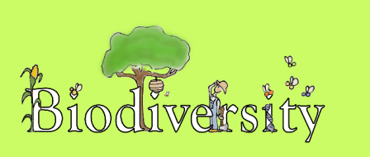

Slide 2
CLASSIFICATION AND ADAPTATION
SECOND LEVEL (SCN 2-01a)

Slide 3
Curriculum for Excellence
Planet Earth Biodiversity and interdependence
‘Learners explore the rich and changing diversity of living things and develop their understanding of how organisms are interrelated at local and global levels. By exploring interactions and energy flow between plants and animals (including humans) learners develop their understanding of how species depend on one another and on the environment for survival. Learners investigate the factors affecting plant growth and develop their understanding of the positive and negative impact of the human population on the environment’

Slide 4
What is ‘biodiversity’?
Biodiversity is all the different kinds of life you’ll find in one area—animals, plants, fungi, and even microorganisms like bacteria that make up our natural world. Each of these work together in ecosystems, like an intricate web, to maintain balance and support life. Biodiversity supports everything in nature that we need to survive: food, clean water, medicine, and shelter.

Slide 5
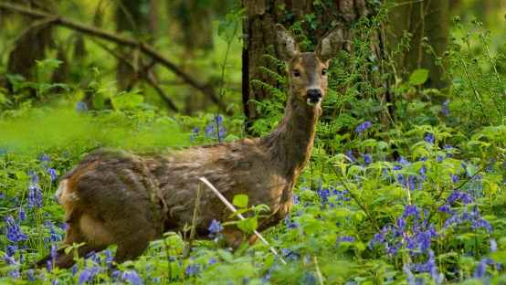
What is biodiversity?
What is biodiversity? | David Attenborough: A Life On Our Planet - YouTube

Slide 6
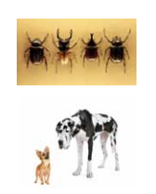
What is a ‘species’?
‘Species’ is the word used to describe a group of living things that can reproduce. An example of a species is ‘humans’ or ‘lions’.
Members of the same species look and act similarly; all dogs are one species but you would be forgiven for thinking that a Chihuahua and Great Dane were not that related!
Sometimes members of the same species are hard to tell apart; there are 350,000 species of Beetle which we might find very hard to tell apart!

Slide 7
What is an ‘ecosystem’?
An ecosystem is the way that living things work together in their surroundings. An example of an ecosystem is a rainforest.
‘Eco’ is the word we use when we are talking about the living things in the environment. So an ecosystem is a collection of living things in one place that work together. The parts of an ecosystem might be water, soil, plants, animals etc.
An ecosystem is changed if you take one part away and won’t work in the same way as it did before which is why we are concerned about extinction of animals and damage to their habitats.

Slide 8
I have observed living things in the environment over time and am becoming aware of how they depend on each other. SCN 0-01a
Benchmarks:
Explores and sorts objects as living, non-living or once living.
Describes characteristics of livings things and how they depend on each other, for example, animals which depend on plants for food.
I can distinguish between living and non living things. I can sort living things into groups and explain my decisions. SCN 1-01a
Benchmarks:
Explains the difference between living and non-living things, taking into consideration movement, reproduction, sensitivity, growth, excretion and feeding.
Creates criteria for sorting living things and justifies decisions.
Sorts living things into plant, animal and other groups using a variety of features.
I can identify and classify examples of living things, past and present, to help me appreciate their diversity. I can relate physical and behavioural characteristics to their survival or extinction. SCN 2-01a
Benchmarks:
Classifies living things into plants (flowering and non-flowering), animals (vertebrates and invertebrates) and other groups through knowledge of their characteristics.
Begins to construct and use simple branched keys which can be used to identify particular plants or animals. ·
Identifies characteristics of living things and their environment which have contributed to the survival or extinction of a species. ·
Describes how some plants and animals have adapted to their environment, for example, for drought or by using flight.

Slide 9
Second Level
I can identify and classify examples of living things, past and present, to help me appreciate their diversity. I can relate physical and behavioural characteristics to their survival or extinction.
SCN 2-01a
Plants and animals display amazing diversity; scientists calculate that only a fraction of species on Earth have been described and categorised. Ecologists studying the rain forests routinely find animals that have never been seen before!
Living things can be divided into groups or 'classified' by looking at similarities and differences between the way they look and behave. Classification is putting things into groups.

Slide 10
Activity: Sort it!
Provide the children with a range of muddled up objects to sort into groups. This could be the toy box, the lost property box, a messy pen/pencil drawer or a mixture of sweets, fruit or vegetables. Encourage the children to give reasons/justify why they have grouped things in that way.
Start with two groups and the children split these again and again until they can’t create anymore subsets. The children should share their ideas with other groups in the class, explaining why/how they split the items into sets/subsets.

Slide 11
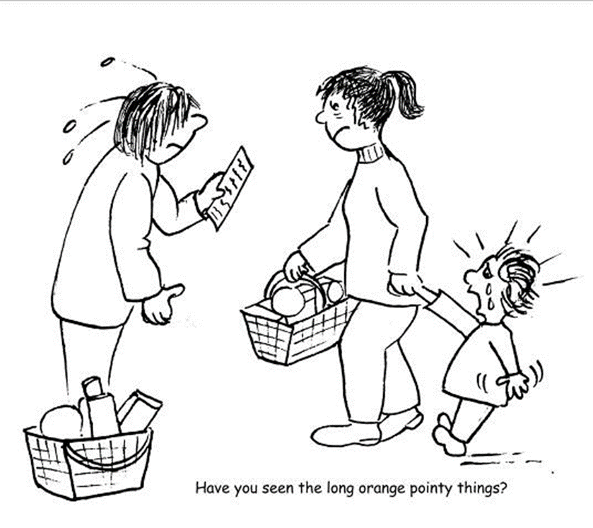
Activity: Why do we need to classify?
Ask the children to think about a supermarket - how do we know where to find what we are looking for? Each type of food has a name and is in its own place. We can tell how items have been classified by looking at the signs above the aisles. Can they think of other situations where classification is essential? How does it make life easier?
Imagine what it would be like doing the shopping if
supermarkets didn’t group similar things together
and they didn’t have names!
Image taken from ‘Plants for Primary Pupils’ SAPS /FSC 2008

Slide 12
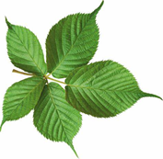
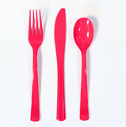
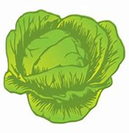
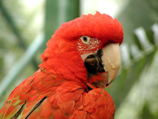
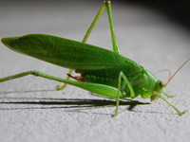
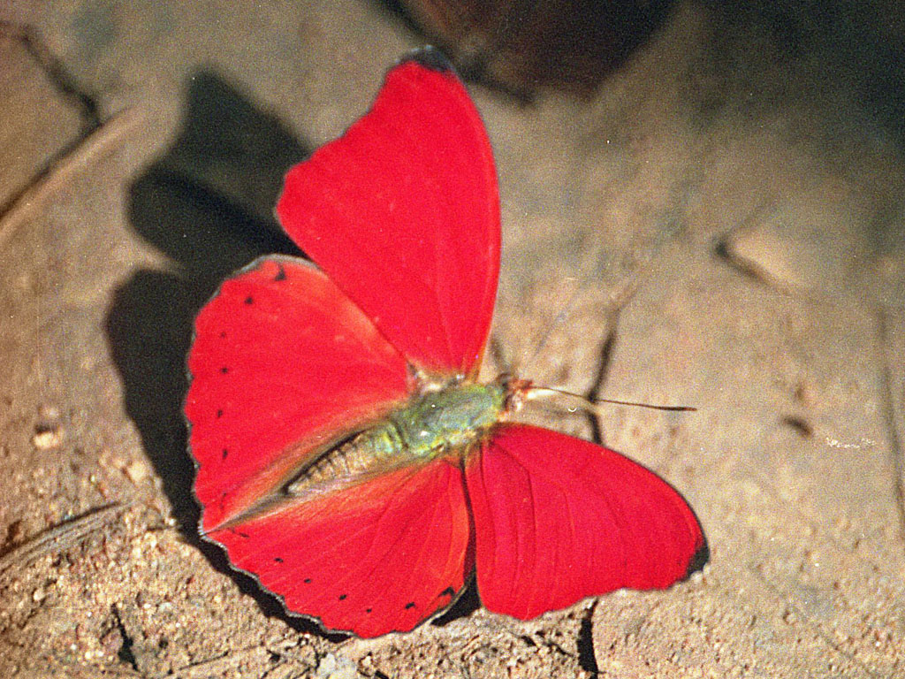
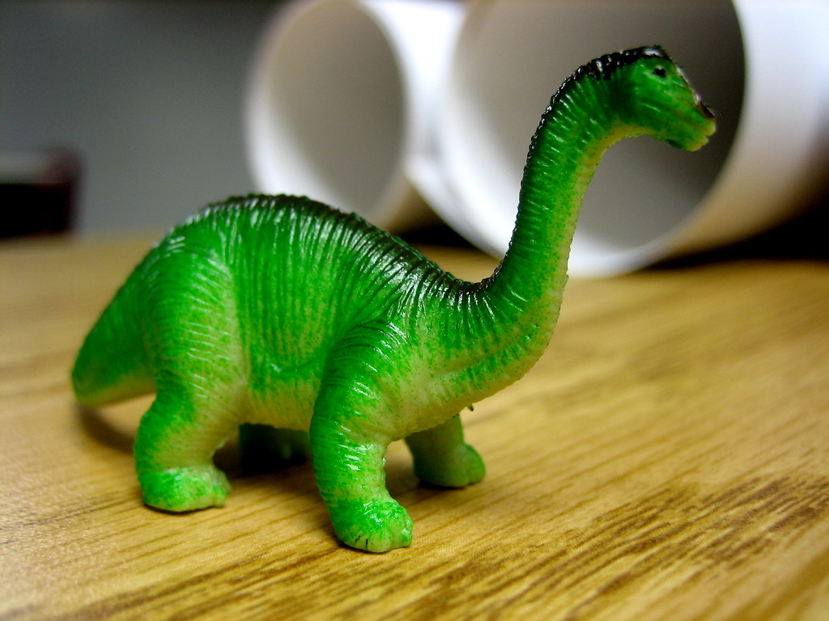
Activity: Ask the children to sort some things into two groups:
There are many ways to sort these objects into two groups:
Living and non-living
Edible and non-edible
Red and green
Plastic and non plastic
Animals and non animals … etc!
This is why scientists have a specific way/system to classify living things!

Slide 13
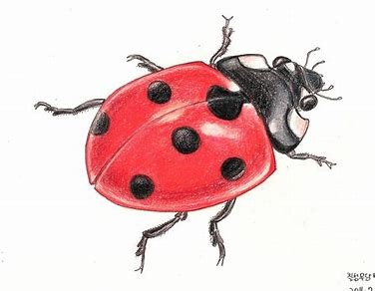
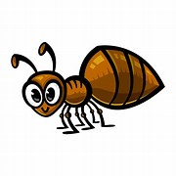
Activity: What’s in our grounds?
Introduce a range of equipment for sampling and observing e.g. magnifying glasses, sweep nets, magnifying jars. Identification charts etc.
Ask the children what they think might live in the grounds, what kinds of animals and plants, what might live where, what animals they will be able to see, what animals might only leave ‘evidence’ e.g. rabbit droppings? Bird poo? Footprints? What animals they might be able to gather and observe? Don’t forget the plants too!
Choose different areas of the school grounds – e.g. flower bed, woodland area, wildflower area, trees, hedges, field, playground etc. Encourage the children to select the right equipment for sampling and observing.
Sample and observe the areas sensitively and handle living things carefully and ensure that any living things are returned to their environment. Discuss ways that they can record what they find e.g. photographs, sketches, named lists etc.
When the class has gathered all of its observations and evidence either use photographs, pictures or words to sort them into groups with things that are similar (e.g. plants, animals, insects, birds) or those that are different (things that can survive underwater, above ground, under the ground etc.) There will be several ways that the children can sort them! (This is why scientists have a specific way/system to classify living things).
Extend their learning by asking if they can think of any other enquiries or questions. E.g. which area of the grounds had the most variety of living things? Why do you think this is? Can we prove that? How could we improve the range of living things that live in our grounds etc.?

Slide 14
Classifying (grouping) living things is called taxonomy and people who do this classifying are called taxonomists
Taxonomists today place all life into categories with sensible names that do not change. A few hundred years ago though scientists gave plants and animals long Latin names and often changed them! Carl Linnaeus changed that when he developed an organised system that is still used today.
A film about Linnaeus can be found here: https://ed.ted.com/on/90vRVJZ6
He had 5 levels in his classification system; kingdom, class, order, genus and species.
Today, scientists use seven levels: kingdom, phylum, class, order, family, genus and species. This system is important because it allows scientists to accurately identify individual species.
This phrase will help you remember the order:
Keep ponds clean or frogs get sick

Slide 15
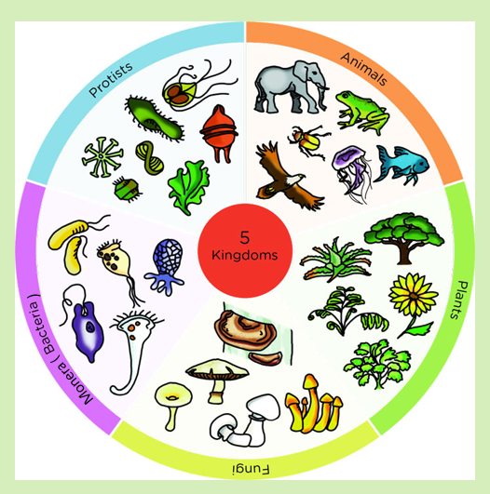
Living organisms are classified into five main groups; these are called kingdoms.
These are based on what they have in common and how they are different from each other.
Note: Linnaeus was not aware of unicellular organisms, as he could not see them with the naked eye and he did not have the equipment /powerful microscopes to magnify tiny things. Linnaeus therefore only identified the Plant and Animal kingdoms.

Slide 16
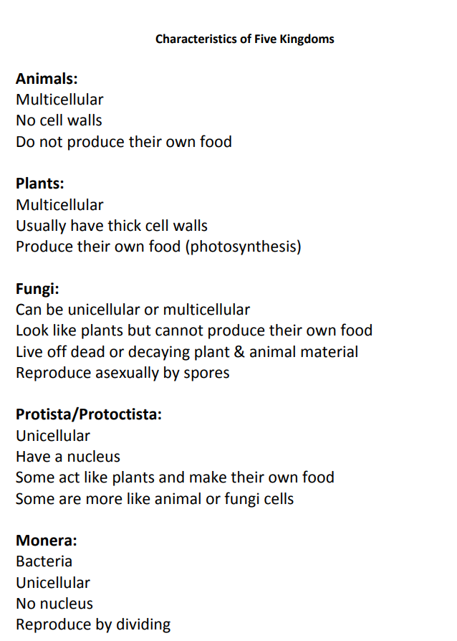

Slide 17
Learn about classification:
https://www.bbc.co.uk/teach/class-clips-video/science-ks1-ks2-ivys-plant-workshop-grouping-living-things/zfjxcqt
Classifying Animals | BBC Bitesize | science - YouTube
An example of how the classification system works can be found here:
Classification of a lion:
https://www.youtube.com/watch?v=vqxomJIBGcY

Slide 18
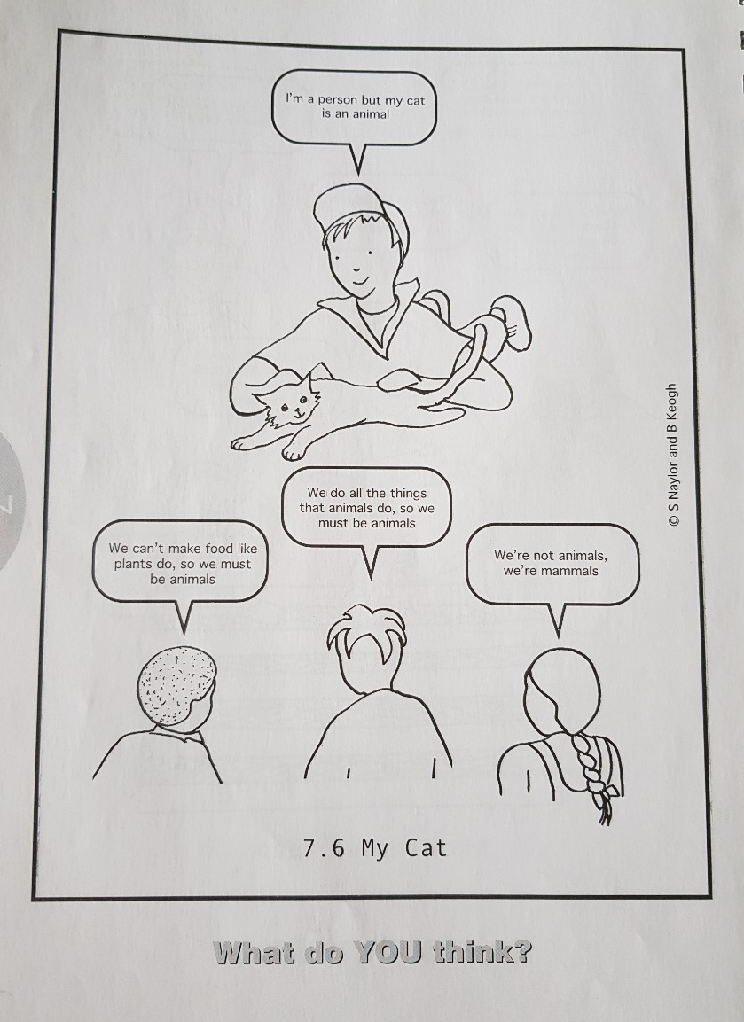
Are humans animals?
Humans are not seen as animals by the majority of children at age seven and this is a common misconception in older children too!
Although children may know about mammals, it is common for children not to think of them as a subset of animals.
This Concept Cartoon (Stuart Naylor and Brenda Keogh, 2000) is a great way of gauging children’s understanding!

Slide 19
Animal Kingdom: Classification
Animals are divided into two main groups:
Animals that have a backbone are called vertebrates. All animals with backbones also have a bony skeleton.
Animals that don't have a backbone are called invertebrates.
Vertebrates and invertebrates are divided into smaller groups.
Vertebrates, are divided into mammals, reptiles, birds, amphibians and fish.
There are many different groups of invertebrates. They include invertebrates which have soft bodies such as jellyfish, worms and molluscs (like slugs and squids). There are also groups of invertebrates with hard bodies, such as insects, crustaceans and spiders.

Slide 20
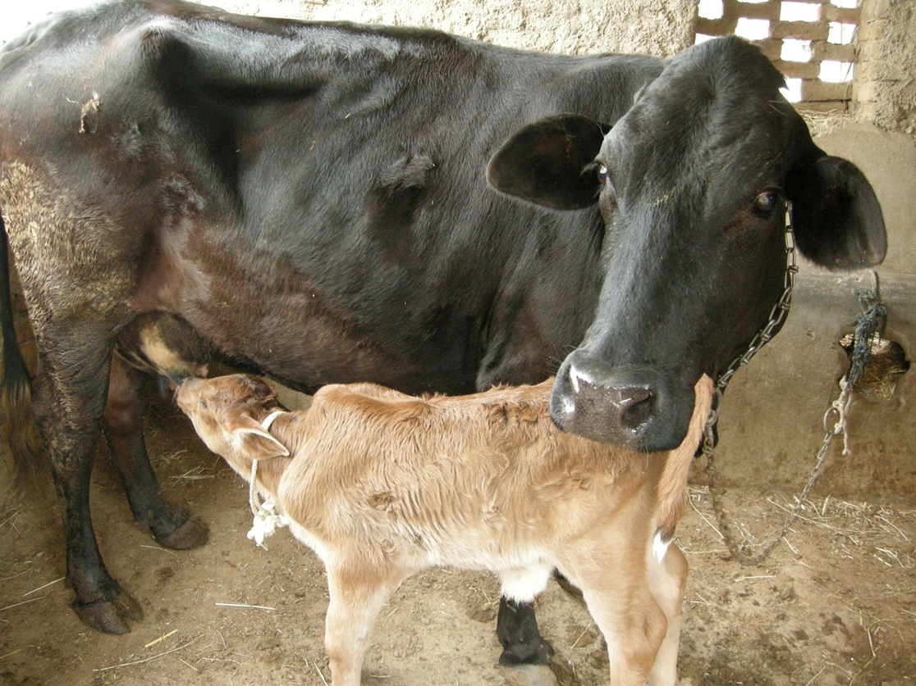
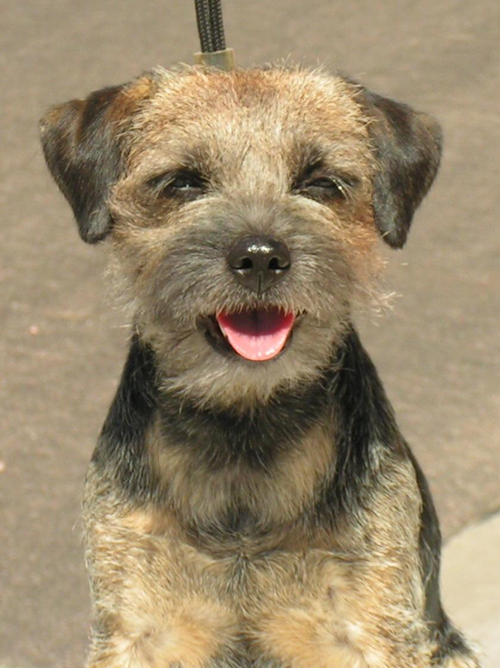
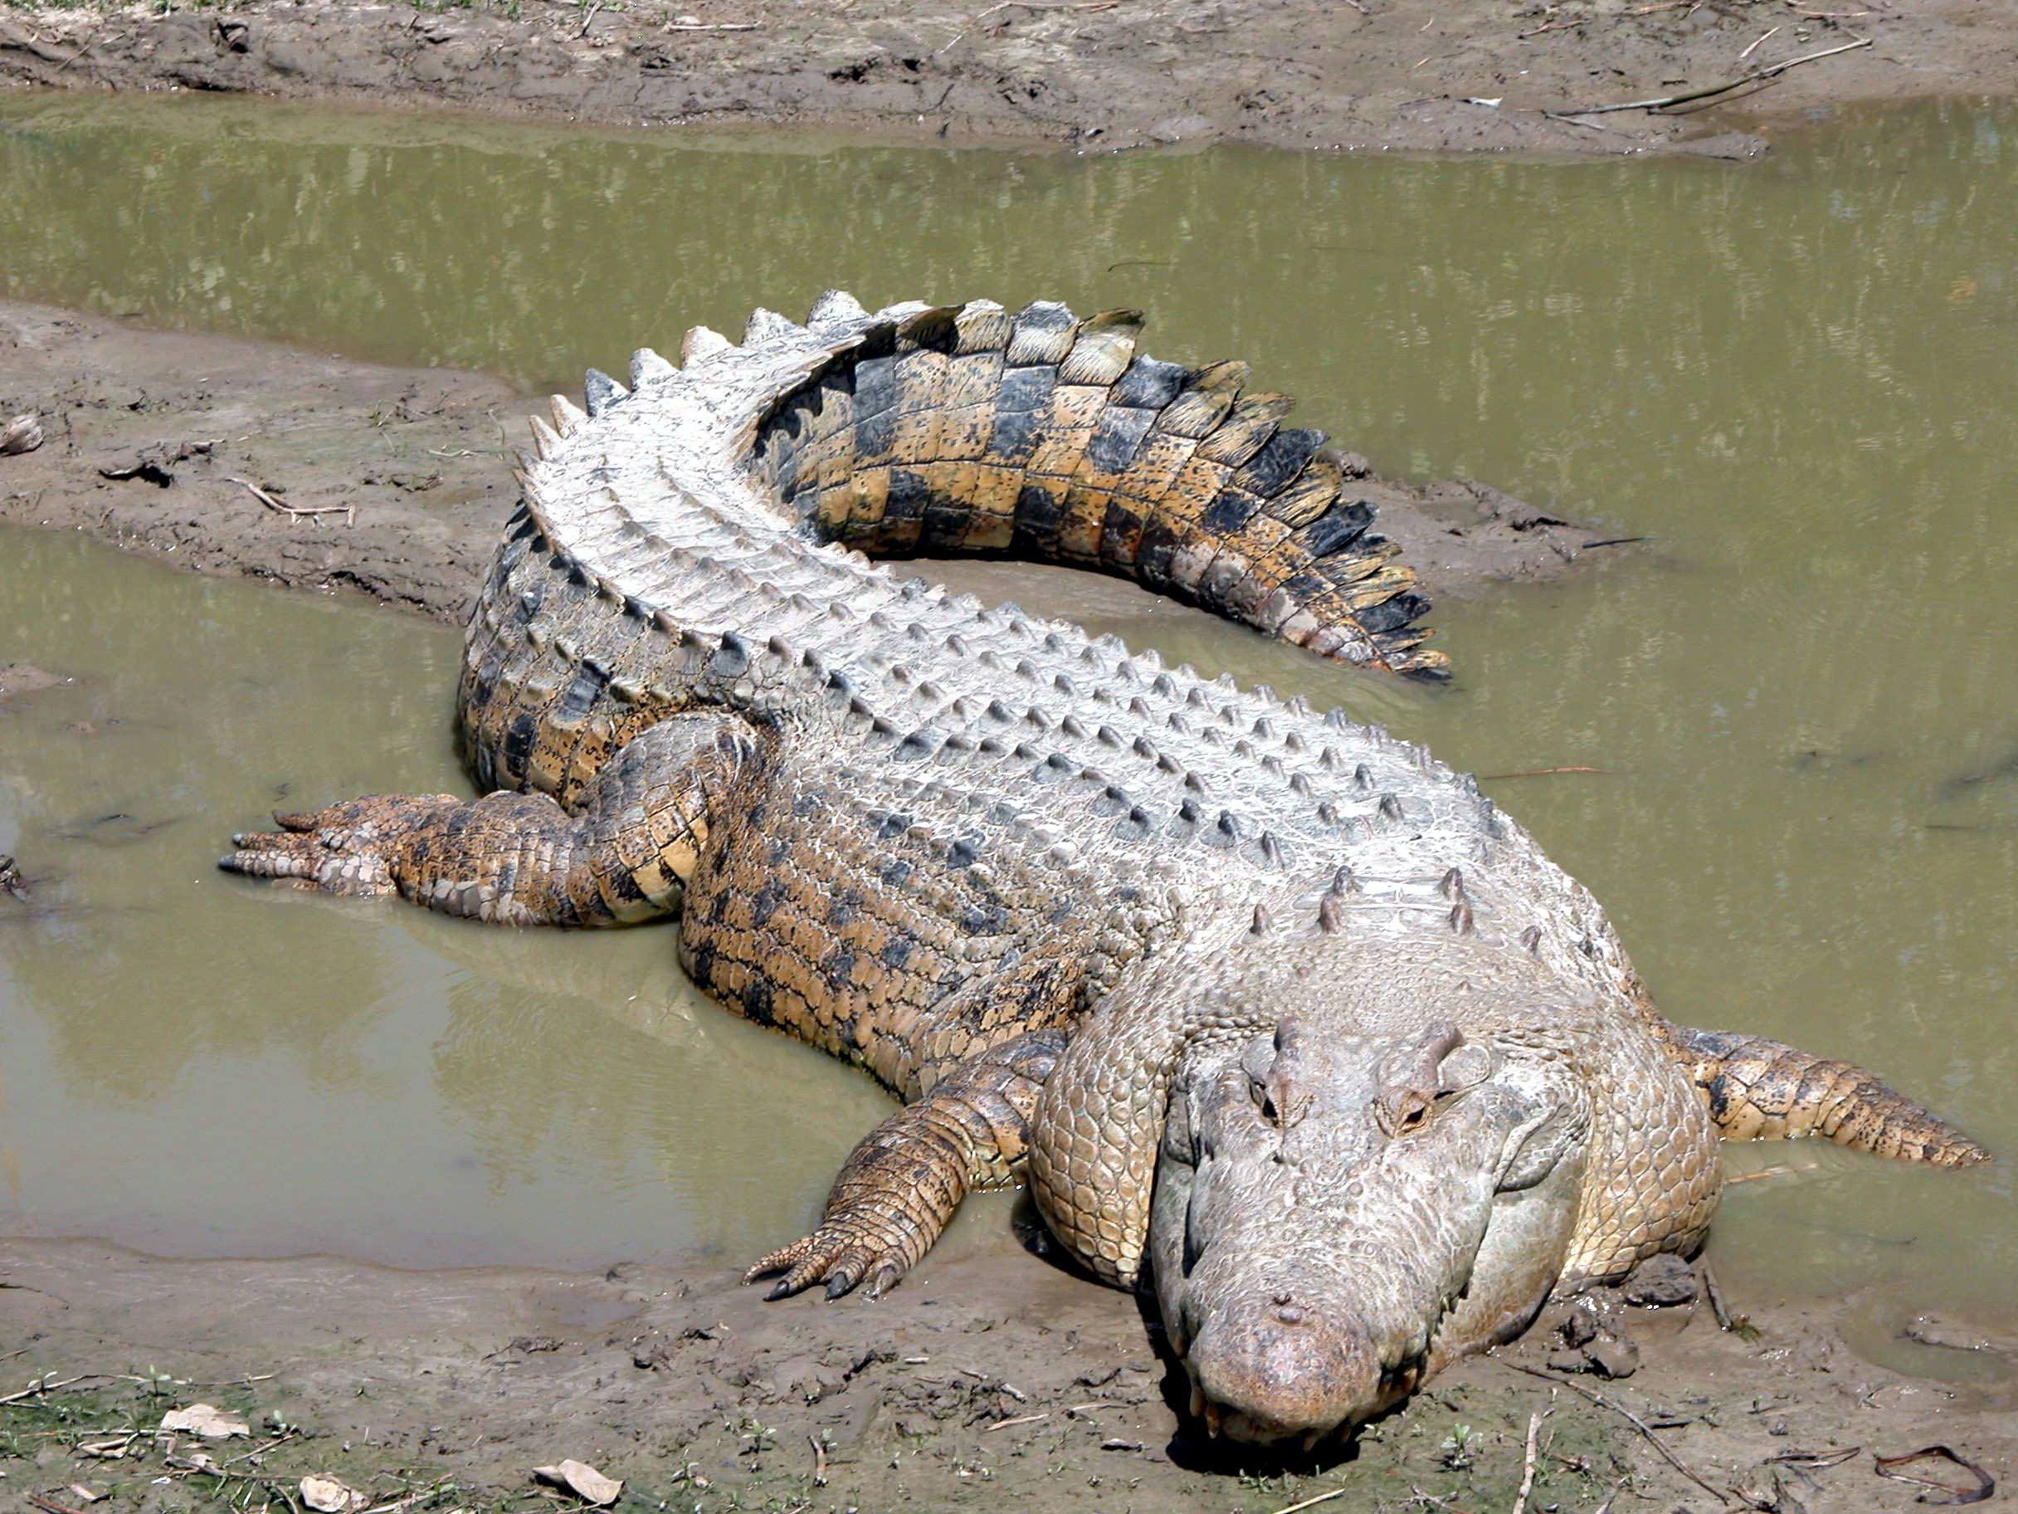
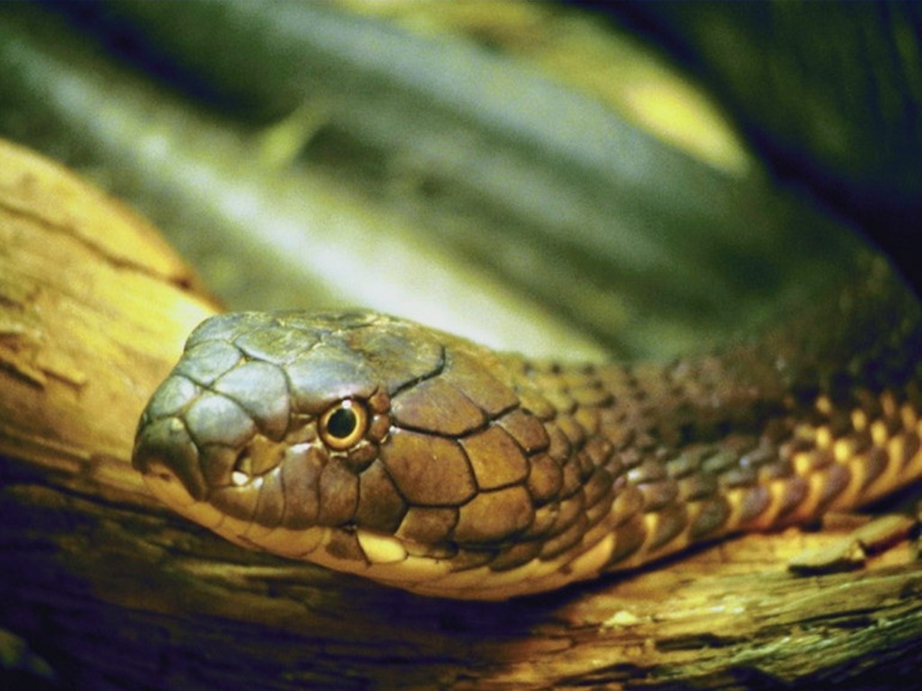
Vertebrates
Vertebrates, are divided into mammals, reptiles, birds, amphibians and fish.
Mammals: give birth to live young. Have fur or hair, feed
their young with their own milk and are warm blooded.
https://www.tigtagworld.co.uk/film/does-it-have-fur-PRM00147/
Reptiles: have scales and not fur, have dry skin, and are cold blooded

Slide 21
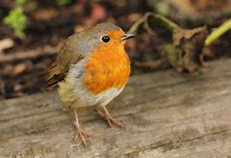
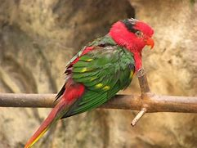
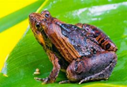
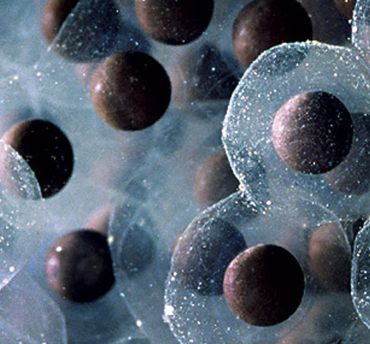
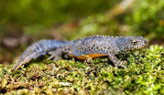
Birds have feathers and wings, lay eggs and are
warm blooded.
Amphibians live on land and in water, are cold blooded, lay eggs and have moist skin and webbed feet.

Slide 22
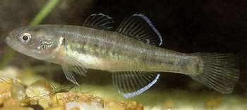
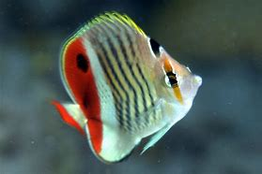
Fish can breathe under water using gills, have scales and fins, lay eggs and are cold blooded

Slide 23
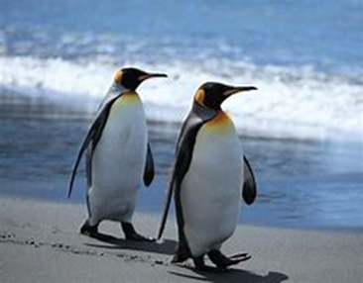
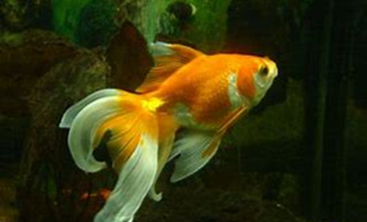
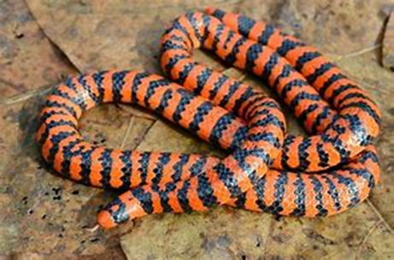
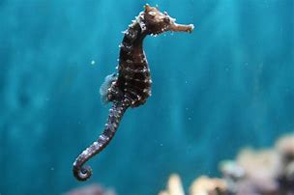
Activity: What types of animals (vertebrates) are these?
Show the children images of vertebrates and ask them to decide what type of animal they are – include some that will make them think!
Penguin – bird
Seahorse – fish
Snake – reptile
Goldish - fish

Slide 24
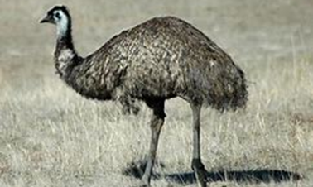
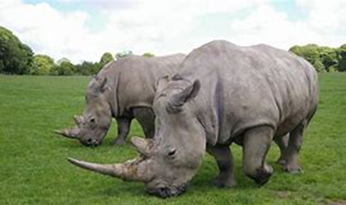
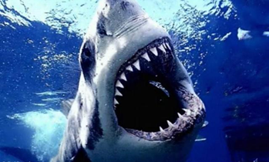
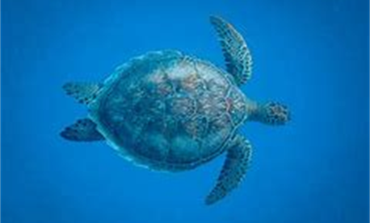
Emu – bird
Human - mammal
Rhino - mammal
Newt - amphibian
Shark - fish
Turtle - reptile

Slide 25
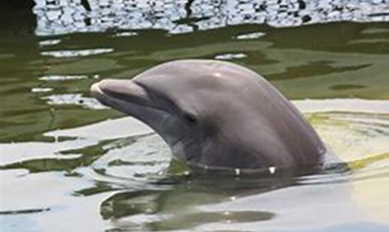
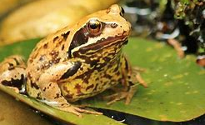
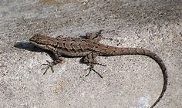
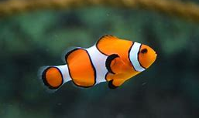
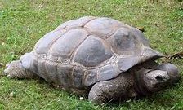
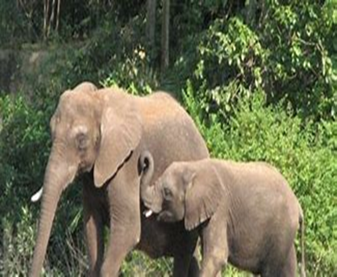
Dolphin – mammal
Frog – amphibian
Lizard – reptile
Clown fish – fish
Tortoise – reptile
Elephant - mammal

Slide 26
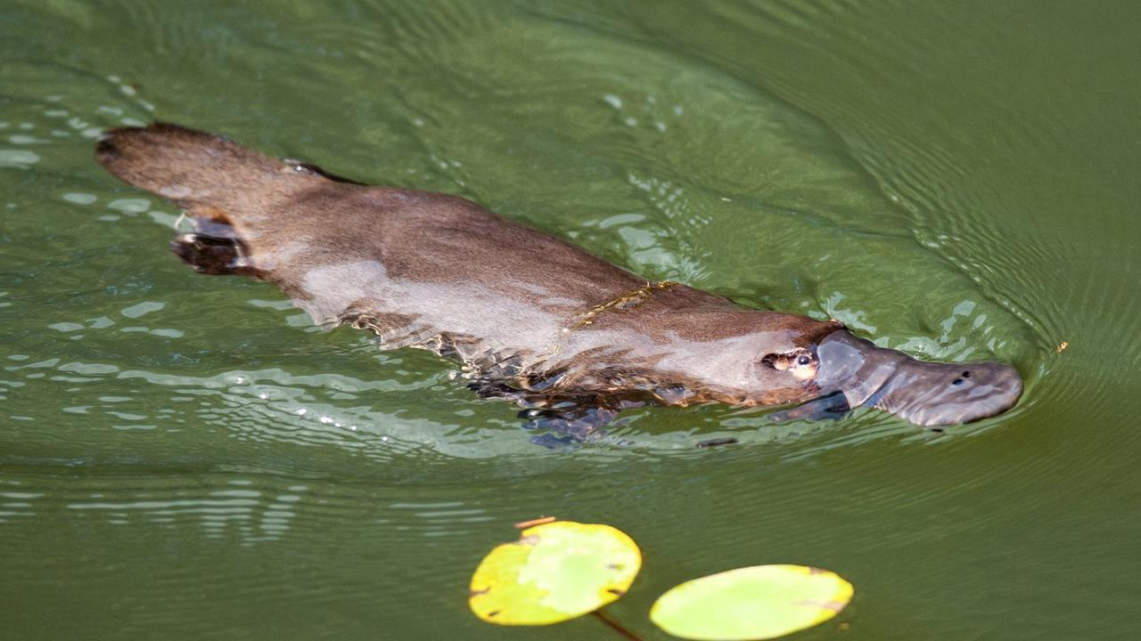
Duck-billed Platypus
Has brown fur and a tail like a beaver
Has a bill and lays eggs like a duck
What is it?
Mammal or Bird?
https://www.tigtagworld.co.uk/film/why-do-we-classify-PRM00146/
Mammal!

Slide 27
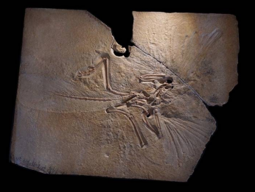
Archaeopteryx
Has feathers
Has wings
Bird or dinosaur(reptile)?
Dinosaur (reptile)
After detailed analysis Chinese scientists reassigned Archaeopteryx to a dinosaur grouping - it was thought to be a bird for a very long time!

Slide 28
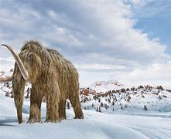
Woolly Mammoth
Mammal!
Has long thick hair
Gave birth to live young
What is it?

Slide 29
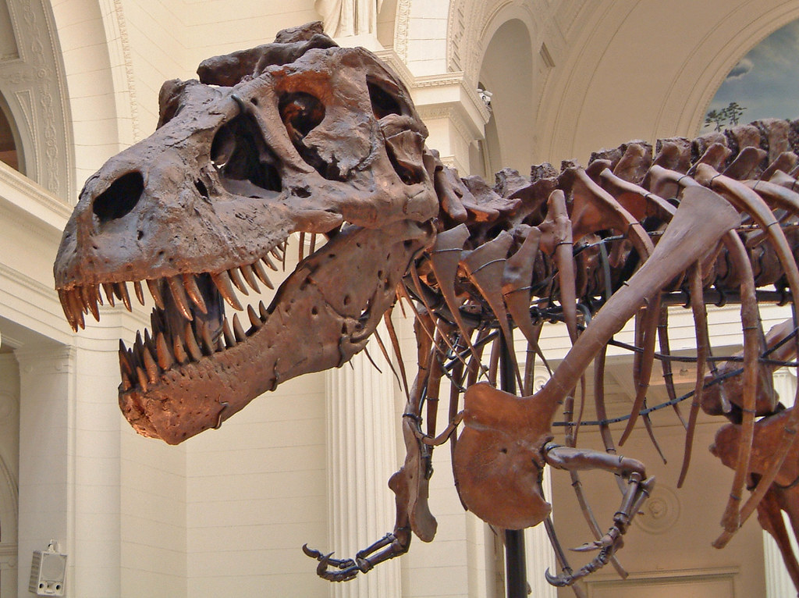
Tyrannosaurus rex
Lays eggs
Has a backbone
Scaly skin
Babies may have been covered in feathers
What is it?
https://www.britannica.com/animal/dinosaur
Reptile!

Slide 30
Invertebrates
The largest invertebrates are found in the sea. These include giant organisms such as jelly fish and squid. On land, without the support/upthrust from the water, huge invertebrates cannot support themselves and would be crushed by their own weight.
The biggest land invertebrates are worms (annelids), large insects such as dragonflies, and snails (molluscs).
Over 80% of the world’s known species are invertebrates and they form the basis of many food chains.
80% of plants rely on invertebrates for pollination.

Slide 31
Invertebrates
Invertebrates are divided into 6 main groups:
Arthropods
Molluscs
Annelids (worms)
Echinoderms (sea urchins and starfish)
Jellyfish and corals (Cnidarians)
Sponges

Slide 32
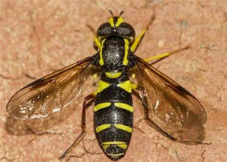
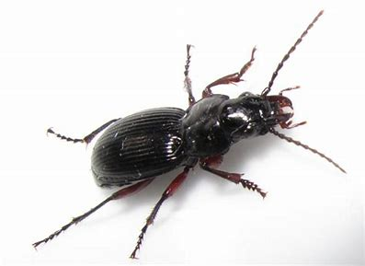
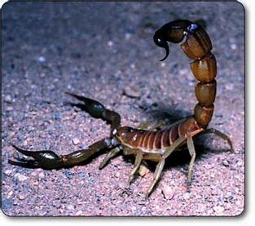
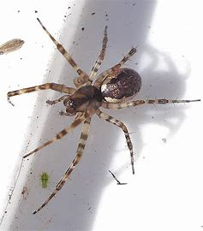
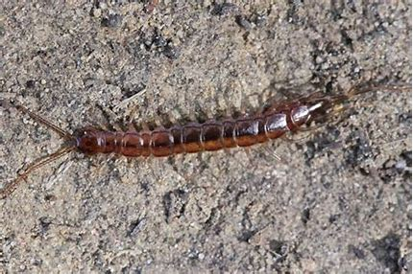
Arthropods have a body with a rigid external skeleton that provides and articulated legs. Some have wings. They are classified as: insects, arachnids, myriapods and crustaceans.
Insects have three pairs of legs, some have wings like flies.
Arachnids have four pairs of legs (spiders, scorpions).
Myriapods have a segmented body and more than 15
pairs of legs (centipedes).
Crustaceans have between five and ten pairs of legs (woodlouse, shrimp, crabs and sea lobsters).

Slide 33
Molluscs have a soft body without legs. They can be live on land or in water. They may have a hard outer shell (snails) or an inner shell (squid) or no shell (octopus and slugs). Land molluscs move slowly on a flat sole called a foot.
Annelids (worms) don’t have any limbs and their bodies are soft. There are three types: flatworms, round or cylindrical worms and segmented worms (earthworms) – these have bodies that are divided into rings or segments.

Slide 34
Echinoderms (sea urchins and starfish) are marine animals that live in the ocean. They have arms or spines that radiate from the centre of their body. The central body contains their organs, and their mouth for feeding. The mouth is underneath, to eat other sea life.
Common echinoderms include the starfish, sea urchin,
sand dollar and sea cucumber.
Jellyfish and Corals (Cnidarians) have a soft, gelatinous and transparent body with tentacles and float in the water.

Slide 35
Sponges look like plants, but they are very simple animal, shaped like a sack. They live in water, attached to rocks.
In the school grounds, you are most likely to come across earthworms, (maybe flatworms if you have a pond), snails, slugs, woodlice, centipedes, millipedes, spiders, harvestman, beetles and flies.
Pond dipping is a great way to find out about biodiversity (risk assessment required).

Slide 36
Activity: Minibeast hunt!
Go for a minibeast hunt in the school grounds! Choose different areas of the school ground. Encourage the children to select the right equipment for sampling and observing.
Sample and observe the areas sensitively and handle living things carefully and ensure that any living things are returned to their environment. The children should record what they find using e.g. photographs, sketches, lists etc.
Remind the children that common land invertebrates (minibeasts) can be divided into worms, molluscs (including snails and slugs), and arthropods (all minibeasts with jointed limbs). Remind them of the 4 main groups of arthropods: insects (6 legs), arachnids (8 legs), myriapods (centipedes and millipedes – 1 or 2 pairs of legs per segment) and crustaceans (five and ten pairs of legs – e.g. woodlice).
Sort the collection based on these criteria. Looking closely is important; one of the keys skills for scientists is the skill of observation! Being able to observe the world around you, use your senses to experience it, and record what you observe are key skills for all types of scientists!
There is lots of opportunity to include Maths (data handling) here too.

Slide 37
Activities:
Children could research a chosen animal, including it’s classification, and create a fact file, or write a non chronological report.
They could research an unusual living thing to find out how it is classified and where in the world it is from (habitat and location).
https://listverse.com/2012/12/12/10-incredible-recently-discovered-animals/
7 New Animals Discovered in 2021 So Far | Discover Magazine
Harry Potter Spider
Domed Land Snail
Links to:
Using what I know about the features of different types of texts, I can find, select and sort information from a variety of sources and use this for different purposes. LIT 2-14a
By considering the type of text I am creating, I can select ideas and relevant information, organise these in an appropriate way for my purpose and use suitable vocabulary for my audience. LIT 2-26a

Slide 38
Activity: to create, name and describe a new animal that sits within the classification of the animal kingdom
Ask the children to imagine they have discovered an animal that has never been seen before. Ask them to create a labelled, detailed (technical) drawing of it, to name it, describe it and to classify it.
This ‘new animal’ must fit within the animal classification system; the children have to decide on the classification route based on the characteristics of their creature and create the unique/unusual characteristics of their creature towards the end of that path.
The children could start with a ‘basic’ animal, such as a dog and research it’s classification online, helping them to pinpoint the main characteristics of their creature. Then they could think about what they are going to add to it to give it some unique characteristics, including how it is uniquely adapted to its environment!

Slide 39
Activity: to create, name and describe a new animal that sits within the classification of the Animal kingdom
An example of this approach is the comparison of the classification of a horse to the mythical unicorn.
The children could write a non chronological report about their imaginary creature.
Links to:
Using what I know about the features of different types of texts, I can find, select and sort information from a variety of sources and use this for different purposes. LIT 2-14a
By considering the type of text I am creating, I can select ideas and relevant information, organise these in an appropriate way for my purpose and use suitable vocabulary for my audience.
LIT 2-26a

Slide 40
We have looked at the Animal Kingdom, now we are going to look at the Plant Kingdom.

Slide 41
Plant Kingdom: Classification
Suggested starter activity: grouping plants
Ask children, in groups, to list as many plants as they can and then discuss the following questions:
What characteristics do the plants all share?
What differences are there?
How are plants different to animals?
Can they think of any simple ways of grouping them (drawing on previous learning or their own ideas)?

Slide 42
Plant Kingdom: Classification
https://www.bbc.co.uk/teach/class-clips-video/science-ks1-ks2-ivys-plant-workshop-classifying-and-grouping-plants/zh9jvk7
There are two main groups of plants: Flowering and Non Flowering
Flowering plants reproduce by attracting pollinators (usually insects) using coloured and/or scented flowers. The pollinators help to spread the pollen between plants which results in fertilisation, followed by the production of a seed which can grow into a new plant. The vast majority of plants are flowering plants.
Non Flowering Plants do not produce pollen. Some directly produce seeds (conifers), others produce spores that are dispersed by the wind to new locations where they can grow into new plants (mosses, ferns).
Interviews with plant groups: lesson starter Interviews with Plant Groups - Lesson starter - YouTube

Slide 43
Simple Plant Classification
&
Liverworts

Slide 44
Simple Plant Classification
Flowering plants
Non flowering plants
&

Slide 45
Flowering Plants
Make up over 80% of all plants on Earth
There are around 352,000 different species
How many can the children name?

Slide 46
Activity: Find out about flowering plants!
Ask the children to research some facts about flowering plants and use them to make a poster, a digital book, a SWAY presentation etc.
They could be assigned specific flower types for their research, such as ‘UK wild flowers’, ‘winter flowers’, or ‘flowers commonly considered to be weeds’.
The children could also discuss how/where they have seen flowers growing (e.g. in gardens, greenhouses, wild flowers growing naturally in fields, etc.). Why do they think different flowers are grown in different environments?
Links to: By investigating the lifecycles of plants and animals, I can recognise the different stages of their development. SCN 2-14a. It is difficult to discuss/explore flowering plants without talking about their structure and how this relates to their life cycle!

Slide 47
Non flowering plants: Conifers
Have seeds inside cones
Do not flower
Thin leaves called needles
588 different species, almost all of which are trees
Examples include cedar, cypress, fir, juniper, larch, pine, yew

Slide 48
Non flowering plants: Ferns
Around 12,000 species
Live in shady places where there is moisture e.g. forests, fields, near streams

Slide 49
Non flowering plants: Mosses and Liverworts
Small flowerless green plants
No true stems, leaves or roots
Grow in low carpets or rounded cushions in damp habitats
Mosses and liverworts do differ, but they share enough important characteristics to be known collectively as bryophytes.
Moss
Liverwort

Slide 50
Activity: Plant hunt!
Go for a walk around the local area looking at the plants, especially those growing on walls and cracks in paving etc. Try to find examples of mosses/liverworts. If you are in an area with a good diversity of plants, you may also find ferns. Draw the children’s attention to those plants they do not flower.
(Note: take samples of mosses and look at them through a microscope
– they look like miniature forests)
Ask the children to choose a plant and draw /photograph it. Get them to identify and name their plant using plant identification books or a website or a plant identification App.
Challenge: Can the children find out where it belongs in the classification system ? (All 7 levels if they can!) Can they explain the features their plant has that places it in particular groups?

Slide 51
Example: Dandelion

Slide 52
Classifying Micro-organisms
A micro-organism is a very small living thing that can only be seen with
a microscope. They are found everywhere - in the air, soil, water and inside our bodies. Some of them are helpful, whilst others can be harmful.
Micro-organisms make up the largest number of living organisms on the planet and we couldn‛t survive without them.
There are 3 kingdoms of micro-organisms: Monera, Protists and Fungi.

Slide 53
Kingdom Monera (bacteria)
Single-celled organisms
Can cause illness
Bacteria help us digest and breakdown our food
Bacteria are used to make cheese, yoghurt, pickles, soy sauce and antibiotics!
Bacteria work hard for us in the soil. One type of bacteria, called decomposers, break down material from dead plants and animals helping to create soil

Slide 54
Kingdom Protista
Protists are divided into two groups:
Protozoa:
Many different types that are many different sizes, shapes
There are a lots of different ways in which how they feed and move
Many cause disease e.g., malaria
Algae:
Plant- like; have chlorophyll and photosynthesize to make own food
Common in water and on surfaces of moist soil, wood and rocks
Big variation in both structure and size - range from microscopic
to 60-metre-long kelps in the sea!

Slide 55
Kingdom Fungi
The fungi kingdom is divided into three groups: yeast, moulds and mushrooms. Most fungi are inconspicuous because of the small size of their structures. They may become noticeable when fruiting, either as mushrooms or as moulds.
They are found almost everywhere.
They cannot make their own food and most live off dead or
decaying plant and animal matter.
Fungi can consist of a single cell (yeast) or
can be made up of many cells (mushrooms).
yeast
mould
mushrooms

Slide 56
Activity: What Makes Yeast Grow?
Ask the children if they have ever made bread - what do they need to include to make the bread rise?
You will need: 4 zip-lock bags, yeast, salt, sugar, water
Label the 4 bags:
Sugar and warm water
Sugar and cold water
Sugar and salt and warm water
No sugar and warm water
Add 2 tsp yeast to each bag, 2tsp sugar to each bag labelled sugar and 1 tsp salt to the bag labelled salt.
Carefully add half a cup of water to each bag. The warm water should not be too hot or it will kill the yeast. The cold water can be room temperature.
Seal the bags, squeezing out as much of the extra air as possible.
You will know yeast is growing in a bag, as it will ‘puff’ up. Discuss the results – what
makes the yeast grow the best? Can the children think of any reasons for this?
This can also be done with balloons: Big Balloon Blow-Up | The University of Edinburgh or https://www.science-sparks.com/blowing-balloons-respiration-style/
Links to: I have contributed to investigations into the role of microorganisms in producing and breaking down some materials. SCN 2-13a

Slide 57
I can identify and classify examples of living things, past and present, to help me appreciate their diversity. I can relate physical and behavioural characteristics to their survival or extinction. SCN 2-01a
Benchmarks:
Classifies living things into plants (flowering and non-flowering), animals (vertebrates and invertebrates) and other groups through knowledge of their characteristics.
Begins to construct and use simple branched keys which can be used to identify particular plants or animals.
Identifies characteristics of living things and their environment which have contributed to the survival or extinction of a species.
Describes how some plants and animals have adapted to their environment, for example, for drought or by using flight.

Slide 58
Constructing and using keys
Links to:
I understand the operation of a process and its outcome. I can structure related items of information TCH 2-13a
I can display data in a clear way using a suitable scale, choosing appropriately from an extended range of tables, charts, diagrams and graphs, making effective use of technology MTH 2-21
What is a classification key?
A key has a set of questions about the characteristics of living things. By answering the questions, it can be used to identify the living thing or decide which group it belongs to.
https://www.bbc.co.uk/bitesize/topics/zxjj6sg/articles/z9cbcwx

Slide 59
Here is a key that could help to identify different types of ‘mini-beast’. It is a series of questions that are answered ‘yes’ or ‘no’.
The chain is followed to the next question until the creature can be identified.

Slide 60
Activity: Twenty questions
Ask the children to ask yes or no questions; this is the basis of binary keys. e.g.
Teacher: I am thinking of an animal
Pupil: Does it have four legs?
Teacher: No
Pupil 2: Can it fly?
Teacher: Yes…
The children have 20 questions to guess the correct animal.
Teach the children about keys and classification using finger puppets! https://www.sciencefix.co.uk/2020/11/keys-and-classification-using-finger-puppets/

Slide 61
Activity: Making a key: Liquorice Allsorts
Either use a packet of Liquorice Allsorts, or use pictures of them. Each group of children is given 6 different sweets and asked to make up 5 ‘yes/no’ questions to sort the sweets. This is called a branching or dichotomous key.
Depending on the learners, you can
start with less e.g. 4 sweets to
simplify the task, which will mean
less questions to make up or start
with more to increase the challenge!
You could also use Dolly Mixtures or
a biscuit variety pack
Image taken from ‘Plants for Primary Pupils’ SAPS /FSC 2008

Slide 62
Example from Hamilton Trust: Living Things & their habitats (Science Year 4) https://di4c76y7libww.cloudfront.net/documents/LKS2_Science_Y4_Spring_2_Name_living_thing_Session5_Resource.pdf

Slide 63
Activity: Making a branching key for woodland invertebrates
Give the children/the children choose 4 invertebrates that they know/have found in the school grounds. Example: an earthworm a ladybird, a spider and a snail.
Ask them to think about the features of the animals and then think of some questions they could ask to help identify criteria for making a key.
The key could look like this:

Slide 64
Does it have legs?
Yes
No
Does it have more than six legs?
Does it have a shell
Yes
Yes

Slide 65
The children could also practise using a branching key like this one:

Slide 66
Activity: make a branching key for these birds
Example from Hamilton Trust: Living Things & their habitats (Science Year 6)

Slide 67
Activity: Using and creating a key to identify plants
Here is a simple key to sort some leaves to discover what tree they come from.
Ask the children to explore the playground, park or local wildlife area. How could they classify some of the plants that grow there? What questions would be good to ask to help group and classify the plants?

Slide 68
Activity: Using a key
Children use a key to identify (and name) certain buttercups. The simple key provided includes seven members of the buttercup group (Genus Ranunculus). All have yellow flowers and are common and widespread. They include species known correctly as buttercups as well as some that closely resemble buttercups and are often mistaken for them.
This activity requires the children to know what the parts of a flower are called. It also illustrates the characters of the leaf and stem, can be important when trying to identify the species.
Full details for this activity can be found here: https://www.saps.org.uk/teaching-resources/resources/1377/primary-booklet-5-grouping-and-classification/ (Booklet 5, pages 25-29) An additional, similar, activity is also provided using leaf characteristics to identify trees/shrubs

Slide 69
Pictures and some notes relating to the different kinds of buttercup are provided in the booklet

Slide 70
The key is also provided for the children to use to identify the buttercups.

Slide 71
I can identify and classify examples of living things, past and present, to help me appreciate their diversity. I can relate physical and behavioural characteristics to their survival or extinction. SCN 2-01a
Benchmarks:
Classifies living things into plants (flowering and non-flowering), animals (vertebrates and invertebrates) and other groups through knowledge of their characteristics.
Begins to construct and use simple branched keys which can be used to identify particular plants or animals.
Identifies characteristics of living things and their environment which have contributed to the survival or extinction of a species.
Describes how some plants and animals have adapted to their environment, for example, for drought or by using flight.

Slide 72
Adaptation And Survival
An adaptation is any trait that can be inherited that allows a living thing to survive and reproduce in its environment. An adaptation can be structural, meaning it is a physical part of the living thing. Or behavioural, meaning it affects the way a living thing responds/reacts to the environment that it is living in.
An example of a structural adaptation is the way some plants
have adapted to life in dry, hot deserts by being able to store
water in their thick stems and leaves. An example of behavioural adaptation is seasonal migration. The blue whale lives in all of the deep oceans except for the Arctic. During winter, the whales migrate to the equator to escape the extreme weather conditions at the poles but migrate to the poles during summer to feed.
Why and when do animals migrate? - BBC Bitesize

Slide 73
What is a habitat?
A habitat is the natural ‘home’ where a plant or animal lives. Ideal habitats provide shelter, space, food and water; a habitat provides the basic needs for all living things. There are lots of different habitats across the world and each plant and animal that lives there is specially adapted to live and survive there.
What is a habitat and examples of how animals have adapted to particular habitats:
https://www.youtube.com/watch?v=ZrSWYE37MJs
Information about the different natural habitats of plants and animals e.g. grassland habitat, freshwater habitat, desert habitat etc. can be found here:
https://kids.nationalgeographic.com/nature/habitats
Environment: all biological, economical, physical, and chemical components that make up the surrounding of living organisms.
Habitat: A place where an organism or a community of organisms naturally lives and grows. It is a specific space located in the environment.

Slide 74
Activity: Adaptation
Discuss with the children what adaptation is and why animals and plants adapt.
In what ways are animals perfectly designed for the habitat that they live in? Why is this important? How have we adapted to live with e.g. cold, heat?
Use an example:
Polar bears are adapted to living in the cold by having thick fur coats, a layer of fat underneath their fur and they have large feet with hair on their paws to help them
to move about on the ice.
Sloths are adapted to living in the rainforest. They can climb trees with the
help of very sharp claws, their fur is covered in green algae to help
camouflage them and they live in the tree tops to avoid predators.
Ask the children to think of other examples.

Slide 75
Activity: Adaptations and Habitats
Provide the children with pictures of different habitats e.g. rain forest, desert, savannah, ocean and some animals that live there. Ask the children to match the animals with the habitat in which they live, justifying their answers, explaining how these animals are adapted to living in that habitat.
Activity: Research task
Ask the children to choose a habitat and an animal that lives in that habitat. Research the habitat and the animal and present the findings as a detailed report, or presentation etc. The report/presentation must include a description of the habitat and how the animal is adapted to living in that environment (either by its behaviour and/or by its physical appearance).
Links to:
Using what I know about the features of different types of texts, I can find, select and sort information from a variety of sources and use this for different purposes. LIT 2-14a
By considering the type of text I am creating, I can select ideas and relevant information, organise these in an appropriate way for my purpose and use suitable vocabulary for my audience. LIT 2-26a

Slide 76
Plant Adaptation
Just like animals, plants can be found in different habitats all over the planet. A plant living in a particular habitat will be adapted to live in that habitat.
Activity: Plant adaptation in the school grounds
In the school grounds or local environment, support the children to notice where plants are growing. Ask them to suggest reasons why they might be growing there. Encourage them to look at where plants of the same species are growing differently to each other in the same location or close by. E.g. a tall, healthy daffodil compared to one that has pushed its way out and growing from under a stone. How has the daffodil adapted to growing in a more challenging environment?
Plants find ways to adapt to changing amounts of sunlight. Phototropism is the movement of plants toward light and heliotropism is the turning of plants
with the sun’s direction. Examples of heliotropism include sunflowers
that turn their leaves and flowers to track the Sun’s movement across
the sky. Place a plant near a sunny window and observe how the plant
grows over time and observe how plants grow toward a light source.

Slide 77
Plant adaptations to different habitats
Activity: Grouping plants that share the same habitat
Give the children pictures of plants and descriptions of the adaptations seen in plants growing in particular habitats. Ask the children to sort them in to groups to match the habitat they are found in and to justify their grouping (see example on the next 2 slides)
Can the children explain why e.g. plants that grow in a warm, wet habitat would not survive in our Scottish forests/woodlands? Why would those growing in a cold, Arctic habitat not survive in a dry, hot habitat? How might climate change threaten the survival of some plants?
Examples of adaptations by plants to ensure their survival:
https://eden.uktv.co.uk/education/inspired-attenborough/article/lesson-4-private-life-plants/

Slide 78
Activity: Grouping plants that share the same habitat
These plants are found in either a cold habitat, a warm, wet habitat, or a dry, hot habitat

Slide 79
Plants adapted to grow in a cold habitat (Arctic/Tundra)
Most of the plants are small, grow close together and close to the ground. This protects them from the cold temperatures and the strong winds. Some flowering plants have fuzzy coverings on the stems, leaves and buds to provide protection from the wind. Some have woolly seed covers. Flowering plants use the long hours of sunlight to produce flowers quickly in the short growing season. Some plants have cup-shaped flowers that face up to the sun, so the sun's rays are directed towards the centre of the flower. These plants stay warmer than the air around them. Only the top layer of soil thaws out so plants have shallow roots. Small leaves help stop the plants loosing water.
Plants adapted to grow in a hot, dry habitat (Desert)
The plants have small leaves to cut down on water loss from the surface of the leaves. They may have long roots (7-10 metres long) that reach deep under the ground to get water. Some of the plants have spines instead of leaves e.g. cacti because spines lose less water and stop animals from eating the plant. They may have leaves that have a thick, waxy skin on their surface to stop water loss. Some plants, known as succulents, store water in their stems, leaves, roots or even fruits.
Plants adapted to grow in a warm, wet habitat (Tropical rainforest)
Hot climates with a lot of rain. Plants have stilt roots to help them anchor into the shallow soil, waxy leaves with ‘drip tips’ to let the rain run off. There is a lot of plants in this habitat and some plants grow on top of/or climb up each other to reach the sunlight.

Slide 80
Activity: Grouping plants that share the same habitat
These plants are found in a cold habitat, a warm, wet habitat, or a dry, hot habitat
dry & hot
warm & wet
cold

Slide 81
Carnivorous plants: the meat-eaters of the plant world
Carnivorous plants have developed a terrific array of weird and wonderful adaptations that help them flourish in nutrient-poor environments such as bogs, swamps, watercourses, sandy and rocky sites. They have roots but usually live where the soil doesn’t have many nutrients.
Being carnivorous, therefore is an adaptation that allows these plants to survive where nutrients are scarce. These plants make the most of all available resources as they are able to supplement the available nutrients by capturing and digesting insects and sometimes small animals.
Activity: Research the different habitats that carnivorous plants live and ways in which they capture their prey
There are five methods: pitfall, adhesive, snap, snare and suction. There are over 450 different species of carnivorous plants and they can be found on every continent apart from Antarctica. In particular, carnivorous plants are most common in North America, south-eastern Asia and Australia. As they live in areas where other plants might not find enough nutrients, they are often found in some unusual places.

Slide 82
Links to resources for examples of how some plants and animals have adapted to their habitat:
Season 2 issue 6: Koala - Twig Science Reporter - Koalas eat leaves poisonous to most animals but have adapted so that they can digest them
Season 2 issue 11: Great grey owl - Twig Science Reporter how the great grey owl‘s hunting abilities allow it to stay well fed in winter
https://www.twigsciencereporter.com/fact-pack/5-facts-about-plant-adaptations/ how plants have adapted to survive in certain environments e.g. Plants that grow in very cold weather often grow close to the ground, helping them to avoid freezing winds and blasts of snow
https://www.twigsciencereporter.com/video/pebble-toad/ as the pebble toad can’t hop, it moves slowly so is vulnerable to predators. It has adapted to escape predators by rolling itself up into a ball
https://www.twigsciencereporter.com/news-update/climate-change-threatens-cacti-sucking-up-air-pollution-weather-sensors-inspired-by-dandelions/ how cacti have adapted to growing in the desert and how climate change is threatening their survival
Video: Hovering hummingbirds I​ Reach Ou​t​ Reporter - Twig Science Reporter Humming birds’ ability to hover allows them to drink nectar from flower

Slide 83
Activity: Extinct Animals
The fossil record tells us that there have been at least five times in the history of the Earth that there have been mass extinctions due to natural causes (e.g. meteors, volcanic eruptions). The one involving the extinction of the dinosaurs is probably the one that people are most aware of.
We are now in what scientists are calling the sixth mass extinction which is mainly being caused by human activity.
Discuss what humans do or can do to cause animals or plants to become endangered or even extinct (e.g. hunting, poaching, things that are causing the climate to change, pollution, destroy habitats (e.g. deforestation), introduce invasive species etc. )
Ask the children to carry out research about an extinct species and try to identify the reasons why it became extinct, and try to link it to any physical or behavioural
adaptations.

Slide 84
The Dodo was a bird well adapted for its habitat; it lived in the woods in the coastal areas of Mauritius.
Scientists have studied the bones of the legs, and believe the Dodo could run quite fast; it’s legs were robust and strong so they could support the bulk of this big bird but are also believed to have made it agile and able to move easily and quickly through a dense wooded habitat (physical adaptation).
There was abundant food available and the Dodo didn’t have any natural predators on Mauritius so it was a flightless bird (physical adaptation).
Dodos laid their eggs in nests on the ground (behavioural adaptation but linked to being flightless).
Within 80 years the Dodo was extinct.
Reasons for extinction:
Hunted by sailors for food and easy to catch because the Dodo could only run and was flightless (physical adaptation) and had no fear of humans
Invasive species (pigs, cats and rats) were introduced to the island and ate the Dodo’s eggs which were on the ground (behavioural adaptation)
Habitat destruction: sailors cut down the trees for the wood (human activity)
The Dodo

Slide 85
Research the survival and extinction of living things – second level | Interdisciplinary learning activities | Resources for practitioners | Scotland Learns | National Improvement Hub (education.gov.scot)
This activity uses digital technologies to develop an appreciation of why some species of living things are endangered: the Sumatran Rhinoceros.
Links with:
I can use digital technologies to search, access and retrieve information and are aware that not all of this information will be credible. TCH 2-02a

Slide 86
General resources:
Aberdeenshire Council Ranger Service Biodiversity Education Pack
Biodiversity Education Interactive Pack - March2022 with video link.pdf (sharepoint.com)
Primary Booklet 5 - Grouping and Classification - Science & Plants for Schools (saps.org.uk) Activities for creating and using classification keys
Engagement Initiative | John Muir Award (johnmuirtrust.org)
The World Wildlife Fund | WWF
Our_Planet_Their_Future.pdf (wwf.org.uk) – educators’ pack
bp educational service | Biodiversity Challenge primary – includes videos and information about biodiversity as well as a design challenge to design a biodiverse, local home for nature

Slide 87
https://forms.office.com/e/SiXYF2cLst

