Slide 1
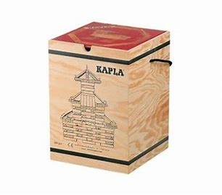
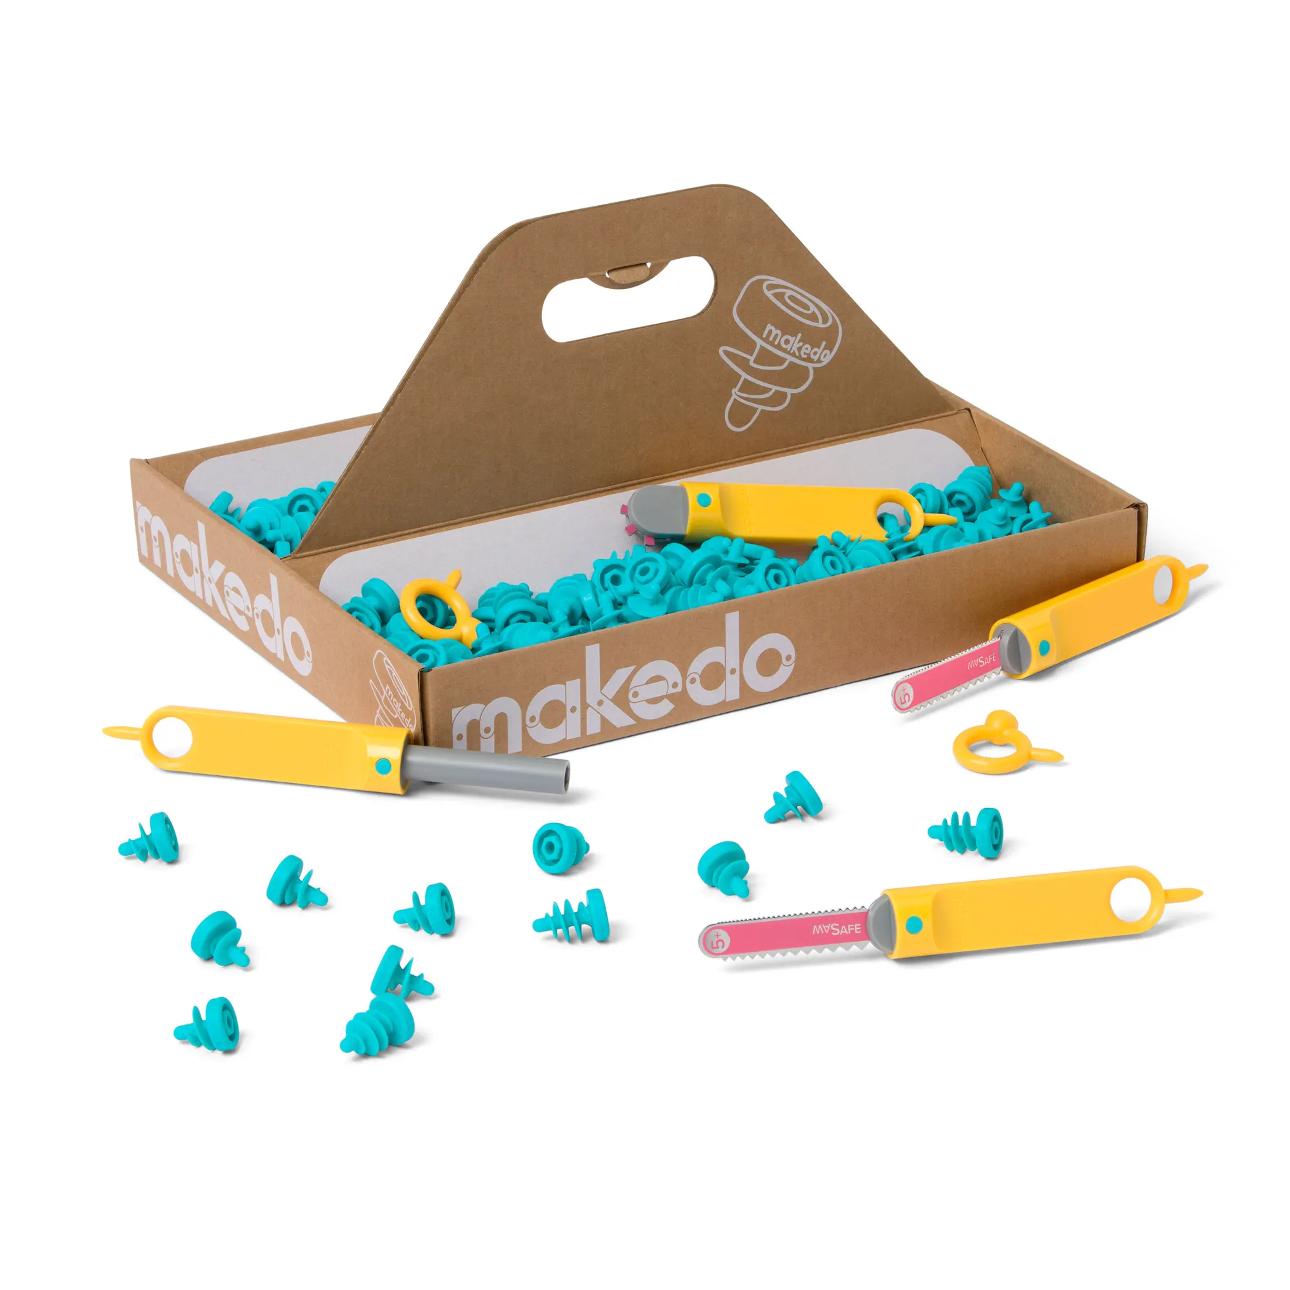
and
CLPL Session 23rd November 2022
Kim Aplin (RAiSE PSDO, Aberdeenshire)
Laura McCafferty (National Officer for RAiSE)

Slide 2
“KAPLA® is an ideal toy for schools, given its wide application potential: for children of all ages, for free play or within a lesson, alone or with a team, to create art or grasp science… KAPLA®’s single module provides an open-ended game, adapting to every child’s abilities and ambitions, and benefits numerous aspects of children’s cognitive and physical development.”
(KAPLA® in the classroom)

Slide 3
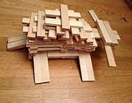
KAPLA is a creative resource with a wide application appeal and suitable for children of all ages.
KAPLA consists of loose parts that are identical pine planks that can be used to create unique models by stacking them. It can be used in classrooms for a wide variety of purposes:
To stimulate creativity
Promote teamwork
Resilience
Perseverance
To teach STEM concepts

Slide 4
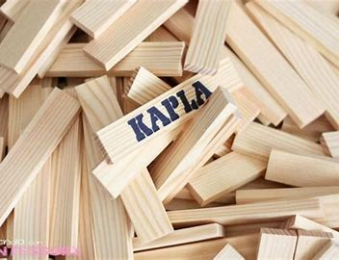
STEM resource for all ages.
Children learn about geometry, maths, physics concepts, gravity, symmetry, ratio, engineering, sequencing, problem solving, logical thinking etc.
Teamwork
Cooperation,
communication,
social interaction and sharing
Development
Cognitive and physical development, patience, fine motor skills, concentration, problem solving, precision, spatial awareness etc.
Creativity
Encourages imagination, artistic sensitivity, pride in accomplishment etc.

Slide 5
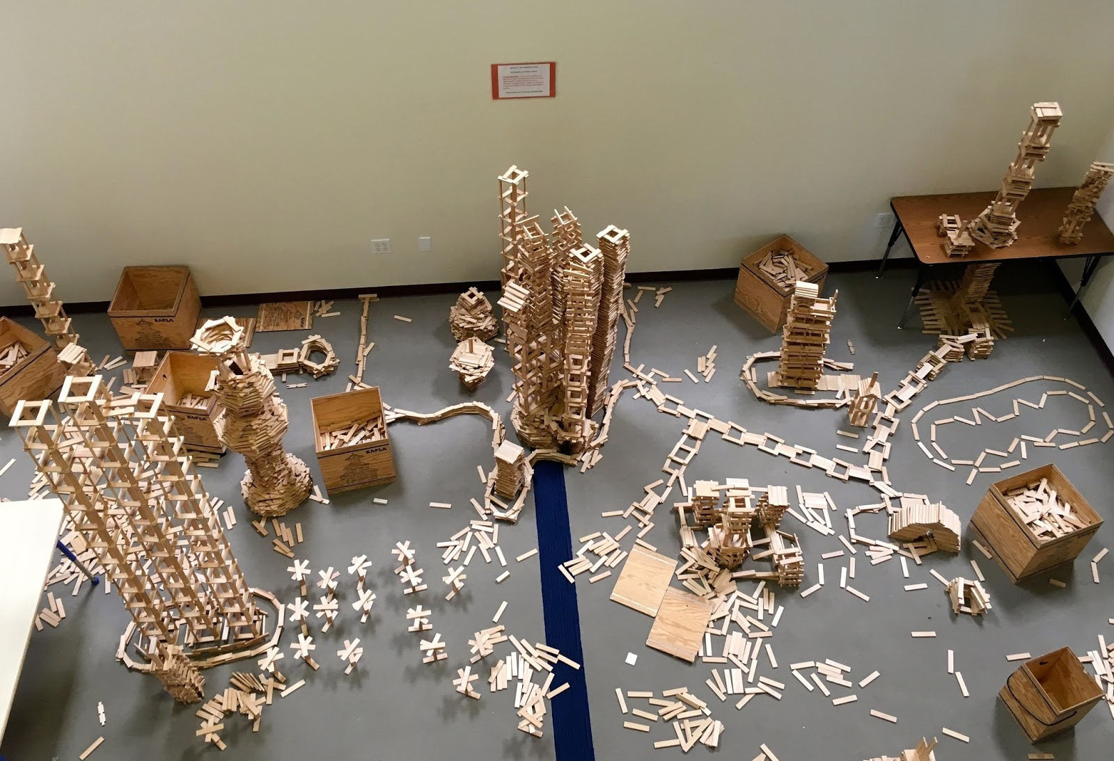
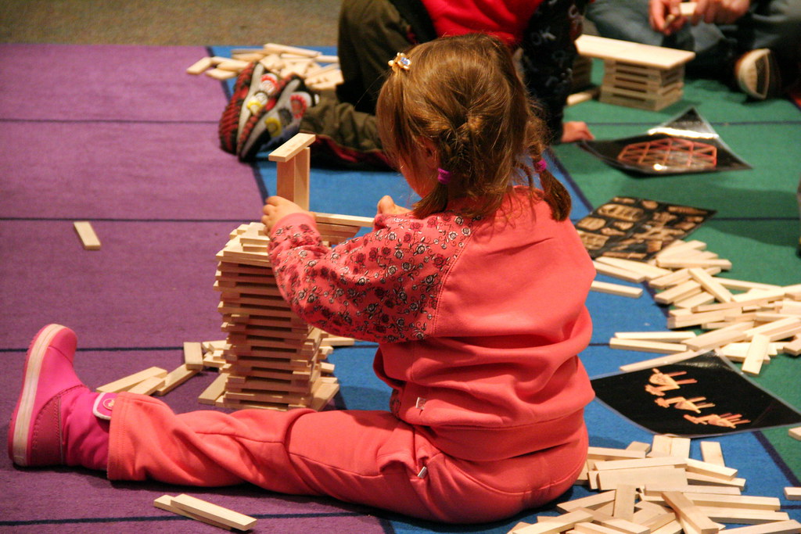
Simpler than Lego. There is only one size, one shape, no holes: a sturdy wooden plank precision milled from hardwood
Because of the uniformity of the planks, very large, high and stable structures can be built and quite quickly
A huge variety of structures can be built
They lack the tricky locking device of Lego, and are not tiny, so young children can build with them.

Slide 6
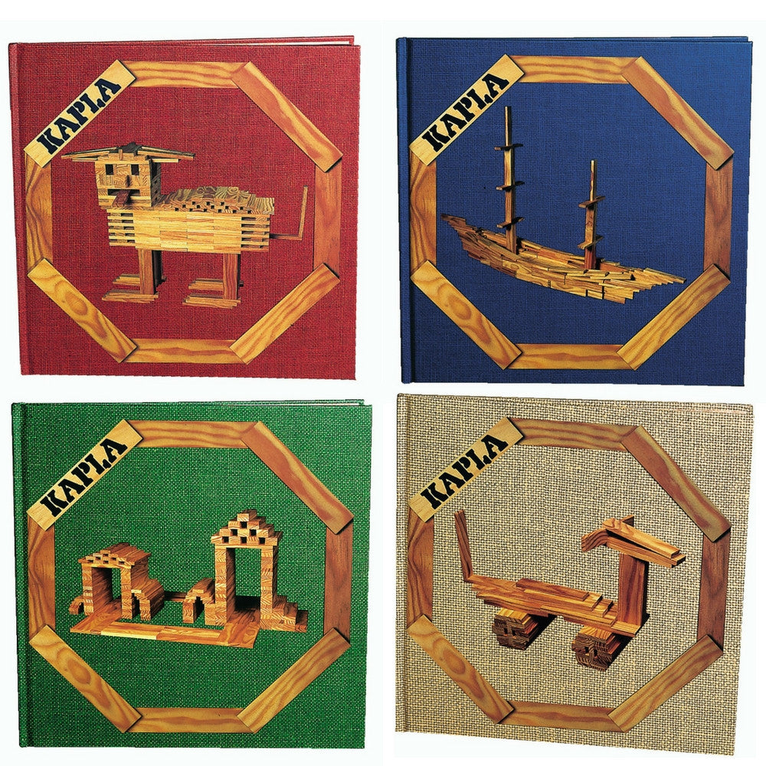
Green – architecture and structures
Easier themed architecture builds.
Age 3+ recommended
Beige – animals
Easier themed animal builds.
Age 3+ recommended
Red – for builders starting out
Two main themes – architecture and animals. Explore different construction styles.
Age 6+ recommended
Blue – for more experienced builders
Discover and explore different types of balance and building when creating more advanced models.
Age 9+ recommended

Slide 7
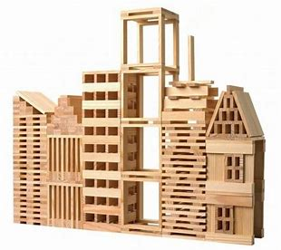
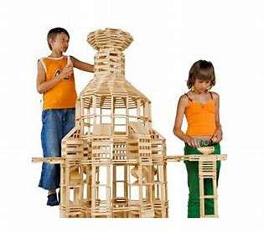
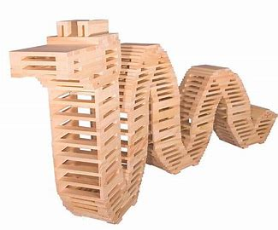
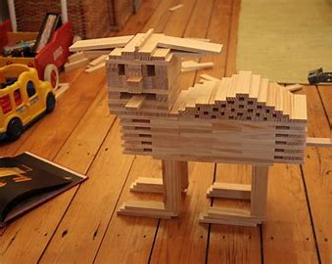
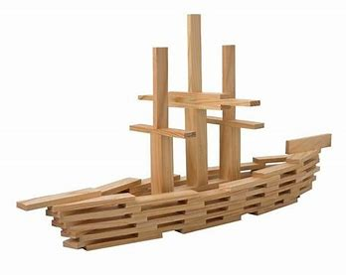
Opportunities are endless……
Kapla Amazing Wooden Toy Construction Sets - YouTube

Slide 9
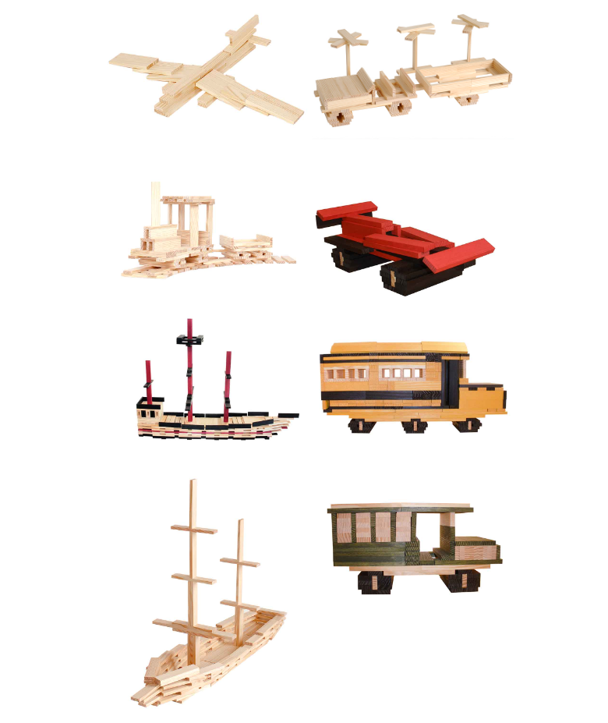

Slide 10
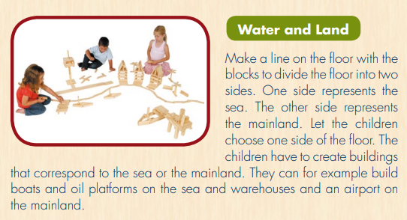

Slide 11
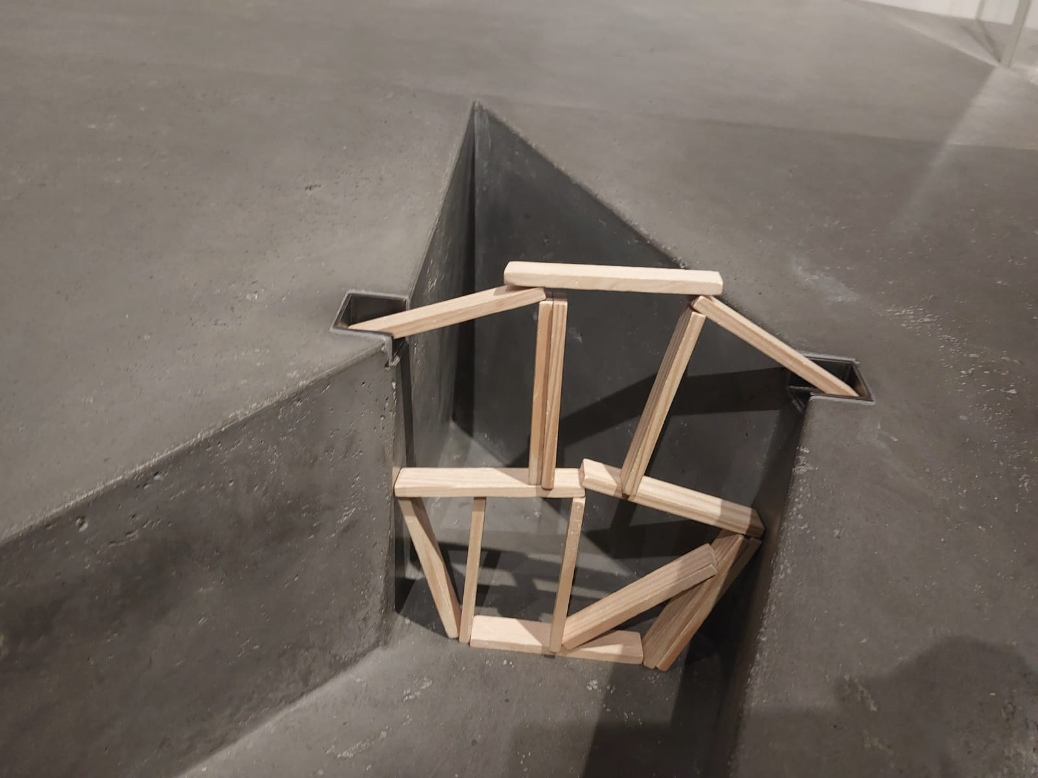
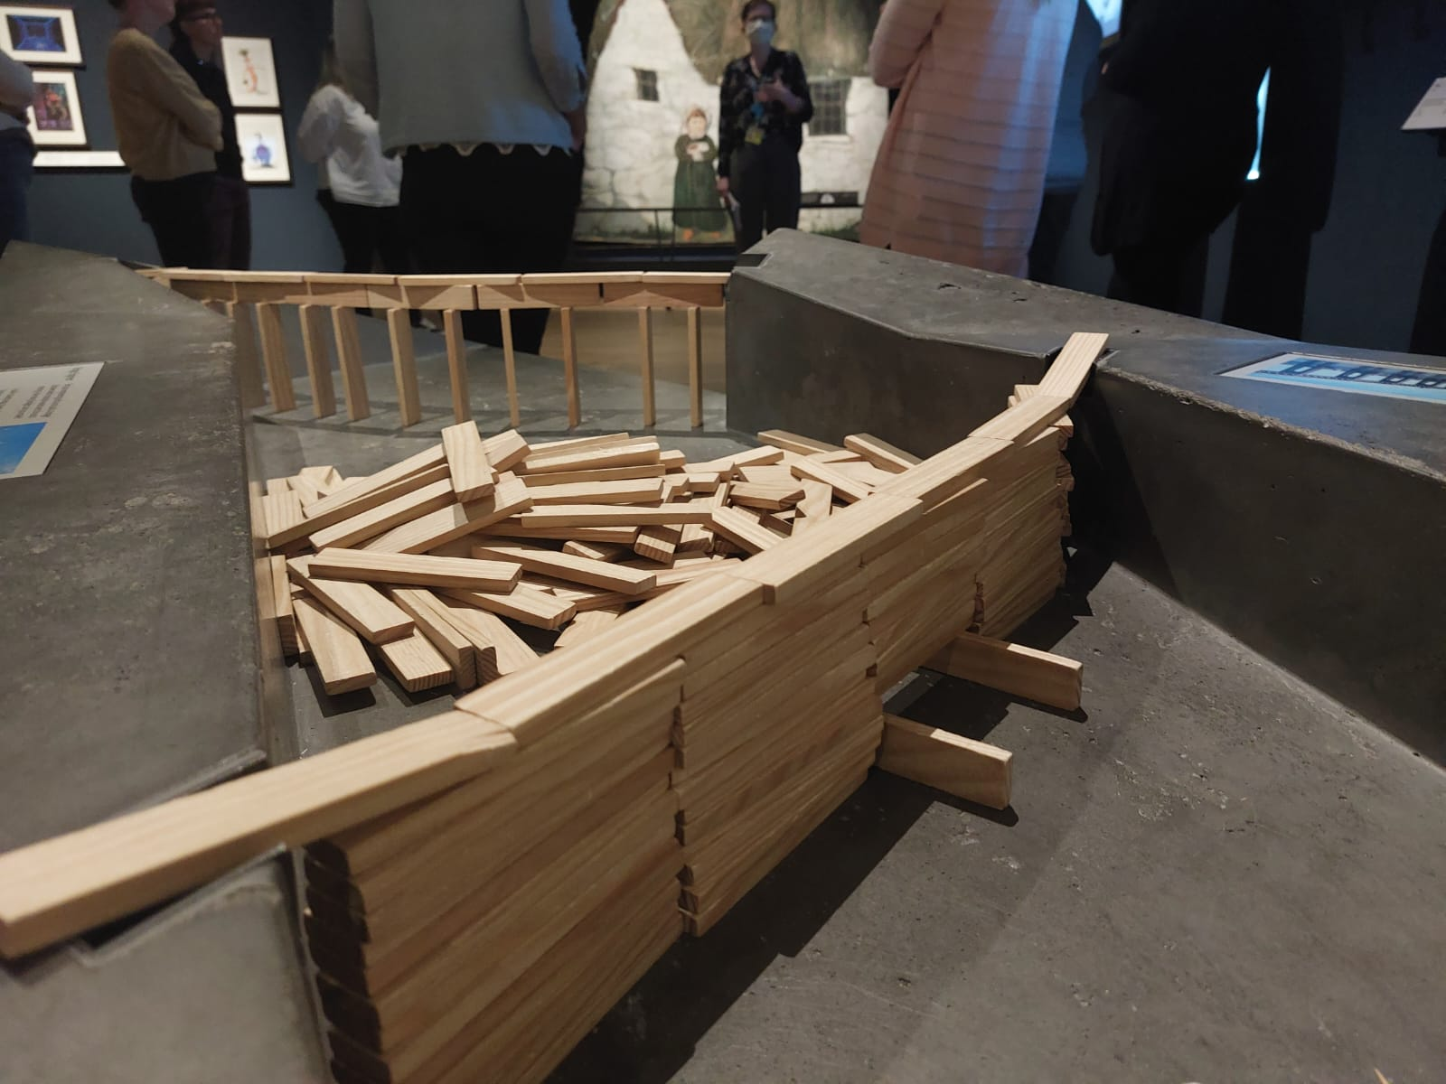
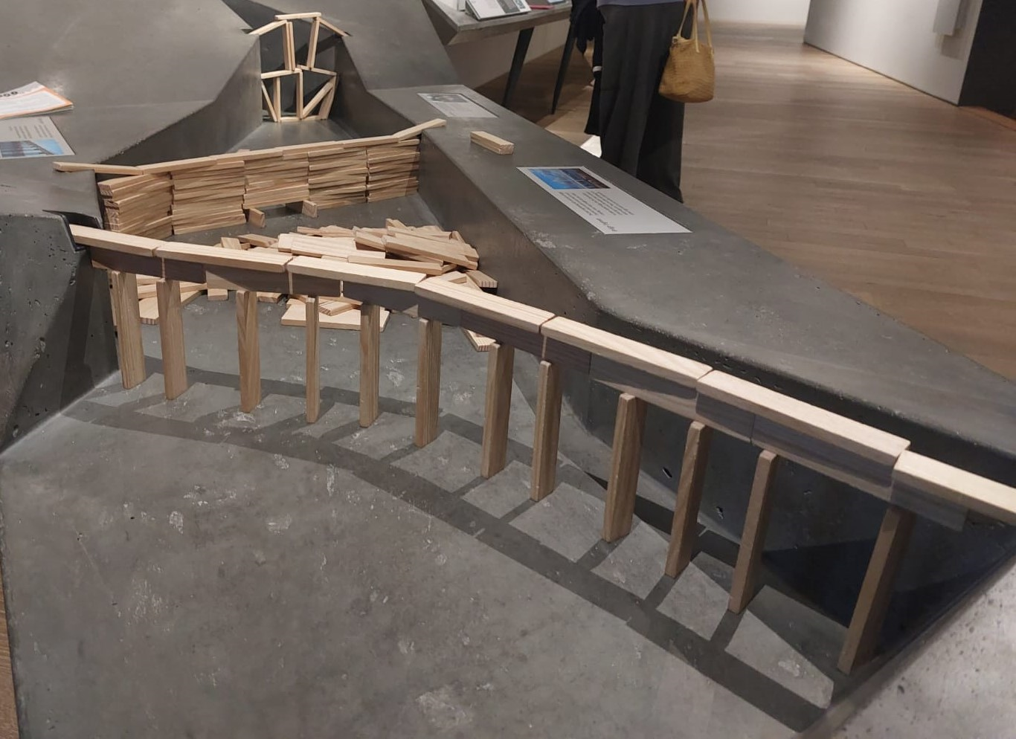
Bridges

Slide 12
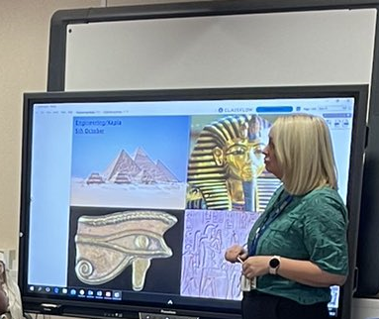
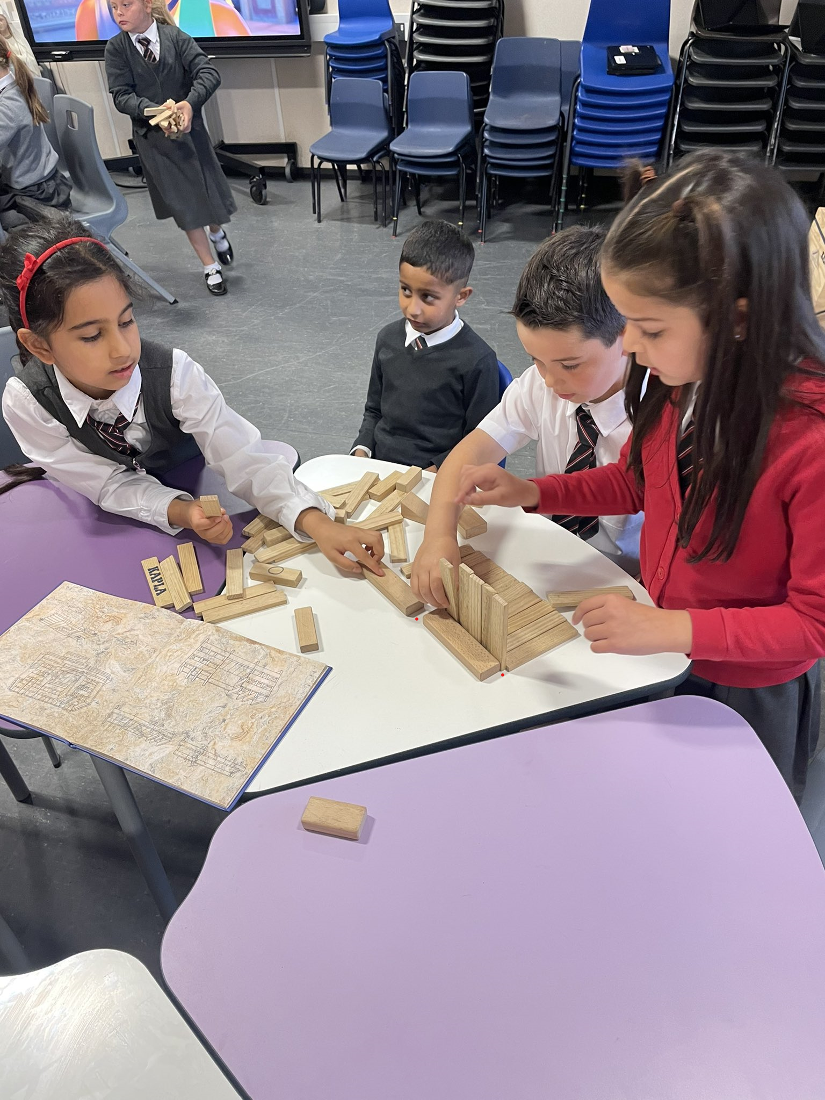
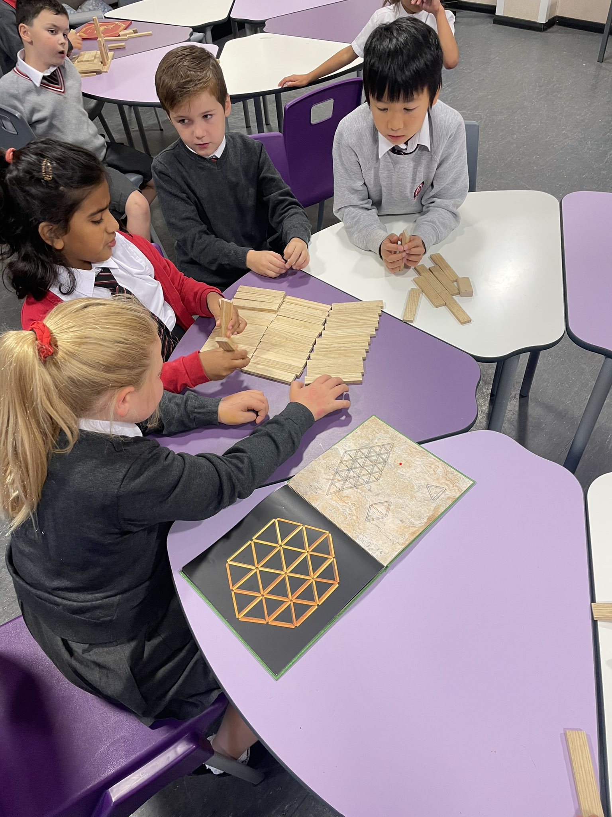
A Primary 3 class using KAPLA blocks to design and build an Ancient Egyptian pyramid or temple. They used the engineering design process, teamwork and communication skills.
Across the Curriculum

Slide 13
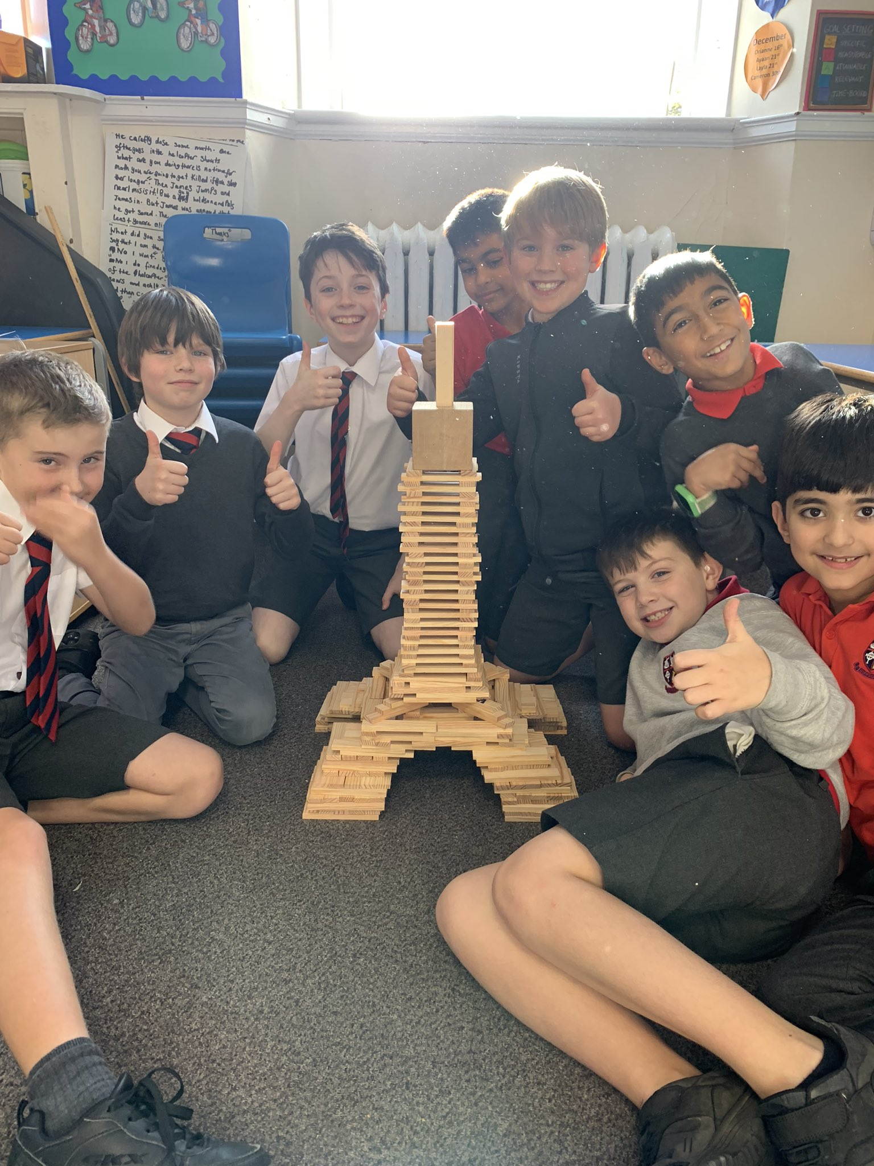
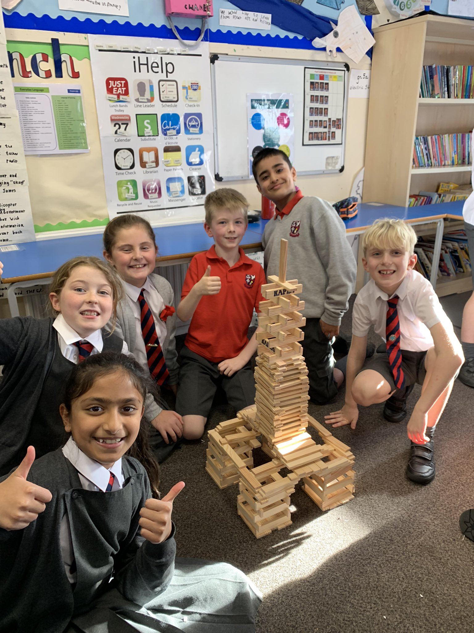
Can you build the Eiffel Tower?
Across the Curriculum

Slide 14
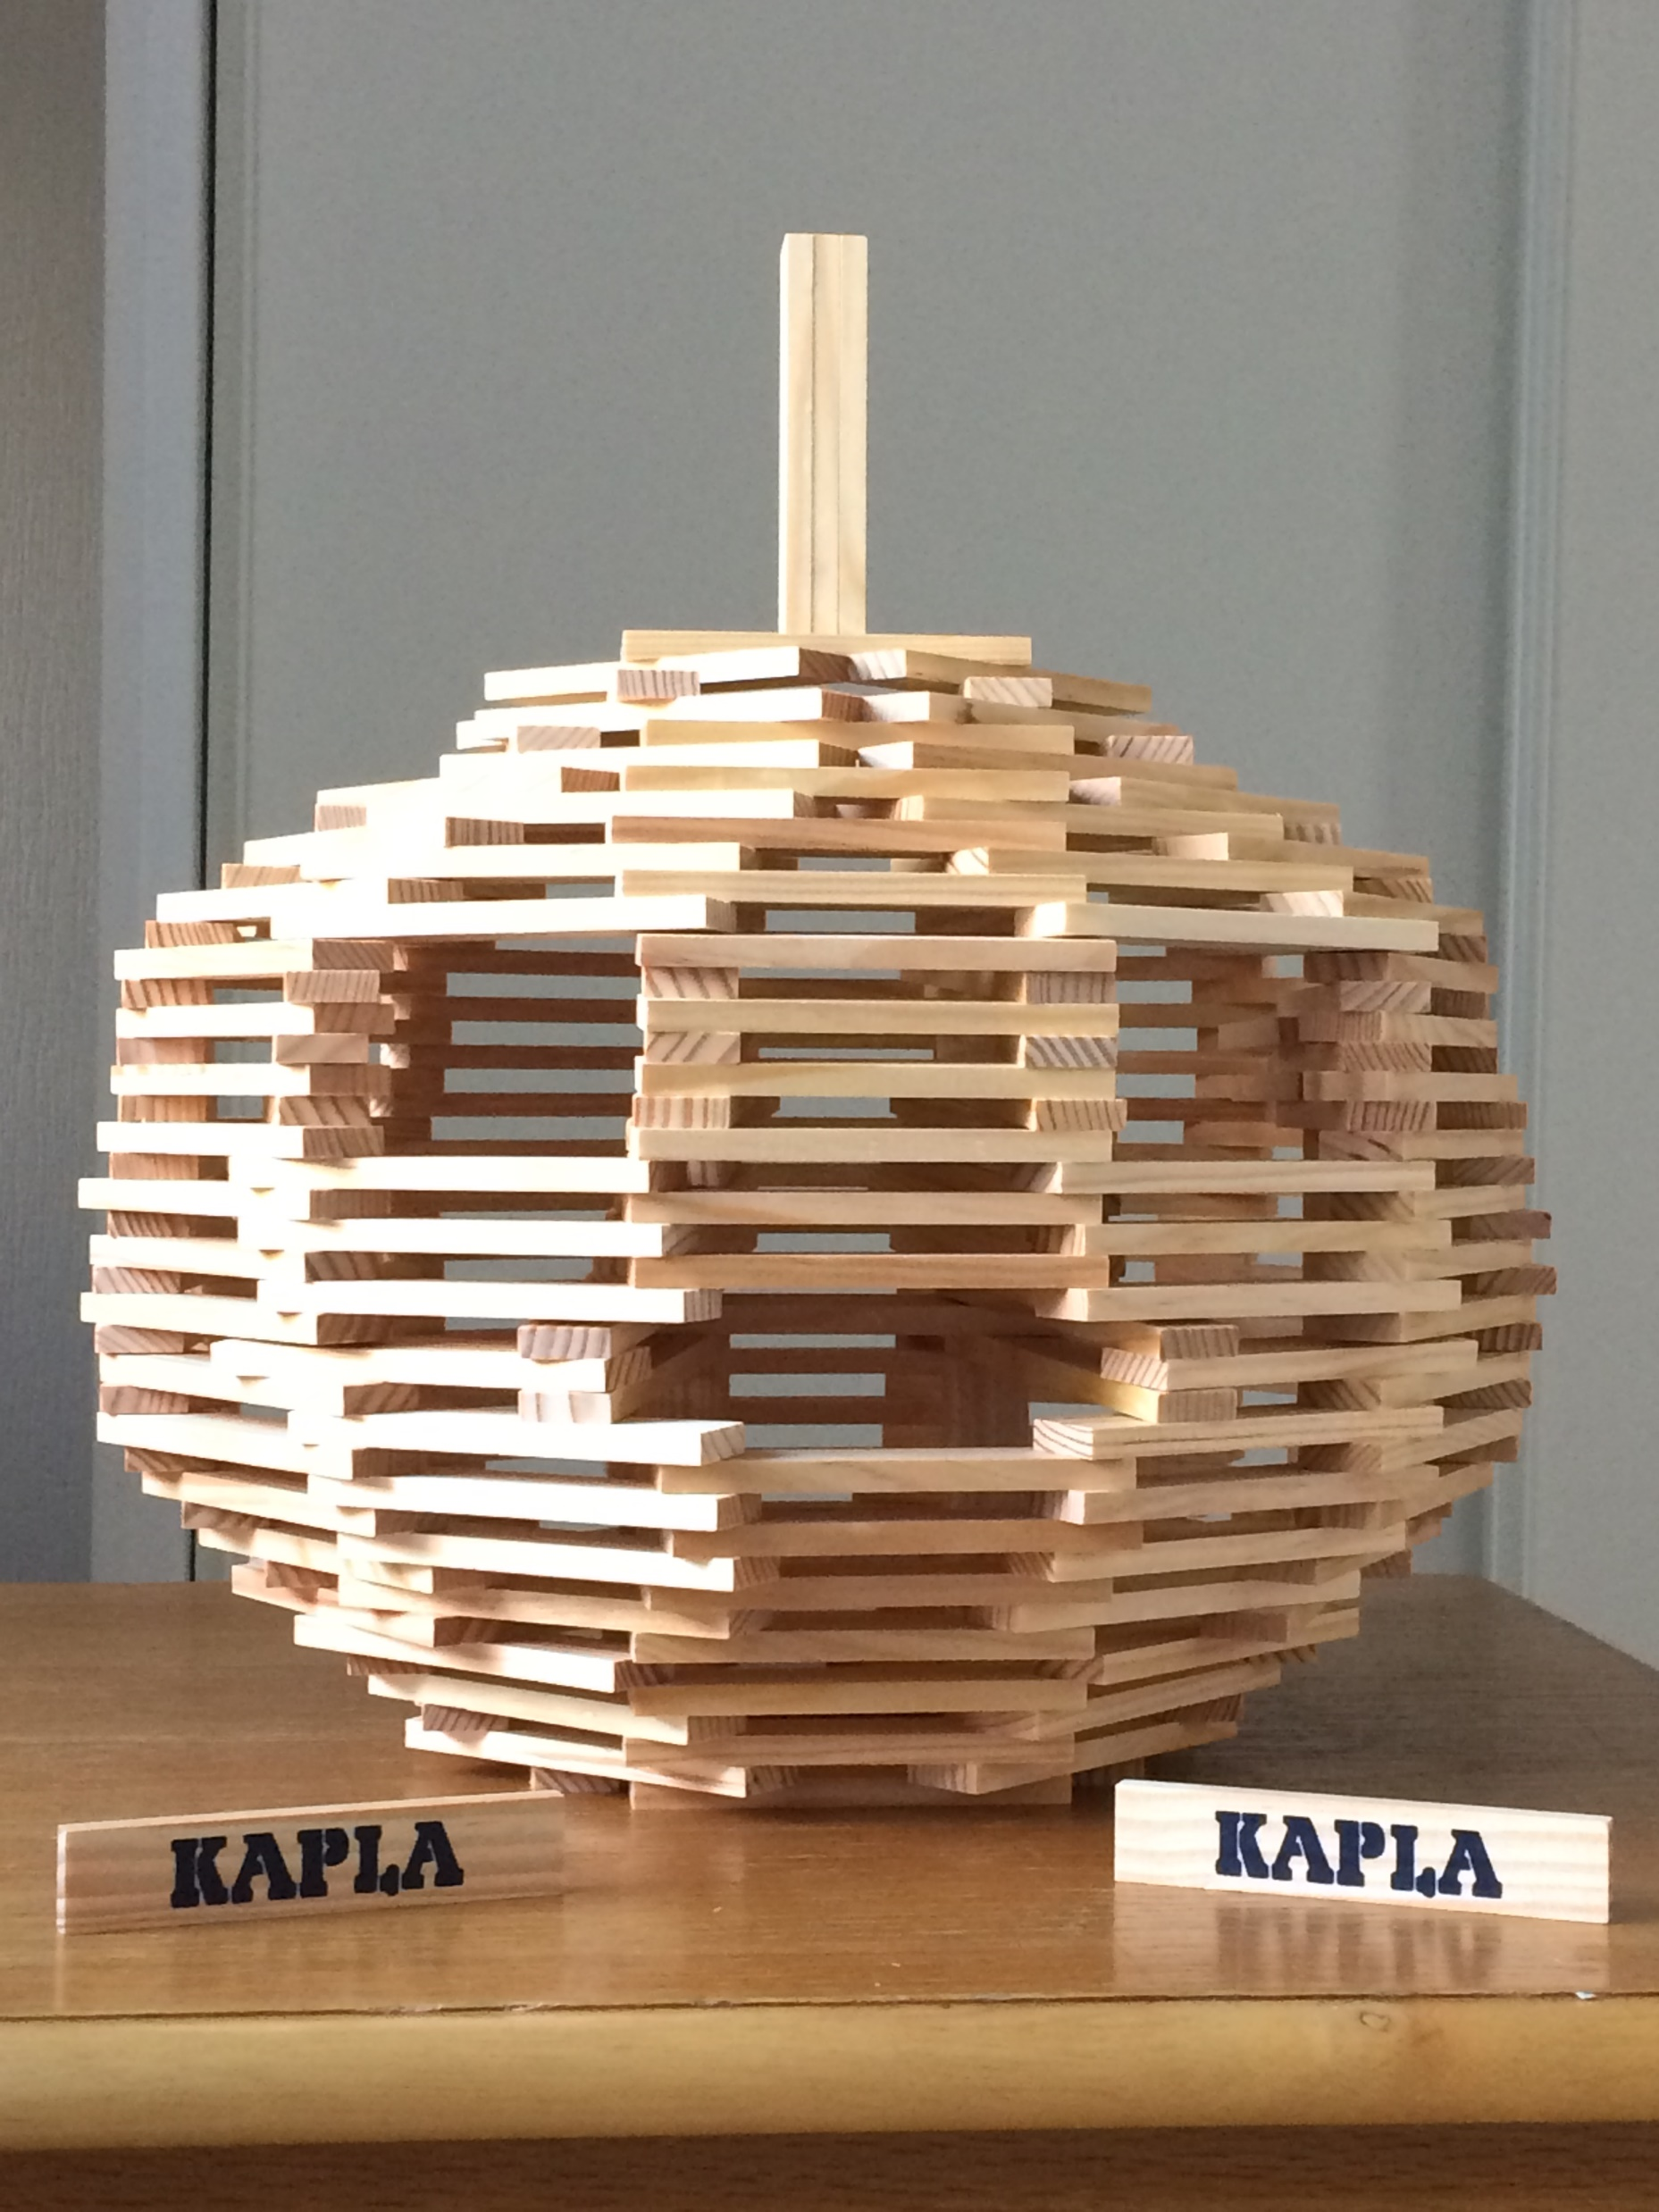
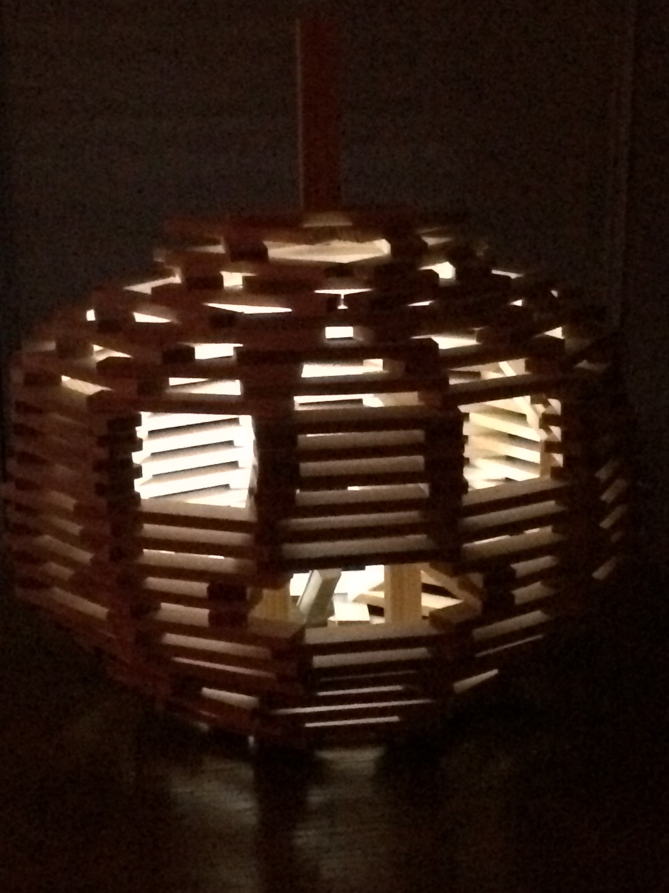
Link to seasonal topics: Halloween!
Across the Curriculum

Slide 15
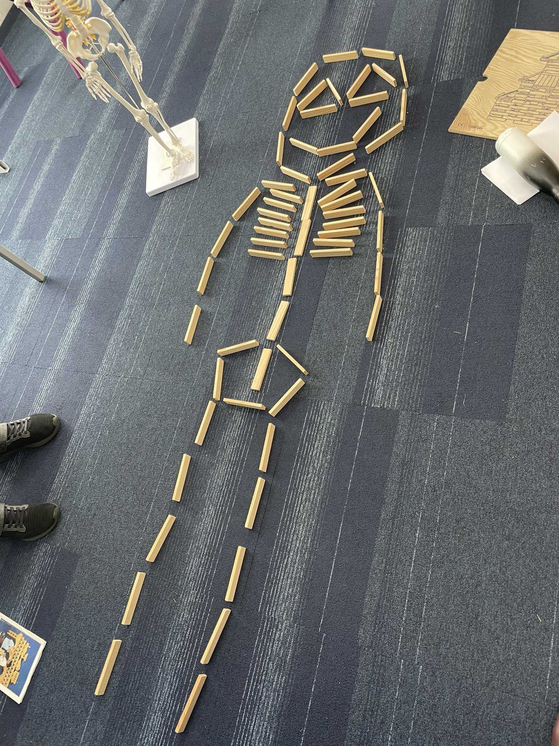
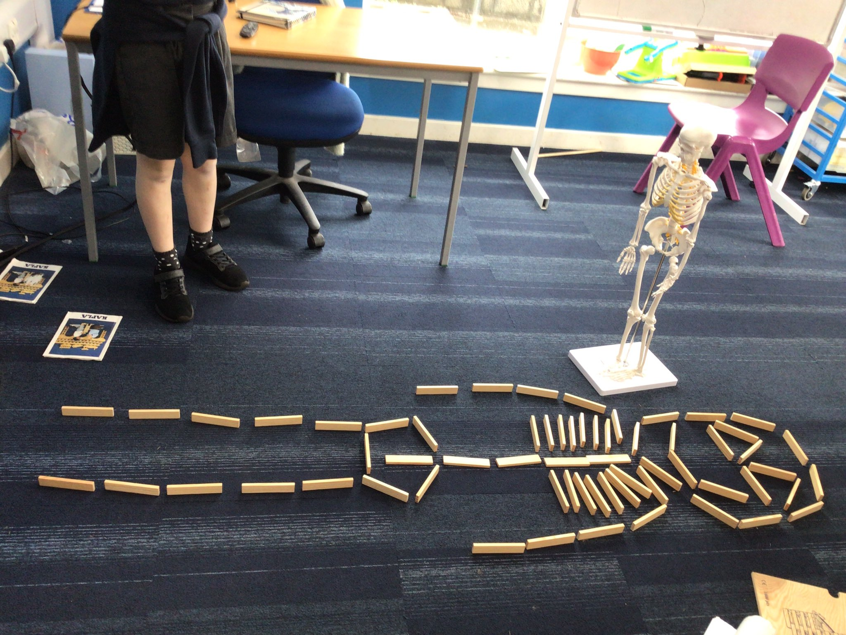
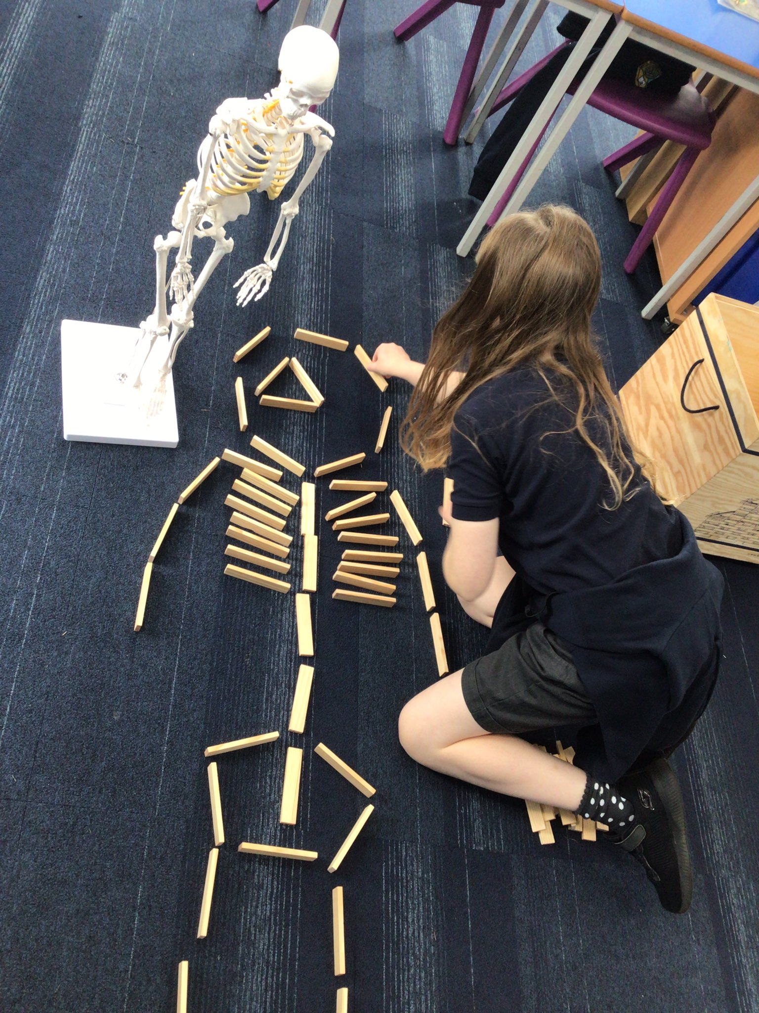
Across the Curriculum

Slide 16
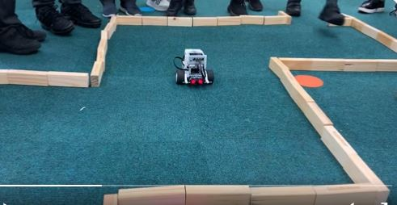
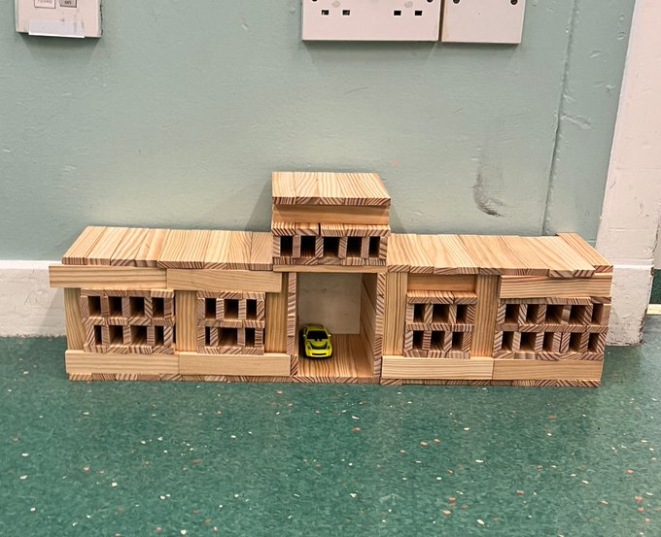
Across the Curriculum

Slide 17
Now it is your turn!
You have 20 minutes.
Working in teams of 4 try one or more of the following:
Build the tallest tower you can – you have 5 minutes!
Build the widest bridge that you can
Construct a bridge that spans a 50cm gap
Build something that is larger than the base it is built on
…….or just have fun! ☺

Slide 18
Next steps:
What ideas do you have for using this with the children?
Any comments/thoughts?
Any questions?

Slide 20
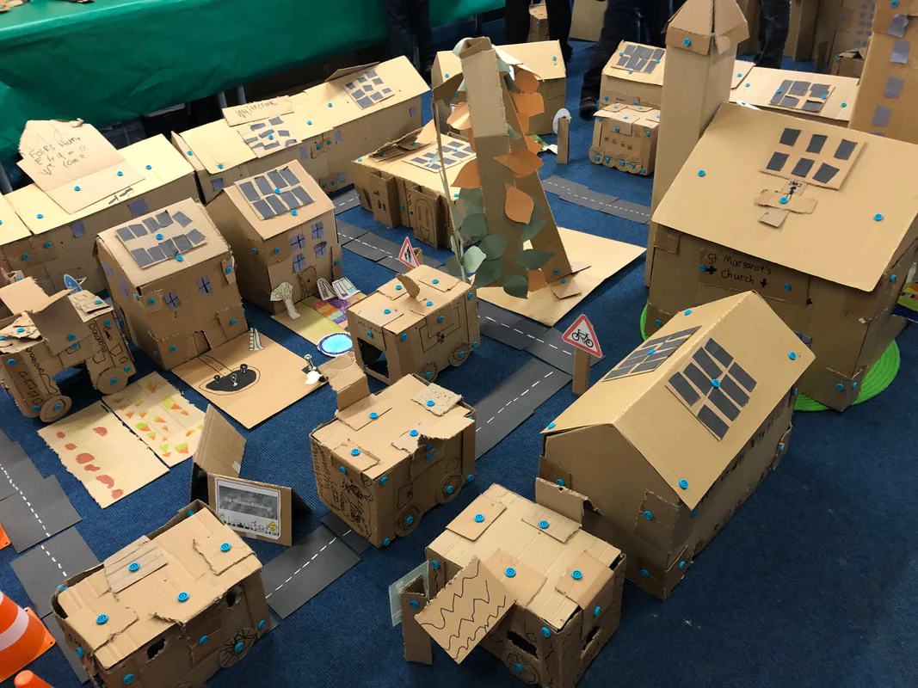
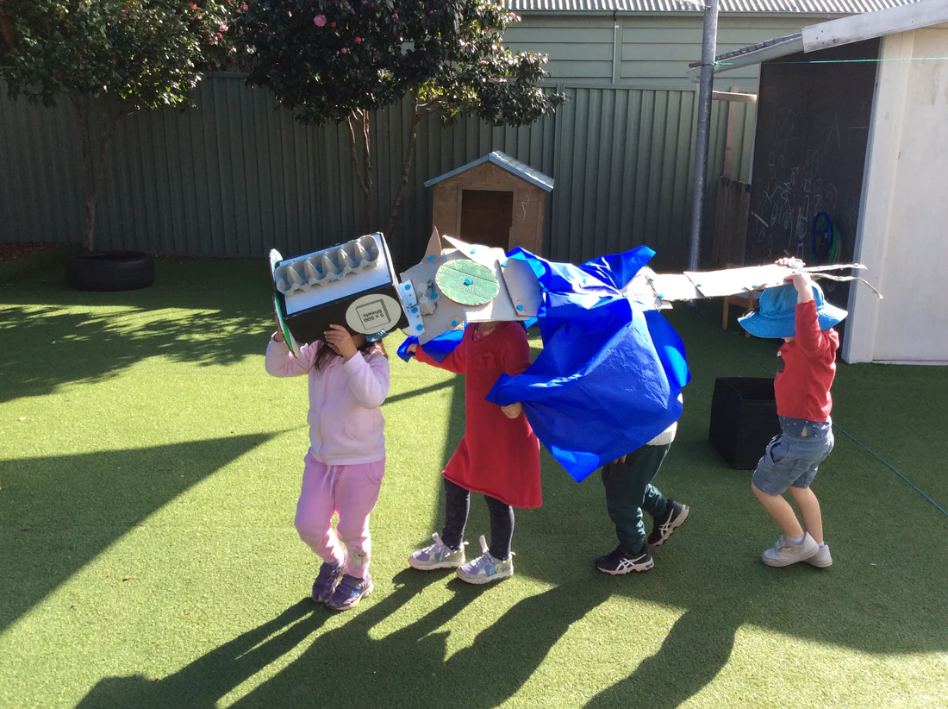
Makedo is a construction system with simple tools that allows children to create models out of cardboard
Cardboard as a building material is sustainable, fully recyclable and can be used again and again. It’s sturdy but pliable enough for small hands to manipulate, and versatile - cardboard can be folded, sawed through and hole-punched without it affecting its durability
Makedo can provide hands-on learning experiences that teach design, construction and problem solving
If fosters children’s imagination, creativity, resilience and perseverance
Makedo can be used across the curriculum and allows for differentiation

Slide 21
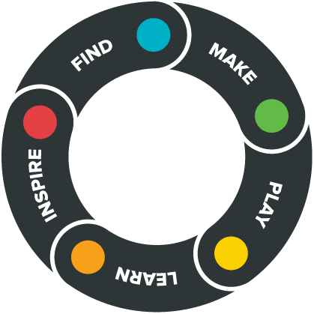
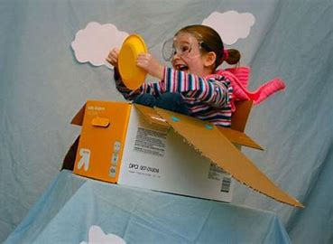
Make – designed for individuals and/or groups of all abilities. You can make something small to something big like a fort or
a maze
Find some cardboard – Makedo is an open ended construction system: the tools are safe and reusable and work with cardboard which is universally available
Play - creations made using Makedo allow immersive, creative and
open ended play
Learn - Makedo develops critical thinking and problem solving. It develops fine and gross motor skills. Children learn by being ‘hands-on’ from step to step making to inquiry projects
Inspire - and be inspired by other makers
Using Makedo, children learn by doing, creating and experimenting.

Slide 22
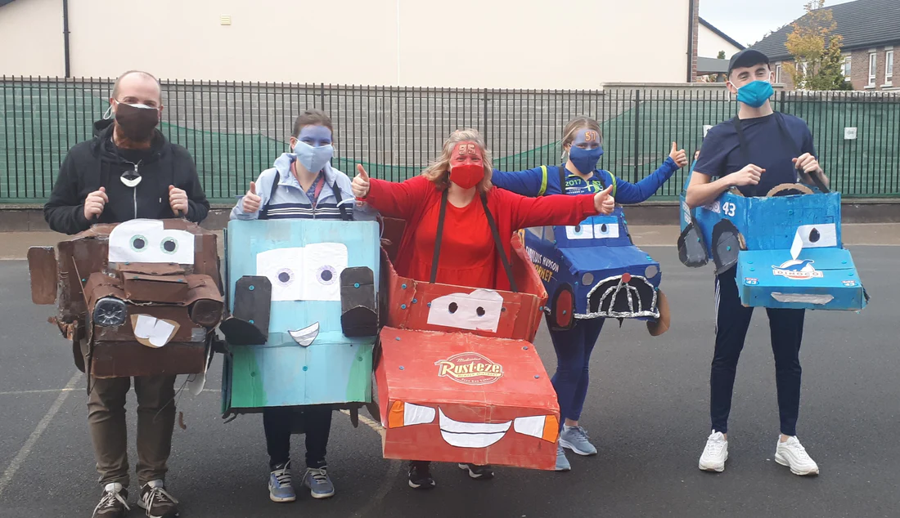
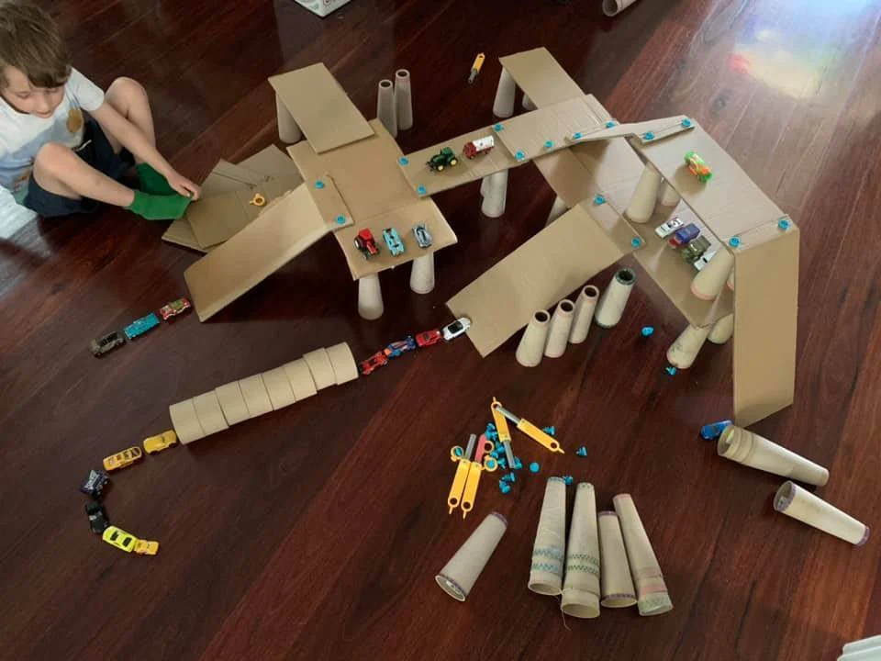
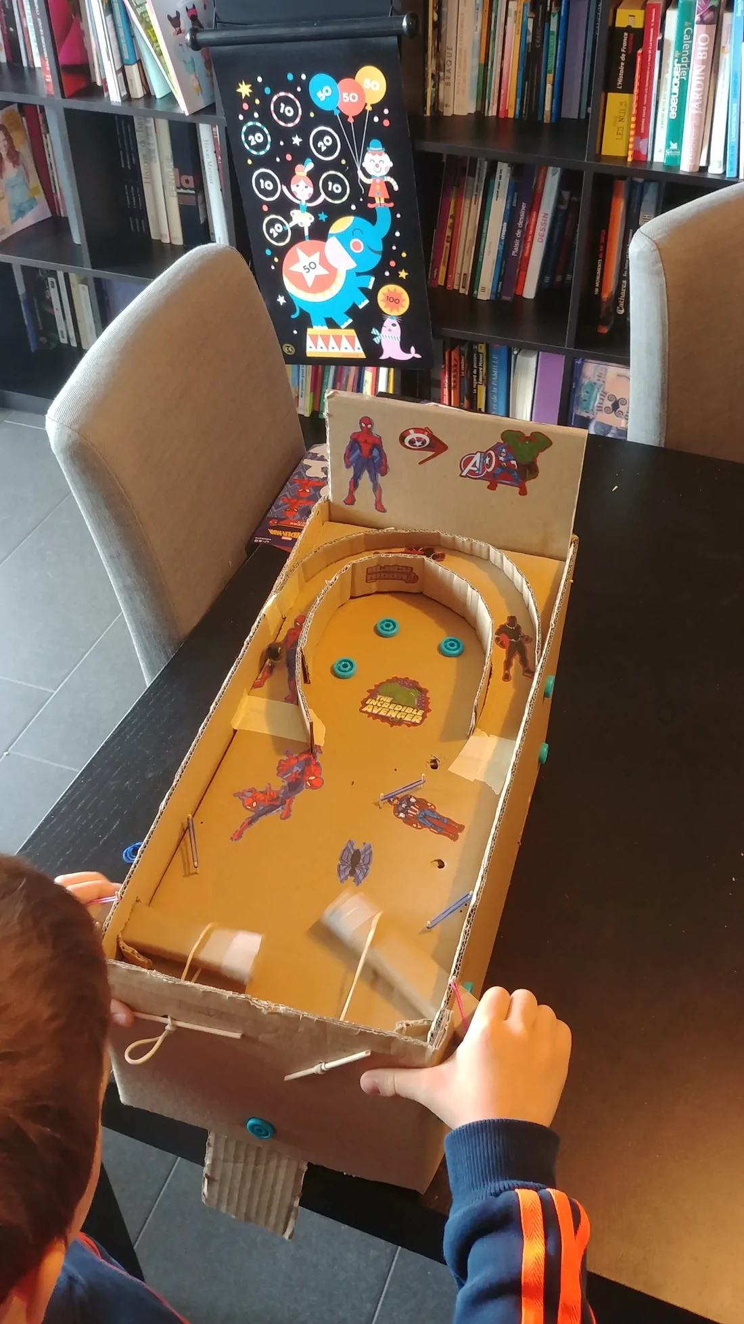
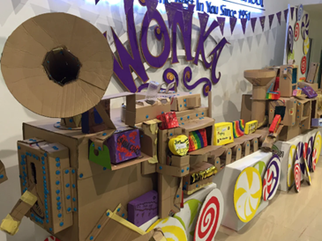
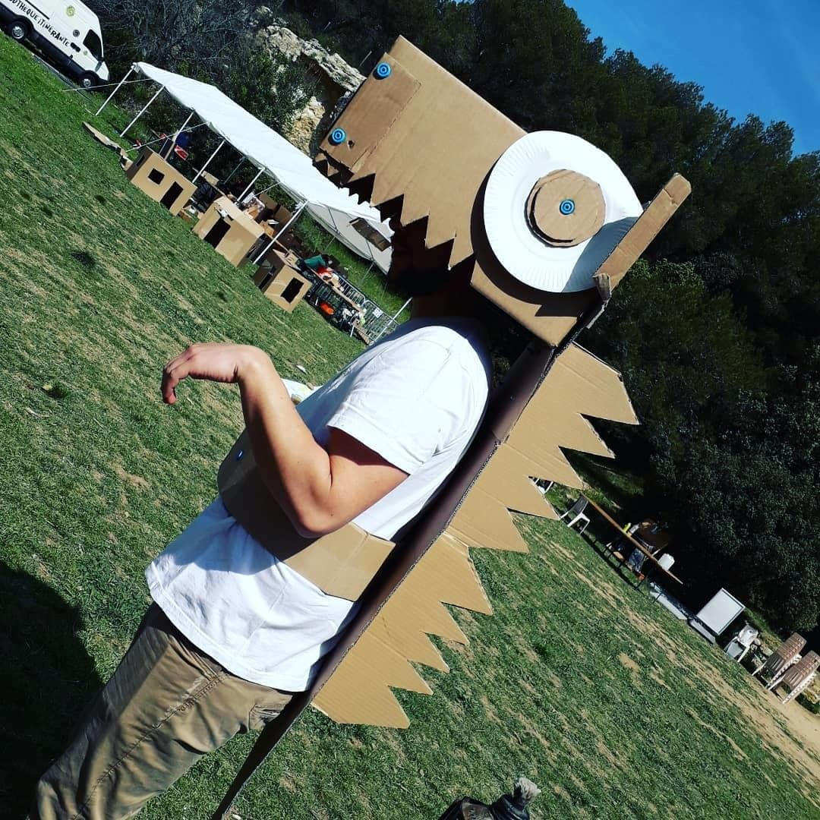
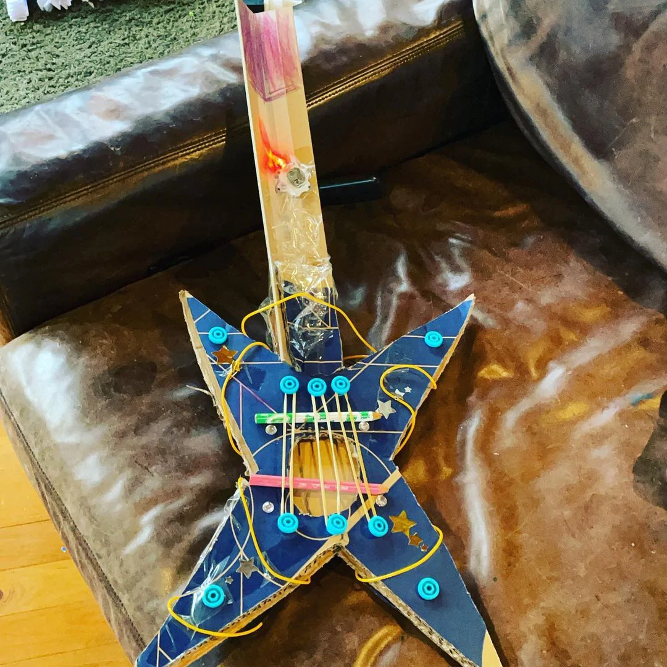
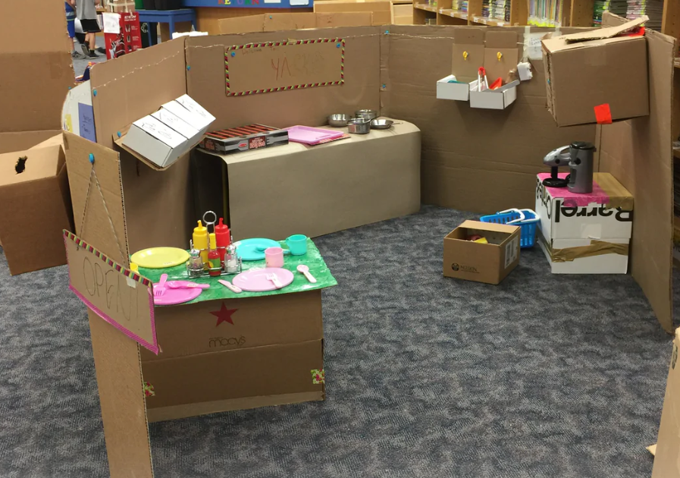
Opportunities are endless……
Makedo Cardboard Construction - YouTube

Slide 23
Makedo Education – make.do/pages/education
Introduction
The Ultimate Cardboard Construction STEAM Teaching and Learning Tool
Resources for Educators
How to use Makedo In Your Classroom
Cardboard As A Building Block
Sourcing Cardboard
Makedo and STEAM
Makedo and the Maker Movement
Join the Makedo Community!
Makedo Education Awards and Testimonials

Slide 24
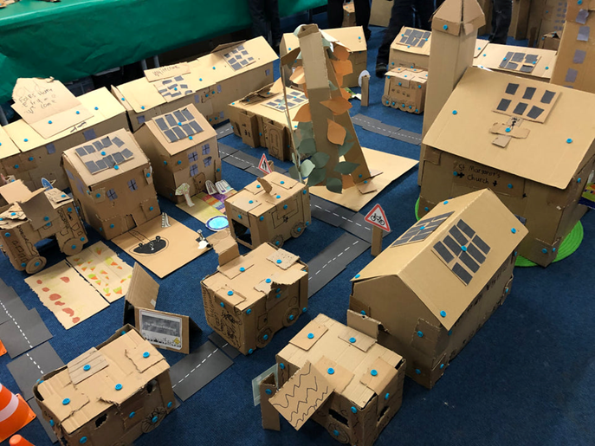
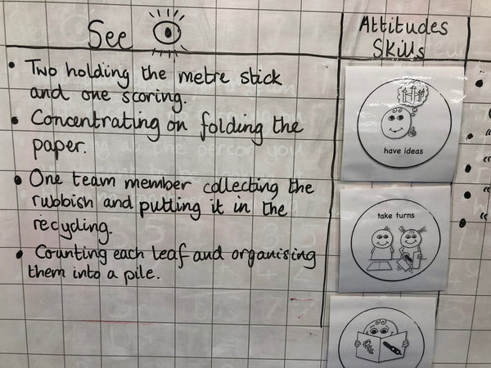
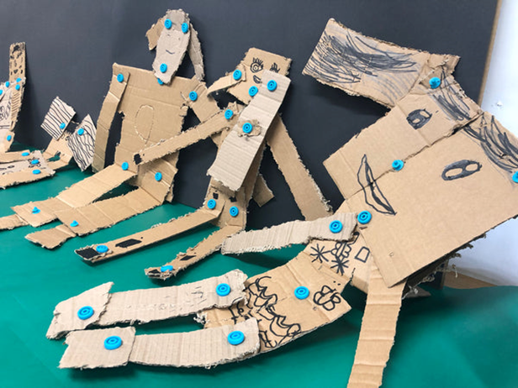
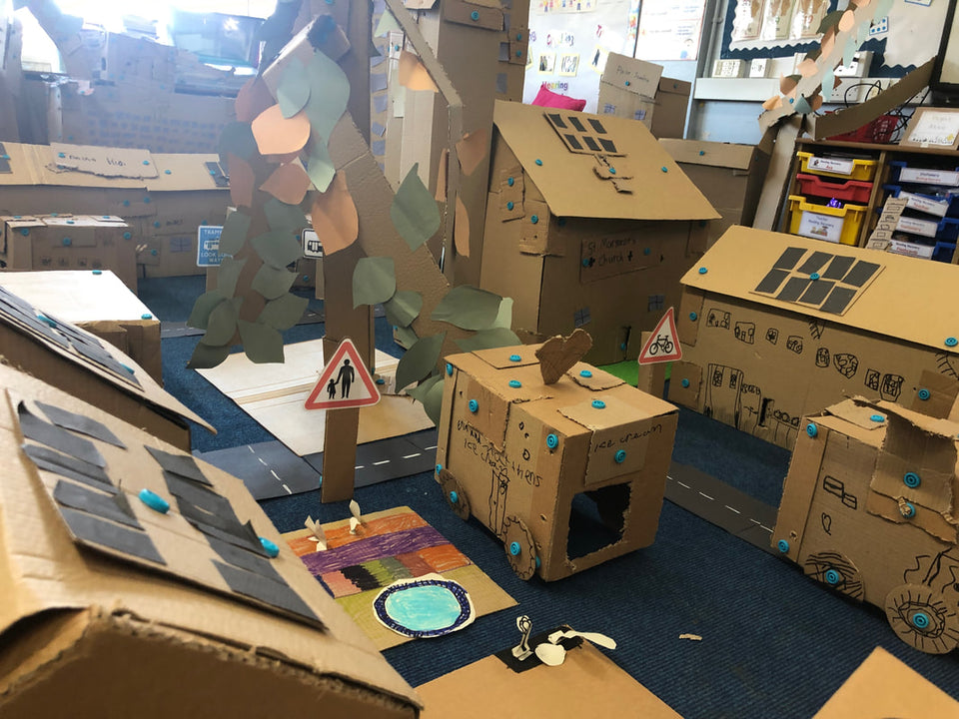
Classroom Snapshots: The Town That Takes Care Of The Planet
One of 'Single Steps Learning' recent projects, called ‘The Town That Takes Care of The Planet' was a collaboration with Our Holy Redeemer School, Clydebank, Scotland. Here, Primary 3 and 4 students designed and built either a prototype or a mini town with Makedo! In the process they learned about making a positive difference in their world.
Their extensive documentation, which you can check out in full detail on Single Steps, outlines the various stages of their project in which students were town planners and worked in engineering teams. With Makedo, they made citizens, vehicles, buildings and RENEWABLE ENERGY SOURCES. Single Steps Learning uses a ‘Think it, Try it, Fix it, Share it’ design process (see their thorough documentation). The project provided opportunities for students to develop a variety of positive attitudes and skills demonstrated through their reflection process like; have a go, keep on trying, listening, speaking, writing, using numbers and teamwork.
https://know.make.do/collections/classroom/products/snapshots-from-the-classroom-the-town-that-takes-care-of-the-planet-1

Slide 25
Engineering Habits of Mind and the Engineering Design Process

Slide 26
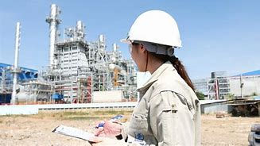
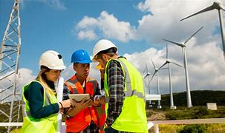
What is Engineering?
engineering (noun)
The branch of science and technology concerned with the design, building, and use of engines, machines, and structures.
engineering (verb)
Design and build.
Engineering is about making things work and making things work better.
(Almost) everything we own and use has involved engineering!

Slide 27
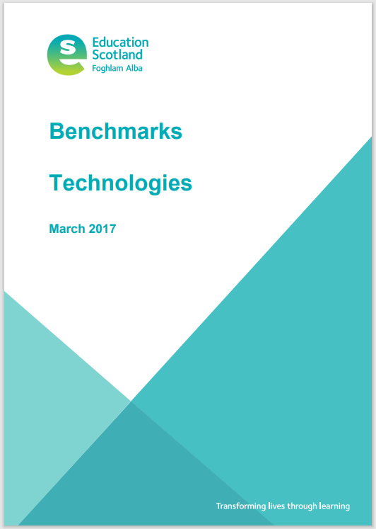
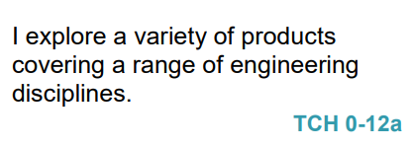
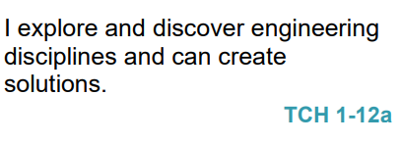
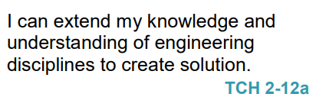
Engineering is part of the Curriculum for Excellence but information is limited
Recognises engineering in the world around them for example bridges, construction, electronics, computers.
Recognises and identify different engineering disciplines.
Builds a solution to a specific task, which has moving parts.
Understands the difference between different engineering disciplines
Understands different energy types.
Builds/simulates solutions to engineering problems.

Slide 28
Engineering Disciplines/Engineering Across the Curriculum
Civil – infrastructure, roads, houses, bridges
SOC: People, Place and Environment
TCH: Exploring Uses of Materials, Design and Construct Models
SCI: Forces, Materials
MNU: Measure
EXA: creating objects for specific tasks/solutions to a design problem.
Mechanical – engines, machines, moving parts
TCH: Design and Construct Models
SCI: Forces
MNU: Measure
EXA: creating objects for specific tasks/solutions to a design problem.
Electrical – application of electricity and electronics
SCI: Electricity
Software – computer programming and computational thinking
TCH: Computing Science
MNU: Shape Position & Movement, Chance and Uncertainty
EXA: creating solutions to a design problem.
Other engineering disciplines: Aerospace, Chemical, Biomedical, Biological, Nuclear, Industrial, Agricultural, Structural, Environmental…
HWB: Career education

Slide 29
So…. how can we encourage pupils to think like and act like engineers and develop the associated skills?
“Skills development is integrated into the Benchmarks to support greater shared understanding.”
(National Improvement Framework, Education Scotland, 2017)
“effective assessment…supports greater breadth and depth of learning and a greater focus on skills development.”
(Education Scotland, Building the Curriculum 5, 2011)
Answer: by teaching the children to use the ‘Engineering Design Process’

Slide 30
The Engineering Design Process
ASK: Students identify the problem, requirements that must be met, and constraints that must be considered.
IMAGINE: Students brainstorm solutions and research ideas. They also identify what others have done.
PLAN: Students choose two to three of the best ideas from their brainstormed list and sketch possible designs, ultimately choosing a single design to prototype.
CREATE: Students build a working model, or prototype, that aligns with design requirements and that is within design constraints.
TEST: Students evaluate the solution through testing; they collect and analyse data; they summarise strengths and weaknesses of their design that were revealed during testing.
IMPROVE: Based on the results of their tests, students make improvements on their design. They also identify changes they will make and justify their revisions.
THIS PROCESS IS A CYCLE – NOT LINEAR

Slide 31
Engineering Habits of Mind
Developed by The Royal Academy of Engineering to outline the skills and attributes employed by Engineers across disciplines.
Systems Thinking – Smaller parts coming together to make a whole.
Problem Finding – Finding problems, deciding how to fix them and checking existing solutions.
Visualising – Thinking about how the final product will look.
Creative Problem Solving – Working together to create solutions to problems.
Improving – Making things better.
Adapting – Applying things in a new context.

Slide 32
When the Engineering Habits of Mind are used along side the design process, they can be used to develop pupils’ STEM skills and skills that can be used across the curriculum.

Slide 33
Ask
Imagine
Plan
Create
Test
Improve
Do we give children the time and space to…
Ask questions
Imagine and share ideas
Plan their solution
Create their solution
Test their solution
Improve their design
…and repeat the process?

Slide 34
tools
Scru-driver
Scru: connects up to 3 layers of cardboard
Scru+: connects up to 6 layers of cardboard
Mini-tool
Safe-saw
Fold-roller

Slide 35
Using the engineering design process, your team brief is to design a model with a moving part
ASK: What is the problem, the requirements and constraints?
Problem: design and build a model with a moving part
Constraints: you must use the cardboard boxes
IMAGINE: Brainstorm solutions and research ideas
PLAN: Choose two/three of the best ideas from the brainstormed list and sketch possible designs, then choose a single design to prototype
CREATE: Build the model/prototype
TEST: Evaluate and testing identifying strengths and weaknesses of the design
IMPROVE: Based on the test, make improvements to the design, identify changes and justify the revisions.

Slide 36
Next steps:
What ideas do you have for using this with the children?
Any comments/thoughts?
Any questions?
Contact details:
kim.aplin@aberdeenshire.gov.uk
caroline.nicol2@aberdeenshire.gov.uk
Twitter : @AbshireSTEM

Slide 38
Please could you complete the Aberdeenshire RAiSE Mid-Point Survey Questionnaire?
Thank you! ☺

