Slide 2
CLASSIFICATION AND ADAPTATION
FIRST LEVEL (SCN 1-01a)

Slide 3
Curriculum for Excellence
Planet Earth Biodiversity and interdependence
‘Learners explore the rich and changing diversity of living things and develop their understanding of how organisms are interrelated at local and global levels. By exploring interactions and energy flow between plants and animals (including humans) learners develop their understanding of how species depend on one another and on the environment for survival. Learners investigate the factors affecting plant growth and develop their understanding of the positive and negative impact of the human population on the environment’

Slide 4
What is ‘biodiversity’?
Biodiversity is all the different kinds of life you’ll find in one area—animals, plants, fungi, and even microorganisms like bacteria that make up our natural world. Each of these work together in ecosystems, like an intricate web, to maintain balance and support life. Biodiversity supports everything in nature that we need to survive: food, clean water, medicine, and shelter.

Slide 5
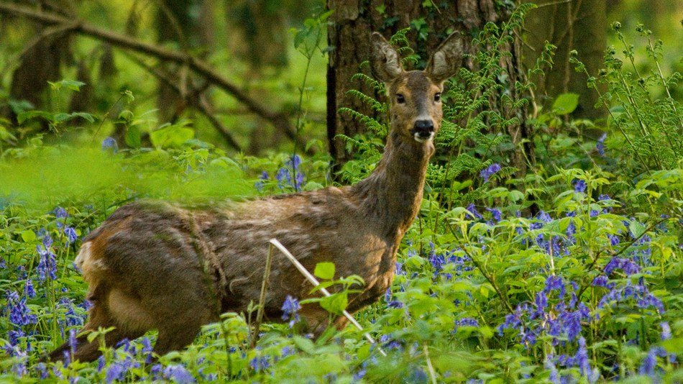
What is biodiversity?
What is biodiversity? | David Attenborough: A Life On Our Planet - YouTube

Slide 6
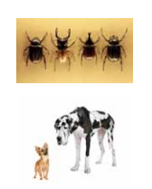
What is a ‘species’?
‘Species’ is the word used to describe a group of living things that can reproduce. An example of a species is ‘humans’ or ‘lions’.
Members of the same species look and act similarly; all dogs are one species but you would be forgiven for thinking that a Chihuahua and Great Dane were not that related!
Sometimes members of the same species are hard to tell apart; there are 350,000 species of Beetle which we might find very hard to tell apart!

Slide 7
What is an ‘ecosystem’?
An ecosystem is the way that living things work together in their surroundings. An example of an ecosystem is a rainforest.
Eco is the word we use when we are talking about the living things in the environment. So an ecosystem is a collection of living things in one place that work together. The parts of an ecosystem might be water, soil, plants, animals etc.
An ecosystem is changed if you take one part away and won’t work in the same way as it did before which is why we are concerned about extinction of animals and damage to their habitats.

Slide 8
I have observed living things in the environment over time and am becoming aware of how they depend on each other. SCN 0-01a
Benchmarks:
Explores and sorts objects as living, non-living or once living.
Describes characteristics of livings things and how they depend on each other, for example, animals which depend on plants for food.
I can distinguish between living and non living things. I can sort living things into groups and explain my decisions.
SCN 1-01a
Benchmarks:
Explains the difference between living and non-living things, taking into consideration movement, reproduction, sensitivity, growth, excretion and feeding.
Creates criteria for sorting living things and justifies decisions.
Sorts living things into plant, animal and other groups using a variety of features.
I can identify and classify examples of living things, past and present, to help me appreciate their diversity. I can relate physical and behavioural characteristics to their survival or extinction. SCN 2-01a
Benchmarks:
Classifies living things into plants (flowering and non-flowering), animals (vertebrates and invertebrates) and other groups through knowledge of their characteristics.
Begins to construct and use simple branched keys which can be used to identify particular plants or animals.
Identifies characteristics of living things and their environment which have contributed to the survival or extinction of a species. ·
Describes how some plants and animals have adapted to their environment, for example, for drought or by using flight.

Slide 9
First Level
I can distinguish between living and non living things. I can sort living things into groups and explain my decisions. SCN 1-01a
Activity: Living, non-living and once living
(This activity revisits/recaps what the children learned at Early Level: ‘living things', things that are ‘non-living’ and things that were ‘once living’).
Discuss with the children what the expression “living” means. Discuss what “non-living” means, encouraging children’s ideas and helping them differentiate between “non-living” and “dead”. Encourage them to give as many examples of living/non-living things as they can.
Extend the discussion by describing “non-living” things made from materials which were once living, for example wooden furniture (from trees) or bread (from wheat).
The children make a list of living things, and non-living things, initially using examples from their immediate environment, but progressively including examples from their wider environment. They could create their own Living/Non-living/Once Living books including their own drawings, photographs that they have taken and images that they have cut out from magazines and catalogues
IDL opportunity: Extend this activity to include Literacy and Art and Design with the children creating a display and making up a quiz for younger children:
Learning for sustainability, living and non-living things – first level | Interdisciplinary learning activities | Resources for practitioners | Scotland Learns | National Improvement Hub (education.gov.scot)

Slide 10
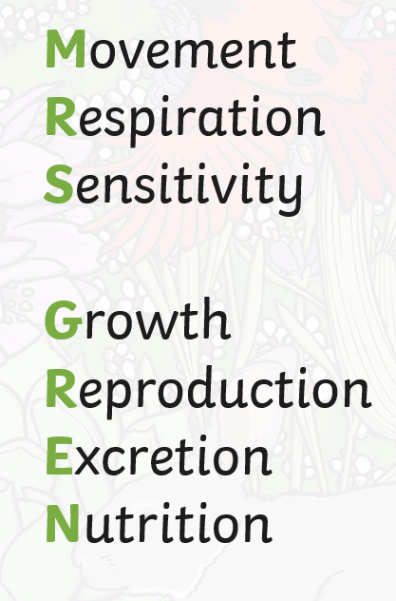
First Level
I can distinguish between living and non living things. I can sort living things into groups and explain my decisions. SCN 1-01a
Living vs Non Living
How do we know something is alive?
Characteristics of living things - 1st level Science - BBC Bitesize
Ask the children to think about what things living things do.
There are 7 ways in which living things such as plants and animals are different from non living things .
These are called the 7 life processes of life and these can be remembered by remembering MRS GREN
Ask the children if plants are living things and get them to list examples to justify their answer.
Plants are living things - BBC Teach

Slide 11
The seven processes of life:
Movement – e.g. animals move to get from place to place, plants turn towards the light (think about how a flower will open up towards sunlight)
Respiration – all living things respire. Plants and animals use oxygen in the air to turn food into energy
Sensitivity – living things notice changes in their environment around them and react to the place they are in. e.g. if a plant is in a dark place, it will try to grow towards the light
Growth – e.g. baby animals grow into adults and seeds grow into plants
Reproduction – living things make more of their own type –e.g. humans and other animals have babies, birds will lay eggs and new plants grow from seeds
Excretion – e.g. get rid of waste – like when humans go to the toilet and both plants and animals get rid of waste water and gas
Nutrition - food is used to provide energy to live. Green plants make their own food using sunlight
https://twitter.com/fastworkers6/status/1578081947070660608?t=vopxisO-gzPdUamEtBmXmA&s=19

Slide 12
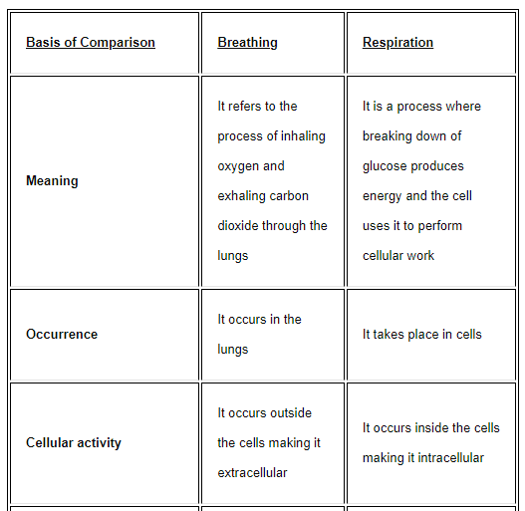

Slide 13
Activity: Sorting
Provide objects and /or pictures and ask the children to sort them into ‘Living’, ‘Non-Living’ (manmade) and ‘Once Living’. Include some items such as paper, a wooden spoon, chocolate, cotton fabric, coal, jam: these are all things that were once part of a living thing.
The children should think about MRS GREN to decide whether something is living or not then review how they have sorted the items/pictures and explain to a partner how they know if something is alive.
Or:
Provide objects/pictures already grouped (‘Living’, ‘Non- Living’ (manmade) and ‘Once Living’) and ask the children if they can work out what each group is.
living+and+non-living+for+kids - Google Search

Slide 14
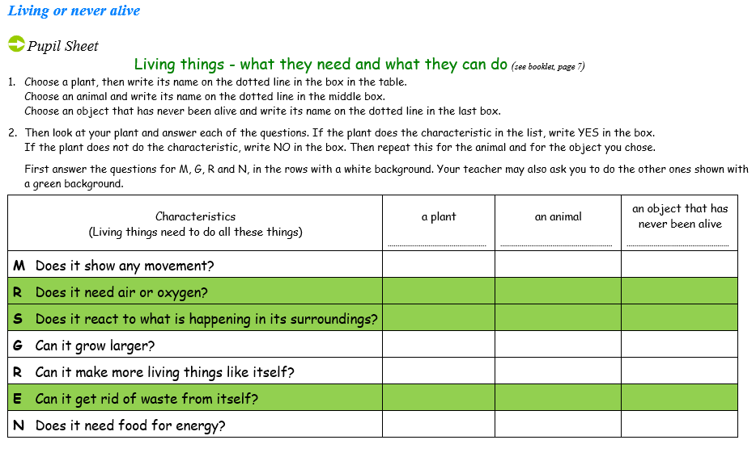
Activity taken from ‘Science & Plants for Schools’: Primary Booklet 5 - Grouping and Classification (saps.org.uk)

Slide 15
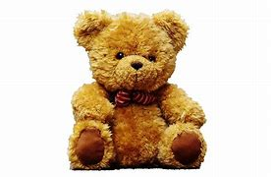
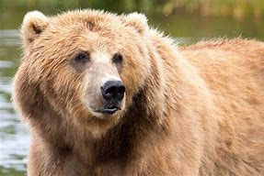
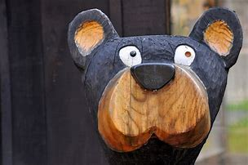
Activity: Which one am I?
Living, Non-Living or Once Living?

Slide 16
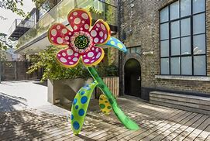
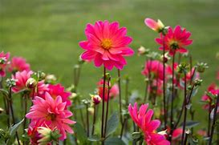
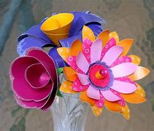
Which one am I?
Living, Non-Living or Once Living?

Slide 17
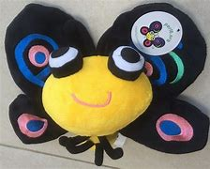
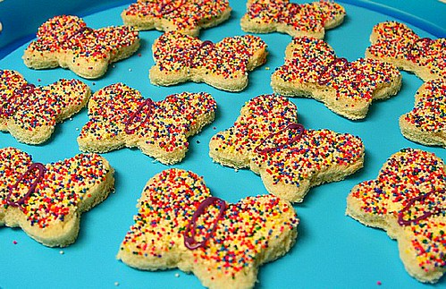
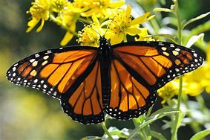
Which one am I?
Living, Non-Living or Once Living?

Slide 18
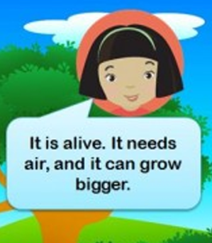
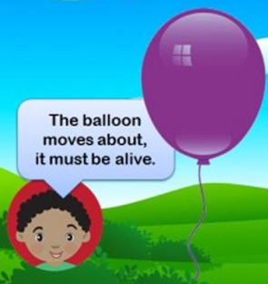
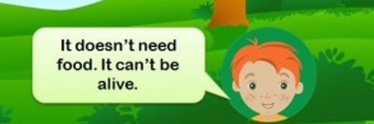
Challenge: Is a balloon living?
What do you think?

Slide 19
Challenge: Is a balloon living?
What do you think?
Although many non-living things show some signs of life, no non-living thing can do everything that living things can do. A balloon, for example, can grow, (but it grows only when it is filled by air that is put in it by someone; it does not grow by itself), and moves with the wind, but it cannot eat food or carry out respiration. A balloon is a non living thing but is made of latex which is from plants so it was ‘once living’ How are balloons made? - Fun Kids - the UK's children's radio station (funkidslive.com)

Slide 20
I can distinguish between living and non living things. I can sort living things into groups and explain my decisions. SCN 1-01a
Benchmarks:
Explains the difference between living and non-living things, taking into consideration movement, reproduction, sensitivity, growth, excretion and feeding.
Creates criteria for sorting living things and justifies decisions.
Sorts living things into plant, animal and other groups using a variety of features.
Links to:
I have explored a variety of ways in which data is presented and can ask and answer questions about the information it contains. MNU 1-20a
I have used a range of ways to collect information and can sort it in a logical, organised and imaginative way using my own and others’ criteria. MNU 1-20b

Slide 21
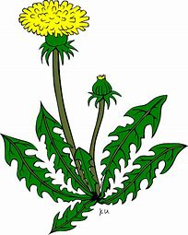
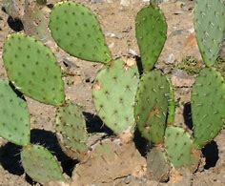
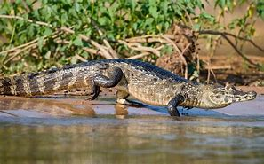
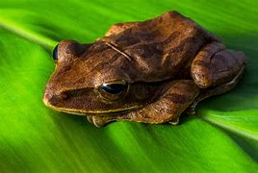
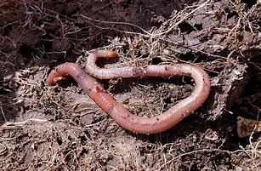
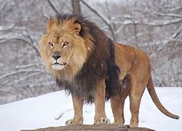
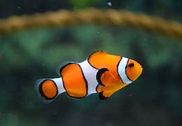
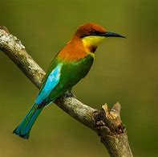
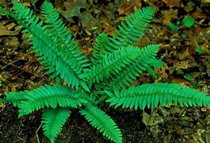
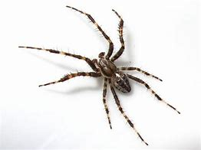
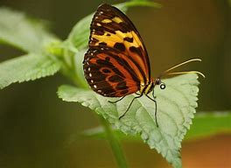
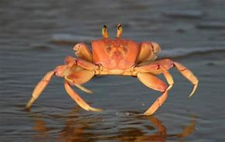
Activity: Sorting and grouping living things
With a partner, ask the children sort these living things into two groups:

Slide 22
Activity: Sorting and grouping living things
The obvious two groups are plants and animals. Can any of the living things be in both groups? No because it cannot be both a plant and an animal!

Slide 23
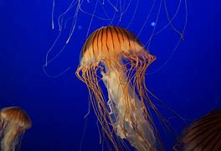
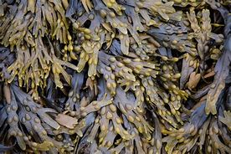
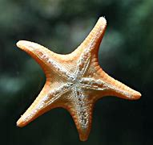
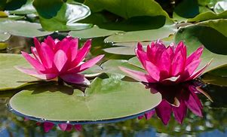
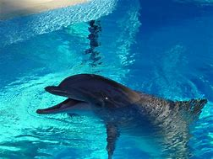
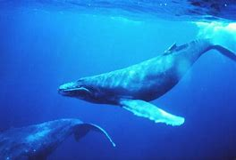
These living things have been sorted into two groups: plants and those living in water. Where does a water lily or seaweed go?
Plants
Lives in water

Slide 24
These living things have been sorted into four groups. Ask the children if they can add a plant to the diagram. What about seaweed or a daisy?
 | Lives in water | Lives on land
Has wings | Flying fish Manta ray | Robin Ostrich
Does not have wings | Crab Whale | Deer Earthworm
Seaweed
Daisy

Slide 25
In order to sort living things into groups, we use questions. These questions are called criteria (a rule used to decide something).
In the above examples the following criteria were used to decide on the groups:
Plant or animal
Lives in water or does not live in water
Has wings or does not have wings
Lives on land or does not live on land
Ask the children to sort a selection of animals and plants into as many groups as possible by deciding on the criteria. Can they sort a selection of plants and animals into three groups for example?

Slide 26
General resources:
Aberdeenshire Council Ranger Service Biodiversity Education Pack
Biodiversity Education Interactive Pack - March2022 with video link.pdf (sharepoint.com)
Book suggestions:
Living Things and Non-living Things: A Compare and Contrast Book (Arbordale Collection) by Kevin Kurtz (Sept. 2017)
Some thought-provoking questions posed to help readers determine if things are living or non-
living. For example, if living things can move, can any non-living things move?
Living and Non-living (Science Concepts) by by Andrea Rivera (Feb. 2021)
Sort It Out! (Arbordale Collection) by Barbara Mariconda (June 2008)
Told in rhyme, the text leads the reader to participate in the sorting process by categorising
Packy's piles of things according to theircharacteristics and attributes.
What Living Things Do by Jennifer Nwokeji (June 2022) (American)

