Slide 1
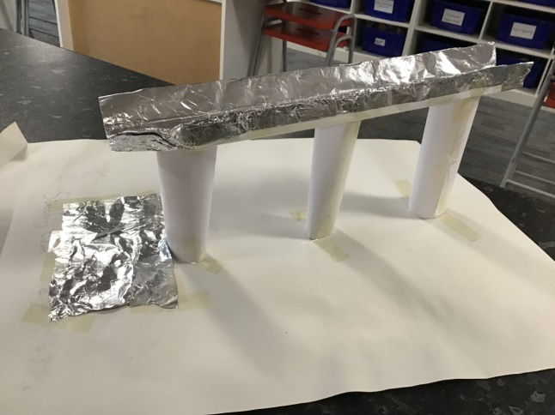

STEMinar:
STEM Challenges for First and Second Level
This event is being supported by Education Scotland’s Enhancing Professional Learning in STEM Grants Programme through the Scottish Government STEM Education and Training Strategy
Our session will start shortly
Please turn camera off and mute microphone
Register using the Forms link
You will need 3 x A4 paper, pencil, scissors, sellotape
You will need your phone or other device
Register here

Slide 2
Recording
This professional learning session is being recorded for other practitioners and so you can revisit the training
Please add ideas and comments on the Teams chat if possible – or just record your thoughts on paper
We will have time for questions at the end – recording will stop for this part of the session
All training materials will be added to the Google Drive following this session – link in your Eventbrite email

Slide 3
STEMinar:
STEM Challenges for First and Second Level
This event is being supported by Education Scotland’s Enhancing Professional Learning in STEM Grants Programme through the Scottish Government STEM Education and Training Strategy
Amy Dixon
City of Edinburgh STEM Development Officer
Science Specialist STEM Teacher
amy.1.dixon@ratho.edin.sch.uk Twitter @STEM_Edin

Slide 4
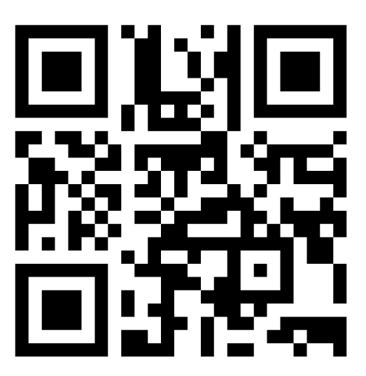
Pre-CLPL self-assessment
Go to www.menti.com – enter code 1874 6265
Or scan the QR code:

Slide 5
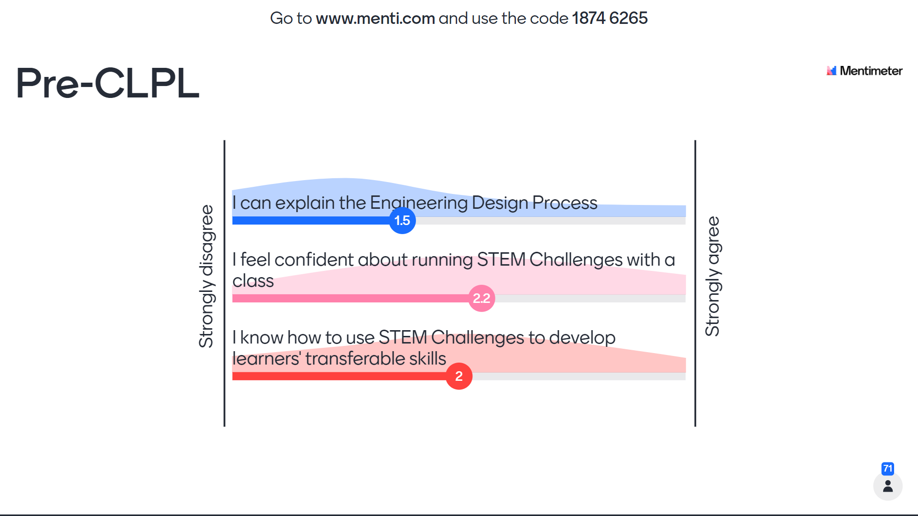
Pre-CLPL self-assessment

Slide 6
Objectives for this CLPL
To develop confidence in running a progression of STEM Challenges in your setting
To understand how the Engineering Design Process can be applied to STEM Challenges
To discuss how transferable skills can be developed through STEM Challenges through self-assessment
To link STEM Challenges to Literacy, Numeracy and Health and Wellbeing and Learning for Sustainability

Slide 7
What is a STEM Challenge?
A STEM Challenge is a problem which requires learners to use their skills and knowledge from Science, Technology, Engineering and Maths to design, build, test and improve a solution
STEM is sometimes known as STEAM including A for Arts

Slide 8
STEM Challenges – why?
Development of transferable skills
Links to Literacy, Numeracy and Health and Wellbeing as well as other curricular areas and Learning for Sustainability
Engagement
Pace and challenge – higher order thinking skills
Child-led including self-assessment
Inclusive – children who find other areas of the curriculum difficult may do very well in STEM Challenges, boosting confidence

Slide 9
What is a quality STEM Challenge?
Interdisciplinary – making connections
Open-ended exploration but within constraints
Stimulates curiosity
Draws on prior learning
Staff facilitate but do not give ideas or answers
Child-led - learners take responsibility and make their own decisions
Learners confident to take risks and try new ideas

Slide 10
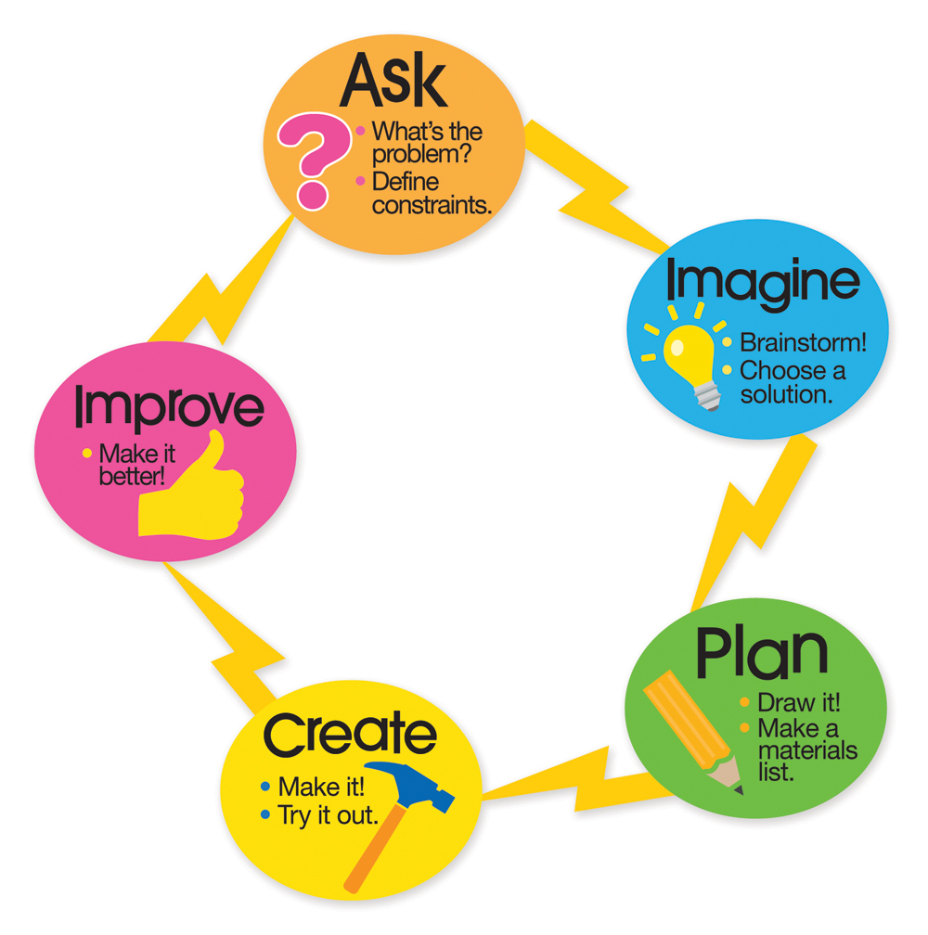
Engineering Design Process

Slide 11
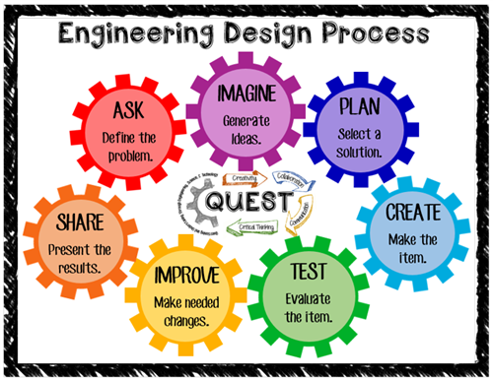

Slide 12
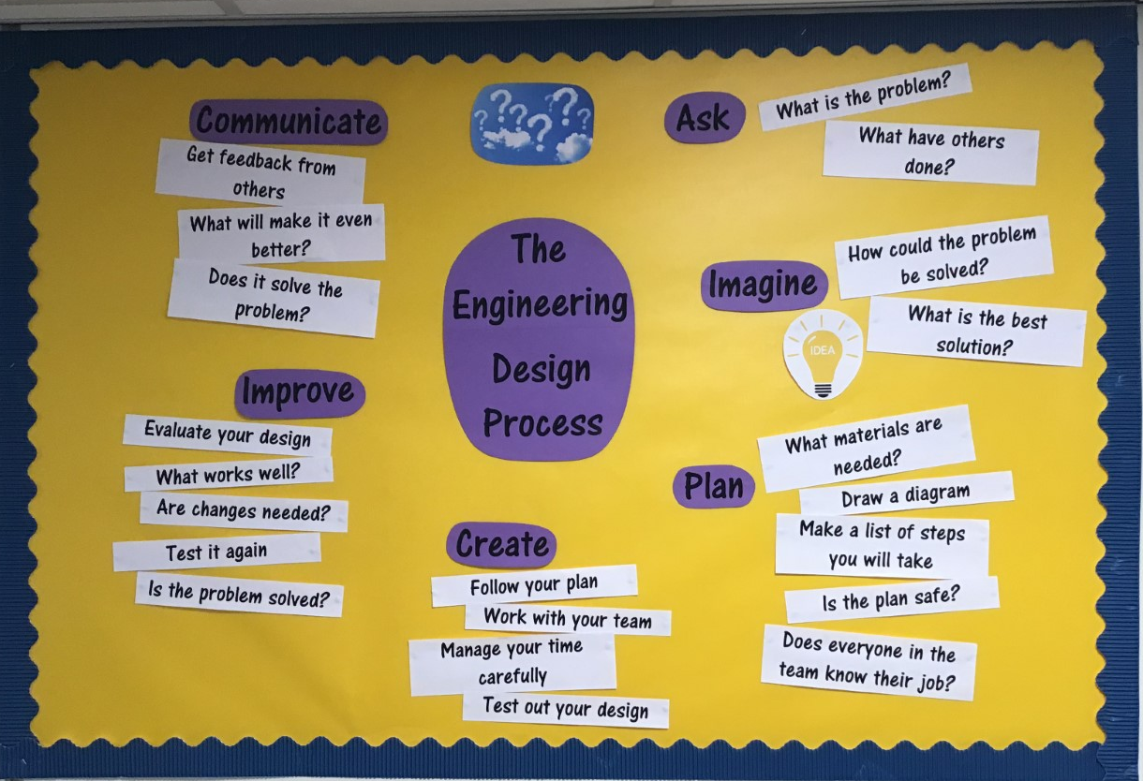

Slide 13

Engineering Design Process
STEM
challenge!

Slide 14


Rock samples from Mars

Slide 15
STEM Challenge
Design 2 separate tools which are held one in each hand, to pick up a rock and place it gently into the cup
The tools must have strong handles!
How would you make sure the rock doesn't get damaged as it is lifted?
Materials
  3 paper, 1 card, 1 cotton wool ball, 1 foam, 1 foil, sellotape
  For testing: Cup and small rock

Slide 16
STEM Challenge
What tools or equipment do you know of that can pick things up?
Think about a few different tools you could make with these materials
What could go wrong when you are building and testing the tools?

Slide 17
STEM Challenge
Design 2 separate tools which are held one in each hand, to pick up a rock and place it gently into the cup
The tools must have strong handles!
How would you make sure the rock doesn't get damaged as it is lifted?
Materials
  3 paper, 1 card, 1 cotton wool ball, 1 foam, 1 foil, sellotape
  For testing: Cup and small rock

Slide 18
STEM Challenge
Design 2 separate tools which are held one in each hand, to pick up a rock and place it gently into the cup
The tools must have strong handles!
How would you make sure the rock doesn't get damaged as it is lifted?
Materials
  3 paper, 1 card, 1 cotton wool ball, 1 foam, 1 foil, sellotape
  For testing: Cup and small rock

Slide 19
STEM Challenge
What is good about your design?
How could you improve it?
What would you need to improve it?

Slide 20
Experiential learning
Try out a STEM Challenge using the Engineering Design Process
You have ten minutes to design and build a phone holder to hold your phone at least 10cm above your desk.
If you don’t have a phone handy you could design a holder for something similar e.g. a book, pair of glasses etc.
Materials: 3 sheets of A4 paper and Sellotape
Identify the emotions that children may experience while carrying out a STEM Challenge
Which transferable skills are learners developing through doing a STEM Challenge?

Slide 21
Feedback – type into Teams chat
Put your camera on if you are happy to show your design!
Identify the emotions that children may experience while carrying out a STEM Challenge
Which transferable skills are learners developing through doing a STEM Challenge?

Slide 22
Transferable skills
Collaboration
Communication
Critical thinking
Creativity
Resilience
…and so many more!
Key employability skills
Required throughout education and life – not just for STEM!

Slide 23
STEM Challenges Progression
Link to the Google Drive containing a progression of 18 fully resourced STEM Challenges
This resource contains:
Progression overview of 18 STEM Challenges
Teaching notes
PowerPoint for each STEM Challenge project
Support materials for assessment, Literacy activities and worksheets
Examples of pupil work
Displays – adjust font and size to your taste
Other STEM Challenges
Training materials will be added following this session

Slide 24
STEM Challenges Progression
Year stage | Project 1 | Assessment stop: Write | Project 2 | Project 3 | Self-assessment of skills
Early Level | Learning Engineering through play e.g. construction challenges with blocks, Lego etc, junk modelling, investigating materials, toy marble runs, ramps, parachutes, floating/sinking etc.
P2 | Perfect pillars and bridge | First Level: Writing task on teamwork. Self-assess skills. | Towers and supporting a weight | Getting down safely! – slide and parachute | Evaluate and self-assess skills.
P3 | Rafts |  | Mars landers | Teepees
P4 | Shipwreck challenge – foil boats |  | Stationery holders | Lifting weights – simple pulleys
P5 | Balloon-powered rafts | Second Level: Writing task on skills. Self-assess skills. | Zip wires | Winding mechanisms – drawbridge and well
P6 | Vertical marble runs |  | Aqueducts | Marble mazes
P7 | Viewing platforms |  | Mars landers with parachute | Chain reaction machine

Slide 25
COVID guidance
You may need to switch some activities if they do not match the current risk assessments and restrictions for your setting
Please see folder: Other STEM Challenges

Slide 26
Resources
Recycled materials
Materials widely available in school – check art, stationery cupboards etc – remember to reorder!
Supermarket materials
STEM Shop – remains closed until planning phase is completed

Slide 27
Resources
Resources for zip wire challenge
How could you adapt these for your setting?
Consider what is essential and what could be swapped or left out

Slide 28

STEM Challenge
Design and build a zip wire which can safely carry 3 marbles from one end to the other
The top of the zip wire must be the top of your desk. The bottom of your zip wire must be on your stool but you can decide where. The marbles represent the dragon eggs.
You will be given a choice of materials:
  Straws – max 3
  Lollypop sticks – max 2
  Pipecleaner – max 1
  Card scraps – max 2
  String – 1 piece
  Foil – 1 piece
  3 marbles in a pot (you cannot use the pot)
  Sellotape
Test your zip wire and try to improve it

Slide 29
Safety
Consider safety before carrying out any practical activity
Ask learners what they think could be a risk and discuss how to minimise risks
Example – what are the risks with using lollypop sticks?
Contact SSERC for guidance if you are unsure
  Tel: 01383 626070
  Email: enquiries@sserc.scot

Slide 30
Typical STEM Challenge lesson
1h30 – 1h45 session works well
Hook
Learning Intentions and Success Criteria
Ask: Introduce STEM Challenge with constraints and materials available (5 mins)
Imagine: Discuss prior learning and what is likely to be problematic (5-10 mins)
Plan: Children into teams (3 max) with design sheets (5-10 mins)
Open the STEM Shop, one person per team collects materials
Create: Children build, test and improve designs – teacher role here is to question, question, question and try to avoid giving answers/ideas. Teacher may need to “pause” the whole class at certain times to draw attention to something, reassert constraints of the challenge etc. (20-25 mins depending on challenge – give clear countdown throughout task)
STOP – keep designs and design sheets, tidy everything else away
Improve: Evaluate designs – discuss how they could be improved (10-15 mins)
Verbal discussion of STEM Skills developed, how these link to the real world and careers. Link back to Learning Intentions and Success Criteria.

Slide 31
Evaluating for improvement
Aim: To build a culture of trial and error, risk-taking, learning from mistakes, learning from each other… leading to improvements
Is this only useful for STEM?
Plan enough time to evaluate thoroughly – at least 10 mins
Tidy up first so children are not distracted / still building

Slide 32

What did you learn today?
What did you learn about building today?
What did you do well in STEM today?
What could you have improved about your work in STEM today?

Slide 33
Evaluation
Discuss how your team approached the STEM challenge today
  What did you learn today?
  Which STEM skills did you develop?
How could you improve your design?
Can you think of another similar STEM challenge you could set yourself to try at home?

Slide 34
What can you learn from others?
Learning loop – look at other people’s work.
How did other groups tackle the STEM challenge?
Which ideas did you see that were successful?
What did you see that hadn’t worked, or that you wouldn’t use?
Provide kind and helpful feedback

Slide 35
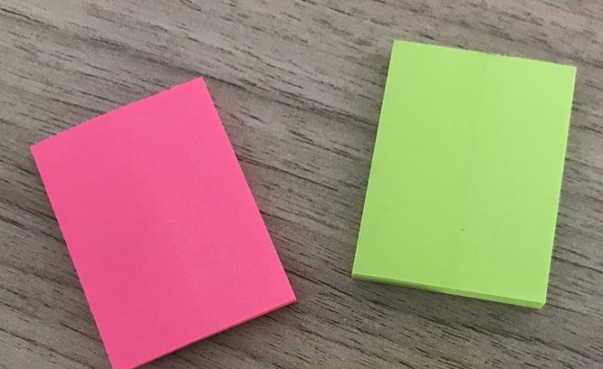
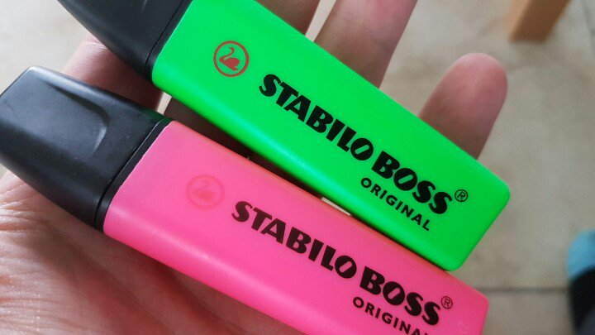
Evaluation
On a pink post-it, write down what you are Tickled Pink about – what is good about your design?
On a green post-it, write down what is Green For Growth – what needs to be improved about your design?
Or you could use pink and green highlighters to draw straight on to your design!

Slide 36
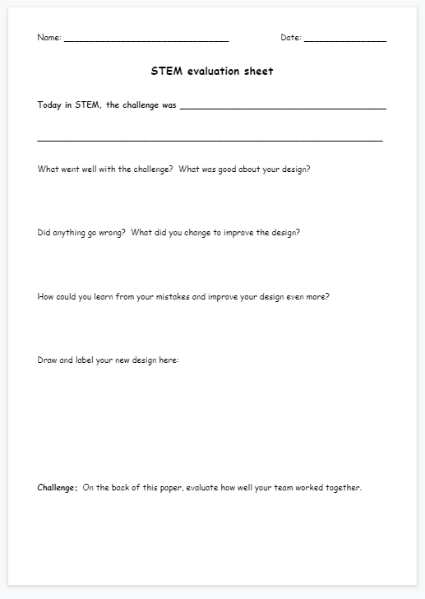
Evaluation sheet

Slide 37
Self-assessment
Learners self-assess their transferable skills and identify areas of strength and areas to develop
Success Criteria
Strategy development
Self-assess again after each project / end of block

Slide 38
How can STEM Challenges be extended or modified?
Different materials
Budgeting
Points scoring system – rather than competitive
“Impossible” challenges
Challenge yourself
Learners leading other groups

Slide 39
Competition in STEM Challenges
STEM Challenges are rich learning experiences
In my experience, competition
  Increases stress levels
  Disengages some children
  Can lead to sabotage of materials or builds
How to get around competition?
  Emphasise it is not a competition!!
  Encourage teams to challenge themselves – to set their own challenge or target
  Challenge individuals and teams to beat their own personal best

Slide 40
Common pitfalls
Too much direction – eg instructions or recipe for success
  Showing videos or photos of end products of similar STEM Challenges
Not enough direction – task is too open-ended
Staff scared of letting children make mistakes and to experience “failure”
  Giving children ideas
  Giving answers instead of questions
Group size too big
Making it competitive

Slide 41
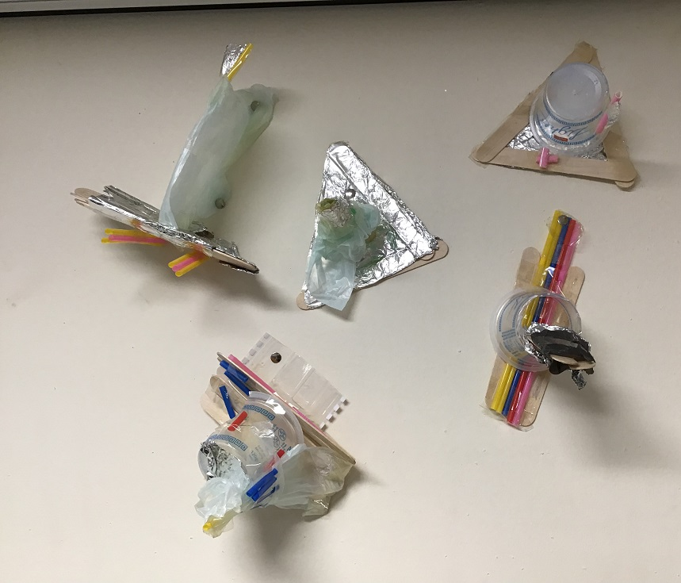
A STEM Challenge should allow a variety of outcomes

Slide 42
Example of STEM Challenge from Progression
P6 Aqueducts STEM Challenge – Part 1
Year stage | Project 1 | Assessment stop: Write | Project 2 | Project 3 | Self-assessment of skills
Early Level | Learning Engineering through play e.g. construction challenges with blocks, Lego etc, junk modelling, investigating materials, toy marble runs, ramps, parachutes, floating/sinking etc.
P2 | Perfect pillars and bridge | First Level: Writing task on teamwork. Self-assess skills. | Towers and supporting a weight | Getting down safely! – slide and parachute | Evaluate and self-assess skills.
P3 | Rafts |  | Mars landers | Teepees
P4 | Shipwreck challenge – foil boats |  | Stationery holders | Lifting weights – simple pulleys
P5 | Balloon-powered rafts | Second Level: Writing task on skills. Self-assess skills. | Zip wires | Winding mechanisms – drawbridge and well
P6 | Vertical marble runs |  | Aqueducts | Marble mazes
P7 | Viewing platforms |  | Mars landers with parachute | Chain reaction machine

Slide 43
Teaching notes
You only need 2 or 3 jugs of water to test this. Each group only needs a tiny amount of water e.g. ¼ of a cup, plus an empty cup to catch it in.
Be prepared for spills.
In Part 1, allow children to try waterproofing paper using Sellotape if they want to – lots of children think this will be fine. Refer to this in Part 2 and link to waterproof materials. Sellotape is not waterproof once it gets wet!

Slide 44
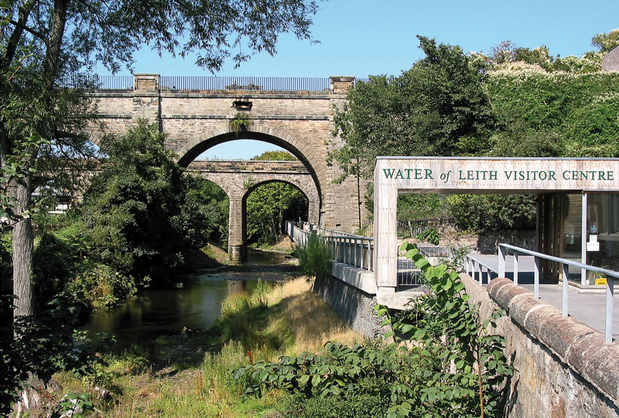
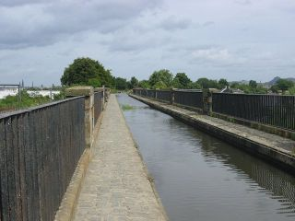
STEM Challenge Project
Aqueduct
challenge

Slide 45
Learning Intentions
To build up our STEM skills:
  Teamwork
  Communication
  Creativity
  Critical Thinking
  Resilience
To use the engineering design process to solve a problem

Slide 46
What are your success criteria for this project?
I would like to get better at
  teamwork
  communication
  creativity
  critical thinking
  resilience
How can you get better at this? Write down some strategies for yourself.
At the end you will decide if you have been successful.

Slide 47
Aqueduct challenge
You are a bridge engineer who has been given the challenge of redesigning the Water of Leith Aqueduct to carry water across a bridge.
The water must travel safely from one end of the bridge to the other.

Slide 48
STEM Challenge
Design and build an aqueduct which can safely carry water from one end to the other
The aqueduct must be at least 25 cm long
You will be given a choice of materials:
  A4 paper – 4 sheets
  Foil – 1 piece
  Sellotape
  Cup of water to test your aqueduct
  Empty cup to catch your water
Test your aqueduct and try to improve it

Slide 49
Aqueduct challenge
What are the problems with this task?
What can you predict being difficult?
Imagine how you could solve each problem.
What have you learned previously about bridges?

Slide 50
What can you learn from others?
Learning loop – look at other people’s work.
How did other groups tackle the STEM challenge?
Which ideas did you see that were successful?
What did you see that hadn’t worked, or that you wouldn’t use?

Slide 51

Example of pupil work

Slide 52
Teaching Literacy through STEM Challenges
Talk and listen
Be respectful, take turns, value contribution of others
Engage with others
Discuss ideas
Explain thinking
Persuade, negotiate, compromise, question, challenge
Instructions and rules
Use information
Collaborate
Present
Evaluate, give and receive useful and constructive feedback
Use STEM language and vocabulary appropriately
Label, list
And more…

Slide 53
Teaching Literacy through STEM Challenges
Assessment stop: Write

Slide 54
Teaching Numeracy through STEM Challenges
M in STEM – STEM Challenges are a context for meaningful real-life Maths skills
Shape – 2D shapes and 3D objects
Measurement, units, equipment
Number and number processes – critical for the design
Budgeting – set prices and budget in the STEM Shop
Time management
Mathematical thinking skills and problem solving
Fractions
Data handling
And more…

Slide 55
Teaching HWB through STEM Challenges
Experience challenge
Social skills
Relationships
Take risks, assess and manage risk
Build resilience
Perseverance
Growth mindset
Experience stress
Manage emotions
Personal achievement
Teamwork skills
And more…

Slide 56


Learning for Sustainability links
…and more!!

Slide 57
Next steps to consider
Look at the STEM Challenges progression materials
How do you / could you use your teaching space for STEM Challenges?
Resources sharing – what is in your resources files? How could you share STEM Challenges you develop?
How could you share this training session and resources with staff in your setting and beyond?

Slide 58
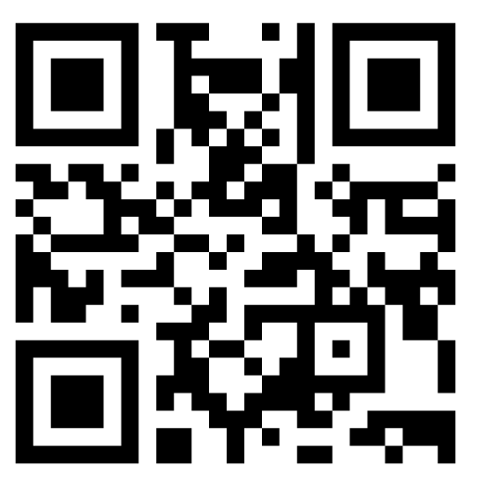
Post-CLPL self-assessment and evaluation
Go to www.menti.com – enter code 4669 9335
Or scan the QR code:

Slide 59
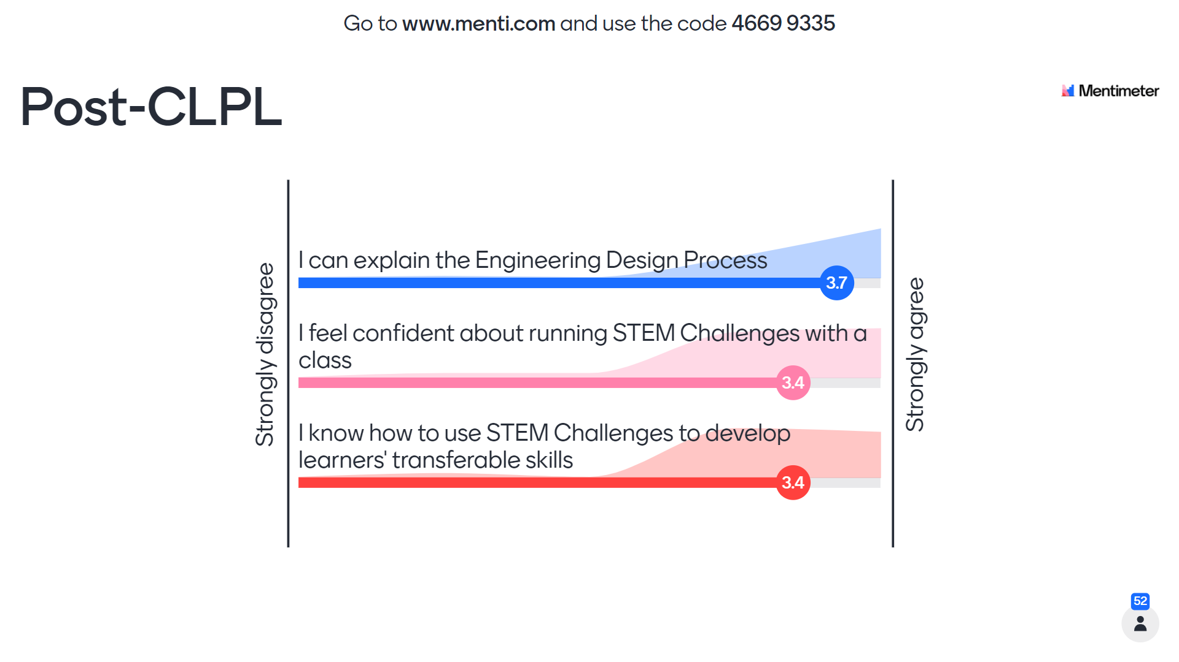
Post-CLPL self-assessment and evaluation

Slide 60
Thank you!
Questions?

Slide 61

This event is being supported by Education Scotland’s Enhancing Professional Learning in STEM Grants Programme through the Scottish Government STEM Education and Training Strategy.
For Scotland’s Learners, with Scotland’s Educators

