Slide 1
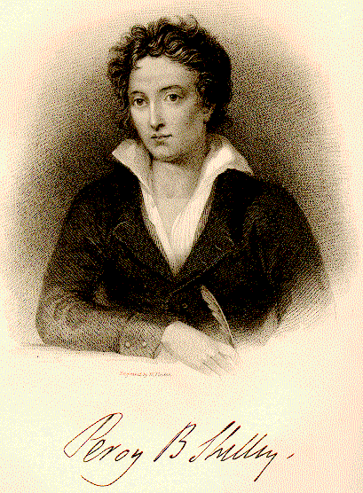
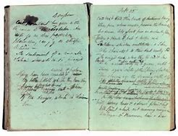
England in 1819
BY PERCY BYSSHE SHELLEY

Slide 2
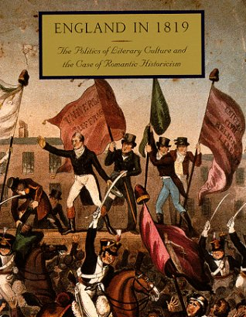
England in 1819
An old, mad, blind, despised, and dying King;
Princes, the dregs of their dull race, who flow
Through public scorn,—mud from a muddy spring;
Rulers who neither see nor feel nor know,
But leechlike to their fainting country cling
Till they drop, blind in blood, without a blow.
A people starved and stabbed in th' untilled field;
An army, whom liberticide and prey
Makes as a two-edged sword to all who wield;
Golden and sanguine laws which tempt and slay;
Religion Christless, Godless—a book sealed;
A senate, Time’s worst statute, unrepealed—
Are graves from which a glorious Phantom may
Burst, to illumine our tempestuous day.

Slide 3
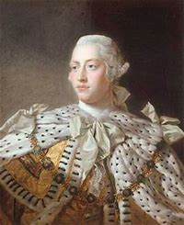
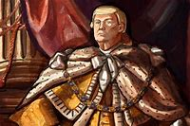
An old, mad, blind, despised, and dying King;
The king is dying, old, blind, insane, and despised.

Slide 4
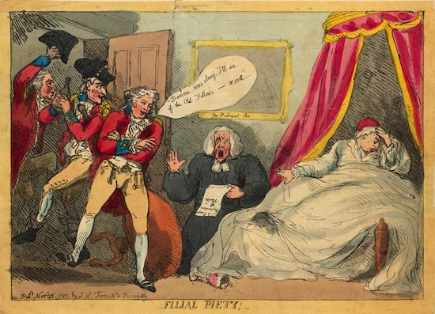
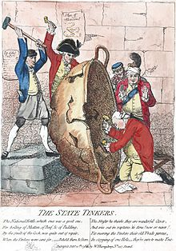
His sons are objects of public scorn. His ministers run the country for their own selfish interests.
Princes, the dregs of their dull race, who flow
Through public scorn

Slide 5
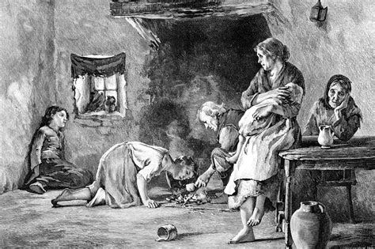
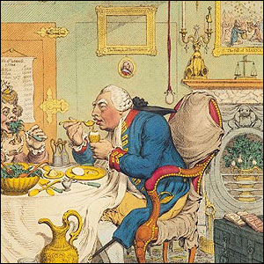
The people are hungry and oppressed.
Rulers who neither see nor feel nor know,
But leechlike to their fainting country cling

Slide 6
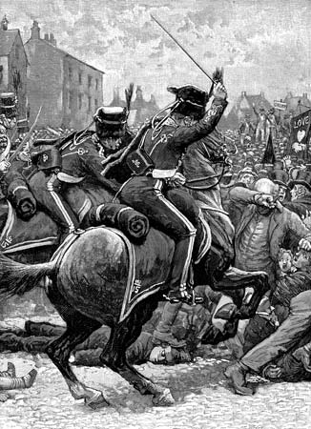
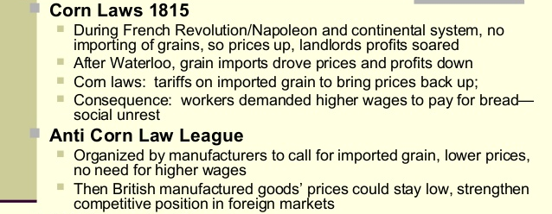
The army is used to destroy liberty and to collect booty. The law is manipulated to protect the rich and enchain the poor.
Till they drop, blind in blood, without a blow.
A people starved and stabbed in th' untilled field;
An army, whom liberticide and prey
Makes as a two-edged sword to all who wield;
Golden and sanguine laws which tempt and slay;

Slide 7
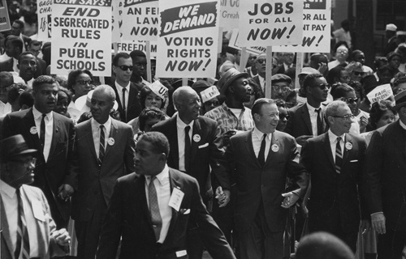
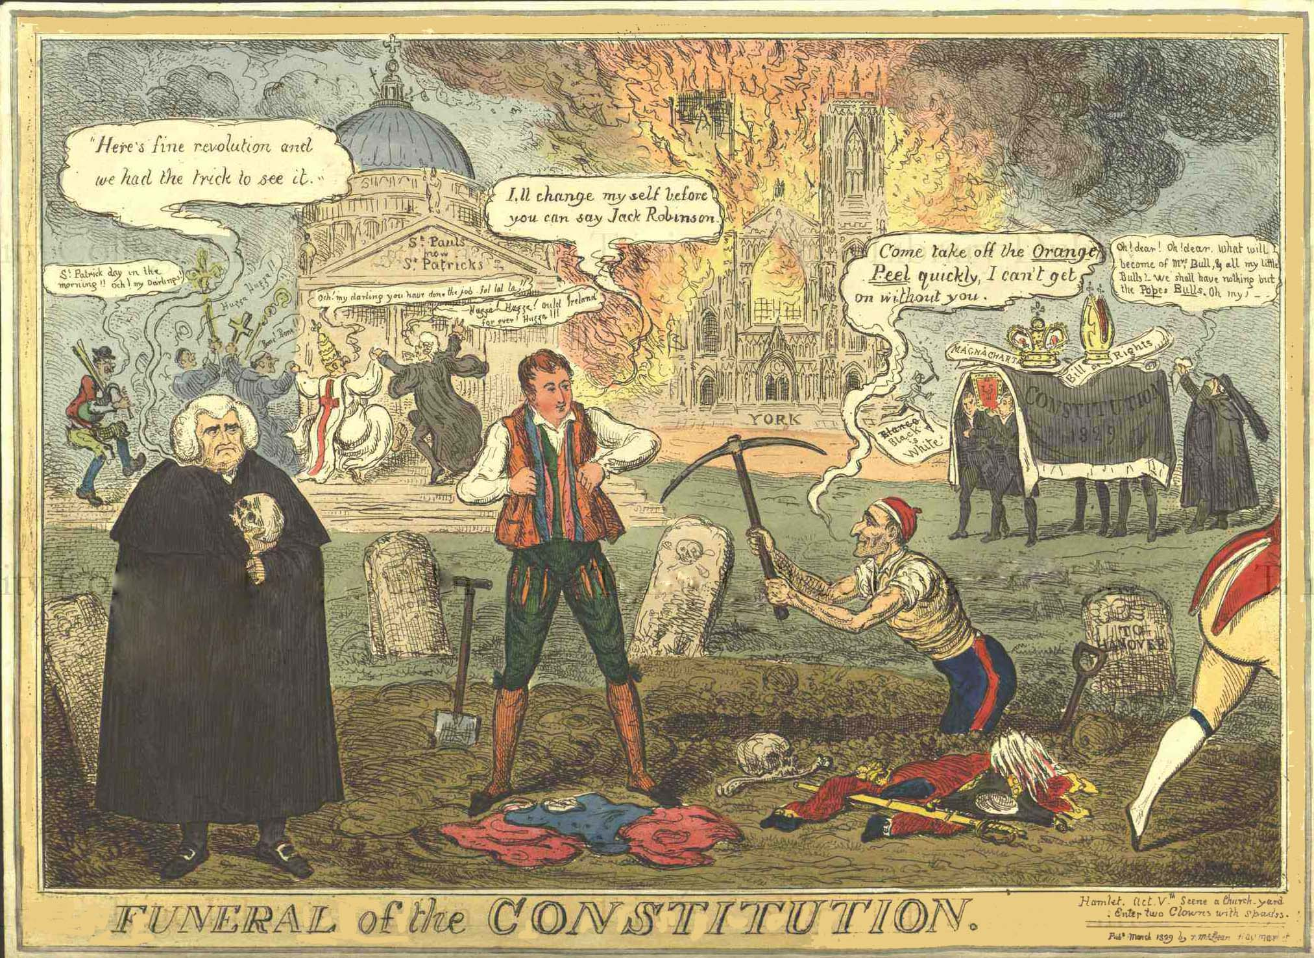
. Religion is in a state of apathy. Parliament denies Roman Catholics their civil rights.
Religion Christless, Godless—a book sealed;
A senate, Time’s worst statute, unrepealed—

Slide 8
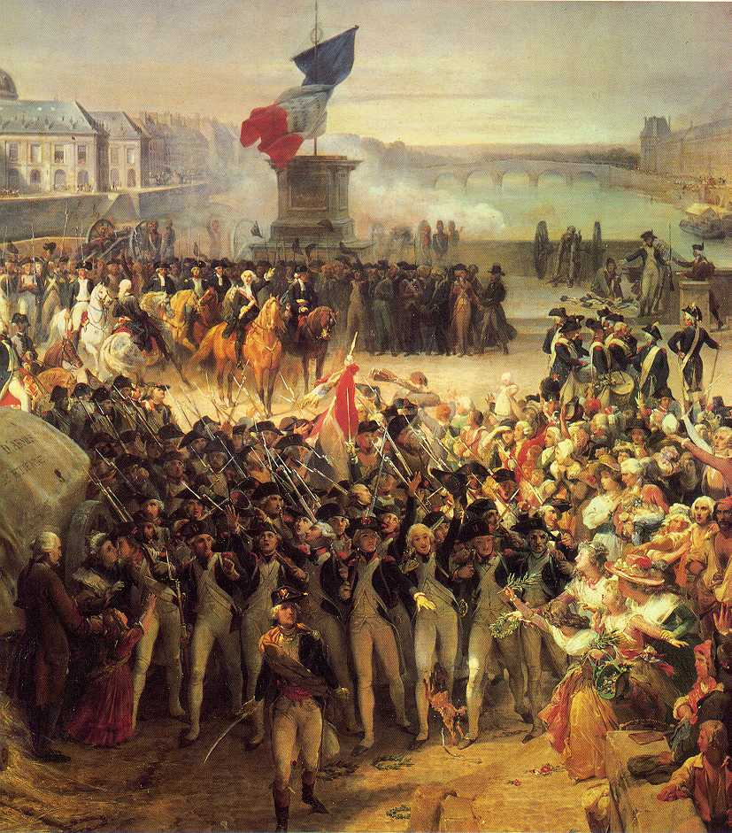
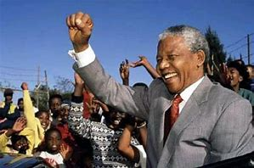
But out of this unhappy state of affairs may come a revolution that will right all wrongs.
Are graves from which a glorious Phantom may
Burst, to illumine our tempestuous day.

Slide 11
Background
"Sonnet: England in 1819" is one of Shelley's most vigorous political statements. The language is unusually vivid and emphatic and shows how deeply Shelley's feelings were involved. The sonnet is probably the best of a group of political poems written by Shelley in 1819 which were inspired by Shelley's indignation in regard to the condition of England at that time. None of them were printed in 1819 because of publishers' fears of the strict libel laws. Any publisher who would print "Sonnet: England in 1819" ran the risk of being jailed or fined or both.

Slide 12
King George
The king Shelley refers to in his poem is George III. In 1819, he was eighty-one years old, insane, blind, and deaf. He died the following year and was succeeded by George IV, the oldest of George III's dissolute sons, "mud from a muddy spring." His separation from his wife, Princess Caroline of Brunswick, after a year of marriage caused a public scandal, and his numerous affairs injured his reputation. English liberals, such as Shelley and Byron, regarded him with profound scorn both as prince regent (1811-20) and as king (1820-30). His cabinet ministers were arch-conservatives.

Slide 13
Revolution
The "rulers who neither see, nor feel, nor know" are Lord Liverpool and his conservative cabinet. In calling them leeches who are bleeding their country, Shelley is indulging in hyperbole. They were men of integrity who happened to be in power at a time of general unrest caused by the unemployment and hunger that followed the end of the Napoleonic wars. There was rioting, some destruction of property, inevitable arrests and repressive measures. The cabinet suspended the Habeas Corpus act and passed laws severely limiting public gatherings. Shelley was convinced that revolution was going to break out in England, "a glorious Phantom" that would "illumine our tempestuous day."

Slide 14
St. Peter's Field in Manchester
The line "a people starved and stabbed in the untilled field" may be an allusion to the Peterloo massacre. On August 16, 1819, a large number of people in favour of parliamentary reform had gathered in St. Peter's Field in Manchester to hear a speech by Henry Hunt, a reformer. When troops made an attempt to arrest Hunt, a panic ensued in which eleven people were killed and four hundred were injured.

Slide 15
two-edged sword
The army, "which liberticide and prey / Makes as a two-edged sword to all who wield" it, seems to be a reference to the use of troops by the government to quell disturbances and repress liberty. "Golden and sanguine laws which tempt and slay" are laws that vested interests caused to be passed and which led to bloodshed. "Religion Christless, Godless" refers to the torpid state of the Anglican Church, from which it was aroused by the Oxford Movement in 1833. "Time's worst statute" refers to the restrictions under which English Roman Catholics were forced to live. They were not allowed to vote or sit in Parliament, preside over law courts, or enter the universities.

Slide 16
"Catholic emancipation"
"Catholic emancipation" had been a lively political issue for several years, and not until 1829 did Catholics recover most of their civil liberties.

Slide 17
Additional Stuff
Rhyme scheme
ABABABCDCDCCDD
Upside-down form of the classic Petrarchan sonnet form
Iambic Pentameter
Untraditional sonnet form represents the disorder of England at the time

