Slide 1
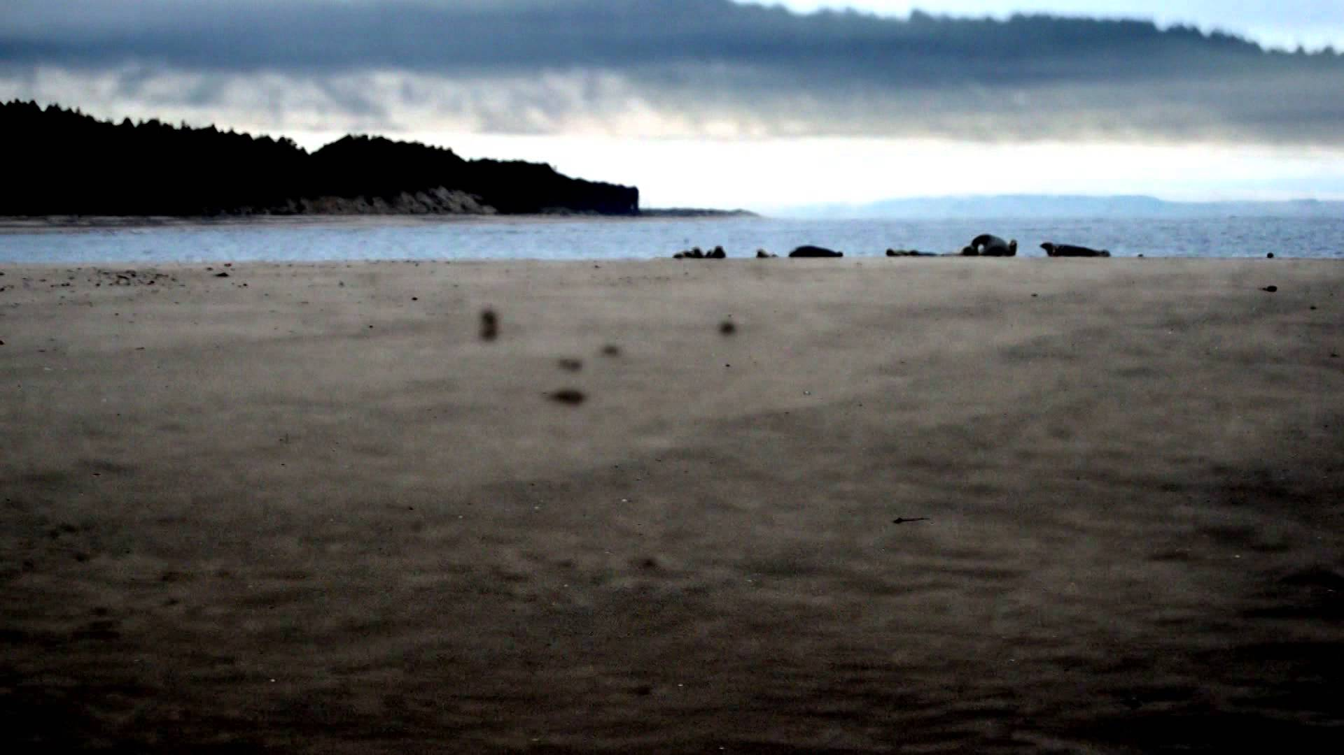
At Roane Head
Robin Robertson

Slide 2
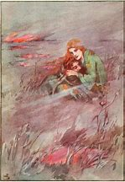
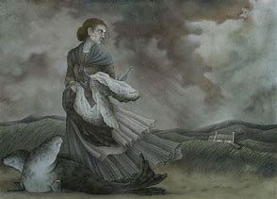
A Celtic Gothic Tragedy
This poem invokes the Celtic myth of the selkie: creatures that swim as seals but which can become human by shedding their skins. The transformation is reversed by climbing back into the sealskin, but if the magical skin is lost, or stolen, the creature is doomed to remain in human form. Ròn - pronounced roane - is the Gaelic for 'seal'.

Slide 3
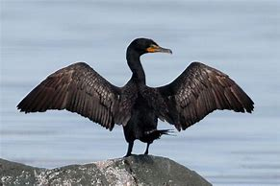
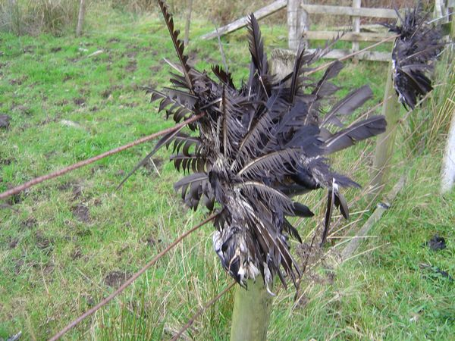
A blend of the magical and the macabre
The cormorants are common in the north but here are a symbol of death and warning
The blinds shut the world out , like a closed door. Also often a sign of respect when someone has died
You’d know her house by the drawn blinds – by the cormorants pitched on the boundary wall, the black crosses of their wings hung out to dry.
Hung out to dry has connotations of worn , done in, dead like the wings you find on farmer’s fences.

Slide 4
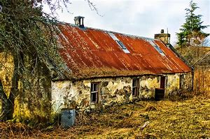
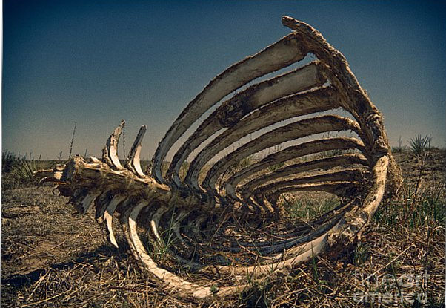
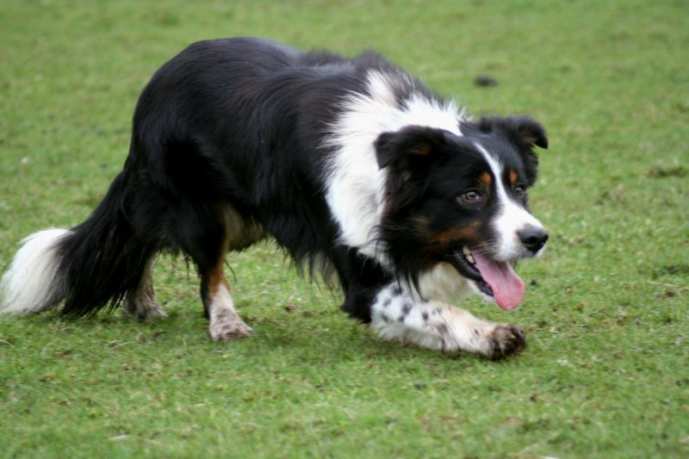
Isolation and symbols of welcome reversed
Whoever lives there is isolated not just from people, but from the beauties of nature. The briefness of the sun serves to heighten the negativity
The house is hidden from the sea view and from the light of the sun as if the person living there had given up on the world symbolised by the light.
You’d tell it by the quicken and the pine that hid it from the sea and from the brief light of the sun, and by Aonghas the collie, lying at the door where he died: a rack of bones like a sprung trap.
The dog lying at the door -familiar and warming image, enjambment replaces this warmth with dread.
A rack of bones, dry and rattling, a "sprung trap" positioned right at the door reinforces the idea that this person wants nothing to do with others.

Slide 5
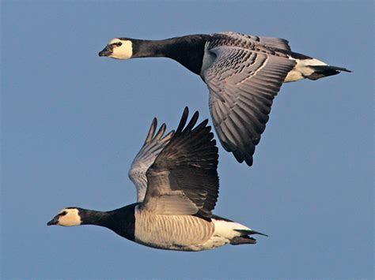
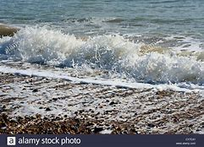
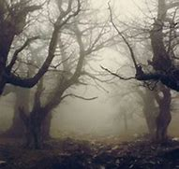
Sounds of decay and Danger
Negativity of the onomatopoeic sound of barnacle geese - "rusty saws," dual connotations of decay and danger-
A fork of barnacle geese came over, with that slow squeak of rusty saws. The bitter sea’s complaining pull and roll; a whicker of pigeons, lifting in the wood.
The onomatopoeic "bitter" sea's "complaining pull" and the enjambment of ‘and roll’ suggests unhappiness .
The onomatopoeic "whicker," of pigeons suggests a sudden, distant, haunting sound like in a horror movie.

Slide 6
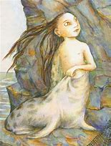
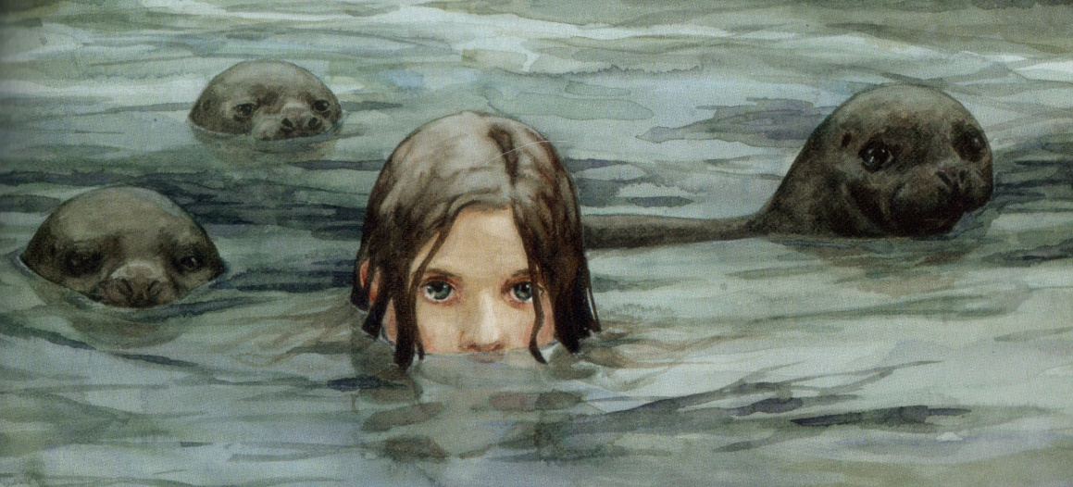
Now the story
enjambment- the image of children, a warming image, suddenly turns "wrong."
Each line shows us how ‘wrong’ they were
She’d had four sons, I knew that well enough, and each one wrong. All born blind, they say, slack-jawed and simple, web-footed, rickety as sticks. Beautiful faces, I’m told, though blank as air.
Enjambment is used to shock again as the ‘beautiful ‘ is turned to ‘blank’ in the following line

Slide 7
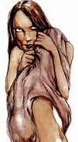
Hints at their true nature
"hirpling," suggests something between walking or crawling- and mimics the onomatopoeic sound of "chittering." This and being compared to rats makes the children less human and more mysterious.
Someone saw them once, outside, hirpling down to the shore, chittering like rats, and said they were fine swimmers, but I would have guessed at that.
The use of ‘I’ in the last line toys with the reader suggesting that the narrator knows more than he is telling us . Why would he have ‘guessed that’?

Slide 8
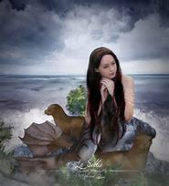
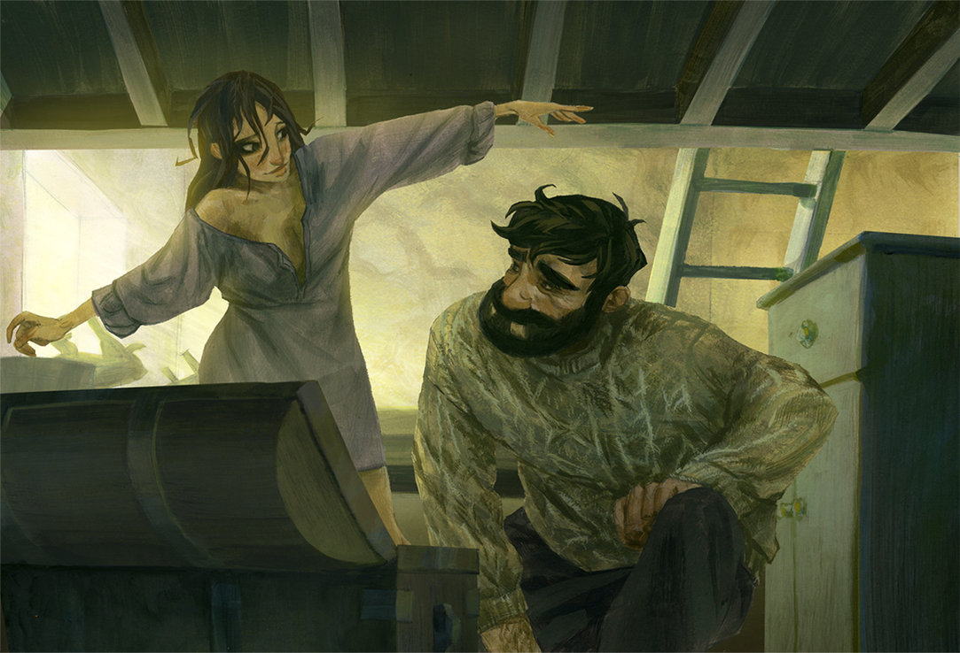
The world of the Celtic myth creeps in
‘beglamoured’ archaic word conjuring up the idea of spells and changelings
More hints at mysticism
Her husband left her: said they couldn’t be his, they were more fish than human; he said they were beglamoured, and searched their skin for the showing marks.

Slide 9
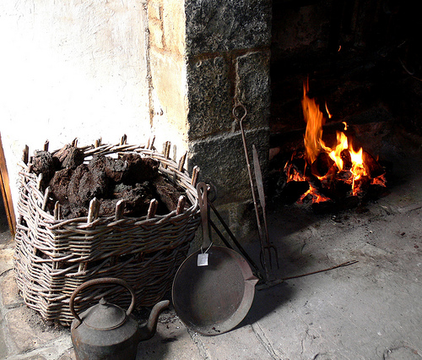
The tragic human bond of love
The image of the woman closing "scales" in place of eyelids leads us to wonder how human the children were.
though deformed and possibly supernatural, are still loved- are still her children
For years she tended each difficult flame: their tight, flickering bodies. Each night she closed the scales of their eyes to smoor the fire.
The extended metaphor of their lives as delicate flames and closing their eyes like smooring the flame refers to old highland traditions of fire and love and family.

Slide 10
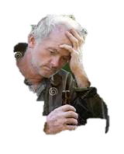
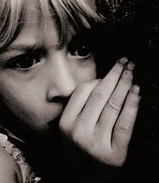
A change in poetic form and rhythm creates tension
The lines become short, irregular and choppy with the repeated ‘k’ sound and the word ‘this’ heightening the tension.
Until he came again, that last time, thick with drink, saying he’d had enough of this, all this witchery, and made them stand in a row by their beds, twitching. Their hands flapped; herring-eyes rolled in their heads.
The use of ‘flapped and ‘herring eyes’ reinforces the father’s sense of their fishy strangeness.
The foreshortened line ‘that last time’ creates an ominous pause .
The enjambment
‘by their beds
Twitching. …
Further ramps up the tension
‘rolled in their heads’ suggests vacancy , like dumb, frightened animals

Slide 11
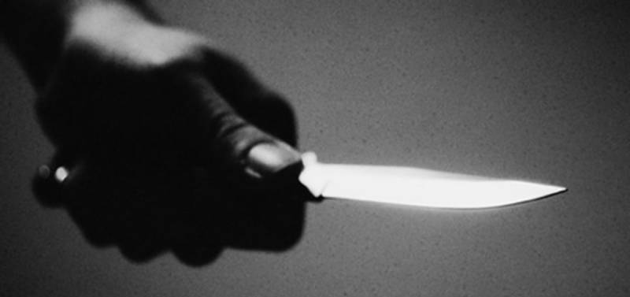
Horror written as commonplace
The use of the innocuous word ‘relaxing’ only serves to make the father’s action even more horrific.
The matter-of-fact way the murder of the four children is expressed only serves to magnify the cruelty of the act
He went along the line relaxing them one after another with a small knife.
The pattern of vowels in ‘one after another’ slows the line down and make the action seem slow and deliberate.

Slide 12
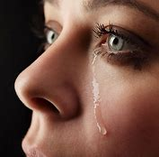
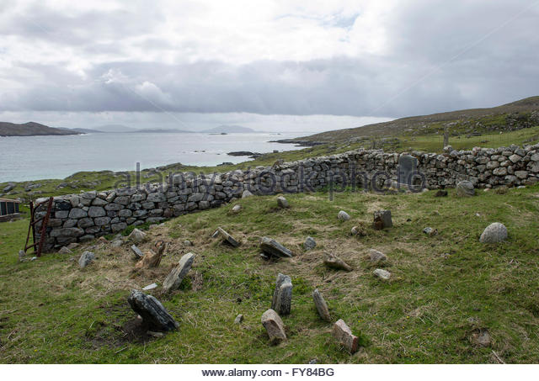
In contrast to the cold murder , the mother is passionate and overcome with grief
They say she goes out every night to lay blankets on the graves to keep them warm. It would put the heart across you, all that grief.
The ‘blankets’ on the grave show she has lost her mind to her grief
The use of Gaelic cadence and idiom ‘ It would put the heart across you’ infers an emotional empathy between the narrator and the mother and enhances our imagined setting for this brutal act and subsequent grief.

Slide 13
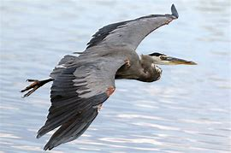
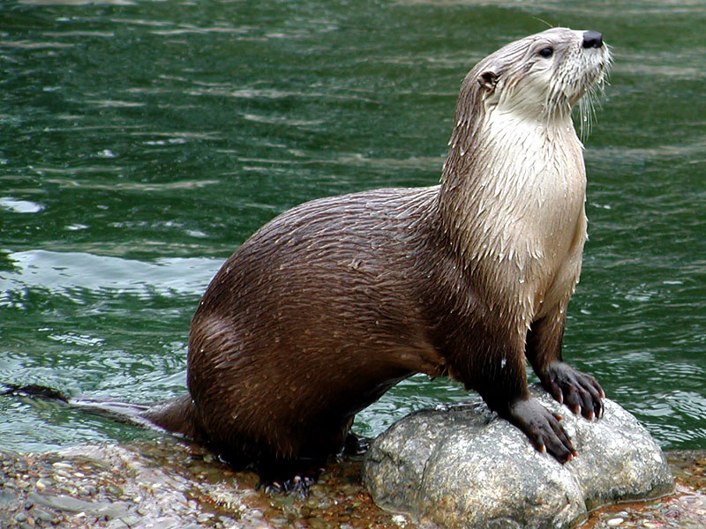
Nature reflects the tension; in steps the narrator
The otter is "worrying," which denotes the act of tearing roughly at the leaves and connotes the act of concern.
The heron flies slowly, almost meditatively . The onomatopoeic ‘scraich’ ( transferred epithet) is the harsh sound the heron makes , here describing the break of day, adding tension to the scene.
There was an otter worrying in the leaves, a heron loping slow over the water when I came at scraich of day, back to her door.
These two images are linked by a periodic sentence- a sentence in which the main action occurs at the end- which creates anticipation. At the end of that sentence, we see the speaker acting within the poem for the first time. Previously, he only narrated, passing on hearsay; now, he unexpectedly enters the poem, stepping onto that isolated threshold at "scraich of day"- at dawn.

Slide 14
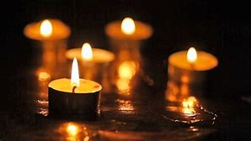
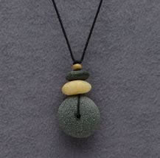
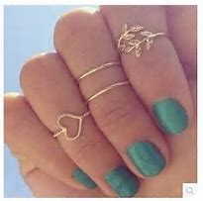
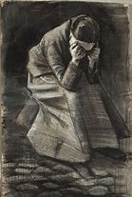
A mystic chant
Each item symbolises an aspect of her children
The poem shifts in rhythm
Candles suggesting their short flickering lives
She’d hung four stones in a necklace, wore four rings on the hand that led me past the room with four small candles burning which she called ‘the room of rain’.
‘Rain’ suggesting tears
The poem becomes a chant as the story moves toward its climax, almost like a mystic song. The images presented only heighten this surreal feeling- in addition to the mystical connotations of candles and rain.

Slide 15
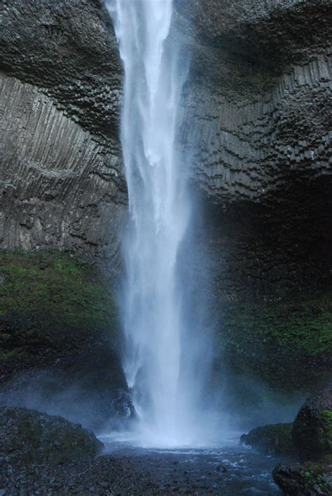
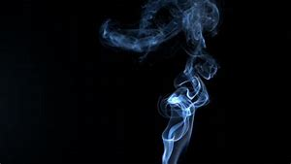
End of the woman’s story
The rising of the "milky smoke," a "waterfall in reverse," seems to hint at reality becoming less and less solid, at the unreal coming closer and closer.
Milky smoke poured up from the grate like a waterfall in reverse and she said my name, and it was the only thing and the last thing that she said.
The chant continues with the last three lines of the stanza, each of which begins with "and," creating a sense of movement that continues to build. It pauses, just for a moment, at the last line, lingering upon the woman's last word. Her story has come to a close.

Slide 16
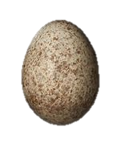
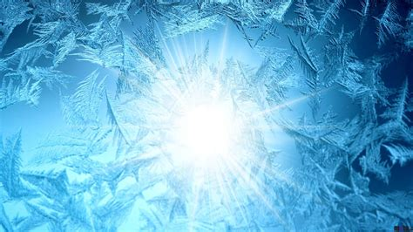
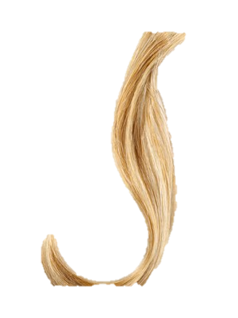
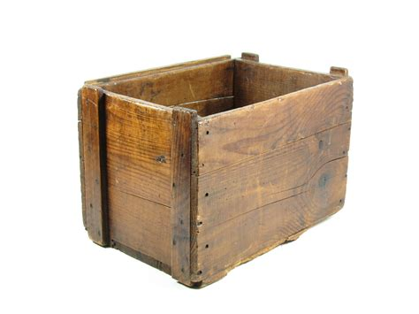
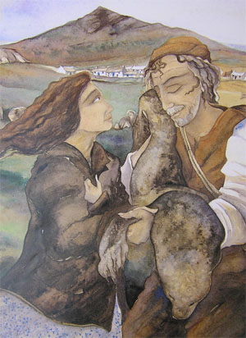
Mystery revealed
The mystical image- a "skylark's egg," preserved in "a bed of frost"- a symbol of freedom, of potential, and of potential that will never hatch.
She gives the speaker twists of his four sons' hair... his sons?
She gave me a skylark’s egg in a bed of frost; gave me twists of my four sons’ hair; gave me her husband’s head in a wooden box. Then she gave me the sealskin, and I put it on.
His story, like his wife's and the four sons', has come to a tragic closure.
The identity of the speaker comes to light, line by line. They were his sons, but, he was not the husband who murdered them. Instead, he receives that husband's head in a box

Slide 17
The conclusion
Then she gave me the sealskin, and I put it on.
That leaves only one story to close- the speaker's. And in the final line, every hint of magic, of his true identity- the reason why his sons were half-fish- it all finally comes together. In the same matter-of-fact manner in which he described the deaths of his sons and the woman's house, he describes being given the sealskin, and putting it on.

Slide 18
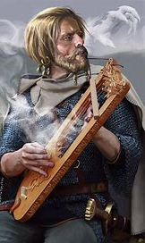
So what do we have?
In the end this is a masterclass in poetic storytelling. The poet Robin Robertson weaves folklore and magic with a vivid evocation of the crofting landscape of the far north of Scotland which keeps the reader guessing right to the end.
It is emotionally charged with the themes of motherly love and isolation lightly touched on , even fear of the odd and magical is part of the story.
His style is that of the traditional bard telling us story round a fireside or at some Viking feasting hall , trying to spook you as with a ghost story, making you weep with the tragic sadness of it all, and creating shock and tension through the mysterious narrator who is not revealed until the very end.

Slide 19
Word choice – the sounds of the language
He uses words that are of the area like ‘Aonghas’ , the dog’s name ‘hirpling’, ‘smoor’ and ‘scraich’ to give the poem a flavor of the North. When describing the woman’s grief he uses the rhythm and cadence of the soft almost Gaelic phrase , ‘It would put the heart across you, all that grief.’

Slide 20
Word choice – the language of myth and folk tale

Slide 21
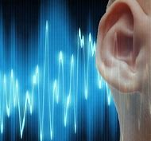
Sound - onomatopoeia
‘… that slow squeak of rusty saws. ‘
‘The bitter sea’s complaining pull’
‘chittering like rats’
‘Their hands flapped …’
‘at scraich of day, ‘
whicker of pigeons, lifting in the wood
Onomatopoeia
Where words make the sounds of the things the poet is describing through the pattern of vowels and consonants or the sound of the word on its own.

Slide 22
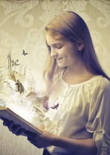
Imagery
‘the cormorants pitched on the boundary wall, the black crosses of their wings hung out to dry.’
‘Aonghas the collie, lying at the door where he died: a rack of bones like a sprung trap.’
‘Beautiful faces, I’m told, though blank as air.’
‘For years she tended each difficult flame: their tight, flickering bodies.’

Slide 23
SQA Paper 2017
The poem ‘At Roane Head’ challenges accepted beliefs and attitudes by combining mythology and powerful emotions to tell this haunting story
The poem ‘At Roane Head’ deals with the powerful emotions of love , isolation and grief in this haunting gothic tale.
The poem ‘At Roane Head’ uses powerful, vivid imagery to tell this tale of love , isolation and grief in this haunting gothic tale.

