Slide 1
Sound Reading System at Grange P1

Slide 2
What does SRS Do?
The Sound Reading System is a high quality systematic phonic programme and teaches the entire alphabet code in logical, incremental steps.
SRS is designed to teach reading (decoding) and writing (encoding) simultaneously.
The children have been learning to listen to the sounds in each word, to think about how many they hear and then to match the sound with its corresponding printed letter. They build words (segment) and the read words (blend).
As the children progress, they move from reading and writing three sound words, to four sounds and so on.
It is extremely important that they hear and say clean sounds so that their reading and writing is accurate.

Slide 3
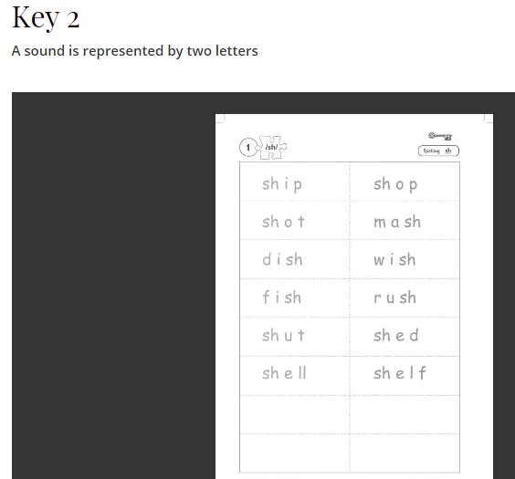
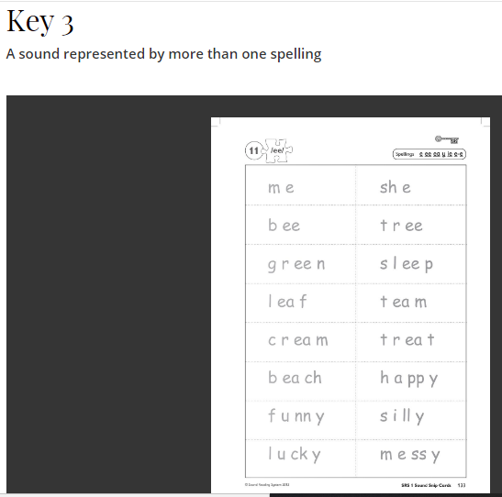
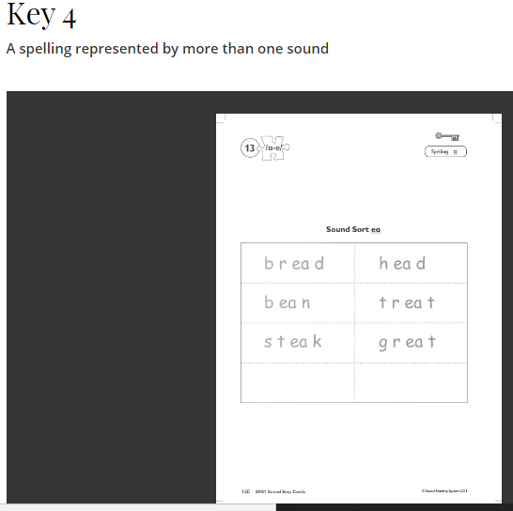
SRS Works on unlocking 4 Main Keys These are opened systemically from simple to complex

Slide 4
SRS Foundation (P1 and non-readers)
Teaches 1:1 correspondences for 23 sounds, 5 vowels and 18 consonants
Introduces all 4 keys at their simplest form
There is a set order for teaching the sounds
There are 4 activities that should take place within the teaching of each sound

Slide 5
SRS Foundation sounds (there are 13 steps altogether)
Step | Sounds and Letters | Example words
1 | a o m n p t | top mop mat map tap man
2 | c d i | pin tip dad mad dot cat can cap cot did camp (CVCC)
3 | g b | bad bit bat pig Pam Dan Tom (capital letters in names)
4 | u s | sat sad sun sip sit bus bud lost gust (CVCC)
5 | e | bed get men pen pond tent bend band (CVCC)
6 | h w | had hat hot web wet
7 | r j k sound/k/ has two spellings cat/kit | run rob rug ran red rag kit kip
7a | Key 3 – one sound two spelling | Sort c and k spellings

Slide 6
SRS Foundation – Activity 1
All Activities are completed for each sound before moving on to the next sound
Building and Writing Words
Using letter cards the teacher says the word t o p can you hear the sounds in t o p while pointing at each individual sound. The teacher then builds the word t o p while saying the word and then blending them together
Ask learner to say each sound with you while they point to each sound individually. The child will then build the word in the same way while saying the sounds.
Build and write

Slide 7
SRS Foundation – Activity 2
All Activities are completed for each sound before moving on to the next sound
Sound Processing
Teacher has a set of sounds that can be used to build several 2/3 sound words
Ask learner the sounds to confirm they know what they are.
Explain to learner you are going to build lots of new words. They will have to listen carefully as sometimes one sound will change or it might be more than one sound.
Build a word with the child e.g. t o p then say now we are going to build m o p , then m a p, t a p etc

Slide 8
SRS Foundation – Activity 3
All Activities are completed for each sound before moving on to the next sound
Really Reading
The aim of this activity is to show the learner that they can use the skills in activity 1&2 to read text.
Start by going over the words you have worked on . Let's read m a t. Let's read p a t etc
Then give the learner a 'Really Reading Story'
Pat a mat
Pat a tap
Pat an ant. Pop!
The learner will soon realise they are really reading.

Slide 9
SRS Foundation – Activity 4
All Activities are completed for each sound before moving on to the next sound
Dictation
Reading is decoding and spelling is encoding. This emphasises the reversibility of the code.
This is a supported activity. Teacher asks the child to spell the word pat. The teacher says the word sounding out the sounds. The child writes the word while whispering the sounds to his/her pencil.
Next the teacher gives no sound clues and the child has to say the sounds and write them down

Slide 10
SRS Foundation – Activity 5 (only used at this stage to introduce key 3- one sound more than one spelling (simple)
All Activities are completed for each sound before moving on to the next sound
Spell Sort
Ask learner to read words cat, kit, cup, cot, kid, can, kip
They are then asked to sort the words by spelling.
The learner discovers early on that one sound can have more than one spelling

Slide 11
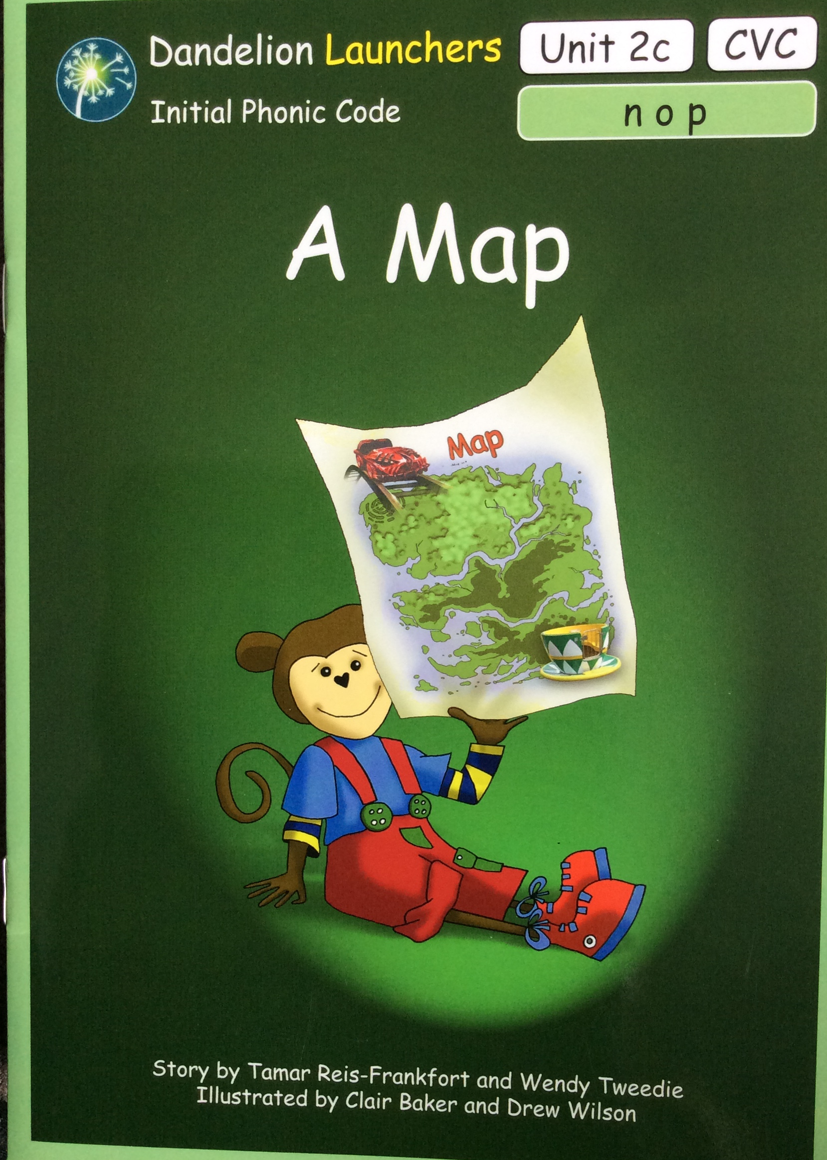
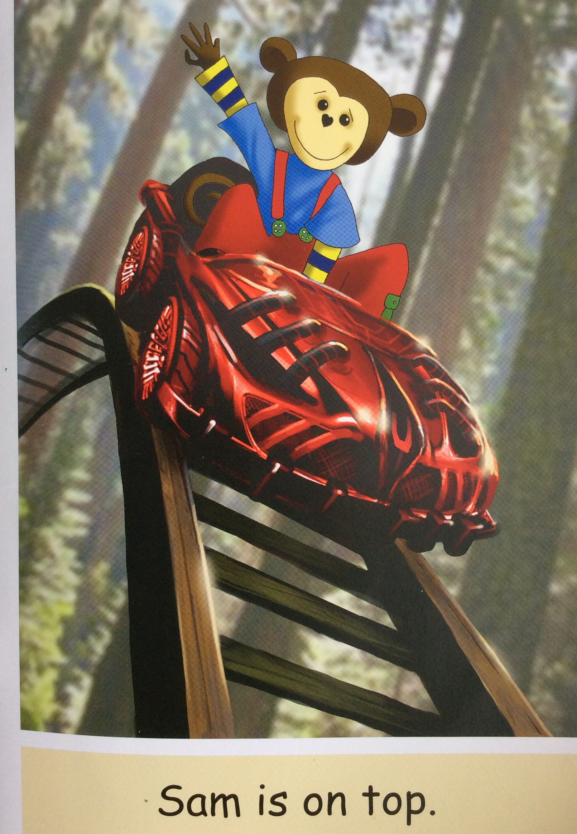
The reading books support the SRS as they build on sounds taught and words can be read using knowledge of phonics. Words like 'I' and 'the' are introduced slowly and within the context of the story.
Reading Books
Dandelion Launchers
Children use their knowledge of sounds taught to read the books.
Encourage your child to use their finger to read the words and please discourage guessing and relying on the pictures to read the words.

Slide 12
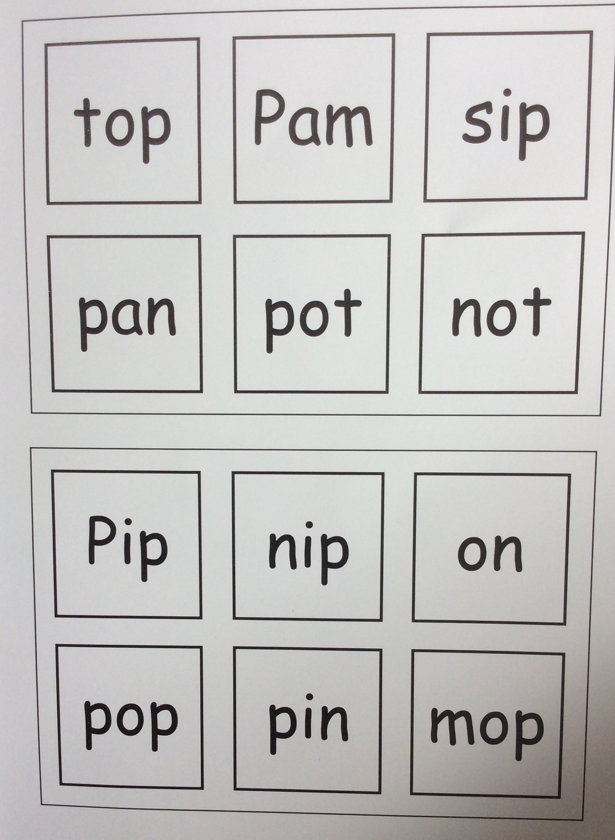
Reading Books
Dandelion Launchers
Each book has a game at the end to practice building reading fluency.
What to expect….
Books are not sent home initially, it will most likely be Really Reading stories. We must ensure that your child is confident with their sounds before moving onto reading books. Even then, they may not bring a book home every week. It may alternate between books and really reading stories.
Continue to read familiar stories, bedtime stories / their chosen library book should be read by an adult perhaps making a game to identify sounds they are learning.

Slide 13
Homework is vital for this stage of reading and writing and you can make all the difference!
It is very important that your child practises most days, repeating and revisiting all letter sounds old and new. Exposure and practice is key for reading and writing. Neither are easy. We recommend short bursts of 10 minutes max a day. One day may be building words, the next reading the words etc.
Please model clean sounds to your child and if writing encourage correct pencil grip and formation of letters (as modelled in homework videos).
Use our homework videos to help support you.
Homework

Slide 14
THANK YOU!

