Slide 1
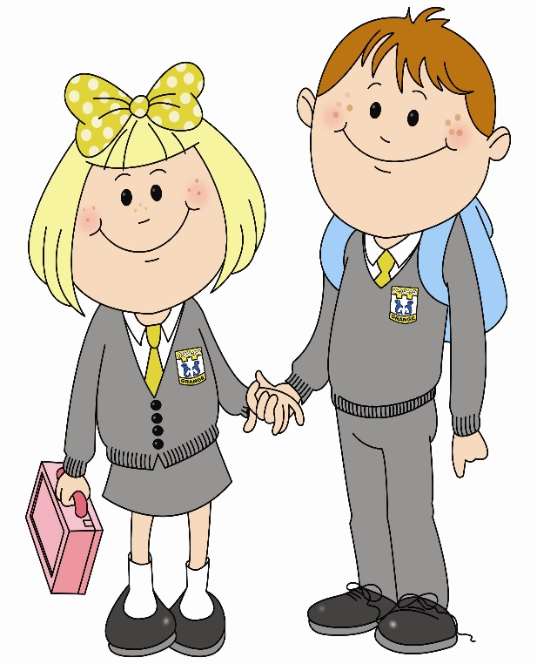
In primary 1 I am improving my writing skills so that I can write my ideas on my own. To do this…

Slide 2
I can use and hold a pencil effectively.
Through my play I have demonstrated use of writing for different reasons e.g. lists, menus, letters etc.

Slide 3
I can form lower case letters.
I can copy over or under a model.

Slide 4
I try to put words in an order that makes sense.
I can write my own first and surname with appropriate upper and lower case letters.

Slide 5
I try to show some control over the size, shape and orientation of letters.
I use finger spaces to separate words.

Slide 6
I can write a sentence using a capital letter and full stop.
I can use sounds represented by letters to write a word.

Slide 7
I can write most CVC words accurately.
I can copy a SRS tricky word from a model.

Slide 8
I can write a sentence using a joining word.
I can check my writing for errors.

Slide 9
I can form some upper case letters.
I can communicate when and what in my writing.

Slide 10
I can communicate who and where in my writing.

Slide 11
What learner qualities could you practise to help you get better at writing?
Successful
Trying Hard
Active
Respectful
Safe

