Slide 1
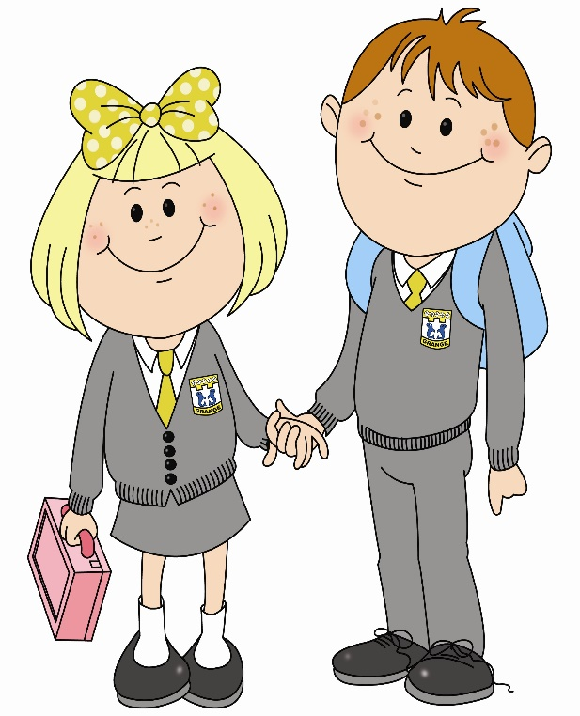
In nursery 2 I am learning to mark make.
To do this…

Slide 2
I can use a pencil and hold it effectively.
I know print has meaning in English, and that it flows from left to right and top to bottom.

Slide 3
I explore and share a range of meaningful mark making opportunities.
I can form some lower case letters.

Slide 4
I can write single letters or groups of letters that mean something to me.
I can ‘read’ what I write.

Slide 5
I can write my own name (although it might have some letters muddled).
I can tell the difference between letters, numbers and symbols.

Slide 6
What learner qualities could you practise to help you get better at writing?
Successful
Trying Hard
Active
Respectful
Safe

