Slide 1
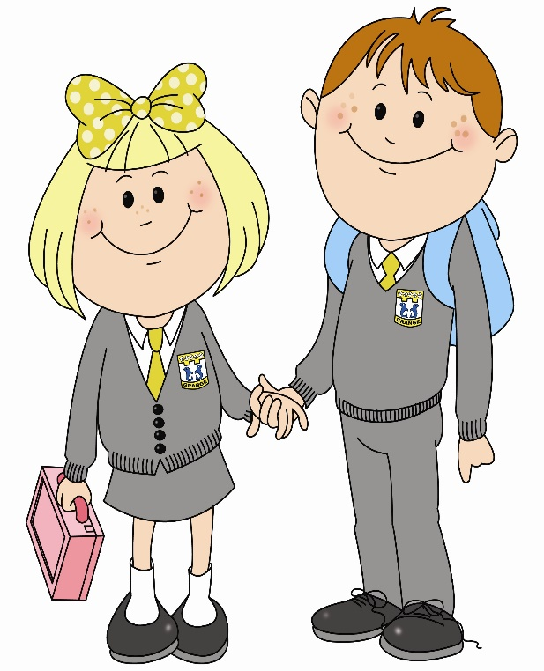
In nursery 1 I am learning to experience different mark making materials. To do this …..

Slide 2
I recognise mark making materials.
I try to mark make by myself.

Slide 3
I show control in mark making.
I can tolerate hand manipulation.

Slide 4
I enjoy using mark making materials.
I can write the first letter of my name.

Slide 5
What learner qualities could you practise to help you get better at writing?
Successful
Trying Hard
Active
Respectful
Safe

