Slide 1
Play @ Home
Grange Nursery
Date: 18th March 2019
Presented by – Mrs Grant

Slide 2
What is the play@home book?
A resource for parents/carers to encourage your child’s overall development
You should receive 3 books within your child’s first three years
Yellow – Baby (Health Visitor)
Turquoise – Toddler (Health Visitor)
Purple – Pre-School (Parent Support Worker)

Slide 3
What are the benefits?
Good (age appropriate) ideas of play activities for you and your child to do together
Helps to further develop a nurturing relationship between adult/child
The activities will develop your child’s social interaction, physicals skills and also helps them to think for themselves

Slide 4
Confident, happy children make good learners
When using the play activities in this book your child will be developing some of the skills below
(the book points out the main benefits of the activity at the bottom of the page)
A sense of belonging
Confidence when in new situations/ability to make new friends
Sharing/turn taking
Memory skills
Literacy and numeracy skills
Most importantly your child will be having lots of fun!

Slide 5
Lets have a look at some ideas…
Play dough recipe – Page 20
Going shopping can be tricky!
ABC & 123 – Pages 44 & 94

Slide 6
Agree – Disagree - Not Sure?
Children are just as active as they have always been
It’s not safe for children to play outside
Does social media have an affect on the amount of time you spend with your child?

Slide 7
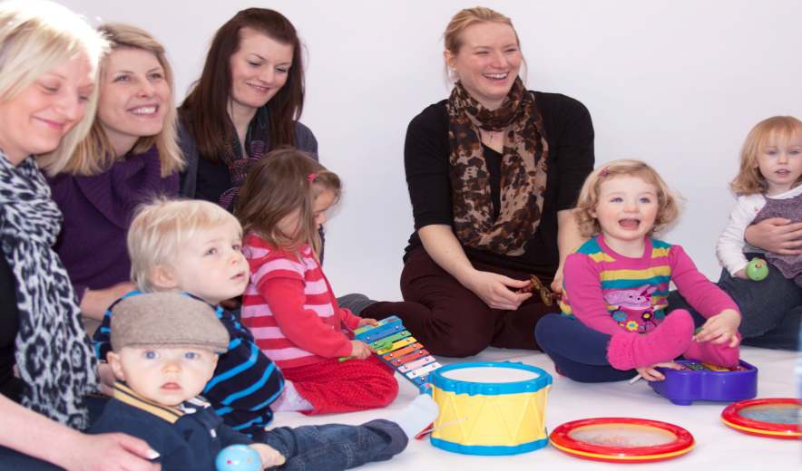
We hope you enjoy using this book to have fun with your child.
Thank you for joining us today. Please feel free to ask any questions you may have about the play@home book or any other parenting support you may require.

