Slide 1
BIG Movers Little Scribblers

Slide 2
Physical literacy
Sport Wales - Physical Literacy
Video link
https://www.youtube.com/watch?v=R8PIXqp3JpA
Notes:
SC
Vital – children given opportunities in early Years to develop Gross and Fine

Slide 3
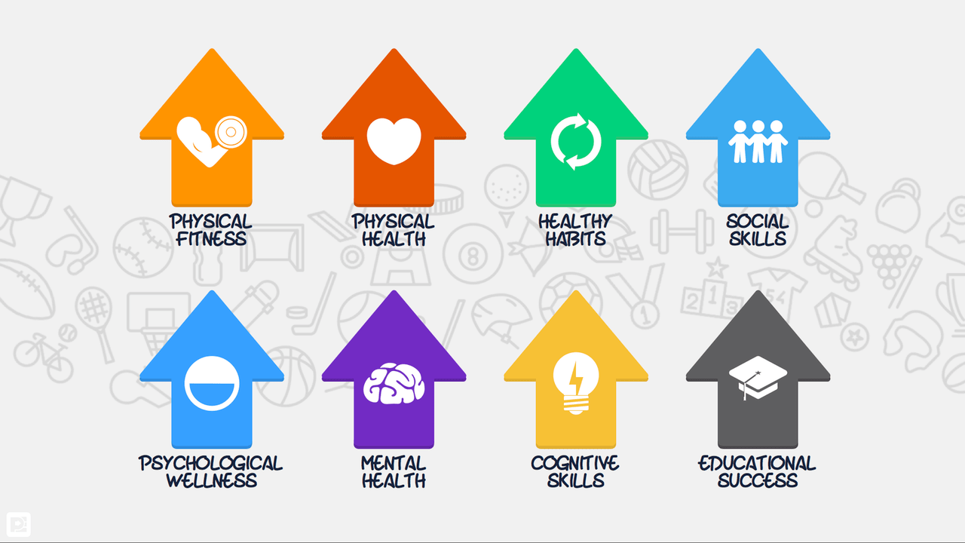
Notes:
FL
Outcome of physical experiences and education is to develop physical literacy
Physical benefits of being active:
Capacity for increased levels of activity
Being able to sit still
Ability to perform gross and fine motor skills with confidence and control
Hand eye coordination to develop reading and writing and catching a ball( eye movement)
Speech and language development
Maintaining good health(healthy weight, strong bones and muscles)
Enjoyment of being physically active and appreciating how much fun it is
Cognitive benefits of being active:
Good listening skills
Good concentration skills
Able to express creativity
Able to use imagination and think in different ways
Enhanced memory skills
Wider vocabulary
Ability to seek solutions to problems and challenges
Personal, social and emotional benefits of being active:
Confidence and competence
High levels of self esteem
Understand acceptable behaviour
Resilient
Independent
Tolerance and respect for others
Playing cooperatively and fairly

Slide 4
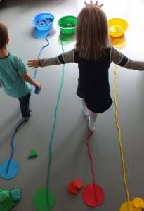
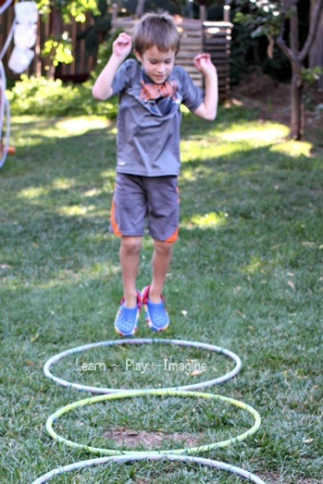
Physical Literacy
Physical literacy is developed at nursery or school, at play time and Physical Education
At home, by going to the play park, going swimming, going to clubs and by exploring the outdoors
Notes:
Children spend the majority of their time after school, during holidays, weekends at home

Slide 5
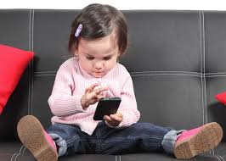
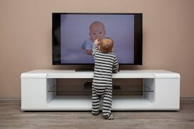
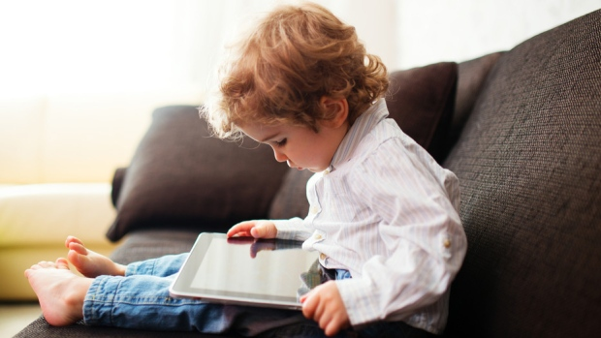

Slide 6
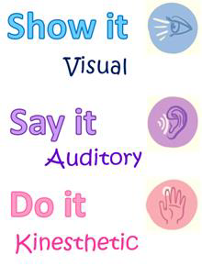
Ways to Help your Child Learn
Notes:
There are different methods you can use to help your child to learn. Learning from adults; at home and at nursery/school etc
You can show your child and model, do the activity next to them or watch videos of the task. The child is watching.
You can explain what you are doing whilst you're doing it and the same when they are trying something…”Look at how you are pressing the play dough”
You can encourage your child to do the task by putting your hands over theirs and doing the task. The child is doing.
Today we are going to show you things you can do with your child, so that you can do these with your child.

Slide 7
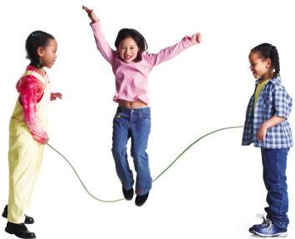
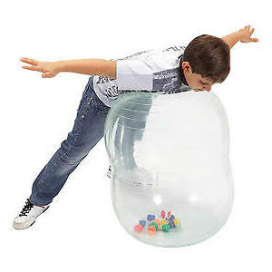
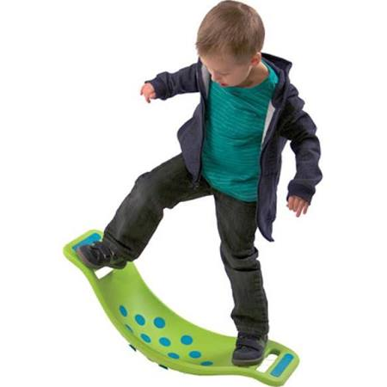
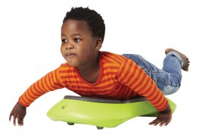
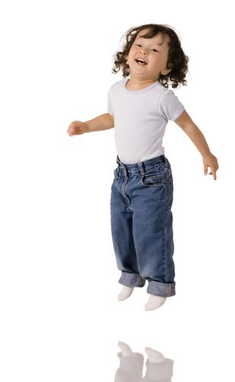
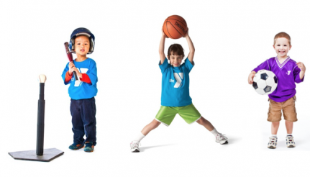
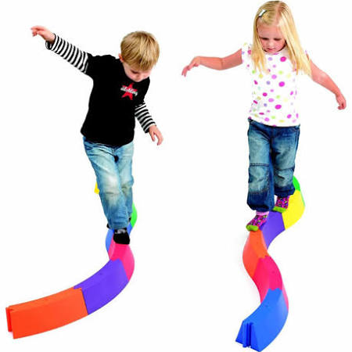
Gross Motor
Notes:
GMS – big movements. Any ideas of what they might be?
Shoulder and pelvic stability…gross motor development
We develop these things before we develop our fine motor control

Slide 8
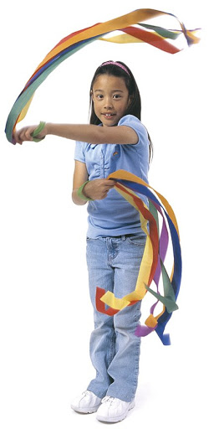
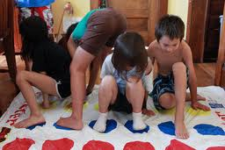
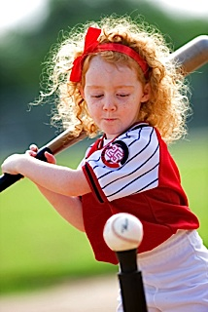
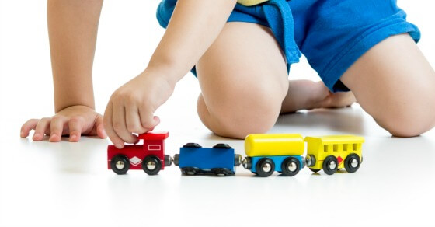
Crossing the midline

Slide 9
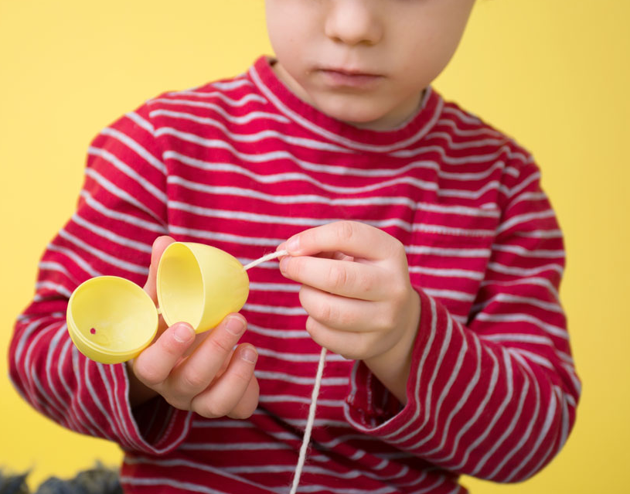
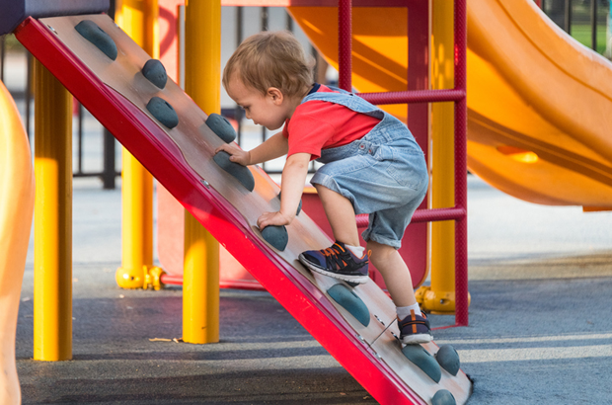
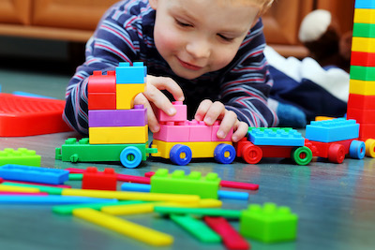
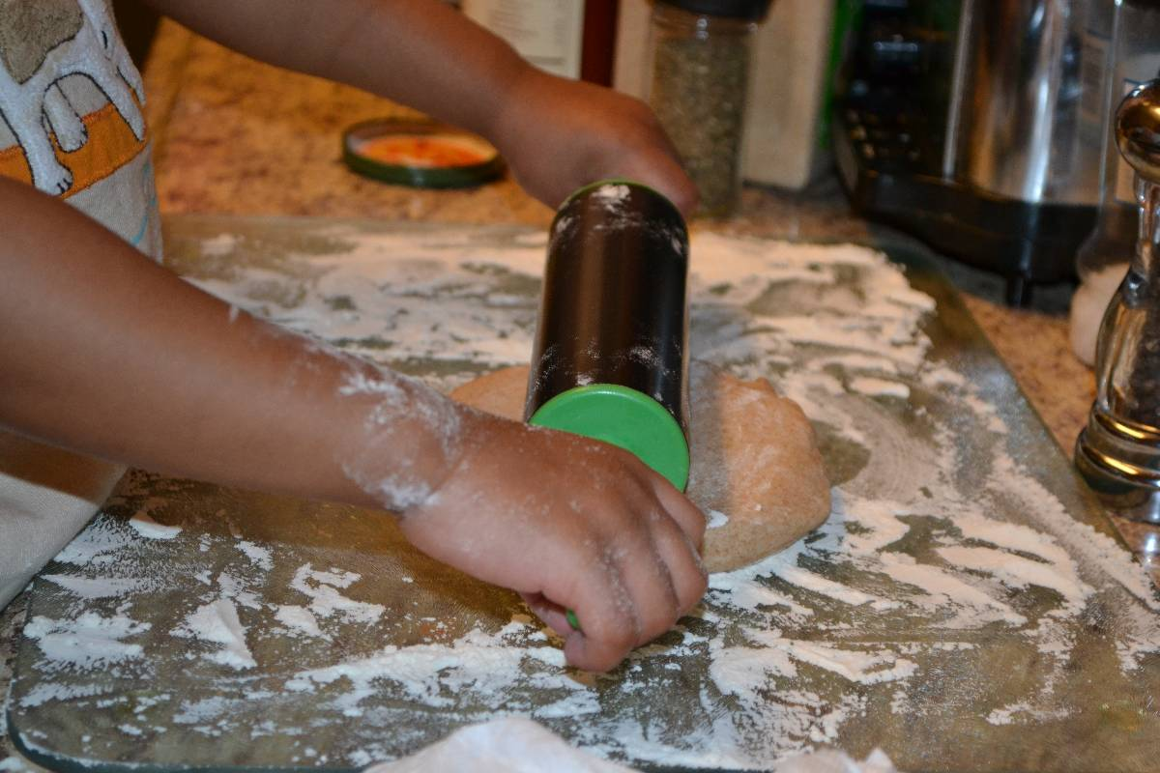
Using two hands together

Slide 10
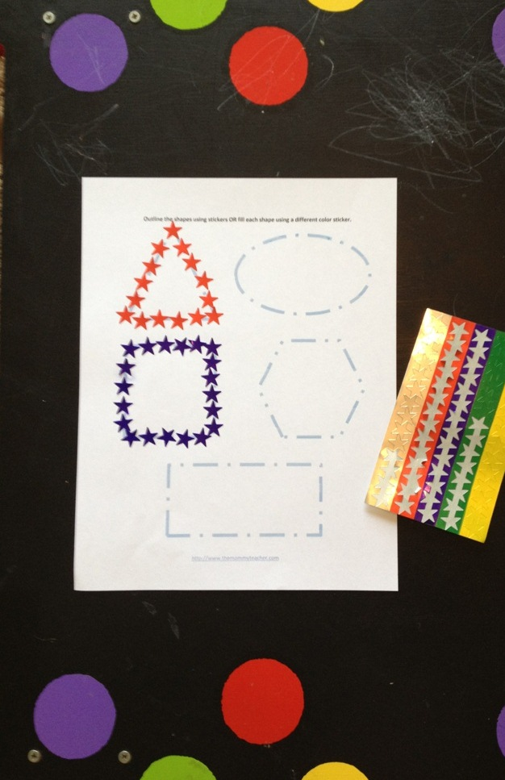
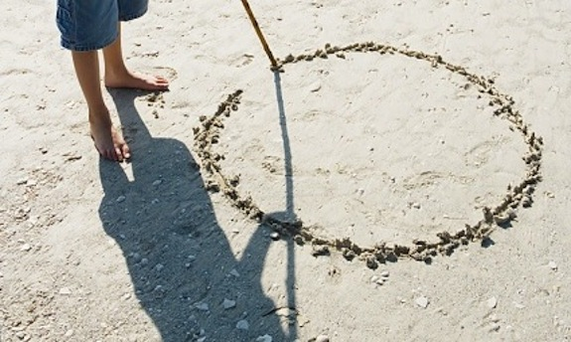
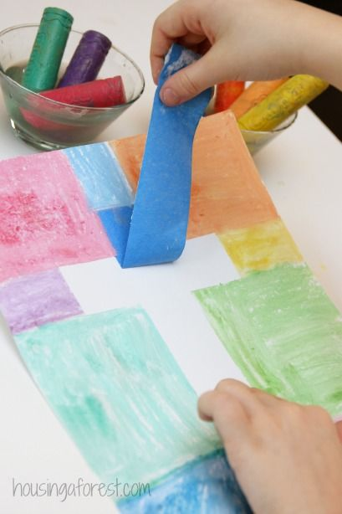
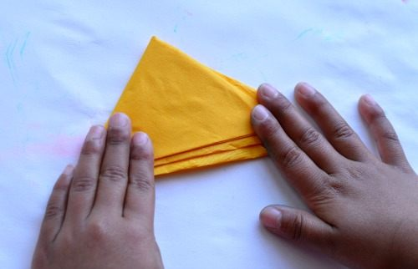
Shape Formation
l - O / \ + X S

Slide 11
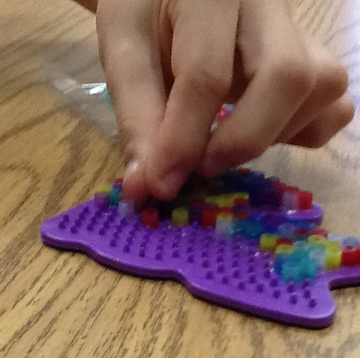
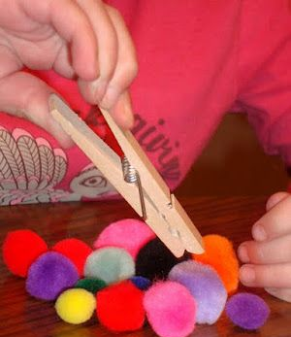
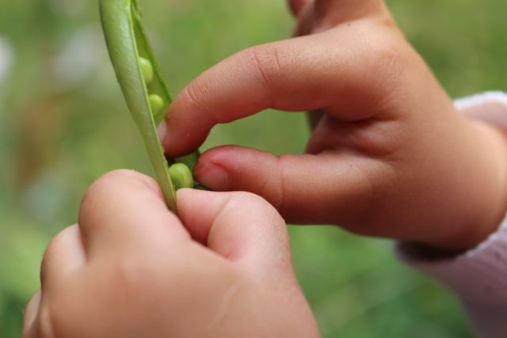
Pincer grasp

Slide 12
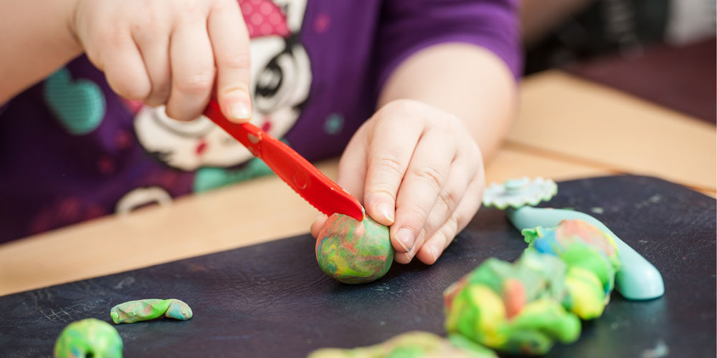
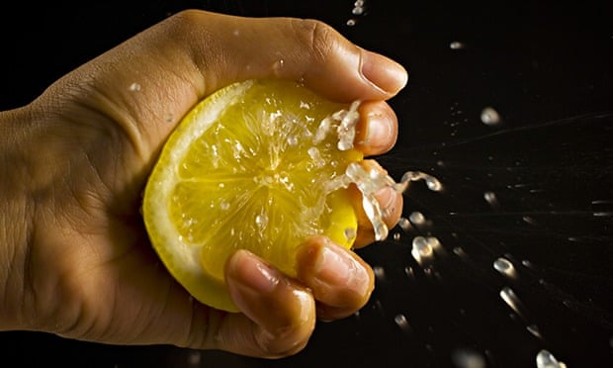
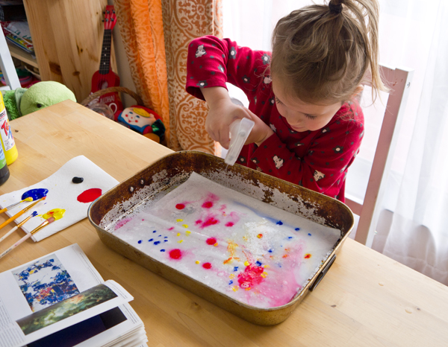
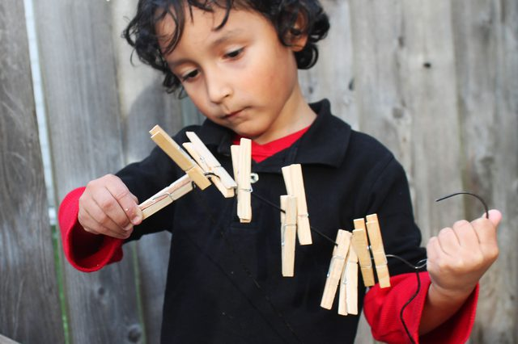
Hand Strength

Slide 13
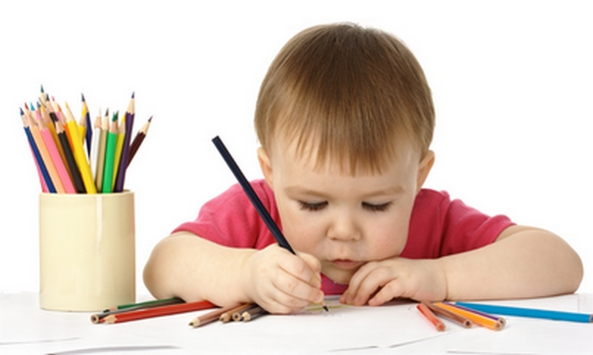
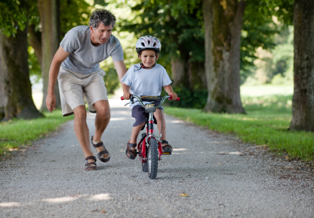
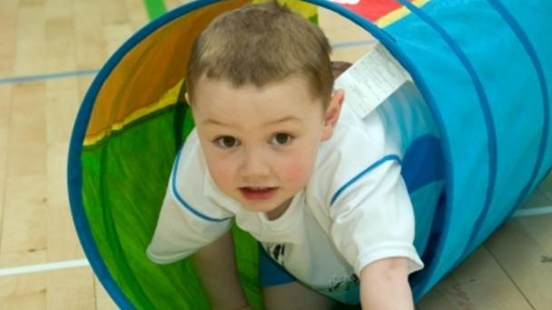
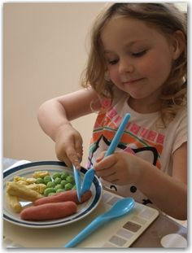
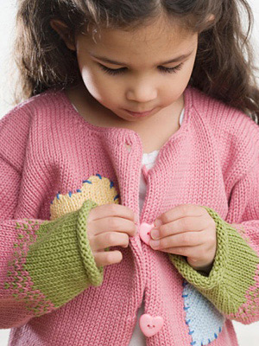
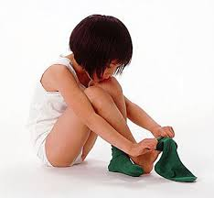
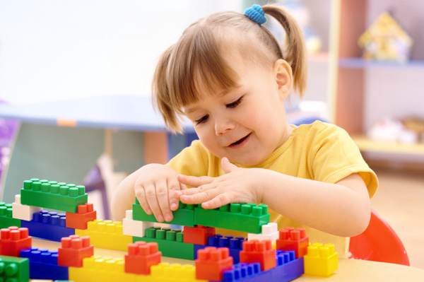
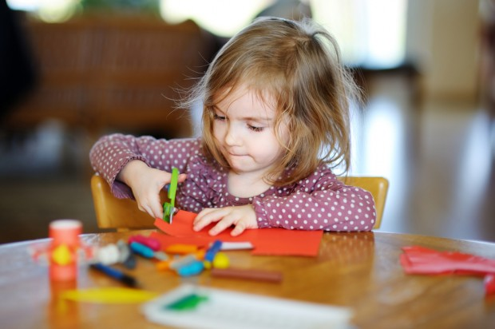
OCCUPATION Is our fancy word for things you want to do, need to do, and are expected to do
Notes:
These are examples of children’s occupations. We often categorise them into self care, play and learning.

Slide 14
www.OTCYP.scot.nhs.uk

