Slide 1
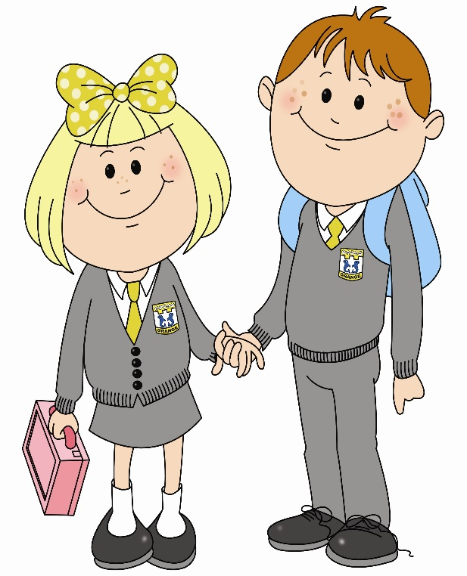
In primary 5 I am improving my writing skills so that I can write 200-250 words on my own…

Slide 2
I use a wide range of interesting words as I write, using resources available to me.
I use lots of different connectives to explain what I mean, such as: when, until, before, although, after.

Slide 3
I use full stops, commas, question marks and exclamation marks accurately.

Slide 4
I am starting to use speech marks.
I have been introduced to the use of ellipses…

Slide 5
As I write I always try to use different sentence openers.
I use phonics and spelling knowledge to attempt to spell unknown words.

Slide 6
I can expand my ideas into a number of linked sentences.
I select different adjectives and descriptive phrases to put my ideas across.

Slide 7
I try to use/follow the taught writing structure for writing a letter, report, diary entry etc.
I write sentences of different length to make my writing more interesting.

Slide 8
I can write a letter using the correct layout and words.
I can describe characters and setting in detail by using adjectives, adverbs, alliteration and onomatopoeia.

Slide 9
I know what a simile is and might try to use one to show description.
I can link ideas/events using words such as: later, first, lastly, often.

Slide 10
I attempt to create a turning point and or cliff hanger in my story writing.
I can use my note making skills to gather information from books, clips or a web page and then create a new text in my own words.

Slide 11
I can identify the first person (I), second person (you) and third person (he/she/it/they) correctly as I write.
I can combine words and images in different ways to engage / influence my audience.

Slide 12
I can label diagrams correctly.
I can edit my work for spelling and punctuation.

Slide 13
I enjoy creating short and extended texts regularly for a range of purposes and audiences.
I can use paragraphs to separate new thoughts and ideas.

Slide 14
What learner qualities could you practise to help you get better at writing?
Trying Hard
Respectful
Active
Safe
Successful

