Slide 1
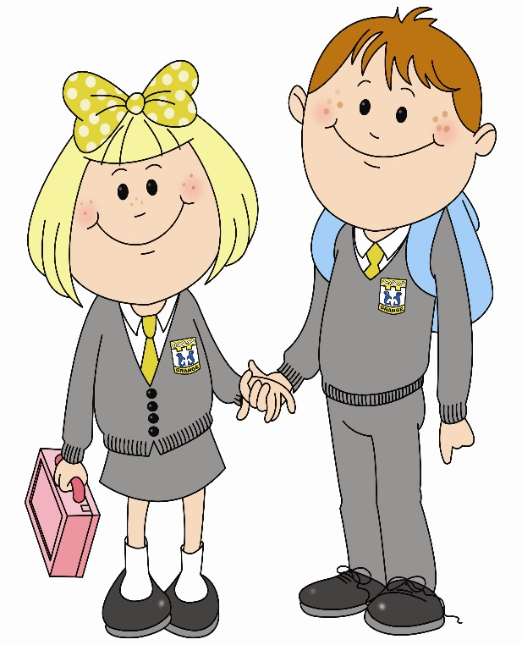
In primary 4 I am improving my writing skills so that on my own I can write over 100 words. To do this…

Slide 2
I can write all lower and upper case letters accurately.
I can use my knowledge of the alphabet to locate words in the dictionary or wordbank to help me spell correctly.

Slide 3
I can create stories, poems and plays with interesting characters through their feelings and actions and physical description.
I can link ideas in an order that makes sense using words like: also, after, then, soon, at last.

Slide 4
I can make short notes, under headings, in different ways e.g. in a table or a mind map.
I can use my short notes to create relevant text in a logical order.

Slide 5
I can write about personal experiences in a logical manner, using appropriate vocabulary, thoughts and events.
I can identify a pronoun and am beginning to use them when I write.

Slide 6
I use the present and past tense correctly.
I use commas and question marks accurately.

Slide 7
I can use exclamation marks independently in my writing.
I can describe the setting of a story including details about time and place.

Slide 8
I can write a letter using the correct layout and words.
I can use the first person (I or we) and third person (he/she/it/they) correctly as I write.

Slide 9
I can describe what a character might look like, how they might feel and what they might think.
I can write a story with a beginning, middle and end.

Slide 10
I can put instructions in order, using numbers, so someone can follow them.
I can communicate my feelings, opinions and what I mean in a series of sentences.

Slide 11
I can create my own choice of text.
I can use my knowledge of phonics and spelling strategies when spelling familiar and unfamiliar words.

Slide 12
I can use common conjunctions like
and, because, but or so.
I can start my sentence in a variety of ways to engage the reader.

Slide 13
I can check writing to ensure it makes sense.
I can present writing in a clear and legible way using images and other features.

Slide 14
I can plan and organise ideas and information using an appropriate format.
I can present writing in a clear and legible way using images and other features.

Slide 15
I can create a variety of texts for different purposes.
I can share my personal viewpoint and attempt to persuade the reader.

Slide 16
What learner qualities could you practise to help you get better at writing?
Successful
Trying Hard
Active
Respectful
Safe

