Slide 1
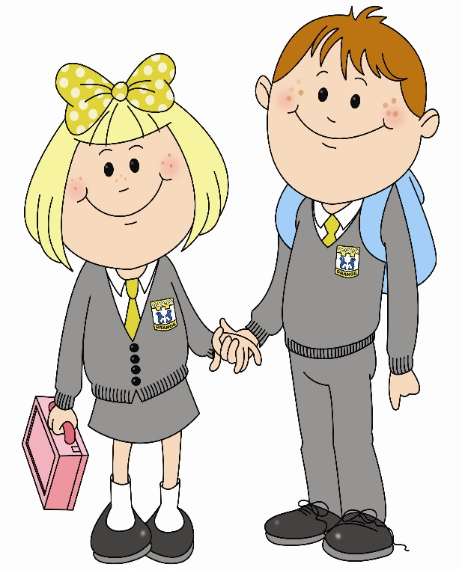
In primary 3 I am improving my writing skills so that I can write my ideas on my own. To do this…

Slide 2
I write most lower and upper case letters in the correct position on the line.
I use finger spaces.

Slide 3
I can spell most common words correctly.
I use my knowledge of phonics to help me spell difficult words.

Slide 4
I use full stops and capital letters in most sentences.
I am beginning to use question marks correctly.

Slide 5
I know what an exclamation mark looks like.
I know commas are used in lists and will have a go at using them.

Slide 6
I use WOW words, at least twice, to make my writing interesting.
I use joining words like “because”, “so” and “but” to join at least two sentences.

Slide 7
I can start sentences using different openers like: soon, at last, next and then.
I can write a simple imaginative text, personal account or set of instructions.

Slide 8
I can write a number of sentences in an order that makes sense.
I can use an adjective to describe a noun and an adverb to describe a verb.

Slide 9
I can describe what a character might look like, how they might feel and what they might think.
I can write a story with a beginning, middle and end.

Slide 10
I make notes to plan what I am going to write in a story.
I can tell the difference between the present and past tense.

Slide 11
I can write simple instructional, personal or imaginative text in order.
I can communicate my feelings, opinions and ideas in a series of sentences.

Slide 12
I can create texts of my own choice.
I can spell commonly used words correctly.

Slide 13
I can use my knowledge of phonics and spelling strategies when spelling familiar and unfamiliar words.
I can link sentences using common conjunctions for example, and, because, but or so.

Slide 14
I can start sentences in a variety of ways to engage the reader.
I can check my writing carefully to ensure it makes sense.

Slide 15
I can present writing in a clear and legible way.
I can plan and organise information using an appropriate format.

Slide 16
I can write about personal experiences using appropriate vocabulary to describe feelings, thoughts and events.
I can create interesting characters
through their feelings and actions and physical description.

Slide 17
What learner qualities could you practise to help you get better at writing?
Successful
Trying Hard
Active
Respectful
Safe

